Slide 1
forces Lesson 6b
How Can Ideas about Forces Help Us Explain the Motion of Objects?

Slide 2
Review: Forces Acting on a Cotton Ball
What force made the cotton ball start to move?
What force caused the cotton ball to change direction?
What force caused the cotton ball to stop moving?

Slide 3
Today’s Focus Question
How can ideas about forces help us explain the motion of objects?
This question is the same as our last focus question, except for one word? Which word is different?

Slide 4
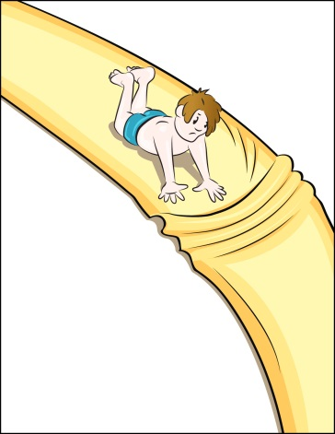
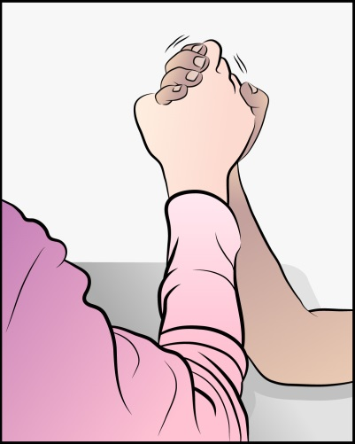
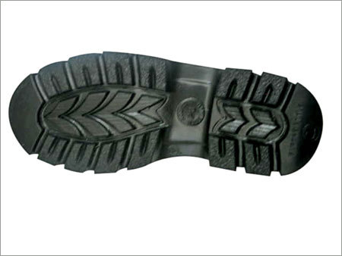
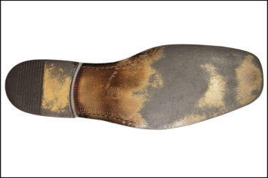
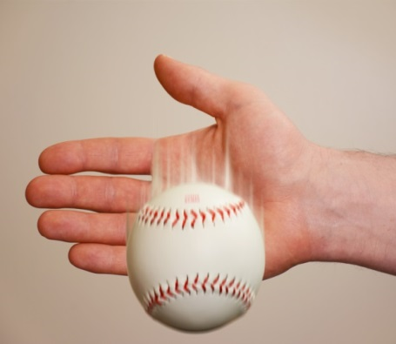
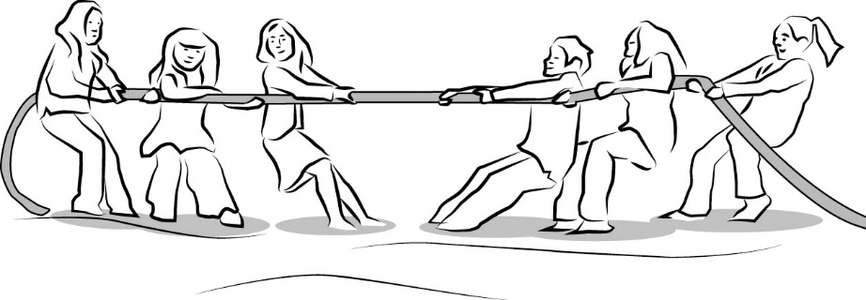
Show What You Know in Real-Life Scenarios
Today you’ll work in teams to explain and illustrate a scenario that might happen in everyday life.

Slide 5
Investigation: Explain Your Scenario
Have one team member read the scenario aloud. Then look carefully at the pictures on your scenario card.
Discuss the scenario with your teammates. Identify and describe all of the forces acting on the people or object(s) in your scenario.
Reach an agreement as a team on the strength and direction of the forces acting on the people or object(s). Then draw arrows (and bumps for some scenarios) on your own pictures to represent the forces involved.

Slide 6
Investigation: Explain Your Scenario
After you finish your drawings, discuss how your team can act out the forces in your scenario using the foam arrows. Keep our focus question in mind as you plan your skits!
You have 5 minutes to make these decisions as a group:
Who will act out the forces in the scenario?
Who will hold the arrows that represent the forces?
Which arrows will you use to represent the strength (size) and direction of the forces?
Let me know when you’ve made these decisions and finished planning your skit, and I’ll give you some props to act out your scenario.

Slide 7
It’s Time to Show What You Know!
Presenting
the
Physics Players
in
Forces and Motion

Slide 8
Our Unit Central Questions
What makes something start to move? What makes something stop moving or change direction?

Slide 9
Today’s Focus Question
How can ideas about forces help us explain the motion of objects?

Slide 10
Our Unit Central Questions
Share with an elbow partner your initial examples and ideas about moving objects from our first lesson. Then talk about these questions:
How do your ideas for answering our unit central questions today differ from your initial ideas?
Were some of your initial ideas wrong? How so?
Did your initial ideas about an object’s motion include pushes or pulls, gravity, or friction?
Based on what you now know about forces and motion, how would you change your initial ideas to make them more correct and complete?

Slide 11
Our Unit Central Questions
What makes something start to move? What makes something stop moving or change direction?
In your science notebook, write your best answer to the unit central questions based using everything you’ve learned about forces and motion in this unit. Make sure to use complete sentences!
Include evidence from our investigations and the words force, friction, gravity, and moving/move.
Share your answer with your partner and talk about ways each of you can improve your answers (make them clearer, more complete, or more accurate).

Slide 12
Future Lessons about Forces and Motion
In future science lessons, we’ll continue building on the important science ideas about forces and motion that we explored in this unit.
Stay tuned!

