Slide 1
RESPeCT PD pROGRAM
Day 5
RESPeCT Summer Institute
Notes:
5 min
a. Take care of any housekeeping issues.

Slide 2
Agenda for Day 5
Day-4 reflections
Focus questions
Review strategy 6: use and apply
What Is the Science Content Storyline Lens?
Introducing SCSL strategy A
Lesson analysis: SCSL strategy A
Lunch
Content deepening: forces
Summary, homework, and reflections
Notes:
2 min
a. Talk through the agenda for the day.

Slide 3
Trends in Reflections
Lesson Analysis | Science Content Learning
Notes:
5 min
a. Give participants time to review your feedback on their reflections from day 4 and offer reactions, comments, or follow-up questions.

Slide 4
Norms for Working Together: The Basics
Purpose: Build trust and develop a productive study group for all participants.
The Basics
Arrive prepared and on time; stay for the duration; return from breaks on time.
Remain attentive, thoughtful, and respectful; engage and be present.
Eliminate interruptions (turn off cell phones, email, and other electronic devices; avoid sidebar conversations).
Make room for everyone to participate (monitor your floor time).
Notes:
5 min
a. Review the norms as a group.
b. Ask: “Any comments or suggested changes? How are we doing with applying these norms?”

Slide 5
Norms for Working Together: The Heart
Purpose: Build trust and develop a productive study group for all participants.
The Heart of RESPeCT Lesson Analysis and Content Deepening
Keep the goal in mind: analysis of teaching to improve student learning.
Share your ideas, uncertainties, confusion, disagreements, questions, and good humor. All points of view are welcome.
Expect and ask questions to deepen everyone’s learning; be constructively challenging.
Listen carefully; seek to understand other participants’ points of view.
Notes:
5 min
a. Review these norms as a group.
b. Ask: “Any comments or suggested changes? Which of these norms do you think we could get better at applying individually and as a group?”
c. Remind participants: “These norms will become increasingly important during the Summer Institute and throughout the academic year as we analyze one another’s classroom videos and learn together.”

Slide 6
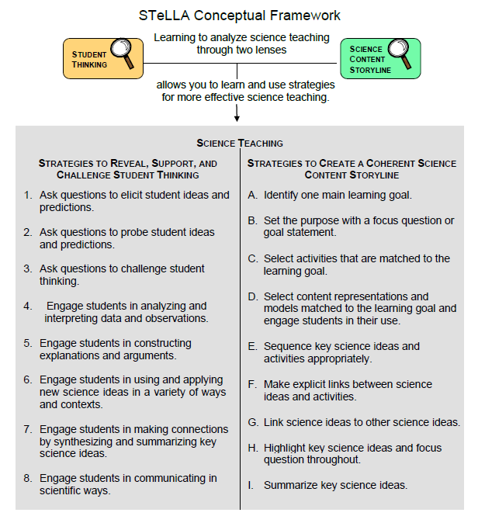
Notes:
1 min
a. Transition: This slide marks the transition from the STL strategies to the Science Content Storyline Lens strategies.
b. “Throughout the PD program, we’ll continue learning about the Student Thinking Lens (STL) strategies, but today we’ll transition to the Science Content Storyline Lens strategies.”
c. Highlight the SCSL strategies on the slide.

Slide 7
Focus for the Week
Content area 2: forces
Science Content Storyline Lens
Strategies A, B, C, D, F, G, H, and I
Video-based lesson analysis (Forces lessons)
Forces lesson plans review (last day)
Academic-year schedule (last day)
Video recording
Study-group sessions
Notes:
1 min
a. “This week we’ll focus on a new content area: forces. We’ll also examine the Science Content Storyline Lens strategies and the Forces lessons you’ll be teaching in the fall, analyze video clips of those lessons, and deepen your science-content knowledge related to the lesson plans.”
b. “On the last day of the RESPeCT PD program, we’ll review the lesson plans and the schedule for the academic year.”
c. “You may notice that we skip strategy E: Sequence key science ideas and activities appropriately. This strategy will be addressed during the school year as you teach the STeLLA lesson plans and analyze how they’re sequenced within each lesson and across lessons.”

Slide 8
Today’s Focus Questions
What is the Science Content Storyline Lens (SCSL)?
Why is one main learning goal essential for science content storyline coherence?
What makes something start to move?
How can we draw the forces pushing or pulling an object when we can’t see them?
Notes:
1 min
a. Introduce the focus questions that will guide today’s session.

Slide 9
Check Your Understanding of Strategy 6
Jot down your responses to this multiple-choice quiz:
Use-and-apply tasks are used [before/during/after] new science ideas are introduced.
For difficult content ideas, students might need to practice applying new ideas in [one/two/many] different contexts.
[True/false]: Use-and-apply questions or activities are used primarily for student assessment at the end of a unit.
It’s appropriate for teachers to ask [elicit/probe/challenge] questions during a use-and-apply activity.
Teachers should [never/judiciously/always] tell students about science ideas they are missing or stating inaccurately.
Notes:
7 min
Note: Display this slide only if it wasn’t used on day 4.
a. “To check your understanding of STL strategy 6, jot down your responses to this multiple-choice quiz in your science notebooks.”
b. Have participants discuss their answers either in pairs or as a group. (If time is short, just read the answers aloud.)
Answer key:
1. After
2. Many
3. False
4. Challenge (and probe)
5. Judiciously (defined as “good or discriminating judgment; wise, sensible, or well advised”)

Slide 10
Use and Apply Your Content Deepening Knowledge
Climate change is affecting environmental conditions around the globe. How might an overall increase in temperatures or a change in rainfall patterns impact trait variation among the plants and animals living in a particular area?
To answer this question, use and apply what you learned last week about trait variation in a population of living things in a particular area.
Notes:
8 min
a. Turn and Talk (4 min): “Discuss the use-and-apply question on the slide with a partner and be ready to share your ideas with the group.”
Note: Alternatively, you might want to divide the group in half and have one group consider possible changes in plant traits and the other group consider possible changes in animal traits.
b. Whole-group share-out (4 min): “What ideas do you have for answering this question?”
Note: One of the main learning goals of the Variations in Traits lesson sequence is recognizing that changing environmental conditions can impact trait variation in a population of living things. Climate change is currently impacting environmental conditions in a variety of ways across the globe. This use-and-apply question specifically relates climate change to an increase in temperatures or a change in rainfall (more or less) in an area.
Ideal responses: There are many possible responses to the use-and-apply questions, but each should include logical reasoning that suggests a plant or animal would have a greater chance of surviving and passing on its characteristics to the next generation.
Changes in plant traits:
Plants with smaller leaves might lose less moisture in higher temperatures than plants with larger leaves, so they might have a greater chance of surviving and producing seeds.
Plants with leaf surfaces that are slightly waxy or hairy might hold moisture better than plants without such protection. Plants with these characteristics might have a greater chance of surviving and reproducing in higher temperatures.
Changes in animal traits:
A population of animals that currently have very thick fur might change over time and grow less fur or shorter fur if overheating caused death among animals with the thickest fur prior to reproducing.
If greater changes in climate cause an area to receive less rainfall, individuals that retain moisture rather than sweating profusely may have a survival advantage.
As in the example of Darwin’s finches, if there is less rainfall, plants may produce seeds with harder shells. Birds with longer beaks might have a greater ability to crack the harder shells and would have a survival advantage because they’re able to access this food supply. Over time, beak length within this population may increase.

Slide 11
Planning Science Lessons: Quick Write
What is generally your thinking process when you plan your science lessons?
Be prepared to share your ideas with the group.
Notes:
6 min
Note: This activity is a lead-in for thinking about specific SCSL strategies. When planning science lessons, are participants thinking primarily about (1) SCSL issues, such as learning goals, (2) student misconceptions (an STL issue), which is a great start but doesn’t include SCSL strategies, or (3) activities and/or classroom management and timing issues?
a. Individuals: Direct participants to take 2–3 minutes to write down the key things they think about when planning science lessons.
b. Whole group: Ask participants to share their reflections with the group.
c. Tell participants: “The Science Content Storyline Lens strategies should provide some new or additional ways of thinking about planning your science lessons.”

Slide 12
Lesson Analysis: Focus Question 1
What is the Science Content Storyline Lens (SCSL)?
What is a science content storyline, and why is it important?
What is challenging about developing a science content storyline?
Notes:
7 min
a. Small groups: Direct half the group to focus on the first bulleted question on the slide, and the other half to focus on the second. Allow groups 2 minutes to think about their assigned questions as they review “Introduction to the Science Content Storyline Lens” in the STeLLA strategies booklet.
b. Whole group: Have each group share their ideas and responses for these questions.
c. As you listen to participants, make sure that what they’re saying is consistent with the strategies booklet. If you aren’t sure they’re interpreting the text accurately, ask them to identify the specific text they are drawing from.

Slide 13
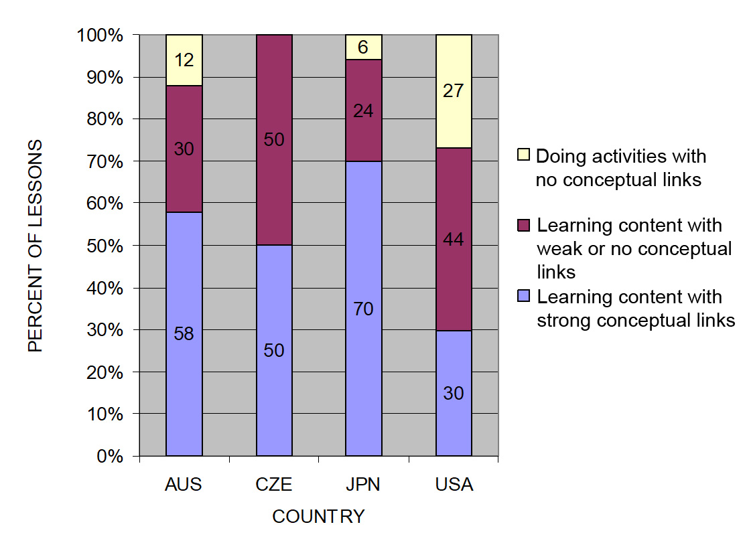
The TIMSS Video Study Findings and the Science Content Storyline Lens
Source: TIMSS study
Notes:
2 min
a. Emphasize the research basis for the Science Content Storyline Lens and its importance. Remind participants that the data on the slide was presented on day 1 of the PD program.
b. Ask: “What does this graph reveal about US science lessons compared with higher-achieving countries?”
Ideal response: According to the study, US science lessons didn’t do as well linking science ideas to lesson activities; in fact, many lessons were activity focused and included significantly fewer science ideas compared to other countries.
c. Summarize: Point to strategies F and G on the STeLLA strategies poster: Make explicit links between science ideas and activities (strategy F) and link science ideas to other science ideas (strategy G). These strategies and the idea of a Science Content Storyline Lens grew out of the TIMSS research findings.
d. “Today we’ll begin our study of the Science Content Storyline Lens, with a focus on strategy A: Identify one main learning goal.”

Slide 14
Lesson Analysis: Focus Question 2
Why is one main learning goal essential for science content storyline coherence?
Notes:
Less than 1 min
a. Read the focus question on the slide.

Slide 15
Notes:
1 min
a. “Now let’s dig into SCSL strategy A!”
b. “As you can see, strategy A is the first of nine Science Content Storyline Lens strategies. It appears first because it’s the foundation on which all the other SCSL strategies are built. This will become clearer as we delve into the other strategies and see how important it is that each of them is matched to the lesson’s main learning goal.”

Slide 16
Purpose and Key Features of Strategy A
Review your SCSL Z-fold summary charts and share with a partner the purpose and key features of strategy A: Identify one main learning goal.
Remember to cite passages from the STeLLA strategies booklet.
Be prepared to share with the group.
Notes:
25 min
a. Pairs: “Share with a partner what you wrote on your Science Content Storyline Lens Z-fold summary chart about the purpose and key features of strategy A.”
b. Whole group: Have one or two participant volunteers lead the group in creating a chart that describes the purpose and key features of strategy A.
c. Transition: “Next, we’ll review the difference between a science idea and the main learning goal of a lesson. Then you’ll practice identifying and clarifying this distinction.”

Slide 17
A Main Learning Goal Is …
A big science idea that you want students to learn
A big idea that shows the relationship among science ideas
The focus of the lesson (or series of lessons)
Stated in a complete sentence (for planning purposes)
Stated by the teacher, a student, a text, or a multimedia resource
A support for teacher planning
Notes:
1 min
a. “This slide lists some key ideas about the definition of a main learning goal.”
b. Read through the ideas.
c. Emphasize: “Notice the parenthetical reference to ‘lessons’ in the third bullet point. Each lesson should have only one main learning goal, but you might need two or more lessons to help students accomplish a difficult goal. So it’s often necessary to spend more than one lesson on a specific learning goal.”

Slide 18
A Main Learning Goal Is NOT …
A topic or phrase
An activity
A question
A performance task or objective
A supporting detail, definition, or fact
A student misconception or idea that isn’t scientifically accurate
Notes:
1 min
a. Review what is not considered a main learning goal.

Slide 19
Definitions: One Main Learning Goal and Science Ideas
Read these sections in the STeLLA strategies booklet: (1) STeLLA Strategy A: Identify One Main Learning Goal, and (2) Student Ideas and Science Ideas Defined.
Based on these readings, what are the differences between a main learning goal and a science idea?
Notes:
10 min
a. Have participants locate these two readings in the strategies booklet: (1) STeLLA Strategy A: Identify One Main Learning Goal, and (2) Student Ideas and Science Ideas Defined.
b. “After you read these sections in the strategies booklet, we’ll discuss the differences between a science idea and a main learning goal.”
c. Individuals (3 min): Give participants time to read the specified sections in the strategies booklet.
d. Whole group (7 min): Discuss the question on the slide.
e. Emphasize: “While you might incorporate several science ideas that support the main learning goal of a lesson, be careful not to plan an ‘all about’ lesson with too many different science ideas that will likely come across to students as a bunch of disconnected facts to be memorized.”

Slide 20
Practice Identifying Student Ideas and Science Ideas
Identify any student ideas and science ideas in this list:
Objects in motion slow down when they run out of force.
Gravity is a force that attracts or pulls objects toward Earth.
Friction
If an object isn’t moving, there are no forces acting on it.
If multiple forces act in the same direction, they can be added together. If multiple forces act in opposite directions, they can be subtracted.
Friction is a force that pushes or pulls in the opposite direction of an object’s motion.
What causes a moving object to stop moving?
Notes:
5 min
a. “Next, we’ll practice identifying student ideas and science ideas just to make sure you understand the way we’re defining these terms.”
Note: As needed, refer participants to the section in the strategies booklet where student ideas are defined (Student Ideas and Science Ideas Defined).
b. Individuals: “First, identify examples of science ideas on the slide. If you need help, refer to the document in your lesson plans binders titled Common Student Ideas about Forces and Motion. Then identify examples of student ideas on the slide.”
c. Individuals: “Next, identify examples of student ideas on the slide.”
d. Whole group: Discuss participants’ responses and the correct answers (see answer key).
Answer key:
Student idea (common but incorrect)
Science idea (complete sentence and scientifically accurate)
Neither a science idea nor a student idea (a topic, not a complete idea)
Student idea (common but incorrect)
Science idea (complete sentence and scientifically accurate)
Science idea (complete sentence and scientifically accurate)
Neither a science idea nor a student idea (a topic, not a complete idea)

Slide 21
Practice Identifying Student Ideas and Science Ideas in a Class Discussion
Identify one student idea and one science idea in this class discussion:
T: What are the forces acting on you when you jump?
S: Gravity.
T: Can you say more? What does gravity do?
S: It makes you move when you jump.
T: Gravity causes you to move up?
S: Uh, I think so.
SN: No. Your feet push on the floor, and that force makes you go up.
Gravity pulls you back down.
SN: Yeah! Your pushing on the floor has to be greater than the pull of gravity, or you won’t go up. Think about the arrows and how big they are. If gravity is greater, you won’t move. If your push is greater you’ll move.
T: Why do you come back down?
SN: Because you ran out of the up force, and gravity took over and pulled you back down.
Notes:
5 min
a. “It’s a little trickier to recognize student ideas and science ideas in class discussions because students sometimes give only one- or two-word answers to teacher questions. But if you link the teacher’s question with the student’s response, you can sometimes find a science idea or a student idea.”
Note: In the RESPeCT PD program, we encourage students to speak in complete sentences as much as possible.
b. “Let’s practice linking the teacher’s question with student responses in the sample discussion on the slide.”
c. Pairs: “Work with a partner to see if you can identify one student idea and one science idea in this discussion.”
d. Whole-group share-out: Have participants share the ideas they identified in the sample discussion. Then review the answers (see answer key).
e. Emphasize: “Here’s some food for thought: To make student thinking more visible, why not require students to speak in complete sentences during classroom discussions about science ideas?”
Answer key:
Student ideas/misconceptions:
Gravity (a word, not an idea)
Gravity makes you move up when you jump.
When you run out of the up force, gravity takes over and pulls you back down.
Science ideas:
The force that pushes you up when you jump comes from your feet pushing on the floor.
When you jump, gravity pulls you back down.
To leave the ground when you jump, the force of your feet pushing on the floor must be greater than the pull of gravity.

Slide 22
Science Ideas That Support the Main Learning Goal
Main learning goal: When bumps on the surfaces of two objects touch, they push against each other, creating a force called friction. Friction is the reason moving objects on Earth eventually slow down and stop.
Supporting ideas:
Most surfaces are uneven or have bumps, even surfaces that seem very smooth.
Two surfaces interact when an object is in motion (e.g., a tire and the road, a shoe and the floor, a soccer ball and the grass). Surfaces also interact in fluids like water and air.
Friction is a force that pushes in the opposite direction of an object’s motion.
The surface an object moves over determines how long it will take for the object to stop.
In a world without friction, objects in motion would keep moving forever.
Notes:
6 min
a. Display only the main learning goal on the slide.
b. Pairs: “Work with a partner to come up with two or three science ideas that might support the development of this main learning goal. Use the content background document and the Common Student Ideas chart as resources.”
c. Whole group: Have pairs share the supporting science ideas they came up with.
d. Next, reveal the list of possible supporting science ideas one by one on the slide and compare them with participants’ ideas.
e. Highlight: “Some of these supporting science ideas could also be a lesson’s main learning goal.”

Slide 23
Practice Identifying Main Learning Goals
Small groups or pairs: Use the criteria in Analysis Guide A (handout 5.1 in binder) to analyze a list of candidate main learning goals related to forces (handout 5.2: Practice Identifying One Main Learning Goal).
Select candidates from the list that you think are good main learning goals for the focus of the lesson and record the reasons for your choices on handout 5.2.
Whole group: Discuss and justify your selections.
Notes:
10 min
a. Direct participants to locate handout 5.1 (Analysis Guide A: Identifying One Main Learning Goal) and handout 5.2 (Practice Identifying One Main Learning Goal) in their PD program binders.
b. Small groups/pairs: Have participants form small groups or pairs and use the criteria from Analysis Guide A to analyze the list of possible learning goals on handout 5.2.
c. Direct participants to write yes or no on the handout to indicate whether the statement is or is not a good candidate for a lesson’s main learning goal. Then have them state the reason for each assessment using criteria from the analysis guide.
d. Whole-group share-out: Have participants share and discuss their selections.
e. Be sure to highlight what distinguishes a main learning goal from supporting science ideas, topics, phrases, activities, questions.
f. Also use this discussion to clarify science content.
Answer key: See PD Leader Master: Practice Identifying One Main Learning Goal (Answer Key).

Slide 24
Lesson Analysis: Strategy A
Next, we’ll watch a sequence of three video clips from the same lesson on forces.
Analysis question for all three clips: Does this lesson have one main learning goal?
Follow-up questions:
If yes, what is it?
If no, what do you think is happening in the lesson?
Notes:
1 min
a. Make sure participants understand that they will be viewing a sequence of three video clips from the same Forces lesson.
b. “For all three clips, we’ll answer the analysis question, Does this lesson have one main learning goal?”
c. “If the answer is yes, what is the learning goal? If no, why do you think that’s the case? What do you think is happening in the lesson?”

Slide 25
Lesson Analysis: Review Lesson Context, Video Clip 1
Read the lesson context on the video transcript (handout 5.3 in PD program binder).
As you watch the clip, keep the analysis question in mind: Does this lesson have one main learning goal?
If yes, what is it?
If no, what do you think is happening in the lesson?
Link to video clip 1: 5.1_mspcp_gr.3.forces_torres_L2_c1-2
Notes:
5 min
a. Have participants read the lesson context at the top of the video transcript (handout 5.3 in PD program binder). (Less than 1 min)
b. Read the information on the slide. (Less than 1 min)
c. Show the video clip. (4 min)

Slide 26
Lesson Analysis: Analyze the Video, Video Clip 1
Study the video transcript and write down any science ideas the students and/or the teacher put on the table.
Pair up and compare the science ideas you identified. Then discuss the analysis question: Does this lesson have one main learning goal?
If yes, what is it?
If no, what do you think is happening in the lesson?
As a group, discuss what the main learning goal might be. Support your answers using your analysis of the science ideas you identified.
Notes:
25 min
a. Before participants analyze the video transcript, remind them of these key points: (1 min)
A science idea is a full-sentence idea that students could take away as something they learned during the lesson.
Science ideas are sometimes identified by linking the teacher’s question with the student’s response.
b. Individuals (8 min): “Study the video transcript and write in your notebooks any science ideas you identify in the discussion.”
c. Pairs (5 min): “Pair up and compare the science ideas you identified. Then discuss the questions on the slide.”
d. Whole group (11 min): Have participants share what they think might be the main learning goal of this lesson, using their analyses of the science ideas they identified.
e. List the possible learning goals on chart paper.
f. Let participants know they’ll revisit this list of possible main learning goals for the lesson after they watch the remaining video clips.

Slide 27
Lesson Analysis: Review Lesson Context, Video Clip 2
Read the lesson context on the video transcript (handout 5.4 in PD binder).
As you watch the clip, keep the analysis question in mind: Does this lesson have one main learning goal?
If yes, what is it?
If no, what do you think is happening in the lesson?
Link to video clip 2: 5.2_mspcp_gr.3.forces_torres_L2_c3
Notes:
5 min
a. Have participants read the lesson context at the top of the video transcript (handout 5.4 in PD binder). (Less than 1 min)
b. Review the instructions on the slide. (Less than 1 min)
c. Show the video clip. (4 min)

Slide 28
Lesson Analysis: Analyze the Video, Video Clip 2
Study the video transcript and write down any student ideas and science ideas you identify.
Pair up and compare the student ideas and science ideas you identified. Then discuss this question: Are these ideas consistent with the possible main learning goal you identified for video clip 1?
As a group, discuss the possible main learning goal for this lesson. Make sure to support your answers using your analysis of the science ideas you identified.
Notes:
25 min
a. Review the definitions of a science idea and a student idea. Remind participants that students can express correct science ideas and inaccurate student ideas at the same time. (1 min)
b. Individuals (8 min): “Study the video transcript and write in your notebooks any student ideas and science ideas you identify.”
c. Pairs (5 min): “Pair up and compare the student ideas and science ideas you identified. Then discuss the question on the slide.”
d. Whole group (11 min): Have participants share out what they think might be the main learning goal of this lesson, using their analyses of the science ideas they identified to support their suggestions.
e. List the possible learning goals on chart paper.
f. Let participants know they’ll revisit this list of possible main learning goals for the lesson after they watch one more video clip.

Slide 29
Lesson Analysis: Review Lesson Context, Video Clip 3
Read the lesson context on the video transcript (handout 5.5 in PD binder).
As you watch the clip, keep the analysis question in mind: Does this lesson have one main learning goal?
If yes, what is it?
If no, what do you think is happening in the lesson?
Link to video clip 3: 5.3_mspcp_gr.3.forces_torres_L2_c4
Notes:
5 min
a. Have participants read the lesson context at the top of the video transcript (handout 5.5 in PD binder). (Less than 1 min)
b. Review the instructions on the slide. (Less than 1 min)
c. Show the video clip. (4 min)

Slide 30
Lesson Analysis: Analyze the Video, Video Clip 3
Study the video transcript and write down any student ideas and science ideas you identify.
Pair up and compare the student ideas and science ideas you identified. Then discuss this question: Are these ideas consistent with the possible main learning goal you identified for clips 1 and 2?
As a group, discuss the possible main learning goal for this lesson. Make sure to support your answers using your analysis of the science ideas you identified.
Notes:
24 min
a. Individuals (8 min): “Study the video transcript and write in your notebooks any student ideas and science ideas you identify.”
b. Pairs (5 min): “Pair up and compare the student ideas and science ideas you identified on the transcript. Then discuss the question on the slide.”
c. Whole group (11 min): Have participants share what they think might be the main learning goal of this lesson. Make sure they use their analyses of the science ideas they identified to support their suggestions.
d. List the science ideas and possible learning goals on chart paper.
e. Ask: “Did the three video clips develop coherence across the lesson or include too many ideas that didn’t support the main learning goal?”

Slide 31
One Main Learning Goal?
Based on your analysis of these three video clips, does this lesson have one main learning goal? What do you think it is?
Use the criteria questions in Analysis Guide A to analyze the main learning goal identified in these clips.
Are there any supporting science ideas that don’t closely match the main learning goal?
Notes:
15 min
a. Whole group: Discuss the first question on the slide and reach a consensus on the main learning goal for the lesson.
b. Pairs: Have participants work in pairs to answer the criteria questions in Analysis Guide A for this agreed-upon main learning goal. Also have them identify any supporting science ideas that don’t closely match the main learning goal.
c. Whole group: Discuss participants’ responses to the questions in Analysis Guide A and question 3 on the slide.

Slide 32
Examine Forces: Lesson 1a
Review the main learning goal for lesson 1a.
Read the main science ideas that support the main learning goal. (See column 3 in the lesson outline or column 2 in the detailed lesson plan.)
Why do you think these ideas are included in the lesson storyline?
What story should students understand from this sequence of ideas?
Do any of the ideas not closely match the main learning goal?
Notes:
5 min
Note: This slide is optional if time is running short. It’s designed to help participants see how the lesson plans are written to highlight the main learning goal and science ideas that support the main learning goal.
a. Have participants look at Forces lesson 1a in their lesson plans binders and compare the main learning goal with the goal they came up with in their analyses of the Torres video clips. It should be a pretty close match.
b. Show participants how to find the main science ideas for the lesson in the lesson plans binder—column 3 of the lesson outline (How the Science Content Storyline Develops) or column 2 of the detailed lesson plan under the Main Science Idea(s) heading. All of these ideas should support the main learning goal.
c. Discuss the questions on the slide.
Note: All of the key science ideas in the lesson outline should closely match the main learning goal.

Slide 33
Forces
SCIENCE CONTENT DEEPENING Grade 3
Notes:
Less than 1 min
“Now let’s begin the content deepening phase on forces.”
Note: Throughout this content deepening phase, refer as needed to the content background document and Common Student Ideas about Forces and Motion.

Slide 34
Unit Central Questions
What makes something start to move? What makes something stop moving or change direction?
Notes:
Less than 1 min
Introduce the unit central questions on the slide.
b. Emphasize: “These questions will guide student thinking throughout the Forces unit.”

Slide 35
Content Deepening: Focus Question 1
What makes something start to move?
Notes:
Less than 1 min
a. “Our first content deepening focus question is from Forces lessons 1a and b.”
b. Read the question on the slide.
c. Ask participants to write the question in their science notebooks and draw a box around it. This will reinforce a process they’ll follow with students in the actual lessons.

Slide 36
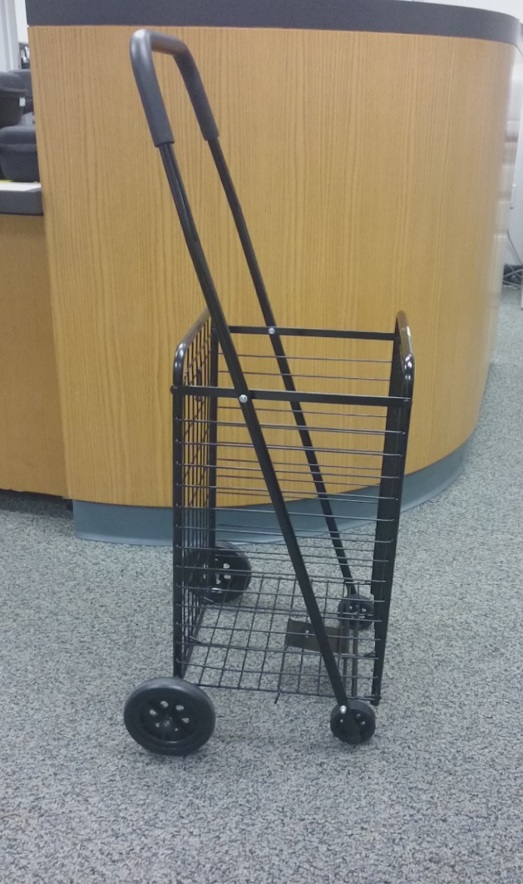
Investigation 1: What Makes Objects Move?
What do you think can make this cart start moving?
Photo courtesy of Cal Poly Pomona
Notes:
Less than 1 min
a. Draw participants’ attention to the shopping cart on the slide.
b. Ask, “What do you think can make this cart start to move?”
c. Elicit a variety of ideas and record them on chart paper.

Slide 37
Investigation 1: What Makes Objects Move?
Directions for each group member:
Choose an object on the tray to investigate.
Explore different ways to make the object move.
On the tree map, circle the name of the object you’re investigating. Then answer these questions using action words like push and pull:
What other object caused the object to move?
What action caused the motion?
What action caused the object to speed up, slow down, change direction, or stop?
Notes:
4 min
a. “Let’s explore what makes other familiar objects move.”
b. Divide participants into small groups and give each group a tray of objects (paddle ball, rubber ball, toy car, block).
c. Distribute handout 5.6 (Tree Map) and go over the instructions. Then highlight each of the questions participants will need to answer as they explore their objects.
d. Read the directions on the slide.

Slide 38
Investigation 1: What Makes Objects Move?
Be specific when you answer the handout questions.
Use words like push and pull to describe actions.
Ask questions like these as you examine the object:
What’s moving?
What other object is touching (pushing or pulling) this object and causing it to move?
What action is causing a change in the object’s motion or making it stop?
Does the object ever move without anything else touching it?
Notes:
6 min
a. Review the guidelines on the slide.
b. Direct small groups to begin their investigations and complete their tree maps. Encourage participants to explore as many of the objects on the tray as time allows.

Slide 39
Investigation 1: What Makes Objects Move?
Volunteers: Select a different object to share with the group.
State the name of your object and then share your descriptions from the tree map:
What other object caused the object to move? (What pushed or pulled it?)
What action caused the motion?
What action caused the object to speed up, slow down, change, direction, or stop?
Notes:
3 min
a. “Next, let’s have a couple of volunteers select a different object to share with the group. When it’s your turn to share, state the name of your object and then share your descriptions from the tree map. Each of you will have 1 minute for your presentation.”
b. Use the following example as a model:
My object is the cart.
My hand (the other object) caused the cart to start moving.
Pushing the cart (the action) caused the motion.
Pulling the cart (action) with my hand (other object) made it change direction.

Slide 40
Key Science Ideas
Something starts to move when something else pushes or pulls it.
An interaction between two objects makes something start to move.
Notes:
Less than 1 min
a. Review the key science ideas on the slide.

Slide 41
Investigation 2: What Is a Force?
Scientists use an important word to describe what makes something start moving, change direction, or stop moving.
That word is …
FORCE!
Notes:
Less than 1 min
a. “Scientists use the word force to describe what makes objects start moving, speed up, slow down, change direction, or stop moving.”
b. “To learn more about what forces are, let’s read a brief essay from lesson 1b.”

Slide 42
Investigation 2: What Is a Force?
Read the handout again and answer these questions in your science notebook:
What is a force?
What is gravity?
Be prepared to share examples of forces and gravity from the reading.
Notes:
3 min
a. Individuals: Ask participants to locate handout 1.2 (Forces) in their lesson plans binders, read it silently, and answer the questions on the slide in their science notebooks.
b. Whole group: Invite participants to share their definitions and examples with the group. Record their ideas on chart paper.
Key science ideas:
Forces are pushes or pulls (interactions) between two objects that make an object start moving, change speed or direction, or stop moving.
In most cases, two objects must touch to exert a force.
Gravity is a special kind of force that pulls an object toward Earth without requiring it to touch the ground.

Slide 43
Investigation 2: What Is a Force?
Think of an example from your own life of a force acting on an object.
Describe how two objects interact (touch) to make something start to move.
Use science words like these in your descriptions:
Force
Gravity
Push
Pull
Twist
Notes:
2 min
Read the instructions on the slide.
Invite participants to share their examples and descriptions with the group.

Slide 44
Investigation 2: What Is a Force?
Draw a picture showing what makes something start to move, change speed or direction, or stop moving.
Use action words (push, pull, twist, fall, drop) to label the force or forces acting on an object.
As you work on your drawing, keep this question in mind:
Where is the force that makes something start to move, change speed or direction, or stop moving?
Notes:
4 min
a. Individuals: “To illustrate key science ideas about motion and forces that we’ve investigated so far, draw a picture in your science notebooks showing what makes something start to move, change speed or direction, or stop moving. You may use an example from our investigations, from the handouts, or from your own life.”
b. “Make sure to label your drawings using action words that show the force or forces acting on an object. As you work on your drawings, ask yourself, Where is the force that makes something start to move, change speed or direction, or stop moving?”
c. Whole group: Invite one or two participants to share their drawings with the group.

Slide 45
Reflect: Content Deepening Focus Question 1
What makes something start to move?
Notes:
3 min
a. Review the focus question on the slide.
b. Individuals: Ask participants to answer the question in their science notebooks using science ideas and evidence from the previous investigations.
c. Whole-group: Invite one or two participants to briefly share their responses with the group.

Slide 46
Key Science Ideas
Forces are pushes or pulls (interactions) between two objects that make an object start moving, change speed or direction, or stop moving.
In most cases, two objects must touch to exert a force.
Gravity is a special kind of force that pulls an object toward Earth without requiring it to touch the ground.
Notes:
Less than 1 min
a. Review the key science ideas on the slide.

Slide 47
Content Deepening: Focus Question 2
How can we draw the forces pushing or pulling an object when we can’t see them?
Notes:
Less than 1 min
a. “Our second content deepening focus question is from Forces lessons 2a and b.”
b. Read the question on the slide.
c. Ask participants to write the question in their science notebooks and draw a box around it.

Slide 48
Analyze Your Drawings
Discuss these questions for each drawing with a partner:
Can you see a force in the drawing?
What part of the drawing lets you know that something has started to move?
How did you represent a force in your drawing?
Can you tell if a push, a pull, or gravity caused something to move in the drawing?
Can you tell how strong the force is that caused something to move?
Notes:
5 min
Note: You can skip this slide if time is running short.
a. Pairs: “Before we begin our next investigation, I’d like you to pair up with an elbow partner and discuss your drawings from the previous investigation. Use the discussion questions on the slide to analyze each of your drawings.”

Slide 49
Investigation 3: Representing a Force
When a pushing force was exerted on the cart, in what direction did it move?
How could we show in a diagram the direction of the force (the push) on the cart?
How could we show in a diagram how strong the force was (a small, weak push or a big, strong push)?
Notes:
3 min
a. Position the rolling cart where everyone can see it.
b. Ask a volunteer to come up and exert a pushing force on the cart.
c. Discuss the questions on the slide as a group and record on chart paper participants’ ideas for the second and third questions.
Note: If no one mentions using arrows to represent the strength of a force, add it to the list of ideas.
d. Emphasize that arrows can be used to represent both the strength and direction of the forces acting on an object.

Slide 50
Investigation 3: Representing a Force
Volunteer 1: Exert a pushing or pulling force on the cart.
Volunteer 2: Select a foam arrow to represent both the strength and direction of the force acting on the cart.
Photo courtesy of Cal Poly Pomona
Notes:
4 min
Note: Make sure the foam arrows of different lengths are available for this activity.
a. “Let’s use foam arrows to represent the strength and direction of a pushing or pulling force acting on our rolling cart.”
b. “I’ll need two volunteers for this demonstration. One volunteer will exert a pushing or pulling force on the cart, and the other volunteers will select one of the foam arrows to represent both the direction and strength of the force acting on the cart. As you watch the demonstration, think about whether the foam arrow our volunteer selects accurately represents both the strength and direction of the force. Be prepared to share your observations with the group.”
c. Select two volunteers and have one of them push or pull the cart. Then ask the second volunteer to select an arrow and describe the direction and strength of the force.
d. Following the demonstration, invite participants to share their observations. Ask, “Do you agree or disagree with the length of arrow selected to represent the force on the cart? Why?”

Slide 51
Investigation 3: Representing a Force
What are the strength and direction of the force acting on the cart in this diagram?
Photo courtesy of Cal Poly Pomona
Notes:
Less than 1 min
a. “What are the strength and direction of the force acting on the cart in this diagram? How do you know?”
b. Participants should observe that based on the length and direction of the arrow in the diagram, the force acting on the cart is pushing it to the right with a medium-sized strength.

Slide 52
Investigation 4: Representing Multiple Forces
What do you think will happen if more than one force acts on the cart at the same time in opposite directions?
What will happen if the forces are the same strength?
What will happen if one force is stronger than the other force?
Photo courtesy of Cal Poly Pomona
Notes:
5 min
a. Read the questions on the slide.
b. Pairs (1 min): Ask participants to share their predictions and reasoning with an elbow partner.
c. Whole group (1 min): Invite a few participants to share their predictions and reasoning with the group.
d. “Now let’s test our predictions!”
e. Select two volunteers to demonstrate multiple forces acting on the cart at the same time. First, ask both volunteers to exert forces of equal (the same) strength on the cart in opposite directions . Then have them exert forces of unequal strength in opposite directions.
f. Following the demonstrations, invite participants to share their observations.
g. Ask, “Did your predictions match what actually happened?”
Key science ideas:
When forces of equal strength are exerted on an object in opposite directions, the object won’t move.
When forces of unequal strength are exerted on an object in opposite directions, the object will move in the direction the stronger force is pushing.

Slide 53
Investigation 4: Representing Multiple Forces
What happens when you and your partner exert the same (equal) forces on a toy car?
How would you show the direction and strength of each force with paper arrows?
What happens when you and your partner exert different (unequal) forces on the car?
How would you show the direction and strength of each force with paper arrows?
Notes:
9 min
a. “Next, we’ll investigate what happens when more than one force is exerted on a toy car at the same time in opposite directions.”
b. Have participants pair up; then give each pair a toy car.
c. First, direct pairs to apply the same or equal forces on the car at the same time in opposite directions.
Note: Make sure participants apply each force from opposite ends of the car.
d. Then ask, “How would you show the direction and strength of each force with paper arrows?”
e. Invite one pair of participants to demonstrate equal forces acting on the car using the paper arrows. Ask participants whether they agree or disagree with the representation or have observations to add.
f. Next, direct pairs to apply different or unequal forces on the car at the same time in different directions. Partners should decide who will exert a gentle force and who will exert a stronger force.
g. Then ask, “How would you show the direction and strength of each force with paper arrows?”
h. Invite one pair of participants to demonstrate the forces acting on the car using the paper arrows. Ask participants whether they agree or disagree with the representation or have observations to add.

Slide 54
Show What You Know
Complete handout 5.7 (What Are the Forces?) using everything you’ve learned so far about equal and unequal forces.
Notes:
5 min
a. Distribute handout 5.7 (What Are the Forces?) and read through the instructions.
b. Individuals: “To show what you know about equal and unequal forces, complete this handout by drawing arrows to represent the force or forces acting on the toy car in each scenario and recording a description of what happens.”
c. Whole group: Briefly discuss what happens when equal and unequal forces act on the toy car.

Slide 55
Reflect: Content Deepening Focus Question 2
How can we draw the forces pushing or pulling an object when we can’t see them?
Notes:
4 min
a. Review the focus question on the slide.
b. Individuals: Ask participants to answer the question in their science notebooks using what they learned during the previous investigations.
c. Whole group: Invite participants to share their ideas with the group.

Slide 56
Key Science Ideas
Forces are invisible pushes or pulls (interactions) between two objects that change an object’s motion.
Scientists use arrows to represent the strength and direction of the forces acting on an object.
The direction of the arrow shows the direction of the force, and the length of the arrow shows the strength of the force.
Longer arrows represent bigger, or stronger, forces, and shorter arrows represent smaller, or weaker, forces.
Notes:
Less than 1 min
a. Review the key science ideas on the slide.

Slide 57
Questions to Think About
What causes an object’s motion to change?
What is the direction of an object’s weight?
What happens to the weight of an object when it rests on top of another object?
Notes:
Less than 1 min
a. Read the questions on the slide.
b. “We’ll explore these questions as we continue deepening our understandings of forces and motion in the next part of our content deepening session.”

Slide 58
Contact and Noncontact Forces
Which objects require physical contact with a force to move?
Which objects can move without physical contact with a force?
Courtesy of Hector Mireles
Notes:
4 min
a. Introduce the objects on the slide and what they represent.
A spring launching a ball upward
A ball falling to the ground
A girl pulling a wagon
The Moon orbiting Earth
A pendulum hanging by a string
A man trying unsuccessfully to push a heavy crate
A magnet attracting nails
b. Ask participants to think about each scenario and decide whether the object can move with or without physical contact.
c. Discuss the questions on the slide.
d. Emphasize: “Scientists use the phrase action at a distance when an object can move without physical contact with a force. Kind of like the force and Darth Vader!”

Slide 59
Describe the Forces
Courtesy of Hector Mireles
Notes:
1 min
a. “The boy in this slide is pushing a shopping cart filled with soccer balls. What forces are involved in this scenario?”
b. Elicit participants’ ideas and record them on chart paper.

Slide 60
Describe the Forces
In what direction is the boy’s force pushing/pulling on the cart?
In what direction is the force of gravity pushing/pulling on the cart?
In what direction is force of the ground pushing/pulling on the cart?
Does each of these “force possessors” (the boy, gravity, the ground) have to touch the cart to push or pull it?
Courtesy of Hector Mireles
Notes:
3 min
a. Discuss the questions on the slide as a group.
Ideal responses:
The boy is pushing the cart to the right.
Gravity is pulling downward on the cart.
The ground is pushing upward on the cart.
The boy and the ground have to touch the cart to exert a force, but gravity doesn’t.

Slide 61
Weight (The Force of Gravity)
In what direction is weight (gravity) acting on each of these objects?
Are any other forces acting on each object?
Courtesy of Hector Mireles
Notes:
5 min
Note: This activity can be scaled back if time is running short.
a. “In our next investigation, we’ll explore how weight or the force of gravity acts on various objects.”
b. Distribute handout 5.8 (Weight [The Force of Gravity]) and go over the instructions.
c. “Make sure to draw the exact direction of the weight or gravity acting on the objects. Focus on only one object at a time.”
d. Individuals: Have participants complete the handout.
e. Whole group: Briefly discuss the answers to the questions for each object.
Key science ideas:
Weight always pulls an object downward regardless of the object’s motion.
Weight always acts on objects, even if other forces are acting on them at the same time.
Weight is proportional to the mass of the object. The bigger the mass, the bigger the weight.
Ideal responses:
Ball: Gravity is pulling the ball downward. No other forces are acting on the ball.
Filing cabinet: Gravity is pulling the cabinet downward. No other forces are acting on the cabinet.
Filing cabinet: Gravity is pulling the cabinet downward. The floor is pushing up on the cabinet.
Filing cabinet: Gravity is pulling the cabinet downward. The floor is pushing up on the cabinet, and the man is pushing it to the right.
Bananas: Gravity is pulling the bananas downward. The scale tray is pushing up on the bananas.
Baseball: Gravity is pulling down on the ball as it flies upward.
Soccer ball: Gravity is pulling down on the ball. The ground is pushing up on it, and the grass is slowing it down.
Feather: Gravity pulls the feather downward toward the ground. The feather acts like a parachute as the air slows its descent a little bit.
NASA satellite: There is no weight or gravity in outer space, but the nearby planets pull the satellite toward them.
Feather: Gravity is pulling the feather downward even as the air from the fan is blowing it to the left.

Slide 62
Identify the Key Science Ideas
Courtesy of Hector Mireles
Notes:
5 min
a. “What key science ideas are the diagrams on the slide illustrating? What do they tell us about normal force, weight, and acceleration?”
Hint: The illustrations are like an answer key.
b. Pairs: Have participants discuss the questions with an elbow partner and then record their ideas in their science notebooks.
c. Whole group: Invite participants to share their answers. Record the key science ideas on chart paper.

Slide 63
Normal Force: Force from a Surface
An object resting on another object can’t penetrate that object, so it can’t accelerate.
If acceleration = 0; then net force = 0. So all of the forces acting on the object add up to zero.
If an object is resting on a surface, the normal force is the opposite of weight.
The normal force is as strong as it has to be to keep an object from falling through the surface.
If the normal force is greater than the weight, the net force exerts an upward force on an object (e.g., a paddleball).
Notes:
5 min
a. Walk participants through the key science ideas on the slide and ask them how closely these ideas match the ideas they came up with in the previous activity.
b. Emphasize the following points during the discussion and encourage participants to ask questions:
Since two objects can’t occupy the same space, a normal force is exerted to keep that from happening.
Gravity is the only force acting on a free-falling apple, so the net force is downward (The apple accelerates downward.)
Gravity exerts a downward force on an apple resting on a table, but a normal force is exerting an upward force on the apple at the same time. These forces are equal and opposite, so the net force is zero.
A heavy object (such as a file cabinet) has a large normal force (longer arrows) compared to the normal force acting on an apple.

Slide 64
Feel the Normal Force
Let your fist fall onto the surface of your desk. Pay close attention to what happens at the point of contact (when your knuckles hit the surface of the desk).
Photo courtesy of Hector Mireles
Notes:
Less than 1 min
a. Read the instructions on the slide.
b. Ask participants to carry out the experiment and pay close attention to what happens at the point of contact with the surface of the desk.
c. Then quickly advance to the next slide.

Slide 65
Feel the Normal Force
Is the weight of your fist enough for your hand to crash through the surface of the desk?
What is the direction of the force that you can feel from the desk surface against your hand?
What is the name for the force the desk is exerting on your hand?
What’s the direction of the force your muscles exert on your fist?
Do these forces add up to zero (net force = 0)?
Photo courtesy of Hector Mireles
Notes:
4 min
a. Ask participants what they felt when their knuckles made contact with the surface of the desk.
Ideal answer: I could feel a downward force from my arm muscles because of the weight of my hand.
b. Discuss the questions on the slide.
Ideal responses:
No. The surface stops my knuckles.
I can feel an upward force from the desk against my hand.
The normal force.
Downward toward the surface of the desk.
No. The normal force is greater than the force from my muscles.
Note: Participants may think that the forces add up to zero because the surface of the table stops their hands. To address this misconception advance to the next slide.

Slide 66
Feel the Normal Force
In what direction did your fist accelerate the moment it makes contact with the desk surface?
My fist didn’t accelerate.
My fist accelerated downward in the direction it was moving before it hit the surface of the desk.
My fist accelerated upward (negative acceleration). The speed it had before striking the surface would suddenly drop to zero the moment it makes contact with the desk.
Do the forces acting on your fist add up to zero?
What would happen if the desk were made of paper?
Notes:
2 min
a. Briefly discuss the questions on the slide.
Ideal responses:
My hand accelerated upward (negative acceleration). The speed it had before striking the desk sudden dropped to zero the moment it made contact with the desk.
No. The normal force was greater than the force my muscles exerted, so the net force was directed upward. Acceleration was upward, so my hand slowed down very quickly and accelerated in the opposite direction of the initial motion (a = F/m).
If the desk were made of paper, my fist would accelerate straight through it, since the normal force would be insufficient to stop it.

Slide 67
Let’s Summarize!
What is a force?
Does an object have to touch another object to exert a force? What is one example?
What’s the difference between a force and motion?
If a force acts on an object in a specific direction, will the object move in the direction the force is pushing or pulling it?
Notes:
4 min
a. Discuss the questions on the slide.
Ideal responses:
A force is a push or pull that involves an interaction between two objects and causes a change in an object’s motion. This is one of our learning goals.
Forces can act on an object without the object touching another object. Example: gravity.
A force is a push or pull on an object that causes a change in the object’s motion. A force must act on an object for it to start moving, but once an object is in motion, other forces can act on it while it’s moving. These forces can change the object’s speed and/or direction. So force and motion are different factors.
The movement of an object depends on the size and direction of the various forces acting on it. Example: If two forces are acting on an object in opposite directions with the equal force, no acceleration occurs.

Slide 68
Representing Forces: Examples
Object
A large force toward the right
A larger force to the right
Object
A large force to the left
A small force to the left
No change in motion
Notes:
Less than 1 min
a. Walk participants through the examples on the slide.

Slide 69
Representing Forces
Use a black arrow to represent a force acting on each object in your Weight handout.
Draw a dot exactly in the center of the object and start your arrow there.
The arrow should point in the direction the force is pushing or pulling the object.
The length of the arrow should indicate the strength of the force. The longer the arrow, the greater the force.
Use a red arrow to represent the direction of the change in motion of each object.
For an increase in speed, point the arrow in the direction of the object’s motion.
For a decrease in speed, point the arrow in the opposite direction of the object’s motion.
A dot with no arrow represents no change in motion.
Notes:
7 min
a. “Let’s practice using arrows to represent forces acting on different objects.”
b. Have participants locate handout 5.8 (Weight [The Force of Gravity]).
c. “For each object on the handout, use a black arrow to represent a force that’s acting on it. First, draw a dot exactly in the center of the object and start your arrow there. The arrow should point in the direction the force is pushing or pulling the object, and the length of the arrow should indicate the strength of the force. The longer the arrow, the greater the force.”
d. Give participants a few minutes to draw their arrows.
e. “Now I’d like you to use a red arrow to represent the direction of the change in motion that each object experiences. If the speed of the object increases, the arrow should point in the direction of the object’s motion. If the speed decreases, the arrow should point in the opposite direction of the object’s motion. If there is no change in motion, draw a dot but no arrow.”
f. Give participants a few minutes to draw their arrows.
e. Whole group: Invite one or two participants to share their representations with the group.

Slide 70
Representing Forces with Vectors
A vector is the scientific name for using a dot and arrow to represent a force. Here’s an example:
F_boy
Courtesy of Hector Mireles
Rules:
Select one object that’s being pushed or pulled.
The vector begins at the center of the object and points in the direction the force is pushing or pulling the object.
The longer the vector, the greater the force.
Label each vector with a name or symbol.
Notes:
1 min
a. Read the definition and rules on the slide.
b. Walk participants through the example, highlighting how each rule has been applied.

Slide 71
Estimating Net Force
Dandelion
Train
Airplane
Net force = the sum of all of the forces acting on an object
Courtesy of Hector Mireles
Notes:
7 min
a. “Next, we’ll explore how to estimate the net force acting on different objects.”
b. Distribute handout 5.9 (Net Forces: Train, Airplane, and Dandelion) and review the instructions.
c. Highlight the following points:
Vectors are scaled. A longer vector = a greater force.
Two or more vectors can add up to zero or something other than zero (e.g., vectors of the same length pointing in opposite directions ).
The sum of all of the forces acting on an object is called the net force.
d. Walk participants through the example on the slide showing the forces acting on car C. Note that the force the train engine exerts and the force cars A and B exert don’t cancel each other out. The vector below the train shows that the net force (the sum of the forces from cars A and B and the engine) is pointing right (black arrow). Contrast this with the normal force and weight for car C, which do cancel each other out.
e. Individuals: Have participants complete the handout independently.
f. Whole group: Invite one or two participants to share their net-force estimates and reasoning. You might want to display one of the completed handouts on a document reader during this discussion.

Slide 72
Representing a Change in Motion
A change in an object’s motion = acceleration (represented by the symbol a).
Newton’s laws: Acceleration occurs in the same direction as the net force.
If the net force is zero, there is no change in motion.
A large net force yields a large acceleration.
Notes:
Less than 1 min
a. Read through the information on the slide.

Slide 73
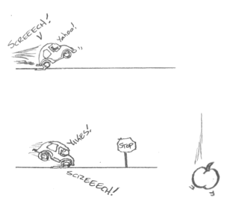
Apple-and-Car Scenario
A change in motion = acceleration (a)
Acceleration occurs in the same direction as the net force.
If the net force is zero, there is no change in motion.
A large net force yields a large acceleration.
Courtesy of Hector Mireles
Notes:
5 min
a. Distribute handout 5.10 (Net Force and Acceleration: Apple-and-Car Scenario) and read through the directions.
b. Make sure participants understand the scenario: In the first diagram, the car accelerates. Then it slams on the breaks in the second diagram when an apple falls in the middle of the road (a little Newtonian humor).
c. Individuals: Have participants predict the direction of the net force in each scenario by identifying the forces acting on the car. Then have them predict the direction of acceleration (change in motion) in each scenario.
d. Whole group: Discuss participants’ predictions and reasoning. Make sure to correct any mistakes or confusion.

Slide 74
Falling-Car Challenge
Courtesy of Hector Mireles
Notes:
4 min
a. “Our next challenge is to figure out the net force acting on a falling car and determine the change in motion or acceleration.”
b. Distribute handout 5.11 (Net Force and Acceleration: Falling-Car Challenge) and review the instructions.
c. Individuals: Have participants complete the handout.
d. Whole group: Briefly discuss participants’ solutions.

Slide 75
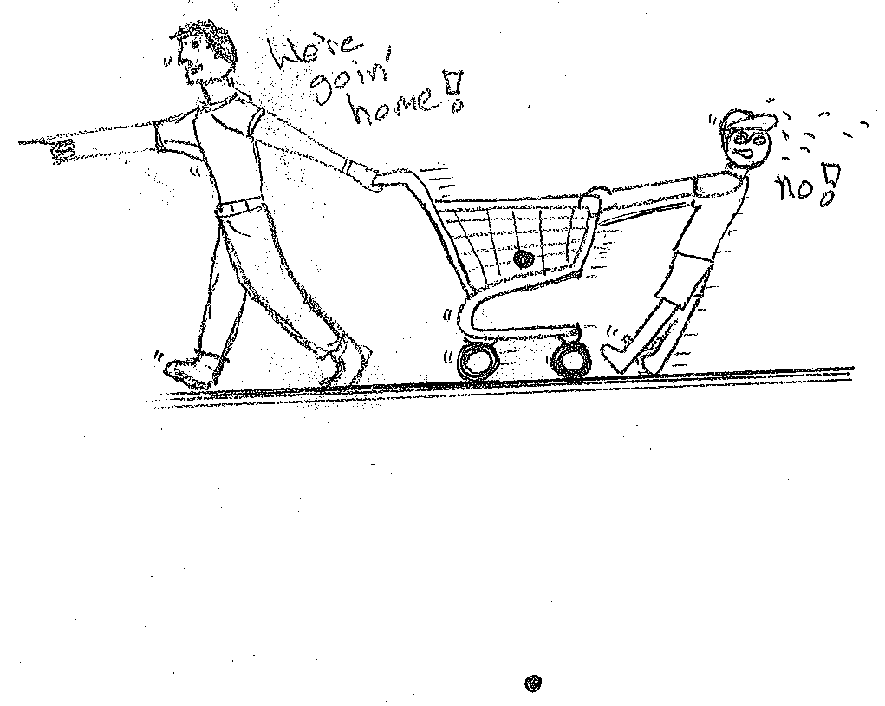
Shopping-Cart Challenge
Scenario: A son pulls on a shopping cart by dragging his feet. But his father pulls much harder, and the cart moves to the left.
Courtesy of Hector Mireles
Notes:
4 min
a. “Now let’s consider another scenario and see if we can figure out the net force and acceleration. In this scenario, a father and son are engaged in a tug-of-war with a shopping cart.”
b. Distribute handout 5.12 (Net Force and Acceleration: Shopping-Cart Challenge) and review the instructions. Emphasize that participants should only consider the forces acting on the cart.
c. Individuals: Have participants complete the handout.
d. Whole group: Briefly discuss the forces acting on the cart.

Slide 76
Forces and Acceleration
Ball
Paddle Ball (Stretched)
Paddle Ball (Impacting Paddle)
Rolling Toy Car
Courtesy of Hector Mireles
Notes:
Less than 1 min
a. “In the Forces lessons, students will investigate these objects, all of which have different dynamics at different times.”
b. “To wrap up our content deepening work today, we’ll use everything we’ve learned so far about forces and motion to make predictions about each of these objects.”

Slide 77
Ball on an Incline
Predict the acceleration of the ball and justify your answer by adding together the forces acting on the ball (net force).
Courtesy of Hector Mireles
Notes:
1 min
a. Ask participants to predict the acceleration of the ball and justify their answers by adding together the forces acting on the ball (net force).
b. Highlight the downward pull of gravity (weight) on the ball and the upward push of the surface of the ramp against the ball (normal force).
c. “We’ll revisit this setup on day 8 of the PD program.”

Slide 78
Paddleball
What’s the net force acting on the ball when the string is fully stretched (left) and when it makes contact with the paddle (right)?
What’s the direction of the net force? What’s the direction of acceleration?
Courtesy of Hector Mireles
Notes:
5 min
a. “The motion of a paddleball is complex. Think about the forces acting on it.”
b. “A stretched elastic band exerts great tension (T) on the ball back toward the paddle, and a very small weight (W) or force of gravity is pulling the ball toward the ground .”
c. Ask participants,
What’s the net force acting on the ball when the elastic is fully stretched?
What’s the direction of the net force?
What’s the direction of acceleration?
d. “When the ball crashes against the paddle, the rubber in the ball compresses and creates a large force moving away from the paddle. Weight or gravity is still exerting a force, but it’s very small.”
e. Ask participants,
What’s the net force acting on the ball when it makes contact with the paddle?
What’s the direction of the net force?
How about the direction of acceleration?

Slide 79
Toy Car
A rolling toy car always seems to slow down. Think about the forces acting on the car and predict the direction of acceleration.
Courtesy of Hector Mireles
Notes:
4 min
a. “Have you ever noticed that a rolling toy car always seems to slow down? Let’s consider the forces acting on the car.”
b. “Weight or gravity is pulling down on it, normal force is pushing up on it, and friction, which we’ll discuss in our next content deepening session, is acting in the opposite direction of the car’s motion.”
c. “In this diagram, the car is moving to the right, but do any of the forces point to the right?”
d. Discuss the following questions:
What is the direction of acceleration?
What would happen if the force of friction were stronger in this diagram?
What would happen to the net force in that scenario?

Slide 80
Reflect: Content Deepening Focus Questions
What makes something start to move?
Revise your answer to this question based on today’s content deepening work.
Group discussion: How can we draw the forces pushing or pulling an object when we can’t see them?
Why was it easier for us to draw the forces, rather than just talk about them.
How does the net force predict acceleration?
Notes:
4 min
a. Revisit the content deepening focus questions on the slide.
b. Individuals: Ask participants to revise their answers for the first question based on today’s content deepening work.
c. Whole group: Discuss the following questions related to the second focus question:
Why was it easier to draw the forces acting on an object than it was to talk about them?
How does the net force predict acceleration?

Slide 81
Key Science Ideas
A force is a push or pull (interaction) between objects that causes a change in an object’s motion.
The forces acting on an object are represented with arrows that begin at the center of the object and point in the direction of the respective forces.
Acceleration is a change in an object’s motion in the same direction as the net force.
The weight of an object is the force of gravity pulling it toward the center of Earth.
When one object rests on another object, the object underneath exerts an upward force called the normal force that keeps the two touching objects separated from each other.
Notes:
Less than 1 min
a. Review the key science ideas on the slide.

Slide 82
Today’s Focus Questions
What is the Science Content Storyline Lens (SCSL)?
Why is one main learning goal essential for science content storyline coherence?
What makes something start to move?
How can we draw the forces pushing or pulling an object when we can’t see them?
Notes:
Less than 1 min
a. Review the focus questions addressed during today’s session.

Slide 83
Summary: Today’s Lesson Analysis Work
Reflect on today’s session:
STL strategy 6: use and apply
The Science Content Storyline Lens (SCSL)
Science ideas and student ideas
SCSL strategy A: identify one main learning goal
Based on our work today, do you have any suggestions for modifying our image of effective science teaching?
Notes:
3 min
a. Individual think time (1 min): Ask participants to reflect on the work they accomplished during today’s lesson analysis and then think about the question on the slide.
b. Whole-group share-out (2 min): Invite participants to share their ideas for modifying the image of effective science teaching based on today’s work. Revise the chart as needed.

Slide 84
Summary: Today’s Content Deepening Work
Name one main learning goal for today’s content deepening work.
OR
Name one supporting science idea you learned about forces today.
OR
Name one common student idea (misconception) about forces.
Notes:
3 min
Individual think time (1 min): Present the options on the slide and give participants 1 minute to come up with a statement that summarizes today’s content deepening work in one of these areas. Emphasize that they should not refer to the science idea that a force is a push or pull on an object.
Whole-group round-robin (2 min): Go quickly around the room and have each participant share one summarizing statement. Push for complete sentences!

Slide 85
Lesson Analysis Homework
Read in the STeLLA strategies booklet:
SCSL strategy B: Set the purpose with a focus question or goal statement
SCSL strategy C: Select activities that are matched to the learning goal
SCSL strategy I: Summarize key science ideas
STL strategy 7: Engage students in making connections by synthesizing and summarizing key science ideas
Fill in the appropriate columns on your SCSL Z-fold summary charts.
Notes:
2 min
a. Review the homework assignment on the slide and have participants write it in their notebooks.
b. Make sure participants are clear about the reading and writing tasks.

Slide 86
Content Deepening Homework
Read sections 4–7 and section 9 in the content background document. Be prepared to discuss these questions next time:
Does the reading clarify the ideas about forces that were discussed today?
What new questions do you have?
Notes:
2 min
a. Go over the content deepening homework assignment and have participants write it in their notebooks.
b. Make sure participants are clear about this reading assignment.

Slide 87
Extended Homework
Locate handout 5.13 (Extended Homework) in your PD program binder.
Between now and Friday, read your assigned two-part lesson plan (parts A and B).
Be prepared to share your findings in a study-group conversation on our last day.
Notes:
3 min
a. Go over the information on this slide.
b. Have participants review the Extended Homework assignment sheet (handout 5.13), which provides further details about the assignment.
c. Remind participants that like the extended homework they were assigned on the Variation in Traits lessons during week 1, they’re responsible for reading parts A and B of their assigned lesson plan.
d. Assign a two-part lesson plan to each participant.
e. Ask if there are any questions about the assignment.
f. Emphasize: The group share-out on the last day of the PD program (day 8) should focus on the assignment-sheet questions (section 2). Participants won’t have time to share all the details of each lesson plan.

Slide 88
Reflections on Today’s Session
Reflect on lesson analysis: In what way(s) did our lesson analysis work and/or our study of SCSL strategy A (one main learning goal) stretch your thinking? Give an example to support your response.
Reflect on content deepening: Describe how our content deepening work today helped you clarify a science-content idea.
Feedback: Provide feedback about today’s session and the program so far (likes, dislikes, questions, concerns, suggestions).
Notes:
7 min
a. Allow at least 5 minutes for participants to think about today’s session and write their reflections and feedback on the Daily Reflections sheet (handout 5.14 in PD program binder).

