Slide 1
RESPeCT PD pROGRAM
Day 6
RESPeCT Summer Institute
Notes:
5 min
a. Take care of any housekeeping issues.

Slide 2
Agenda for Day 6
Day-5 reflections
Review: Science content storyline
Today’s focus questions
Lesson analysis: STeLLA strategies B, I, and 7
Content deepening: forces
Lunch
Content deepening (continued)
Lesson analysis: SCSL strategy C
Summary, homework, and reflections
Notes:
5 min
a. Go over the agenda for the day.

Slide 3
Trends in Reflections
Lesson Analysis | Science Content Learning
Notes:
7 min
a. Give participants time to review your feedback on their reflections from day 5 and offer reactions, comments, or follow-up questions.

Slide 4
Review: Science Content Storyline
In your notebooks, jot down …
things you remember from yesterday’s session,
ideas that seem important to you, and
question you have.
Be prepared to share one idea and question with the group.
3
2
1
Notes:
10 min
a. Point out the three tasks on the slide. Allow 4–5 minutes for participants to write their responses in their science notebooks.
b. Have each participant share one idea about the science content storyline that she or he thinks is really important.
c. Then ask participants to share their questions. If you can answer them quickly, go ahead and do so. If a question needs a more detailed response, write it down and schedule a time to address it.

Slide 5
Today’s Focus Questions
How can we begin and end a lesson to help students develop a coherent science content storyline?
How can selecting appropriate science activities help students develop a coherent science content storyline?
Why do moving objects slow down and eventually stop?
What force makes a moving object slow down and eventually stop?
Notes:
2 min
a. Introduce today’s focus questions.

Slide 6
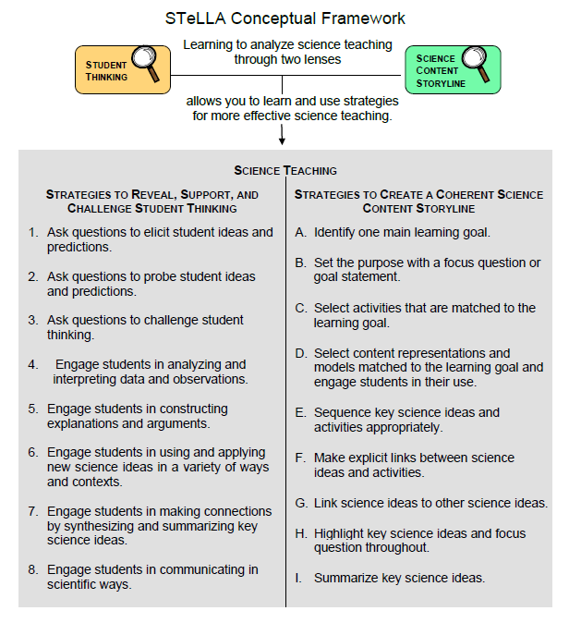
Notes:
1 min
a. “Today we’ll be looking at four new STeLLA strategies. Three of them are Science Content Storyline Lens strategies, and one is a Student Thinking Lens strategy. Throughout the session, think about how these strategies are different from one another and how they are closely linked to each other.”

Slide 7
Lesson Analysis: Focus Question 1
How can we begin and end a lesson to help students develop a coherent science content storyline?
Notes:
Less than 1 min
a. “Now let’s dig into our first focus question.”

Slide 8
Strategies B, I, and 7: Purposes and Key Features
Group 1: What are the purpose and key features of strategy B?
Why is a focus question or goal statement important for science content storyline coherence?
Group 2: What are the purpose and key features of strategy I?
Why is summarizing key science ideas important for science content storyline coherence?
Group 3: What are the purpose and key features of strategy 7?
How does strategy 7 compare with strategy I?
All groups: Make sure to cite ideas from the STeLLA strategies booklet in your answers.
Notes:
25 min
a. Pairs (3 min): Direct participants to retrieve their Z-fold summary charts and share with a partner what they learned from their homework assignment about STeLLA strategies B, I, and 7.
b. Small groups (12 min): Divide participants into three small groups and have them make charts that capture the purposes and key features of the three strategies.
Note: Challenge participants to imagine themselves in a Teacher Leader role. Ask them, “How would you explain these strategies to the teachers you’re leading?”
c. Whole group (10 min): Have small groups share their charts in a whole-group share-out.
Key ideas:
Make sure participants understand that a focus question is designed to do more than just get students interested in the lesson. It gets them thinking about a phenomenon or something else they’ve never thought about before. It also reveals important things about the knowledge and experiences they’re bringing to the lesson, it conceptually situates the learning, and it’s referred to throughout the lesson.
STeLLA strategies B, I, and 7 are like bookends that mark the beginning and end of a lesson. The science ideas used in the summary should match the focus question from the beginning of the lesson, and both the focus question and the summary should match the lesson’s main learning goal.

Slide 9
Discussion Questions: Strategy B
What is the difference between focus questions and goal statements?
Which do you think would be more useful in engaging student interest and making their thinking visible—focus questions or goal statements?
Notes:
7 min
a. Whole group: Discuss the questions on the slide as a group.
Key ideas:
A focus question is designed to be answered using the lesson’s main learning goal and supporting science ideas. A goal statement describes the main science idea to be learned.
Focus questions are always used in RESPeCT lesson plans because they are useful in engaging student interest, making their thinking visible, and eliciting initial ideas at the beginning of a lesson. When posed at the end of a lesson, focus questions challenge students to use new ideas developed during the lesson.

Slide 10
Discussion Questions: Strategies I and 7
What are various ways a lesson or unit can be synthesized and/or summarized?
How are strategies I and 7 similar and different?
SCSL strategy I: Summarize key science ideas.
STL strategy 7: Engage students in making connections by synthesizing and summarizing key science ideas.
Notes:
7 min
a. Whole group: Discuss the first question on the slide. Participants can refer to the information on strategy 7 in the STeLLA strategies booklet to identify a variety of ways in which key science ideas in a lesson can be synthesized.
b. Emphasize: “Toward the end of a unit, an entire lesson may be devoted to strategy 7, which engages students in synthesizing and summarizing science ideas across several lessons.”
c. Discuss the second question on the slide.
Key ideas:
In strategy I, the teacher creates a summary of key science ideas in the lesson. Strategy 7, however, engages students in synthesizing and summarizing key science ideas in the lesson. When students themselves perform this work, it makes their thinking visible, engages them in active sensemaking, and reveals to the teacher any misunderstandings or gaps in knowledge. Using both strategies brings coherence to a science lesson and is a powerful way to end it.
In strategy 7, summarizing involves making connections between key science ideas, which helps students synthesize the main learning goal or big idea in a lesson.
Summaries should focus on key science ideas, not activities; that is, focusing on “what we learned” versus “what we did.”
For a variety of reasons, a lesson sometimes ends before the main learning goal has been fully developed. However, summarizing work should still take place. For example, the teacher might say, “Our focus question today was How do plants get their food? What have we found out so far?” After students respond, the teacher could reply, “Yes, so far we’ve discovered that water and soil aren’t food for plants. But we still haven’t figured out what is food for plants. We’ll continue working on this question next time.”

Slide 11
Video-based Lesson Analysis
Next we’ll analyze two video clips from the beginning and end of a lesson on forces.
Notes:
Less than 1 min
a. Transition: This slide marks the transition to video-based lesson analysis.

Slide 12
Lesson Analysis: Strategy B
In Analysis Guides B and I (handout 6.1), review the four criteria for strategy B: Setting the purpose.
Read the lesson context at the top of the video transcript (handout 6.2).
Watch the first video clip, keeping in mind the criteria for strategy B.
Analyze the transcript using the analysis guide.
How well does the beginning of this lesson match the criteria for strategy B?
Share and compare your analyses.
Link to video clip 1: 6.1_mspcp_gr.3.forces_torres_L1_c1-2
Notes:
20 min
a. Have participants locate Analysis Guides B and I (handout 6.1 in PD program binder) and spend 1 or 2 minutes reading the criteria for strategy B: Setting the purpose.
b. Ask: “Do you have any questions about these criteria?”
c. Emphasize: “Keep the criteria for strategy B in mind as you watch the first video clip from the beginning of a lesson on forces.”
d. Individuals: Give participants a couple of minutes to read and think about the lesson context at the top of the video transcript (handout 6.2).
e. Show the video clip.
f. Whole group: “How well does the beginning of this lesson match the criteria for strategy B?
Note: During the discussion, be on the lookout for opportunities to clarify science-content ideas.
Ideal responses for questions from Analysis Guide B:
Implied main learning goal: Forces (pushes, pulls) cause things to move.
Uses everyday language: Yes, the focus question uses everyday language (“What might cause something to move?”).
Scientifically accurate: The focus question is presented in a scientifically accurate way.
Goal statement: Not applicable.

Slide 13
Lesson Analysis: Strategy I
In Analysis Guides B and I (handout 6.1), review the six criteria for strategy I: Summarizing key science ideas.
Review the lesson context at the top of the video transcript (handout 6.3).
Watch the second video clip, keeping in mind the criteria for strategy I.
Analyze the transcript using the analysis guide.
How well does the end of this lesson match the criteria for strategy I?
Share and compare your analyses.
Link to video clip 2: 6.2_mspcp_gr.3.forces_torres_L1_c5
Notes:
20 min
a. Allow participants 1 or 2 minutes to read the six criteria in the analysis guide for strategy I: Summarizing key science ideas.
b. Ask: “Do you have any questions about these criteria?”
c. Emphasize: “Keep the criteria for strategy I in mind as you watch the next clip from the end of the same Forces lesson.”
d. Individuals: Give participants a couple of minutes to review the lesson context at the top of the video transcript (handout 6.3).
e. Show the second video clip.
f. Whole group: “How well does the end of this lesson match the criteria for strategy I? How well does the summary statement match the beginning of the lesson?”
Note: During the discussion, be on the lookout for opportunities to clarify science-content ideas.
Ideal responses for questions from Analysis Guide I:
Summary statement/activity: Yes, the teacher engages students in summarizing key ideas from the activity (video segment 00:03–02:18). Then students write what they learned about the focus question, which is another summarizing activity.
Conceptual understanding: Yes, the summary discussion focuses on using the conceptual idea of forces to explain how things move.
Matched to the MLG and FQ: Yes, the summary is matched to the focus question. In fact, in the final summary activity, students write an answer to the focus question.
Scientifically accurate: The summary discussion is scientifically accurate; however, from segments 00:35–00:37, the teacher pushed (or led) the student to be more accurate by saying that a pushing force, not a hand, caused the block to move.
Sensemaking: Yes, students are engaged in making sense of the summary both during the discussion and in the writing/drawing task.
Improvements: After affirming students’ use of the words push and force (segments 00:37–01:13), the teacher could have included examples of pulling forces.
A missed opportunity: When a student refers to gravity (segment 02:09), the teacher could have asked students whether gravity is a push or a pull. That would link this unexpected response to the day’s learning goal, since gravity isn’t a focus in this lesson.

Slide 14
The Forces Lesson Plans: Reading and Analysis
Examine the main learning goal, the lesson focus question, and the lesson summary for your assigned Forces lesson plan (parts A and B).
Answer these questions in your notebooks, keeping in mind the analysis-guide criteria for strategies B and I:
What do you notice?
What do you wonder about?
Notes:
10 min
Note: This slide can be abridged or skipped if time is running short.
a. Read the instructions on the slide and assign a two-part lesson plan (parts A and B) to each participant.
b. Ask participants if they have any questions about the assignment.
c. Individual reading-and-analysis time (5 min): “Answer the slide questions in your notebooks, keeping in mind the analysis-guide criteria.”
d. Whole-group discussion (5 min): Briefly discuss participants’ observations and questions for their assigned lesson plans.
Note: Participants should see a close match between the main learning goal, the lesson focus question, and the summary. However, also welcome critiques and suggestions for improvement. Just make sure critiques are based on good understandings of the strategies involved.

Slide 15
forces
SCIENCE CONTENT DEEPENING Grade 3
Notes:
Less than 1 min
Transition: This slide marks the transition to the content deepening work.
Note: Throughout this content deepening phase, refer as needed to the content background document and Common Student Ideas about Forces and Motion.

Slide 16
Content Deepening Homework
Share a new idea or question from the content deepening homework.
What helped clarify your understandings of the science content?
What idea was new to you?
What idea were you confused about?
What big idea do you think is important to highlight for students?
What burning question do you have?
Notes:
3 min
a. Invite participants to briefly share a new idea or question related to the content deepening homework from the previous session.
b. Quickly address any misunderstandings or confusion, but don’t spend time discussing ideas that will be presented during today’s session (e.g., forces in outer space).

Slide 17
Unit Central Questions
What makes something start to move? What makes something stop moving or change direction?
Notes:
Less than 1 min
Review the unit central questions on the slide.
b. Remind participants that these questions will guide student thinking throughout the Forces unit.

Slide 18
Content Deepening: Focus Question 1
Why do moving objects slow down and eventually stop?
Notes:
Less than 1 min
a. Read the focus question on the slide.
b. “To help us answer this question, we’ll explore science ideas from Forces lessons 3a and 3b.”
c. Have participants write the question in their science notebooks and draw a box around it. Make sure they leave space below the question to write a response later.

Slide 19
Investigation 1: Does the Surface Matter?
Think about this scenario: Students rolled a soccer ball over three different surfaces:
Grass
Blacktop on the playground
Tile flooring in the school hallway
The students tried to use the same force each time. Then they measured how far the ball rolled.
Question: Do you think the ball traveled the same distance on all three surfaces? Why or why not?
Notes:
2 min
a. Introduce the scenario on the slide; then ask, “Do you think the ball traveled the same distance on all three surfaces? Why or why not?”
b. Invite participants to share their ideas and reasoning.

Slide 20
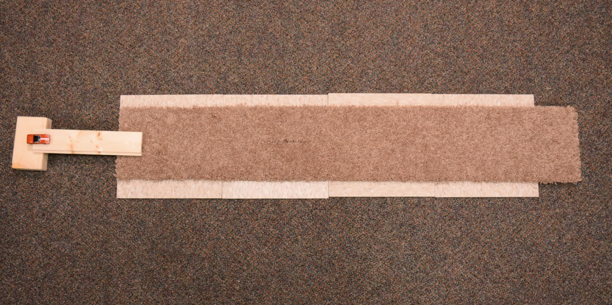
Investigation 1: Does the Surface Matter?
Carpet
Car
Ramp
Meter Stick
Photo courtesy of BSCS
Notes:
6 min
a. In this investigation, we’ll explore whether the surface a toy car rolls over has anything to do with making it slow down and eventually stop. We’ll also consider whether differences in surface textures affect the distance the car travels before it stops.
b. “Before we break up into teams to conduct the investigation, I’d like you to predict what you think will happen.”
c. Distribute handout 6.8 (Does the Surface Matter?) and read the overview aloud.
d. Individuals: Direct participants to answer the questions on page 1 of the handout.
e. Whole group: Invite a few participants to share their predictions and reasoning with the group. Record predictions on chart paper.

Slide 21
Investigation 1: Does the Surface Matter?
Record your distance measurements on this data table in the handout.
Surface | Distance Trial 1 | Distance Trial 2 | Distance Trial 3 | Middle Distance
Carpet
Tile
Sandpaper
Notes:
10 min
a. Divide participants into teams and distribute the supplies for the ramp setup.
b. Walk participants through the instructions on page 2 of handout 6.8 (Does the Surface Matter?). Encourage them to ask clarification questions as needed.
c. Go over the data table on the handout (and slide). Make sure participants understand how to record their measurements for each trial and compute the middle distance. Note that following the activity, each team will add data from their tables to the “class” data table.
d. Remind participants not to exert any force on the car at the top of the ramp. They should place it gently on the ramp, let it go, and allow gravity to take over. Also emphasize that they should leave the meter stick in place during the investigation and not pick it up to take measurements.
e. Have teams begin the investigation. Circulate among the teams as they work and be available to answer questions or provide support.

Slide 22
Investigation 1: Does the Surface Matter?
Record your team’s Middle Distance measurement on the class data table.
Surface | Team 1 | Team 2 | Team 3 | Team 4 | Team 5 | Team 6 | Team 7
Carpet
Tile
Sandpaper
Notes:
5 min
a. After teams have finished recording their trial measurements on the handout and computing the middle distances, have them complete step 3 on the handout and add their team’s data to the class data table (step 4).

Slide 23
Investigation 1: Does the Surface Matter?
What patterns do you see in the “class” data?
Do these results match your predictions?
Notes:
1 min
a. Briefly discuss the questions on the slide.

Slide 24
Investigation 1: Does the Surface Matter?
Question 1: Why do you think the car traveled different distances over the three surfaces?
Write your explanation on the handout.
Make sure to support your ideas with evidence from the data table and our investigation.
Notes:
3 min
a. Read the first handout question and the tasks on the slide.
b. Individuals: Ask participants to write their explanations on the handout, making sure to include evidence from the data table and investigation.
c. Whole group: Invite a few participants to share their explanations and evidence with the group.

Slide 25
Investigation 1: Does the Surface Matter?
Question 2: If forces make an object start to move, do they also have something to do with making an object stop moving?
Think about this question. Then complete the sentence on the handout:
I think forces [do/do not] have something to do with making an object stop moving because __________________________.
Use evidence from your investigation to explain your answer.
Notes:
4 min
a. Review the second handout question and the tasks on the slide.
b. Individuals: Ask participants to complete the sentence on the handout, using evidence from the data table and investigation to support their explanations.
c. Whole group: Invite a few participants to share their explanations and evidence with the group.

Slide 26
Reflect: Content Deepening Focus Question 1
Why do moving objects slow down and eventually stop?
Notes:
4 min
a. Revisit the first content deepening focus question.
b. Individuals: Have participants write a concise answer in their science notebooks using evidence from the ramp investigation.
c. Whole group: “Do you have any new ideas for answering this question based on our investigation?”
d. As participants share, record key ideas on chart paper.

Slide 27
Key Science Ideas
The surface an object moves over or through has something to do with the object slowing down and stopping.
Moving objects slow down and stop at different distances on different surfaces.
Objects take longer to slow down and stop on smooth surfaces, but they slow down and stop more quickly on rough surfaces.
So differences in surface texture must have something to do with variations in the distance an object travels when the same force is applied.
Notes:
Less than 1 min
a. Highlight the key science ideas on the slide.
b. Ask: “Does everyone agree with these ideas? Would you like to add or revise anything?”

Slide 28
Content Deepening: Focus Question 2
What force makes a moving object slow down and eventually stop?
Notes:
Less than 1 min
a. Read the focus question on the slide.
b. Have participants write the question in their science notebooks and draw a box around it. Make sure they leave space below the question to write a response later.
c. Emphasize that this focus question will guide student learning throughout Forces lessons 4a and 4b.

Slide 29
Let’s Analyze Our Data!
Why do you think the car traveled different distances over the three surfaces?
What do you think the bumpiness of the surface had to do with the distance the car rolled before it stopped?
Based on our data, do we all agree that an object will move farther on a smooth surface than it will on a rough surface?
Notes:
3 min
Note: Make sure the “class” data chart is displayed where everyone can see it.
a. Briefly review the results on the data chart.
b. Ask participants, “What pattern did we identify in the data from our ramp investigation?”
Answer: The car traveled a greater distance over a smooth surface and a shorter distance over a rough surface.
c. Discuss the questions on the slide.

Slide 30
Investigation 2: The Hand-Strip Model
Describe the surface of the “hand strip.”
How is the hand strip like or not like the three surfaces (carpet, tile, and sandpaper)?
What do you think will happen when the toy car rolls over the hand strip?
Notes:
5 min
a. “Next, we’ll investigate a different kind of surface and see what happens when the toy car rolls over it.”
b. Introduce the hand-strip model you assembled from handout 6.9 (Hand Strip).
c. Ask participants to describe the surface of the hand strip and compare it with the carpet, tile, and sandpaper, noting similarities and differences.
d. Ask, “What do you predict will happen when the toy car rolls over this hand strip?”
e. Elicit a variety of predictions and record them on chart paper.

Slide 31
Investigation 2: The Hand-Strip Model
Why do you think the car stopped? (Use the words force, push, or pull in your explanation.)
Notes:
4 min
a. Have participants gather around the ramp setup. Make sure the hand strip and meter stick are correctly positioned at the bottom of the ramp.
b. Let the toy car run down the ramp and over the hand strip at least two times so participants can see that it travels about the same distance each time before stopping.
c. Ask, “Why do you think the car stopped?”
d. As participants share their ideas, record them on chart paper.

Slide 32
Investigation 2: The Hand-Strip Model
Take turns using the hand lens (magnifying glass) to examine the three surfaces (carpet, tile, sandpaper).
Think about how each surface is like or not like the hand strip.
Discuss these questions with your partner; then record your observations in your science notebook:
How is the carpet like or not like the hand strip?
How is the sandpaper like or not like the hand strip?
How is the tile like or not like the hand strip?
Notes:
5 min
a. “Let’s revisit our ideas about the similarities and differences between the hand strip and the carpet, tile, and sandpaper.”
b. Have participants pair up with an elbow partner; then give each pair a hand lens (magnifying glass).
c. Pairs: “Take turns examining the three surfaces with the magnifying glass and think about how each surface is like or not like the hand-strip model. Then discuss the questions on the slide with your partner.”

Slide 33
Investigation 2: The Hand-Strip Model
Create a data table in your science notebook and describe how the three surfaces are like or not like the hand strip.
 | Like the Hand Strip | Not Like the Hand Strip
Carpet
Sandpaper
Tile
Notes:
2 min
a. “Now I’d like you to create a data table in your science notebooks like the one on this slide.”
b. “Think about the surfaces you examined with a magnifying glass and record how each surface is like or not like the hand-strip model.”

Slide 34
Investigation 2: The Hand-Strip Model
Share the observations you recorded on your data table.
How is the carpet like or not like the hand strip?
How is the sandpaper like or not like the hand strip?
How is the tile like or not like the hand strip?
Notes:
2 min
a. Invite participants to share the observations they recorded on their data tables.
b. Record key similarities and differences on chart paper as participants share their observations.

Slide 35
Investigation 2: The Hand-Strip Model
Can we agree that the carpet is most like the hand strip?
What would you say is the main difference between the carpet and the tile when you compare it with the hand strip?
Why do you think the car travels the shortest distance over both the carpet and the hand strip? What does this have to do with our science idea of force?
Notes:
3 min
a. Discuss the questions on the slide.

Slide 36
Key Science Idea
Friction is a force that’s created when bumps on the surfaces of two objects push against one another. Friction is what causes moving objects to slow down and eventually stop.
Notes:
Less than 1 min
a. Introduce the key science idea on the slide and ask participants to copy it into their science notebooks.

Slide 37
Investigation 3: What Is Friction?
Locate Forces handout 4.2 (Friction) in your lesson plans binder.
Think about these questions as you read the essay:
What causes friction?
Why does friction exert a different amount of force on different surfaces?
What would happen if there were no friction acting on an object? (Hint: What would happen in outer space?)
Notes:
2 min
a. Have participants locate Forces handout 4.2 (Friction) in their lesson plans binders.
b. “As you read this essay about friction from Forces lesson 4b, think about the questions on the slide.”

Slide 38
Investigation 3: What Is Friction?
Reread the fourth and fifth paragraphs of the essay.
How do these paragraphs relate to what you observed when you used a hand lens to examine the wheels of the toy car and the three surfaces (carpet, tile, and sandpaper)?
What happens when tiny bumps on the surface of one object push against tiny bumps on the surface of another object? Why do the bumps matter?
Notes:
4 min
a. Reread the fourth and fifth paragraphs of the essay as a group (starting with “When you let go of the toy car” and ending with “That pushing force is the friction that makes a moving object slow down and eventually stop”).
b. Discuss the questions on the slide.

Slide 39
Reflect: Content Deepening Focus Question 2
What force makes a moving object slow down and eventually stop?
Write your best answer to this question in your science notebook. Describe friction in your own words using the key science ideas and terms you’ve learned about so far.
Notes:
3 min
a. Review the focus question on the slide.
b. Ask participants to write their best answer to the question in their notebooks, describing friction in their own words using the key science ideas and terms they’ve learned about so far.

Slide 40
Key Science Ideas
Friction is a force that’s created when bumps on the surfaces of two objects push against one another. Friction is what causes moving objects to slow down and eventually stop.
Rougher, bumpier surfaces create more friction, causing objects to slow down and stop more quickly.
Smoother surfaces create less friction, causing objects to travel farther before they stop.
Notes:
Less than 1 min
a. Highlight the key science ideas on the slide.
b. Ask: “Does everyone agree with these ideas? Would you like to add or revise anything?”

Slide 41
Review: Forces and Motion
What causes a change in an object’s motion?
What is net force?
How do scientists represent a force acting on an object?
Notes:
3 min
“Before we explore friction in more detail, let’s review some key science ideas from our previous content deepening session.”
Briefly discuss the questions on the slide.
Answers:
Question 1: An object’s motion changes when a force is exerted on the object. Forces are pushes or pulls that occur in an interaction between two objects. These pushes or pulls make an object start moving, change speed or direction, or stop moving. In most cases, physical contact is required between two objects for a force to be exerted. Gravity is one kind of force that can be exerted without physical contact between two objects.
Question 2: Net force is the sum of all the forces acting on an object. If the net force is zero, there is no change in motion.
Question 3: Scientists use arrows or vectors to represent the forces acting on an object. The direction of an arrow indicates the direction of the force, and the length of the arrow represents the strength of the force. The longer the arrow, the stronger the force exerted on an object.

Slide 42
Questions to Think About
What is the direction of a frictional force on an object that is sliding or rolling across a surface?
What is the direction of a frictional force on an object at rest that is “trying” to start sliding across a surface?
Why are massive objects harder to slide across the floor than light-weight objects?
Notes:
Less than 1 min
a. Read the questions on the slide.
b. “These questions will guide our content deepening work for the rest of the session.”

Slide 43
Friction: Tall Grass versus Asphalt
Scenario: Two toy cars coasting at the same speed encounter two different surfaces: tall grass and asphalt.
Why does the car driving through tall grass slow down faster than the car traveling over asphalt?
Tall Grass
Asphalt
Courtesy of Hector Mireles
Notes:
3 min
Note: This scenario is similar to the soccer-ball scenario in Forces lesson 3a.
a. Describe the scenario on the slide. Emphasize that both cars are initially coasting at the same speed. When they encounter different surfaces, they begin slowing at different rates. The car driving on the asphalt travels farther before stopping than the car driving through tall grass.
b. Ask, “Why does the car driving through tall grass slow down faster than the car traveling over asphalt?”
c. Invite participants to share their explanations and reasoning.
Key ideas:
Friction opposes the motion of one object rolling or sliding over another object. The car driving through the tall grass slows down more quickly than the car traveling over asphalt because the grass surface is rougher than the asphalt and creates greater friction against the car tires.

Slide 44
Types of Friction
Rolling friction: A force that resists or opposes motion when an object rolls over a surface.
Sliding (dynamic) friction: A force that resists or opposes motion when an object slides across a surface.
Static friction: A force that opposes the initial push on an object to get it moving. The force of friction equals the force of the push, so the object doesn’t move.
Fluid friction (draft force): The force that resists the movement of an object through water or air.
Notes:
3 min
a. “So from the essay we read earlier, we know that friction causes all moving objects on Earth to slow down and eventually stop. But are all frictional forces the same?”
b. “The content background document mentions four key types of friction: rolling friction, sliding friction, static friction, and fluid friction. We’ll focus on the first three.
c. Walk participants through the definitions of each type of friction on the slide.
d. Emphasize: “Static friction acts in the opposite direction of the intended motion of an object. Since the force of friction equals the force of the push, the object doesn’t move. All other types of friction act in the opposite direction of the motion of an already-moving object.”
e. “First, we’ll investigate rolling friction.”

Slide 45
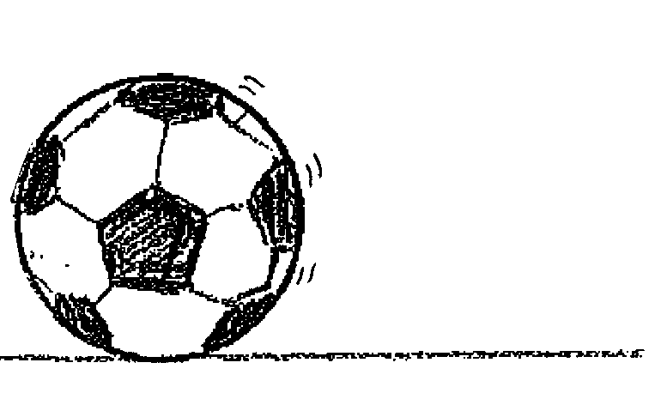
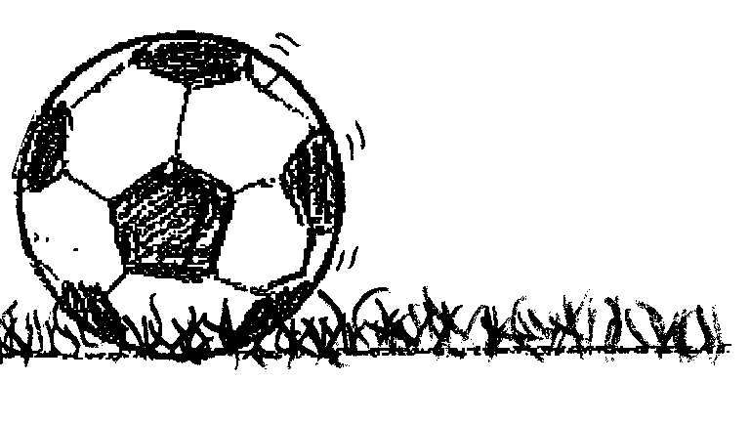
Rolling Friction
Scenario: Two identical soccer balls are rolling over different surfaces. One ball is rolling over a concrete surface, and the other ball is rolling over a grassy surface.
Draw all of the forces acting on the soccer balls.
Courtesy of Hector Mireles
Notes:
8 min
a. Distribute handout 6.10 (Friction and Rolling Soccer Balls) and introduce the scenario.
b. Individuals: Ask participants to draw the forces acting on each of the soccer balls and answer the questions on the handout.
c. Whole group: Discuss participants’ diagrams and responses to the handout questions.
Note:
Participants should draw a downward-pointing arrow representing weight (the downward pull of gravity) and an upward-pointing arrow representing normal force. Other arrows should represent the direction the balls are rolling across each surface, as well as the opposing force of friction.

Slide 46
Rolling Friction
A force that resists or opposes an object’s motion when it rolls over a surface.
Where might you encounter rolling friction in everyday life?
Examples:
Coasting in your car after it runs out of gas
Pushing a shopping cart down a grocery aisle
Notes:
2 min
a. Review the definition of rolling friction on the slide.
b. Ask participants to share examples of rolling friction in their everyday lives. Record their ideas on chart paper.

Slide 47
Sliding Friction
A force that resists or opposes an object’s motion when it slides across a surface.
The strength of the frictional force depends on the following:
The surface composition of both objects
The normal force the surface exerts on the object moving over it.
Questions: Which frictional force is greater? Why?
Tires skidding on dry pavement OR wet pavement
An empty box OR a full box of books sliding across the floor
Notes:
3 min
a. Review the definition of sliding friction on the slide and discuss the key points about the strength of a frictional force.
b. Present the alternatives on the slide and elicit participants’ ideas and reasoning.
Key ideas:
The liquid on wet pavement reduces friction between the tires and the ground, so tires skidding on dry pavement create a greater frictional force.
A box full of books generates a greater frictional force because the weight of the box causes the surface bumps on the box and the floor to push together more closely.

Slide 48
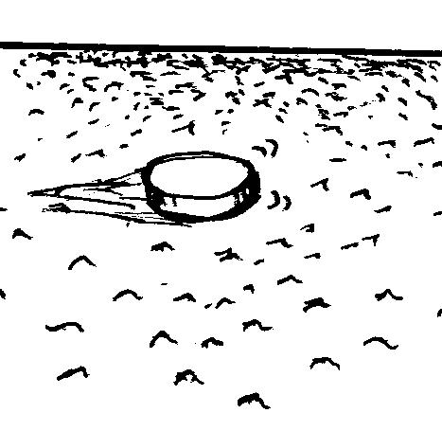
Sliding Friction
Scenario: Two identical hockey pucks glide over different surfaces: smooth ice and playground asphalt.
Draw all of the forces acting on the hockey pucks.
Smooth Ice
Playground Asphalt
Courtesy of Hector Mireles
Notes:
7 min
a. Distribute handout 6.11 (Friction and Sliding Hockey Pucks) and introduce the scenario.
b. Individuals: Ask participants to draw the forces acting on each of the hockey pucks and answer the questions on the handout.
c. Whole group: Discuss participants’ diagrams and responses to the handout questions.
Note:
Participants should draw a downward-pointing arrow representing weight/gravity and an upward-pointing arrow representing normal force. Other arrows should represent the direction the pucks are gliding across each surface, as well as the opposing force of friction.

Slide 49
Static Friction
A force that opposes the initial push on an object to get it moving.
Key ideas:
Static friction acts in the opposite direction of the intended motion of an object.
The force of friction equals the force of the push, so the object doesn’t move.
The strength of the frictional force is just enough to resist the opposing force pushing on the object.
Maximum strength can be reached by applying a larger force.
Notes:
2 min
a. Review the definition of static friction on the slide and highlight the key ideas.
b. Encourage participants to ask questions and offer observations. Make sure they understand that static friction acts on an object that isn’t moving yet.

Slide 50
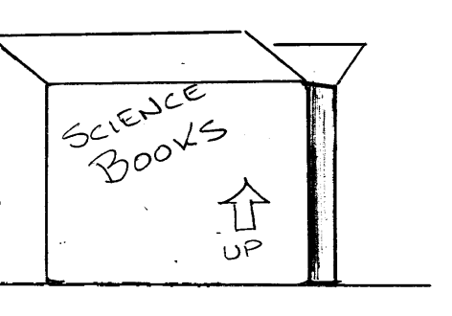
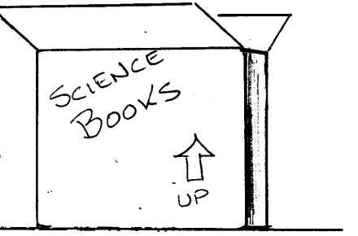
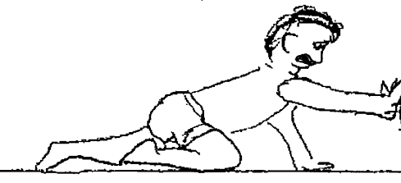
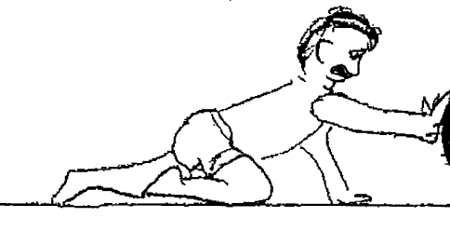
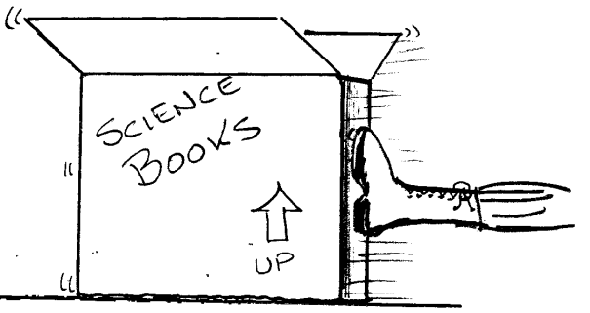
Static Friction
Scenario: A child tries and tries to push a box of science books, but the box doesn’t budge. Then his father comes along and gives the box a good shove with his boot to get it moving.
Courtesy of Hector Mireles
Notes:
8 min
a. Distribute handout 6.12 (Pushing a Box against Static Friction) and introduce the scenario.
b. Individuals: Ask participants to draw the forces and change in motion in each instance and then answer the questions on the handout.
c. Whole group: Discuss participants’ diagrams and responses to the handout questions.
Key ideas:
When the child tries to push the box in either direction, it doesn’t budge, so the opposing frictional force is equal to the force the child exerts on it.
For box to move, a larger force is necessary than the child is able to exert. The force the father exerts when he shoves the box with his boot is greater than the static friction, and the box begins to move.
Static friction grows to match the force the child exerts on the box. As long as the box isn’t moving, the net force is zero, and so is the acceleration.

Slide 51
Challenge: Moving a Refrigerator
Scenario: A refrigerator is resting on the floor. A worker tries to push the fridge, but it won’t budge because it’s too heavy. The worker exerts more effort, and the fridge starts sliding across the floor. The worker flings the fridge to the right, and it slides a short distance across the floor before stopping.
Courtesy of Hector Mireles
Notes:
8 min
a. “Are you ready to show what you know about friction? Our next challenge involves moving a refrigerator.”
b. Distribute handout 6.13 (Moving a Refrigerator) and introduce the scenario. Then read through the instructions on the handout.
c. Individuals: Have participants complete the first page of the handout, using black ink to show the forces acting on the fridge and red ink to show the change in motion. Then have them answer the challenge questions on page 2.

Slide 52
Challenge: Moving a Refrigerator
Courtesy of Hector Mireles
What types of friction are exerted on the fridge?
What change could you make to increase the friction acting on the fridge? Explain how this change increases friction.
What change could you make to decrease the friction? Explain how this change decreases friction.
Notes:
7 min
Note: Display page 1 of the handout on a document reader or overhead projector to mark up during this discussion.
a. Invite participants to share their diagrams from the handout. As participants share their ideas, mark up a copy of the diagram showing the forces acting on the fridge, the net force, and the change in motion/acceleration.
Note: Alternatively, you could display a participant’s completed diagram or have participants copy their diagrams onto chart paper or a Smart Board.
b. Discuss the challenge questions on page 2 of the handout. During this discussion, encourage participants to agree or disagree with the ideas others share, add other ideas, and ask questions.
Ideal responses:
Question 1: Static friction and sliding friction are acting on the fridge.
Question 2: To increase the friction, we could increase the weight of the fridge. More weight will cause the bumps on the surfaces of the fridge and the floor to press together more closely, which will generate greater friction.
Question 3: To decrease the friction, we could put some oil on the ground. The layer of oil will separate the surfaces so they aren’t pressing together as closely, which will reduce friction between the fridge and the floor.

Slide 53
Challenge: Moving a Refrigerator
What is the direction of a frictional force on an object at rest that someone is trying to slide across a surface?
Why are heavy objects harder to slide across the floor than light-weight objects?
Notes:
5 min
a. Read the questions on the slide.
b. “Based on everything you’ve learned about friction so far, how would you answer these questions?”
c. During this discussion, encourage participants to agree or disagree with others’ ideas, add on, and ask questions.

Slide 54
Reflect: Content Deepening Focus Question 1
Why do moving objects slow down and eventually stop?
Notes:
6 min
a. Revisit the content deepening focus question on the slide.
b. “How would you revise your answers to this focus question based on our content deepening work today? Do you have any new ideas to add or other changes you’d like to make?”
c. Individuals: Ask participants to spend a few minutes reviewing and revising the answers they wrote in their notebooks earlier. Remind them to include evidence from today’s investigations.
d. Whole group: Invite a few participants to share their revised answers with the group, using science ideas about friction and evidence from the content deepening investigations.
e. As participants share their responses, record key ideas on chart paper. During this share-out, encourage participants to agree or disagree, add on, or ask questions.

Slide 55
Key Science Ideas
Friction is a force that acts in the opposite direction of an object’s motion, causing the object to slow down and eventually stop.
Tiny bumps on the surfaces of two objects generate friction by pushing against one another.
Rougher surfaces create more friction than smoother surfaces.
Greater friction causes objects to slow down and stop more quickly on rougher surfaces.
Less friction causes objects to travel farther over smoother surfaces before stopping.
Notes:
2 min
a. Review the key science ideas on the slide.
b. Ask participants, “Do you agree with these key ideas? Would you like to revise anything?”

Slide 56
Key Science Ideas
Rolling friction and sliding friction act in the opposite direction of motion when an object rolls or slides over a surface.
The strength of a frictional force depends on (1) the surface composition of the objects in contact, and (2) the normal force the surface exerts on the object moving over it.
Static friction opposes the initial push on an object to get it moving. The force of friction equals the force of the push, so the object doesn’t move.
Notes:
2 min
a. Review the key science ideas on the slide.
b. Ask participants, “Do you agree with these key ideas? Would you like to revise anything?”

Slide 57
Lesson Analysis: Focus Question 2
How can selecting appropriate science activities help students develop a coherent science content storyline?
Notes:
1 min
a. Read the focus question on the slide.
b. “To help us answer this focus question, we’re going to explore STeLLA strategy C: Select activities that are matched to the learning goal.”

Slide 58
Strategy C: Purpose and Key Features
According to the strategies booklet, what are the purpose and key features of strategy C: Select activities that are matched to the learning goal?
Notes:
25 min
a. Ask participants to locate the section on strategy C in the STeLLA strategies booklet.
b. Have one participant lead the group in creating a chart that summarizes the purpose and key features of strategy C: Select activities that are matched to the learning goal.
c. Ask: “What does the strategies booklet say about science activities that are fun and engaging for students?
Ideal responses:
Activities should be selected because they can support students in understanding the main learning goal, not because they’re fun or easy to do.
Avoid activities that are only topically related (e.g., something about forces); instead, activities should focus on a specific science idea that is closely linked to the main learning goal (e.g., Arrows can be used to represent the strength and direction of a force).
Activities should not just be interesting supplements to the science content storyline; they should help develop it.
d. Follow-up: “Think back on science-lab activities in high school or college. Did these activities play a key role in helping you better understand the science concepts presented in textbooks or lectures? Or were they more like add-on activities that were only loosely related to the science concepts being taught?”

Slide 59
Lesson Analysis Question
Main Learning goal: Objects slow down and stop at different distances on different surfaces.
Focus question: Why do moving objects slow down and eventually stop?
Activity: Students roll a toy car down a ramp and over three different surfaces—carpet, tile, and sandpaper—to determine the distance traveled over each surface.
Analysis question: Is the activity well matched to the main learning goal?
Notes:
2 min
a. For this lesson analysis, participants will view a set of three video clips from one Forces lesson.
b. Review the main learning goal, focus question, and activity on the slide. Then introduce the analysis question: Is the activity well matched to the main learning goal?

Slide 60
Lesson Analysis: Strategy C
Write this main learning goal at the top of Analysis Guide C (handout 6.4):
Objects slow down and stop at different distances on different surfaces.
For this analysis, we’ll watch three video clips from the same Forces lesson.
Before each clip: Read the lesson context at the top of the corresponding video transcript.
After each clip: Complete part 1 of the analysis guide.
Links to Torres video clips: 6.3_mspcp_gr.3.forces_torres_L3_c1; 6.4_mspcp_gr.3.forces_torres_L3_c2; 6.5_mspcp_gr.3.forces_torres_L3_c3
Notes:
60 min
Note: Refer to the content background document as needed throughout this lesson analysis.
a. Have participants locate Analysis Guide C (handout 6.4) in their PD binders and write the main learning goal for the selected Forces lesson at the top. Then orient them to part 1 of the analysis guide.
b. Before each video clip: Have participants read the lesson context at the top of the corresponding video transcript (handout 6.5 for clip 3, handout 6.6 for clip 4, and handout 6.7 for clip 5).
c. Show each video clip.
d. After each clip (individuals or pairs): Allow time for participants to review the analysis guide, write down science ideas revealed in the activity, and assess how well matched these ideas are to the main learning goal.
Note: For sample responses for the analysis-guide tasks, see PD Leader Master: Analysis Guide C: Selecting Activities Matched to the Learning Goal (Answer Key).

Slide 61
Lesson Analysis: Strategy C
Discuss these questions with a partner:
Were the activities well matched to the learning goal? Provide evidence to support your response.
Suggest ways to improve the match between the activities and the main learning goal (part 2, Analysis Guide C).
Be prepared to share your ideas in a group discussion.
Notes:
10 min
a. Pairs: “Discuss the questions on the slide and be ready to share your ideas with the group.”
b. Whole group: Discuss how well the activities in the video clips matched the main learning goal, and ask participants to offer suggestions for improving the match.

Slide 62
Lesson Analysis: Strategy C
Study the video transcripts again and gather evidence to answer these questions:
What kept students focused on the main learning goal?
What distracted students from the learning goal?
Notes:
5 min
a. Read the questions on the slide.
b. Individuals: Direct participants to look for evidence in the video transcripts that will help them answer these questions.
c. Whole group: Ask one or two participants to share their ideas and evidence in response to the questions.

Slide 63
Practice: Strategy C
Examine the main learning goal, focus question, lesson summary, and activity phase for your assigned lesson from the Forces unit.
Questions:
Are the activities matched to the learning goal?
If so, how will students learn the content through this activity?
If not, how might the activity be modified to match the main learning goal?
Notes:
7 min
Note: This activity may be skipped if time is running short.
Assign each participant one of the Forces lessons. Direct participants to quickly examine the main learning goal, focus question, lesson summary, and activity phase for their assigned lessons.
b. Individuals (2–3 min): “Think about how well the activities in your assigned lesson are matched to the main learning goal. Be prepared to give a rationale for your choices.”
c. Whole group: Invite participants to share their ideas and reasoning with the group.

Slide 64
Today’s Focus Questions
How can we begin and end a lesson to help students develop a coherent science content storyline?
How can selecting appropriate science activities help students develop a coherent science content storyline?
Why do moving objects slow down and eventually stop?
What force makes a moving object slow down and eventually stop?
Notes:
Less than 1 min
a. Remind participants of today’s focus questions.

Slide 65
Summarize Today’s Work
Hold up three fingers when you have all of these in mind:
One idea you’re taking away about strategy C: Select activities that are matched to the learning goal
One idea you’re taking away about strategies B, I, and 7:
Set the purpose with a focus question or goal statement (strategy B)
Summarize key science ideas (strategy I)
Engage students in making connections by synthesizing and summarizing key science ideas (strategy 7)
One science idea about forces that you’re taking away from today’s content deepening work.
Notes:
7 min
a. Individuals: Read the instructions on the slide and give participants enough time to come up with three ideas to summarize today’s work.
b. Whole group: In a round-robin, invite participants to share a key idea for each category on the slide. (Allow participants to pass if they wish.)

Slide 66
Lesson Analysis Homework
In the STeLLA strategies booklet, read about SCSL strategy D:
Select content representations and models matched to the learning goal and engage students in their use.
Fill in the appropriate column on your SCSL Z-fold summary chart.
Notes:
Less than 1 min
a. Go over the lesson analysis homework assignment and have participants write it in their notebooks.
b. Make sure participants understand each part of the assignment.

Slide 67
Content Deepening Homework
Read section 3 (Friction) in the content background document and be prepared to discuss these questions next time:
Does the reading clarify ideas about friction that were discussed today?
What new questions do you have?
Notes:
Less than 1 min
a. Go over the content deepening homework assignment and have participants write it in their notebooks.
b. Make sure participants are clear about this reading assignment.

Slide 68
Reflections on Today’s Session
How are STeLLA strategies B, I, 7, and C related to one another?
What new insights or questions have emerged about forces and motion?
Only two more days are left of our time together at the Summer Institute. What burning questions do you think should be answered before the end of the week?
Notes:
7 min
a. Allow participants at least 5 minutes to think about today’s session and write their reflections and feedback on the Daily Reflections sheet (handout 6.14 in PD program binder).

Slide 69
Norms for Working Together: The Basics
Purpose: Build trust and develop a productive study group for all participants.
The Basics
Arrive prepared and on time; stay for the duration; return from breaks on time.
Remain attentive, thoughtful, and respectful; engage and be present.
Eliminate interruptions (turn off cell phones, email, and other electronic devices; avoid sidebar conversations).
Make room for everyone to participate (monitor your floor time).
Notes:
Hidden slide—available for use as needed.

Slide 70
Norms for Working Together: The Heart
Purpose: Build trust and develop a productive study group for all participants.
The Heart of RESPeCT Lesson Analysis and Content Deepening
Keep the goal in mind: analysis of teaching to improve student learning.
Share your ideas, uncertainties, confusion, disagreements, questions, and good humor. All points of view are welcome.
Expect and ask questions to deepen everyone’s learning; be constructively challenging.
Listen carefully; seek to understand other participants’ points of view.
Notes:
Hidden slide—available for use as needed.

