Slide 1
RESPeCT PD pROGRAM
Day 8
RESPeCT Summer Institute
Notes:
5 min
Take care of any housekeeping issues.

Slide 2
Agenda for Day 8
Day-7 reflections
Focus questions
Introducing SCSL strategies F, G, and H
Lesson analysis: SCSL strategies F, G, and H
Forces Lesson plan review
Fall overview and study-group scheduling
Lunch
Content deepening: forces
Wrap-up and celebration!
Notes:
2 min
Talk through today’s agenda.

Slide 3
Trends in Reflections
Lesson Analysis | Science Content Learning
Notes:
5 min
Give participants time to review your feedback on their reflections from day 7 and offer reactions, comments, or follow-up questions.

Slide 4
Today’s Focus Questions
How can science content storyline coherence be enhanced by explicitly implementing STeLLA strategy F (Make explicit links between science ideas and activities), strategy G (Link science ideas to other science ideas), and strategy H (Highlight key science ideas and focus question throughout)?
How will the Student Thinking Lens and Science Content Storyline Lens strategies help you teach the Forces lessons in the fall?
How can ideas about forces help us explain the motion of objects?
What is the difference between mass and weight?
How does precision in defining quantities affect our ability to analyze relationships between quantities and understand the world around us?
Notes:
2 min
Introduce the focus questions that will guide today’s work.

Slide 5
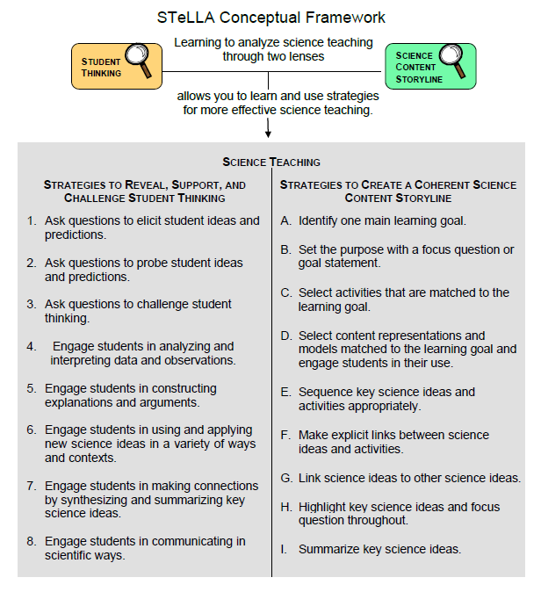
Notes:
1 min
“Today we’ll focus on three Science Content Storyline Lens strategies, all of which make explicit links to science ideas:
Strategy F explicitly links science ideas to activities that students are doing.
Strategy G explicitly links science ideas to other science ideas.
Strategy H explicitly highlights key science ideas and links them back to the focus question.”
“We won’t address strategy E about sequencing science ideas and activities until the school year, since you’ll learn a lot about sequencing from teaching the RESPeCT lesson plans.”

Slide 6
Lesson Analysis: Focus Question 1
How can science content storyline coherence be enhanced by explicitly implementing STeLLA strategy F (Make explicit links between science ideas and activities), strategy G (Link science ideas to other science ideas), and strategy H (Highlight key science ideas and focus question throughout)?
Notes:
Less than 1 min
Read the focus question on the slide.

Slide 7
SCSL Strategies F, G, and H: Purposes and Key Features
Group 1:
What are the purposes and key features of strategy F?
Why is this strategy important for science content storyline coherence?
Group 2:
What are the purposes and key features of strategy G?
Why is this strategy important for science content storyline coherence?
Group 3:
What are the purpose and key features of strategy H?
Why is this strategy important for science content storyline coherence?
Notes:
30 min
Small groups: Divide participants into three groups to make charts that capture the purposes and key features of strategies F, G, and H. Direct groups to refer to their Z-fold summary charts and the STeLLA strategies booklet.
Whole group: Have small groups share their charts with the entire group.
Challenge participants to imagine themselves in their Teacher Leader roles. Ask them, “How would you explain these strategies to the teachers you’re leading?”

Slide 8
SCSL Strategies F, G, and H: Discussion Question
What’s similar and different about these three strategies?
Notes:
10 min
Note: This slide may be skipped if similarities and differences were addressed in the previous discussion.
Individuals (3 min): “Look at your three strategy charts, your Z-fold summary charts, and the strategies booklet as you think about the question on the slide.”
Whole group: Have participants share their ideas about the three strategies.
Key ideas about strategies F, G, and H:
1. Similarities:
These strategies are all focused on linking complete sentence-length science ideas: Strategy F links science ideas to activities, strategy G links science ideas to other science ideas, and strategy H highlights key science ideas and links them to the focus question throughout the lesson.
All of these strategies emphasize making the links explicit, not just assuming that students will see the intended links.
All of these strategies can and should occur throughout the lesson.
2. Differences:
Strategy F explicitly links science ideas to student activities.
Strategy G explicitly links science ideas to other science ideas.
Strategy H explicitly highlights key science ideas and links them back to the focus question.

Slide 9
Preparing for Video-based Lesson Analysis
Read Analysis Guide F, part 1.
What is the difference between the main learning goal and supporting science ideas?
What is similar about the main learning goal and supporting science ideas?
Notes:
5 min
“Next we’re going to watch a series of three classroom video clips from one lesson on forces. The first clip takes place before students begin the activity. The second clip shows students while they’re working on the activity, and the third clip shows the teacher following up with students after the activity. Our focus for this analysis will be strategy F.”
Have participants locate Analysis Guide F (handout 8.1) in their PD program binders.
Tell participants that part 1 of the guide provides the context for the video clips.
Individuals: “Read part 1 of the analysis guide and be prepared to discuss the two questions on the slide.”
Whole group:
Discuss the questions on the slide.
Ask whether participants have any questions about the activity they’ll be observing in the video clips.
Key ideas:
Difference between the main learning goal and supporting science ideas: The main learning goal is the big idea that is the focus of the lesson. Supporting science ideas are smaller, connected ideas that build upon each other to support the main learning goal.
Similarity between the main learning goal and supporting science ideas: The main learning goal and supporting science ideas are all expressed as complete-sentence science ideas (not as topics, phrases, or activities).
Example of a main learning goal:
Earth’s consistent tilt and the angle at which sunlight strikes the surface at different times of the year cause the Northern and Southern Hemispheres to experience different intensities of sunlight and, as a result, opposite periods of warmer and cooler temperatures (seasons).
Examples of supporting ideas:
Earth is tilted on its axis at 23.5 degrees from a perpendicular line to its orbital plane around the Sun.
Earth’s axis always tilts toward the North Star, regardless of the Sun’s position.
Because of Earth’s tilt and yearly orbit, the Sun at the equator isn’t directly overhead at midday all year long. This happens only twice a year—March 21 and September 21—during the solar equinoxes.
From June through August, the entire Northern Hemisphere tilts toward the Sun, and the angle of sunlight is more direct and concentrated, resulting in warmer temperatures (summer). This pattern occurs in the Southern Hemisphere from December through February.
Earth maintains a consistent 23.5-degree tilt toward the North Star as it orbits the Sun during the year, but the locations on Earth that receive the most direct sunlight vary. The Northern Hemisphere receives the most direct sunlight (intense, concentrated, and closest to a perpendicular angle) between the spring and fall equinoxes. The Southern Hemisphere receives the most direct sunlight between the fall and spring equinoxes.

Slide 10
Lesson Analysis: Strategy F
Read the context at the top of each transcript and then watch the corresponding clip:
Video clip 1: setup for the activity
Video clip 2: during the activity
Video clip 3: follow-up to the activity
For each clip, use the criteria in part 2 of Analysis Guide F to analyze how well science ideas were linked to the activity.
Link to video clip 1: 8.1_mspcp_gr.3.forces_wilde_L4_c5
Link to video clip 2: 8.2_mspcp_gr.3.forces_wilde_L4_c6-7
Link to video clip 3: 8.3_mspcp_gr.3.forces_wilde_L4_c8-9
Notes:
45 min—15 min/clip
Have participants review part 2 of Analysis Guide F. After they watch each video clip, ask them to study the corresponding transcript, answer the questions in part 2 of the analysis guide, and then analyze the links between science ideas and activities that were (or were not) made before, during, or after the activity.
Have participants read the context for video clip 1 at the top of the transcript (handout 8.4 in PD program binder).
Show video clip 1. Then guide participants through these tasks:
Individuals : “Study the video transcript and then complete part 2, section 1 of the analysis guide, Setup for the Activity.”
Whole group: Ask participants to share their analyses of the video clip.
Have participants read the context for video clip 2 at the top of the transcript (handout 8.5 in PD binder).
Show video clip 2 and then guide participants through these tasks:
Individuals: “Study the video transcript and then complete part 2, section 2 of the analysis guide, During the Activity.”
Whole group: Ask participants to share their analyses of the video clip.
Have participants read the context for video clip 3 at the top of the transcript (handout 8.6 in PD binder).
Show video clip 3 and then guide participants through these tasks:
Individuals: “Study the video transcript and complete part 2, section 3 of the analysis guide, Follow-up to the Activity.”
Whole group: Ask participants to share their analyses of the video clip.
Sample analysis for video clip 1:
Overview: In the setup, the teacher helps students clarify that the force that made the car move—gravity—was always the same regardless of the surface it rolled over. This is a key idea, since the common misconception is that the car stops because it “runs out of force.” Since the initial force is the same each time, something else must be causing the car to stop at different distances. In this clip, the teacher allows students to surface their initial ideas. When Eliza voices the common misconception that the force must be different each time, the teacher uses probe and challenge questions to support the whole class in reconsidering and solidifying their thinking around what force made the car start moving versus what force caused the car to stop moving.
Question a: Students don’t discuss or write about the focus question. Instead, the teacher uses a review of the car-and-ramp data to set up the focus question, If gravity is the force that started the motion and gravity didn’t change, then why do the cars stop?
Question b: Explicit links are made between the car-and-ramp activity and science ideas:
Video segments 00:02–00:52—Gravity starts the motion by pulling the car (not pushing it).
Segments 00:57–02:19—The force of gravity doesn’t change as the car continues to roll down the ramp.
Question c: If students are following the teacher’s logic, they should understand that the force of gravity keeps pulling on the car as it goes down the ramp. So what causes the car to stop? Thus, the teacher uses data and science ideas to set up the focus question.
Sample analysis for video clip 2:
Question a: Yes, students make links to science ideas. They’re trying to use their observations of the bumps on the three surfaces to come up with explanations for why the car stops at different distances as it travels over different surfaces. They’re also using the hand-strip content representation in their reasoning (video segments 01:31–01:45; 02:23–03:05. Students come up with the idea that the smoother surfaces have tinier “hands” to slow down the car.
Question b: Yes, students should know they’re expected to link science ideas to their observations because the context at the top of the transcript indicates that students were examining the three surfaces in order to generate an explanation for why the toy car stopped at a different distance on each surface.
Sample analysis for video clip 3:
Question a: Yes, science ideas are explicitly linked to the activity in the follow-up. Students first use their own ideas and language (e.g., “negativity,” “blocking,” “gravity”) to explain what causes the car to stop. The teacher then tells them that the force that stops the car is friction and has them write this word in their notebooks.
Question b: Yes, students are involved in making links between science ideas and the activity by identifying other examples of friction in their daily lives that causes objects to slow down and stop.
Missed opportunity: At video segment 03:56, the teacher asks a student, “What is the object that slows the ball down?”This is a missed opportunity to have students think about grass pushing on the ball as a force, not as an object. At segment 04:11, a student starts talking in a way that could suggest he’s thinking about grass applying a force. A probe question here would have been very helpful!

Slide 11
Lesson Analysis: Strategies G and H
Read the context at the top of the transcript (handout 8.7) and then watch video clip 4.
Use the criteria in Analysis Guide G to analyze how well science ideas were linked to other science ideas.
Use the criteria in Analysis Guide H to analyze how well the teacher highlighted key science ideas and the focus question throughout the lesson.
Link to video clip 4: 8.4_mspcp_gr.3.forces_wilde_L5_c10
Notes:
15 min
Note: This analysis is optional.
Have participants review the criteria in Analysis Guides G and H. After they watch the video clip, ask them to study the corresponding transcript (handout 8.7) and answer the questions in the analysis guides.
Have participants read the context for video clip 4 at the top of the transcript (handout 8.7 in PD program binder).
Show video clip 4. Then guide participants through these tasks:
Individuals: “Study the video transcript and then complete Analysis Guides G and H.”
Whole group: Ask participants to share their analyses of the video clip.
Key ideas to highlight:
How strategy G might look in a classroom setting:
The teacher or students link ideas from one lesson to another.
The teacher asks questions that encourage students to link ideas (make comparisons or connections). Examples:
“Do these new ideas about x, y, z help you think about the focus question in new ways?”
“Use the ideas we’ve been talking about to do this activity.”
“What does energy have to do with plants? Animals?”
The teacher or students create concept maps or thinking maps to show relationships among ideas.
How strategy H might look in a classroom setting
The teacher highlights key ideas on the board or chart paper.
The teacher states, “This is an important idea.”
The teacher summarizes key science ideas at key points during the lesson (not just at the end).
The teacher uses content representations to highlight key science ideas.
The teacher refers back to the focus question during the lesson.
The teacher repeats or revisits key ideas multiple times in a lesson.

Slide 12
Lesson Analysis: Strategies F, G, and H
Strategy F:
Find examples in the video transcripts where students are linking science ideas to a lesson activity.
Suggest one specific way to strengthen strategy F in this lesson.
Strategy G:
Find examples where two or more science ideas are being linked together.
Suggest one specific way to strengthen strategy G in this lesson.
Strategy H:
Find an example where the teacher is highlighting key science ideas or referring back to the focus question.
Suggest one specific way to strengthen strategy H in this lesson.
Notes:
20 min
Note: If time is running short, have participants work only on part A of their assigned tasks.
Assign participants one of the strategies (F, G, or H) to analyze for this activity and then go over the directions on the slide. Emphasize the importance of using the STeLLA strategies booklet and strategy charts as resources.
Note: Participants may also refer to the analysis guides for strategies G and H during this analysis, but there isn’t enough time to work through each part.
Individuals: “Study the transcripts for video clips 1–4 and search for examples of your assigned strategy being used during the lesson. Be ready to share your ideas with the group, and make sure to support your answers with evidence.”
Whole group: Have participants share their findings. Encourage listeners to agree or disagree, ask clarification questions, and add on.
Sample analyses from the transcript for clip 4:
Strategy F: In this clip, students clearly link their ideas about friction to the previous day’s activity, referencing how far the car traveled, the bumps on a surface, and the push caused by the bumps (pushing “hands”) as a force causing the car to slow down and stop.
Strategy G: An excellent example of a student making a link between two science ideas occurs at segment 04:17 when Giselle mentions that “you always can’t see friction, just like you can’t see gravity” (i.e., forces aren’t visible; we can only observe the results of forces when an object’s motion changes). Here the student is comparing and connecting what she knows about gravity and friction.
At video segments 02:50–04:11, students discuss whether air is a pushing force. In this discussion, they’re linking ideas about the bumps on solid surfaces with ideas about how air might push back against a ball’s motion.
Strategy G, strengthened: At segments 02:05–02:44, Lucy begins to connect the ideas about different-sized “hands” pushing back against motion and the amount of friction that the carpet, sandpaper, and tile surfaces generate. Perhaps with some probing (e.g., “Say more about …”), Lucy could have explicitly connected pushing with friction. Then a challenge question might have helped her connect pushing and friction to the concept of forces (e.g., “What do the ideas of pushing and friction have to do with forces?”).
Strategy H: In this clip, the teacher’s primary highlighting strategy is to more clearly restate key ideas from student responses. Examples:
Segment 01:11: “So he’s saying the friction is causing the car to stop.”
Segment 05:52: “So Storm is saying the car is going this way, [and] the friction is pushing back the opposite way on the car.”
Strategy H, strengthened: The teacher could have done more to highlight key ideas. Examples:
Segment 02:44: At this point, the teacher could have engaged students in a Turn and Talk to highlight the concept of friction (e.g., “Why does the carpet create more friction than the sandpaper or tile? Come up with a sentence or two to summarize what we’ve learned.”).
Segment 04:11: The teacher could have engaged students in an activity highlighting the idea that friction can be present even if it can’t be seen (e.g., “Everyone draw a picture to show why the ball thrown against the wind won’t go as far as the ball thrown when there is no wind. What does this have to do with friction?”).

Slide 13
Summary: Strategies F, G, and H
Use linking strategies to make the science ideas explicit to the whole class (strategies F and G).
Engage students in linking science ideas to activities before, during, and after an activity (strategy F).
Engage students in linking science ideas to other science ideas (strategy G).
Highlight key science ideas throughout the lesson (strategy H).
Keep returning to the focus question throughout and at the end of the lesson (strategy H).
Notes:
Less than 1 min
Read the summary statements on the slide or give participants time to read them silently.
Ask participants whether they have a brief comment or question about the summary.

Slide 14
Lesson Analysis: Focus Question 2
How will the Student Thinking Lens and Science Content Storyline Lens strategies help you teach the Forces lessons in the fall?
Notes:
Less than 1 min
Read the focus question on the slide.

Slide 15
Forces Lesson Plan Conversation
The science content storyline across lessons
Review the main learning goal for each lesson sequentially.
The science content storyline within lessons (5–7 min for each two-part lesson)
How does this lesson fit into the arc of all the lessons?
What are the main learning goal and focus question?
Describe the main activity (or activities).
How will the activity help students better understand the learning goal for the day?
What STeLLA strategy/strategies are highlighted in this activity?
What concerns or suggestions do you have about this activity?
Practical issues and questions
Notes:
60 min (in conjunction with next two slides)
Note: Create charts like the samples on the next two slides so that participants can view both as they report out.
Timing note: Make sure you limit the time for each lesson conversation so you can get through them all. Aim for 5–7 minutes for each lesson.
Give a brief overview of the science content storyline across lessons and then begin the lesson conversation.
For step 1 on the slide, review the main learning goal for each lesson sequentially and how it connects to the lesson before and after it. (5 min)
For steps 2 and 3, ask each participant to report on her/his two-part lesson, which was assigned on day 5.
Note: Encourage participants to present the big picture using the questions in step 2 on the slide, not to walk through every step in their lesson plans. They should bring up details only when they have some concern, question, or suggestion about a modification.
As participants give their reports, fill in the charts you’ve created, checking off the main strategies highlighted in each lesson. (See the chart format on next two slides.)
Note: Encourage participants to pick just one or two Student Thinking Lens strategies and one or two Science Content Storyline Lens strategies that are actually highlighted in the lesson. (Each lesson uses several strategies.)
Ideal pattern to highlight for the Student Thinking Lens strategies:
Lesson 1 should highlight questions that elicit and probe student thinking. Probe questions should continue throughout the lesson sequence, but the emphasis should shift to challenge questions throughout the later lessons as questioning strategies help to push student thinking forward.
Lessons 3 and 4 highlight analyzing and interpreting data and generating explanations.
Lessons 5 and 6 highlight use-and-apply tasks.
Ideal pattern to highlight for the Science Content Storyline Lens strategies:
Each lesson should have a clear content storyline with an identifiable main learning goal, focus questions, and opportunities for students to summarize their thinking at the end of the lesson. Beginning with lesson 1, some connection should be made between what students learned in this lesson and what they’ll learn in the next lesson. Beginning with lesson 2, clear links should be made between student learning in previous lessons and what students will learn in the current lesson.

Slide 16
STL Strategies Highlighted in Forces Lessons
Lesson | 1a | 1b | 2a | 2b | 3a | 3b | 4a | 4b | 5a | 5b | 6a | 6b
1. Elicit
2. Probe
3. Challenge
4. Analyze/ Interpret
5. Explain/ Argue
6. Use/Apply
7. Synthesize/ Summarize
Notes:
Used in conjunction with slide 15
As participants report out, complete this chart, indicating with check marks the STL strategies highlighted in the lessons.
Discuss the reasons certain strategies appear at specific times in the lesson sequence. (See ideal patterns on slide 15 and refer to the summary charts in the STeLLA strategies booklet as needed.)

Slide 17
SCSL Strategies Highlighted in Forces Lessons
Lesson | 1a | 1b | 2a | 2b | 3a | 3b | 4a | 4b | 5a | 5b | 6a | 6b
A. Identify Main Learning Goal
B. Set Purpose and Focus Question
C. Match Activity to MLG
D. Match Content Reps to MLG
F. Link Activity to Science Ideas
G. Link Science Ideas
H. Highlight Key Science Ideas and Focus Question
I. Summarize Key Science Ideas
Notes:
Used in conjunction with slide 15
As participants report out, complete this chart, indicating with check marks the SCSL strategies highlighted in the Forces lessons.
Discuss the reasons certain strategies appear at specific times in the lesson sequence. (See ideal patterns on slide 15 and refer to the summary charts in the STeLLA strategies booklet as needed.)

Slide 18
Overview of Study-Group Sessions
Purpose: To practice, analyze, and learn from the use of the STeLLA strategies in your science teaching.
Review the focus of each study-group session:
What is the main focus for fall study-group sessions 1–3?
What is the purpose of the 2-hour meeting in December/January?
What is the main focus for spring study-group sessions 4–6?
Notes:
5 min
Have participants locate handout 8.8—Overview of School-Year RESPeCT Study Groups—in their PD program binders.
Emphasize: “The purpose of the study-group sessions is to practice, analyze, and learn from the use of the STeLLA strategies in your teaching of the Forces lessons in the fall and the Variation in Traits lessons in the spring.”
Talk participants through Study Groups 1–3 on the handout.
Pause for questions and a summary task. Ask participants, “What is the main focus for fall study-group sessions 1–3?”
Talk participants through the 2-hour meeting in December/January and Study Groups 4–6 on the handout.
Pause for questions and a summary task. Ask participants, “What is the purpose of the 2-hour meeting in December/January?” and “What is the main focus for spring study-group sessions 4–6?”

Slide 19
Teaching the Forces Lessons
Before teaching lesson 1, give your students the classroom pretest.
Teach all the lessons and have one lesson video recorded.
Give your students the classroom posttest.
Hold on to your students’ pre-post tests! You’ll analyze them in preparation for Study Group 3.
Notes:
10 min
Before going over this slide, have participants locate the Forces classroom pre-post test in their lesson plans binders (pretabs section).
The classroom pre-post test: “This test is in your lesson plans binder. After you administer the test to your students, you’ll need to save all of them, since you’ll be analyzing them as part of our study-group work in the fall.”
Review the steps on the slide.
Emphasize: “It’s very important to follow these steps in order and save all of your classroom pre-post tests. Don’t return them to students until after Study Group 3.”

Slide 20
Scheduling School-Year Study Groups
Proposed meeting day/time: Wednesdays 2:00–6:00 p.m.
Meeting place: In our classrooms, rotating from school to school
Possible dates for our study-group sessions:
Study Group 1: [insert possible date]
Study Group 2: [insert possible date]
Study Group 3: [insert possible date]
2-hour meeting to review Genetics lessons: [insert possible date]
Study Group 4: [insert possible date]
Study Group 5: [insert possible date]
Study Group 6: [insert possible date]
Notes:
15 min
Note: Include on this slide some possible dates for six 4-hour study-group meetings and the 2-hour meeting that occurs between Study Groups 3 and 4.
Suggest possible dates for the study-group sessions, starting with the Wednesday afternoon slot from 2:00 to 6:00 p.m.
Note: As you schedule the meetings, keep in mind that you’ll need some time between the end of the school day and the beginning of the meeting to get to the location and set up everything.
Study Group 1: Early October. Round-1 teachers should have their classroom video recordings completed at least three weeks before this session. You will need three weeks to watch the classroom video(s), select the ones you’ll use during the study groups, and prepare the video-clip selections and transcripts.
Study Group 2: Mid-November. Round-2 teachers should have their classroom video recordings completed at least three weeks before this session. You will need three weeks to watch the classroom video(s), select the ones you’ll use during the study groups, and prepare the video-clip selections and transcripts.
Study Group 3: Early December. This session can occur anytime after Study Group 2 and before the holiday break.
2-hour meeting: December/January. The purpose of this meeting is to review the Variation in Traits lesson plans in preparation for teaching them.
Study Group 4: Early February. Round-1 teachers should have their classroom video recordings completed at least three weeks before this session. You will need three weeks to watch the classroom video(s), select the ones you’ll use during the study groups, and prepare the video-clip selections and transcripts.
Study Group 5: March. Round-2 teachers should have their classroom video recordings completed at least three weeks before this session. You will need three weeks to watch the classroom video(s), select the ones you’ll use during the study groups, and prepare the video-clip selections and transcripts.
Study Group 6. April. This session can occur anytime after, but preferably within a month of, Study Group 5.

Slide 21
Forces
SCIENCE AND MATH CONTENT DEEPENING Grade 3
Notes:
Less than 1 min
“Now we’ll engage in some science and math content deepening to strengthen our understandings of forces and motion.”
Note: Throughout this content deepening phase, refer as needed to the content background document and Common Student Ideas about Forces and Motion.

Slide 22
Content Deepening Homework
Share a new idea or question from the content deepening homework.
What helped clarify your understandings of the science content?
What idea was new to you?
What idea were you confused about?
What big idea do you think is important to highlight for students?
What burning question do you have?
Notes:
3 min
Invite participants to briefly share a new idea or question related to the content deepening homework from the previous session.
Quickly address any misunderstandings or confusion, but don’t spend time discussing ideas that will be presented during today’s session (e.g., forces in outer space).

Slide 23
Content Deepening Focus Questions
How can we use our science-content knowledge about forces to explain and act out real-life scenarios?
What is the difference between mass and weight?
How does precision in defining quantities affect our ability to analyze relationships between quantities and understand the world around us?
Notes:
Less than 1 min
Read the focus questions on the slide that will be the focus of today’s content deepening work.

Slide 24
Content Deepening: Focus Question 1
How can ideas about forces help us explain the motion of objects?
Notes:
Less than 1 min
“We’ll begin today’s content deepening work by exploring how science ideas about forces can help us explain the motion of objects. This activity comes from Forces lesson 6b.”
Have participants write the focus question in their science notebooks and draw a box around it.

Slide 25
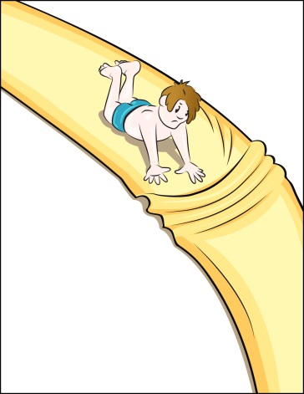
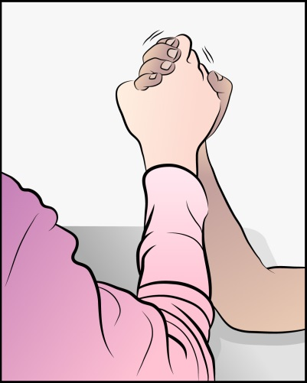
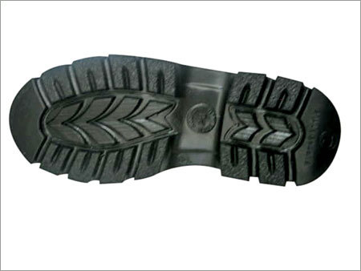
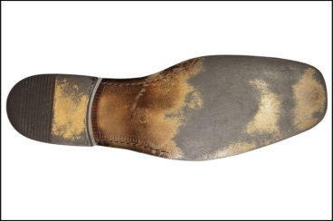
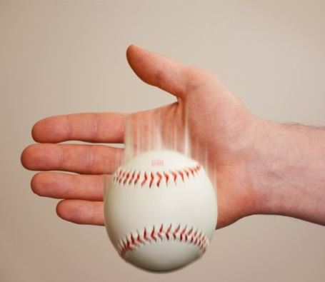
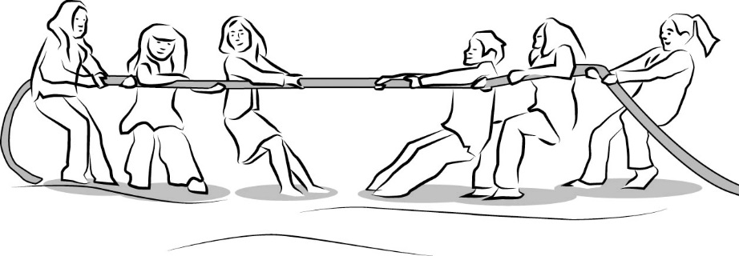
Investigation 1: Show What You Know
Each team will explain and illustrate a scenario that might happen in everyday life.
Notes:
2 min
“For this investigation, you’ll work in teams to explain the forces acting on objects in real-life scenarios and then act out these scenarios.”
Divide the group into teams of three or four participants and distribute one scenario from handout 8.9 (Scenario Cards) to each team. Then give each team member the corresponding picture for the team’s scenario from handout 8.10 (Scenario Pictures).

Slide 26
Investigation 1: Show What You Know
Have one team member read the scenario and instructions aloud.
Discuss the scenario with your teammates. Identify and describe all of the forces acting on the people or object(s) in your scenario.
Reach an agreement as a team on the strength and direction of the forces acting on the people or object(s). Then draw arrows (and bumps for some scenarios) on your own pictures to represent the forces involved.
Notes:
6 min
Read through the directions on the slide before teams begin working on their assigned scenarios.
Circulate among the teams and provide support as needed.

Slide 27
Investigation 1: Show What You Know
After you finish your drawings, discuss how your team can act out the forces in your scenario using the foam arrows. Keep our focus question in mind as you plan your skits!
You have 3 minutes to make these decisions as a group:
Who will act out the forces in the scenario?
Who will hold the arrows that represent the forces?
Which arrows will you use to represent the strength (size) and direction of the forces?
Let me know when you’ve made these decisions and finished planning your skit, and I’ll give you some props to act out your scenario.
Notes:
4 min
Read through the directions on the slide. Then give teams 3 minutes to decide how they’ll act out their scenarios.
Distribute the props for each scenario when teams have finished planning their skits.

Slide 28
Investigation 1: Show What You Know
Presenting
the
Physics Players
in
Forces and Motion
Notes:
10 min
Announce that each team will have 2 or 3 minutes to act out the forces in their scenario, using the props to illustrate the action taking place and the foam arrows to represent the strength and direction of the forces.
Direct participants in the audience to pay close attention during the skit and be prepared to share their observations and feedback following the skit.
Proceed through the skits in the following order:
Arm Wrestling
Tug-of-War
Shoes on the Ice
Slip and Slide
The Ball Drop
Following each skit, engage in a brief group discussion. Encourage participants ask questions, offer comments, and agree or disagree with the team’s explanations of the forces in the scenario.

Slide 29
Reflect: Content Deepening: Focus Question 1
How can ideas about forces help us explain the motion of objects?
Notes:
2 min
Revisit the focus question on the slide.
Ask participants to reflect on the previous investigation and answer the question in their science notebooks.

Slide 30
Our Unit Central Questions
What makes something start to move? What makes something stop moving or change direction?
Notes:
5 min
Review the unit central questions on the slide.
Individuals: “Next, I’d like you to think about what you’ve learned about forces during our content deepening work this week. Then write your best answers for these questions in your science notebooks. Make sure to support your explanations with evidence and reasoning and include key science words like force, friction, and gravity.”
Note: Encourage participants to use their notes and resources from the investigations to help them develop their best answers to the questions.
Whole group: Invite one or two participants to briefly share their explanations and reasoning with the group.

Slide 31
Content Deepening: Focus Question 2
What is the difference between mass and weight?
Notes:
Less than 1 min
Read the second content deepening focus question on the slide.
“Next, we’ll deepen our understandings of the distinctions between mass and weight.”
Ask participants to write the focus question in their science notebooks.

Slide 32
Review: Distinguishing Mass and Weight
Mass
The amount of “stuff” or substance that makes up an object; the number and type of atoms in an object; not a force
A measurement of the resistance of an object to acceleration; measured in grams (g), kilograms (kg), and milligrams (mg)
Massive objects (bowling ball) accelerate less for a given amount of force. Objects with less mass experience greater acceleration.
Acceleration = Net Force/Mass
Weight
The force of gravity pulling an object with mass toward the center of Earth; measured in pounds (lb) or Newtons (N).
An object with mass has no weight in outer space.
Mass = 2.5 kg
Weight = 24.5 N or 5.5 lb
Notes:
6 min
Quickly review the science ideas on the slide.
Pairs: Ask participants to pair up with an elbow partner and develop a one-sentence statement summarizing the key differences between mass and weight.
Whole group: Invite one pair of participants to share their statements with the group. Record key ideas on chart paper.
Ask participants whether they would like to add or change anything.
“In our next investigation, we’ll continue exploring the differences between mass and weight on Earth and in space and why these differences matter.”

Slide 33
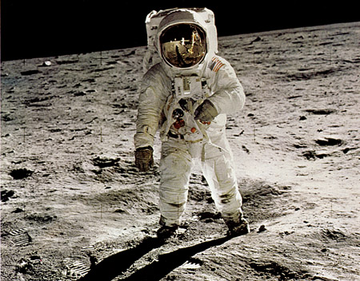
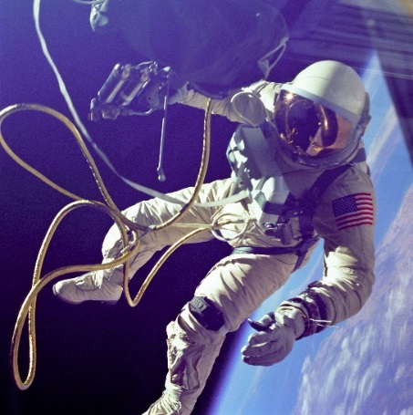
Investigation 2: Mass versus Weight
For each scenario, draw vectors representing the strength and direction of the forces acting on the astronaut.
Describe how the astronaut’s mass in each scenario compares with his mass in the other scenarios.
Photo courtesy of Wikimedia.com
Photo courtesy of Wikimedia.com
Photo courtesy of Wikimedia.com
Notes:
8 min
Distribute handout 8.11 (Mass versus Weight) and introduce the three scenarios.
Emphasize that the astronaut’s motion doesn’t change in any of the scenarios.
Individuals: Have participants complete the handout independently.
Whole group: Invite participants to share their drawings and descriptions with the group.

Slide 34
Reflect: Content Deepening Focus Question 2
What is the difference between mass and weight?
Notes:
3 min
Revisit the focus question on the slide.
Individuals: Have participants answer the question in their science notebooks, including any new ideas and evidence they gathered from the previous investigation.
Whole group: Invite one or two participants to share their ideas and evidence with the group.

Slide 35
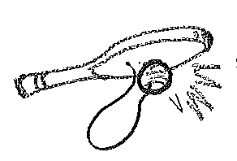
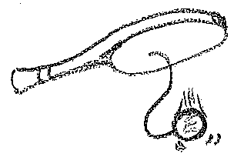
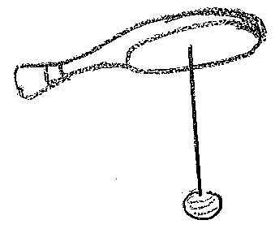
Investigation 3: Paddleball
Photo courtesy of Hector Mireles
Notes:
7 min
Note: The next four investigations are use-and-apply tasks. They also require participants to synthesize and summarize the science concepts they’ve learned this week. If there isn’t enough time to conduct all of the investigations, select the ones you feel would be most beneficial for participants.
“Next, we’ll analyze phenomena that students will encounter during the Forces lesson sequence. In the first scenario, we’ll use science ideas to analyze the forces acting on a paddleball.”
Distribute handout 8.12 (Paddleball) and describe the scenario.
You may want to note that in each frame, the ball is the object receiving a push or pull from one or more other objects. This is the answer for column 3 (Object Experiencing Force[s]) on the handout. Alternatively, you can wait to provide this information after participants have completed the handout.
Pairs: Have participants work with a partner to complete the table on the handout.
“As you work through each frame, think about how you can use your science-content knowledge to analyze the forces acting on the paddleball, and how you can support students in their analyses.”
Whole group: Ask one or two pairs to share their responses and describe the way the ball’s motion changes in each frame.

Slide 36
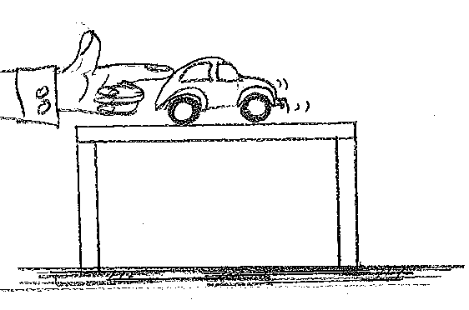
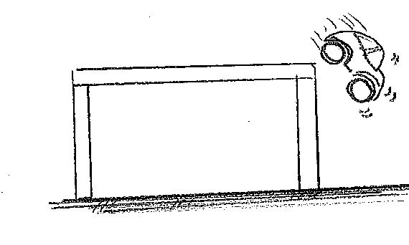
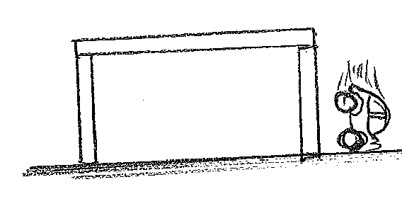
Investigation 4: Toy Car
Photo courtesy of Hector Mireles
Notes:
6 min
“In this scenario, we’ll use science ideas to analyze the forces acting on a toy car.”
Distribute handout 8.13 (Toy Car) and describe the scenario.
Pairs: Have participants work with a partner to complete the table on the handout.
“As you work through each frame, think about how you can use your science-content knowledge to analyze the forces acting on the car, and how you can support students in their analyses.”
Whole group: Ask one pair of participants to share their responses and describe the way the car’s motion changes in each frame.

Slide 37
Investigation 5: Hockey Puck in Motion
Hockey puck resting
on smooth ice
B. Stick pushing hockey puck
C. Hockey puck
gliding across the ice
D. Hockey puck gliding
across the ice
E. Hockey puck getting
caught in goal net
F. Hockey puck at rest
Photo courtesy of Hector Mireles
Photo courtesy of Hector Mireles
Notes:
7 min
“In this scenario, we’ll use science ideas to analyze the forces acting on a hockey puck.”
Distribute handout 8.14 (Hockey Puck in Motion) and describe the scenario. Participants should assume that the ice has recently been resurfaced, so it’s perfectly smooth, with no friction.
Review the three unique characteristics of motion: force, speed, and acceleration.
Individuals: Have participants draw the forces acting on the hockey puck in each frame and then answer the questions on the handout.
“As you work through each frame, think about how you can use your science-content knowledge to analyze the forces acting on the hockey puck, and how you can support students in their analyses.”
Whole group: Invite participants to share their drawings for each frame. Then discuss their responses to the questions.

Slide 38
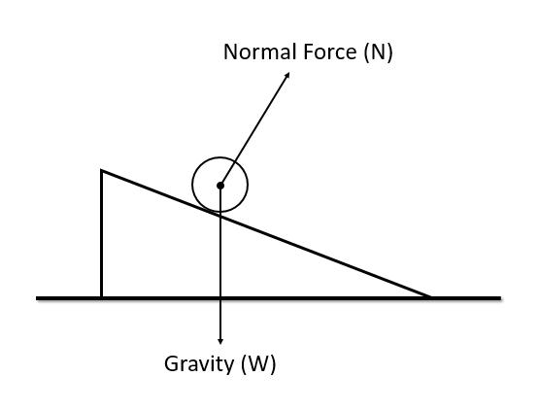
Investigation 6: Ball on an Incline
Notes:
10 min (20 min including YouTube video)
“In our final scenario, we’ll use science ideas to predict the acceleration of a ball rolling down an incline.”
Distribute handout 8.15 (Ball on an Incline) and describe the diagram.
Individuals: Have participants work through the challenge.
An object rolling down a ramp can create confusion, since gravity causes the object to accelerate, but the acceleration isn’t straight down. If participants are struggling with the task, engage them in the following discussion:
Ask, “If gravity alone acted on the ball, what would be the direction of gravity?”
Key ideas:
To predict a net force, add the two forces on the diagram (gravity and normal force).
Net force predicts the acceleration of an object.
The ball experiences a downward pull (weight) and an upward pushing force from the ramp surface (normal force).
Ask, “What is the sum of these two vectors?”
Whole group: Invite participants to share their predictions and justifications.
Show the YouTube video of Dr. Mireles explaining the solution to the challenge in detail (Explanation: Inclined Plane by Dr. Hector Mireles).
Note: The video is optional if time is running short. To allow enough time for both the investigation and the video, you may need to skip one or two of the previous investigations.

Slide 39
Math Content Deepening: Central Question
Why is it important to carefully define quantities that are being compared?
Notes:
Less than 1 min
Introduce the central question that will guide the math content deepening sessions participants engage in over the summer and during the school year.

Slide 40
Content Deepening: Focus Question 3
How does precision in defining quantities affect our ability to analyze relationships between quantities and understand the world around us?
Notes:
Less than 1 min
Introduce the third content deepening focus question on the slide.
“This focus question will guide our thinking for the rest of this content deepening session.”

Slide 41
Common Core Mathematical Practices
Practice 2: Reason abstractly and quantitatively.
Practice 6: Attend to precision, including precision of language and symbols
One strategy we can use in the classroom to accomplish these practices is encouraging students to be precise in the way they define quantities in a given scenario.
Notes:
2 min
Note: This slide may be skipped if time is running short.
Highlight the Common Core practices on the slide.
Key ideas to emphasize:
Practice 2: Quantitative reasoning entails (1) creating a coherent representation of the problem at hand; (2) considering the units involved; (3) attending to the meaning of quantities, not just how to compute them; and (4) knowing and flexibly using different properties of operations and objects.
Practice 6: Attending to precision includes the need for precision using language and symbols when communicating about mathematical ideas.
“One strategy we can use in the classroom to accomplish these practices is encouraging students to be precise in the way they define quantities in a given scenario.”

Slide 42
What Is a Quantity?
Definition: A quantity is a measurable attribute of an object or a relationship between objects.
Turn and Talk: Use this definition to brainstorm an example of a quantity and answer these questions:
What is the object (or objects)?
What is the quantity?
What is a possible unit of measure? (Do not use actual number values)
Notes:
8 min
Introduce the definition on the slide.
Turn and Talk: Ask participants to pair up with an elbow partner and brainstorm an example of a quantity. Participants should indicate what the object and quantity are, as well as the possible unit of measure. Discourage them from using actual number values.
If participants are struggling to communicate what a quantity is beyond saying it’s “a number” or “an amount,” provide an example, such as the following:
The height of a desk. [Answers: The object is a desk; a measurable attribute is the height of the desk from the bottom of the leg to the surface of the tabletop; a possible unit of measure is inches.]
The height of an airplane above ground. [Answers: The objects are the airplane and the ground; a measurable attribute is the distance between the airplane and the ground; a possible unit of measure is feet.]
The distance of a football scrimmage line from the 50-yard line. [Answers: The object is the scrimmage line in a football game; a measurable attribute is the distance between the scrimmage line and the 50-yard line on the football field; a possible unit of measure is yards.]
Listen to participants during the Turn and Talk and note any vague references to quantities (e.g., distance, time, speed, length).
Whole group: Invite one or two pairs to share their examples with the group. Make sure they answer all of the questions on the slide.
Emphasize that quantities can be defined without using numerical values. A quantity is something that can be measured, but that doesn’t mean we must measure it. When a quantity is defined as something measurable, the description of that quantity must clearly indicate the meaning of zero and directionality. For instance, we could define a quantity as the number of hours since noon.
If the value of the quantity is zero, then we know that corresponds to a clock reading 12:00 p.m.
If the value of the quantity is −1.5, then we know that corresponds to a clock reading 10:30 a.m.
If the value of the quantity is 2.75, then we know that corresponds to a clock reading 2:45 p.m.

Slide 43
Defining Quantities: Scenario 1
Three students conduct an experiment to see how far a block of wood moves on different surfaces—carpet, sandpaper, and tile—before stopping.
Each student measures the distance the block moved without discussing their results. This is the data they reported:
Student (Surface) | Cathy (Carpet) | Samuel (Sandpaper) | Tonya (Tile)
Distance Measurement | 8 in | 8 in | 8 in
Notes:
4 min
“Next, we’ll analyze how quantities are defined in four different scenarios.”
Distribute handout 8.16 (Carefully Defining Quantities) and introduce scenario 1.
Turn and Talk: Direct participants to work with an elbow partner to generate possible explanations for the identical distance measurements in spite of the logical expectation that friction would cause the block to travel different distances on different types of surfaces.
Whole group: Invite one pair of participants to share their explanation with the group. Encourage others to agree, disagree, add on, and ask questions during this discussion.
Note: If time is running short, you may need to scale back or skip the group discussion.

Slide 44
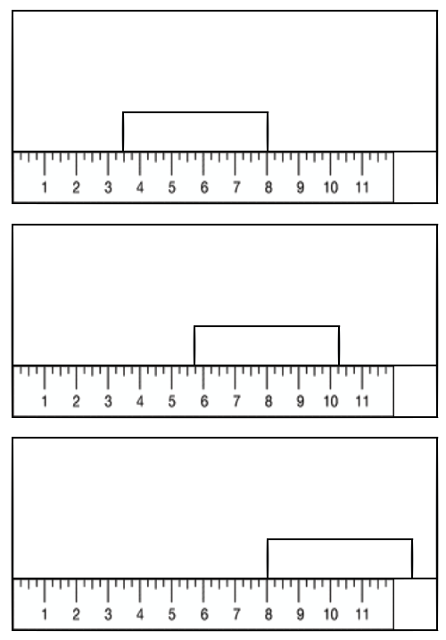
Visualizing Scenario 1
Carefully examine each diagram.
What distance did each student measure?
How did each student measure the distance the block traveled?
Cathy (Carpet)
Samuel (Sandpaper)
Tonya (Tile)
Notes:
4 min
“To figure out why the distance measurements were identical, we need to determine exactly how each student measured the distance the block traveled on each surface.”
Individuals: Ask participants to carefully study the diagrams on the slide and precisely define the quantity each student measured. Tell them to assume that the ruler was placed at the base of the ramp starting at 0 inches in each instance.
Whole group: Invite participants to share their ideas with the group. Encourage those listening to ask questions if a definition is vague or open to multiple interpretations. For example, if a participant says, “Cathy measured the distance from the base of the ramp in inches,” someone might ask whether a value of 3.5 inches could be used to describe that distance. A more precise description would be that Cathy measured the distance in inches from the base of the ramp to the front of the block (the end closest to the ramp).
Ideal responses:
Cathy measured the distance in inches from the base of the ramp to the front of the block (the end closest to the ramp).
Samuel measured the distance in inches from the base of the ramp to the middle of the block.
Tonya measured the distance in inches from the base of the ramp to the back of the block (the end farthest from the ramp).

Slide 45
Defining Quantities: Scenario 2
Josh lives 100 yards from school, and Sara lives 40 yards from school along the same road. How far from her house would Sara need to walk to be 10 yards from school?
Notes:
7 min
Introduce scenario 2 on the handout.
Ask, “Which buildings represent the school, Josh’s house, and Sara’s house?”
Individuals: Have participants work through the tasks on the handout and answer the question. Challenge them to reflect throughout the activity on how being careful with their definitions helps them better understand the relationships they’re investigating.
Note: The ruling lines on the slide measure distances from the center of the buildings rather than the perimeter. If you prefer having participants measure from the perimeter of each building, you may want to adjust the lines on the slide.
Whole group: Invite participants to share their definitions and solutions with the group. Remind them to use precise definitions to define the quantities involved. For example, if a participant says, “Sara’s distance,” there is no exact reference point, so the participant could be talking about Sara’s distance from Josh’s house, her school, her own house, or any other location.
Ideal response:
In this scenario, Sara is walking from home to school. That’s the activity. The quantities of interest are as follows:
The distance in yards from Sara’s house as she walks to the school.
The distance in yards from Sara to the school.
A measure of 0 for the first quantity signifies that Sara’s distance from her home is 0 yards, which means that she hasn’t left her house yet. A measure of 0 for the second quantity signifies that Sara is 0 yards from school, which means that she has arrived at school.
We know the sum of these two distances is 40 yards because Sara’s house is 40 yards from the school. So for Sara to be 10 yards from the school, she must walk a distance of 30 yards from her house.

Slide 46
Defining Quantities: Scenario 3
Josh lives 100 yards from school, and Sara lives 40 yards from school along the same road. Josh is walking home from school, and Sarah joins him as he passes her house. When Sara has walked 32 yards, how far has Josh walked?
Notes:
7 min
Introduce scenario 3 on the handout.
Individuals: Have participants work through the tasks on the handout and answer the question.
Note: The ruling lines on the slide measure distances from the center of the buildings rather than the perimeter. If you prefer having participants measure from the perimeter of each building, you may want to adjust the lines on the slide.
Whole group: Invite participants to share their definitions and solutions with the group. Make sure they’re using precise definitions and reasoning to define the quantities involved.
Ideal response:
In this scenario, Josh is walking from school to his house. As he passes Sara’s house, she joins him and walks with him to his house. That’s the activity. The quantities of interest are as follows:
The distance in yards from Sara’s house to Josh’s house.
The distance in yards from school to Josh’s house.
A measure of 0 for the first quantity signifies that the distance from Sara’s house is 0 yards, which means that Josh and Sara are right in front of Sara’s house. A measure of 0 for the second quantity signifies that the distance from school to Josh’s house is 0 yards, which means that Josh is at the school.
The distance Josh walks from the school will be the distance he walks before Sara joins him (40 yards), plus the distance Sara walks with him to his house. So when Sara has walked 32 yards, Josh will have walked 72 yards.

Slide 47
Defining Quantities: Scenario 4
Josh lives 100 yards from school, and Sara lives 40 yards from school along the same road. How far does Josh need to walk from home to meet Sara halfway through her walk home from school?
Notes:
5 min
Introduce scenario 4 on the handout.
Individuals: Have participants work through the tasks on the handout and answer the question.
Note: The ruling lines on the slide measure distances from the center of the buildings rather than the perimeter. If you prefer having participants measure from the perimeter of each building, you may want to adjust the lines on the slide.
Whole group: Invite one or two participants to share their definitions and solutions with the group. Make sure they’re using precise definitions and reasoning to define the quantities involved.
Ideal response:
In this scenario, Josh is walking from home to the school. He is going to meet up with Sara when she is halfway from the school to her house and walk with her the rest of the way. That’s the activity. The quantities of interest are as follows:
The distance in yards from the school to Sara’s house.
The distance from Josh’s house to the school.
We know the sum of the two defined quantities will equal 100 yards because Josh’s house is 100 yards from school, and Sara is walking home from school. When Sara is halfway home, the distance from the school to her house will be half of 40, or 20 yards. So Josh must walk 80 yards to meet her halfway through her walk.

Slide 48
Carefully Defining Quantities: Negatives
Carefully defining quantities makes the meaning of zero clear.
How could you carefully define quantities to make sense of negative numbers?
Can you think of ways the various distances defined in the four scenarios allow for interpretations of negative values like −10 or −20?
Work with a partner to come up with an example that involves negative numbers.
Notes:
7 min
Walk participants through the scenario on the slide.
Turn and Talk: Have participants pair up with an elbow partner and come up with an example of how carefully defined quantities in one of the scenarios would allow for interpretations of negative values.
If participants are struggling with this challenge, use the following example: If Josh walked a distance of −20 yards from Sara’s house toward the school, then he’s actually 20 yards in the opposite direction of school from Sara’s house.
Whole group: Invite participants to share their examples with the group.
Note that using a number line or measuring tools like rulers can support the practice of carefully defining quantities. If time allows, discuss why a ruler is placed with 0 at a specific location and is pointed in a specific direction.

Slide 49
Reflect: Content Deepening Focus Question 3
How does precision in defining quantities affect our ability to analyze relationships between quantities and understand the world around us?
Notes:
4 min
Review the focus question on the slide.
Individuals: Ask participants to reflect on the big ideas from the previous investigations regarding precision in defining quantities. Then have them answer the focus question in their notebooks using two or three complete sentences.
Whole group: Invite one or two participants to share their answers with the group.
Highlight these takeaways:
Language precision in defining quantities allows for viable comparisons of the quantities involved (e.g., the block-and-ramp experiment was a failure because the quantities weren’t precisely or consistently defined).
Language precision in defining quantities requires a rich understanding of the problem scenario and can be used as a tool for analyzing novel situations.
A carefully defined quantity will convey a meaning for all values of the quantity, especially a meaning for zero and positive versus negative values.
Focusing on language precision in defining quantities supports thinking about number lines, a reference point (and a corresponding frame of reference), and measurement.

Slide 50
Today’s Focus Questions
How can science content storyline coherence be enhanced by explicitly implementing STeLLA strategy F (Make explicit links between science ideas and activities), strategy G (Link science ideas to other science ideas), and strategy H (Highlight key science ideas and focus question throughout)?
How will the Student Thinking Lens and Science Content Storyline Lens strategies help you teach the Forces lessons in the fall?
How can ideas about forces help us explain the motion of objects?
What is the difference between mass and weight?
How does precision in defining quantities affect our ability to analyze relationships between quantities and understand the world around us?
Notes:
5 min
Individuals: Give participants a couple of minutes to think about today’s focus questions and then answer them in their notebooks.
Note: If time is running short, have participants choose one question to answer.
Whole group: If time allows, have a share-out of ideas.

Slide 51
Summarizing Science Content Storyline Lens Strategies
What does the organization of the summary chart in the STeLLA strategies booklet highlight about the Science Content Storyline Lens strategies?
Do you want to make any revisions or additions to our poster on effective science teaching?
Notes:
10 min
Note: Display one question at a time on the slide.
“This week we focused on the Science Content Storyline Lens and strategies. Let’s synthesize and summarize our learning by looking at the summary chart in your strategies booklet—Summary of the STeLLA Science Content Storyline Lens Strategies.”
Note: Participants may also refer to their SCSL Z-fold summary charts for this activity.
Individuals: “Look at this summary chart and how it’s organized. What do you think the organization highlights? Write your observations in your notebooks.”
Whole group: “What did you notice about the organization of this chart? What does it highlight about the science content storyline strategies?”
Reveal the second discussion question on the slide and invite participants to suggest additions or changes to the Effective Science Teaching chart.
Key ideas:
Many of the SCSL strategies must be completed during the lesson planning stage. For example, the main learning goal and activities that match them must be selected ahead of time.
Strategies B, F, G, H, and I are moves the teacher makes while teaching the lesson, but planning and anticipating how these strategies will help develop the lesson is critical to success.
The RESPeCT lesson plans provide examples of how strategies B, F, G, H, and I might be used during the lessons.
Strategies F, G, and H should be applied throughout the lesson. Strategy B is used at the beginning of a lesson, and strategy I is used at the end.
Each strategy has its own distinct purpose(s), but all of them contribute to creating a coherent science content storyline.

Slide 52
Let’s Celebrate!
Design your own end-of-program celebration and insert any comments or instructions here.
Notes:
15 min
Decide how you’ll celebrate the end of the RESPeCT PD program, and modify the slide accordingly. Here are a few ideas:
Have refreshments and toast the group’s success with a bubbly, nonalcoholic drink.
Have everyone write on an index card a “golden nugget” that represents something they’re taking away from the Summer Institute experience. Pass around a bowl filled with chocolates wrapped in gold paper, and have participants take a piece of chocolate when they drop their cards in the bowl. After the bowl is passed around, share the golden nuggets with the group.
Take a group photo.

Slide 53
Thank You!
Thank you for participating in the RESPeCT PD program!
Notes:
Less than 1 min
Before dismissing participants, thank them for participating in the RESPeCT PD program.

