Slide 1
Variation In traits Lesson 1A
How Are Living Things of the Same Kind Alike and Different?

Slide 2
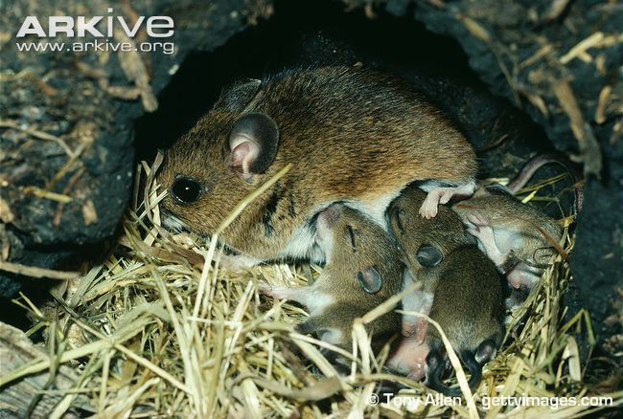
What Do You See?
Photograph by Tony Allen

Slide 3
Unit Central Question
Do all of the mice living in the same environment, such as a field or forest, have an equal chance of surviving?

Slide 4
Today’s Focus Question
How are living things of the same kind alike and different?

Slide 5
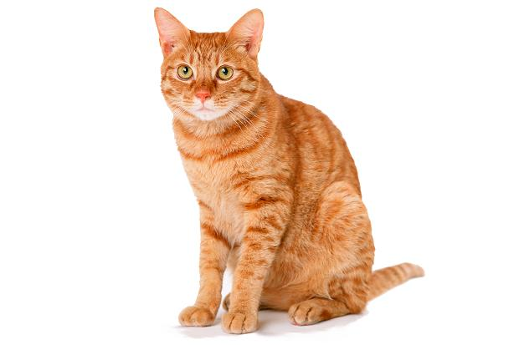
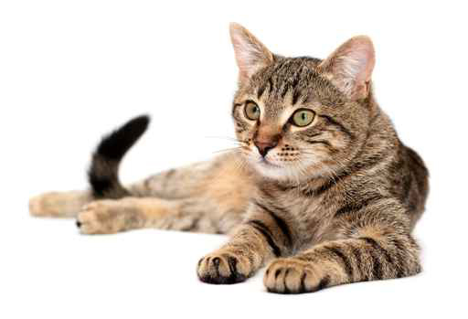
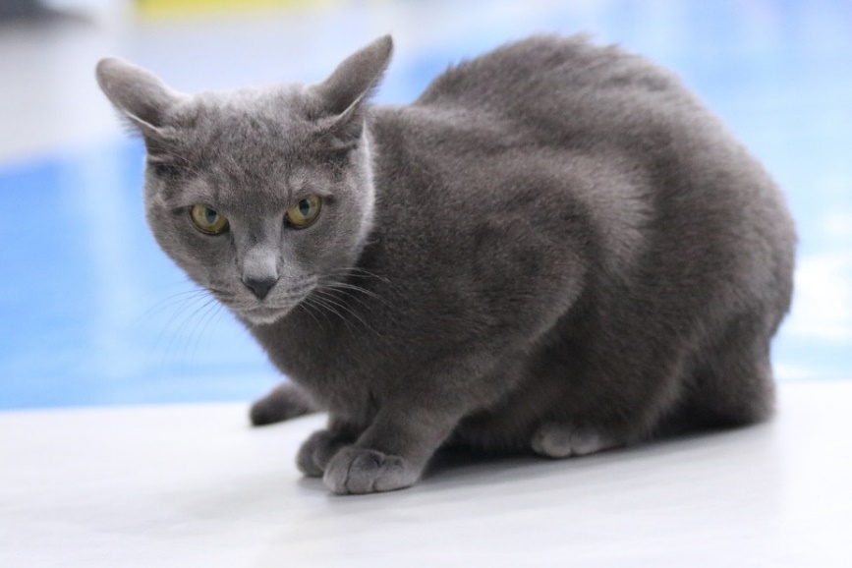
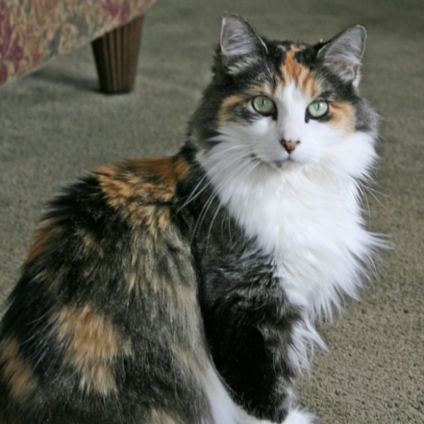
How Do You Know These Are Cats?
Art: Cat Image 1 RES.C2.VIT.L1HO.002 | Art: Cat Image 2 RES.C2.VIT.L1HO.003
Photo used with permission by BSCS
Photo used with permission by BSCS
Photo courtesy of Pixabay.com
Photograph by Cassie Jones

Slide 6
Key Science Idea
Traits are features or characteristics of living things of the same kind. A trait can be the way a living thing looks or the way it acts.
Write this definition in your science notebook.
List an example of something that’s a trait and something that isn’t a trait.

Slide 7
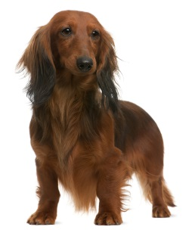
What Traits Do Dogs Have?
Photo courtesy of © Isselee | Dreamstime.com

Slide 8
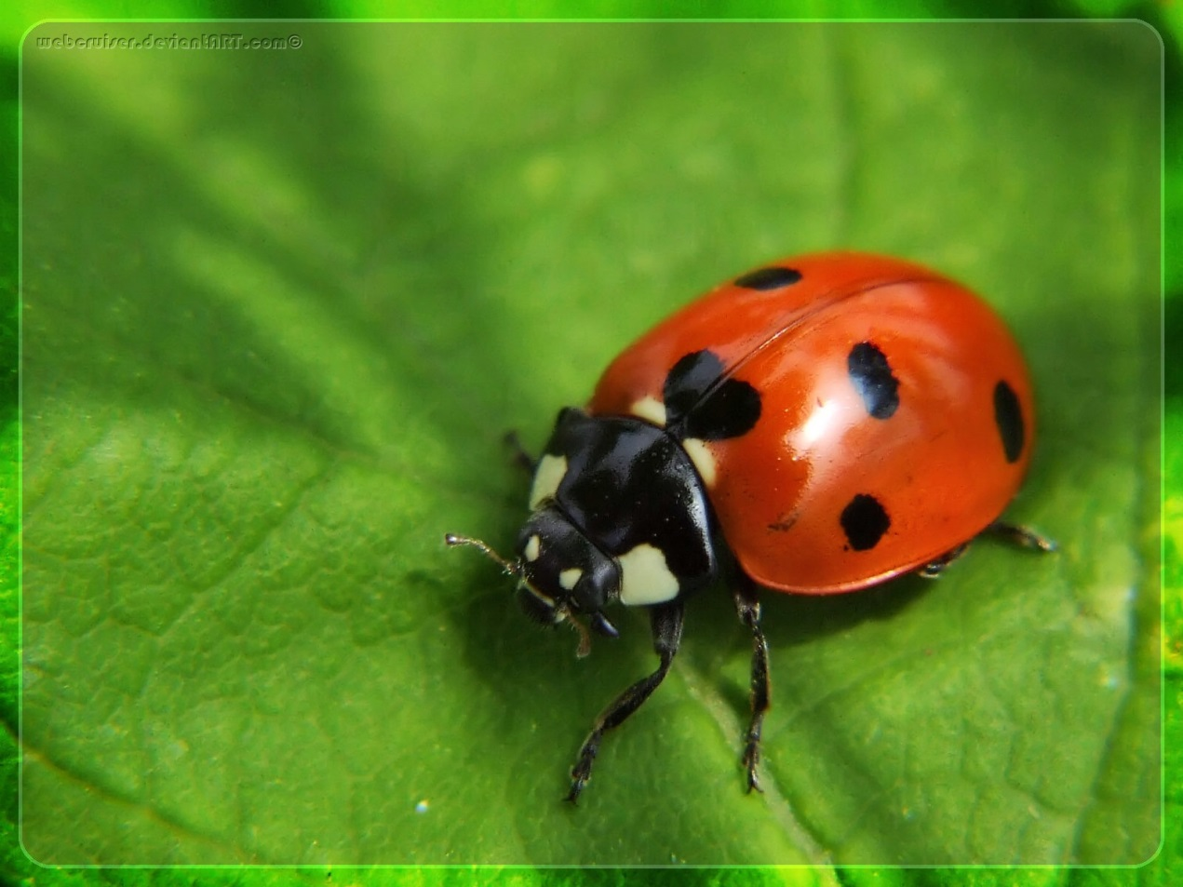
What Are the Traits of This Living Thing?
Photo courtesy of Clipart-library.com

Slide 9
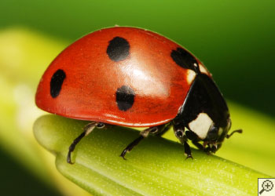
Compare Your Ladybugs
Share your picture with a partner and compare the ladybugs’ traits.
Which ladybug traits are alike?
Photo courtesy of Clipart-library.com
Photo courtesy of Clipart-library.com

Slide 10
Compare Your Ladybugs
Now compare your ladybugs and talk about any differences you observe.
Scientists call these differences variations.
Variation is a science idea that describes the differences in traits among living things of the same kind.

Slide 11
Ladybugs: Traits and Variation
Ladybugs
TRAITS
VARIATION

Slide 12
Our Focus Question
How are living things of the same kind alike and different?

Slide 13
Key Science Ideas
Traits are features or characteristics that identify living things of the same kind.
A trait can be the way a living thing looks or the way it acts.
Variation refers to the differences in traits among living things of the same kind.

Slide 14
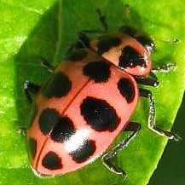
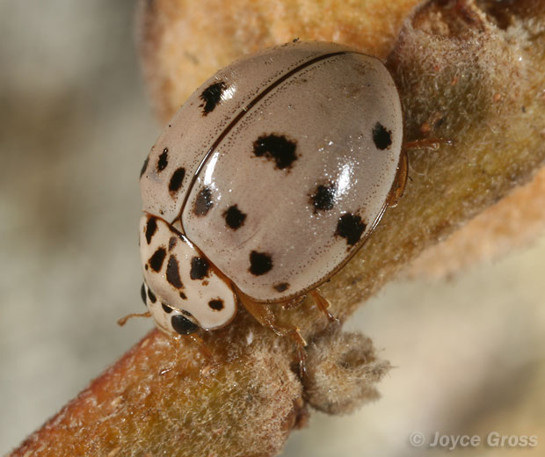
Let’s Summarize!
Art: Cat Image 1 RES.C2.VIT.L1HO.002 | Art: Cat I RES.C2.VIT.L1HO.003
Photo used with permission by BSCS
Photograph by Cassie Jones
Photo courtesy of Wikimedia.org
Photograph by Joyce Gross

Slide 15
Let’s Summarize!
In your science notebook, list the following:
One trait of a cat and two variations of that trait
One trait of a ladybug and two variations of that trait
Resources to use:
Our class circle map for the cats
Your Trait and Variation circle maps for the ladybugs

Slide 16
Next Time
In our next lesson, we’ll gather data on one ladybug trait—the number of spots they have.
Then we’ll find out how scientists organize their data so they can identify patterns and analyze variations in a trait.

