Slide 1
Variation In traits Lesson 1b
How Are Living Things of the Same Kind Alike and Different?

Slide 2
Ladybugs: Traits and Variation
Ladybugs
TRAITS
VARIATION

Slide 3
Our Focus Question
How are living things of the same kind alike and different?

Slide 4
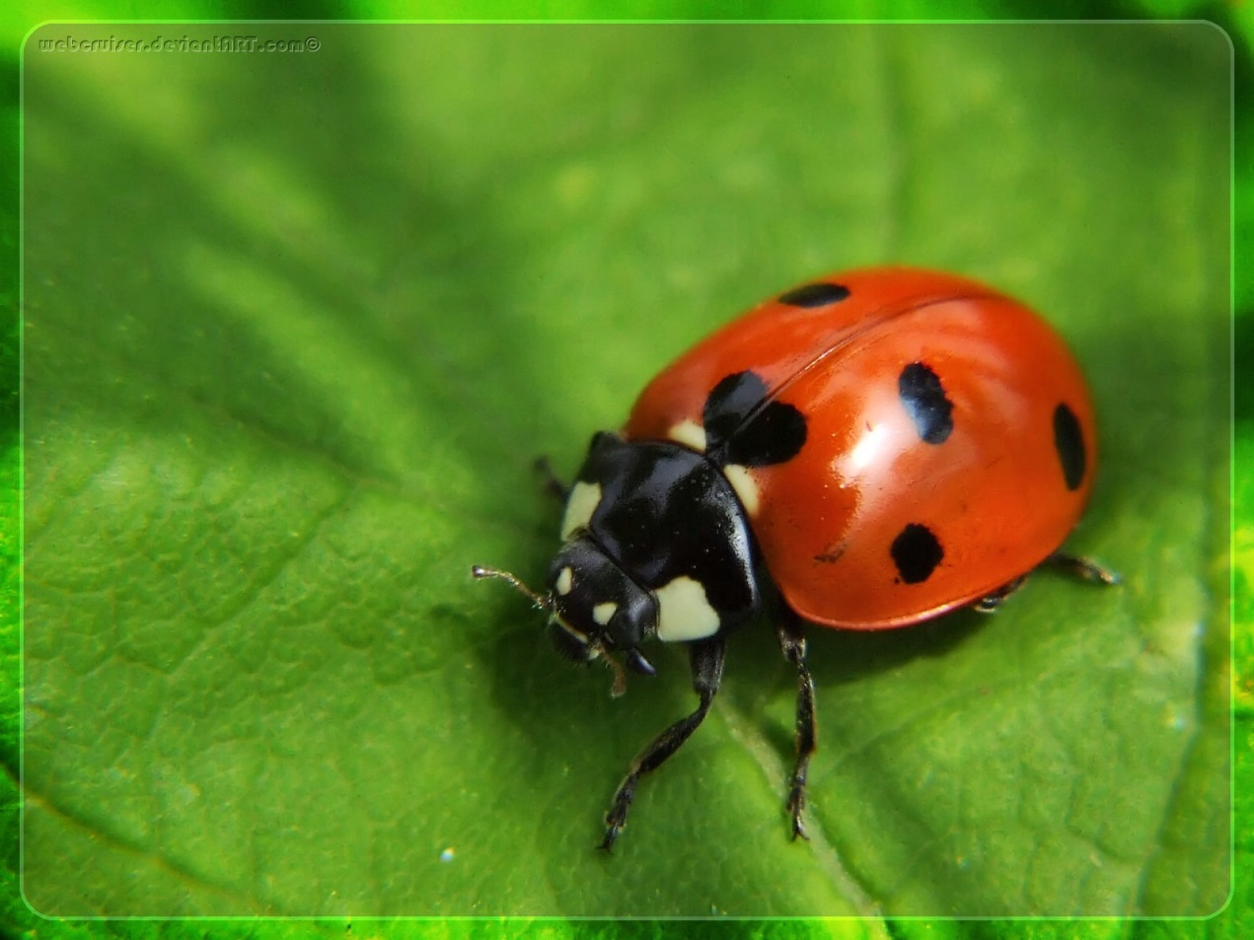
Count the Spots
Photo courtesy of Clipart-library.com

Slide 5
Create a Bar Graph
Place your sticky note on our class bar graph to show how many spots your ladybug has.
Bar Graph of Ladybug Spots
20
19
18
17
16
15
14
13
12
11
10
9
8
7
6
5
4
3
2
1
 | 0 | 1 | 2 | 3 | 4 | 5 | 6 | 7 | 8 | 9 | 10 | 11 | 12 | 13 | 14 | 15 | 16 | 17 | 18 | 19 | 20 | 21 | 22
Number of Ladybugs
9
9
9
9
9
9
9
Number of Spots

Slide 6
Examine the Ladybug Data
How many spots do most of our ladybugs have? How do you know?

Slide 7
Examine the Ladybug Data
In your small group, come up with two more observations about the ladybugs’ spots based on evidence from our class bar graph.
Be ready to share your observations and ideas with the class.

Slide 8
How Can Bar Graphs Help Us?
What did we learn about ladybugs from our bar graph?
How did the bar graph help us learn those things?
Would calling out the numbers of spots have made it easier or harder to learn about the differences (variations) in this trait among ladybugs? Why?
What makes a bar graph a better way to share our data than calling out the number of spots?

Slide 9
Another Ladybug Trait
How many legs does your ladybug have?

Slide 10
Another Ladybug Trait
Talk about these questions in your small group:
Do ladybugs show variation for the number-of-legs trait?
What would a class bar graph look like for the number of legs our ladybugs have?
Sketch the graph in your notebook to help you imagine what it would look like. As you create your graph, think about a few ladybugs and the number of legs they have.

Slide 11
Our Focus Question
How are living things of the same kind alike and different?
Observations:
All of our ladybugs have spots, but there was a difference in the number of spots. This difference is called variation. So our ladybugs showed variation in the number-of-spots trait.
All of our ladybugs have six legs, so they showed no variation in the number-of-legs trait.

Slide 12
Key Science Idea
Among living things of the same kind, some traits show variation and some don’t.

Slide 13
Let’s Summarize!
Our focus question: How are living things of the same kind alike and different?
Write an answer to this question in your science notebook, using everything you’ve learned about traits and variation.
Include evidence from our investigations today and last time to support your ideas.

Slide 14
Next Time
Do other living things, such as plants, show variation in some traits and not in others?
Photo courtesy of Wikimedia.com

