Slide 1
Variation in Traits Lesson 2A
Do Plants Show Variation in Traits? How Do We Know?

Slide 2
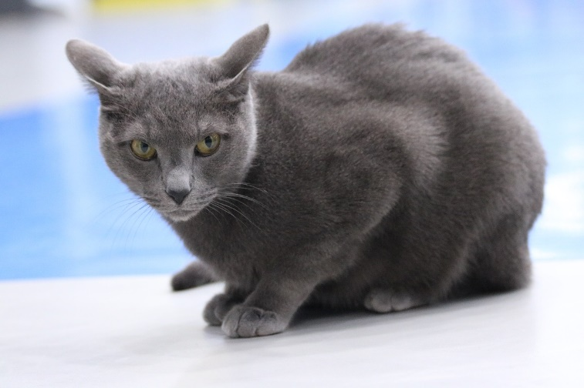
What Have You Learned So Far?
Share with a partner what you’ve learned so far about traits and variation. Use these words as you share.
Photo courtesy of Pixabay.com
Photo used with permission from BSCS
Photo courtesy of Clipart-library.com

Slide 3
Today’s Focus Questions
Do plants show variation in traits? How do we know?

Slide 4
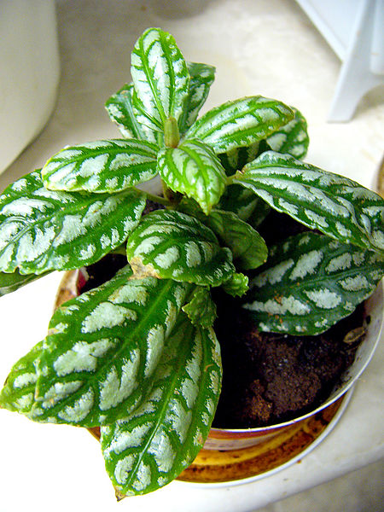
Investigation: Do Plants Have Traits?
Photo courtesy of Wikimedia.com

Slide 5
Investigation: Do Plants Have Traits?
Talk about this question with a partner and list some of the traits plants might have. Also talk about whether plants show variation in their traits.
Make sure each trait you list matches our definition:
A trait is a feature or characteristic of living things of the same kind that helps us identify them.
Photo courtesy of Wikimedia.com

Slide 6
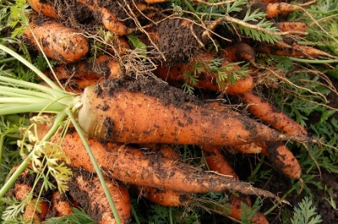
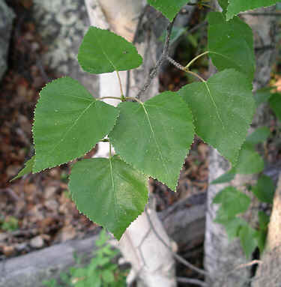
Investigation: Do Plants Have Traits?
Carrots
Leaves
Photo courtesy of Pixabay.com
Photo used with permission by BSCS

Slide 7
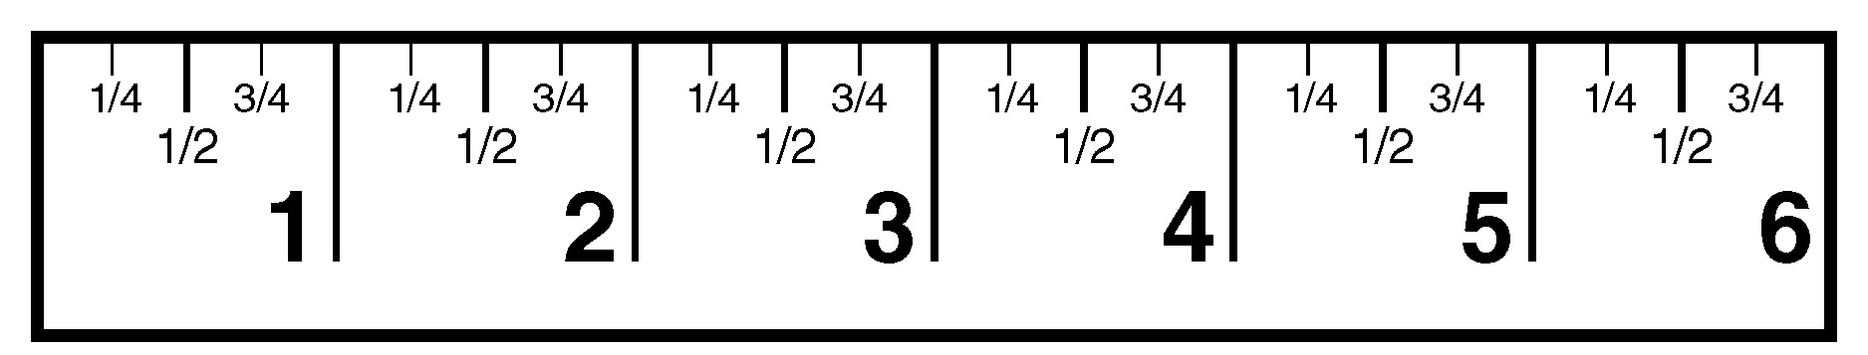
Using a Ruler
How many inches do you see on this ruler?

Slide 8
Practice Using a Ruler
Identify the following measurements:

Slide 9
Record Your Measurements
In your notebook under today’s focus question, write these headings:
Length of My Carrot/Leaf:
Length of Each Group Member’s Carrot/Leaf:
Make sure to leave enough space on the page for all of your group’s measurements.

Slide 10
Compare Your Measurements
In your small group, place your carrots or leaves next to each other from shortest to longest. Then talk about these questions:
Are all of your measurements the same?
What do the measurements tell you about the length of the plants? (Compare your measurements with what you saw when you lined up the plants from shortest to longest.)
Does the length trait of your plants show variation? How do you know?

Slide 11
Let’s Summarize!
Our focus questions: Do plants show variation in traits? How do we know?
Using everything you’ve learned so far about traits and variation, complete this statement in your science notebook:
Plants [show/do not show] variation in their traits. My evidence is __________.

Slide 12
Next Time
In our next lesson, we’ll record all of our measurements on two class data tables—one for carrots and one for leaves.
Then we’ll use this data to figure out whether plants show variation in traits.
Do you think we’ll see variation in the length trait in our plants?
Let’s find out!

