Slide 1
Variation in Traits Lesson 2b
Do Plants Show Variation in Traits? How Do We Know?

Slide 2
Review: Plant Traits and Variation
How did you complete this statement in our last lesson?
Plants [show/do not show] variation in their traits. My evidence is __________.
What plant trait did you measure?
What is a variation in a trait?
How does measuring help us find out whether there’s variation in a trait?

Slide 3
Our Focus Questions
Do plants show variation in traits? How do we know?

Slide 4
Our Plant Data
Choose one member from your small group to add your data to the class data table for your plant.
Plant length should be measured to the nearest quarter of an inch.
Place an X next to the measurement on the table that matches the length of each plant in your group.
Length | Tally Marks
2 inches
2 ¼ inches
2 ½ inches
2 ¾ inches | X
3 inches | XXX
3 ¼ inches
3 ½ inches | X
3 ¾ inches
4 inches

Slide 5
Is There Variation in the Length Trait?
Look at the data tables for the carrots and the leaves. Discuss in your small group whether the length trait shows variation for each kind of plant.
Do you observe variation in the length trait for carrots? How can you tell?
Do you observe variation in the length trait for leaves? How can you tell?

Slide 6
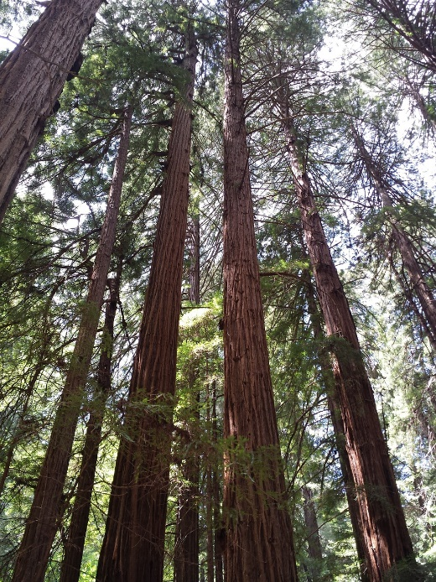
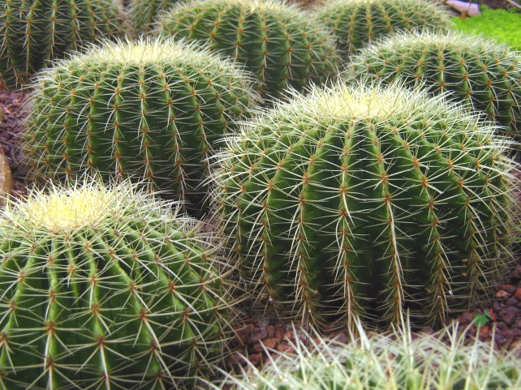
Trait Variation in Other Kinds of Plants
Talk with an elbow partner and come up with two more traits that plants have.
Then think of another kind of plant and decide whether it shows variation for those traits?
Photo courtesy of Wikimedia.com
Photo courtesy of Pixabay.com
Photo courtesy of Pixabay.com

Slide 7
Finding Patterns in Our Data
What patterns did we observe in our class bar graph showing the number of ladybug spots?
What patterns did we observe on our class data tables showing the length of carrots and leaves?

Slide 8
Bar Graphs and Data Tables
Think about the bar graph and data tables we used to organize our data.
How are a bar graph and a data table alike and different?
Do both ways of organizing data help us find patterns?
Do both show evidence of variation in traits of living things of the same kind? In what ways?

Slide 9
More or Less Trait Variation?
Do you see more or less trait variation for the number of spots on the ladybugs? What is your evidence?
Do you see more or less trait variation for the length of the carrots? What is your evidence?
Do you see more or less trait variation for the length of the leaves? What is your evidence?

Slide 10
Let’s Summarize!
Today’s focus questions: Do plants show variation in traits? How do we know?
To summarize what you’ve learned about variation in traits, answer these revised focus questions in your notebook:
Do plants and animals of the same kind show variation in traits? How do we know?
Include evidence from our investigations of the ladybugs, carrots, and leaves. Make sure to use the words trait and variation in your responses.

Slide 11
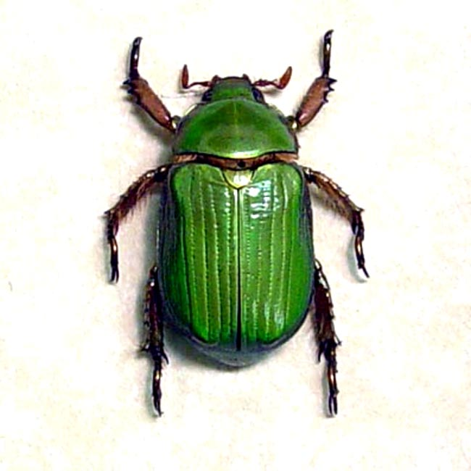
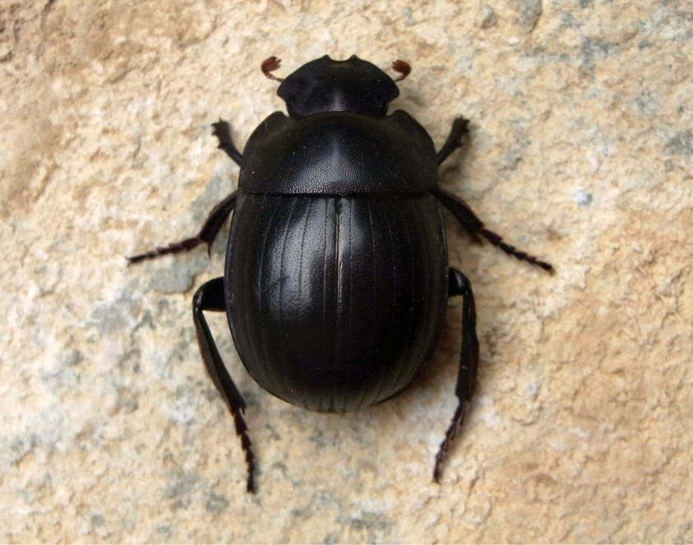
Next Time
In our next lesson, we’ll explore how traits affect beetles and their chances of surviving in the desert.
We’ll also gather more information to help us answer our unit central question.
Photo used with permission from BSCS
Photo courtesy of Wikimedia.com

