Slide 1
Variation in Traits Lesson 3a
Why Do Trait Variations among Desert Beetles Matter?

Slide 2
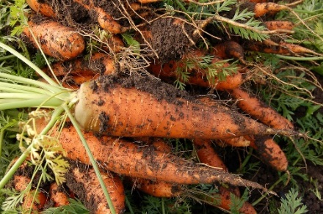
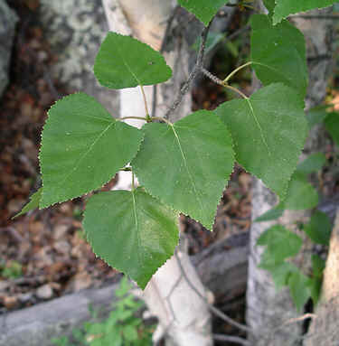
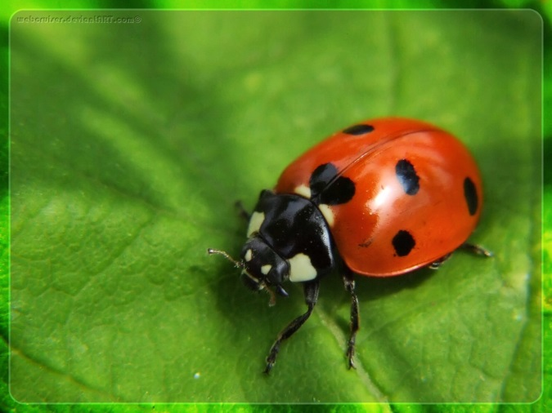
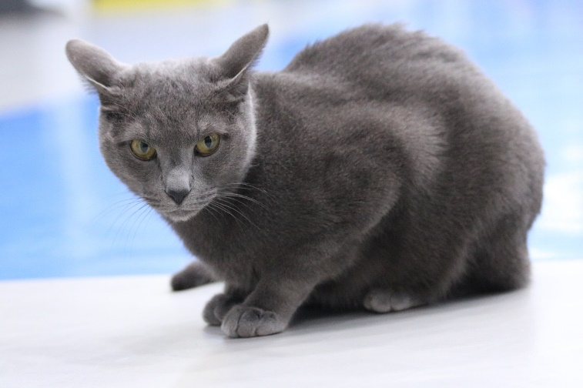
Review: Traits and Variations
What trait variations in animals and plants did we investigate in previous lessons?
Photo courtesy of Pixabay.com
Photo used with permission by BSCS
Photo courtesy of Pixabay.com
Photo courtesy of Clipart-library.com

Slide 3
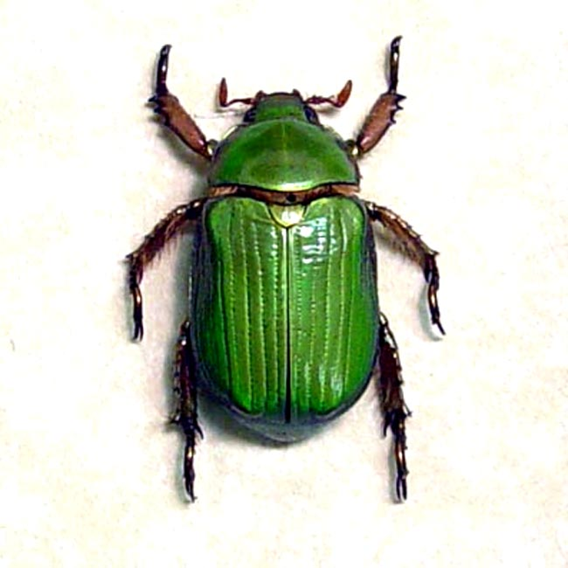
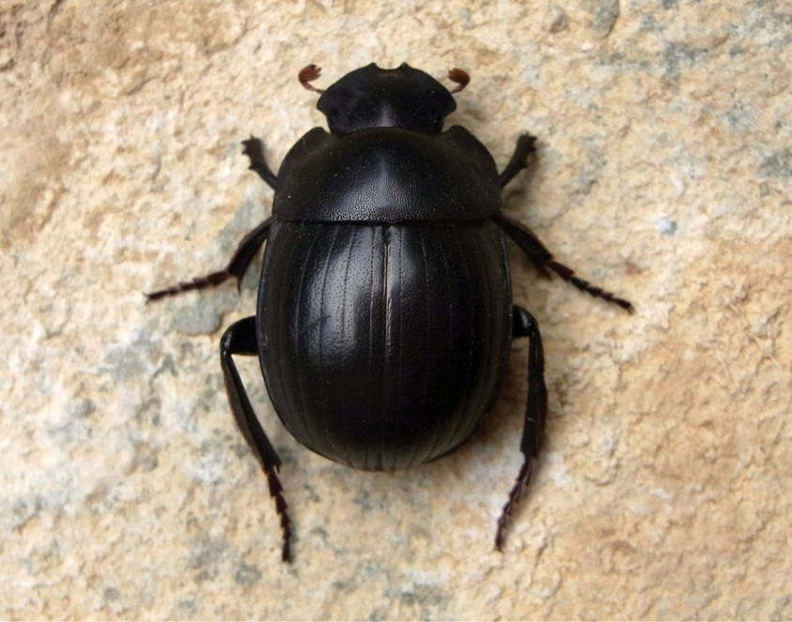
Today’s Focus Question
Why do trait variations among desert beetles matter?
Scarab beetles
RES.C2.VIT.L3HO.003
Photo courtesy of Pixabay.com
Photo used with permission from BSCS
Photo courtesy of Wikimedia.com

Slide 4
Beetles in the Desert
While you’re reading the story “Beetles in the Desert,” think about these questions:
What living thing is this story about?
What are some of its traits?
Is there variation in the traits?

Slide 5
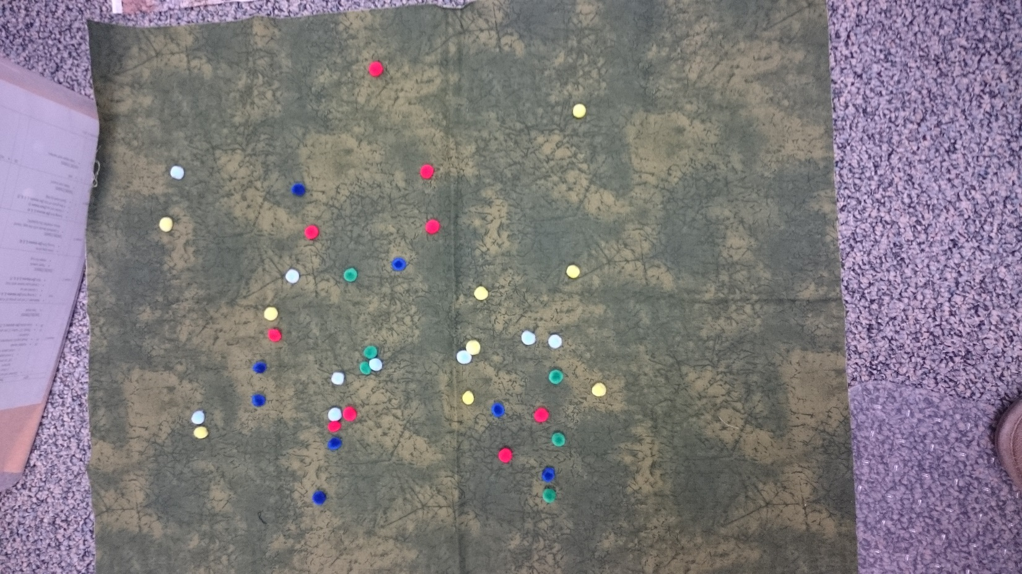
The Desert Model
The model represents what might happen to the beetles in nature.
Each colored pom-pom represents a beetle​.
Pinching my index finger and my thumb together represents a lizard eating a beetle.​
The fabric represents the desert​ environment where the beetles and lizards live.
Photo courtesy of Cal Poly Pomona

Slide 6
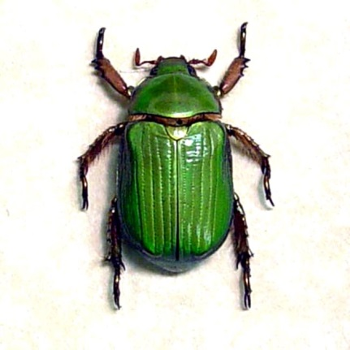
What Will Happen to the Beetles?
Do you think some beetles will survive longer than other beetles in our desert environment?
List one or two reasons why you think a particular beetle might or might not survive longer than other beetles.
Photo used with permission from BSCS
Photo courtesy of Pixabay.com
Photo courtesy of Wikimedia.com

Slide 7
Share Your Predictions
Share your predictions and reasons using this sentence starter:
I predict that some beetles [will/won’t] survive longer than others in our desert environment because _______________.
Share comments using these sentence starters:
I agree/disagree with your idea because …
I want to add …
I have a question about …

Slide 8
Our Focus Question
Why do trait variations among desert beetles matter?

Slide 9
Let’s Summarize!
Look at the prediction and reasons you recorded earlier in your notebook for this question:
Do you think some beetles will survive longer than other beetles in our desert environment?
If your prediction has changed based on the ideas we shared in our class discussion, revise it.
You can change or add to your original prediction. Or you can write a new prediction and reasons to support it.

Slide 10
Next Time
Next time, we’ll use our desert model to test our predictions about whether some beetles will survive longer than others in their environment.
Do you think variation in traits among beetles has anything to do with their survival?
Stay tuned!

