Slide 1
Variation in Traits Lesson 3b
Why Do Trait Variations among Desert Beetles Matter?

Slide 2
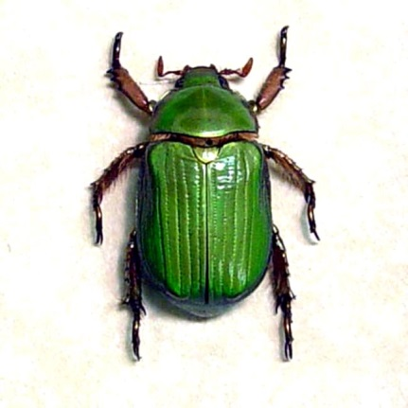
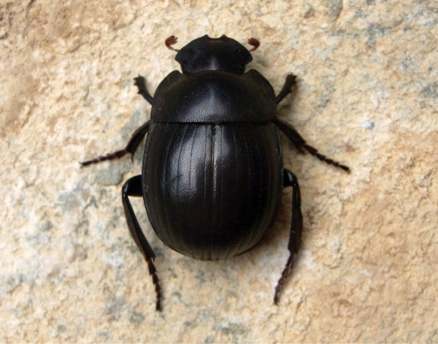
Review: What Will Happen to the Beetles?
Do you think some beetles will survive longer than other beetles in our desert environment?
List one or two reasons why you think a particular beetle might or might not survive longer than other beetles.
Photo used with permission from BSCS
Photo courtesy of Pixabay.com
Photo courtesy of Wikimedia.com

Slide 3
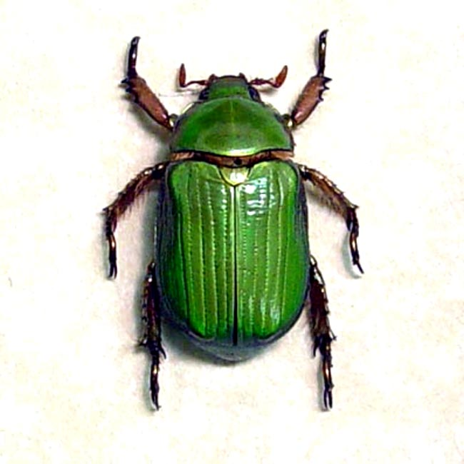
Today’s Focus Question
Why do trait variations among desert beetles matter?
Scarab beetles
RES.C2.VIT.L3HO.003
Photo courtesy of Pixabay.com
Photo used with permission from BSCS
Photo courtesy of Wikimedia.com

Slide 4
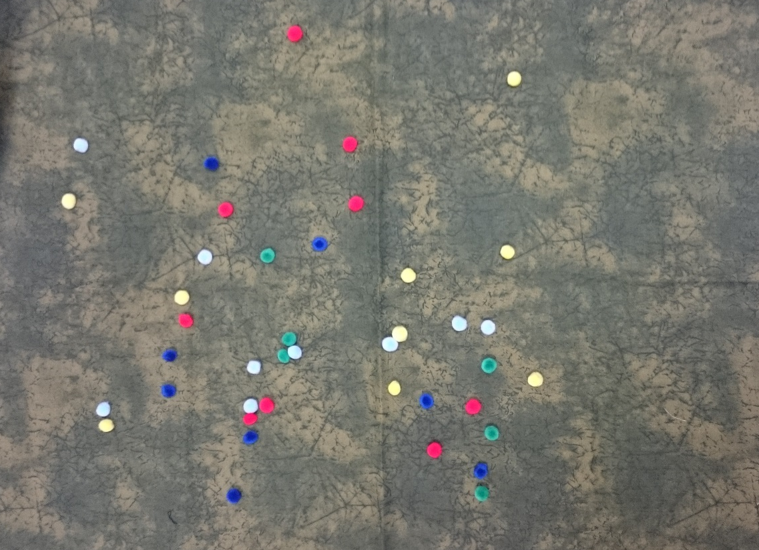
Using Our Desert Model
Photos courtesy of Cal Poly Pomona

Slide 5
Role Assignments
Lizards: Your role is to hunt for pom-pom beetles. Keep your eyes closed when you aren’t hunting. Do not peek!
Counters: Your role is to count the number of pom-pom beetles in your assigned color and report that number to the recorder.
Recorder: Your role is to record the number of pom-pom beetles on the class data table as the counters report this information.
Observers: Your role is to watch the simulation and record your observations in your notebooks.

Slide 6
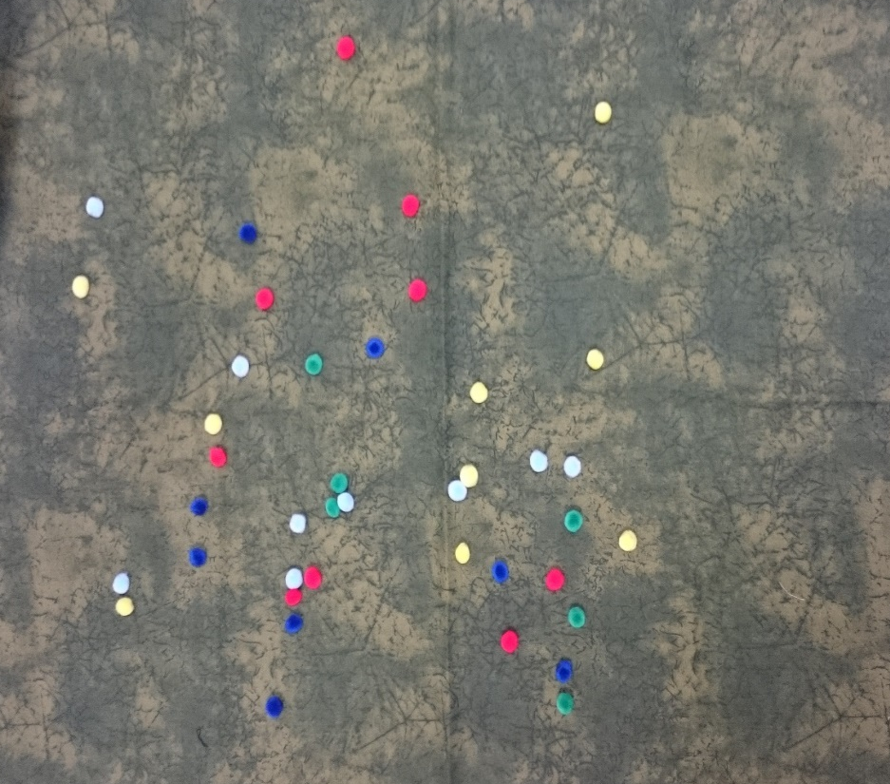
Review: Our Desert Model
What does our model represent?
What does the fabric represent?
What does each colored pom-pom represent?
How will our​ student lizards hunt for beetles and eat them?
Photo courtesy of Cal Poly Pomona

Slide 7
Comparing Our Results and Predictions
Look at the revised prediction you wrote in your science notebook. Compare your prediction with the results on our data table.
Does your prediction match what happened in our simulation?
What is your evidence?

Slide 8
Beetles in the Desert—Analogy Map
Part of Our Model | Is/Are Like | Part of the Real World | Because …
Pom-poms | are like | different- colored beetles | both the beetles and the pom-poms are black, brown, red, green, and yellow.
 | are like | a lizard’s mouth
Picking up a pom-pom | is like
Fabric | is like

Slide 9
Let’s Analyze Our Desert Model
What are the strengths of the model?
Example: The pom-poms are the same colors as the beetles in the story and in real life.
What are the limitations of the model?
Example: Lizards in real life wouldn’t eat only six beetles.

Slide 10
Let’s Summarize!
Today’s focus question: Why do trait variations among desert beetles?
Answer this question in your science notebook using these sentence starters:
Variations among desert beetles matter because _________.
The model showed that variations in the beetles’ color matter because _________.

Slide 11
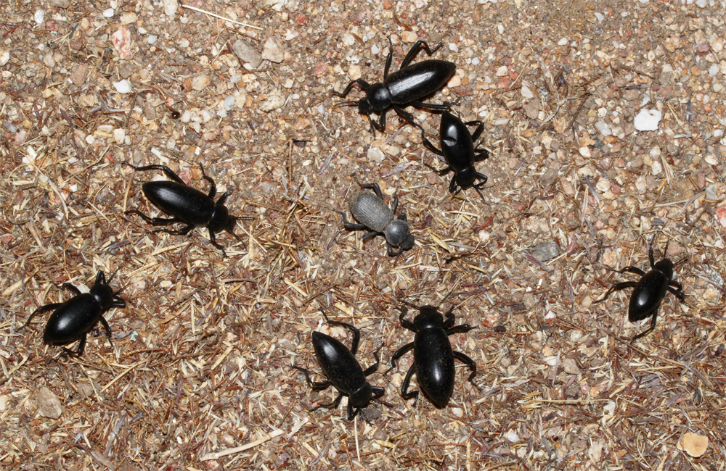
Next Time
In the next lesson, we’ll use our data in some different ways to help us explain what can happen in the real world when living things of the same kind show trait variations.
Photo courtesy of Beetlesofcuyamacamountains.net

