Slide 1
Variation in Traits Lesson 4a
How Can Data Help Us Explain Why Trait Variations among Desert Beetles Matter?

Slide 2
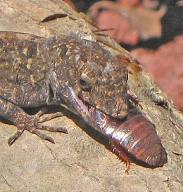
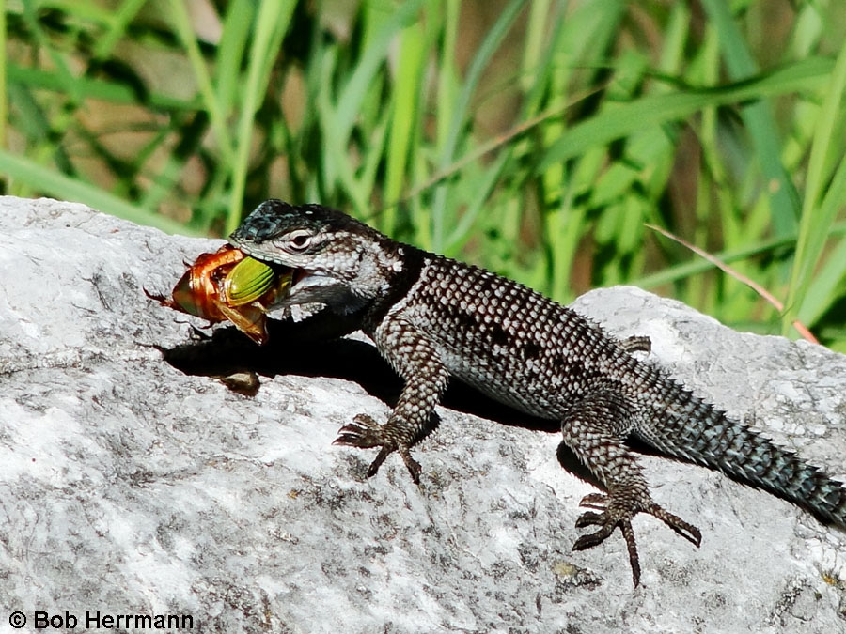
Beetles (and Lizards) in the Desert
Photo used with permission from BSCS
Photograph by Bob Herrmann

Slide 3
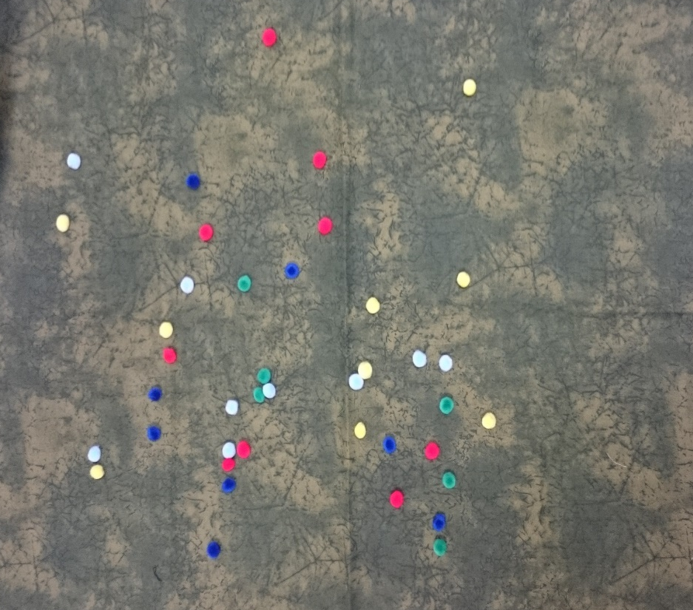
Review: Our Desert Model
What did we use to represent the desert where the beetles live?
What did we use to represent the beetles?
What did our​ student lizards use to grab the pom-pom beetles?
What did grabbing a pom-pom represent?
Photo courtesy of Cal Poly Pomona

Slide 4
Today’s Focus Question
How can data help us explain why trait variations among desert beetles matter?

Slide 5
Which Answer Is Most Convincing?
Imagine hearing about a new movie and asking two friends what they think about it.
One friend says, “You should see this movie because I liked it.”
The other friend says, “You should see this move because it has a lot of action. It also has a good actor and a lot of really funny parts.”
Which friend’s answer is more likely to convince you to see the movie? Why?

Slide 6
Key Science Ideas
Scientists use evidence to help them explain and support their ideas so their answers are convincing.
Evidence makes it easier for other scientists to understand and trust the results of an investigation.
Scientists gather evidence from observations, measurements, and their senses (seeing, hearing, and smelling).
Like scientists, we can use evidence from our desert simulation to help us explain why trait variations, like color, among desert beetles matter.

Slide 7
Using Evidence to Answer Questions
What evidence from our simulation can help you explain why color variations among desert beetles matter?
How would you explain which beetles in our model were eaten by the lizards and which beetles survived?

Slide 8
Using Fractions as Evidence
Fractions can help us compare the data from our desert model and explain more easily and clearly how many of the beetles of each color were eaten.

Slide 9
Calculating the Fraction of Beetles
Color of Beetle | Beetles Eaten | >, <, or = | Beetles That Survived
 | Number of the color eaten Total number of the color |  | Number of the color not eaten Total number of the color
4
5
Red
<
9
9

Slide 10
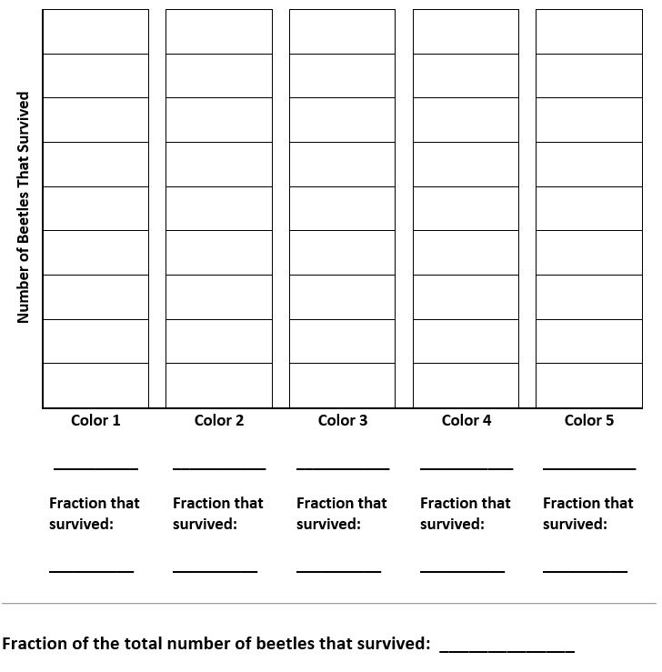
Creating a Bar Graph

Slide 11
Let’s Summarize!
Our focus question: How can data help us explain why trait variations among desert beetles matter?
Today, we used two different methods to represent the data from our desert simulation:
We calculated the fractions of beetles eaten and not eaten.
We made a bar graph showing the number of beetles that survived (weren’t eaten).

Slide 12
Let’s Summarize!
Which method makes it easier for you to understand the data from our desert model? Why?
Think-Pair-Share: Think about these questions and then share your answers with an elbow partner.
Explain why you think the method you chose makes it easier to understand the data. Use this sentence starter:
[Fractions/bar graphs] make it easier for me to understand the data from our desert model because ____________.

Slide 13
Next Time
In our next lesson, we’ll use our fraction data and bar graphs to help us explain why trait variations among desert beetles matter.

