Slide 1
Variation in Traits Lesson 4b
How Can Data Help Us Explain Why Trait Variations among Desert Beetles Matter?

Slide 2
Review: Understanding Our Data
How did you complete this sentence last time?
[Fractions/bar graphs] make it easier for me to understand the data from our desert model because ____________.

Slide 3
Today’s Focus Question
How can data help us explain why trait variations among desert beetles matter?

Slide 4
Our Focus Question from Lesson 3
Why do trait variations among desert beetles matter?
Our revised focus question: Do differences in the color of desert beetles affect whether they get eaten?
A follow-up question: What data can we use as evidence to support our claim (answer)?

Slide 5
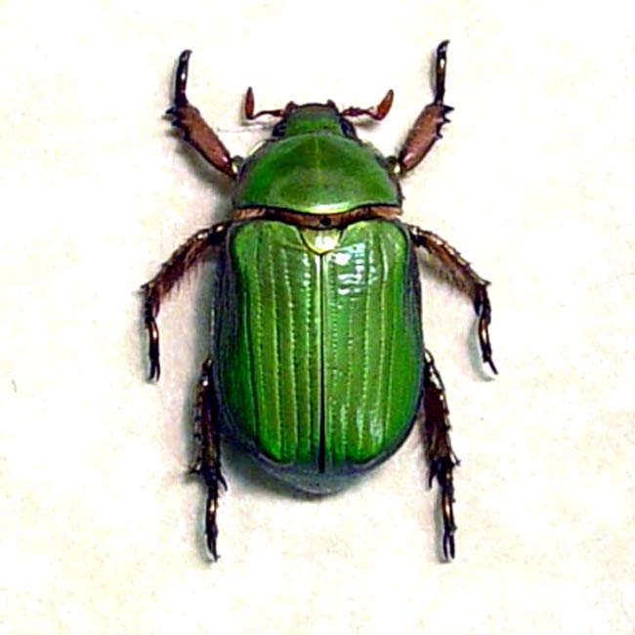
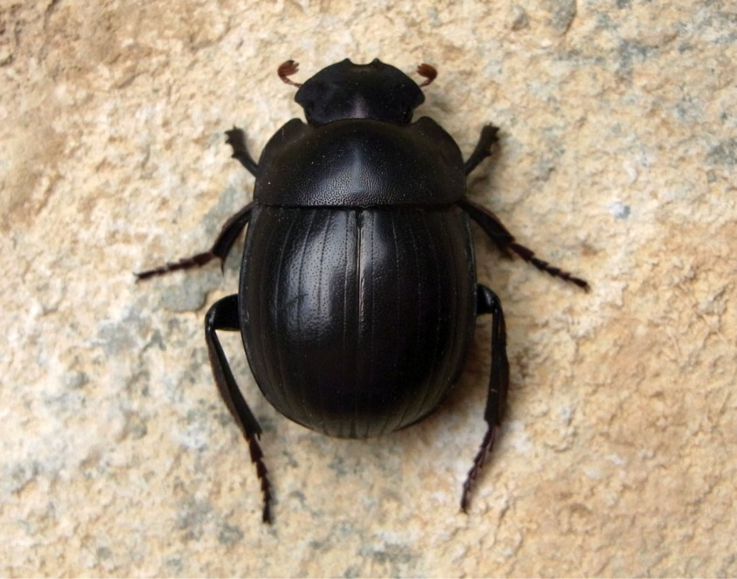
Write a Claim to Answer This Question
Do differences in the color of desert beetles affect whether they get eaten?
Scarab beetles
RES.C2.VIT.L3HO.003
Photo courtesy of Pixabay.com
Photo used with permission from BSCS
Photo courtesy of Wikimedia.com

Slide 6
Write a Claim
Write a sentence that answers the question, Do differences in the color of desert beetles affect whether they get eaten?
Use data from our desert simulation as evidence to support your claim. Include data from our data table in lesson 3 and our fractions and bar graph from last time.
Sentence starters:
Differences in the color of desert beetles do affect whether they get eaten because _____________.
Differences in the color of desert beetles do not affect whether they get eaten because _____________.

Slide 7
List Your Evidence
Below your claim, list the information, data, and observations from our desert simulation that prove your claim is right.
Try to include as much evidence as you can to support your claim.

Slide 8
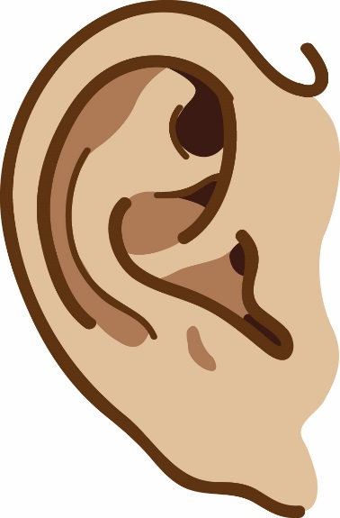
Communicating in Scientific Ways
Sharing ideas helps scientists develop the best possible explanations for things they investigate.
Let’s review what it means to communicate in scientific ways!

Slide 9
Share Your Claim and Evidence
Do differences in the color of desert beetles affect whether they get eaten?
Share your claim and evidence with a partner.
Use the sentence starters from our Communicating in Scientific Ways poster.

Slide 10
Revise Your Claim
Think about whether you want to make any changes to your claim based on your partner’s feedback.
If you want to make any changes, use a different-colored pencil.
You can add something to your claim and evidence, remove something, or make other changes you think will improve your explanations and evidence.

Slide 11
Share Your Revised Claim
What is your revised claim? Does it answer this question?
Do differences in the color of desert beetles affect whether they get eaten?

Slide 12
Share Your Evidence
How did you answer this question?
What data can we use as evidence to support our claim (answer)?

Slide 13
Let’s Summarize!
Our focus question: How can data help us explain why trait variations among desert beetles matter?
What data did we use today to help us explain why trait variations among desert beetles matter?
How did the data from our desert model help us explain why color variations among desert beetles matter?
Based on our data, do trait variations among desert beetles matter? Why or why not?

Slide 14
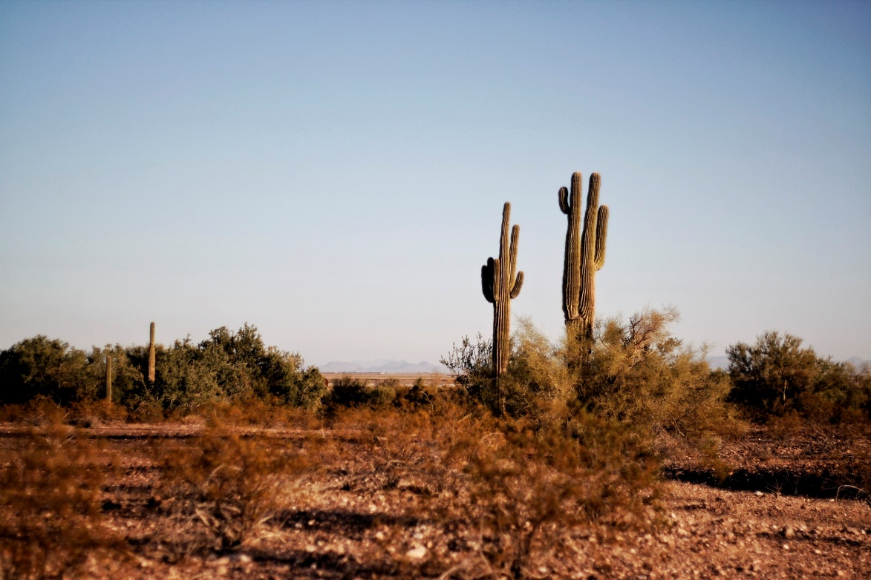
Next Time
What happens if the beetles’ environment changes?
We’ll investigate this next time!
Photo courtesy of Pexels.com

