Slide 1
Variation in Traits Lesson 5a
What Happens If the Beetles’ Environment Changes?

Slide 2
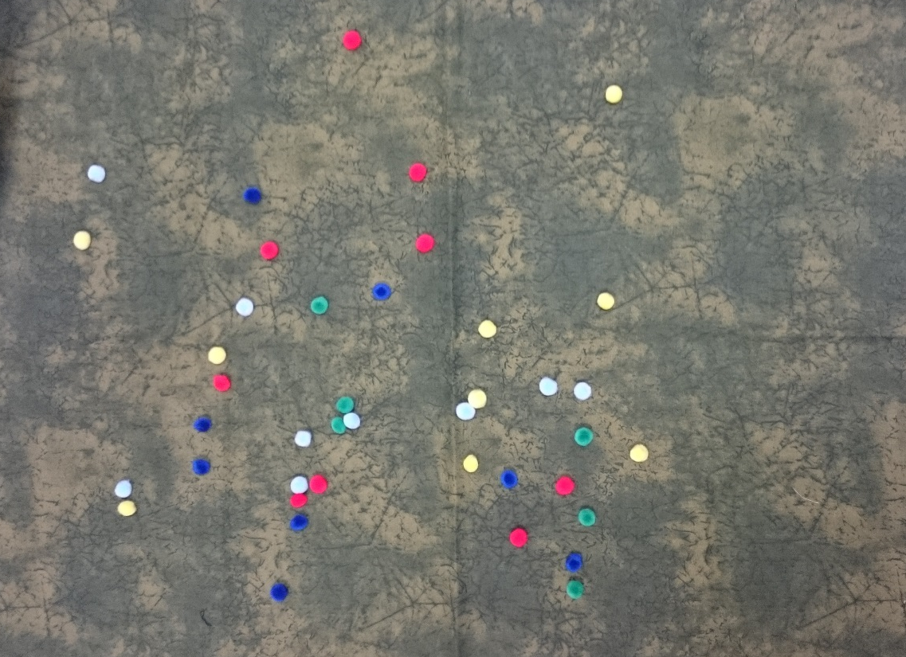
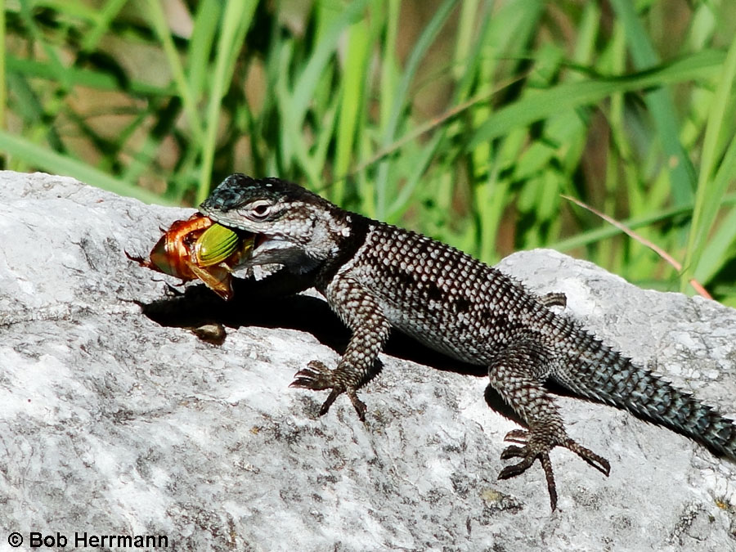
Review: Our Desert Model
Photo courtesy of Cal Poly Pomona
Photograph by Bob Herrmann

Slide 3
Review: Our Claims
What important science ideas did we highlight in our claims and explanations?
What kind of evidence did we use to support our claims?

Slide 4
Today’s Focus Question
What happens if the beetles’ environment changes?

Slide 5
What Is an Environment?
When do we mean when we talk about an environment?
What is an environment?
What did we use to represent the environment in our desert model?
How does the fabric fit with how we just described an environment?

Slide 6
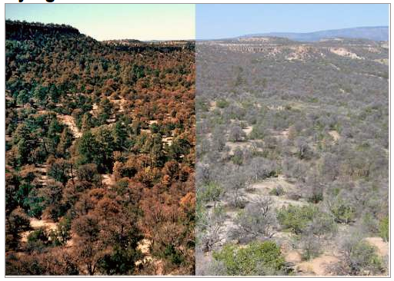
Environments Can Change
Drought before and after
RES.C2.VIT.L5HO.002
Photograph by Craig D. Allen

Slide 7
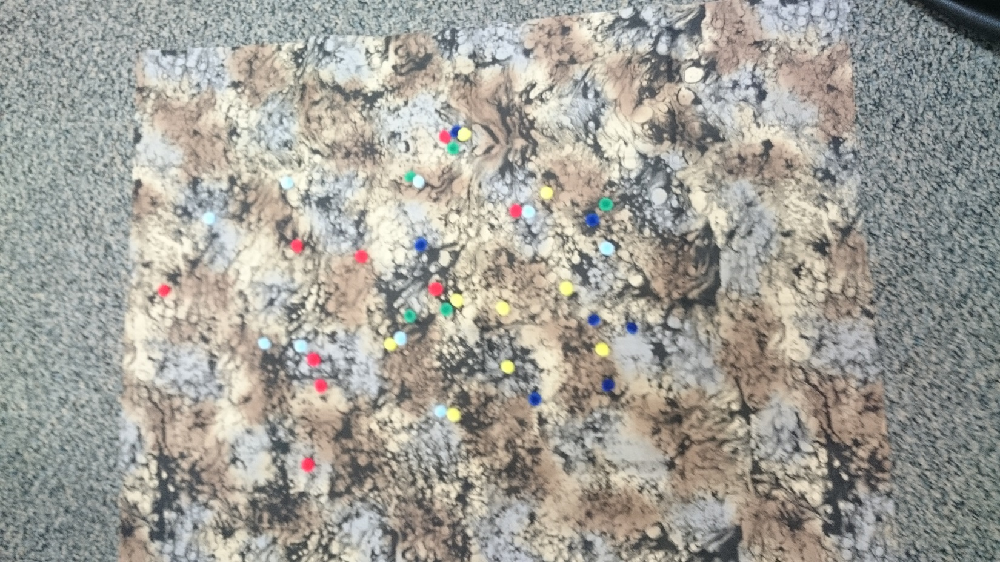
Changes in Our Desert Environment
Both pieces of fabric represent the environment in our desert model. But the new fabric represents a change in the environment.
What do you notice about this new piece of fabric? How is it different from the other fabric? What has changed?
Photo courtesy of Cal Poly Pomona
Photo courtesy of Cal Poly Pomona

Slide 8
What Do You Predict?
What do you think will happen to the beetles in this changed environment?
Which colors of beetles do you think will be eaten more often, and which will survive more often?
Share your predictions with an elbow partner. Then write your predictions and explanations in your notebook using these sentence starters:
I predict that more of the [color] beetles will be eaten because ________.
I predict that more of the [color] beetles will survive because _________.

Slide 9
Role Assignments
Lizards: Your role is to hunt for pom-pom beetles. Keep your eyes closed when you aren’t hunting. Do not peek!
Counters: Your role is to count the number of pom-pom beetles in your assigned color on the fabric and report that number to the recorder.
Recorder: Your role is to record the number of pom-pom beetles on the class data table as the counters report this information.
Observers: Your role is to watch the simulation and record your observations in your notebooks.

Slide 10
Comparing Our Results
Look at the data on each of our class data tables. Then compare the results of our first desert simulation with the results of today’s simulation.
Which color of beetle was eaten most often in each simulation?
Which color of beetle was eaten least often in each simulation?
Why do you think the results of the two simulations are different?

Slide 11
How Can Data Help Us?
Lesson 4 focus question: How can data help us explain why trait variations among desert beetles matter?
A related question:
How can data help us explain why trait variations among beetles and changes in the environment affect which beetles are more likely to survive?

Slide 12
Today’s Focus Question
What happens if the beetles’ environment changes?

Slide 13
Let’s Summarize!
Key science ideas:
Living things of the same kind show variation in their traits.
Trait variations help some individuals of the same kind survive longer than others in their environment.
Trait variations that help some individuals survive longer in their environment might not help them survive longer if their environment changes.
Both trait variations and the environment affect which living things of the same kind survive longer than others.

Slide 14
Next Time
Today, we used our desert model to investigate what happens to beetles if their environment changes.
Next time, we’ll investigate whether trait variations help other kinds of living things survive if their environment changes.

