Slide 1
Variation in Traits Lesson 5b
How Do Trait Variations Help Living Things When Their Environment Changes?

Slide 2
Our Focus Question from Last Time
What happens if the beetles’ environment changes?

Slide 3
Key Science Ideas
Living things of the same kind show variation in their traits.
Trait variations help some individuals of the same kind survive longer than others in their environment.
Trait variations that help some individuals survive longer in their environment might not help them survive longer if their environment changes.
Both trait variations and the environment affect which living things of the same kind survive longer than others.

Slide 4
Beetle Traits and Their Environment
Both variations in the color trait of beetles and their environment affected which beetles survived longer.
Some beetles survived longer in the first environment because of their color trait.
When the environment changed, other beetles were more likely to survive because their color blended into the environment better.

Slide 5
Today’s Focus Question
How do trait variations help living things survive if their environment changes?

Slide 6
Review: Changing Environments
Last time, we investigated what happened to the desert beetles when their environment changed.
How did the change in environment affect which beetles survived compared to the beetles that survived in our first simulation?
What did the data show us?

Slide 7
Review: Changing Environments
Drought caused a lack of water that changed the beetles’ environment.
Do you think an environment can change in other ways that affect the survival of living things?

Slide 8
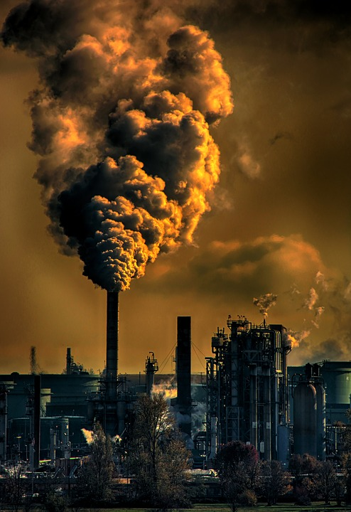
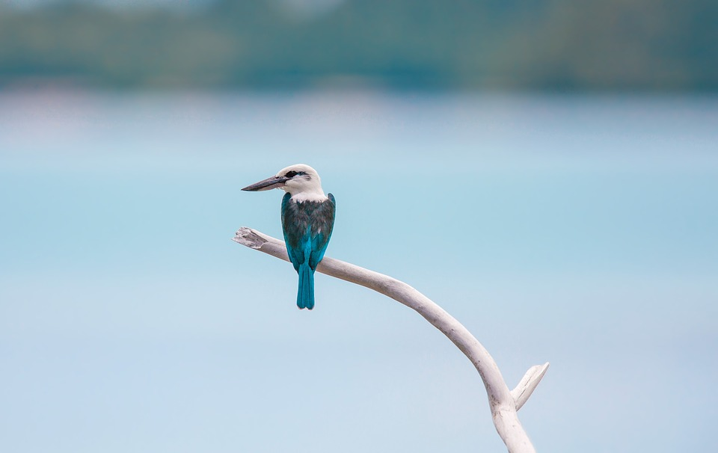
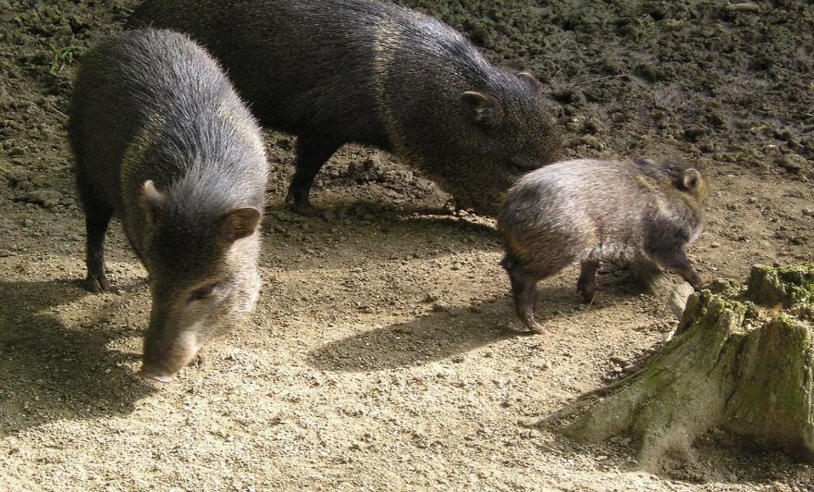
Changing Environments: Three Scenarios
Photo courtesy of Pixabay
Photo courtesy of Pixabay
Photo used with permission from BSCS

Slide 9
Changing Environments: Three Scenarios
Read each scenario in the essay and underline any changes that happen in each environment.
Read each scenario again and circle examples of traits that show variation in living things.

Slide 10
Changing Environments: Three Scenarios
Name a change to the environment that you underlined in the reading.
How did this change affect a living thing in the scenario?
Give an example of a trait variation you circled in the reading.
How did that variation help some living things survive?

Slide 11
Changing Environments: Three Scenarios
A new idea:
If some living things survive long enough, they can produce young (babies).
Why is that important for the survival of living things?

Slide 12
Key Science Ideas
Trait—a feature or characteristic of living things of the same kind
Variation—the differences in a trait among living things of the same kind
Change in the environment—means that the surroundings of living things are no longer the same
Survival and next generation—when living things of the same kind survive long enough in their changed environment to produce young (babies).

Slide 13
Changing Environments Data Table
Scenario | Trait | Variation | Change in Environment | Survival and Next Generation
Example: Beetles from lesson 5a | Color of beetles | Red Yellow Brown Green Black | Drought (lack of water) caused the desert to turn browner. | More brown beetles survived longer, so brown beetles are more likely to have baby beetles.
Scenario 1
Scenario 2
Scenario 3

Slide 14
Today’s Focus Question
How do trait variations help living things survive if their environment changes?

Slide 15
Let’s Summarize!
Four key science ideas:
Traits
Variation in traits
Changes in the environment
Survival and the next generation of living things of the same kind
State in one or two sentences how variations in a trait helped living things in each scenario survive when the environment changed.
Try to use the four key science ideas in your answer.

Slide 16
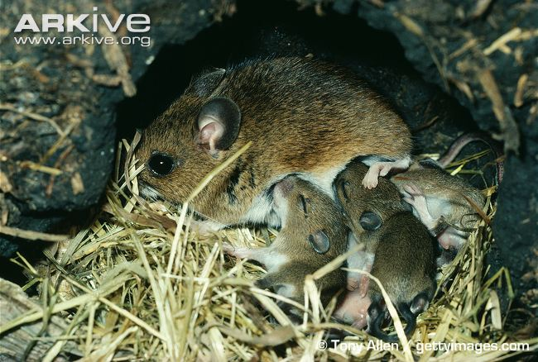
Next Time
Do the babies of living things that survive have the same traits and variations as their parents?
Photo with baby mice
RES.C2.VIT.L5HO.007
Photograph by Tony Allen

