Slide 1
Variation in Traits Lesson 6a
Do Babies of Living Things Have the Same Traits as Their Parents? How Do You Know?

Slide 2
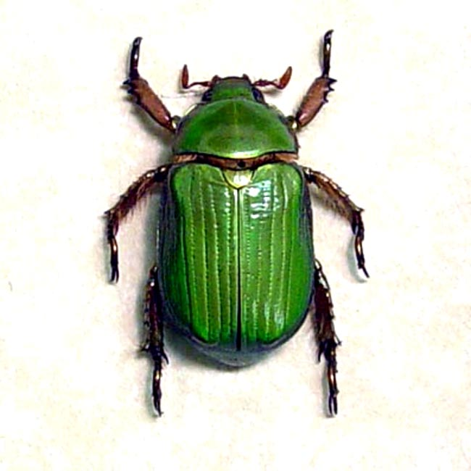
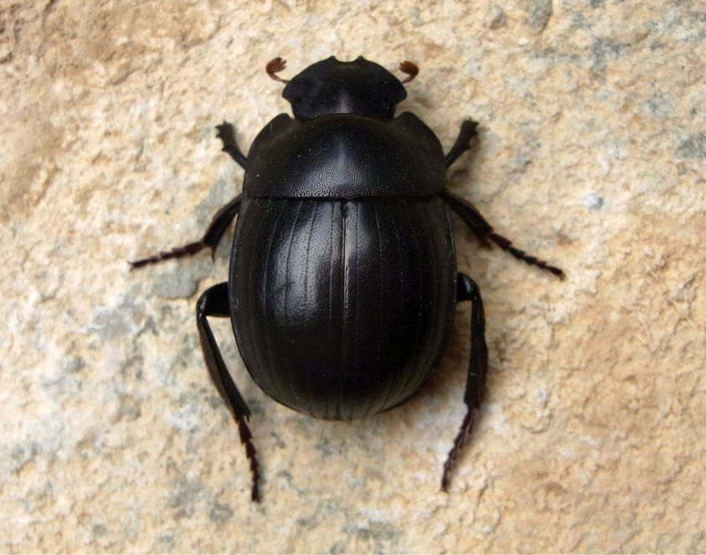
Review: Trait Variations in Desert Beetles
How did variations in the color trait affect which beetles survived in our simulations?
Scarab beetles
RES.C2.VIT.L3HO.003
Photo courtesy of Pixabay.com
Photo used with permission from BSCS
Photo courtesy of Wikimedia.com

Slide 3
Review: A New Science Idea
If living things survive long enough, they can produce young (babies).
Today, we’ll explore what happens when living things have babies.

Slide 4
Today’s Focus Questions
Do babies of living things have the same traits as their parents? How do you know?

Slide 5
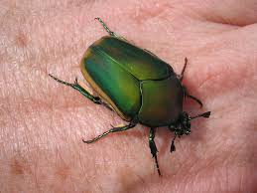
What Do You Predict?
A green mother beetle and a green father beetle have a baby beetle. What color do you think the baby beetle will be?
Mother
Father
Photograph by Dean Johnson
Photo used with permission from BSCS

Slide 6
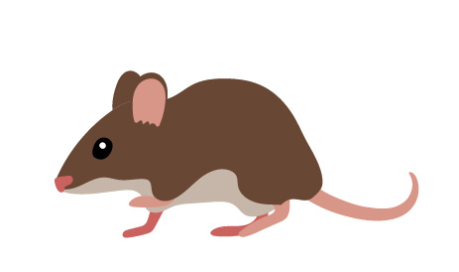
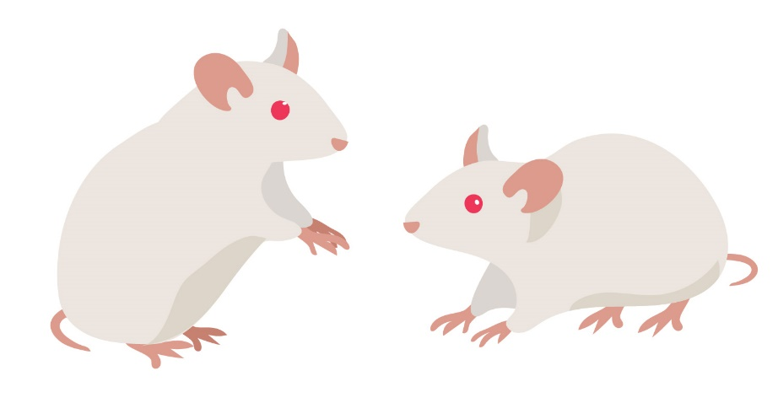
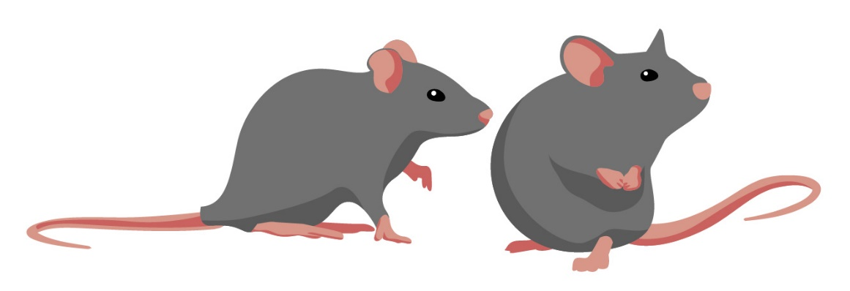
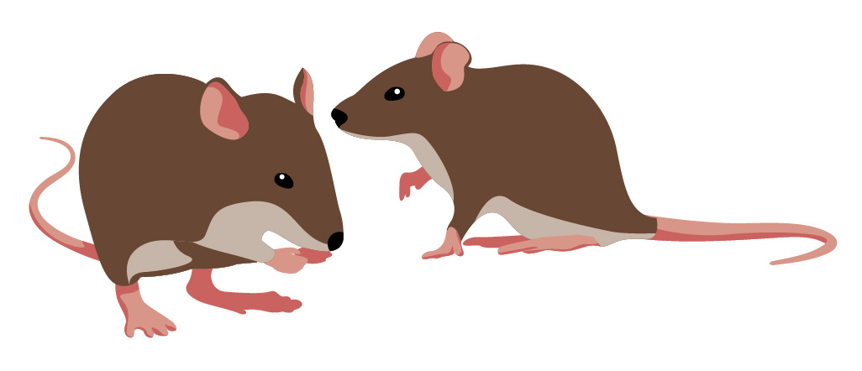
Are You My Parents?
Which pair of adult mice do you think might be the baby mouse’s parents? Why do you think so?
Baby Mouse
Possible Parents

Slide 7
Data Table of Mouse Traits
Adult Mice | Number of Legs | Number of Ears | Fur Color | Length of Tail | Color of Eyes | Color of Nose

Slide 8
Which Mice Are the Parents?
Share your data in your group and discuss which pair of adult mice might be the baby mouse’s parents.
Talk about which of the baby mouse’s traits are the same as the traits of each pair of adult mice, and which are different.
During this discussion, keep our focus questions in mind: Do babies of living things have the same traits as their parents? How do you know?
As a group, come up with a sentence that explains which pair of adult mice might be the baby mouse’s parents and why you think so.

Slide 9
Today’s Focus Questions
Do babies of living things have the same traits as their parents? How do you know?
Baby animals, like the baby mouse, have traits that make them look like their parents, but what about baby plants?
Do you think they have the same traits as their parents?

Slide 10
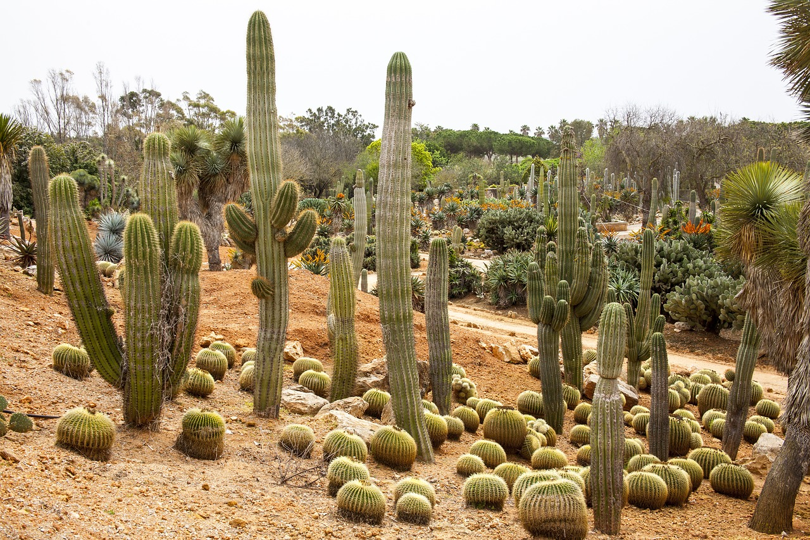
What about Baby Plants?
If two adult cacti have a baby, what traits do you think the baby cactus might have?
Draw a picture of the baby cactus and label the traits you think are the same as the parents’ traits.
Picture of two cacti
RES.C2.VIT.L6HO.007
Photo courtesy of Pixabay.com

Slide 11
Next Time
Today, we investigated whether babies of living things have the same traits as their parents.
The data we collected showed that the baby mouse shared most of its traits with the pair of brown mice we think are its parents.
Next time, we’ll think about why babies of living things have traits that are similar to, but not exactly like, their parents’ traits.

