Slide 1
Variation in Traits Lesson 6b
Do Babies of Living Things Have the Same Traits as Their Parents? How Do You Know?

Slide 2
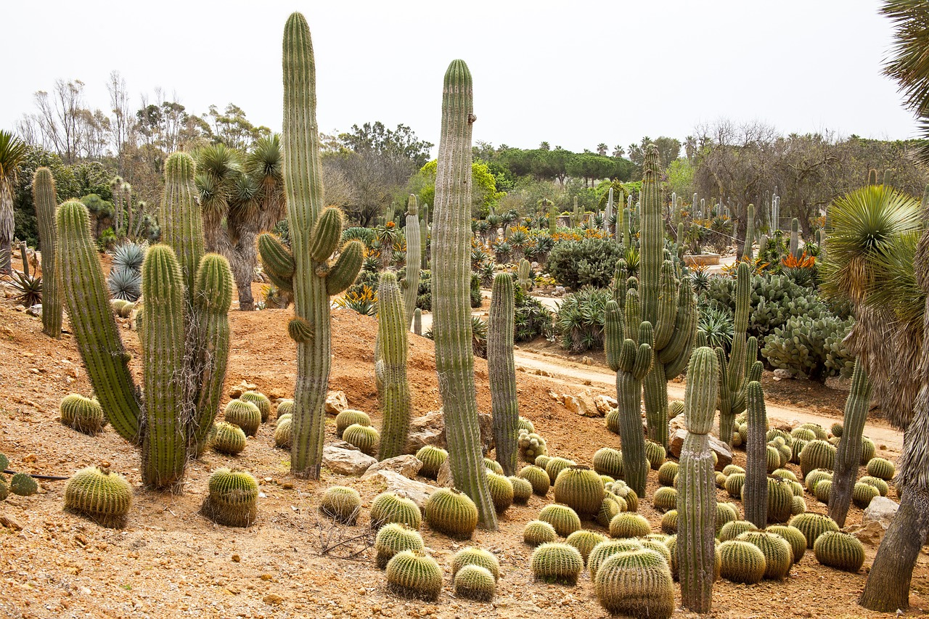
Review: Parent and Baby Cacti
Do baby plants have the same traits as their parents?
Picture of two cacti
RES.C2.VIT.L6HO.007
Photo courtesy of Pixabay.com

Slide 3
Today’s Focus Questions
Do babies of living things have the same traits as their parents? How do you know?

Slide 4
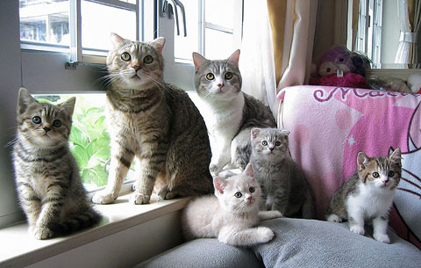
Parents and Their Offspring
Photograph by Yukari Ryu

Slide 5
True or False?
Statement 1:
The babies of living things have traits exactly like their parents’ traits.

Slide 6
True or False?
Statement 2:
The babies of living things don’t have any of their parents’ traits.

Slide 7
True or False?
Statement 3:
The babies of living things have some traits that are like their parents’ traits and some traits that are different from their parents’ traits.

Slide 8
Traits of Parents and Their Offspring
Look at the list of things you noticed about the parents and babies in the photograph.
Share with a partner what you noticed about the parents.
Then list two or three traits of the parent animals on your table (under the “Parents” column).
Share with a partner what you noticed about the babies (offspring).
Then list two or three traits of the baby animals on your table (under the “Offspring (Babies)” column).
Compare the parents’ traits with the babies’ traits. Then draw a line connecting any traits of the babies that match the traits of one or both parents.

Slide 9
Parents and Their Offspring
Photograph by Yukari Ryu

Slide 10
True or False?
Statement 1: The babies of living things have traits exactly like their parents’ traits.
Statement 2: The babies of living things don’t have any of their parents’ traits.
Statement 3: The babies of living things have some traits that are like their parents’ traits and some traits that are different from their parents’ traits.

Slide 11
Statement 3
The babies of living things have some traits that are like their parents’ traits and some traits that are different from their parents’ traits.
How do you know this statement is true? What is your evidence from the photograph?
Photograph by Yukari Ryu

Slide 12
Key Science Ideas
The babies of living things get many traits from their parents.
Traits are passed to offspring (babies) through information in the bodies of living things. This process is called inheritance.
The traits that parents give their offspring are called inherited traits.

Slide 13
Inherited Traits and Variation
What are the inherited traits of the kittens?
Which traits of the kittens are variations of the parents’ traits?
Photograph by Yukari Ryu

Slide 14
Let’s Summarize!
Our focus questions: Do babies of living things have the same traits as their parents? How do you know?
Answer these questions in your science notebook using evidence from today’s investigation of the cats and kittens to support your ideas.
Word list:
Trait
Variation
Inherited
Babies/offspring

Slide 15
Next Time
Lesson 7:
New Situation
Variations affect which living things survive.
Environments can change.
Babies inherit traits from their parents.

