Slide 1
Variation in Traits Lesson 7a
When Mice Survive Long Enough to Have Babies, What Will the Next Generation Look Like?

Slide 2
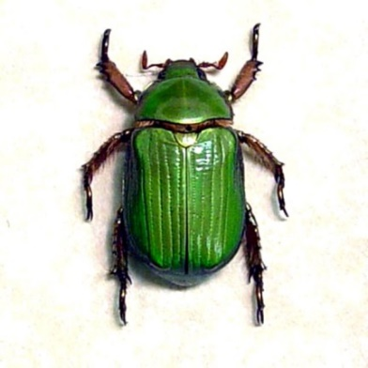
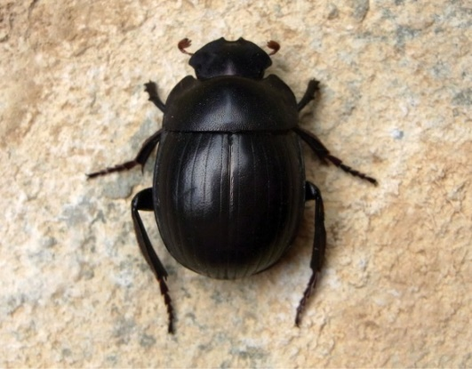
Review: What Affects Survival in Beetles?
Variation
Traits
Environment
Survival
Photo used with permission from BSCS
Photo courtesy of Pixabay.com
Photo courtesy of Wikimedia.com

Slide 3
Today’s Focus Question
When mice survive long enough to have babies, what will the next generation look like?

Slide 4
Traits and Trait Variation in Mice
What do you know about mice and their environment?

Slide 5
Traits and Trait Variation in Mice
Do you think variations in the fur-color trait of mice might give them a better chance of surviving in their environment?

Slide 6
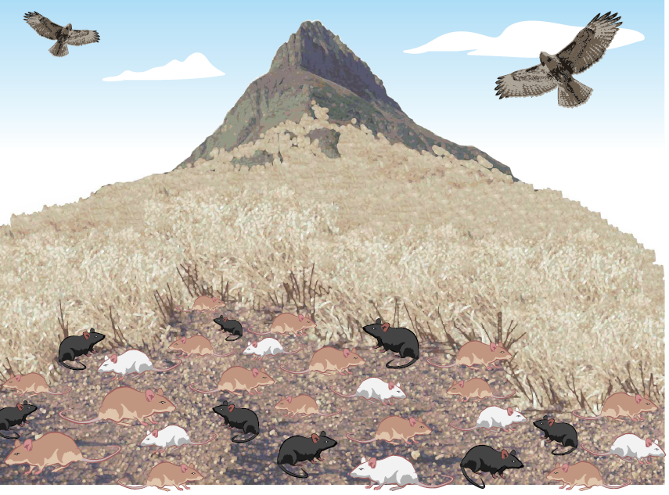
A Story about Mice in a Field: Part 1
Which color variation (tan, white, or black) will help the mice survive best in this environment?

Slide 7
Fur Color in Baby Mice
If two mice with tan fur have a baby, what color fur do you think the baby will have?
Mother
Father
Baby?

Slide 8
Key Science Ideas
The mice show variation in the fur-color trait. Some mice are tan, some are white, and some are black.
Some variations in fur color help the mice blend into their environment better so the hawk can’t see them as easily. These trait variations give the mice a better chance of surviving.
The mice that survive long enough can have baby mice.
The baby mice will have the same color variation as their parents.

Slide 9
Cartoon Summary of Mice in a Field Environment
Box 1: The fur colors of mice in this field environment are ________, ________, and __________. | Box 2: The hawks eat more of the mice that have these fur colors : __________ and ___________. In the picture below, draw an X over eight mice that the hawks are most likely to eat. Write the fur colors of those mice in the blanks above.

Slide 10
Let’s Summarize!
Our focus question: When mice survive long enough to have babies, what will the next generation look like?
What are the variations in the fur-color trait of the mice?
Which colors of mice do the hawks eat more of?
Which fur-color trait do most of the surviving mice have?
Which fur-color trait will the next generation of mice be more likely to have?

Slide 11
Let’s Summarize!
Our focus question: When mice survive long enough to have babies, what will the next generation look like?
Use this sentence starter to answer the focus question in your science notebook:
When mice survive long enough in a field environment to have babies, the next generation will look like ____________.
Make sure to include key science ideas from our cartoon summary in your explanation.

Slide 12
Next Time
What do you think might happen if the mice’s environment changes?
Will the mice with tan-colored fur still be more likely to survive long enough to have babies?
Stay tuned for part 2 of our story!

