Slide 1
Variation in Traits Lesson 7b
When Mice Survive Long Enough to Have Babies, What Will the Next Generation Look Like?

Slide 2
Our Unit Central Question
Do all of the mice living in the same environment, such as a field or forest, have an equal chance of surviving?

Slide 3
Review: What Affects Survival in Mice?
Variation
Traits
Environment
Survival
Babies or Young (Next Generation)

Slide 4
Today’s Focus Question
When mice survive long enough to have babies, what will the next generation look like?

Slide 5
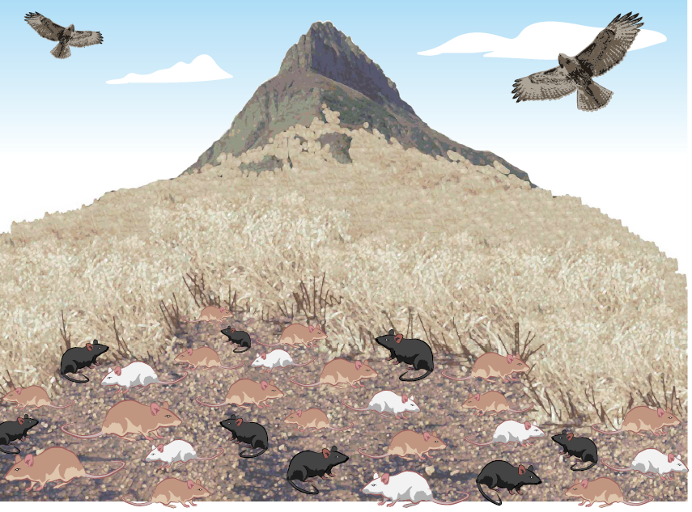
Mice in a Field: Part 1

Slide 6
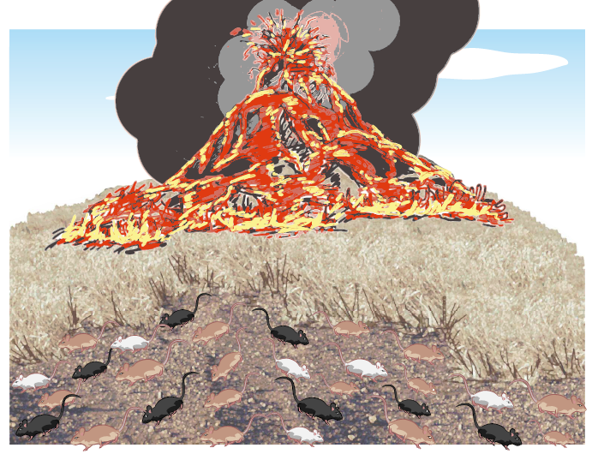
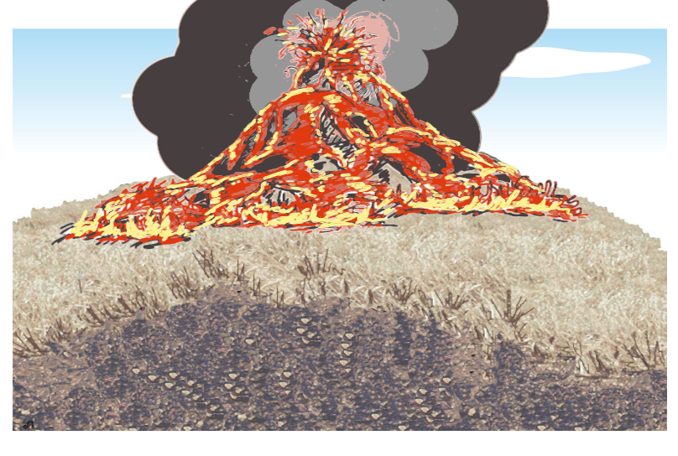
The Environment Changed!

Slide 7
The Mice Returned!

Slide 8
What Do You Predict?
Which mice do you think are more likely to survive in the changed environment? Why do you think so?
Turn and Talk: Discuss these questions with an elbow partner. Then write your predictions and reasoning in your science notebook using this sentence starter:
I predict the [tan/white/black] mice are more likely to survive in the changed environment because ____________.

Slide 9
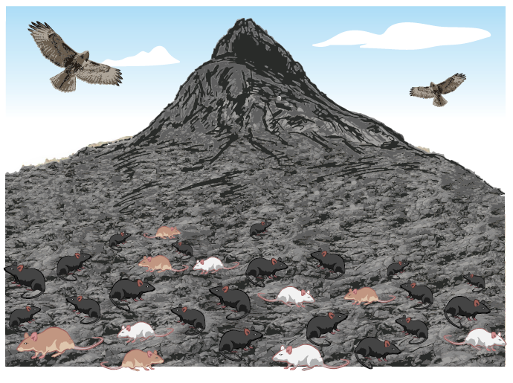
Cartoon Summary of Mice in a Lava Environment
Box 1: The fur colors of mice in new lava environment are ________, ________, and __________. | Box 2: The hawks eat more of the mice that have these fur colors : __________ and ___________. In the picture below, draw an X over eight mice that the hawks are most likely to eat. Write the fur colors of those mice in the blanks above.

Slide 10
Your Predictions
I predict the [tan/white/black] mice are more likely to survive in the changed environment because ____________.

Slide 11
Share Your Cartoon Summaries
Box 1: The fur colors of mice in new lava environment are ________, ________, and __________. | Box 2: The hawks eat more of the mice that have these fur colors : __________ and ___________. In the picture below, draw an X over eight mice that the hawks are most likely to eat. Write the fur colors of those mice in the blanks above.

Slide 12
Today’s Focus Question
When mice survive long enough to have babies, what will the next generation look like?
Answer this question in your science notebook using this sentence starter:
I think the next generation of mice will have [tan/white/black] fur because _____________.
Use science words from our word wall and evidence from the cartoon summary in your explanation.

Slide 13
Our Unit Central Question
Do all of the mice living in the same environment, such as a field or forest, have an equal chance of surviving?

Slide 14
Before the Volcano Erupted
Talk about these questions with an elbow partner:
Which variation in the fur-color trait gave the mice more of a survival advantage before the volcano erupted?
Which color of mice (tan, white, or black) do you think would become more common over time if the environment stayed the same? Why do you think so?

Slide 15
After the Volcano Erupted
Talk about these questions with an elbow partner:
Which variation in the fur-color trait gave the mice more of a survival advantage after the volcano erupted?
Which color of mice (tan, white, or black) do you think would become more common over time in the lava environment ? Why do you think so?

Slide 16
Key Science Ideas
Variation in traits and the environment affect which living things of the same kind survive long enough to produce young (babies).
When the environment changes, living things with trait variations that blend into the environment have a better chance of surviving.
Living things of the same kind that survive pass on their trait variations to the next generation (the babies). Over time, these variations become more common.

Slide 17
Let’s Summarize!
Variation
Traits
Environment
Survival
Babies or Young (Next Generation)

