Slide 1
Variation in Traits Pre-Post Test
3rd Grade

Slide 2
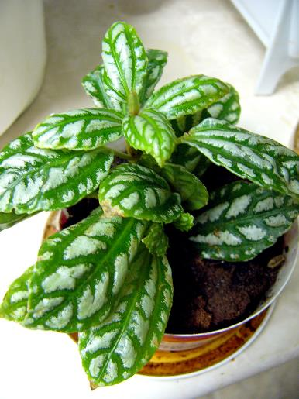
Plants
Photo courtesy of Wikimedia.org

Slide 3
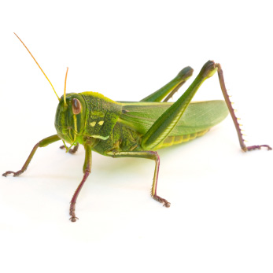
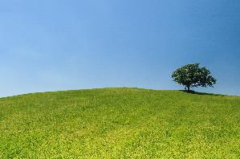
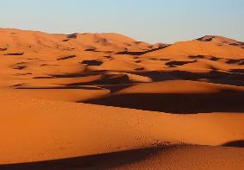
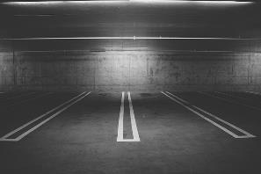
Grasshopper
Photo courtesy of Pngimg.com
Meadow
Desert
Parking Lot
Photo courtesy of Pexels.com
Photo courtesy of Pixabay.com
Photo courtesy of Pixabay.com

Slide 4
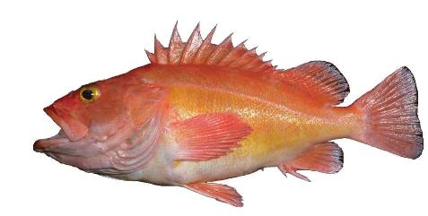
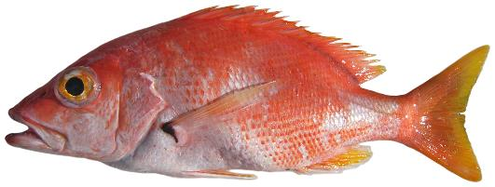
Long-spined Fish
Photo courtesy of Wikimedia.org
Short-spined Fish
Photo courtesy of Wikimedia.org

