Slide 1
Earth’s changing surface Lesson 1a
Does the Surface of Earth Look the Same Everywhere? In What Ways Does Earth’s Surface Look Different or the Same in Different Places?

Slide 2
Earth’s Surface
What do you already know about the surface of Earth?
How would you describe the landscape where we live?
What shapes and features do you notice when you look outside?

Slide 3
Unit Central Questions
Why isn’t all of Earth’s surface flat? What causes the surface to look different in different places?

Slide 4
Today’s Focus Questions
Does the surface of Earth look the same everywhere? In what ways does Earth’s surface look different or the same in different places?

Slide 5
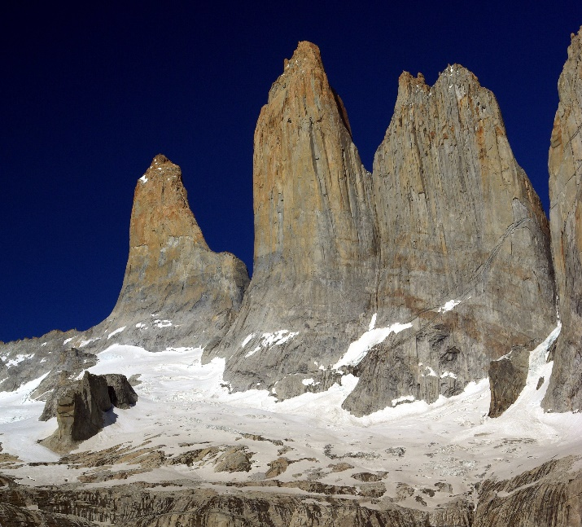
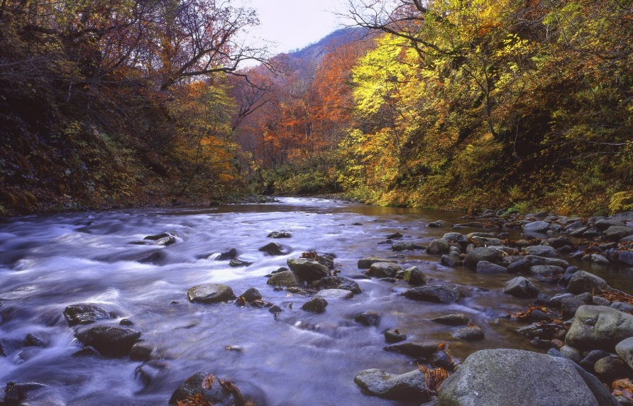
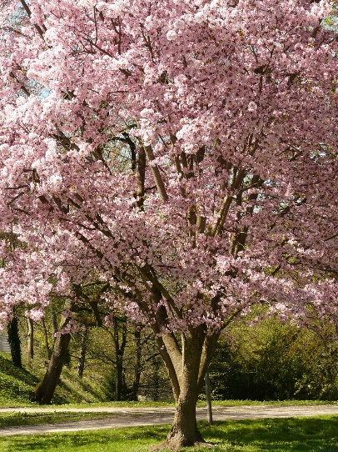
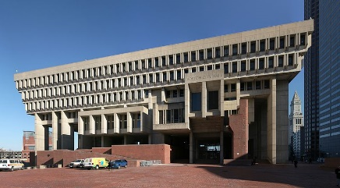
Can You Identify the Landforms?
Photo courtesy of Pxhere.com
Photograph by Steve Bennett / Wikipedia Commons
Photograph by Daniel Schwen / Wikipedia Commons
Photo courtesy of Pixabay.com

Slide 6
Let’s Brainstorm!
How many different kinds of landforms on Earth’s surface can you name?
Hint: Think about the natural parts of Earth’s surface, not living things or the things people make.

Slide 7
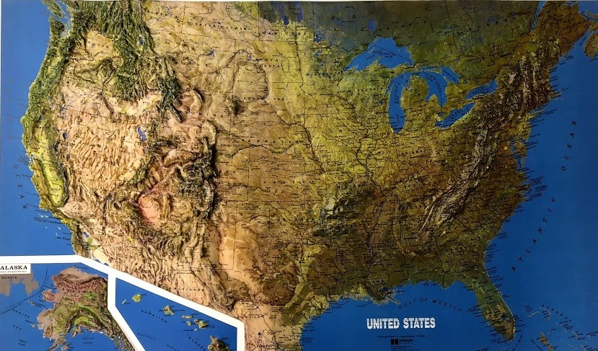
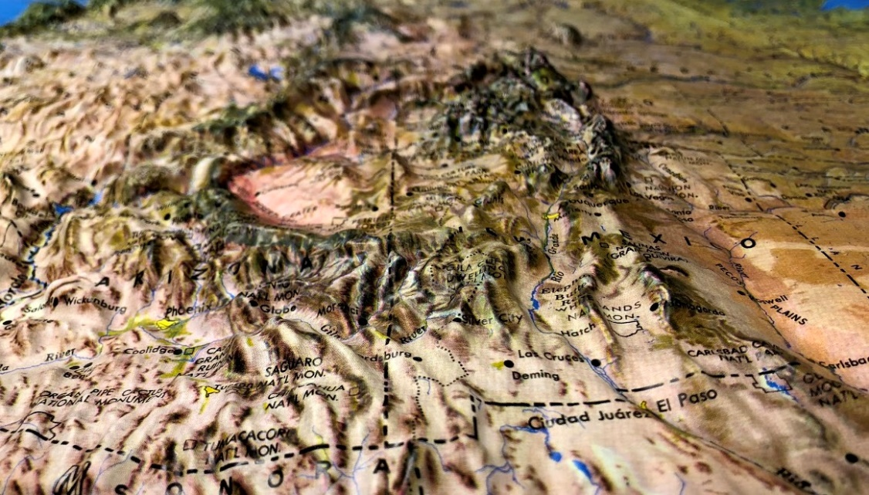
Relief Maps of the United States
Photo courtesy of Cal Poly Pomona
Photo courtesy of Cal Poly Pomona

Slide 8
Investigation: Identifying Landforms
How many different landforms can you find on this relief map of the United States?
To find the landforms, make sure to LOOK AT and TOUCH the map!
Photo courtesy of Cal Poly Pomona

Slide 9
Investigation: Identifying Landforms
What different landforms did you find on the relief map?
What new landforms can we add to our list?

Slide 10
Identifying Landforms and Their Locations
What do you notice about the locations of specific landforms in the United States?
Where do you find mountains?
Where do you find rivers and lakes?
Use the directions north, south, east, and west to describe where landforms are located.

Slide 11
Let’s Summarize!
Our focus questions:
Does the surface of Earth look the same everywhere?
In what ways does Earth’s surface look different or the same in different places?

Slide 12
Key Science Ideas
Earth has a variety of landforms, such as mountains, hills, valleys, canyons, plains, rivers, and lakes.
The landforms on Earth’s surface aren’t the same everywhere.

Slide 13
Landforms in the United States
During our map investigation, we observed these differences and similarities in landforms across the country:
Some areas are low (valleys, plains), and some areas are high (mountains).
Many place across the country are flat.
There are many lakes in the northern part of the country.
Many rivers run from north to south, but some go from west to east.

Slide 14
Next Time
Do you think the surface of Earth has always looked the way it does today?
Do you think it will always look this way?
Let’s find out!

