Slide 1
Earth’s changing surface Lesson 1b
In What Ways Does Earth’s Surface Look Different or the Same in Different Places? Do You Think the Surface of Earth Changes. Why Do you Think That?

Slide 2
Review: Landforms on Earth’s Surface
What landforms did we list on our class chart last time?
What else did we notice about landforms from our relief map of the United States?

Slide 3
Review: Landforms on Earth’s Surface
Key science ideas about landforms:
There are many different kinds of landforms on Earth’s surface.
Landforms aren’t the same everywhere on Earth.
Relief maps can help us identify the differences and similarities in landforms in different places.

Slide 4
Today’s Focus Questions
In what ways does Earth’s surface look different or the same in different places?
Do you think the surface of Earth changes? Why do you think that?

Slide 5
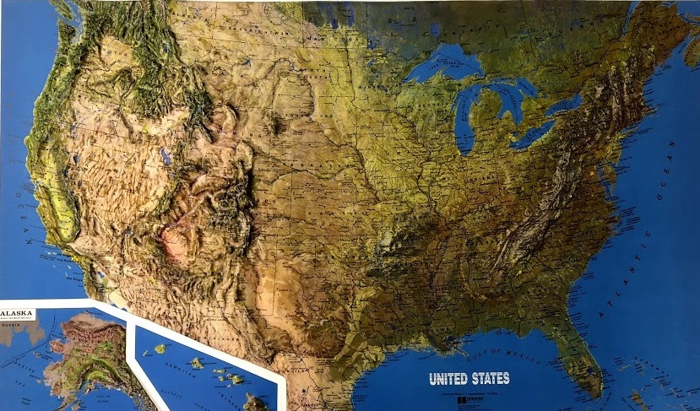
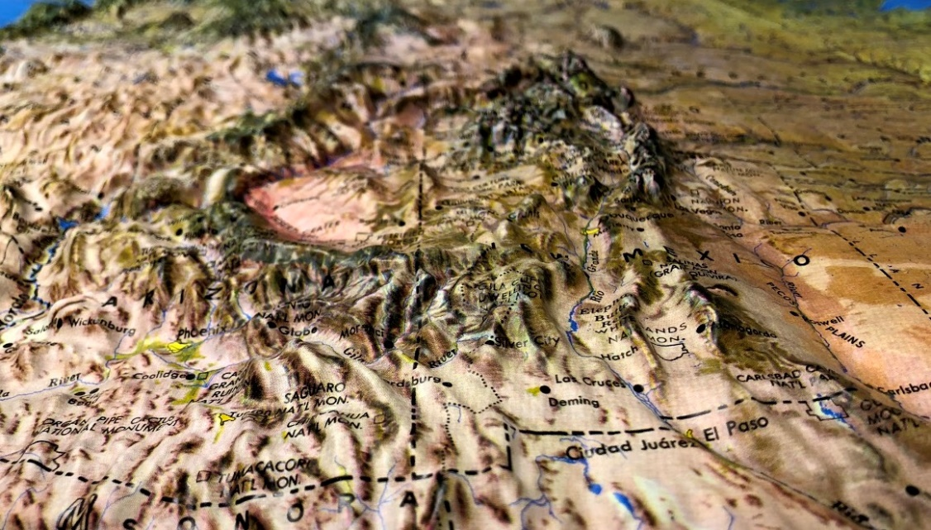
Investigation: Identifying Landform Patterns
Photo courtesy of Cal Poly Pomona
Photo courtesy of Cal Poly Pomona

Slide 6
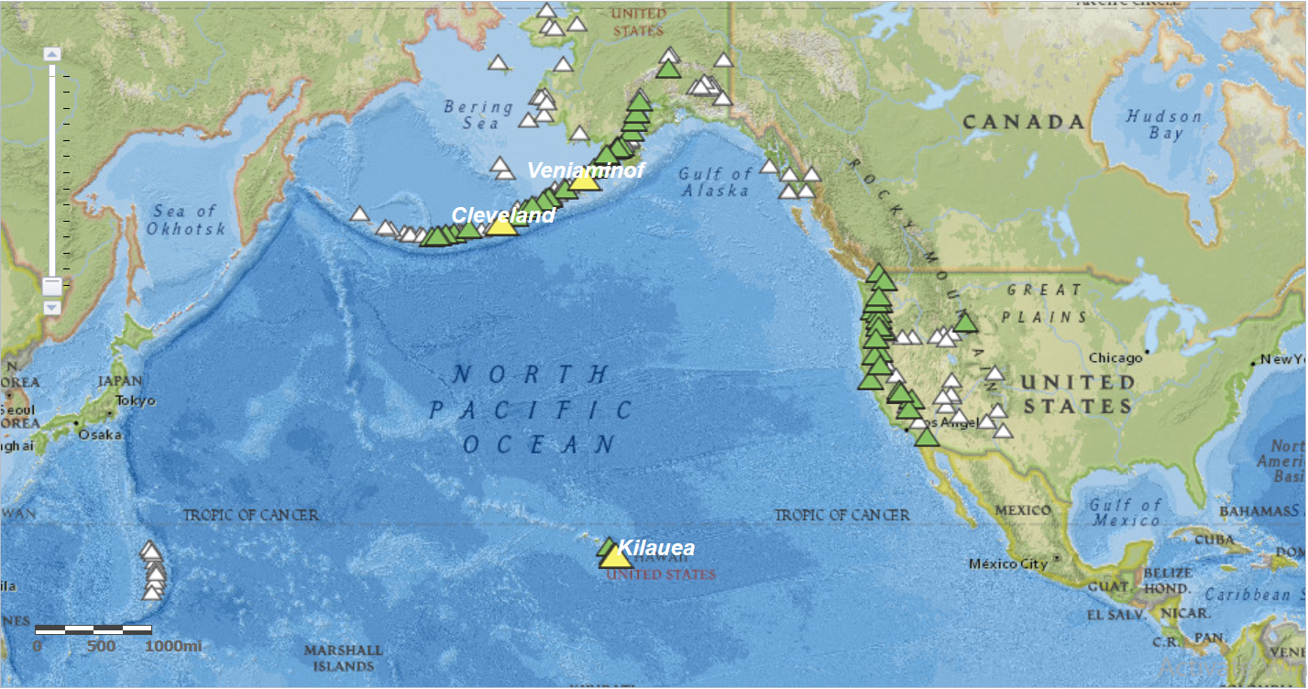
Investigation: Identifying Landform Patterns
Photo courtesy of USGS
Notes:
Source: US Geologic survey https://www.americangeosciences.org/critical-issues/maps/volcano-activity-alerts

Slide 7
Investigation: Identifying Landform Patterns
Study the relief map in your small groups:
What landform patterns do you notice?
Where are different landforms located on the map?
Try to find at least three landform patterns on the map.
Each time you identify a pattern, describe it in your science notebook. Make sure to use complete sentences!

Slide 8
What Patterns Did You Identify?
Share the patterns you observed on the relief map.
As your classmates share, listen carefully to their ideas and be prepared to agree, disagree, or add an idea. Make sure to use evidence from the map!
Patterns We Noticed | What We Wonder About

Slide 9
Does Earth’s Surface Change?
Do you think the surface of Earth changes? Why do you think that?
Think about these questions:
Do you think landforms on Earth’s surface have always looked the way they do now? Why?
Do you think these landforms will change in the future? Why?

Slide 10
Does Earth’s Surface Change?
In your science notebook, write a few ideas for answering these questions. Make sure to include your reasoning!
Do you think landforms on Earth’s surface have always looked the way they do now? Why?
Do you think these landforms will change in the future? Why?
Be ready to share your ideas with the class.

Slide 11
Does Earth’s Surface Change?
Share your ideas for answering this question.
Listen carefully to the ideas of others. Do you agree, disagree, or have something to add?
Remember to communicate in scientific ways!

Slide 12
Let’s Summarize!
Today’s focus questions:
In what ways does Earth’s surface look different or the same in different places?
Do you think the surface of Earth changes? Why do you think that?
Turn and Talk: Pair up with an elbow partner and use what you’ve learned so far about Earth’s surface and landform patterns to answer these questions.
Make sure to include your observations and evidence from the relief map. And be prepared to share your ideas with the class.

Slide 13
Next Time
Today we identified landform patterns on a relief map of the United States. These patterns offer more evidence that Earth’s surface isn’t the same everywhere.
We also thought about whether Earth’s surface changes over time. We’ll continue this investigation in our next lesson!

