Slide 1
Earth’s changing surface lesson 2b
What Happens to Earth’s Surface That Causes Mountains to Form?

Slide 2
Review: Changes to Earth’s Surface
What have we learned so far about the ways Earth’s surface changes over time?

Slide 3
Today’s Focus Question
What happens to Earth’s surface that causes mountains to form.

Slide 4
What Causes Mountains to Form?
Do you think tectonic plates have anything to do with mountains forming on Earth’s surface? Why or why not?

Slide 5
Key Science Ideas
Earth’s crust is very thin.
Earth’s crust is made up of interlocking tectonic plates that fit together like puzzle pieces.
Two new ideas:
Earth’s tectonic plates move.
There is a thick layer of hot, slowly moving rock inside Earth.

Slide 6
First New Science Idea
Earth’s tectonic plates move.
That means there are moving plates underneath the ground we’re standing on! How is that possible?
Using your scientific imaginations, see if you can come up with some ideas about how Earth’s tectonic plates could be moving underneath the ground we’re standing. What could make them move?

Slide 7
Second New Science Idea
There is a thick layer of hot, slowly moving rock inside Earth.
Scientists think that this underlying layer of hot, slow-moving rock causes Earth’s tectonic plates to move!
How could this happen?
It’s hard to imagine broken sections of an eggshell moving, so we need another model to help us understand how this works!

Slide 8
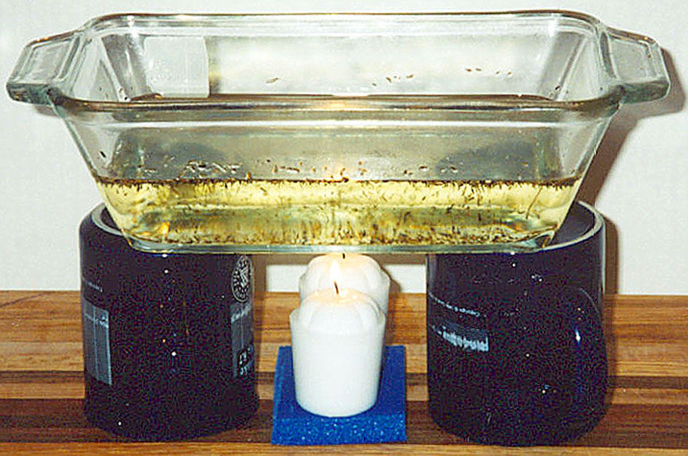
Investigation: Earth’s Moving Plates
Photograph by L. Braile
We’ll use this model to investigate what makes Earth’s tectonic plates move.

Slide 9
Investigation: Earth’s Moving Plates
What do these parts of our model represent?
The pieces of wood
The vegetable oil
The heat source
What do you observe about this system?
Do you think the heat will cause any changes to the plates? If so, what do you think will change?

Slide 10
Investigation: Earth’s Moving Plates
As the system heats up, observe what happens.
What patterns of movement do you notice? (Observe the baking dish from the top and from the sides.)
Where do you observe upward flow in the oil? What about sideways flow? Downward flow?
What’s happening to the plates?
Remember: The oil represents hot, slow-moving rock inside Earth!

Slide 11
Investigation: Earth’s Moving Plates
In your science notebooks:
Draw a picture of what you observed when you looked at the baking dish from the side.
Label your picture.
Write a description telling how this model is like what happens to Earth’s crust. Make sure to use complete sentences!

Slide 12
Investigation: Earth’s Moving Plates
Listen carefully as your classmates share their ideas.
Do you agree, disagree, or have something to add?
Do you have any questions about the model or about any of your classmates’ ideas?

Slide 13
Let’s Summarize!
Focus question: What happens to Earth’s surface that causes mountains to form?
What did we learn from the following activities that can help us answer this question?
The pictures of volcanoes
The hard-boiled egg and cracked eggshell
The model using heated vegetable oil
Hint: What did we learn about Earth’s crust?

Slide 14
Your Ideas about Mountain Building
Do you think the movement of Earth’s tectonic plates has anything to do with building mountains? Why or why not?
Sentence starters:
Yes, I think plate movement causes mountains to form because _________.
No, I don’t think plate movement causes mountains to form because _________.

Slide 15
What We’ve Discovered So Far
Volcanic eruptions can build mountains.
Earth’s crust is very thin and is divided into tectonic plates that fit together like puzzle pieces.
A thick layer of hot, slow-moving rock inside Earth causes these crustal plates to move.

Slide 16
Next Time
Are Earth’s tectonic plates involved in building mountains? If so, how?
That’s what we’ll investigate next time!

