Slide 1
Earth’s changing surface Lesson 4a
What Evidence Can We Find to Support the Idea That Mountains Form When Earth’s Crustal Plates Collide?

Slide 2
Last Time
Think about what we’ve discovered so far about Earth’s plates from our models and investigations.
What are your current ideas about what happens when Earth’s plates collide? What’s your evidence?
How do we know for sure that plate collisions cause mountains to form?

Slide 3
Today’s Focus Question
What evidence can we find to support the idea that mountains form when Earth’s crustal plates collide?

Slide 4
Earth’s Crustal Plates
What different models of Earth’s crustal (tectonic) plates have we explored so far?
What did we learn about Earth’s surface from these models?
What evidence did we find from using these models to support our ideas about Earth’s plates?

Slide 5
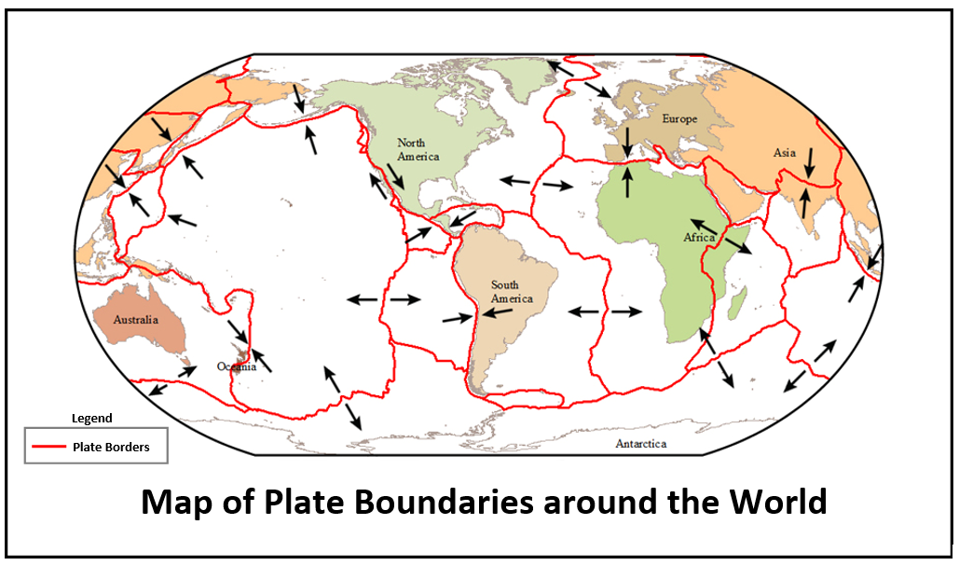
Investigation: Map of Plate Boundaries
What do you notice about this map?
Courtesy of BSCS

Slide 6
Investigation: Map of Plate Boundaries
How do you think the lines on the map relate to our cracked eggshell from an earlier lesson?
How would you describe the plates on the map?
Are they large or small?
Do they touch each other?
Are the borders even or uneven?
What else do you notice?
How many plates do you see on the map?

Slide 7
Investigation: Map of Plate Boundaries
Study the map with a partner and share your observations and ideas about the plates and arrows. Try to make sense of what you see.
What else do you notice about the plates and the arrows?
What do you think it means?
What evidence does the map provide that might support our ideas about Earth’s plates and mountain building?

Slide 8
Investigation: Map of Plate Boundaries
Look at the map again and predict where you think plates might collide.
Draw a circle around those locations on your maps and write your ideas in your science notebooks using the sentence starters below.
Sentence starters:
I think Earth’s plates might collide in these places: ___________________________.
My evidence is _____________________.

Slide 9
Investigation: Map of Plate Boundaries
What landforms might you see at the places where Earth’s plates collide? Why do you think that?
Try to imagine two gigantic sections of Earth’s crust colliding.
Do you think it’s really possible for Earth’s crust (made up of a thin layer of cold, hard rock) to bend and break and get pushed up into a mountain range?

Slide 10
Let’s Summarize!
In the last lesson, you completed this sentence in your science notebooks: I think mountains are formed by ________.
Read the sentence you wrote last time.
Think about today’s focus question: What evidence can we find to support the idea that mountains form when Earth’s crustal plates collide?
Add to or change your sentence based on evidence from today’s map investigation.

Slide 11
Next Time
Today we found some evidence to support the idea that Earth’s crustal plates collide at plate boundaries.
But are these plate collisions involved in mountain building?
In our next lesson, we’ll examine other maps to see if we can gather more evidence to support this idea.

