Slide 1
earth’s changing surface Lesson 7b
How Can We Use What We’ve Learned about Earth’s Changing Surface to Answer the Unit Central Questions?

Slide 2
Review: Earth’s Changing Surface
What processes build up Earth’s surface?
What processes wear down Earth’s surface?
Now let’s apply what we know to answer our unit central questions!

Slide 3
Our Unit Central Questions
Why isn’t all of Earth’s surface flat? What causes the surface to look different in different places?

Slide 4
Today’s Focus Question
How can we use what we’ve learned about Earth’s changing surface to answer the unit central questions?

Slide 5
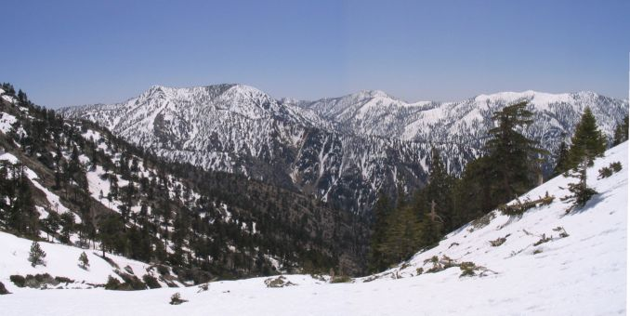
The San Gabriel Mountains
Photo courtesy of Wikimedia.org

Slide 6
Investigation: Use and Apply What You Know
In your small groups, use science ideas about Earth’s changing surface to answer these questions:
How do you think the San Gabriel Mountains were formed? What is your evidence?
Do you think the San Gabriel Mountains today are being built up and growing taller, or do you think they’re wearing down and getting smaller? What is your evidence?
Make sure to support your answers with evidence from the maps!

Slide 7
Investigation: Use and Apply What You Know
Complete these sentences in your science notebook:
The San Gabriel Mountains were formed by __________. My evidence is _______.
The San Gabriel Mountains are [building up/wearing down]. My evidence is _____.
Use evidence from the maps to support your answers and include drawings to illustrate your ideas.

Slide 8
Investigation: Use and Apply What You Know
Share your sentences and evidence.
The San Gabriel Mountains were formed by __________. My evidence is _______.
The San Gabriel Mountains are [building up/wearing down]. My evidence is _____.
Support your answers with evidence from the maps. You can also display your drawings to illustrate your ideas.

Slide 9
Challenge Question
Is it possible for landforms to build up and wear down at the same time?

Slide 10
Let’s Summarize!
Unit central questions:
Why isn’t all of Earth’s surface flat? What causes the surface to look different in different places?
Review the ideas you’ve written in your science notebook throughout this unit on Earth’s changing surface.
Small groups: Discuss which ideas help you craft a complete answer to the unit central questions.
Individuals: Write your best answer to these questions in your science notebook.

