Slide 1
energy transfer Lesson 2a
What Causes a Moving Object to Have More or Less Motion Energy?

Slide 2
Energy Detectives at Home
What three objects did you find at home that have energy?
What’s your evidence?

Slide 3
Today’s Focus Question
What causes a moving object to have more or less motion energy?

Slide 4
Making a Ramp Plan
Materials:
2 marbles
2 rulers (1 ruler for each ramp)
Blocks of wood (to elevate each ramp)
Discuss in your small group:
How would you set up a ramp to make a marble roll slow?
How would you set up a ramp to make a marble roll fast?

Slide 5
What Did You Observe?
Describe the speed of the marbles.
Describe the ramps these marbles rolled down.
Compare the ramps and marble speed:
The marble on Ramp 1 was [faster/slower] because _____________.
The marble on Ramp 2 was [faster/slower] because _____________.

Slide 6
Key Science Idea
Complete this sentence in your science notebook and draw a box around it:
If an object is moving, it has _______.

Slide 7
Your Predictions
Which marble has the most energy—the faster marble or the slower marble?
Sentence starter:
I predict that the [faster/slower] marble has the most energy because _________.

Slide 8
Investigation: Two Ramps and a Marble
Look at the two ramps on your handout:
Predict the speed of the marble as it rolls down Ramp 1. Record your prediction on your handout (column 1, question 1).
Predict the speed of the marble as it rolls down Ramp 2. Record your prediction on your handout (column 1, question 1).

Slide 9
Investigation: Two Ramps and a Marble
Materials for each group:
1 ruler (for the ramps)
1 marble
Wood blocks (to elevate the ramps)
Small block of Styrofoam (with a groove)
2 pieces of plain white paper
Tape

Slide 10
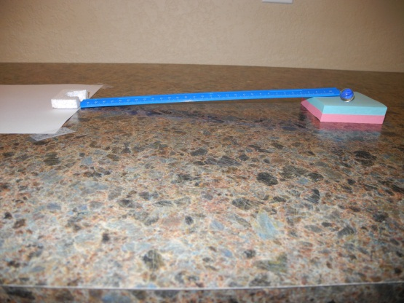
Investigation: Two Ramps and a Marble
Carefully follow the procedure shown on the document reader. Your ramp setup should look something like this.
Photo courtesy of BSCS

Slide 11
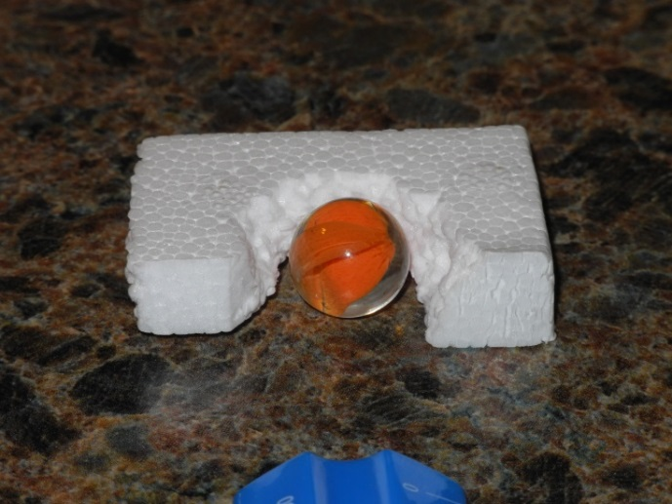
Investigation: Two Ramps and a Marble
Make sure the groove in your Styrofoam block is facing the ramp so the marble will roll into the groove when it reaches the bottom of the ramp.
Photo courtesy of BSCS

Slide 12
Investigation: Two Ramps and a Marble
Complete work on Ramp 1 before you move on to Ramp 2!
1. Speed of the marble: __________ 1. Speed of the marble __________
(faster or slower) (faster or slower)
2. Distance Styrofoam block moved: 2. Distance Styrofoam block moved:
______________________________ ____________________________
(inches or centimeters) (inches or centimeters)
3. Energy of the marble: __________ 3. Energy of the marble: ________
(more or less) (more or less)
4. Height of the ramp: 4. Height of the ramp:
______________________________ ____________________________
(inches or centimeters) (inches or centimeters)
slower
faster

Slide 13
Your Observations and Evidence
Where did your group detect energy in the ramp-and-marble setups?
How did you detect motion energy in the marbles?
Did you detect energy in any other objects?

Slide 14
Let’s Summarize!
Today’s focus question:
What makes a moving object have more or less motion energy?
Think about what you’ve learned so far about energy as energy detectives. Then answer the focus question in your science notebook using this sentence starter:
I think a moving object has [more motion energy /less motion energy] when _______.
My evidence is ______________________.

Slide 15
Next Time
Using our senses, we observed that a marble rolls faster down a higher ramp. We think that the faster marble has more energy.
But how do we know that our ideas about motion and energy are correct?
Next time, we’ll examine the data we collected and look for evidence to support these ideas.

