Slide 1




RESPeCT PD pROGRAM
Day 1
RESPeCT Summer Institute
Notes:
5 min
a. Greet participants as they enter the room.
b. Help them find their notebooks and table tents.

Slide 2
Before We Dig In: Essentials
On-time session starts and endings
Sign-in sheets
Restrooms
Sustenance (lunch and snack breaks)
Questions or special needs?
Notes:
20 min for slides 2–14 presentation (averaging approximately 1 min per slide)
a. Give everyone a big welcome to the RESPeCT PD program!
b. Fill participants in on the essential details listed on the slide.

Slide 3
What Is RESPeCT?
Reinvigorating Elementary Science through a Partnership with California Teachers
A partnership built for long-term success!
A professional development program
A leadership development program
A research study
Notes:
Approximately 1 min
a. Emphasize: The RESPeCT project began with three main components:
A professional development program
A leadership development program
A research study
b. The district now sustains RESPeCT as a professional development program.

Slide 4

The RESPeCT Partnership
PUSD
CPP
PUSD:
Pomona Unified School District
CPP:
California State Polytechnic University, Pomona
Photo courtesy of Pixabay.com
BSCS
BSCS:
Biological Sciences Curriculum Study
Notes:
Approximately 1 min
a. The original RESPeCT partners included the following:
Cal Poly: science, science education, and mathematics faculty, as well as the Center for Excellence in Mathematics and Science Teaching (CEMaST)
PUSD: district central administrators, principals, teacher specialists, and teachers
BSCS: an additional partner located in Colorado that provides expertise on science curriculum development, science teacher professional development, and research on science teaching and learning. Note: Established in 1958, BSCS stands for Biological Sciences Curriculum Study, but the organization now deals with all sciences, not just biology.
Students: Emphasize that students are at the center of this partnership. Their learning is what the project is all about.

Slide 5
The RESPeCT PD Program
  Builds on the successful Science Teachers Learning from Lesson Analysis (STeLLA) program
  Has a significant impact on student learning as demonstrated in two rigorous studies
  Teaches videocase-based lesson analysis
  Facilitates science-content deepening
Notes:
Approximately 1 min
a. Let participants know they’ll be learning more about the RESPeCT PD program and STeLLA teaching strategies as they experience firsthand what it means to perform videocase-based lesson analysis.

Slide 6
The RESPeCT PD Program
Extends the STeLLA approach by
  Addressing grade-level standards in Next Generation Science Standards (NGSS)
  Incorporating Common Core English language arts (ELA) and math standards
  Addressing more explicitly the needs of English language learners (ELLs)
  Addressing all grade levels, K–6
Notes:
Approximately 1 min
a. Read the information on the slide.
b. Emphasize the importance of these additions to the STeLLA approach. By integrating Common Core English language arts (ELA) and math standards into the science curriculum, the RESPeCT PD program enables teachers to invest more time in teaching science. The teaching strategies developed in the RESPeCT PD program are also valuable tools in other subject areas.

Slide 7
Goals of the RESPeCT PD Program
Deepen teachers’ science-content knowledge and knowledge of effective science teaching.
Develop teachers’ analytical skills to improve lesson-plan development and the teaching of science.
Support teachers in the practical use of new knowledge and analytical skills in their classrooms.
Improve students’ science learning.
Achieve sustainability by eventually reaching all
K–6 teachers.
Notes:
Approximately 1 min
a. The bottom line: improving students’ science learning—a goal that has been reached in two previous research studies of this approach.

Slide 8
Summer Institute Study-Group Leaders
Grade [Insert grade level here]
[Insert leader names here]
[Insert leader names here]
Notes:
Approximately 1 min
a. Modify this slide to include the grade level of your study group and the names of the Teacher Leaders who will be facilitating the study-group sessions.
b. Formally introduce yourselves to the group.

Slide 9

The Key
Each of us is key to the success of the
RESPeCT PD program!
Notes:
Approximately 1 min
a. Many people are involved in organizing, planning, and leading this program, but the teacher-participants are the key to its success.

Slide 10
Summer Institute Schedule
Notes:
Note: This is a transition slide.

Slide 11
Summer Institute: A Typical Daily Schedule
8:00 Getting started
8:30 Video-based lesson analysis
10:00 BREAK
10:10 Lesson analysis continued
12:00 LUNCH
12:45 Content deepening
2:00 BREAK
2:10 Content deepening continued
3:00 Wrap-up: homework, summary, reflections
3:30 Adjourn
Notes:
Approximately 1 min
a. A typical daily schedule includes the following:
Time spent on videocase lesson analysis
Time focused on content deepening
Short homework assignments
A morning and an afternoon break, with a 45-minute lunch break

Slide 12
Summer Institute at a Glance
Week 1: Content Area 1 (Earth’s Changing Surface)
  Student Thinking Lens—strategies to make student thinking visible
  Analysis of video teaching in content area 1
  Analysis of lesson plans to be taught second semester
  Content deepening in content area 1
Week 2: Content Area 2 (Energy Transfer)
  Science Content Storyline Lens—strategies to create coherence
  Analysis of video teaching in content area 2
  Analysis of lesson plans to be taught in the fall
  Content deepening in content area 2
Notes:
Approximately 1 min
a. During the Summer Institute, each grade level will focus on two content areas, with one week devoted to each area. Participants will deepen their science-content knowledge, study lesson plans in each content area, and analyze videocases of teachers presenting this content.

Slide 13
School-Year Schedule
Fall [Insert year here]
Teach the first lesson set.
Meet three times as a study group (4 hours each).
Meet an additional time to review the second lesson-set plans (2 hours).
Winter/Spring [Insert year here]
Teach the second lesson set.
Meet three times as a study group (4 hours each).
Note: The study group will determine meeting dates and times.
Notes:
Approximately 1 min
a. “The Summer Institute is just the beginning! During the school year, you’ll continue meeting with your grade-level study group.”

Slide 14
Your RESPeCT PD Program Materials
Your science notebook
STeLLA strategies booklet
RESPeCT PD program binder
RESPeCT lesson plans binder
Materials kit (1 per topic)
Notes:
Approximately 1 min
a. Transition slide: “In a moment we’ll break up into grade-level study groups and dig into the RESPeCT PD program! But first let’s review this list of materials you’ll receive in your designated meeting rooms.”

Slide 15
Transition to Grade-Level Study Groups
Any questions before we break up into our grade-level study groups?
Notes:
5 min
a. “Any questions before we head to our grade-level study groups?”
b. Send-off: “Have a great day and be sure to let us know if there is anything we can do to support you in getting the most out of this experience!”

Slide 16
Notebook Setup
Write your name on the front cover of the notebook.
Leave two or three pages for the table of contents. (You’ll add to the TOC each day throughout the program.)
Number your pages. (Front and back pages should be numbered separately.)
Use sticky tabs to divide your notebook into two main sections: Lesson Analysis and Content Deepening. (Each section will comprise about half the notebook.)
Keep a chronological record of your activity in each section. Add a title for each entry and enter in your TOC to easily locate.
Customize and decorate your notebook any way you wish.
Notes:
8 min
a. Welcome participants to the study group and introduce yourself as they arrive.
b. Help participants find their table tents and materials so they can get settled.
c. Direct them to the instructions for setting up their notebooks (Setting Up Your Summer Institute Notebook in the pretabs section of their PD program binders) and get them started working on this task. Interact informally with them and allow them to chitchat as they work.

Slide 17
Getting Started: Introductions
Quick-write exercise:
  Describe your experience learning science in school.
  What do you hope to learn through RESPeCT in the coming year?
Share your responses with a partner.
Introduce each other to the group.
Notes:
15 min
a. Individuals (3 min): Have participants write their responses to the questions on the slide in their notebooks. Emphasize that this is an independent writing exercise.
b. Pairs (3 min): Have participants pair up and share their responses to the questions. Encourage them to learn other things about their partners as well (e.g., school, years of teaching, favorite subjects to teach, hobbies).
Note: If the group has an odd number of participants, pair up with one of them.
c. Whole group (9 min): Have each participant introduce her or his partner, highlighting what that partner hopes to learn from the RESPeCT PD program. Model the first pair of introductions to demonstrate that they should be brief.
Note: If you weren’t able to pair up with someone, simply introduce yourself.
Monitor the time: Introductions should be longer than a sentence, but not the length of a full essay!

Slide 18
RESPeCT PD Program Goals
Business-as-Usual PD
Not closely linked to day-to-day classroom teaching
Rarely see other teachers practice
Learning about content separate from learning about teaching
RESPeCT PD Program
Learn science content in the context of analyzing teaching and student learning.
Engage with one another
in a collaborative analysis of content-specific videocases
of other teachers.
Learn science content in the context of analyzing teaching and student learning.
Notes:
2 min
a. Talk through this slide, emphasizing how RESPeCT PD is different from many other professional development opportunities.

Slide 19
RESPeCT PD Program Goals: Lesson Analysis PD
Business-as-Usual PD
Focus on what to do tomorrow and “cool” activities
Development not sustained over time
Effectiveness measured in terms of teachers’ enjoyment
RESPeCT Lesson Analysis PD
Learn how to select and carry out science activities based on analysis of science content and student thinking and learning.
Be supported in using new teaching knowledge throughout the year.
Measure effectiveness in terms of teacher and student learning.
Notes:
1 min
a. Highlight the goals of RESPeCT lesson analysis PD and how it differs from other professional development opportunities.

Slide 20
Norms for Working Together: The Basics
Purpose: Build trust and develop a productive study group for all participants.
The Basics
Arrive prepared and on time; stay for the duration; return from breaks on time.
Remain attentive, thoughtful, and respectful; engage and be present.
Eliminate interruptions (turn off cell phones, email, and other electronic devices; avoid sidebar conversations).
Make room for everyone to participate (monitor your floor time).
Notes:
3 min
a. “To do this kind of work together, we need to develop a strong study group where everyone feels safe sharing their ideas, questions, confusion, successes, and stumbles. Having a set of agreed-upon norms will help us build such a learning community.”
b. Read over these basic norms.
c. “What do you think? Are there any changes or additions you’d like to suggest?”

Slide 21
Norms for Working Together: The Heart
Purpose: Build trust and develop a productive study group for all participants.
The Heart of RESPeCT Lesson Analysis and Content
Deepening
Keep the goal in mind: analysis of teaching to improve student learning.
Share your ideas, uncertainties, confusion, disagreements, questions, and good humor. All points of view are welcome.
Expect and ask questions to deepen everyone’s learning; be constructively challenging.
Listen carefully; seek to understand other participants’ points of view.
Notes:
5 min
a. “This set of norms moves beyond the basics and targets the heart of RESPeCT PD program goals.”
b. Read the list.
c. “Is anything unclear? Do you have any changes or additions you’d like to suggest? Do you have any concerns about these norms?”
d. Direct participants to handout 1.1 (Norms for Working Together) and pass out the half-page copy of the norms for participants to paste on the inside front cover of their notebooks.
e. Ask participants if they’re willing to live with these norms today; then tell them they’ll have an opportunity to revise them tomorrow.

Slide 22
Agenda for Day 1
Focus questions and ideas about effective science teaching
The case for the Science Content Storyline Lens (SCSL)
The case for the Student Thinking Lens (STL)
Content deepening: Earth’s changing surface
Lunch
Content deepening (continued)
STL strategies: elicit, probe, and challenge questions
Summary, homework, and reflections
Notes:
Less than 1 min
a. Talk through the agenda for the day.

Slide 23
Today’s Focus Questions
What are the STeLLA lenses and teaching strategies, and what is the evidence that they will make a difference in your science teaching?
Does the surface of Earth look the same everywhere? In what ways does the surface look different or the same in different places?
Do you think the surface of Earth changes? Why do you think that?
What happens to Earth’s surface that causes mountains to form?
Notes:
1 min
a. “Each day we’re going to have at least one lesson analysis focus question and one content deepening focus question. These are today’s focus questions.”
b. Read the focus questions on the slide.

Slide 24
Ideas about Effective Science Teaching
What is your image of effective science teaching?
  What does it look like in action?
  What are key features of good science teaching?
Notes:
15 min
a. “Before we explore these questions, let’s create a list of ideas about effective science teaching.”
b. Individuals (3 min): “Take a few minutes to think and write about the questions on the slide.”
c. Whole group (10 min): Go around the group (round-robin) asking everyone to contribute an idea. Write the ideas on chart paper and title the chart “Effective Science Teaching.”
d. “Throughout the sessions, we’ll revisit this list to add new ideas, clarify our thinking, and make other modifications.”

Slide 25

Lesson Analysis Focus Question
What are the STeLLA lenses and teaching strategies, and what is the evidence that they will make a difference in your science teaching?
Student
Thinking Lens
Science
Content
Storyline Lens
Notes:
2 min
a. “This PD program will focus on two lenses as analytical tools to guide our learning: the Student Thinking Lens and the Science Content Storyline Lens.”
b. “Today we’re going to examine why these two lenses were chosen for our focus.”
c. “Let’s begin with the Science Content Storyline Lens.”

Slide 26
TIMSS Video-Study Questions
What does science teaching look like in different countries?
What can we learn from looking at science-teaching practice in higher-achieving countries?
Notes:
2 min
a. “A large video study of science teaching in different countries revealed the importance of the Science Content Storyline Lens.”
b. “The TIMSS video study explored the research questions on this slide.”
Background info:
TIMSS stands for Trends in Mathematics and Science Study.
TIMSS is known for its achievement studies comparing student performance in math and science internationally.

Slide 27
TIMSS Video-Study Comparisons
The study compared science teaching in the United States with science teaching in these higher-achieving countries:
Australia
Czech Republic
Japan
Notes:
2 min
a. “Australia, the Czech Republic, and Japan are higher-achieving countries in science compared to the United States.”
b. “In these countries, 100 eighth-grade lessons were randomly video recorded. The goal was to describe typical science teaching in each country.”

Slide 28
TIMSS Video-Study Results
Although each higher-achieving country had its own approach, they all had strategies for engaging students with core science concepts and ideas.
In US lessons, content played a less central role, and sometimes no role at all. Instead, lessons engaged students in carrying out a variety of activities.
Notes:
2 min
a. “The TIMSS video study showed these results.”

Slide 29
TIMSS Video-Study Results
Although each higher-achieving country had its own approach, they all had strategies for engaging students with core science concepts and ideas.
In US lessons, content played a less central role, and sometimes no role at all. Instead, lessons engaged students in carrying out a variety of activities.
Notes:
2 min
a. Call attention to the text highlighted in red to emphasize the difference between US science lessons and science lessons in higher-achieving countries.

Slide 30
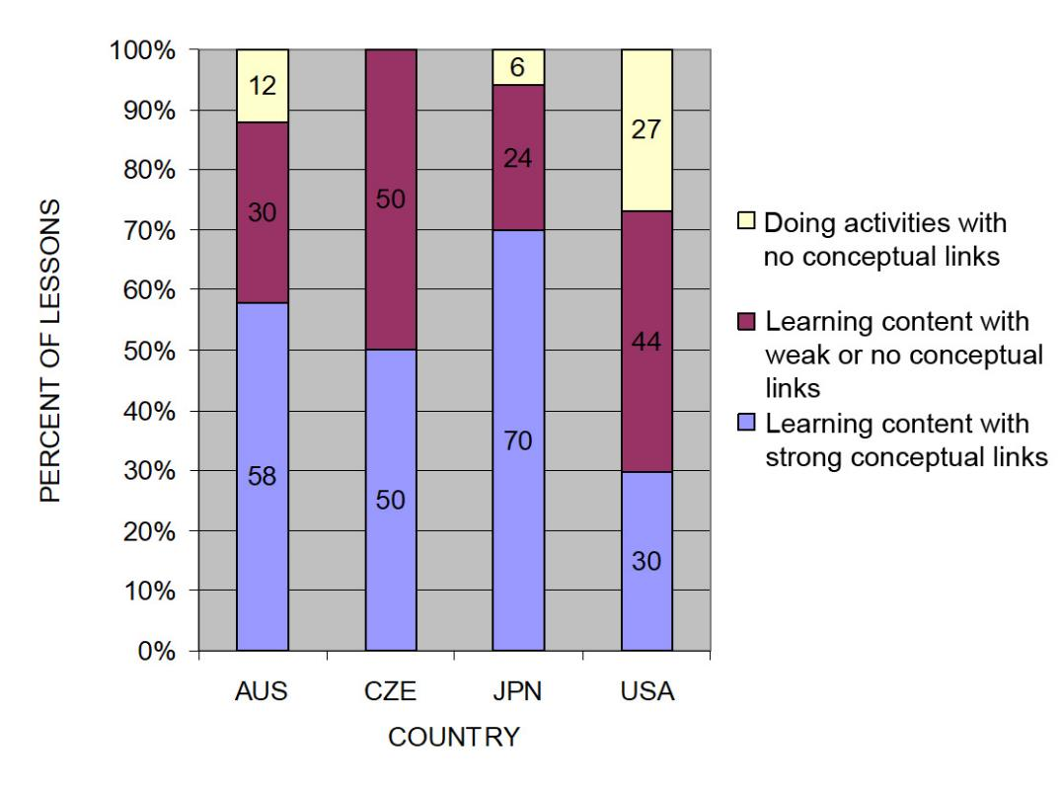
TIMSS: Conceptual Links
Source: TIMSS study
Notes:
3 min
a. Ask: “What do you notice from this graph? What do you make of this data?”
b. Emphasize: “In the US, more than a quarter of the lessons had no science content; whereas in the other countries, the majority of the randomly selected lessons (or typical lessons) had content with strong conceptual links.”
c. Example of a lesson with no science content: “What’s a science lesson with no content? In this research, a lesson with at least one complete statement of a science idea was scored as ‘learning content.’ Lessons with ‘no content’ had only topic-level mentions of science concepts. For example, one teacher started a lesson by telling students to take out their rockets and get to work. They had directions to follow, but the teacher’s only focus in his interactions with students was on how to build the rockets. At the end of the lesson, he told students to clean up and then dismissed them. This is a lesson with no science content!”
Other key ideas to highlight:
Each higher-achieving country engaged students with core science concepts and ideas (more consistently than the US).
All the higher-achieving countries linked ideas and activities (more consistently than the US).
In US lessons, the focus was on performing activities with less attention to content and even less attention to linking activities and science ideas.

Slide 31
What Makes a Difference?
Watch two video clips of 8th-grade science:
  A US classroom
  A Japanese classroom
What did you notice about these two classrooms?
In which classroom are students more likely to learn? Why do you think so?
Link to TIMSS US video clip: 1.1_TIMSS_US_Lesson3_c1
Link to TIMSS Japan video clip: 1.2_TIMSS_Japan_Lesson_c1_1
Notes:
20 min
a. Direct participants to the transcripts for Video Clips 1.1 and 1.2 (handouts 1.2 and 1.3) before showing each clip.
b. Show US classroom video: Ask participants to focus on what is going on with the science content and storyline.
c. Discuss: “What did you notice?”
Key ideas to emphasize and link back to the results include the following:
The teacher focuses on the activity and the procedure needed to complete the activity.
The teacher and students place no real focus on important science ideas.
There’s only a topic-level mention of science ideas (“pulleys,” “effort distance,” “resistance force”).
d. Show Japanese classroom video: Ask participants to focus on what is going on with the science content.
e. Discuss: “What did you notice?”
Key ideas to emphasize and link back to the results include the following:
Content ideas are made clear to students (focus question, pairs talk) before doing any activity.
Students are asked to talk about science ideas, not just procedures.
The lesson purpose is made clear to students.
f. Ending discussion: “In which classroom are students more likely to learn science concepts? Why?”
Note: Participants may be critical of both classrooms because student thinking isn’t made visible. This is true, but bring their focus back to the science content and storyline. They should see a clear distinction between the science content storylines in the Japanese and US lessons. Students in the Japanese classroom are more likely to learn because science-content ideas are made visible, and students are engaged in thinking about these ideas, not just science activities.

Slide 32
The TIMSS Findings Show …
Each higher-achieving country engaged students with core science concepts and ideas.
All the higher-achieving countries linked ideas and activities.
In US lessons, the focus was on performing activities with less attention to content and even less attention to linking activities and science ideas.
Notes:
1 min
a. Use this slide and the next to summarize key ideas from the TIMSS video study.

Slide 33
What Can We Learn from the Research?
A coherent science content storyline can …
make science ideas more prominent in science lessons,
  strengthen connections among science-content ideas,
  strengthen connections between science-content ideas and activities, and
improve lesson coherence by shaping science lessons as stories that make sense to students.
For more insights, see TIMSS Educational Leadership article, “What Science Teaching Looks Like: An International Perspective” (handout 1.4 in binder).
Notes:
1 min
a. After reading this slide, share with participants that the Science Content Storyline Lens addresses the need uncovered in the TIMSS video study: to strengthen the links between science ideas and lesson activities.
b. Encourage participants to read handout 1.4 (TIMSS Educational Leadership article) for further insight.

Slide 34
Discussion Questions
What new features can we add to our earlier description of effective science teaching?
Are there any ideas we should add to our list, modify, or delete?
Notes:
5 min
a. “What features on our list of ideas about effective science teaching are consistent with the TIMSS video-study findings?”
b. “Are there any ideas you’d like to add to our list, delete, or modify?”
Note: Use a different color to add/delete/modify ideas. Encourage participants to keep an open mind about changing their ideas. Provide opportunities for them to reflect on any changes and the reasons for those changes.
c. Transition: “During week 2 of the Summer Institute, we’ll focus on strategies for creating a strong, coherent science content storyline. This week, we’ll focus on the Student Thinking Lens. Right now, let’s consider the reasons for this focus.”

Slide 35
Lesson Analysis Focus Question
What are the STeLLA lenses and teaching strategies, and what is the evidence that they will make a difference in your science teaching?
Student
Thinking
Lens
Science
Content
Storyline
Lens
Notes:
Less than 1 min
a. “At this point, we’ll transition from a focus on the Science Content Storyline Lens (SCSL) to the Student Thinking Lens (STL).”
b. “We’ll be focusing on the Student Thinking Lens the rest of the day and throughout this week.”

Slide 36
Research on How Students Learn
Respond in your notebooks to the following question:
    Imagine that a seed is planted in the ground and grows into a tree. Where does most of the matter come from that makes up the wood and leaves of the tree?
We won’t share our responses with the whole group.
Notes:
3 min
a. Individuals: Have participants answer the question on the slide in their science notebooks.
Background for PD leaders: Participants will likely have the same misconceptions revealed in the video, but they may not yet be comfortable sharing their confusion. At this point, don’t ask them to share their ideas with the group. It will be interesting to see if some of them are willing to share their “wrong” ideas after they see the video.

Slide 37
Minds of Our Own
Minds of Our Own is a video that visually summarizes a large body of research on student learning in science classrooms.
As you watch, think about the following questions:
How do Harvard graduates answer the question about the mass of a tree? Is their response the same as or different from yours?
Does this give you any new ideas about effective science teaching?
Link to Minds of Our Own video clip.
Notes:
10 min
a. Read the information and instructions on the slide.
b. Watch the Minds of Our Own Lessons From Thin Air video. Total viewing time is approximately 10 minutes. (https://www.learner.org/series/minds-of-our-own/2-lessons-from-thin-air/?jwsource=cl)
MIT/Harvard interview—start at segment 3:30 and end at 5:40.
John preinterview, class, and post interview—start at segment 7:50 and end at 16:45.
Note: If time is short, stop after Phil Sadler. If you have enough time, you can show the entire segment from 3:30 to 16:45.

Slide 38
Discussion Questions
What did you notice in the Minds of Our Own video?
What does research on learning say to us about effective science teaching?
What new features can we add to our description of effective science teaching?
Notes:
15 min
a. There’s a lot to talk about in this video! Here are some additional questions you might pose:
Did John’s ideas about photosynthesis change through instruction?
What did the teacher say about his instruction?
What did the experts say?
How do the Harvard students’ responses compare with your own? What ideas does this give you about your own science learning experiences?
Key idea to emphasize: Research shows that we not only need to engage students in more thinking and sensemaking, but we also need to listen to their ideas—especially when they’re wrong—and use them to guide our instruction.
b. Modify the chart of ideas about effective science teaching as participants share features from the research.

Slide 39
What Can We Learn from the Research?
A Student Thinking Lens can …
reveal, support, and challenge student thinking throughout instruction;
provide opportunities for students to analyze and interpret data, as well as construct arguments and explanations;
engage students in making connections between ideas and activities; and
provide structures to teach students how to communicate in scientific ways.
For more insights, see “Synthesis of Research from How Students Learn: Science in the Classroom” (handout 1.5 in binder).
Notes:
2 min
a. “This slide nicely summarizes some of the ways we get students thinking and make their thinking visible.”
Note: Encourage participants to read handout 1.5 (“Synthesis of Research from How Students Learn: Science in the Classroom”) for further insight.
b. Transition: “Today we’ll start learning some particular strategies for making student thinking more prominent in science lessons.”
Background for PD leaders: The STeLLA conceptual framework addresses the need uncovered in this and other studies on how people learn and, more specifically, how students learn science.
If students’ initial knowledge is not engaged, they may fail to grasp the new concepts and information that are taught and may distort the new information to make it fit their prior experience.
This idea of learning with understanding has two parts: (1) factual knowledge must be placed in a conceptual framework (a big idea or a set of big ideas) organized in ways that enable students to use and apply that knowledge to make predictions, solve problems, explain new situations, and so forth; and (2) multiple representations that are rich in science ideas and details give concepts meaning.
This idea helps students monitor their developing understandings, engaging them in reflecting on their learning experiences, their changing ideas, and their remaining questions and musings.

Slide 40

EARTH’S CHANGING SURFACE
SCIENCE CONTENT DEEPENING Grade 4
Notes:
Less than 1 min
a. “Now let’s begin our investigation of Earth’s changing surface.”
Note: Throughout this content deepening phase, refer as needed to Earth’s Changing Surface: Learning Goals for Students and Teachers, the content background document, and Common Student Ideas about Earth’s Changing Surface.

Slide 41
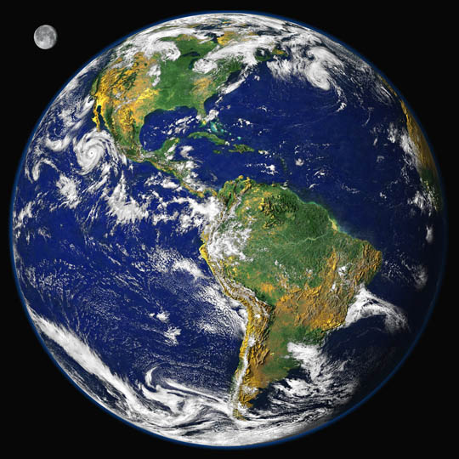
Earth’s
Changing
Surface
Content
Deepening
Developed by
Dr. Jeff Marshall
Geological Sciences
Cal Poly Pomona
Used by permission
Photo courtesy of Visible Earth
Notes:
Less than 1 min
a. “Today’s content deepening work will focus on science ideas about Earth’s changing surface from ECS lessons 1 and 2.”

Slide 42
How We Think about Landscapes and Landforms
How would you describe the landscape of your home area?
What is your favorite kind of natural landscape on Earth? Why?
Share a story about visiting a place like this. What was it like?
Notes:
20 min
a. Read the three questions on the slide.
b. Individuals (5 min): “Briefly answer these questions in your science notebooks.”
c. Whole-group share-out (12 min): In a round-robin, ask participants to state their names, school affiliations, where they were born, and where they live now. Then invite them to share their answers to the questions.
d. As participants share their answers, record their descriptions on chart paper.
e. Following the share-out, briefly summarize some key descriptions, focusing on the diversity of landscapes (e.g., flat urban landscape; rural farm; high, snowy mountains; tropical beach at sunset).

Slide 43
How We Think about Landscapes and Landforms
What kinds of words did we use to describe various landscapes and landforms? Share a few good examples.
What do our descriptions tell us about how we think about landscapes and landforms?
Do you think 4th graders will be able to use similar words to describe landscapes and landforms? Why or why not?
Notes:
10 min
a. Whole-group discussion (10 min): Discuss the questions on the slide.
b. Highlight some of the descriptive terminology on the chart that participants used for landscapes, landforms, and shapes. Examples may include the following:
Landscapes: mountains, deserts, coastlines, cities
Landforms: peaks, ridges, hills, valleys, canyons, gullies, plains, prairies, plateaus, coastlines, shores, cliffs, beaches, headlands, deltas, islands, lakes, ponds, rivers, streams
Topographic shapes: steep, sloping, gentle, flat, rough, rugged, jagged, abrupt, smooth, low, high

Slide 44
Unit Central Questions
  Why isn’t all of Earth’s surface flat? What causes the surface to look different in different places?
Notes:
1 min
a. Read the unit central questions on the slide.
b. Emphasize that these questions will guide student learning throughout the entire ECS unit.
c. Tell participants that the information they gather during the content deepening investigations this week will help them answer these questions.
d. Have participants write these questions in their science notebooks and draw a double-lined box around them. This practice reinforces the process they’ll follow with students in the lessons.

Slide 45
Earth’s Changing Surface
Lesson 1a
Photo courtesy of Visible Earth
Notes:
Less than 1 min
a. “Next, we’ll explore science ideas about Earth’s changing surface from ECS lesson 1a.”

Slide 46
Content Deepening Focus Questions
  Does the surface of Earth look the same everywhere? In what ways does the surface look different or the same in different places?
Notes:
1 min
a. Read the focus questions on the slide.
b. Emphasize that these questions will guide student learning throughout ECS lesson 1a.
c. Have participants write these questions in their science notebooks and draw a box around them.

Slide 47
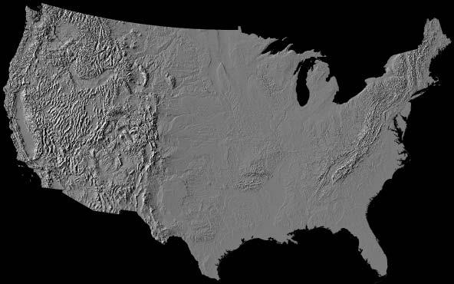
Investigation 1: Identifying Landforms
Photo courtesy of NPS.gov
Notes:
2 min
a. “For this investigation, you’ll work with a partner to identify landforms on this relief map of the United States.”
b. Have participants pair up; then give each pair a relief map.

Slide 48
Investigation 1: Identifying Landforms
How many different landforms can you find on the map? (You’ll need to LOOK AT and TOUCH the map to find the landforms.)
Record the landforms in your science notebooks using the descriptive words we used earlier.
What landform patterns can you identify on the map?
Where do you find mountains, rivers, and lakes?
Record at least 3 different patterns in your notebook using descriptive words.
Use directions (north, south, east, west) to indicate where the landforms are located.
Notes:
10 min
a. Pairs: “First, work with your partner to identify as many different landforms on the map as you can. You’ll need to look at and touch the map to find the landforms. When you identify a landform, record it in your science notebooks using descriptive words like the ones we discussed earlier.”
b. “Next, search for landform patterns on the map. Notice where certain types of landforms appear and don’t appear. Where are mountains located? What about rivers and lakes? Record at least three different landform patterns in your notebooks using descriptive words, and use directions like north, south, east, or west to indicate where the landforms are located.”
c. Whole-group share-out: Invite pairs to describe the landforms and landform patterns they identified on the relief map. Probe their responses (e.g., “What do you mean by ‘more mountains in the west’?” “What do you mean by ‘flat in the middle’?”) and elicit differing points of view (e.g., “Does everyone agree with that observation?”).

Slide 49
Reflect: Content Deepening Focus Questions
Does the surface of Earth look the same everywhere? In what ways does the surface look different or the same in different places?
Notes:
5 min
a. “Reflect on the focus questions for a moment and then share your answers in concise statements. Make sure to use evidence from the relief map to support your ideas.”
b. “As others share their ideas and evidence, listen carefully and be prepared to agree, disagree, ask questions, or add new ideas using evidence from the map.”
c. During this discussion, record key ideas on chart paper.

Slide 50

Key Science Ideas and Observations
Earth’s surface has a variety of landforms, such as mountains, hills, valleys, canyons, plains, rivers, and lakes.
Landforms on Earth are distributed in different patterns and aren’t the same everywhere.
In the United States, some surface areas are low (valleys, plains), and some are high (mountains).
There are more mountains in the western US and more lakes in the northern US.
Many rivers in the US flow north to south, but some flow west to east or east to west.
Notes:
5 min
a. Review the key science ideas and observations on the slide that answer the focus questions. Emphasize that participants’ observations and the map evidence they gathered helped shape these responses.
b. Whole-group discussion: “Does everyone agree with these ideas and observations? Would you like to add or revise anything?”
c. Ask participants to copy these ideas and observations into their science notebooks under the focus questions.

Slide 51
Earth’s Changing Surface
Lesson 1b
Photo courtesy of Visible Earth
Notes:
Less than 1 min
a. “Now let’s explore ideas about Earth’s changing surface from lesson 1b.”

Slide 52
Content Deepening Focus Questions
  Do you think the surface of Earth changes? Why do you think that?
Notes:
Less than 1 min
a. Read the focus questions on the slide.
b. Emphasize that these questions will guide student learning throughout ECS lesson 1b.
c. Have participants write the focus questions in their science notebooks and draw a box around them.

Slide 53
Review: Identifying Landforms on Earth’s Surface
Photo courtesy of NPS.gov
Notes:
Less than 1 min
a. “In our first investigation, we used a relief map of the United States to explore landforms and landform patterns on Earth’s surface. From the evidence we gathered, we concluded that Earth’s surface doesn’t look the same everywhere. There are a variety of landforms distributed in different patterns.”

Slide 54
Investigation 2: Does Earth’s Surface Change?
  Look at the relief map of the United States from our first investigation.
  Do you think landforms in the United States have always looked the way they
  do today?
  Do you think landforms in the United States will change in the future?
Notes:
6 min
a. Read the questions on the slide and ask participants to share their ideas and reasoning. Encourage them to refer to the relief map throughout this discussion.
b. “Listen carefully to the ideas and reasoning others share and be prepared to agree, disagree, ask questions, or add ideas.”
c. During this discussion, record participants’ ideas and reasoning on chart paper.

Slide 55
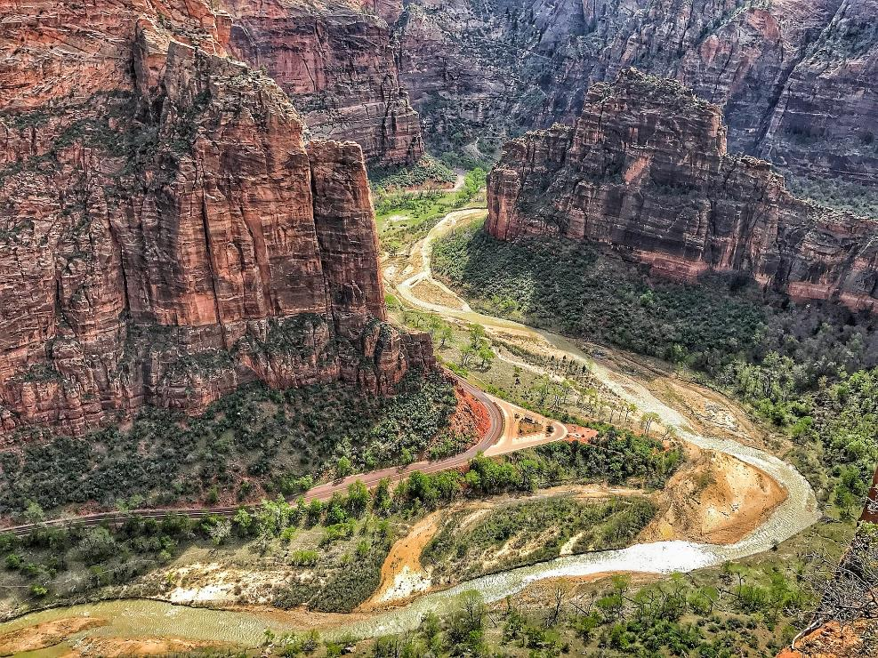
Investigation 2: Does Earth’s Surface Change?
Photo courtesy of Pexels.com
Geomorphology is the geologic study of Earth’s surface and the natural processes that shape and change its form.
Notes:
Less than 1 min
a. “Next, we’ll explore geomorphology, or the science of Earth’s surface.”
b. Read the definition at the bottom of the slide.

Slide 56
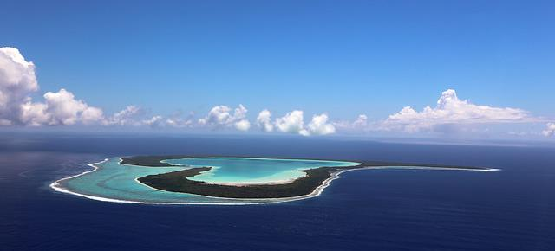
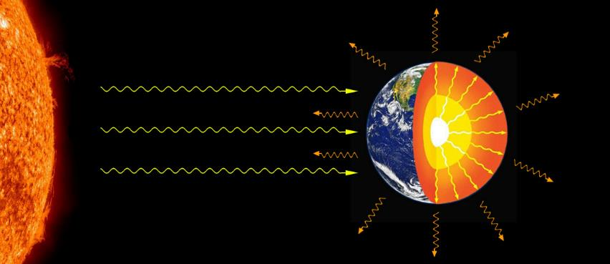
Geomorphology
Earth’s Surface is the interface between the geosphere, the atmosphere, the hydrosphere, and the biosphere.
The shape of Earth’s surface is a result of competing energy sources and processes:
Photograph by Stephan Debelle
Geothermal Energy
Earth is an open system that exchanges energy and mass with its surroundings.
Plate tectonics builds up the land.
Solar Energy
Climate and erosion wear down the land.
Courtesy of Cal Poly Pomona
Notes:
2 min
Read the information on the slide describing the relationship between Earth’s surface and the two main energy sources in Earth’s system: geothermal energy and solar energy.
Highlight these key science ideas:
Geothermal energy (heat) from Earth’s core powers plate tectonics, which builds up the land.
Solar energy (heat) powers climate and erosion, which wear down the land.
Emphasize that gravity plays an important role in both processes.
“We’ll talk more about plate tectonics in subsequent investigations.”

Slide 57
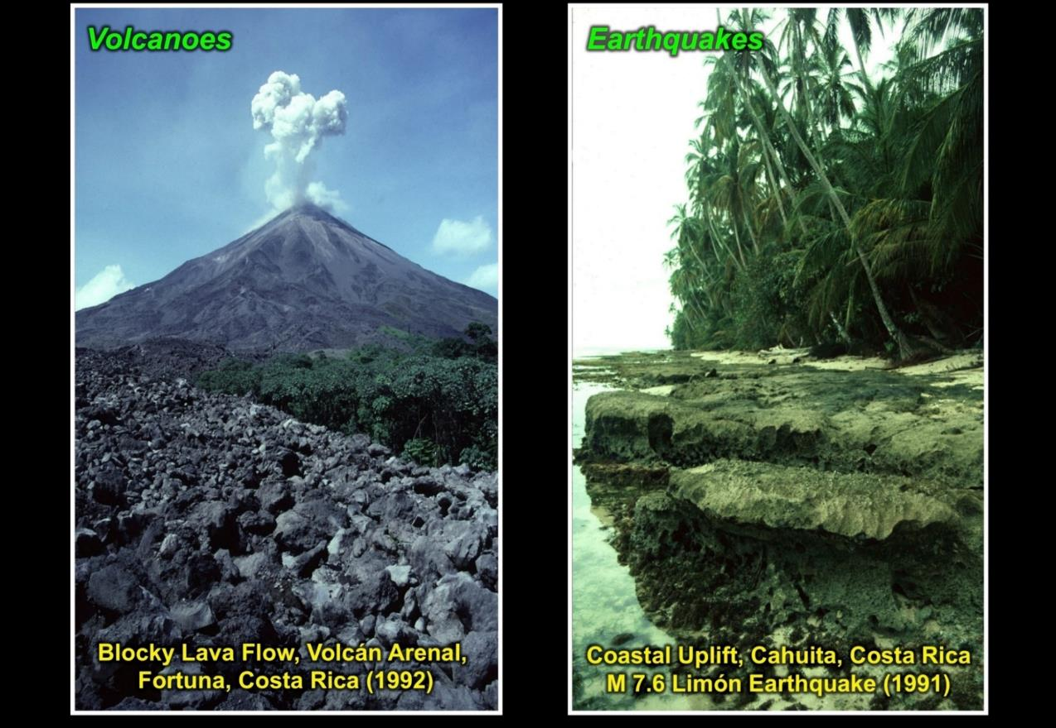
Investigation 2: Does Earth’s Surface Change?
Plate tectonics builds up Earth’s surface.
Blocky Lava Flow, Volcán Arenal,
Fortuna, Costa Rica (1992)
Coastal Uplift, Cahuita, Costa Rica
M 7.7 Limón Earthquake (1991)
Photographs by Jeffery Marshall
Notes:
1 min
“Volcanic eruptions and earthquakes are two examples of tectonic processes that build up Earth’s surface.”
“The photo on the left shows a blocky andesite lava flow from Volcán Arenal in Costa Rica that plowed its way through the rain forest in 1992, creating a brand-new built-up area of land.”
“The photo on the right shows an area of coseismic uplift along Costa Rica’s Caribbean coast that occurred in 1991 during a magnitude 7.7 earthquake. The coastal uplift of the coral reef was 1.5 meters. Older uplifts of coral deposits from previous earthquakes are found inland in the jungle.”

Slide 58
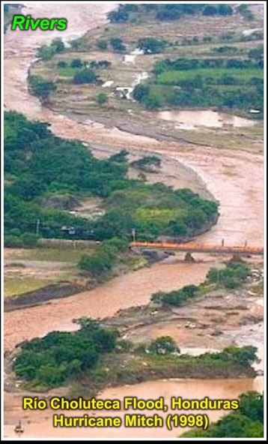
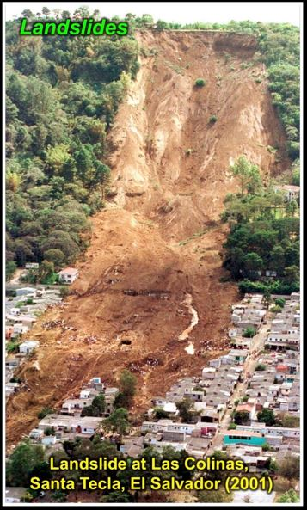
Investigation 2: Does Earth’s Surface Change?
Erosion wears down Earth’s surface.
Source: unknown
Notes:
1 min
“Floods and landslides are two examples of erosional processes that wear down Earth’s surface.”
“The photo on the left shows a major flood of the Río Choluteca in Honduras during Hurricane Mitch in 1998. The deep-brown color of the water indicates that it’s carrying large amounts of eroded sediment from the landscape. Hurricane Mitch was a major disaster for much of Central America, causing widespread flooding and landslides that killed thousands of people and displaced billions of tons of sediment.”
“The photo on the right shows the Las Colinas landslide and debris flow that plowed through Santa Tecla, El Salvador, in 2001, killing more than 580 people. This ‘flowslide’ was triggered by a magnitude 7.6 earthquake that loosened rain-saturated volcanic soils above the town and sent 170,000 cubic yards of rock and soil (plus water) plunging down the mountain in a matter of seconds.”

Slide 59
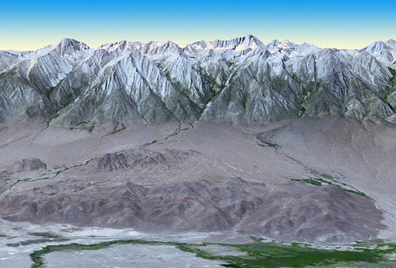
Investigation 2: Does Earth’s Surface Change?
Sierra Nevada Mountains
and Owens Valley, California
Topography refers to the
shape of Earth’s surface.
Photo courtesy of NASA/GSFC/METI/ERSDAC/JAROS, and U.S./Japan ASTER Science Team
Notes:
Less than 1 min
a. Explain to participants that the term topography refers to the shape of Earth’s surface.
b. “This image shows the dramatic topographic relief of the Sierra Nevada Mountains, with Mount Whitney towering more than 14,000 feet above sea level, and the adjacent Owens Valley reaching only 4,000 feet in elevation.”

Slide 60
Investigation 2: Does Earth’s Surface Change?
Sierra Nevada Mountains
and Owens Valley, California
Topography is the result of
competing natural processes that
build up and wear down Earth’s surface
at the same time.
Photo courtesy of NASA/GSFC/METI/ERSDAC/JAROS, and U.S./Japan ASTER Science Team
Notes:
Less than 1 min
a. Emphasize that topography is the result of competing natural processes that build up and wear down Earth’s surface at the same time.

Slide 61
Investigation 2: Does Earth’s Surface Change?
Sierra Nevada Mountains
and Owens Valley, California
Plate tectonics and climate vary
from place to place.
Earth’s surface gets higher where
Rate > Rate
Earth’s surface gets lower where
Rate < Rate
(building up)
(wearing down)
(building up)
(wearing down)
Photo courtesy of NASA/GSFC/METI/ERSDAC/JAROS, and U.S./Japan ASTER Science Team
Notes:
Less than 1 min
a. “The topography of Earth changes in response to the relative impacts, or rates, of tectonic and climatic processes that either build up or wear down Earth’s surface.”

Slide 62
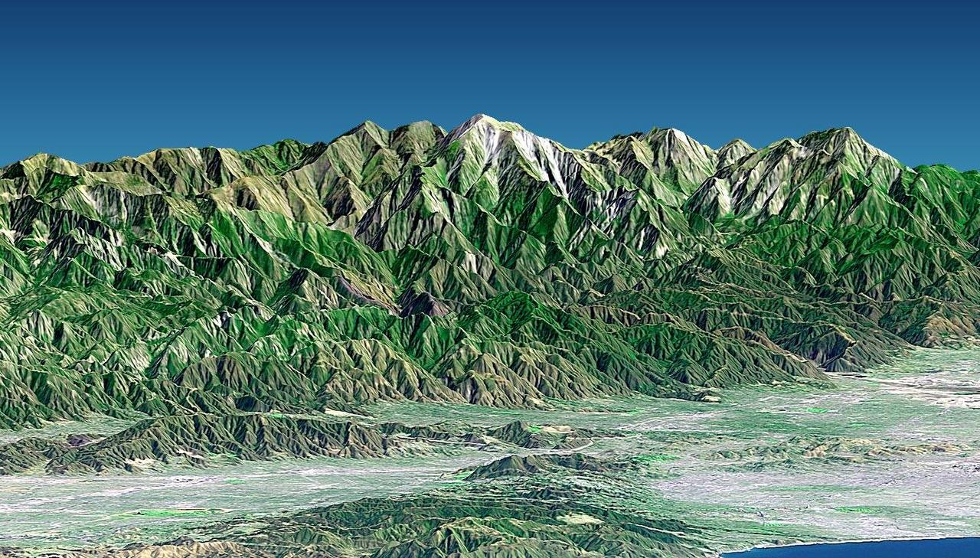
Investigation 2: Does Earth’s Surface Change?
San Gabriel Mountains
Southern California
Photo courtesy of NASA/JPL/NIMA
The surface of Earth is continually changing, and the landscapes we see around us are only snapshots.
Notes:
Less than 1 min
a. “This slide shows a digital elevation model of the San Gabriel Mountains rising above the Pomona Valley. Mount Baldy (also known as Mount San Antonio) towers more than 10,000 feet above sea level.”
b. “The surface of Earth is continually changing, or evolving, and the landscapes we see around us are only momentary snapshots or freeze-frames in a full-length movie.”

Slide 63
Investigation 2: Does Earth’s Surface Change?
Tectonics + Erosion = Earth Surface Form
Photo courtesy of NASA/JPL/NIMA
The surface of Earth is continually changing, and the landscapes we see around us are only snapshots.
Notes:
Less than 1 min
a. “Earth’s surface form is the result of tectonic processes that build up the land and erosional processes that wear down the land at the same time.”

Slide 64
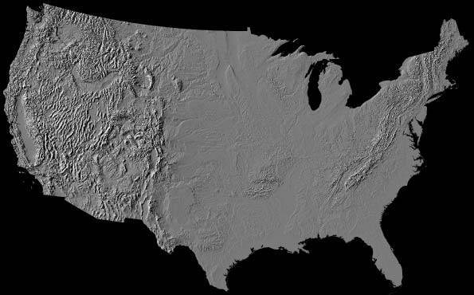
Investigation 2: Does Earth’s Surface Change?
Landform
Landscape
Geomorphic
Province
Photo courtesy of NPS.gov
Notes:
Less than 1 min
a. “Geomorphologists use the terms landform, landscape, and geomorphic province to describe features of Earth’s surface.”

Slide 65
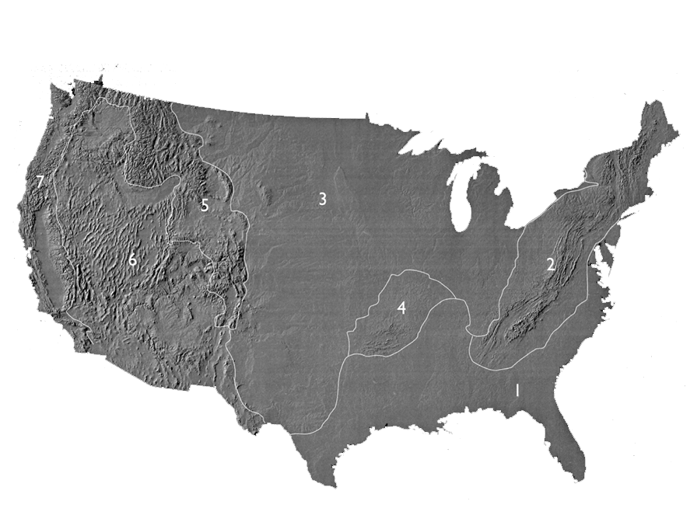
Investigation 2: Does Earth’s Surface Change?
Atlantic plain
Appalachian highlands
Interior plain
Interior highlands
Rocky Mountain system
Intermontane plateau
Pacific Mountain system
Photo courtesy of NPS.gov
Notes:
Less than 1 min
a. “Earlier, we searched for distinctive landform patterns on a relief map of the United States. Based on these patterns, we can divide the North American continent into regional sectors called geomorphic provinces or physiographic provinces.”
b. “Geomorphic provinces are broad sectors of a continent that share a common geologic history and tectonic origin.”
c. “The geomorphic provinces represented on this slide are quite generalized, but next, we’ll examine a more detailed model of geomorphic provinces in the western United States.”

Slide 66
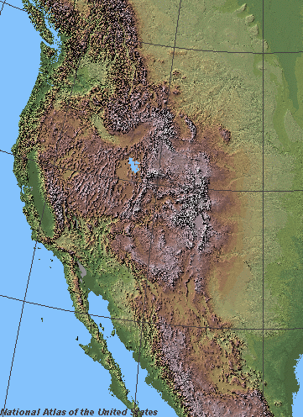
Investigation 2: Does Earth’s Surface Change?
Geomorphic
Provinces
Western
North
America
Photo courtesy of Wikimedia.org
Notes:
3 min
a. “This slide shows a digital elevation model of western North America.”
b. “What distinct surface patterns do you observe on this map?”
c. Ask participants to think about how they might divide this area into geomorphic provinces.

Slide 67
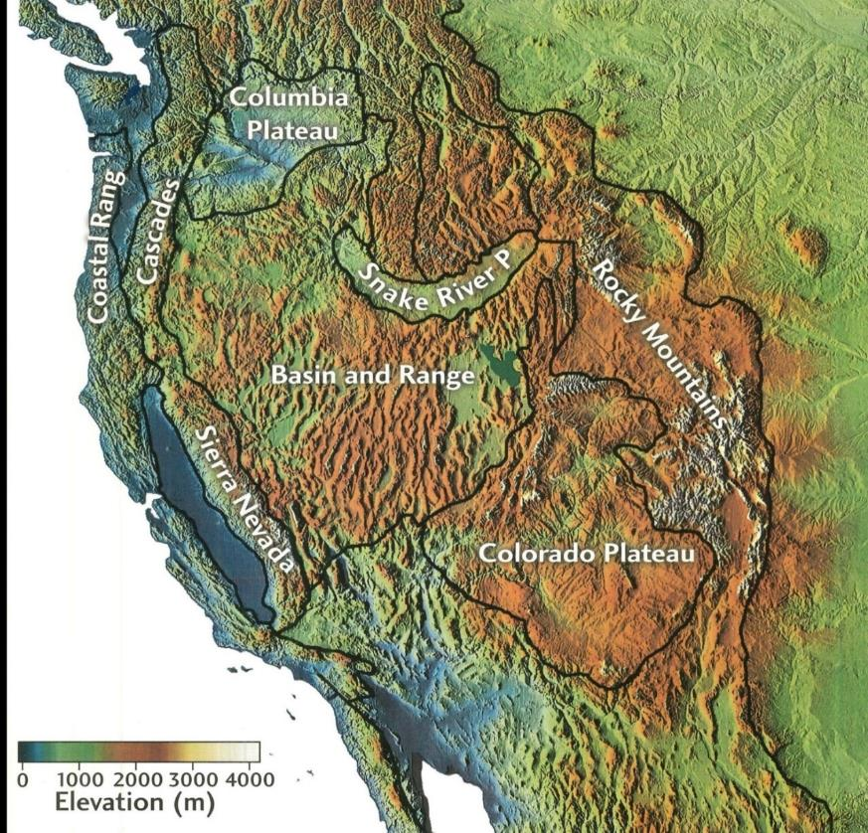
Investigation 2: Does Earth’s Surface Change?
Geomorphic
Provinces
Western
North
America
Source: unknown
Notes:
3 min
a. “This slide shows the standard geomorphic provinces that geomorphologists have identified for western North America.”
b. “How does this model compare with the geomorphic divisions you came up with?”
c. “Next, we’ll zoom in on one province that stretches from eastern California across Nevada to central Utah.”

Slide 68
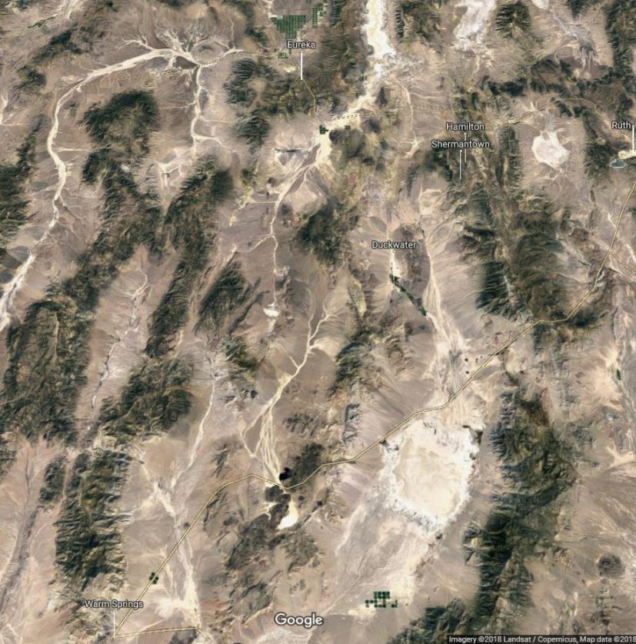
Investigation 2: Does Earth’s Surface Change?
Geomorphic
Province
Basin
and
Range
Photo courtesy of Imagery @2018 Landsat/Copernicus, Map Data @2018 Google
Notes:
Less than 1 min
a. “This image in this slide is a close-up view of a portion of the Basin and Range geomorphic province. This region is known for its parallel rows of rugged, snowy (Nevada) mountain ranges and deep desert valleys. The ranges and valleys are separated by extensional normal faults that accommodate tectonic stretching from west to east.”
b. “In this region, the North American continent is actually being pulled apart from both sides. This movement has resulted in a distinctive pattern of north-south-trending mountain ranges and intervening basins or valleys.”

Slide 69
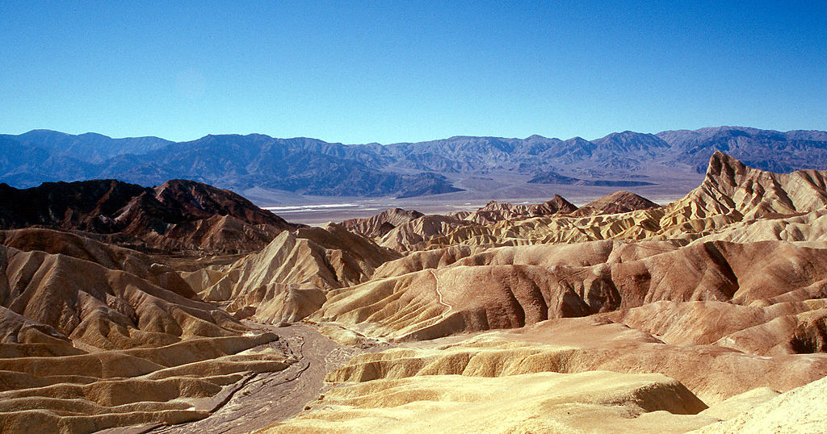
Investigation 2: Does Earth’s Surface Change?
Photo courtesy of Wolfgangbeyer / Wikimedia Commons
Horst and Graben Landscape
Death Valley, California
Basin and Range Geomorphic Province
Notes:
Less than 1 min
a. “This is an example of a typical Basin and Range landscape within the western geomorphic province. The photo was taken from Zabriskie Point in Death Valley National Park, looking east across the desert basin toward the mountain range on the far side.”
b. “At the bottom of the valley is a desert playa lake, which is depression in the ground filled with water at certain times of the year. Alluvial fans, or accumulations of sediment, appear along the edges of the mountain range, and a fault runs along the foot of the mountains.”
c. Point out that in geomorphology, the term landscape refers to a regional assemblage of landforms that characterize a certain tectonic or climatic environment. Death Valley can be described as a horst and graben landscape. In German, horst and graben are geologic terms that describe extensional mountain ranges, or horst, and intervening basins, or graben.

Slide 70
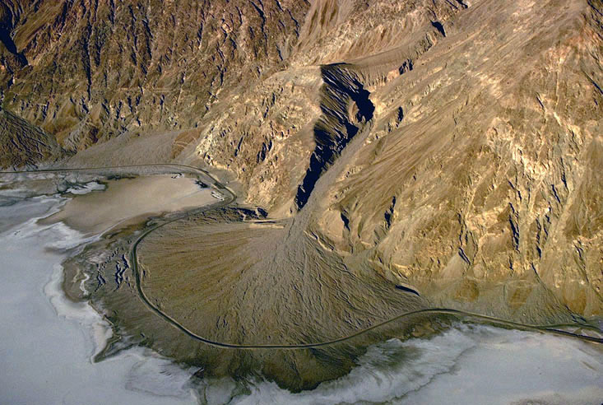
Investigation 2: Does Earth’s Surface Change?
Photograph by Marli Miller/Geologypics.com
Alluvial Fan Landform
Death Valley, California
Notes:
Less than 1 min
a. “This photo of an alluvial fan is an example of a characteristic landform in a horst and graben landscape.”
b. “Alluvial fans are piles of sediment that accumulate at the mouth of a mountain stream where it empties into an adjacent valley or basin. This landform results from a sudden change in stream gradient crossing a mountain front. As the streambed builds up, it maintains a continuous longitudinal profile.”
c. Explain that landforms are local surface features that result from a specific natural process or set of processes. Many types of landforms exist around the world.

Slide 71
Investigation 2: Does Earth’s Surface Change?
Landform:
Landscape:
Geomorphic
Province:
Local feature of Earth’s surface formed by a
characteristic natural process or set of processes
(e.g., sand dune, cliff, sinkhole, moraine, crater,
gully, alluvial fan, stream channel, delta)
Regional assemblage of landforms that are typical
of a particular tectonic and/or climatic setting
(e.g., coastline, desert, savannah, volcanic belt,
tundra, karst, badland, tropical lowland)
Broad sector of a continent that has a common
geologic history and tectonic origin
(e.g., Colorado Plateau, Appalachian Piedmont,
Basin and Range, Rocky Mountains)
Photo courtesy of NPS.gov
Notes:
2 min
a. Read the definitions on the slide to summarize this investigation of Earth’s changing surface.

Slide 72
Reflect: Content Deepening Focus Questions
  Do you think the surface of Earth changes? Why do you think that?
Notes:
5 min
a. “Reflect on these focus questions for a moment and then share your answers in a concise statement. Make sure to include evidence from our investigation of landforms, landscapes, and geomorphic provinces to support your ideas.”
b. “As others share their ideas and evidence, listen carefully and be prepared to agree, disagree, ask questions, or add new ideas using evidence from the map.”
c. During this discussion, record key ideas on chart paper.

Slide 73
Key Science Ideas
Earth’s surface form, or shape, is the result of competing energy sources (geothermal and solar energy) and processes (plate tectonics and erosion) that build up and wear down the surface at the same time.
Volcanic eruptions and earthquakes are examples of tectonic processes that build up Earth’s surface.
Floods and landslides are examples of erosional processes that wear down Earth’s surface.
The surface of Earth is continually changing, and the landscapes we see around us are only momentary snapshots.
Landforms, landscapes, and geomorphic provinces are distinct aspects of Earth’s surface.
Notes:
5 min
a. Review the key science ideas on the slide that answer the focus questions. Emphasize that the information they gathered during this investigation helped shape these responses.
b. Whole-group discussion: “Does everyone agree with these ideas? Would you like to add or revise anything?”
c. Ask participants to copy these ideas into their science notebooks under the focus questions.

Slide 74
Earth’s Changing Surface
Lesson 2a
Photo courtesy of Visible Earth
Notes:
Less than 1 min
a. “Next, we’ll explore ideas about Earth’s changing surface from lesson 2a.”

Slide 75
Content Deepening Focus Question
  What happens to Earth’s surface that causes mountains to form?
Notes:
Less than 1 min
a. Read the focus question on the slide.
b. Emphasize that this question will guide student learning throughout ECS lesson 2a.
c. Have participants write the focus question in their science notebooks and draw a box around it.

Slide 76
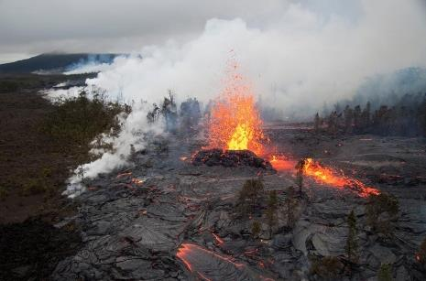
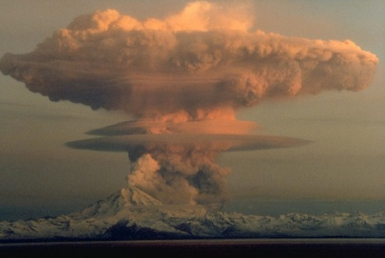
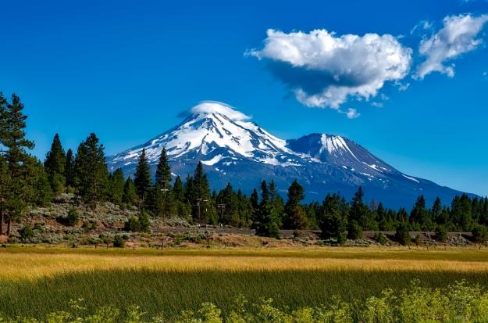
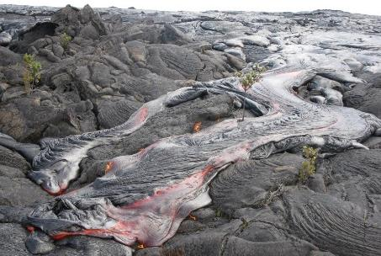
Investigation 3: Volcanic Mountain Building
Photo courtesy of USGS
Photo courtesy of USGS
Photo courtesy of Pixabay.com
Photo courtesy of USGS
Notes:
5 min
a. Have participants pair up with their partners from the previous investigation.
b. “Examine the photographs on this slide. What kinds of landforms do you observe? What’s happening in each photo? What changes are taking place on Earth’s surface?”
c. “Share your observations with your partner; then record them in your science notebooks.”

Slide 77
Investigation 3: Volcanic Mountain Building
Do you think volcanoes change Earth’s surface? Use evidence from the photographs to support your answer.
What do you think happens when a volcanic erupts many, many times?
Notes:
5 min
a. Read the questions on the slide.
b. Ask participants to answer these questions using evidence from the volcano photographs to support their ideas. Probe participants’ responses and elicit differing points of view.
c. During this discussion, record key ideas and evidence on chart paper.

Slide 78
Investigation 3: Volcanic Mountain Building
Do you think volcanoes change Earth’s surface? Use evidence from the photographs to support your answer.
  Yes. The photographs of volcanic eruptions show lava and an ash cloud spreading out on Earth’s surface and changing how the surface looks.
What do you think happens when a volcanic erupts many, many times?
  I think that after many eruptions, layers of hardened lava, ash, and other materials will build up and form a cone-shaped mountain.
Notes:
5 min
a. Read through the answers on the slide.
b. Ask participants, “Does everyone agree with these observations and ideas? Would you like to add or revise anything?”

Slide 79
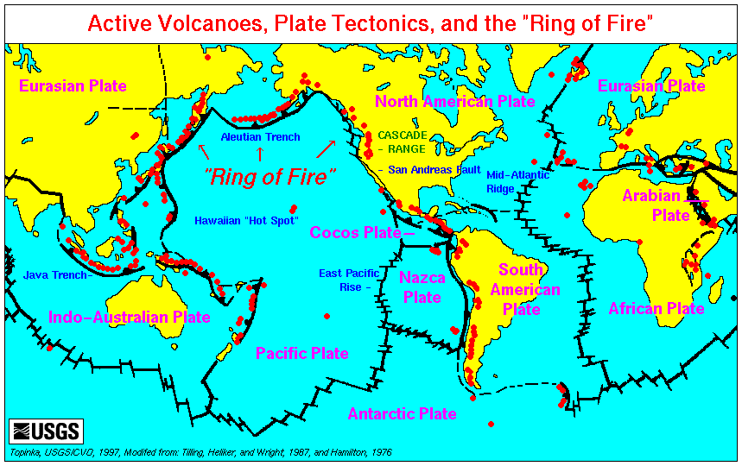
Investigation 3: Volcanic Mountain Building
Courtesy of USGS.gov
Map of Earth’s Major Volcanoes
Notes:
2 min
a. “This map shows the locations of major volcanoes around the world.”
b. Point out some of the volcanoes on the map and ask, “Do you think the volcanoes on this map correspond with major mountain ranges? Why or why not?”
c. Note that many volcanoes form under the ocean and correspond with undersea mountain ranges.

Slide 80
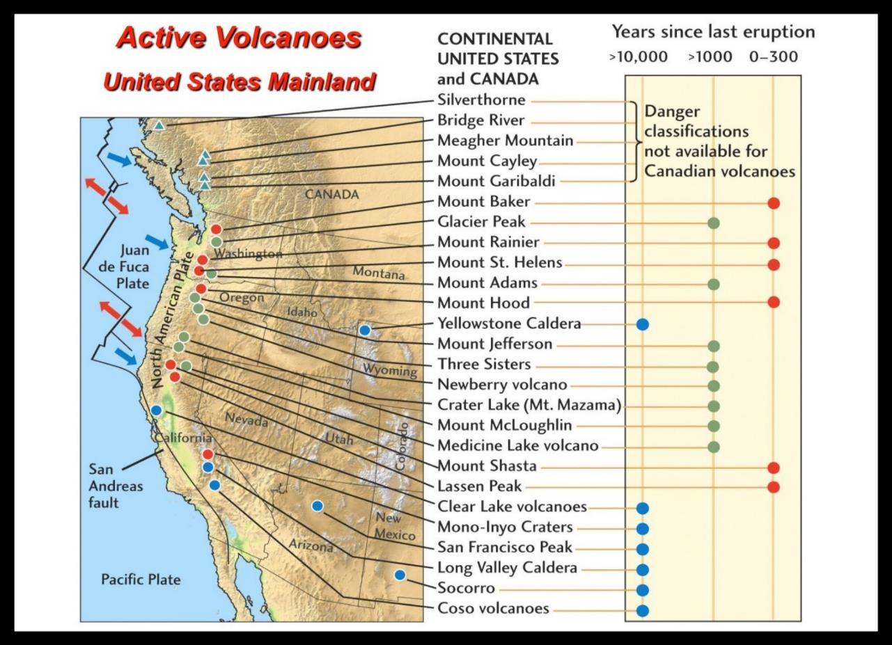
Investigation 3: Volcanic Mountain Building
Source: unknown
Notes:
2 min
a. “This map shows major active volcanoes on the US mainland. The United States ranks third after Indonesia and Japan in the total number of active volcanoes on record.”
b. “Do you think the volcanoes on this map correspond with major mountain ranges in the western United States? Why or why not?”
c. Highlight some examples on the map.

Slide 81
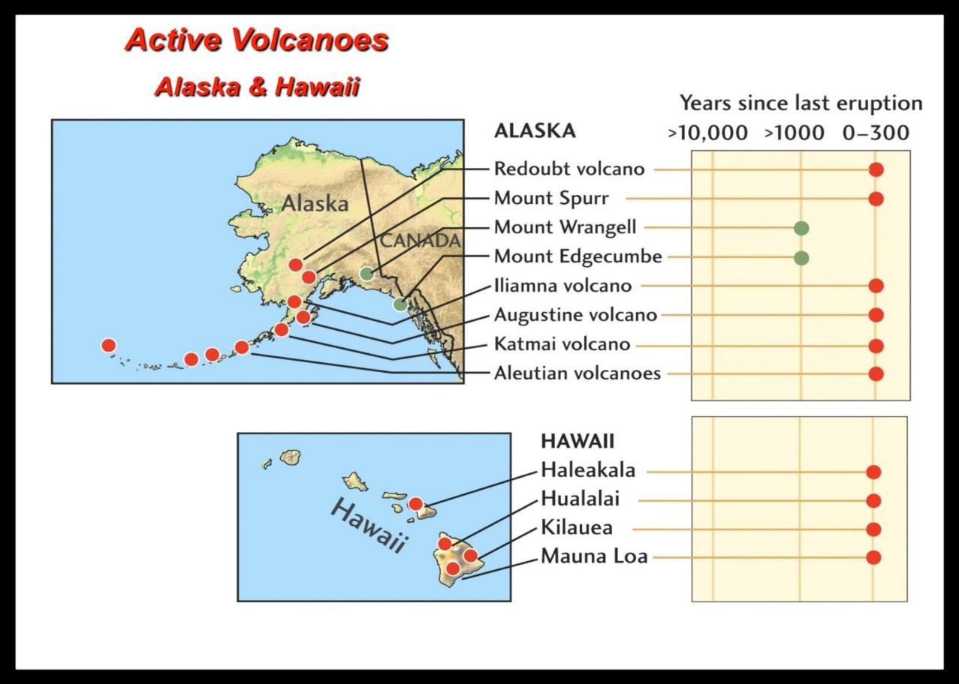
Investigation 3: Volcanic Mountain Building
Source: unknown
Notes:
2 min
a. “These maps show major active volcanoes in Alaska and Hawaii. Notice how many of these volcanoes have erupted within the last 300 years.”
b. Again, ask participants whether they think the volcanoes on these maps correspond with mountains in these regions. Then highlight some examples.

Slide 82
Reflect: Content Deepening Focus Question
  What happens to Earth’s surface that causes mountains to form?
Notes:
5 min
a. Review the focus question on the slide.
b. Ask participants to share their ideas for answering this question using evidence from the volcano investigation to support their answers.
c. Encourage participants to agree, disagree, ask questions, or add to the ideas others share.
d. During this discussion, record key ideas on chart paper.

Slide 83
Key Science Ideas
Volcanic eruptions change Earth’s surface by spreading lava, ash, and other materials across the surface.
After many eruptions, layers of hardened lava, ash, and other materials build up and form a cone-shaped mountain.
Notes:
Less than 1 min
a. Review the key science ideas on the slide that answer the focus question. Emphasize that participants’ observations helped shape these responses.
b. Ask participants to copy these ideas into their science notebooks under the focus questions.
c. “So far we’ve determined that volcanic eruptions are involved in causing mountains to form.”
d. “Next, we’ll investigate other aspects of Earth’s surface and consider whether they might be involved in mountain building.”

Slide 84
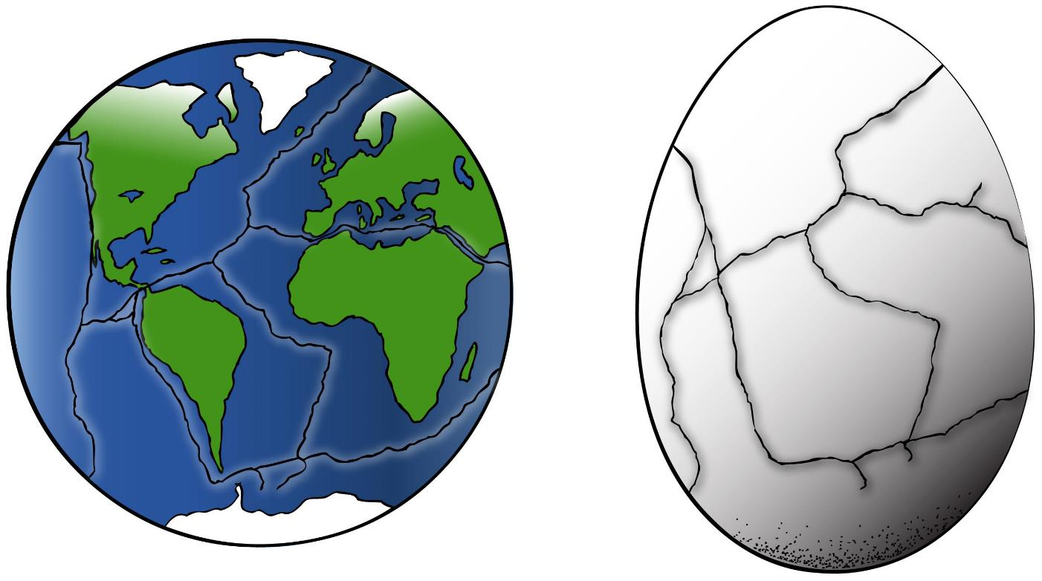
Investigation 4: An Eggshell Model of Earth
Courtesy of Art4clip.com
Notes:
5 min
a. Have participants pair up with their partners from the previous investigation. Give each pair two hard-boiled eggs, one intact and one with a cracked shell.
b. “Examine these eggs and share your observations with your partner. How would you describe the shape of your eggs? How would you describe the surface of the intact egg? How would you describe the surface of the cracked egg?”
c. “Record your observations in your science notebooks and include drawings.”

Slide 85
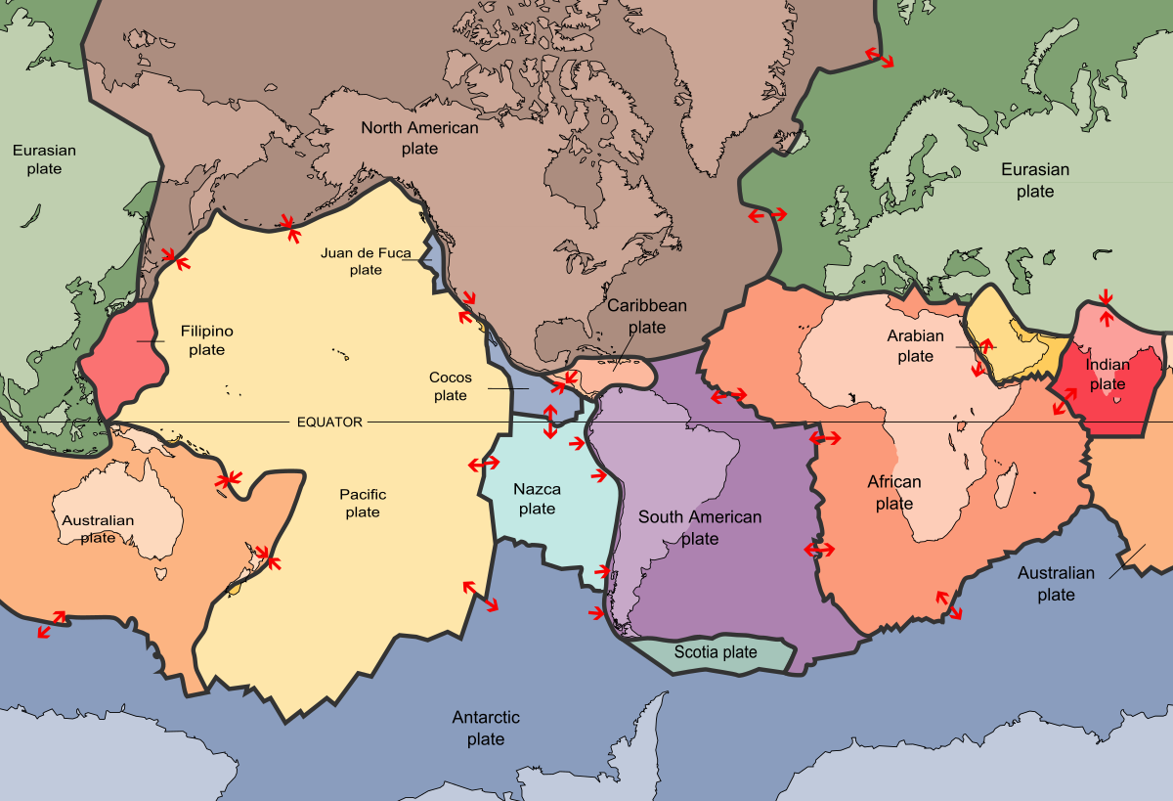
Investigation 4: An Eggshell Model of Earth
Courtesy of Wikimedia.org
Notes:
3 min
a. “Does this map of Earth remind you of anything?”
b. If participants don’t immediately observe that the map looks like a cracked eggshell, ask whether the lines and sections on the map remind them of anything. In addition to a cracked eggshell, participants may note that the map looks like a puzzle with interlocking pieces.
c. “The outer layer of Earth’s surface is called the crust. Like a cracked eggshell, this layer is very thin and is broken into sections called tectonic plates that fit together like a puzzle. This map shows Earth’s major tectonic plates and the boundaries where various plates meet.”
d. “Plate tectonics is a fundamental scientific theory, or paradigm, that explains all of the major geologic characteristics of Earth’s surface.”
e. “We’ll explore Earth’s crustal layer in a bit more detail later on, but right now, we’ll focus on investigating similarities and differences between our hard-boiled eggs and Earth’s surface.”

Slide 86
Investigation 4: An Eggshell Model of Earth
In what ways is an egg like Earth?
In what ways is an egg not like Earth?
Notes:
6 min
a. Read the questions on the slide.
b. Pairs (2 min): Have pairs briefly discuss similarities and differences between an egg and Earth. Remind them to think about the plate-tectonics map from the previous slide as well as the general features of Earth.
c. Whole-group discussion (3 min): Call on pairs to share their observations and ideas for answering these questions using evidence from the egg investigation and the map of Earth to support their answers. Probe participants’ responses and elicit differing points of view.
d. During this discussion, record key ideas on chart paper.

Slide 87
Investigation 4: An Eggshell Model of Earth
In what ways is an egg like Earth?
  Earth’s outer layer (the crust) is thin, just like
  an eggshell.
  Like a cracked eggshell, Earth’s crust is broken into sections (tectonic plates) that fit together like a puzzle.
In what ways is an egg not like Earth?
  An egg has an oval shape, and Earth is round (spherical).
  An egg is small, and Earth is very large.
Notes:
5 min
a. Read through the answers on the slide.
b. Ask participants, “Does everyone agree with these answers? Would you like to add or revise anything?”
c. Have participants copy these ideas and observations into their science notebooks.

Slide 88
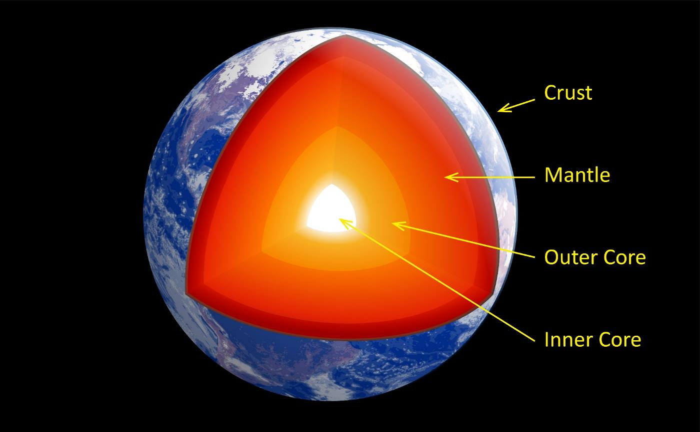
Investigation 5: Earth’s Internal Structure
Courtesy of Wikimedia.org
Notes:
1 min
a. “To better understand plate tectonics, we need to understand some key ideas about Earth’s internal structure.”
b. “This diagram shows Earth’s internal layers based on chemical composition. The three main layers are the core, the mantle, and the crust. Scientists believe that the core, which has a solid inner portion and a liquid outer portion, is composed primarily of iron and nickel. This metallic core, which is extremely hot and under very high pressure, is the main source of Earth’s geothermal heat.”
c. “Earth’s mantle is made up of hot, solid rock that flows slowly beneath Earth’s surface by heat convection. This layer is composed of iron, magnesium, silicon, aluminum, oxygen, and other minerals.”
d. “Earth’s crust is made up of cold, solid rock composed of a wide variety of silicate minerals. This layer of rock is very thin and rigid. As we learned earlier, Earth’s crust is broken into interlocking pieces called tectonic plates.”

Slide 89
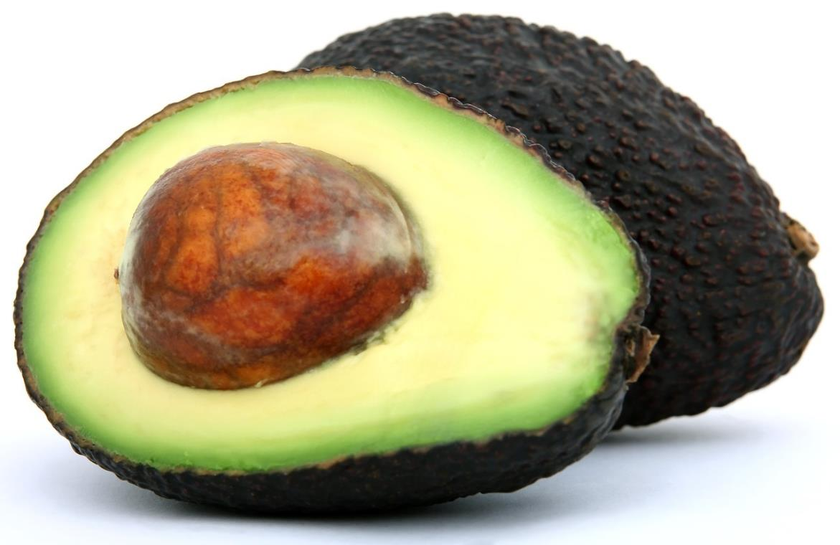
Investigation 5: Earth’s Internal Structure
An Avocado Model of Earth
Photo courtesy of Pixabay.com
Notes:
5 min
a. “In this investigation, you’ll pair up again and explore Earth’s internal structure using an avocado as a model of Earth.”
b. Give each pair an avocado and a knife and instruct participants to carefully slice the avocado in half lengthwise as shown on the slide.
c. “Examine the avocado and discuss your observations with your partner. What does the outer surface of the skin look like? How would you describe the different internal layers? What do they look like? How thick are they? Are the layers hard or soft? What color are they?”
d. “Record your observations in your science notebooks and include a drawing. Make sure to label the different layers of the avocado in your drawings.”

Slide 90
Investigation 5: Earth’s Internal Structure
An Avocado Model of Earth
Skin
Pit
Flesh
Photo courtesy of Pixabay.com
Notes:
2 min
a. “This photo of an avocado shows three different layers: the pit or core, the flesh and the skin. Did you and your partner come up with the same results? Do you have any other observations to add?”
Note: Some pairs may have identified two layers of flesh: the yellow inner layer and the green outer layer. This is also correct.

Slide 91


Investigation 5: Earth’s Internal Structure
An Avocado Model of Earth
How is Earth’s internal structure like that of an avocado?
Photo courtesy of Pixabay.com
Courtesy of clipartxtras.com
Avocado
Earth
Notes:
5 min
a. Read the question on the slide.
b. Call on pairs to share their ideas for answering this question. Remind them to use evidence from the diagram of Earth’s layers and the avocado-Earth model to support their answers. Probe participants’ responses and elicit differing points of view.

Slide 92
Investigation 5: Earth’s Internal Structure
An Avocado Model of Earth
How is Earth’s internal structure like that of an avocado?
Crust
Skin
Mantle
Flesh
Pit
Core
Photo courtesy of Pixabay.com
Courtesy of clipartxtras.com
Avocado
Earth
Notes:
5 min
a. “The diagrams on this slide compare the layers of Earth with the layers of an avocado. Did you and your partner come up with similar results? Do you have any other observations or ideas to add?”
b. Summarize key similarities and differences between and avocado and Earth. Point out that the relative sizes or thicknesses of an avocado’s pit, flesh, and skin are similar to Earth’s core, mantle, and crust. An avocado’s flesh is solid but soft and deformable like Earth’s mantle, and the skin is solid, rigid, and bumpy like Earth’s crust. However, there are also some key differences. For example, an avocado pit is hard and solid, whereas Earth’s core consists of both a solid inner core and a liquid outer core. And even though an avocado’s skin is thin, Earth’s crust is proportionally much thinner.
c. “Overall, an avocado is a pretty good model of Earth, with a few exceptions. What makes it not such a good model?”
d. Participants may note that an avocado is not such a good model for the following reasons:
An avocado has an oval shape, and Earth is round (spherical).
An avocado pit is hard, whereas Earth’s outer core is liquid.
The chemical composition of an avocado isn’t metallic like Earth.
The flesh of an avocado is soft, but Earth’s mantle is composed of solid rock.

Slide 93
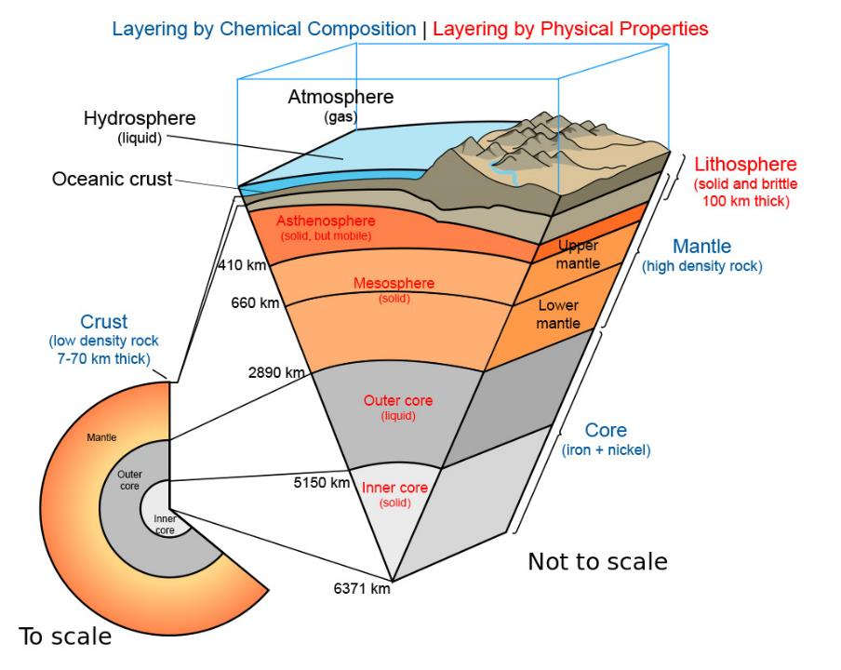
Investigation 5: Earth’s Internal Structure
Two Models of Earth’s Layers
Chemical Composition vs. Physical Composition
Courtesy of Wiki.Seg.org
Notes:
1 min
a. “Geologists use two different models to describe Earth’s internal layers. One model, similar to our avocado Earth model has four layers: an inner core and an outer core, the mantle, and the crust. These layers are defined by their chemical composition.”
b. “But when they’re talking about plate tectonics, geologists use another model with five layers: an inner core, an outer core, the mesosphere, the asthenosphere, and the lithosphere. These layers are defined by their physical properties.”
c. “Tectonic plates are actually part of the lithosphere, which is thicker than the crust and comprises all of the crust as well as the uppermost mantle that’s stuck to it.”

Slide 94
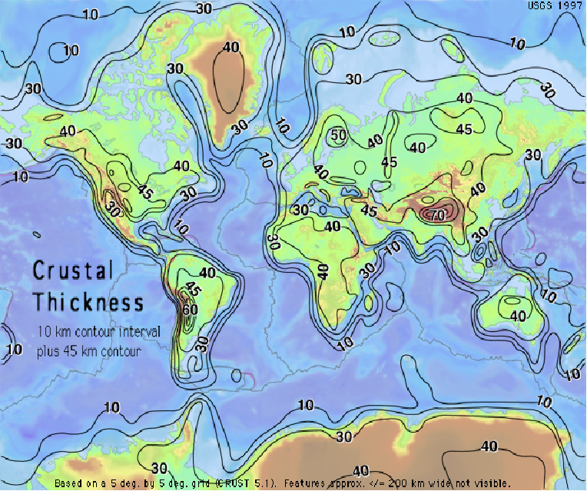
Investigation 5: Earth’s Internal Structure
Two Types of Crust
Oceanic Crust vs. Continental Crust
Courtesy of Earthquake.USGS.gov
Notes:
Less than 1 min
a. “To understand plate tectonics, it’s also important to understand the different types of crust on Earth’s surface that are part of the lithosphere. This map contrasts the thickness of oceanic crust and continental crust.”
b. “Oceanic crust is composed of dense, heavy rock called basalt that is primarily volcanic rock. Continental crust, on the other hand, is composed of rock that is similar to granite but is lighter and less dense. Because of these differences in crustal composition, ocean basins are low places on Earth’s surface that are filled with water, and continents are high places that rise above the oceans.”

Slide 95
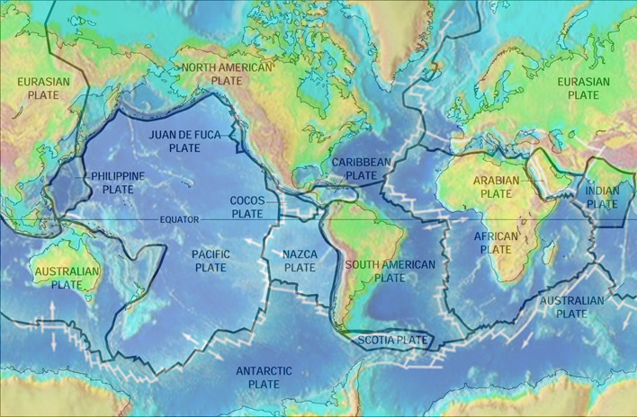
Investigation 5: Earth’s Internal Structure
Courtesy of Wikimedia.org and NOAA.gov
Tectonic plates can have both oceanic and continental crust.
Notes:
2 min
a. “Most of Earth’s tectonic plates are composed of both oceanic and continental crust.”
b. “For example, the North American Plate on this map is made of continental crust in the west (under the United States) and the oceanic crust in the east (under the Atlantic Ocean). In contrast, the Pacific Plate is made up almost entirely of oceanic crust.”
c. Point to the North American Plate and the Pacific Plate on the map and outline the crustal boundaries.

Slide 96
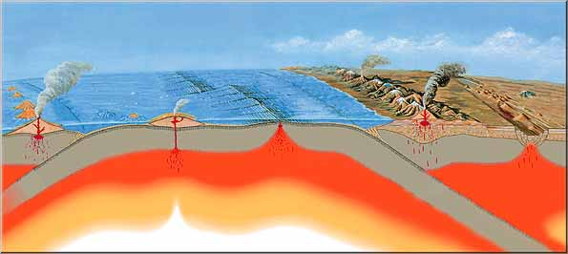
Investigation 5: Earth’s Internal Structure
Oceanic Crust vs. Continental Crust
Trench
Continental Plate
Oceanic Plate
Midocean Ridge
Courtesy of USGS.gov
Seafloor
Spreading
Young, Warm, Rising: Oceanic Crust Formed
Seafloor
Subduction
Old, Cold, Sinking: Oceanic Crust Consumed
Stable Continent
Low Density Continental Crust Remains at Earth’s Surface
Notes:
1 min
a. “The difference in density between oceanic crust and continental crust is very important in plate tectonics.”
b. “New oceanic crust is formed where plates move away from each other. This process is called seafloor spreading. Where Earth’s plates move toward each other, old oceanic crust returns to the mantle in a process called seafloor subduction. Old oceanic crust can sink back into the mantle because it’s cold, heavy, and dense. But continental crust is less dense and too thick to sink into the mantle. This is why continents are relatively stable and don’t sink below Earth’s surface.”

Slide 97
Reflect: Content Deepening Focus Question
  What happens to Earth’s surface that causes mountains to form?
Notes:
Less than 1 min
a. Review the focus question on the slide.
b. “In our next content deepening session, we’ll investigate how tectonic plates move and change Earth’s surface. The information we gather will help us answer this focus question.”
c. “Based on what we’ve learned so far, what initial ideas do you have for answering this question?”

Slide 98
Unit Central Questions
  Why isn’t all of Earth’s surface flat? What causes the surface to look different in different places?
Notes:
5 min
a. “Based on today’s investigations, what initial ideas do you have that might help us answer these questions?”
b. “We’ll add to these ideas in our next content deepening session.”

Slide 99
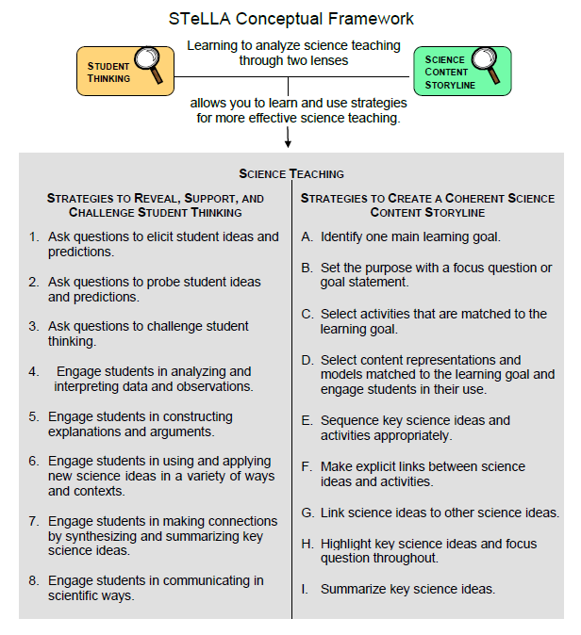
Lesson Analysis Focus Question
What are the STeLLA lenses and teaching strategies, and what is the evidence that they will make a difference in your science teaching?
Notes:
1 min
a. Read the focus question on the slide.
b. “This visual on this slide tells us a little about the first part of our focus question: What are the STeLLA lenses and teaching strategies? As you can see, there are eight specific science teaching strategies to support the Student Thinking Lens.”
c. Acknowledge: “I know you have existing frameworks (ideas and language) regarding teaching and learning, and I expect you’ll continuously draw from them throughout the Summer Institute.”

Slide 100
Lesson Analysis Focus Question
What are the STeLLA lenses and teaching strategies, and what is the evidence that they will make a difference in your science teaching?
Notes:
1 min
a. “Today we’ll begin learning about three of the Student Thinking Lens teaching strategies.
b. Read the strategies highlighted on the slide.
c. “These three types of questions will help reveal, support, and challenge student thinking.”
d. Emphasize: “Even though we’re studying the strategies this summer, you’ll better understand them as you start trying them out in your teaching next fall.”

Slide 101
Strategies 1, 2, and 3: Questions That Elicit, Probe, and Challenge Student Thinking
Student Thinking Lens: Strategies to reveal, support, and challenge student thinking.
  Strategy 1: Ask questions to elicit student ideas and predictions.
  Strategy 2: Ask questions to probe student ideas and predictions.
  Strategy 3: Ask questions to challenge student thinking.
Read and fill in the purpose and key features of each strategy on your blank STL Z-fold summary chart. Then share your charts with a partner.
Notes:
20 min
a. Orient participants to the STeLLA strategies booklet. Forecast that you’ll come back to this resource repeatedly to ensure consistent use of ideas, meaning, and language that match the STeLLA conceptual framework.
b. Individuals: Have participants read about all three strategies and write on their blank STL Z-fold summary charts the purpose(s) and key features of each strategy. State that in the future, they’ll do this kind of reading and writing as homework.
c. Pairs: Have participants pair up and share their Z-fold summary charts. Encourage them to provide evidence from the readings to support their ideas and ask each other questions consistent with the norms for working together, such as “Where did you find that?” or “I interpreted that differently.”

Slide 102
Elicit Questions
What are the purpose and key features of questions that elicit student ideas and predictions?
  Which question from the examples in the strategies booklet do you think would elicit the highest number of different student responses in your classroom? Why do you think so? (Cite ideas from the strategies booklet.)
Notes:
5 min
a. As a group, discuss the purpose and key features of questions that elicit student ideas and predictions. Write these features on chart paper and hang the chart where it can be referenced later.
b. Sample chart:
Key Ideas about Elicit Questions
Purpose: To reveal student ideas, predictions, misconceptions, and experiences before they learn about the content.
Key features:
Asked anytime, but often at the beginning of a lesson
Phrased in everyday language that students can understand even before studying the related content
Addressed to multiple students (usually the whole class)
Reveals a variety of student ideas
Useful to teachers in adapting instruction
Useful to students so they see that others have different ideas
Can be a prediction
Can set up a discrepant event

Slide 103
Probe and Challenge Questions
Probe Questions
What are the purpose and key features of questions that probe student ideas and predictions?
Challenge Questions
What are the purpose and key features of questions that challenge student thinking?
  Remember to cite ideas from the strategies booklet!
Notes:
13 min
a. Small groups (5 min): Split participants into two groups—one group for probe questions and one group for challenge questions. Have each group create a chart of the purpose and key features of the assigned strategy from the STeLLA strategies booklet (not from experience).
b. Whole group (8 min): Share the charts with the entire group. Encourage participants to add to, delete from, and modify them as needed to ensure they’re accurate and match the language in the strategies booklet.

Slide 104
Elicit versus Probe Questions
  What are some key differences between questions that elicit and questions that probe student ideas and predictions?
Notes:
5 min
a. Turn and Talk: “Discuss this question with an elbow partner.”
b. Whole-group share-out: Invite participants to share their ideas with the group.
Key ideas about elicit questions versus probe questions:
Elicit questions are addressed to the whole class; probe questions are addressed to individual students.
Elicit questions are used before students have studied a concept; probe questions can be asked at any time.
Elicit questions start a discussion; probe questions follow up on something a student has already said.

Slide 105
Elicit/Probe Questions versus Challenge Questions
  What are some key differences between questions that elicit and probe student ideas and predictions and questions that challenge student thinking?
Notes:
5 min
a. Turn and Talk: “Discuss this question with your elbow partner.”
b. Whole-group share out: Invite participants to share their ideas with the group.
Key ideas about elicit/probe questions versus challenge questions:
Elicit and probe questions focus on understanding students’ existing ideas rather than trying to change students’ thinking.
In contrast, challenge questions are designed to push students’ thinking toward more-scientific understandings and support them in changing their thinking.

Slide 106
The RESPeCT Lesson Plans Binder
What comes before the lessons?
  Scope and sequence
  Learning goals
  California NGSS
  Student pretest/posttest
  Features analysis chart
  Working with English language learners (ELLs) in science
Overview of lesson format and structure:
  Lesson overview
  Lesson outline
  Detailed lesson plan
Notes:
5 min
a. Foreshadow: “In a moment, we’ll review the details of a homework assignment related to the lesson plans you’ll be teaching in the upcoming school year.”
b. “But before we look at the assignment, let’s review the organization and contents of the lesson plans binder.”
c. Use the slide to guide participants through the binder contents.

Slide 107
Let’s Summarize Today’s Work!
We thought about what constitutes effective science teaching.
We examined the rationale for the Science Content Storyline Lens and analyzed the US and Japanese video clips from the TIMSS video study.
We examined the rationale for the Student Thinking Lens and watched the video of the Harvard and MIT graduates and John and his teacher.
We deepened our understandings of Earth’s surface and why it looks different in various places.
We read and talked about the purposes and key features of elicit, probe, and challenge questions.
Notes:
5 min
a. Remind participants of the various activities they’ve been involved in today.
b. Foreshadow: Let participants know that you’re going to ask them to reflect on what they’ve learned from these activities.

Slide 108
How Did Today’s Work Help You Think about Our Focus Questions?
What are the STeLLA lenses and teaching strategies, and what is the evidence that they will make a difference in your science teaching?
Does the surface of Earth look the same everywhere? In what ways does the surface look different in different places?
Do you think the surface of Earth changes? Why do you think that?
What happens to Earth’s surface that causes mountains to form?
Notes:
10 min
Note: If time is running short, you may want to skip the Turn and Talk or the entire slide.
a. Turn and Talk: “Discuss these questions with an elbow partner.”
b. Whole-group share-out: Invite participants to share their ideas with the group.

Slide 109
Extended Homework
Locate handout 1.6 (Extended Homework: RESPeCT Lesson Plan Analysis) in your PD program binder .
Between now and Friday, read the scope and sequence for the set of lessons and your assigned lesson plan in the lesson plans binder.
Be prepared to share your findings about your assigned lesson plan in a study-group conversation on Friday.
Notes:
5 min
a. Assign each participant one of the lessons in the Earth’s Changing Surface lesson-plan sequence. There are six 2-part lessons in this content area. Each teacher should take responsibility for one 2-part lesson. That is, Teacher 1 will study lessons 1a and 1b; Teacher 2 will study lessons 2a and 2b; and so forth.
b. If the study group is small, figure out who will be assigned an extra lesson (or when you, as the PD leader, will cover any extra lessons).
c. If the study group is large, assign lessons to more than one teacher later in the sequence.
d. Go over the homework sheet (handout 1.6) with participants. If time allows, have them read the assignment sheet before discussing.

Slide 110
Reflections on Today’s Session
Complete the Daily Reflections sheet.
What were your first reactions to the STeLLA claim that it’s important to plan and analyze science teaching through the Student Thinking Lens and the Science Content Storyline Lens? What was convincing or not so convincing for you and why?
What questions do you have about why the surface of Earth looks the way it does?
Provide feedback about today’s session and the program so far (likes, dislikes, questions, concerns, suggestions).
Notes:
5 min
a. Review the questions on the Daily Reflections sheet (handout 1.7).
b. Ask participants to think about these questions and write down their reflections.

