Slide 1
RESPeCT PD pROGRAM
Day 3
RESPeCT Summer Institute
Notes:
5 min
a. Take care of any housekeeping issues.

Slide 2
Agenda for Day 3
Day-2 reflections
Focus questions
Introducing Student Thinking Lens strategies 4 and 5
Lesson analysis: STL strategies 4 and 5
Lunch
Content deepening: Earth’s changing surface
Summary, homework, and reflections
Notes:
2 min
a. Talk through the agenda for the day.

Slide 3
Trends in Reflections
Lesson Analysis | Science Content Learning
Notes:
5 min
a. Invite participants to look at your feedback on their reflections from day 2 and offer reactions, comments, or follow-up questions.
b. Optional: Give participants an opportunity to refine the norms for working together.

Slide 4
Today’s Focus Questions
Lesson Analysis
Content Deepening
How can analyzing data and constructing explanations help students move forward toward deeper understandings of science ideas?
Can mountains grow so tall they reach outer space? Why or why not?
What is an angle, and how do you measure it?
Notes:
2 min
a. Introduce the focus questions that will guide today’s session.
b. “The words moving forward are in bold on the slide because that’s our theme for today and the rest of the week. Yesterday we practiced asking elicit and probe questions, which are great for revealing student ideas. But what do we do with those ideas once we’ve elicited them? How do we support students in moving forward toward deeper understandings of science ideas?”

Slide 5
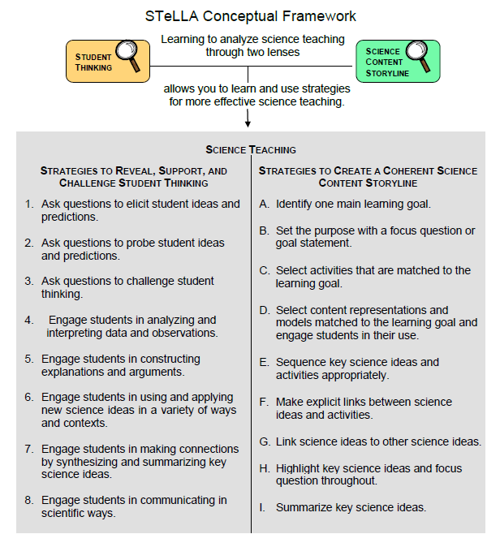
Notes:
1 min
a. Point out the strategies highlighted on the slide.
b. “We’ll continue working on understanding and using the Student Thinking Lens questioning strategies, but today we’ll focus on two closely related activity strategies. Strategy 4 engages students in analyzing and interpreting data and observations, and strategy 5 engages students in constructing explanations and arguments.”

Slide 6
The Student Thinking Lens: Moving Student Thinking Forward
How can we advance students’ science learning without just telling them about science ideas and expecting them to memorize the concepts?
By using STeLLA strategies 4–8 to engage students in making sense of the world around them.
Notes:
10 min
a. Initially, reveal only the question on the slide.
b. Have participants think about the question for a minute; then open up a brief conversation about it.
c. Ask the following questions to stimulate discussion if participants are struggling:
What was your experience as a science student in school or college?
How were you expected to learn science ideas? What learning methods were used?
Did you ever have the opportunity in science classes to make sense of the experiments you performed (instead of just recording the correct answers in a lab report)?
Did science teachers ever support your learning in ways that went beyond merely having you take lecture notes, read from a textbook, or record the correct answers in lab reports?
d. After discussing the questions, reveal the second part of the slide and emphasize the following points:
“Strategies 4 and 5 (as well as 6, 7, and 8) are designed to move student thinking forward by engaging students in sensemaking as they observe data. Rather than just spoon-feeding students science content to read or memorize, these activities lead them toward deeper understandings of science ideas as they construct meaning from evidence.”
“Telling students about science ideas is important, but teachers tend to tell students too much. Instead of doing the hard cognitive work for them, we need to create more opportunities for students to do the thinking and sensemaking themselves so they can truly understand the science concepts. So don’t be in such a hurry to tell students the right answers. Slow down and give them a chance to think!”

Slide 7
The Student Thinking Lens: Moving Student Thinking Forward
Strategies That Reveal Student Thinking | Strategies That Move Student Thinking Forward
1. Elicit questions
2. Probe questions
3. Challenge questions | 3. Challenge questions
4. Analysis and interpretation of data | 4. Analysis and interpretation of data
5. Construction of explanations | 5. Construction of explanations
6. Use and application of new ideas | 6. Use and application of new ideas
7. Synthesis and summarizing | 7. Synthesis and summarizing
8. Scientific communication | 8. Scientific communication
Notes:
5 min
a. Have participants look at the slide representation of the Student Thinking Lens strategies.
b. Ask: “What do you notice?”
Key ideas:
Elicit and probe questions are designed only to reveal student thinking, not to challenge it.
The rest of the strategies reveal and challenge student thinking.

Slide 8
The Student Thinking Lens: From Questions to Activities
Look at the Summary of STeLLA Student Thinking Lens Strategies in the strategies booklet.
What distinguishes strategies 1–3 from the rest of the Student Thinking Lens strategies?
Notes:
5 min
a. Individuals: Have participants briefly examine the summary chart of STL strategies in the STeLLA strategies booklet (Summary of STeLLA Student Thinking Lens Strategies).
Note: Direct participants to the correct page in the strategies booklet or have them consult the table of contents.
b. Whole group: “How are the first three strategies different from the rest?”
Key ideas:
Strategies 1–3 are questions; the rest are activities.
Probe and challenge questions can and should be asked during all types of activities.

Slide 9
STL Strategies 4 and 5: Purposes and Key Features
Strategy 4
What are the purpose and key features?
Strategy 5
What are the purpose and key features?
Notes:
30 min
a. Small groups (12 min): Divide participants into two groups and assign one strategy to each group. Have one group create a chart listing the purpose and key features of strategy 4, and have the other group chart the purpose and key features of strategy 5. Each group should be prepared to answer the discussion question for the assigned strategy.
b. Whole-group share-out (18 min): Have groups report the purpose and key features of each strategy.
Key ideas:
Strategy 4 involves activities that engage students in organizing their data and/or observations and looking for patterns and meaning in them. They aren’t just “doing” activities or describing their observations.
Strategy 5 engages students in learning how to use logical thinking, evidence, and science ideas to construct explanations of scientific data or phenomena they have observed. It also engages them in critiquing various proposed explanations through scientific argumentation.
Remind participants that these strategies are closely related and will overlap in some activities. However, each has a specific purpose and unique attributes.

Slide 10
Relationships between Strategies 4 and 5
Discuss the question assigned to your group and be ready to share your ideas:
Group 1: How is analyzing/interpreting different from describing observations?
Group 2: How are strategy 4 and strategy 5 different? How are they related?
Group 3: How are scientific explanation and scientific argumentation related? How are they different? How are arguments in science different from arguments in everyday situations?
To support your responses, use the STeLLA strategies booklet and Quick Reference Tools for Strategies 4 and 5 (handout 3.1).
Notes:
15 min
a. Small groups (5 min): Divide participants into three small groups or pairs. Assign each group one question to discuss and tell participants to be ready to share their ideas with the entire group.
b. Emphasize: Participants should use the STeLLA strategies booklet and Quick Reference Tools for Strategies 4 and 5 (PD handout 3.1) to support their responses.
c. Whole-group share-out (10 min):
“What did you come up with for the first question?”
Key ideas for question 1: Analysis and interpretation involve moving beyond simply describing observations to doing something with the data, including (but not limited to) making comparisons, identifying relationships, and organizing data in ways that will reveal patterns (such as using charts, diagrams, and graphs).
“What did you come up with for the second question?”
Key ideas for question 2: Strategy 4 lays the groundwork for strategy 5. Before we can build a scientific explanation for a specific phenomenon, we need to make some observations, analyze the data to reveal patterns, and organize the data to gather the necessary evidence to support construction of a scientific explanation. A scientific explanation includes a claim that answers the question being studied, evidence that supports the claim, and reasoning that links the claim to the evidence and to science ideas.
“What did you come up with for the third question?”
Key ideas for question 3: A scientific explanation includes a claim that answers the question being studied, evidence that supports the claim, and reasoning that links the claim to the evidence and to science ideas. Scientific arguments involve assessing the strength and quality of the evidence and reasoning in different scientific explanations for the same observations and determining which proposed explanation has the best supporting evidence, science ideas, and reasoning.

Slide 11
Practice Identifying Strategies 4 and 5
Examine student statements made during a science-class activity. Decide whether each statement represents the following:
An observation
An analysis or interpretation of the observations (e.g., describing a pattern) (strategy 4)
An attempt to construct an explanation that has a claim, some evidence, and/or reasoning that uses science ideas (strategy 5)
An attempt to construct an argument (strategy 5)
Refer to Practice Identifying Strategies 4 and 5 (handout 3.2).
Notes:
15 min
a. “Before we view classroom video clips to identify and analyze strategies 4 and 5, we’re going to practice identifying observations, analyses, interpretations, explanations, and arguments from a handout of student statements. Learning to distinguish which strategy students are using in these examples will help us when we review the classroom videos, where the strategies aren’t always as clear cut.”
b. Refer participants to handout 3.2 in their PD program binders (Practice Identifying Strategies 4 and 5).
c. Pairs: Have participants work in pairs to analyze student statements in the handout.
d. Whole group: As participants discuss and clarify their analyses of the student statements, encourage them to refer frequently to the STeLLA strategies booklet and the Quick Reference Tools handout (PD handout 3.1).
Note: For examples of ideal participant responses, see PD Leader Master: Practice Identifying Strategies 4 and 5.

Slide 12
Lesson Analysis Focus Question
How can analyzing data and constructing explanations help students move forward toward deeper understandings of science ideas?
Notes:
Less than 1 min
a. Review the focus question that will guide today’s lesson analysis work.

Slide 13
Lesson Analysis: Review Lesson Context
Video Clip 1
Review the lesson context at the top of the video transcript (handout 3.3 in your program binder).
Notes:
3 min
a. “Now let’s see if we can recognize students analyzing and interpreting data in a classroom video clip.”
b. Review the lesson context at the top of the transcript for video clip 1 (handout 3.3 in PD binder), making sure participants understand both the content and activity in focus.

Slide 14
Lesson Analysis: Identify Strategy 4
Video Clip 1
Identify instances where the teacher or the students are engaged in analyzing and interpreting data and observations by
clarifying key observations,
identifying a pattern in the observations,
identifying what needs to be explained,
organizing data/observations, and/or
trying to make sense of the observations (analyzing, interpreting).
Discuss: How are these actions implemented in the video?
Link to video clip 1: 3.1_stella2-04-potter4-L4_C1-2
Notes:
25 min
a. “As we watch the video clip, we’ll identify actions that illustrate strategy 4. Be on the lookout for instances where the teacher or the students do something listed on the slide. That’s what we’ll discuss first.”
b. Show the video clip.
c. Individuals: “Think about the strategy 4 actions listed on the slide.”
d. Whole group: “Discuss the question on the slide. Make sure to support your claims with evidence from the video transcript.”

Slide 15
Lesson Analysis: Analyze Strategy 4 and Reflect
Video Clip 1
Analyze
What student thinking is revealed in the video clip by engaging students in analysis and interpretation?
Were any opportunities missed for engaging students in analyzing and interpreting data and observations?
Reflect
What did you learn about strategy 4 from analyzing this video clip?
Did the analysis process focus your attention on aspects you might not have noticed before? If yes, what is one example?
Notes:
25 min
a. Individuals: “For the first analysis question on the slide, study the transcript for video clip 1 and come up with a claim, evidence, and reasoning to support your claim. For the second analysis question, consider alternative moves the teacher could have made as you identify missed opportunities.”
b. Whole group: After participants have shared their analyses, ask, “Were there any missed opportunities for engaging students in analyzing and interpreting data?”
c. Reflect: Discuss the reflection questions on the slide, making sure participants share specifically what they learned about strategy 4.

Slide 16
Strategy 5 Practice: Explanation and Argumentation
Analyze the sample transcript in the strategies booklet to find evidence of students engaged in constructing explanations and arguments by
making a claim that answers the investigation question,
making a claim and supporting it with evidence,
making a claim and supporting it with science ideas,
using logical reasoning to explain why the evidence supports a claim, and/or
making an argument.
Notes:
10 min
a. “Strategy 5 is the focus of the next video clip, although you may also see evidence of strategy 4 being used.”
b. Have participants analyze the two transcript examples (under “About Earth’s Changing Surface” in the strategy 5 chapter) in the STeLLA strategies booklet and look for evidence of students engaging in constructing explanations and arguments.
Note: This is an important activity, but it can be cut if time is short.
c. “Before we view another classroom video, let’s practice analyzing examples of strategy 5 in the STeLLA strategies booklet. Read the sample transcript in the section titled ‘About Earth’s Changing Surface’ and see if you can find any evidence of students engaging in constructing explanations and arguments. Refer to the list on the slide for guidance.”
Individual work time (5 min).
Whole-group share-out: Have participants share evidence from the transcript of students engaging in strategy 5, noting the specific action illustrated from the list on the slide. Ask what makes the first student’s explanation different from the second student’s argument.

Slide 17
Lesson Analysis: Review Lesson Context
Video Clip 2
Read the lesson context at the top of the video transcript (handout 3.4 in your program binder).
Notes:
2 min
a. “Now we’re going to look at another video clip and focus on identifying strategy 5: Engage students in constructing explanations and arguments.”
b. Read the context of the lesson at the top of the transcript for video clip 2 (handout 3.4 in the PD program binder).
c. “In this synthesis activity, students are using science ideas from a lesson investigation to answer the focus question, ‘Can mountains grow so tall they reach outer space? Why or Why not?’”

Slide 18
Lesson Analysis: Identify Strategy 5
Video Clip 2
Identify instances in the video clip where students are constructing explanations or arguments by
stating an explanation or claim,
using evidence from observations to support or develop the explanation/claim,
using science ideas to support or develop the explanation/claim,
using logical reasoning to develop the explanation/claim, and/or
engaging in argumentation (agreeing, disagreeing).
Discuss: How are these actions implemented in the video?
Link to video clip 2: 3.2_stella2-04-potter4-L4_C9
Notes:
25 min
a. “As you watch the video clip, identify instances where students are engaged in constructing explanations and arguments (strategy 5). You might notice examples of strategy 4 (analyzing and interpreting data), but focus on identifying strategy 5. Also notice the kinds of questions the teacher asks (elicit, probe, or challenge).”
b. Before showing the video clip, read the list of actions on the slide.
c. Individuals: “Think about the strategy 5 actions listed on the slide.”
d. Whole group: “Discuss the question on the slide. Make sure to support your claims with evidence from the video transcript.”
e. Emphasize: “Strategy 5 is designed to help move student thinking forward toward deeper understandings of science ideas, so we should see challenge questions as well as probe questions in the video clip.”

Slide 19
Lesson Analysis: Analyze Strategy 5 and Reflect
Video Clip 2
Analyze
What student thinking is revealed by engaging students in constructing explanations of Earth’s changing surface?
Were there any missed opportunities to support students in constructing explanations and arguments?
Reflect
What did you learn about strategy 5 from analyzing this video clip?
Did the analysis process focus your attention on aspects you might not have noticed before? If yes, what is one example?
Notes:
20 min
a. Individuals: “For the first analysis question on the slide, study the video transcript and come up with a claim, evidence, and reasoning to support your claim. For the second analysis question, consider alternative moves the teacher could have made as you identify any missed opportunities.”
b. Whole group: After participants have shared their analyses, ask, “Were there any missed opportunities for engaging students in constructing explanations and arguments?”
c. Reflect: Discuss the reflection questions on the slide, making sure participants share specifically what they learned about strategy 5.

Slide 20
Reflect: Key Ideas about Lesson Analysis
Lesson analysis slows down classroom events so we can focus on specific student thinking.
Making a claim based on evidence challenges us to listen carefully to what students are saying and understanding. When we make quick assessments, we might think they understand things they’re actually still struggling with.
Even though events happen fast in classroom teaching, we can get better at listening to students and making on-the-spot assessments of their understandings and confusion!
Notes:
3 min
a. “Let’s reflect on some key ideas you can take away from your lesson analysis experiences. These ideas may not reflect your personal experiences with lesson analysis so far, but hopefully you’ll see their value in the lesson analysis process over time.”
b. Read the key ideas on the slide.
c. Ask participants for their reactions to these ideas.

Slide 21
Summarizing Strategies 4 and 5
Create a word picture (a concept map, a thinking map, or other visual) to show how analysis and interpretation (strategy 4) are related to explanation and argumentation (strategy 5). Label any connecting arrows. Suggested words to use:
Analyze and interpret
Argument
Data
Evidence
Explanation
Logical thinking
Organize
Observe/observations
Patterns
Reasoning
Science ideas
Notes:
12 min
Note: Skip this activity if time is short.
a. Individuals: To summarize strategies 4 and 5, have participants work independently to create visuals that show how analysis and interpretation (strategy 4) are related to explanation and argumentation (strategy 5).
b. Pairs: “Share and compare your visuals with a partner.”
c. Whole group: “What questions did this activity raise for you?”

Slide 22
Reflect: Lesson Analysis Focus Question
How can analyzing data and constructing explanations help students move forward toward deeper understandings of science ideas?
Notes:
5 min
a. Review today’s lesson analysis focus question.
b. Think-Pair-Share: “Think for a moment about this focus question and how you might convince parents or colleagues that analyzing data and constructing explanations moves student thinking forward toward deeper understandings of science ideas. Then share your ideas with an elbow partner.”

Slide 23
EARTH’S CHANGING SURFACE
SCIENCE AND MATH CONTENT DEEPENING Grade 4
Notes:
Less than 1 min
a. Transition: This slide marks the transition to the content deepening work.
Note: Throughout this content deepening phase, refer as needed to Earth’s Changing Surface: Learning Goals for Students and Teachers, the content background document, and Common Student Ideas about Earth’s Changing Surface.

Slide 24
Earth’s
Changing
Surface
Content
Deepening
Developed by
Dr. Jeff Marshall
Geological Sciences
Cal Poly Pomona
Used by permission
Photo courtesy of Visible Earth
Notes:
Less than 1 min
a. “Today’s content deepening will focus on science ideas about Earth’s changing surface from ECS lessons 5a/b. We’ll also explore Common Core math standards regarding angles and their measurement.”

Slide 25
Unit Central Questions
Why isn’t all of Earth’s surface flat? What causes the surface to look different in different places?
Notes:
Less than 1 min
a. Review the unit central questions on the slide.
b. Remind participants that these questions will guide student learning throughout the entire series of ECS lessons.
c. “We’ll gather more information during today’s content deepening investigations to help us answer these questions.”

Slide 26
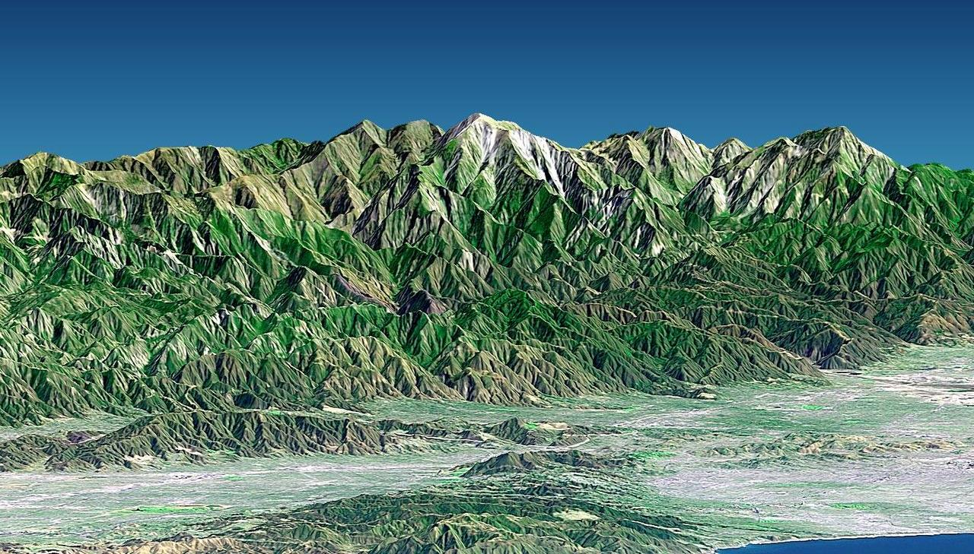
Key Science Idea
Tectonics + Erosion = Earth Surface Form
Photo courtesy of NASA/JPL/NIMA
Earth’s surface form is the result of tectonic processes that build up the land and erosional processes that wear down the land at the same time.
Notes:
Less than 1 min
a. Remind participants that Earth’s surface form is the result of tectonic processes that build up the land and erosional processes that wear down the land at the same time. This key science idea is the fundamental theme of the ECS unit.

Slide 27
Earth’s Changing Surface
Lesson 5a
Photo courtesy of Visible Earth
Notes:
Less than 1 min
a. “Next, we’ll explore ideas about Earth’s changing surface from ECS lesson 5a.”

Slide 28
Content Deepening Focus Questions
Can mountains grow so tall they reach outer space? Why or why not?
Notes:
Less than 1 min
a. Read the focus questions on the slide.
b. Emphasize that these questions will guide student learning throughout ECS lesson 5a.
c. Have participants write these questions in their science notebooks and draw a box around them.

Slide 29
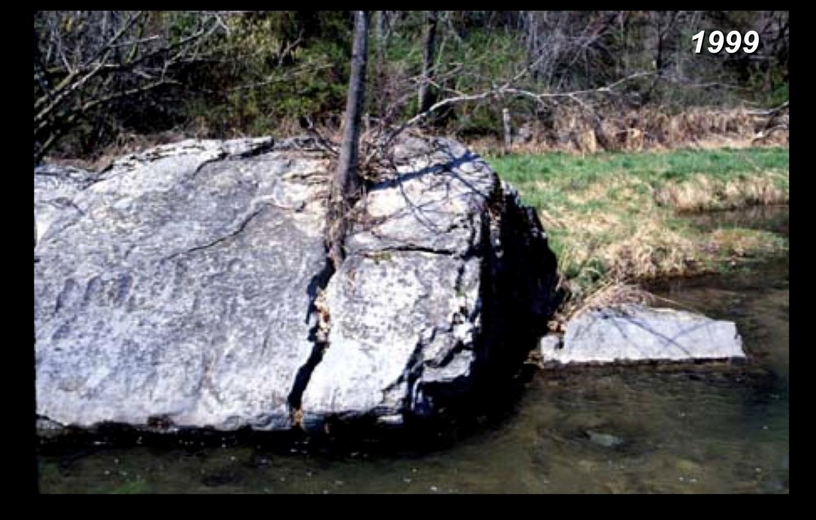
Investigation 1: A Tree in a Boulder
Photograph by Dr. Christopher Woltemade
Notes:
1 min
a. Have participants locate handout 5.2 (Pictures of a Tree in a Boulder) in their lesson plans binder.
b. “The first photograph on the handout was taken in 1999. Examine this photograph closely, focusing on the tree and the crack in the rock.”

Slide 30
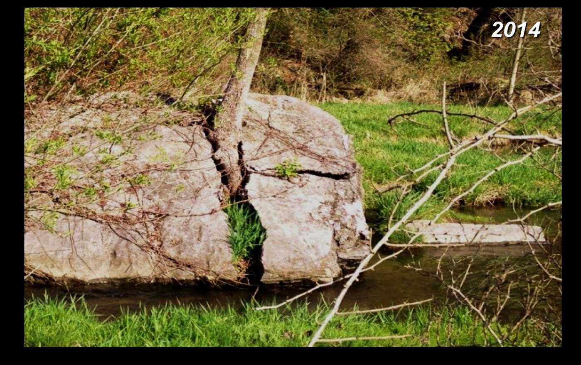
Investigation 1: A Tree in a Boulder
Photograph by Dr. Christopher Woltemade
Notes:
1 min
a. “Now look at the second photograph on your handout. This photo of the same rock and tree was taken 15 years later in 2014.”
b. Think-Pair-Share: “Examine this photo closely, focusing again on the tree and the crack in the rock. Think about the similarities and differences between the two photographs. Then turn to an elbow partner and share your observations.”

Slide 31
Investigation 1: A Tree in a Boulder
Task A: Observe the two pictures of a tree growing in the crack of a boulder. Discuss your observations with an elbow partner.
Talk about the differences you observe between the two photographs. Focus on the tree and the boulder.
Describe what happened between 1999 and 2014.
Predict what you think will happen in 50 years. Explain why you think so.
Notes:
5 min
a. Read the instructions on the slide.
b. Pairs: Direct participants to work through Task A with their elbow partners.
c. Whole group: Invite pairs to share their observations and predictions with the group. Probe participants’ responses and elicit differing points of view.
d. During this discussion, record participants’ observations and predictions on chart paper.

Slide 32
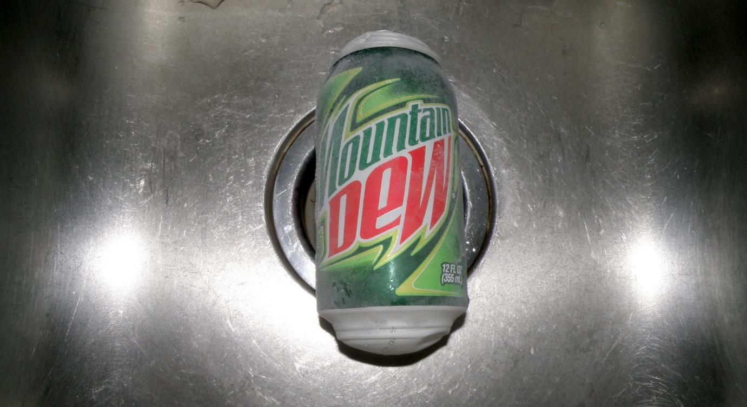
Investigation 2: Soda Cans
Photo courtesy of Master Marf
Notes:
Less than 1 min
a. Distribute two cans of soda—one frozen and the other at room temperature—to each pair of participants.
Note: Make sure the frozen cans are bulging or show some other kind of expansion deformities.
b. “One of these soda cans was frozen overnight, and the other remained at room temperature.”

Slide 33
Investigation 2: Soda Cans
Task B: Observe the two cans of soda. Discuss your observations with an elbow partner.
How is the frozen soda can different from the room-temperature can?
Why is the frozen soda can deformed?
What do you think will happen when the soda in the frozen can thaws?
What do you predict will happen over time when water freezes and then thaws in the crack of a rock?
Notes:
5 min
a. Read the instructions for Task B on the slide.
b. Pairs: Direct participants to work through this task with their elbow partners.
c. Whole group: Invite pairs to share their observations and predictions with the group. Probe participants’ responses and elicit differing points of view.
d. During the discussion, record participants’ observations and predictions on chart paper.

Slide 34
Earth’s Changing Surface
Lesson 5b
Photo courtesy of Visible Earth
Notes:
Less than 1 min
a. “Now we’ll explore ideas about Earth’s changing surface from lesson 5b.”

Slide 35
Content Deepening Focus Questions
Can mountains grow so tall they reach outer space? Why or why not?
Notes:
Less than 1 min
a. Review the focus questions on the slide.
b. “These questions from ECS lesson 5a will guide student learning throughout lesson 5b as well.”

Slide 36
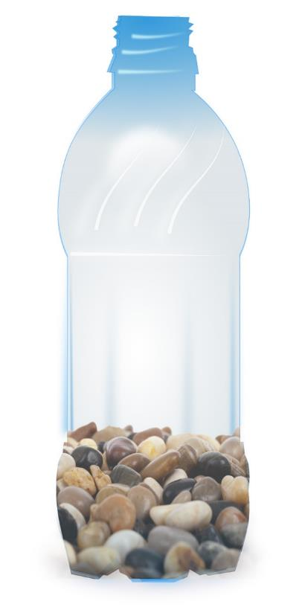
Investigation 3: Rock Shakers
Courtesy of Cal Poly Pomona
Notes:
Less than 1 min
a. For this investigation, have participants pair up again.
b. Distribute one plastic jug with lava rocks to each pair. Make sure all the jugs have lids.
Note: Alternatively, you may use water bottles or tubs with lids for this activity.

Slide 37
Investigation 3: Rock Shakers
Task C: Shake rocks in a plastic jug.
Before shaking the jug, make sure to count and observe the rocks. Share your observations with your elbow partner and record them in your notebook.
Take turns shaking the jug for 1 minute each.
After 2 minutes of shaking, count and observe the rocks again. Share your observations and record them in your notebooks. Describe any differences you observe in the rocks after shaking compared to before.
Based on this investigation, what do you think might happen to a large rock that rolls down a mountain slope or is carried by flowing water down a riverbed.
Notes:
15 min
a. Read through the instructions on the slide.
b. Pairs (10 min): “You and your elbow partner will have 4 minutes to complete your preshaking rock count, sharing your observations, and recording them in your notebooks. Then you’ll have a total of 2 minutes to take turns shaking your jug. I’ll cue you when it’s time to trade off. After 2 minutes of shaking, you’ll have 4 minutes to count your rocks again and share your postshaking observations. Make sure to record your observations in your notebooks.”
c. Answer any questions participants may have. Then direct pairs to count their rocks and make their preshaking observations.
d. At the end of 4 minutes, make sure everyone has finished recording their observations before directing pairs to start shaking their jugs. Use a timer to keep track of the time, or keep an eye on the clock. After 1 minute of shaking, tell partners to trade off.
e. After 2 minutes, ask pairs to stop shaking their jugs. Give them 4 minutes to count their rocks again and discuss their observations before recording them in their notebooks.
f. Whole-group discussion (4 min): Make sure everyone has finished the task before inviting pairs to share their observations with the group. After the share-out, ask participants to explain how this investigation relates to the previous investigations with the soda cans and the tree and boulder. Probe participants’ responses and elicit differing points of view.
g. During this discussion, record key observations and ideas on chart paper.

Slide 38
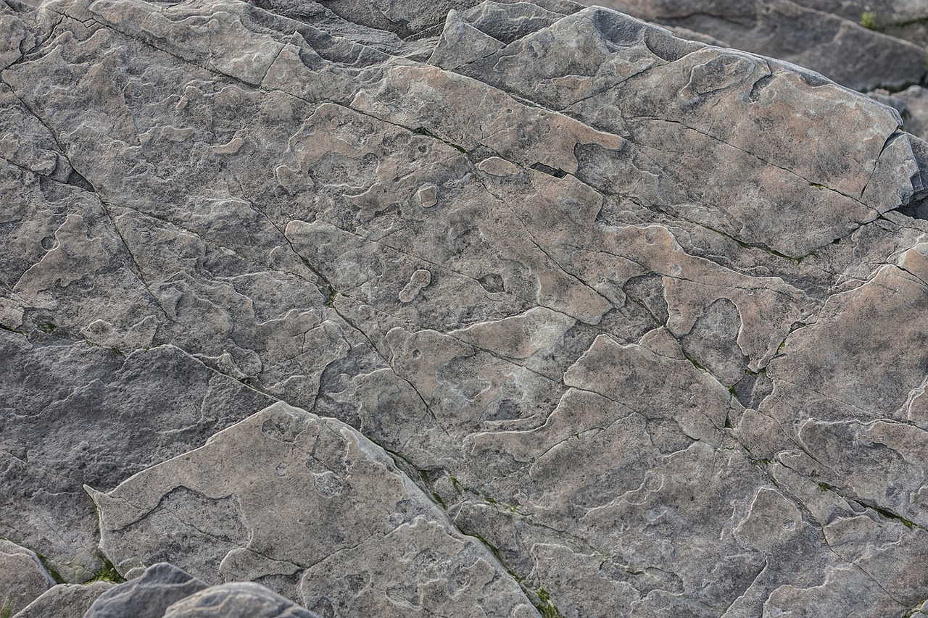
Rock Weathering
Rock weathering refers to all natural processes that break down and reduce the strength of intact rock.
Physical weathering: The mechanical disintegration of intact rock and minerals into smaller pieces.
Chemical weathering: The chemical alteration of minerals that reduces rock strength.
Photo courtesy of Pixabay.com
Photo courtesy of Pixabay.com
Notes:
10 min
a. “Next, we’ll explore some key science ideas about rock weathering.”
b. “The term rock weathering refers to all natural processes that break down and reduce the strength of intact rock. Weathering processes take place in situ at rock outcroppings. These processes break down rocks and prepare them for erosion. Erosion is the removal and transport of weathered material by means of flowing water, ice, wind, or gravity. In this case, weathered rock is removed and transported to a new location as sediment.”
c. “As the slide indicates, there are two main categories of rock weathering: physical weathering and chemical weathering.”
d. Read the definitions on the slide.
e. Think-Pair-Share: “Think for a moment about the three investigations we just completed: the tree-and-boulder investigation, the soda-can investigation, and the rock-shakers investigation. Which of the weathering categories on the slide do you think best describes each investigation? Share your ideas with an elbow partner and then write them in your notebooks.”
f. Whole-group share-out: “So which weathering category do you think best describes each of our investigations? Let’s hear your ideas.”
g. As participants share, probe their ideas and elicit differing points of view. Guide the discussion toward the conclusion that all three investigations describe physical weathering. In each investigation, rock was mechanically broken down through physical force. In the tree-and-boulder investigation, tree roots widened a preexisting crack in rock. The frozen soda can demonstrated that expanding ice can widen a preexisting crack in rock, and the rock-shakers investigation demonstrated that larger rocks can be broken into smaller pieces as they collide with one another.
h. “Rust is an example of chemical weathering. A rock turning rust red is an example of rainwater chemically oxidizing iron-bearing minerals in much the same way a metal wagon or bicycle rusts when left outside in the rain for a long time.”
i. Emphasize that both physical and chemical weathering reduce the strength of hard rocks and make them more susceptible to erosion.

Slide 39
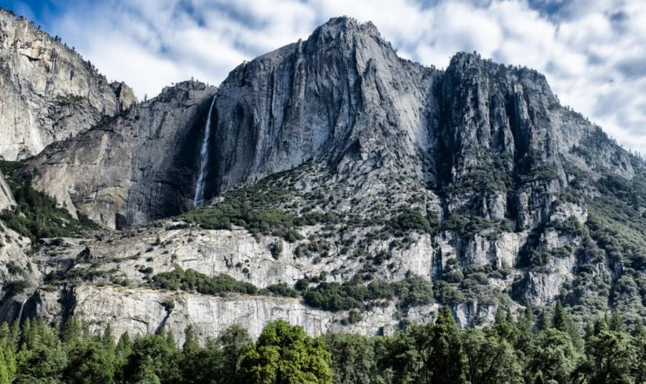
Physical-Weathering Processes
Pressure release
Thermal expansion and contraction
Growth of foreign crystals
Photo courtesy of Publicdomainpictures.net
Photo courtesy of Pixabay.com
Notes:
3 min
a. “This slide shows the three primary physical-weathering processes.”
b. “Pressure release causes rocks and minerals to crack by expansion in response to reduced confining pressure. Hard rock formed deep underground—like the granite in this photo—is under very high pressure from the weight of overlying rock. As erosion removes rock from Earth’s surface over millions of years, the deeper rock moves closer to the surface and is under much less pressure. That rock will expand and crack outward like an onion skin in a process called exfoliation. The famous granite domes in Yosemite National Park are one example of this process.”
c. “Thermal expansion and contraction is another process that cracks rocks and minerals. Over long periods of time, rocks on Earth’s surface are exposed to cyclic heating and cooling, from day to night, summer to winter, warm period to ice age. Rocks can also be exposed to sudden heating from forest fires or lava flows. Heating results in expansion, and cooling results in contraction. Repeated heating and cooling cause rocks to crack and break down.”
d. “The growth of foreign crystals is the third important process that causes rocks to crack. This primarily happens on a microscopic scale as minerals undergo chemical changes that produce lower-density, higher-volume by-products that take up more space and push outward on surrounding minerals. This mineral expansion causes rocks to crack.”
e. Point out an important potential misconception: Students may think that the tree-and-boulder and soda-can investigations illustrate how tree roots and ice can cause rocks to crack. But it’s important to emphasize that these illustrations focus on preexisting cracks in rock formed by one of the three rock-weathering processes. Although growing tree roots and expanding ice are capable of increasing the size of preexisting cracks in rock, neither can exert enough pressure to cause new cracks to form.
f. Highlight another potential misconception: Students may relate the rock-shakers investigation to weathering, since it illustrates how rocks break down when they collide with each other during erosion and transport. However, this is more of an erosional process than strictly a weathering process. Weathering is generally limited to things that happen to rock before erosion and transport.

Slide 40
Chemical-Weathering Processes
Oxidation-reduction
Hydrolysis
Biochemical weathering
Photo courtesy of Pixabay.com
Notes:
3 min
a. “This slide shows the three primary chemical-weathering processes.”
b. “Oxidation-reduction is a common process that occurs when oxygenated rainwater comes in contact with iron-bearing minerals on Earth’s surface (such as pyroxene and magnetite) and converts these minerals into iron oxide or rust. This chemical-weathering process weakens rock and gives it a reddish color like the rocks on the slide.”
c. “Hydrolysis is the most common chemical-weathering process. Carbon dioxide dissolved in rainwater leads to the formation of carbonic acid that breaks down silicate minerals like feldspar and biotite, converting them to clay and releasing common nutrient ions like calcium, sodium, and potassium into the soil. The various types of soil that cover Earth’s surface and allow humans to grow crops are the product of hydrolysis.”
d. “In biochemical weathering, living organisms, such as tiny microbes in water or soil, cause a wide range of chemical reactions that break down rock minerals. Plant roots also cause chemical reactions in rocks and soil. This allows a plant to take in needed nutrient ions originating from rock minerals.”
e. “Physical weathering and chemical weathering take place at the same time and are often interdependent processes that break down rocks and minerals, preparing them for erosion.”

Slide 41
Reflect: Content Deepening Focus Questions
Can mountains grow so tall they reach outer space? Why or why not?
Notes:
5 min
a. Review the focus questions on the slide.
b. Invite participants to share their ideas for answering the questions, using observations and evidence from today’s investigations.
c. Encourage participants to agree, disagree, ask questions, or add to the ideas others share.
d. During this discussion, record key ideas on chart paper.

Slide 42
Key Science Ideas
Rock weathering refers to all natural processes that break down and reduce the strength of intact rock.
Physical weathering involves the mechanical disintegration of intact rock and minerals into smaller pieces. This process includes pressure release, thermal expansion and contraction, and the growth of foreign crystals.
Chemical weathering involves the chemical alteration of minerals that reduces rock strength. This process includes oxidation-reduction, hydrolysis, and biochemical weathering.
Physical weathering and chemical weathering occur at the same time and are often interdependent processes that break down rock and minerals to prepare them for erosion.
Weathering and erosion limit mountain growth.
Notes:
3 min
a. Review the key science ideas on the slide that answer the focus question. Emphasize that participants’ observations and evidence from the map investigations helped shape these responses.
b. Whole-group discussion: “Does everyone agree with these ideas? Would you like to add or revise anything?”
c. Ask participants to copy these ideas into their science notebooks under the focus question.

Slide 43
Math Content Deepening Focus Question
What is an angle, and how do you measure it?
Notes:
Less than 1 min
a. Read the focus question on the slide.
b. Emphasize that these questions will guide student learning throughout ECS lesson 5a.
c. Have participants write these questions in their science notebooks and draw a box around them.

Slide 44
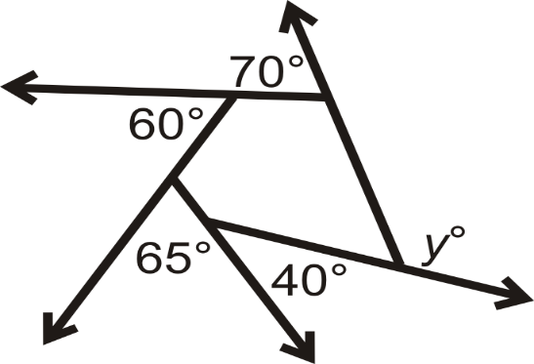
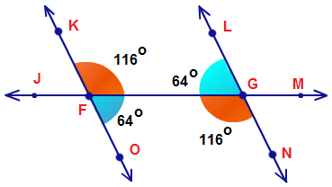
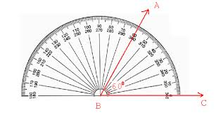
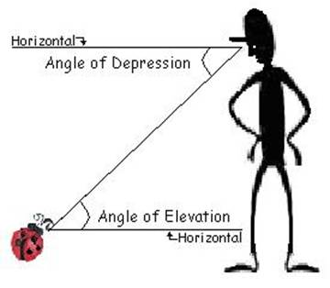
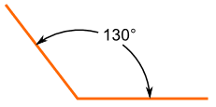
What Do You Know about Angles?
Notes:
Less than 1 min
a. Ask participants what they know about angles. (Keep this discussion brief.)

Slide 45
Common Core State Standards (CCSS)
According to the California Common Core standards for mathematics, 4th-grade students must be able to do the following:
Recognize angles as geometric shapes that are formed wherever two rays share a common endpoint, and understand concepts of angle measurement.
Notes:
Less than 1 minute
a. Review the CCSS standard for geometric measurement on the slide.
b. Note that this is a new domain for 4th grade.

Slide 46
CCSS: Concepts of Angle Measurement
The Common Core standard for angle measurement:
An angle is measured with reference to a circle with its center at the common endpoint of the rays, by considering the fraction of the circular arc between the points where the two rays intersect the circle. An angle that turns through $\frac{1}{360}$ of a circle is called a “one-degree angle,” and can be used to measure angles.
What part of this standard do you think is hardest for students?
Notes:
3 min
a. Read the California Common Core standard for angle measurement on the slide.
b. Ask: “What part of this standard do you think is hardest for students?”
c. Invite participants to share some of the challenges students have in understanding angle measurement.

Slide 47
CCSS: Concepts of Angle Measurement
According to the geometric-measurement standard,
An angle that turns through n one-degree angles is said to have an angle measure of n degrees.
This may sound easy, but it requires laying a new foundation for students.
Why is angle measurement hard for students?
Why are some students better at it than others?
Notes:
3 min
a. Read the standard on the slide and note the use of the word turns. This supports the concept of how angles are measured, but it requires laying a new foundation for students.
b. Ask: “Why is angle measurement hard for students? Why are some students better at it than others?”

Slide 48
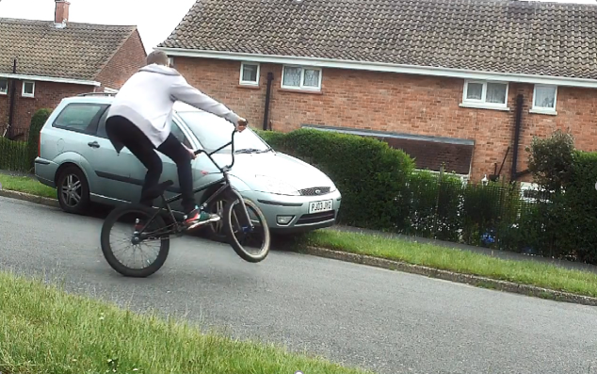
Describing Turn: Video Clip 1
Source: unknown
Link to Describing Turn video clip 1
Notes:
4 min
a. Show the video clip of a boy riding a bike.
b. Ask participants, “How would you describe this turn?”
c. Discuss what a complete turn means and how it’s measured. Consider the idea that 360 degrees is a full turn or rotation.

Slide 49
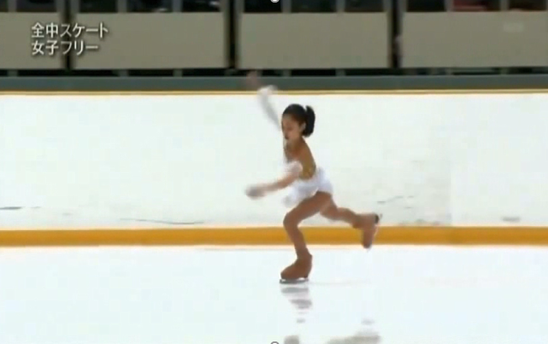
Describing Turn: Video Clip 2
Source: unknown
Link to Describing Turn video clip 2
Notes:
4 min
a. “The next video clip of an ice skater engages us in the idea of a 360-degree turn that allows for some computation. Watch the skater’s feet to get an accurate count and result.
b. Show the video clip.
c. Highlight the result of the computation: (360 x 3) + (360 x 3).

Slide 50
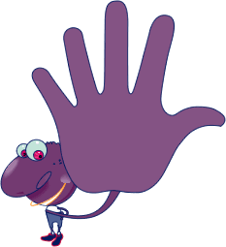
Estimating Angle Measures
Challenge: Estimate the angle measures between your fingers when you spread out your hand.
Notes:
Less than 1 min
a. “Your next challenge will be to estimate the angle measures between your fingers when you spread out your hand.”

Slide 51
Estimating Angle Measures
The angle measure between your thumb and index finger when your hand is shaped like an L is about 90 degrees.
How do the angle measures between your other fingers compare to this angle measure? Are they larger or smaller? Half that measure?
Draw the 90-degree angle between your thumb and index finger in your notebook. Then sketch an angle with half that measure.
Use your sketch to estimate the other angle measures between your fingers.
Notes:
7 min
a. Read the directions on the slide.
b. Individuals (4 min): Have participants work independently on their estimates. Be available to answer questions as they arise.
c. Whole group (2 min): After participants have completed their estimates, discuss the results as a group.

Slide 52
Do Longer Fingers Mean Larger Angles?
Do people with long fingers have larger angles between their fingers?
Notes:
7 min
a. Read the question on the slide.
b. “This question highlights an important misconception about angle measurement: Students may think that when two sides of an angle are longer than the sides of another angle, the angle with the longer sides is bigger.”
c. Have participants think about the question on the slide for a moment; then elicit participants’ ideas and reasoning.
d. Individuals: Distribute handout 3.5 (Misconception Related to Angles) and give participants a couple of minutes to read through the information silently.
e. Whole group: Discuss the misconception and the suggested remedies. Invite participants to share other possible remedies.

Slide 53
Do Longer Fingers Mean Larger Angles?
Answer: Finger length does NOT affect angle measures.
The largest angle between the thumb and index finger measures about 90. (A 90-degree angle is a right angle.)
The other angle measures between fingers vary somewhat depending on the person. But turn doesn’t change even though longer fingers extend the lines of an angle.
Notes:
2 min
a. Read the answer on the slide.
b. Ask participants whether they agree or disagree with this answer or have anything to add.

Slide 54
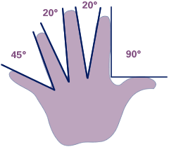
Comparing Angle Measures
The angle measures between fingers vary somewhat depending on the person. Here’s one possibility:
Notes:
1 min
a. Have participants compare angle measures between the fingers on their hands to see whether they’re the same or vary.
b. Highlight the sample variations on the slide.

Slide 55
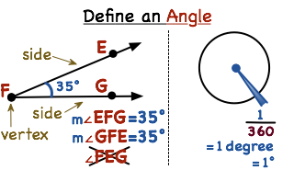
What Is an Angle?
Notes:
2 min
Discuss the denotations on the slide.
“Based on these denotations, how would you define an angle?”
Elicit ideas from the group and record them on chart paper.
After the discussion, have participants copy these ideas and the slide denotations into their science notebooks.

Slide 56
What Is an Angle? Formal Definition
An angle is formed by two rays with a common endpoint. The vertex is where the rays intersect. Each ray makes up a side of the angle.
Notes:
1 min
a. Read the formal definition of an angle on the slide.
b. Have participants copy this definition into their science notebooks.

Slide 57
Naming Angles
Three points name an angle.
One point comes from each side.
One point must be the vertex.
The vertex is the middle point.
Notes:
2 min
a. Walk participants through the information on the slide.
b. Ask: “What do students struggle with when they name angles? Does order matter?”
c. Elicit responses and reasoning from the group.
d. Emphasize that order does matter. The vertex has to be in the middle of the three points (e.g. EFG or GFE, not FGE).

Slide 58
Measuring Angles
Angles are measured in degrees.
$\frac{1}{360}$ of a circle = 1 degree = 1°
Notes:
Less than 1 min
a. Walk participants through the information on the slide.

Slide 59
What Is a Radian Measurement?
Angles can be measured in radians as well as degrees.
A radian is a standard unit of angular measure. An angle’s measurement in radians is numerically equal to the length of a corresponding arc of a unit circle. So one radian is just under 57.3 degrees (when the arc length is equal to the radius).
Notes:
3 min
a. Reveal only the first bullet point on the slide and read the information.
b. Ask participants how they would define a radian measurement.
c. Reveal the definition on the slide. Then show the slide animation at least once.
Note: The animation is about 45 seconds.
d. “What helped you better understand what a radian measurement is: the definition on the slide or the animation?”
e. “If one radian is just under 57.3 degrees, how many radians are in a 90-degree angle?”
Note: The answer is pi/2.

Slide 60
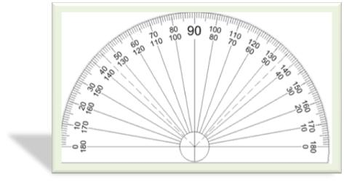
Tools for Measuring Angles
Notes:
5 min
a. Discuss the tools used to measure angles.
b. Tell participants that in the next activity, they’ll measure angles using a 360-degree protractor like the one on the left side of the slide.
c. Emphasize the importance of identifying the vertex and initial side of an angle when using a protractor to measure angles.
d. “Students often struggle with identifying the initial side of an angle when using a protractor. What are some ways to support students in using this tool?”
e. After this discussion, have participants pair up; then give each participant a protractor.

Slide 61
Angle-Measurement Challenge
What is the angle measure between the hands on a clock if the long hand is on the number 12 and the other hand is on the number 1?
Notes:
3 min
a. Read the angle-measurement challenge on the slide.
b. Individuals: Give pairs 2 minutes to work out the solution.
c. Whole group: Call on one or two pairs to share their answers and reasoning. Invite other participants to agree, disagree, ask questions, or add on.

Slide 62
Guess My Angle
Make a paper-plate angle model by cutting a radius on two different-colored paper plates.
I’ll make an angle first and then ask you to make one just like mine.
Write down what you think your angle measure is. Then measure the angle using a protractor. Record the result and compare it with your estimate.
Then we’ll see whose angle measure comes closest to mine.
Photo courtesy of Cal Poly Pomona
Notes:
7 min
a. “Next, we’ll use paper plates to estimate and measure angles.”
b. Distribute two different-colored paper plates to each participant. The read the directions on the slide.
c. Demonstrate how to make an angle model by cutting a radius on two paper plates. Make sure to record the angle measurement.
d. Direct participants to make an angle like yours with their paper plates.
e. First, have participants estimate their angle measures and record them in their science notebooks. Then direct them to use their protractors to measure their angles and record the results.
f. Have participants compare their results with their estimates to see how close they are.
g. Next, tell participants your angle measure and ask them whether their results are close or an exact match.
h. Throughout this activity, encourage participants to share their ideas and consider how this activity gives students an opportunity to reflect on their own estimates.

Slide 63
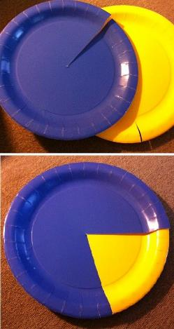
Make My Angle
Use your paper plates to make the following angles. Then measure the angles using a protractor to see how accurate you are:
45°
120°
31°
165°
Photo courtesy of Cal Poly Pomona
Notes:
8 min
a. Direct participants to use their paper plates to make the angles on the slide and then perform angle measures with their protractors to see how accurate they are. Remind participants to record their results in their science notebooks.
b. When participants have completed these measurements, measure the angles yourself and record the results on chart paper.
c. Have participants compare their results with yours and make any necessary corrections.
d. Discuss why it’s valuable for students to attempt to make and measure the angles themselves.
e. Note some of the challenges students might encounter when they attempt to measure angles. For example, students often don’t align the initial side correctly (which means they don’t start at 0), or they use the 180-degree mark as their initial side.

Slide 64
Common Core Geometry Standard
Recognize angle measure as additive. When an angle is decomposed into non-overlapping parts, the angle measure of the whole is the sum of the angle measures of the parts. Solve addition and subtraction problems to find unknown angles on a diagram in real world and mathematical problems, e.g., by using an equation with a symbol for the unknown angle measure.
Notes:
Less than 1 min
1. Read the Common Core standard on the slide.
2. Ask participants whether they have any questions or comments.

Slide 65
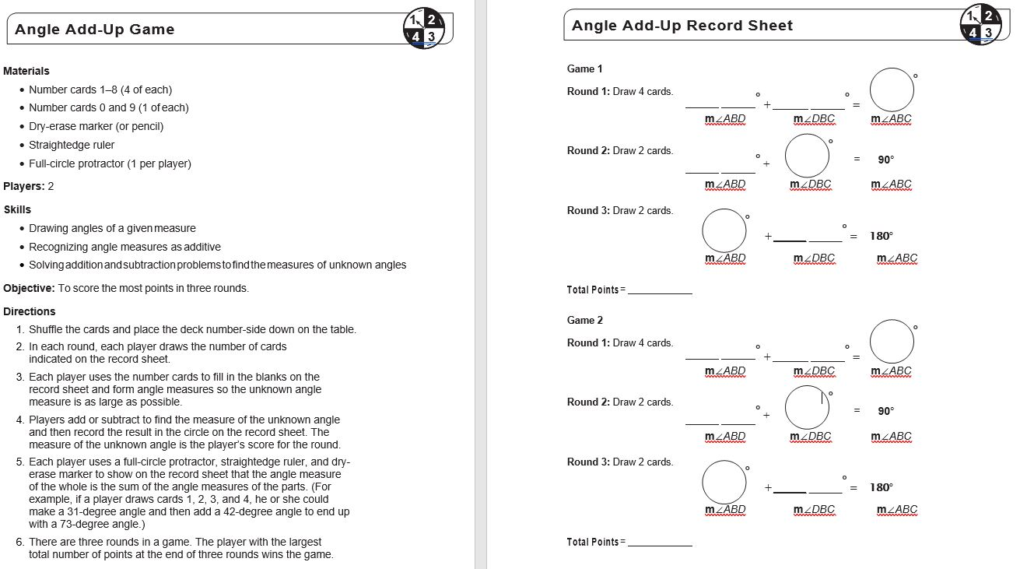
Angle Add-Up Game
Notes:
15 min
a. Have participants pair up for this activity. Then give a copy of handout 3.7 (Angle Add-Up Game) to each participant and a set of number cards, a straightedge ruler, and a dry-erase marker to each pair. Participants will also need their protractors.
b. Emphasize that this game directly addresses the Common Core standard they just reviewed.
c. Walk participants through the supply list and directions on the handout.
d. Ask participants whether they have any questions and then begin the game. Circulate around the room during the activity to answer questions or address any difficulties participants may encounter.
e. After the game, debrief participants on their experience. Ask, “How do you think this game will help students understand the concept of angle measurement?”

Slide 66
Common Core Geometry Standard
Draw points, lines, line segments, rays, angles (right, acute, obtuse), and perpendicular and parallel lines. Identify these in two-dimensional figures.
Notes:
Less than 1 min
a. “Another Common Core standard we need to address relates specifically to the vocabulary associated with angles.”

Slide 67
Classifying Angles
List all the angles you know about in your science notebook. Try to use their formal names. (Hint: There are seven types of angles.)
Notes:
1 min
a. “Next, we’ll classify, or name, the types of angles according to their measure.”
b. Individuals: Ask participants to list in their notebooks all the angles they know about. Encourage them to use the formal names, though it’s unlikely they’ll know all seven.
c. Whole group: Call on participants to name the seven types of angles.

Slide 68
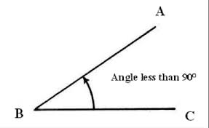
Classifying Angles: Acute Angle
This is an acute angle (so cute).
Notes:
Less than 1 min
a. “The angle on this slide is an acute angle.”
b. Note that the measure of an acute angle is less than 90 degrees.

Slide 69
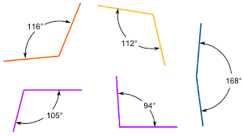
Classifying Angles: Obtuse Angle
These are obtuse angles.
Notes:
Less than 1 min
a. “These are obtuse angles.”
b. Note that the measure of an obtuse angle is between 90 and 180 degrees.

Slide 70
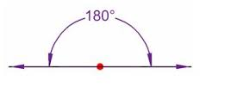
Classifying Angles: Straight Angle
This is a straight angle.
Notes:
Less than 1 min
a. “This is a straight angle.”
b. Note that the measure of a straight angle is 180 degrees.

Slide 71
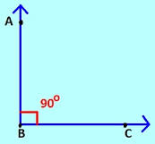
Classifying Angles: Right Angle
This is a right angle. Students should be able to use this notation.
Notes:
Less than 1 min
a. “This is a right angle.”
b. Note that the measure of a right angle is 90 degrees.
c. “Fourth-grade students should be able to use the notation on the slide.”

Slide 72
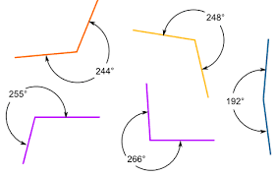
Classifying Angles: Reflex Angle
These are reflex angles.
Notes:
Less than 1 min
a. “These are reflex angles.”
b. Note that the measure of a reflex angle is greater than 180 degrees and less than 360 degrees.

Slide 73
Classifying Angles: Zero Angle
This is a zero angle.
Notes:
Less than 1 min
a. “This is a zero angle.”
b. “What does the name of this angle tell you about its measure?”
c. Emphasize: “If you think of angles as turns, a zero angle has a zero turn.”

Slide 74
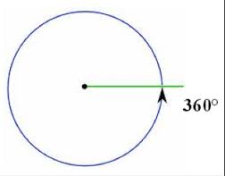
Classifying Angles: Complete Angle
This is a complete angle, also called a full angle.
Notes:
Less than 1 min
a. “This is a complete angle. Complete angles are also called full angles.”
b. Note that the measure of a complete angle is 360 degrees. This is equivalent to 1 turn or 2 pi radians.

Slide 75
Review: The Seven Types of Angles
Notes:
Less than 1 min
a. Review the seven angles on the slide.
b. Emphasize: “Even though you’ll be teaching only acute, obtuse, and right angles, you should know the other types of angles in case a student asks about an angle that doesn’t fall into these classifications. For example, a student may ask about an angle that measures 250 degrees. This is a reflex angle, not an obtuse angle.”
Note: These angle classifications are mutually exclusive (i.e., an angle can’t be both a right angle and an acute angle). However, a triangle can have both acute and right angles.

Slide 76
Use and Apply: Angles and Geometric Shapes
Think about these questions. Then discuss them with an elbow partner:
Can a triangle have more than one type of angle? Explain your reasoning.
Can a triangle have only one type of angle? Explain your reasoning.
What are the different angle combinations in a triangle?
Can a triangle have a reflex angle?
Can a polygon have a reflex angle?
Notes:
3 min
a. Introduce the questions on the slide.
b. Think-Pair-Share: Ask participants to think about these questions and then share their ideas and reasoning with an elbow partner.
c. Whole group: Invite participants to share their ideas and reasoning with the group. As they explain their reasoning, consider the Common Core standards of practice. Ask probe and challenge questions to clarify participants’ thinking as needed.

Slide 77
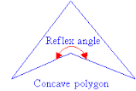
Answers: Angles and Geometric Shapes
Can a triangle have more than one type of angle? Explain your reasoning. Yes. A right angle has two acute angles and a right angle.
Can a triangle have only one type of angle? Explain your reasoning. Yes. An equilateral triangle has three acute angles (60, 60, 60).
What are the different angle combinations in a triangle? (1) acute, acute, acute, (2) acute, obtuse, acute, (3) acute, acute, right.
Can a triangle have a reflex angle? No.
Can a polygon have a reflex angle? Yes. A concave polygon can have a reflex angle.
Notes:
Less than 1 min
a. Review the answers to the use-and-apply questions on the slide.

Slide 78
Reflect: Math Content Deepening Focus Question
What is an angle, and how do you measure it?
Notes:
2 min
a. Review the focus question on the slide.
b. Invite participants to share their ideas for answering the question, using observations and evidence from today’s investigations.
c. Encourage participants to agree, disagree, ask questions, or add to the ideas others share.
d. During this discussion, record key ideas on chart paper.

Slide 79
Key Science Ideas
An angle is formed by two rays with a common endpoint. The vertex is where the rays intersect. Each ray makes up a side of the angle.
An angle is measured in degrees using a protractor. One degree equals 1/360 of a circle.
There are seven types of angles: zero, acute, obtuse, right, straight, reflex, complete.
Notes:
1 min
a. Review the key science ideas on the slide that answer the focus question.
b. Whole-group discussion: “Does everyone agree with these ideas? Would you like to add or revise anything?”
c. Ask participants to copy these ideas into their science notebooks under the focus question.

Slide 80
Summary: Moving Student Thinking Forward
How can we advance student thinking without just telling students about ideas and asking them to memorize those concepts?
Refer to our Effective Science Teaching chart from day 1. Which of these ideas do you want to highlight based on the strategies we’ve explored so far? Anything you want to add or modify?
Notes:
5 min
a. Have participants share ideas about the first question on the slide. Then ask, “What are some things we’ve discussed today that address this question?”
b. Refer participants to the Effective Science Teaching chart from day 1 and discuss the remaining questions on the slide. Modify the chart as participants share their ideas.

Slide 81
Summary: Today’s Focus Questions
Lesson Analysis
Content Deepening
How can analyzing data and constructing explanations help students move forward toward deeper understandings of science ideas?
Can mountains grow so tall they reach outer space? Why or why not?
What is an angle, and how do you measure it?
Notes:
5 min
a. Review today’s focus questions.
b. Discuss: “The STeLLA strategies booklet claims that strategies 4 and 5 are ways of moving student thinking forward. How would you support or challenge that claim? In other words, are you convinced that letting students analyze data and construct explanations will help them move forward toward deeper understandings of science ideas?”
c. Ask: “What key ideas do you now have about how to address our science content deepening focus question?”

Slide 82
Homework
Review strategy 6 in the STeLLA strategies booklet and complete the STL Z-fold summary chart for this strategy: Engage students in using and applying new science ideas in a variety of ways and contexts.
Be prepared to share your assigned lesson plan review.
Notes:
2 min
a. “Tomorrow we’ll focus on another strategy to help move student thinking forward toward deeper understandings of science ideas.”
b. Review the homework assignment and have participants copy it into their science notebooks.

Slide 83
Reflections on Today’s Session
Complete the Daily Reflections sheet (handout 3.9).
What new idea or insight did you have today related to strategy 4 (analyzing and interpreting data and observations) and strategy 5 (constructing explanations and arguments)?
What ideas do strategies 4 and 5 give you about things to try or change in your science teaching?
Answer one of these questions: (1) What important science idea are you taking away from our content deepening work today? Remember to state the idea in a complete sentence. (2) What question do you have about Earth’s changing surface (i.e., something you’re unclear or wonder about)?
Notes:
3 min
a. Have participants reflect on today’s session and answer the questions on the Daily Reflections sheet (handout 3.9 in PD program binder).
Note: To support this task, encourage participants to refer to the STeLLA strategies booklet, the strategy charts they created for STL strategies 4 and 5, the Effective Science Teaching chart, and their STL Z-fold summary charts.

Slide 84
Norms for Working Together: The Basics
Purpose: Build trust and develop a productive study group for all participants.
The Basics
Arrive prepared and on time; stay for the duration; return from breaks on time.
Remain attentive, thoughtful, and respectful; engage and be present.
Eliminate interruptions (turn off cell phones, email, and other electronic devices; avoid sidebar conversations).
Make room for everyone to participate (monitor your floor time).
Notes:
Hidden slide—available for use as needed.

Slide 85
Norms for Working Together: The Heart
Purpose: Build trust and develop a productive study group for all participants.
The Heart of RESPeCT Lesson Analysis and Content Deepening
Keep the goal in mind: analysis of teaching to improve student learning.
Share your ideas, uncertainties, confusion, disagreements, questions, and good humor. All points of view are welcome.
Expect and ask questions to deepen everyone’s learning; be constructively challenging.
Listen carefully; seek to understand other participants’ points of view.
Notes:
Hidden slide—available for use as needed.

