Slide 1
RESPeCT PD pROGRAM
Day 4
RESPeCT Summer Institute
Notes:
5 min
a. Take care of any housekeeping issues.

Slide 2
Agenda for Day 4
Day-3 reflections
Importance of STL strategy 5: constructing explanations
Introducing Student Thinking Lens strategy 6
Lesson analysis: STL strategy 6
Review: STL strategies 1–6
Earth’s Changing Surface lesson plans review
Lunch
Content deepening: Earth’s Changing Surface
Summary, homework, and reflections
Notes:
3 min
a. Talk through the agenda for the day.

Slide 3
Trends in Reflections
Lesson Analysis | Science Content Learning
Notes:
5 min
a. Invite participants to look at your feedback on their reflections from day 3 and offer reactions, comments, or follow-up questions.

Slide 4
Today’s Focus Questions
Why is it necessary to engage students in using and applying new science ideas in a variety of ways and contexts?
How will the Student Thinking Lens strategies help you teach the Earth’s Changing Surface (ECS) lessons?
How does flowing water change Earth’s surface?
How can we use what we’ve learned about Earth’s changing surface to answer the unit central questions?
Notes:
1 min
a. Introduce the focus questions that will guide today’s work.
b. “Like STeLLA strategies 4 and 5, the goal of strategy 6 is to move student thinking forward toward deeper understandings of science ideas.”

Slide 5
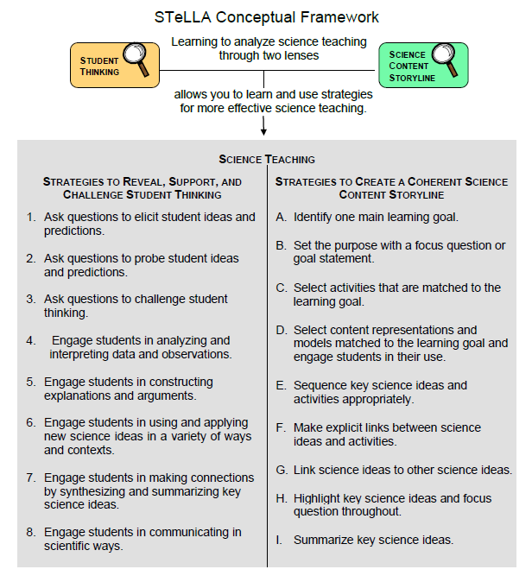
Notes:
1 min
a. Draw participants’ attention to the new strategy highlighted on the slide.
b. “Strategy 6 is the third STL strategy that is a type of activity designed to move student thinking forward.”

Slide 6
The Importance of Engaging Students in Constructing Scientific Explanations
Read handout 4.1 and your group-specific handout. Then complete the assigned task:
Group 1: Analyze a student explanation (handout 4.2).
Group 2: Summarize benefits for students of constructing scientific explanations (handout 4.3).
Group 3: Summarize the benefits for teachers of engaging students in constructing scientific explanations (handout 4.3).
Notes:
25 min
Note: If you need some time to catch up on day-3 activities, you can skip this slide. However, this activity is beneficial for reviewing strategy 5 (constructing explanations) and helping participants understand why explanation building is such important work in science and beyond.
Timing note: For this segment, allot 5 minutes for reading, 10 minutes to prepare for a group share-out, and 10 minutes for the share-out.
a. Divide participants into three groups or pairs. Assign each group a number (1, 2, 3).
b. Direct participants to three handouts:
Importance of Engaging Students in Constructing Scientific Explanations (handout 4.1 in PD program binder) (This handout describes what groups are to do with the following two handouts.)
Student Work from Zembal-Saul Book What’s Your Evidence? (handout 4.2 in PD binder) (Group 1’s task is linked to this handout.)
Benefits of Engaging Students in Constructing Scientific Explanations (handout 4.3 in PD binder) (Tasks for Groups 2 and 3 are linked to this handout.)
c. After participants have read the designated handouts for their groups and completed their assigned tasks, invite them to share out.

Slide 7
The CERA Framework for Constructing Scientific Explanations
Next, we’ll watch video clip of a 3rd-grade teacher instructing students how to construct scientific explanations.
Think about ideas this clip gives you for helping your students learn to construct scientific explanations by making a claim, supporting it with evidence and reasoning, and considering alternative explanations and strategies (CERA).
Link to Introducing the CER video clip.
Notes:
10 min
Note: This activity is optional but powerful.
a. “Let’s watch how one 3rd-grade teacher taught her students to construct scientific explanations. This is the teacher whose student writing Group 1 just read about. The class in this video clip has been studying simple machines (such as pulleys and levers).”
b. “We’re not going to analyze this video clip in terms of STeLLA strategies. Instead, think about ideas this gives you as to how you might introduce your students to the CERA framework for constructing scientific explanations, which involves making a claim, supporting it with evidence and reasoning, and suggesting alternatives.”
c. After watching the clip, discuss participants’ reactions and any ideas it gave them about how they might help their students learn to construct strong scientific explanations.
Note: Make sure participants are aware that in addition to using the CERA framework as a tool for teaching students how to develop scientific explanations and arguments (STeLLA strategy 5) in the classroom, they will be using the same framework for videocase-based lesson analysis of their science teaching in RESPeCT study groups throughout the school year.

Slide 8
Introducing STL Strategy 6
Engage students in using and applying new science ideas in a variety of ways and contexts.
What are the purpose and key features of this strategy?
Why do you think use-and-apply questions or activities are often shortchanged in science teaching?
Notes:
20 min
a. Small groups (10 min): Divide teachers into two groups to make charts highlighting the purpose and key features of strategy 6: Engage students in using and applying new science ideas in a variety of ways and contexts. Encourage participants to refer to the STeLLA strategies booklet and STL Z-fold summary charts for this activity.
b. Whole group (10 min): Have groups present their charts in a whole-group share-out and compare them. Ask participants, “What differences and similarities do you notice when you compare your charts with those of other groups?”
Key ideas:
Strategy 6 is a time for “strategic telling” and making sure students are using science ideas accurately.
A use-and-apply question or activity occurs after students have experienced/encountered a new science idea. It provides an opportunity for students to use and apply the idea in a new context or novel way and/or link two or more ideas together.
A common misconception is that use-and-apply questions or activities assess student learning. Teachers often talk about asking these kinds of questions on tests. However, according to research findings published in How People Learn (National Academy of Sciences, 2000) , application is part of the learning process, or developing a conceptual framework. If application is treated like assessment, students may encounter a use-and-apply question on a test without ever having had the opportunity to practice this way of thinking as part of their learning.

Slide 9
Lesson Analysis: Focus Question 1
Why is it necessary to engage students in using and applying new science ideas in a variety of ways and contexts?
Notes:
Less than 1 min
a. Highlight the focus question that will guide the lesson analysis work during this phase.

Slide 10
Lesson Analysis: Review Lesson Context
Read the lesson context for this video clip at the top of the transcript (handout 4.4 in your PD program binder).
Notes:
2 min
a. “Read the lesson context at the top of the video transcript (handout 4.4 in your PD program binders).”
b. Make sure participants understand the science content and activity that are the focus of this video clip.
Note: Refer to the content background document as needed throughout the lesson analysis.

Slide 11
Lesson Analysis: Identify Strategy 6
What makes the activity in this video clip a use-and-apply task? (Focus on task.)
What do you notice about the types of questions the teacher asks during the clip?
Link to video clip 1: 4.1_stella2-04-potter4-L6_c1-c2
Notes:
25 min
a. “As you watch the video, think about what makes the activity in this clip a use-and-apply task. What science ideas should students be using and applying in each scenario? Also notice what kinds of questions the teacher asks.”
b. Show the video clip.
c. Individuals: “Think about the questions on the slide and mark the transcript as you identify the use of strategy 6.
d. Whole group: Discuss participants’ responses to the questions.

Slide 12
Lesson Analysis: Analyze Strategy 6 and Reflect
Analyze:
What student thinking is revealed by engaging students in using and applying new science ideas? By providing a claim, evidence, and reasoning?
Reflect:
What did you learn about strategy 6 from watching and analyzing this video clip?
Notes:
25 min
a. Individuals: “For the analysis question on the slide, study the video transcript and come up with a claim, evidence, and reasoning to support your claim.”
b. Whole-group share-out: As participants share their claims, evidence, and reasoning, encourage them to challenge one another by asking questions, disagreeing, and suggesting improvements or alternative explanations and arguments. (Refer to the norms at the heart of the RESPeCT program.)
Note: You may also want to ask participants whether they noticed in the transcript any missed opportunities for engaging students in using and applying new science ideas.
c. Reflect (1 min): Give participants time to think about the reflection question on the slide.
d. Whole-group discussion: Discuss the reflection question as a group. Make sure participants note specifically what they learned about strategy 6 from watching and analyzing this video clip.

Slide 13
Check Your Understanding of Strategy 6
Jot down your responses to this multiple-choice quiz:
Use-and-apply tasks are used [before/during/after] new science ideas are introduced.
For difficult content ideas, students might need to practice applying new ideas in [one/two/many] different contexts.
[True/false]: Use-and-apply questions or activities are used primarily for student assessment at the end of a unit.
It’s appropriate for teachers to ask [elicit/probe/challenge] questions during a use-and-apply activity.
Teachers should [never/judiciously/always] tell students about science ideas they are missing or stating inaccurately.
Notes:
5 min
Note: This activity is optional if time is running short.
a. “To check your understanding of STL strategy 6, jot down your responses to this multiple-choice quiz.”
b. Have participants discuss their answers either in pairs or as a group. (If time is short, just read the answers aloud.)
Answer key:
After
Many
False
Challenge (and probe)
Judiciously (defined as “good or discriminating judgment; wise, sensible, or well advised”)

Slide 14
Reflect: Lesson Analysis Focus Question 1
Why is it necessary to engage students in using and applying new science ideas in a variety of ways and contexts?
Notes:
3 min
a. Individuals (1 min): “Think for a moment about how you would answer the focus question on this slide.”
b. Whole-group share-out (2 min): Have a few participants share their ideas.

Slide 15
Lesson Analysis: Focus Question 2
How will the Student Thinking Lens strategies help you teach the Earth’s Changing Surface (ECS) lessons?
Notes:
Less than 1 min
a. Transition: “Now we’ll shift our attention to the second lesson analysis focus question and spend some time summarizing what we’ve learned so far about Student Thinking Lens strategies 1–6. Then we’ll review the ECS lesson plans and highlight how these strategies are used in the lessons you’ll start teaching in January.”

Slide 16
Notes:
Less than 1 min
a. “These are the Student Thinking Lens strategies we’ve explored so far. You’ll get practice using them as you teach the Energy Transfer and Earth’s Changing Surface lessons next year.”

Slide 17
Review: Student Thinking Lens Strategies
Review the STL summary chart in the STeLLA strategies booklet and discuss these questions:
What pattern(s) do you see in this arrangement (organization) of the STL strategies?
How does this arrangement (organization) highlight the differences and similarities among the Student Thinking Lens strategies?
Notes:
3 min
a. Individuals: Have participants review STL strategies 1–6 on the summary chart in the strategies booklet (Summary of STeLLA Student Thinking Lens Strategies).
b. Whole group: Discuss the questions on the slide.
Key ideas:
Strategies 1–3 are types of questions, and strategies 4–6 are activities designed to move student thinking forward toward more-scientific understandings.
Some strategies are used at any time during the lesson (e.g., probe questions); others are used at specific times (e.g., elicit questions used before students have been introduced to new science ideas; use-and-apply activities used after students have been introduced to new science ideas).
Each strategy has it’s own specific purpose(s), but the strategies are closely connected to one another. That is, these strategies aren’t used in isolation; they’re complementary.

Slide 18
Lesson Analysis: Review Lesson Context
Before watching each video clip in this series, read the lesson context at the top of the corresponding transcript in your PD program binder:
Handout 4.5 (Video Clip 4.2)
Handout 4.6 (Video Clip 4.3)
Handout 4.7 (Video Clip 4.4)
Handout 4.8 (Video Clip 4.5)
Notes:
1 min
a. Before showing each video clips in this series, have participants read the lesson context at the top of the corresponding transcript (handouts 4.5–4.8 in the PD program binder).
b. Make sure participants understand the science content and activity that are the focus of each clip.

Slide 19
Lesson Analysis: Identify Student Thinking Lens Strategies
What Student Thinking Lens strategies can you identify in this video clip?
After watching each video, study the transcript and fill in handout 4.9 (Identifying Student thinking Lens Strategies).
Be ready to share your findings with the group, including any missed opportunities.
Links to video clips 2-4: 4.2_stella2-04-torres4-L3 _c5;
4.3_stella2-04-torres4-L3_c6;
4.4_stella2-04-torres4-L3_c7;
4.5_stella2-04-torres4-L3_c8
Notes:
30 min
Note: If absolutely necessary, you can skip this video analysis.
a. Orient participants to handout 4.9, Identifying Student Thinking Lens Strategies.
b. Before showing each video clip, make sure participants understand the context from the corresponding transcript.
c. Show the video clip.
d. Individuals: “Study the video transcript and complete handout 4.9, Identifying Student Thinking Lens Strategies.”
e. Whole group: “What STL strategies did you identify in the video transcript? Did you spot any missed opportunities?”

Slide 20
RESPeCT PD Program School-Year Plan
Summer Institute
Content deepening: Earth’s Changing Surface and Energy Transfer |  | Lesson analysis: Introduction to the STeLLA framework and strategies
Fall Study-Group Sessions
Fall Teaching Rounds 1 and 2 | Use the STeLLA strategies while teaching lessons on energy transfer. Analyze student thinking and science content storylines using video from our own classrooms. Deepen content knowledge of energy transfer through lesson video analysis. |  | Energy Transfer (ET)
Spring Study-Group Sessions
Spring Teaching Rounds 1 and 2 | Use the STeLLA strategies while teaching lessons on Earth’s changing surface. Analyze student thinking and science content storylines using video from our own classrooms. Deepen content knowledge of Earth’s changing surface through video analysis. |  | Earth’s Changing Surface (ECS)
Notes:
2 min
a. “Before we share our reports about each of the Earth’s Changing Surface lesson plans and how they support you in practicing these Student Thinking Lens strategies, let’s review the plan for the school year.”
b. “In the fall, you’ll teach the Energy Transfer lessons, and we’ll meet in our study group to analyze video clips and student work from these lessons. This analysis will help us deepen our understandings of the STeLLA strategies, the science content, the lesson plans, and our students’ thinking and learning.”
c. “Starting in January, you’ll teach the Earth’s Changing Surface lessons, and we’ll meet in our study group to analyze video clips and student work from these lessons. Do you have any questions?”
d. Important reminder: “Remember that we’re analyzing video clips of our own classroom teaching to help us all learn, not to evaluate and critique one another. Everyone is learning to use both new strategies and new lesson plans, so it’s predictable that our first attempts at teaching these lessons will have rough spots. We need to appreciate and acknowledge the courage each of us is demonstrating to share our initial efforts to teach these lessons. Please be assured that our analyses of the videos will focus on the strategies, the science content, and most importantly, how students are making sense of the lessons. We’re not going to focus on rough spots, or management problems. We’re here to support one another and to learn and grow as science teachers.”

Slide 21
The RESPeCT Lesson Plans as a Study Tool: Part 1
The RESPeCT lesson plans are study tools designed to support your learning and for our study group to analyze.
This has two implications.
These lessons don’t represent a complete unit. You may need to add lessons to help your students achieve all the learning goals, and …
Notes:
1 min
a. Read through the information on this slide.
b. Elicit and respond to any comments or questions from participants.

Slide 22
The RESPeCT Lesson Plans as a Study Tool: Part 2
As a study tool, the lesson plans are highly scripted to model how they might be implemented.
Study this script in your lesson planning.
Adapt the plans and PowerPoint slides to make them work for you and your students (but don’t add or drop main activities).
You don’t have to be tied to the script as you teach! Using the slides as a guide can help free you from the script.
Notes:
2 min
a. Read through the information on the slide.
b. Elicit and respond to any comments or questions from participants.

Slide 23
Lesson Plan Conversation
The science content storyline across lessons
Review the main learning goal for each lesson sequentially.
The science content storyline within lessons (5–8 min for each two-part lesson)
How does this lesson fit into the arc of all the lessons?
What are the main learning goal and focus question?
What is the main activity (or activities)?
How will the activity help students better understand the learning goal for the day?
What STeLLA strategies are highlighted in the activity?
What concerns or suggestions do you have regarding the activity?
Practical issues and questions
Notes:
60 min in conjunction with next slide
a. For step 1 on the slide, have participants describe the main learning goal for their assigned two-part lesson (parts A and B) and how it connects to lessons that precede and follow it. (5 min)
b. For steps 2 and 3, have participants report on their assigned two-part lesson.
Note: Rather than walking through every step in the lesson plan, participants should present the big picture using the questions in step 2 on the slide. They should bring up details only when they have some concern, question, or suggestion about a modification.
c. As participants give their reports, mark on a chart the Student Thinking Lens strategies that are highlighted in each lesson. (Use the chart on the next slide as a model.)
Note: Encourage participants to pick just one or two Student Thinking Lens strategies that are highlighted in the lesson. (Several strategies may be used in a lesson.)
d. Highlight the following ideal pattern and how STL strategies work together across lessons:
Elicit and probe strategies are very important in lesson 1.
Probe and challenge strategies are used throughout the lessons.
Strategies 4 and 5 are highlighted in the middle lessons.
Strategy 6 is highlighted toward the end of a lesson, after students encounter new science ideas but before final unit assessments.
Timing note: Make sure you limit the time allotted for each lesson so you can get through them all. If you have 6 two-part lessons, you’ll have approximately 8 minutes for each lesson (4 minutes for part A, and 4 minutes for part B). If your lesson series has more than 6 two-part lessons, you’ll have to decrease the time for each lesson.

Slide 24
STL Strategies Highlighted in the ECS Lessons
Lesson | 1a | 1b | 2a | 2b | 3a | 3b | 4a | 4b | 5a | 5b | 6a | 6b | 7a | 7b
1. Elicit
2. Probe
3. Challenge
4. Analyze/ Interpret
5. Explain/ Argue
6. Use/Apply
7. Synthesize/ Summarize
Notes:
a. Use this slide in conjunction with the previous slide.

Slide 25
EARTH’S CHANGING SURFACE
SCIENCE CONTENT DEEPENING Grade 4
Notes:
Less than 1 min
Transition: This slide marks the transition to the content deepening work.
Note: Throughout this content deepening phase, refer as needed to the content background document and Common Student Ideas about Earth’s Changing Surface.

Slide 26
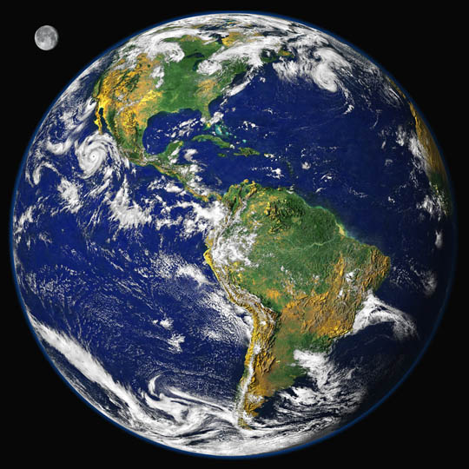
Earth’s
Changing
Surface
Content
Deepening
Developed by
Dr. Jeff Marshall
Geological Sciences
Cal Poly Pomona
Used by permission
Photo courtesy of Visible Earth
Notes:
Less than 1 min
a. “Today’s content deepening will focus on science ideas about Earth’s changing surface from ECS lessons 6a/b and 7a/b.”

Slide 27
Unit Central Questions
Why isn’t all of Earth’s surface flat? What causes the surface to look different in different places?
Notes:
Less than 1 min
a. Review the unit central questions on the slide.
b. Remind participants that these questions will guide student learning throughout the entire series of ECS lessons.
c. “By the end of today’s content deepening session, we should have enough information from all of our investigations to answer these questions.”

Slide 28
Earth’s Changing Surface
Lesson 6a
Photo courtesy of Visible Earth
Notes:
Less than 1 min
a. “First, we’ll explore science ideas about Earth’s changing surface from lesson 6a.”

Slide 29
Content Deepening: Focus Question 1
How does flowing water change Earth’s surface?
Notes:
Less than 1 min
a. Read the focus question on the slide.
b. Emphasize that this question will guide student learning throughout ECS lesson 6a.
c. Have participants write this question in their science notebooks and draw a box around it.

Slide 30
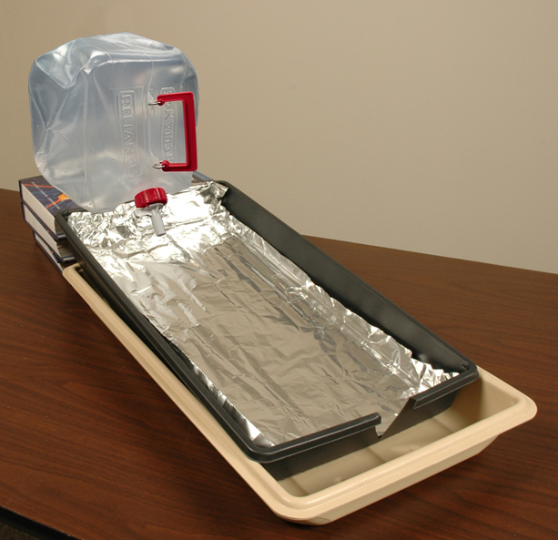
Investigation 1: Stream-Table Model
Photo courtesy of BSCS.org
Notes:
5 min
a. Have participants bring their notebooks and pencils to the front of the room and gather around the stream-table model.
Note: You should already have set up the stream-table apparatus and stacked the erosion and deposition cards on the table next to the apparatus.
b. Divide the group into pairs. Ask participants to examine the apparatus and discuss their initial observations with their partners.

Slide 31
Investigation 1: Stream-Table Model
Observe the stream-table model and look for examples of these processes:
Erosion—when flowing water moves earth materials from one location to a new location
Deposition—when earth materials are left behind or deposited in a new location
Question: Where would you place the erosion and deposition cards to indicate where each process is occurring in the model?
Notes:
20 min
a. “Today we’ll become stream scientists and use this stream-table model to investigate how flowing water changes Earth’s surface.”
b. Read the instructions and the question on the slide.
c. Begin the investigation by slowly opening the valve on the water jug. (Be sure to loosen the cap on top to allow for proper airflow.)
d. Adjust the valve so the water flow isn’t too strong but is adequate to erode the sand, form a stream channel, and deposit sand at the bottom of the tray.
e. Pairs: Direct pairs to look for examples of erosion and deposition taking place in the model and discuss where they would place the erosion and deposition cards to indicate where each process is occurring.
f. Whole-group discussion: Following the investigation, invite pairs to share with the group their observations and answers to the question on the slide. Probe participants’ responses and elicit differing points of view.
g. During the discussion, record key ideas and observations on chart paper.

Slide 32
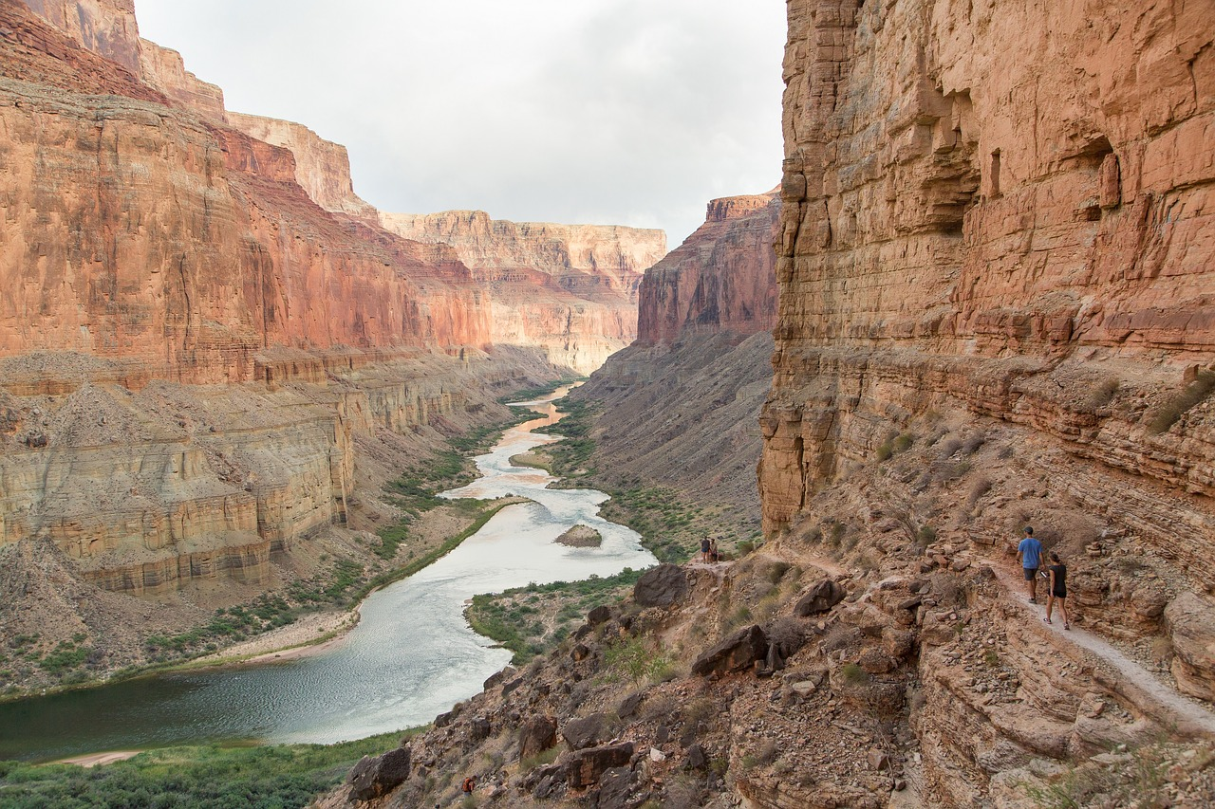
River Erosion and Deposition
Photo courtesy of Pixabay.com
Notes:
Less than 1 min
a. “Let’s review some key science ideas about erosion and deposition.”
b. “This slide shows the Colorado River flowing through the Grand Canyon. It’s a familiar example of a river eroding its bed and cutting a canyon through hard rock. The flowing water erodes the rock and carries sediment away to be deposited somewhere else downstream, such as behind a dam or in the Colorado River delta at the Gulf of California.”

Slide 33
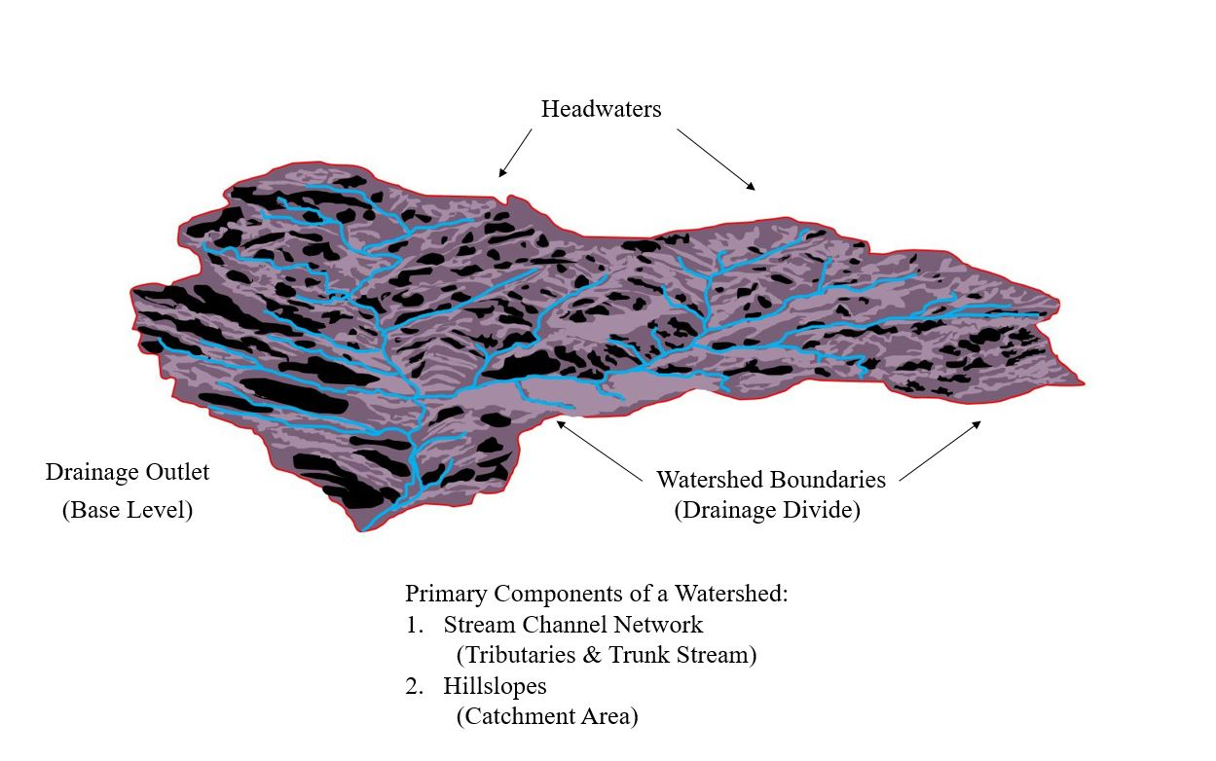
Watersheds
Courtesy of Cal Poly Pomona
Notes:
3 min
a. “To understand river erosion and deposition, we must first understand the concept of a watershed, sometimes called a drainage basin.”
b. “A watershed is an area of Earth’s surface drained by a particular river. Drainage divides, like those on the slide, are boundaries that separate a watershed from neighboring watersheds. These divides are high points, like ridgelines, that surround a watershed.”
c. “Headwaters mark the upper end of a watershed, and the lower end is called a drainage outlet or base level. The outlet is the lowest elevation point in the watershed where the main river or stream flows out of the basin.”
d. “The main river or stream in the watershed is called the trunk river or trunk stream. Smaller streams or rivers that feed into the trunk stream are called tributaries. Together, a trunk stream and its tributaries make up a stream channel network that funnels rain runoff and sediment from the landscape into the trunk stream.”
e. “Hill slopes are located between stream channels. In this area of land, precipitation either infiltrates or soaks into the ground or flows downhill into a stream channel as runoff.”
f. “A watershed is a natural system that transports rainwater runoff and eroded sediment into the trunk stream and out of the basin at the drainage outlet for deposition elsewhere.”

Slide 34
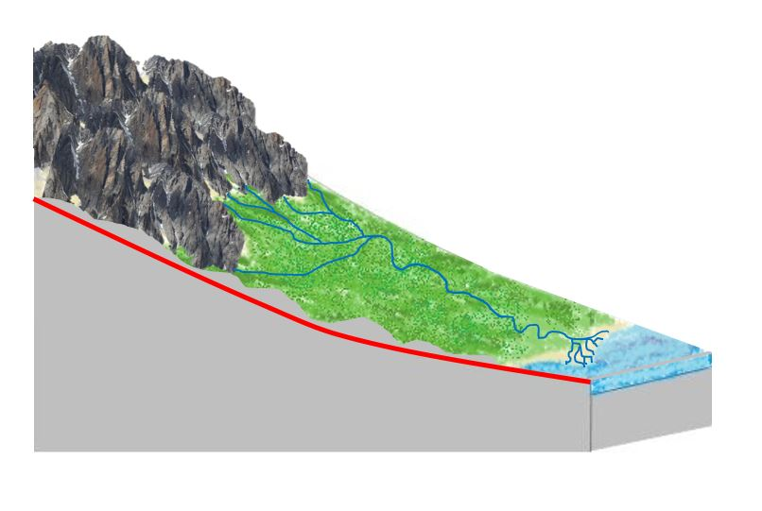
River Longitudinal Profile
Courtesy of Cal Poly Pomona
Notes:
1 min
a. “This slide shows a longitudinal profile of a river.”
b. “Natural rivers typically develop a profile along their length that curves upward like a dish. This is called a concave-up longitudinal profile because the concavity in the curve faces upward. This curve is steepest at its upper end near the headwaters and flattest at its lower end near the drainage outlet.”
c. “This concave shape forms because of the interaction between gravity and the mass of flowing water and sediment. It reflects the fact that the small headwater tributaries carry less water and sediment and thus require a steeper slope to move that small mass downhill. On the other hand, a large trunk stream carries much more water and sediment in the lower basin and thus only requires a gentle slope to move that greater mass downhill toward the outlet.”

Slide 35
Types of River Channels
Bedrock
Channel
Alluvial
Channel
Courtesy of Cal Poly Pomona
Notes:
1 min
a. “Most rivers begin their journey in the mountainous headwaters area of a watershed and flow downward into a valley that leads to a drainage outlet at an ocean, a lake, or another bigger river.”
b. “As rivers erode their profile, they may either cut their beds downward into hard rock or build their beds upward by depositing sediment. This results in two different types of river channels: a bedrock channel, where a river cuts a canyon in the hard rock of a mountain, or an alluvial channel, where a river builds up its bed by depositing sediment across a floodplain.”

Slide 36
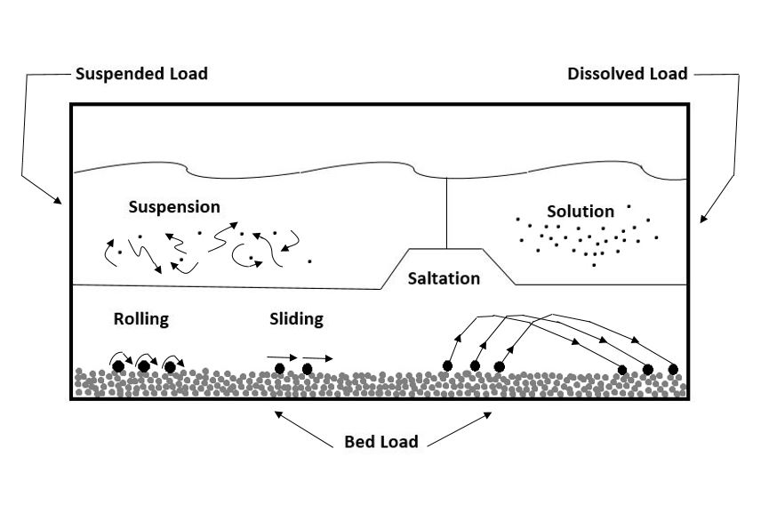
Types of Sediment Load
Courtesy of Cal Poly Pomona
Notes:
3 min
a. “This slide shows various types of sediment load.”
b. “River channels carry both water and sediment. The sediment consists of broken particles of weathered rock that have eroded from the surface of the watershed. Fast-flowing river water carries the sediment down a channel and deposits it in another location where the water flow is slower.”
c. “The sediment load of a river is defined as ‘the volume or mass of material a river transports in a given amount of time.’”
d. “There are three different types of sediment load in a river: (1) suspended load, (2) bed load, and (3) dissolved load.”
e. “A suspended load consists of small grains that are carried aloft by turbulence in the flowing water. These small silt or sand grains turn river water brown during a flood.”
f. “A bed load consists of larger, heavier grains that roll, slide, or bounce along the bed as the flowing water carries them along. These are the pebbles and boulders we see on the bottom of a streambed when it’s dry.”
g. “A dissolved load consists of ions that dissolve in the flowing water. The chemical weathering of rocks and minerals upstream produce these ions.”
h. “The physical particles of rock in suspended and bed loads are visible, but the chemical ions of a dissolved load are part of the flowing water and can’t be seen with the naked eye.”

Slide 37
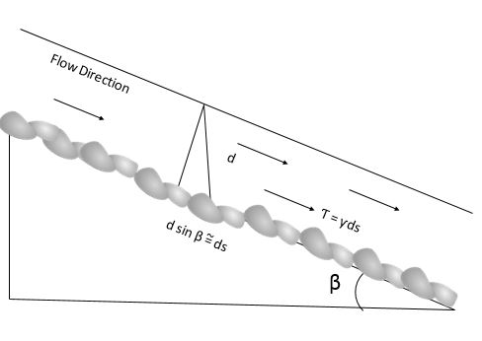
Stream-Channel Erosion: Part 1
Courtesy of Cal Poly Pomona
Bed shear stress is a function of
water depth, channel slope, and flow velocity.
Notes:
2 min
a. “The equation on this slide illustrates stream-channel erosion.”
b. “Rivers erode their beds by either removing sediment grains that have accumulated on the bed or by cutting directly into the hard bedrock beneath the sediment. Both of these processes require sufficient sideways force or shear stress exerted by the column of flowing water. This bed shear stress is proportional to the water depth, or mass, and the steepness, or slope, of the stream channel.”
c. “With greater water flow, water depth increases, which means that more mass is pressing down on the streambed. With a steeper stream channel, more of that mass is directed downhill, increasing the sideways force or shear stress on the streambed. So more water and/or a steeper streambed increase erosion.”
d. “We’ll test these ideas later using a stream-table model. This type of model can show us how increasing or decreasing water flow and/or changing the tilt of the stream table affect erosion and deposition.”

Slide 38
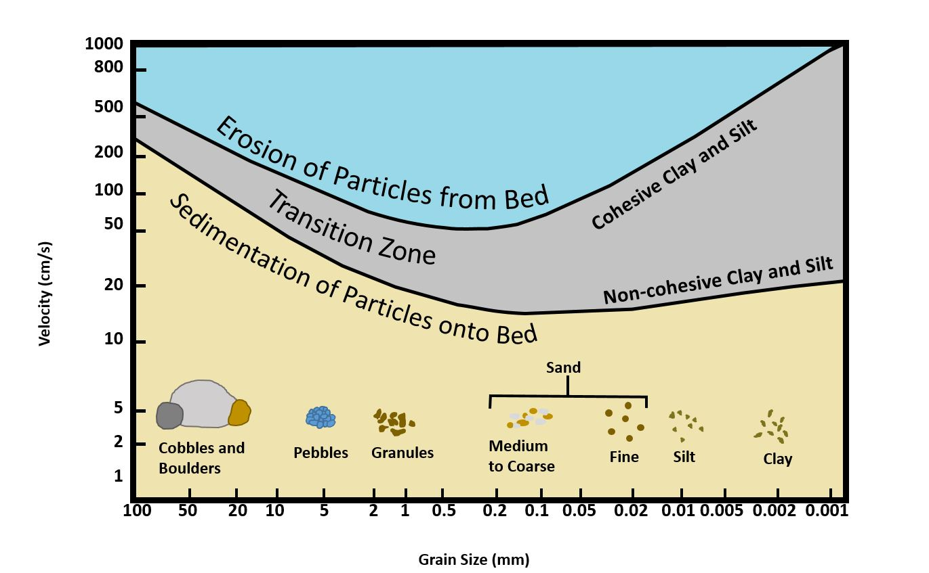
Stream-Channel Erosion: Part 2
Courtesy of Cal Poly Pomona
Notes:
2 min
a. “Water depth and channel steepness determine the speed at which river water flows. So flow velocity is also related to a river’s ability to erode its bed.”
b. “The graph on this slide plots water velocity versus the size of sediment grains that can be lifted off the bed.”
c. “On the left side of the graph, faster water flow, with deeper water and a steeper channel, is required to move large sediment grains like cobbles and boulders. In the middle, smaller grains, such as grains of sand, can be moved with slower velocities of water, shallower water, and a gentler slope. But on the right side, faster velocities of water are required to move the smallest grains of silt and clay because those grains are sticky or cohesive.”
d. “So it’s hardest for a stream to erode big boulders and sticky clay from its bed, and it’s easiest to move small, loose grains of sand.”

Slide 39
Dynamic
Equilibrium
and
the
Graded
River
3000
2000
1000
0
Altitude above Sea Level (m)
0 200 400 600 800 1000 1200
Source
Distance from Headwaters of River (km)
Mouth
Courtesy of Cal Poly Pomona
Notes:
2 min
a. “To better understand river erosion and deposition, we need to understand the important concept of dynamic equilibrium.”
b. “According to this concept, rivers are dynamic systems that respond to changing conditions within the watershed. As plate tectonics build up Earth’s surface and erosion wears it down, rivers respond by adjusting their profile to achieve a balance between opposing forces. If any characteristic of a river changes, such as its channel shape or the flow of water and sediment, other characteristics will adjust to achieve a new balance or equilibrium. The dish-shaped profile we discussed earlier is an expression of dynamic equilibrium.”
“Geomorphologists refer to this balanced form as a graded river profile. A graded river is a river in equilibrium or balance with the prevailing conditions in the watershed.”

Slide 40
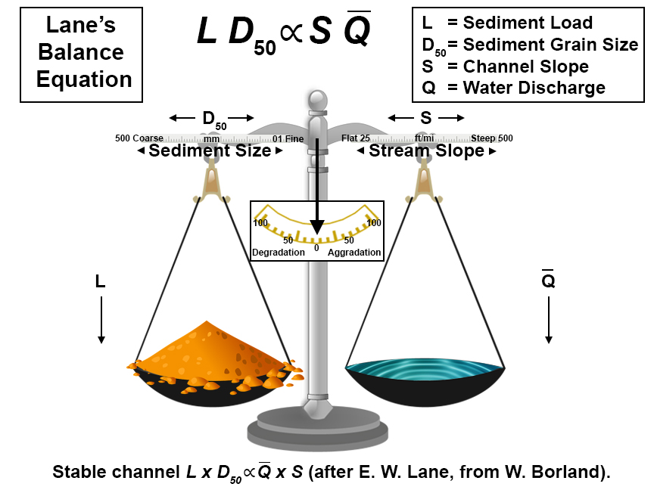
Courtesy of Cal Poly Pomona
Notes:
1 min
a. “Four basic parameters control river equilibrium: (1) sediment load (L), (2) average sediment grain size (D₅₀), (3) channel slope (S), and (4) water flow or discharge (Q).”
b. “The equation on the slide, called Lane’s balance, is a mathematical relationship that expresses this equilibrium. L x D₅₀ is proportional to S x Q.”
c. “If any of these four parameters is altered, the other three will adjust to achieve a new balance or equilibrium.”

Slide 41
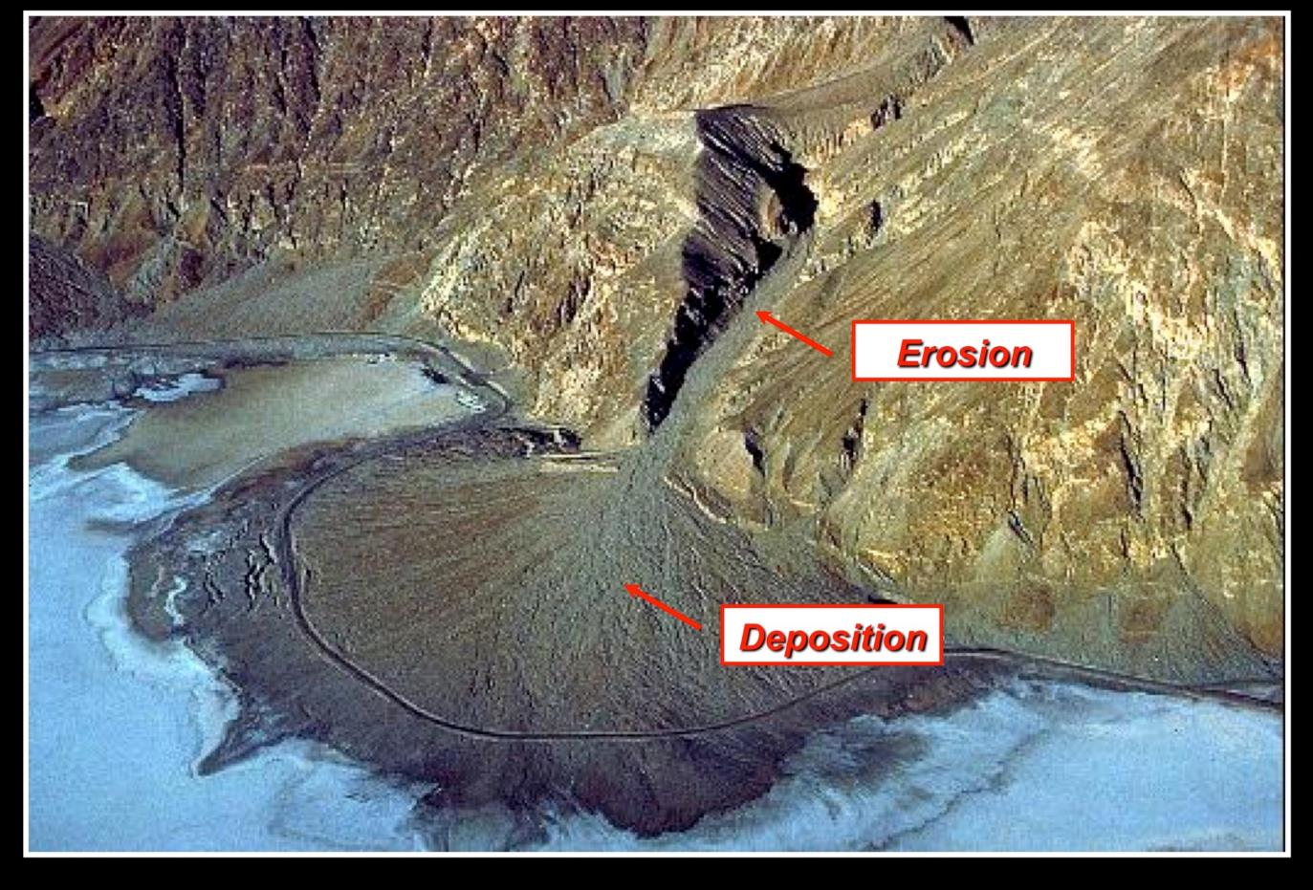
Graded River Profile
Photograph by Marli Miller/Geologypics.com
Notes:
1 min
a. “This photo of Death Valley, California, is an excellent example of a graded stream. The stream channel follows a concave-up graded profile from its head on the mountainside to its base on the alluvial fan.”
b. “Scarps, or steep slopes, are visible at the base of the hill, and with repeated earthquakes on the mountain-front fault, the mountain block rises and the valley bottom drops down. To maintain an equilibrium-graded profile, the stream erodes its bed upstream, cutting a deeper canyon into the rock, and deposits sediment downstream, building up its bed on the alluvial fan.”
c. “Think about how this relates to your observations during our stream-table investigation.”

Slide 42
Earth’s Changing Surface
Lesson 6b
Photo courtesy of Visible Earth
Notes:
Less than 1 min
a. “Next, we’ll explore science ideas about Earth’s changing surface from lesson 6b.”

Slide 43
Content Deepening: Focus Question 1
How does flowing water change Earth’s surface?
Notes:
Less than 1 min
a. Review the focus question on the slide.
b. Emphasize that this question from ECS lesson 6a will guide student learning throughout ECS lesson 6b as well.

Slide 44
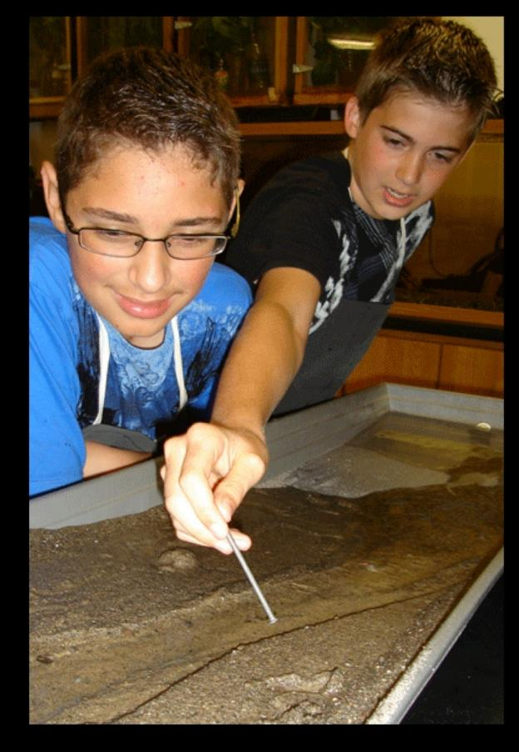
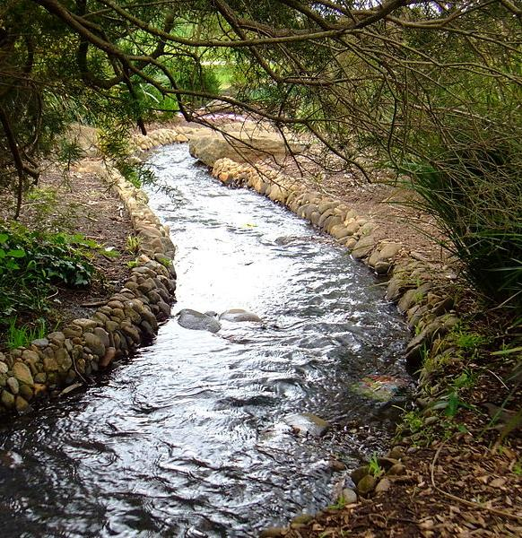
Investigation 2: Stream Tables and Real Streams
Source unknown
Photo courtesy of Sprocket2cog, Wikimedia
Notes:
5 min
a. Pairs: “Examine these two photographs of a stream-table model juxtaposed with a real stream and discuss with an elbow partner how the model compares with a real stream. See if you can come up with three similarities and three differences. Then write your ideas in your science notebooks.”

Slide 45
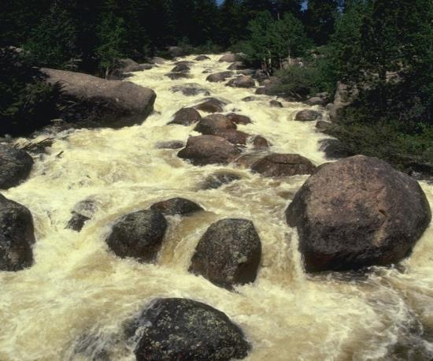
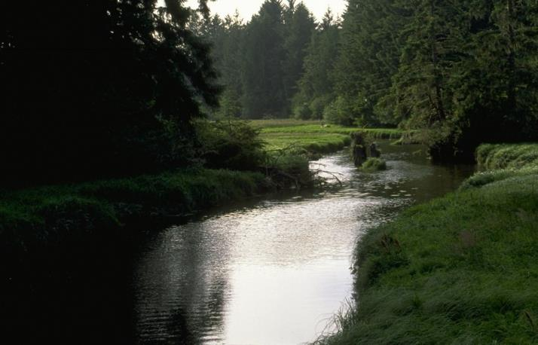
Investigation 2: Stream Tables and Real Streams
How is the stream-table model like a real stream?
How is the model different from a real stream?
Where do you think erosion and deposition happen in the streams below?
Photo courtesy of Corel
Photo courtesy of Corel
Notes:
10 min
a. Read the first two questions on the slide.
b. Call on pairs to share their ideas for answering these questions, citing the similarities and differences they recorded in their notebooks to support their answers. Probe participants’ responses and elicit differing points of view.
c. Then read the third question on the slide and invite several participants to share their ideas. Probe and challenge their responses.

Slide 46
Reflect: Content Deepening Focus Questions
Focus question from lesson 5:
Can mountains grow so tall they reach outer space? Why or why not?
Focus question from lesson 6:
How does flowing water change Earth’s surface?
Notes:
10 min
a. “As we reflect on the first content deepening focus question from ECS lesson 6, let’s revisit the focus question from lesson 5 as well. Think about how today’s investigations answer both questions.”
b. Review the focus questions on the slide.
c. “To answer these questions, make a claim and support it with evidence and reasoning from today’s investigations.”
d. “As others share their claims, listen carefully and be ready to agree, disagree, ask questions, or add on. Make sure to support your arguments using evidence and reasoning from today’s investigations.”
e. During this discussion, record key ideas on chart paper.

Slide 47
Key Science Ideas
Lesson 5: Can mountains grow so tall they reach outer space? Why or why not?
Mountains can’t grow so tall they reach outer space, because the process of weathering wears them down.
Physical and chemical weathering break rocks into smaller pieces that can erode.
Lesson 6: How does flowing water change Earth’s surface?
Flowing water changes Earth’s surface by eroding rocks and depositing them in other places as sediment.
Weathering prepares rocks for erosion by breaking them into smaller pieces.
Together, weathering and erosion wear down the land.
Notes:
5 min
a. Review the key science ideas on the slide that answer the focus questions from ECS lessons 5 and 6. Emphasize that participants’ observations and evidence from today’s investigations helped shape these responses.
b. Whole-group discussion: “Does everyone agree with these ideas? Would you like to add or revise anything?”
c. Ask participants to copy these ideas into their science notebooks under the focus questions for lessons 5 and 6.

Slide 48
Earth’s Changing Surface
Lesson 7a
Photo courtesy of Visible Earth
Notes:
Less than 1 min
a. “Now we’ll explore science ideas about Earth’s changing surface from lesson 7a.”

Slide 49
Content Deepening: Focus Question 2
How can we use what we’ve learned about Earth’s changing surface to answer the unit central questions?
Notes:
Less than 1 min
a. Read the focus question on the slide.
b. “This question will guide student learning throughout ECS lesson 7a.”
c. Have participants write this question in their science notebooks and draw a box around it.

Slide 50
Unit Central Questions
Why isn’t all of Earth’s surface flat? What causes the surface to look different in different places?
Notes:
Less than 1 min
a. Review the unit central questions on the slide and remind participants that these questions will guide student learning throughout the entire series of ECS lessons.
b. Explain that the purpose of lesson 7 is for students to summarize what they’ve learned about Earth’s changing surface throughout the unit and develop answers for these questions.

Slide 51
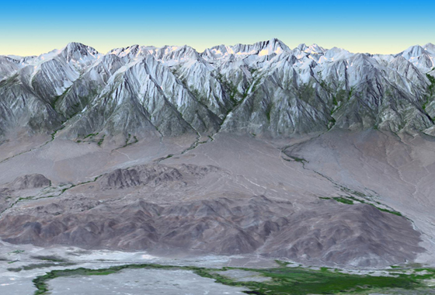
Investigation 3: Building Up and Wearing Down Earth’s Surface
Sierra Nevada Mountains
and Owens Valley, California
Photo courtesy of NASA/GSFC/METI/ERSDAC/JAROS, and U.S./Japan ASTER Science Team
Notes:
Less than 1 min
a. “For our next investigation, you’ll work with your elbow partner to answer a series of questions about the processes that build up and wear down Earth’s surface.”

Slide 52
Investigation 3: Building Up and Wearing Down Earth’s Surface
What processes are involved in forming mountains?
Do plate collisions build up or wear down Earth’s surface? Why do you think so?
Do volcanic eruptions build up or wear down Earth’s surface? Why do you think so?
Notes:
10 min
a. Have participants pair up with their elbow partners.
b. “The questions on this slide focus on the processes involved in building up Earth’s surface.”
c. Pairs: “Discuss these questions with your partners and write your answers in your science notebooks.”

Slide 53
Investigation 3: Building Up and Wearing Down Earth’s Surface
What is the difference between these processes?
Weathering and erosion
Erosion and deposition
Does weathering build up or wear down Earth’s surface? Why do you think so?
Does erosion build up or wear down Earth’s surface? Why do you think so?
Does deposition build up or wear down Earth’s surface? Why do you think so?
Notes:
10 min
a. “The questions on this slide relate to weathering, erosion, and deposition. Think about whether these processes are involved in building up or wearing down Earth’s surface.”
b. Pairs: “Discuss these questions with your partners and write your answers in your science notebooks.”

Slide 54
Investigation 3: Building Up and Wearing Down Earth’s Surface
As each of the 11 scenarios on the handout is read aloud, decide whether the scenario builds up or wears away Earth’s surface.
Use an X to mark the box on the handout that reflects your answer.
Next, decide what process caused the scenario and write your answer in the third column on the handout.
Be prepared to share your answers and reasoning!
Notes:
15 min
a. Distribute handout 4.11 (Building Up and Wearing Down Earth’s Surface).
b. Inform participants that they’ll work independently on this activity.
c. Walk participants through the instructions on the slide and ask if they have any questions.
d. Read the scenarios on the handout one at a time. Give participants about 30 seconds to think about their answers and record them on the handout.
e. Whole group: Read through each scenario again and direct participants to indicate their answers to the following questions with a show of hands:
“How many think this is an example of building up Earth’s surface?”
“How many think this is an example of wearing down Earth’s surface?”
“What is the cause of each scenario? What process is involved?”
f. Record participants’ answers on chart paper and reach a consensus on each scenario.

Slide 55
Earth’s Changing Surface
Lesson 7b
Photo courtesy of Visible Earth
Notes:
Less than 1 min
a. “For our final investigation, we’ll explore ideas about Earth’s changing surface from lesson 7b.”

Slide 56
Content Deepening: Focus Question 2
How can we use what we’ve learned about Earth’s changing surface to answer the unit central questions?
Notes:
Less than 1 min
a. Review the focus question on the slide.
b. Emphasize that this question from ECS lesson 7a will guide student learning throughout lesson 7b as well.

Slide 57
Unit Central Questions
Why isn’t all of Earth’s surface flat? What causes the surface to look different in different places?
Notes:
Less than 1 min
a. Review the unit central questions on the slide.

Slide 58
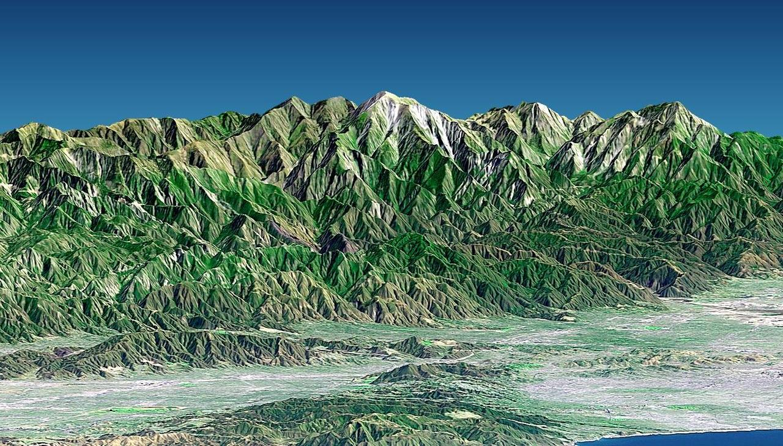
Investigation 4: Use and Apply
San Gabriel Mountains
Southern California
Photo courtesy of NASA/JPL/NIMA
Do you think the San Gabriel Mountains are being built up and growing higher or are wearing away and getting lower?
Notes:
1 min
a. Have participants pair up with their elbow partners again.
b. “The image on this slide is a digital topographic model of the San Gabriel Mountains that rise above Pomona.”
c. “This investigation will focus on the processes that shape these mountains.”
d. Ask participants to think about the question on the slide.

Slide 59
Investigation 4: Use and Apply
How do you think the San Gabriel Mountains near Pomona, California, were formed?
What evidence can you find on the maps from ECS lesson 4 to support your answer?
Do you think the San Gabriel Mountains today are being built up and growing higher or wearing away and getting lower?
What evidence can you find on the maps to support your answer?
Notes:
15 min
a. Have participants locate ECS handouts 4.1 (Map of Plate Boundaries around the World) and 4.2 (Physical Map of the World) in their lesson plans binders.
b. Read the questions on the slide.
c. Pairs: “Discuss your ideas for answering these questions with your partners. Then write your answers in your science notebooks.”
d. Whole group: Invite pairs to share their ideas and evidence with the group. Probe participants’ responses and elicit differing points of view.

Slide 60
Investigation 4: Use and Apply
Using the relief map of the United States and the plate-boundaries map, work with your partner to complete these sentences:
The San Gabriel Mountains were formed by ___________. My evidence is ___________.
The San Gabriel Mountains are [building up/wearing down]. My evidence is ________.
Write your answers in your science notebook and include drawings to support your ideas.
Notes:
15 min
a. Distribute a plastic relief map of the United States (from ECS lesson 1a) to each pair of participants.
b. Inform participants that they’ll also need handout 4.1 (Map of Plate Boundaries around the World) for this investigation.
c. Read through the instructions and statements on the slide.
d. Pairs: “Work with your partners to develop answers for each statement. Then record your responses in your science notebooks and include drawings to support your ideas.”

Slide 61
Key Science Idea
Tectonics + Erosion = Earth Surface Form
Photo courtesy of NASA/JPL/NIMA
Earth’s surface form is the result of tectonic processes that build up the land and erosional processes that wear down the land at the same time.
Notes:
1 min
a. “Throughout our content deepening sessions this week, we’ve been developing one key science idea: Earth’s surface form is the result of tectonic processes that build up the land and erosional processes that wear down the land at the same time.”
b. Remind participants that this idea is the fundamental theme behind the ECS unit.

Slide 62
Reflect: Unit Central Questions
Why isn’t all of Earth’s surface flat? What causes the surface to look different in different places?
Notes:
5 min
a. “Based on everything we’ve learned this week about Earth’s changing surface, how would you answer our unit central questions?”
b. Invite several participants to answer these questions using one-sentence statements.
c. After participants have shared their answers, ask the group if they would like to add or change anything.

Slide 63
Today’s Focus Questions
Why is it necessary to engage students in using and applying new science ideas in a variety of ways and contexts?
How will the Student Thinking Lens strategies help you teach the Earth’s Changing Surface (ECS) lessons?
How does flowing water change Earth’s surface?
How can we use what we’ve learned about Earth’s changing surface to answer the unit central questions?
Notes:
2 min
a. Review today’s focus questions.
b. Individual think time (1 min): Ask participants to reflect on these questions and think about how they might revise their answers.

Slide 64
Let’s Summarize!
Lesson Analysis Strategy 6
What new understandings did you develop?
What do you still have questions about?
Lesson Plans Review
What new insight(s) did you gain?
What do you still have questions about?
Content Deepening
What did you learn?
What do you still have questions about?
Notes:
5 min
a. Individual think time (1 min): Give participants a minute to think about the questions on the slide and consider questions they still have. Challenge them to formulate a statement summarizing what they learned in each area.
b. Whole-group share-out: Have participants share at least two different statements about each of the areas on the slide. Elicit more if time allows.

Slide 65
Homework
Read in the STeLLA strategies booklet:
Student Ideas and Science Ideas Defined
Introduction to the Science Content Storyline Lens
Science Content Storyline Lens, STeLLA Strategy A: Identify One Main Learning Goal
Complete strategy-A column on the Coherent Science Content Storyline Strategies Z-fold summary chart (front binder pocket).
Notes:
3 min
a. “Next week we’ll focus on the Science Content Storyline Lens strategies and explore a new content area: energy transfer. To prepare, complete the homework tasks on the slide.”
b. Make sure participants copy the assignment into their science notebooks.

Slide 66
Reflections on Today’s Session
Complete the Daily Reflections sheet (handout 4.12 in PD program binder).
This weekend you bump into a friend who knew you were attending RESPeCT this week. What would you say you’ve learned about the STeLLA Student Thinking Lens strategies and their potential impact on your teaching practice and/or student learning?
What do you understand better about Earth’s changing surface after this week’s session? What helped clarify your understanding?
Notes:
5 min
a. Give participants time to reflect on today’s session and write their responses to the questions on the Daily Reflections sheet (handout 4.12 in PD program binder).

Slide 67
Norms for Working Together: The Basics
Purpose: Build trust and develop a productive study group for all participants.
The Basics
Arrive prepared and on time; stay for the duration; return from breaks on time.
Remain attentive, thoughtful, and respectful; engage and be present.
Eliminate interruptions (turn off cell phones, email, and other electronic devices; avoid sidebar conversations).
Make room for everyone to participate (monitor your floor time).
Notes:
Hidden slide: Available for use at any time as needed.

Slide 68
Norms for Working Together: The Heart
Purpose: Build trust and develop a productive study group for all participants.
The Heart of RESPeCT Lesson Analysis and Content Deepening
Keep the goal in mind: analysis of teaching to improve student learning.
Share your ideas, uncertainties, confusion, disagreements, questions, and good humor. All points of view are welcome.
Expect and ask questions to deepen everyone’s learning; be constructively challenging.
Listen carefully; seek to understand other participants’ points of view.
Notes:
Hidden slide: Available for use at any time as needed.

