Slide 1
RESPeCT PD pROGRAM
Day 6
RESPeCT Summer Institute
Notes:
6 min
a. Take care of any housekeeping issues.

Slide 2
Agenda for Day 6
Day-5 reflections
Focus questions
Review: science content storyline
Lesson analysis: STeLLA strategies B, I, and 7
Content deepening: energy transfer
Lunch
Content deepening (continued)
Lesson analysis: SCSL strategy C
Summary, homework, and reflections
Notes:
5 min
a. Go over the agenda for the day.

Slide 3
Trends in Reflections
Lesson Analysis | Science Content Learning
Notes:
5 min
a. Give participants time to review your feedback on their reflections from day 5 and offer reactions, comments, or follow-up questions.

Slide 4
Review: Science Content Storyline
In your notebooks, jot down …
things you remember from yesterday’s session,
ideas that seem important to you, and
question you have.
Be prepared to share one idea and question with the group.
3
2
1
Notes:
10 min
a. Point out the three tasks on the slide. Allow 4–5 minutes for participants to write their responses in their science notebooks.
b. Have each participant share one idea about the science content storyline that she or he thinks is really important.
c. Then ask participants to share their questions. If you can answer them quickly, go ahead and do so. If a question needs a more detailed response, write it down and schedule a time to address it.

Slide 5
Today’s Focus Questions
How can we begin and end a lesson to help students develop a coherent science content storyline?
How can selecting appropriate science activities help students develop a coherent science content storyline?
What happens to energy when objects collide?
Where does the energy of a moving object come from?
Notes:
1 min
a. Introduce today’s focus questions.

Slide 6
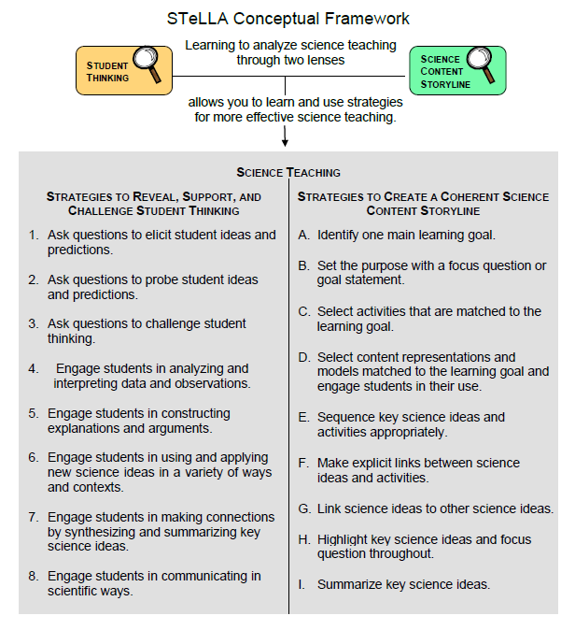
Notes:
3 min
a. “Today we’ll be looking at four new STeLLA strategies. Three of them are Science Content Storyline Lens strategies, and one is a Student Thinking Lens strategy. Throughout the session, think about how these strategies are different from one another and how they are closely linked to each other.”

Slide 7
Lesson Analysis: Focus Question 1
How can we begin and end a lesson to help students develop a coherent science content storyline?
Notes:
Less than 1 min
a. “Now let’s dig into our first focus question.”

Slide 8
Strategies B, I, and 7: Purposes and Key Features
Group 1: What are the purpose and key features of strategy B?
Why is a focus question or goal statement important for science content storyline coherence?
Group 2: What are the purpose and key features of strategy I?
Why is summarizing key science ideas important for science content storyline coherence?
Group 3: What are the purpose and key features of strategy 7?
How does strategy 7 compare with strategy I?
All groups: Make sure to cite ideas from the STeLLA strategies booklet in your answers.
Notes:
25 min
a. Pairs (3 min): Direct participants to retrieve their Z-fold summary charts and share with a partner what they learned from their homework assignment about STeLLA strategies B, I, and 7.
b. Small groups (12 min): Divide participants into three small groups and have them make charts that capture the purposes and key features of the three strategies.
Note: Challenge participants to imagine themselves in a Teacher Leader role. Ask them, “How would you explain these strategies to the teachers you’re leading?”
c. Whole group (10 min): Have small groups share their charts in a whole-group share-out.
Key ideas:
Make sure participants understand that a focus question is designed to do more than just get students interested in the lesson. It gets them thinking about a phenomenon or something else they’ve never thought about before. It also reveals important things about the knowledge and experiences they’re bringing to the lesson, it conceptually situates the learning, and it’s referred to throughout the lesson.
STeLLA strategies B, I, and 7 are like bookends that mark the beginning and end of a lesson. The science ideas used in the summary should match the focus question from the beginning of the lesson, and both the focus question and the summary should match the lesson’s main learning goal.

Slide 9
Discussion Questions: Strategy B
What is the difference between focus questions and goal statements?
Which do you think would be more useful in engaging student interest and making their thinking visible—focus questions or goal statements?
Notes:
7 min
a. Whole group: Discuss the questions on the slide as a group.
Key ideas:
A focus question is designed to be answered using the lesson’s main learning goal and supporting science ideas. A goal statement describes the main science idea to be learned.
Focus questions are always used in RESPeCT lesson plans because they’re useful in engaging student interest, making their thinking visible, and eliciting initial ideas at the beginning of a lesson. When posed at the end of a lesson, focus questions challenge students to use new ideas developed during the lesson.

Slide 10
Discussion Questions: Strategies I and 7
What are various ways a lesson or unit can be synthesized and/or summarized?
How are strategies I and 7 similar and different?
SCSL strategy I: Summarize key science ideas.
STL strategy 7: Engage students in making connections by synthesizing and summarizing key science ideas.
Notes:
7 min
a. Whole group: Discuss the first question on the slide. Participants can refer to the information on strategy 7 in the STeLLA strategies booklet to identify a variety of ways in which key science ideas in a lesson can be synthesized.
b. Emphasize: “Toward the end of a unit, an entire lesson may be devoted to strategy 7, which engages students in synthesizing and summarizing science ideas across several lessons.”
c. Discuss the second question on the slide.
Key ideas:
In strategy I, the teacher creates a summary of key science ideas in the lesson. Strategy 7, however, engages students in synthesizing and summarizing key science ideas in the lesson. When students themselves perform this work, it makes their thinking visible, engages them in active sensemaking, and reveals to the teacher any misunderstandings or gaps in knowledge. Using both strategies brings coherence to a science lesson and is a powerful way to end it.
In strategy 7, summarizing involves making connections between key science ideas, which helps students synthesize the main learning goal or big idea in a lesson.
Summaries should focus on key science ideas, not activities; that is, focusing on “what we learned” versus “what we did.”
For a variety of reasons, a lesson sometimes ends before the main learning goal has been fully developed. However, summarizing work should still take place. For example, the teacher might say, “Our focus question today was How do plants get their food? What have we found out so far?” After students respond, the teacher could reply, “Yes, so far we’ve discovered that water and soil aren’t food for plants. But we still haven’t figured out what is food for plants. We’ll continue working on this question next time.”

Slide 11
Video-based Lesson Analysis
Next we’ll analyze four video clips from the beginning and end of an Energy Transfer lesson.
Notes:
Less than 1 min
a. Transition: This slide marks the transition to video-based lesson analysis.

Slide 12
Lesson Analysis: Strategy B
In Analysis Guides B and I (handout 6.1), review the four criteria for strategy B: Setting the purpose.
Read the lesson context for the first two video clips at the top of the transcripts (handouts 6.2 and 6.3).
Watch each video clip, keeping in mind the criteria for strategy B.
Analyze each transcript using the analysis guide.
How well does the beginning of this lesson match the criteria for strategy B?
Share and compare your analyses.
Links to video clips: 6.1_stella_et_bernstein_L2_c1;
6.2_stella_et_knight _L5_c1
Notes:
20 min
a. Have participants locate Analysis Guides B and I (handout 6.1 in PD program binder) and spend 1 or 2 minutes reading the criteria for strategy B: Setting the purpose.
b. Ask: “Do you have any questions about these criteria?”
c. Emphasize: “Keep the criteria for strategy B in mind as you watch the video clips from the beginning of an Energy Transfer lesson.”
d. Individuals: Give participants a couple of minutes to read and think about the lesson context at the top of each video transcript (handouts 6.2 and 6.3).
e. Show each video clip.
f. Whole group: “How well does the beginning of this lesson match the criteria for strategy B?”
Note: During the discussion, be on the lookout for opportunities to clarify science-content ideas.

Slide 13
Lesson Analysis: Strategy I
In Analysis Guides B and I (handout 6.1), review the six criteria for strategy I: Summarizing key science ideas.
Read the lesson context for the next two video clips at the top of each transcript (handouts 6.5 and 6.6).
Watch each video clip, keeping in mind the criteria for strategy I.
Analyze the transcript using the analysis guide.
How well does the end of this lesson match the criteria for strategy I?
Share and compare your analyses.
Link to video clips: 6.3_stella_et_bernstein_L3_c3a-d;
6.4_stella_et_knight_L5_c5
Notes:
20 min
a. Allow participants 1 or 2 minutes to read the six criteria in the analysis guide for strategy I: Summarizing key science ideas.
b. Ask: “Do you have any questions about these criteria?”
c. Emphasize: “Keep the criteria for strategy I in mind as you watch the video clips from the end of the same Energy Transfer lesson.”
d. Individuals: Give participants a couple of minutes to read and think about the lesson context at the top of each video transcript (handouts 6.5 and 6.6).
e. Show each video clip.
f. Whole group: “How well does the end of this lesson match the criteria for strategy I? How well does the summary statement match the beginning of the lesson?”

Slide 14
Energy Transfer Lesson Plans: Reading and Analysis
Examine the main learning goal, the lesson focus question, and the lesson summary for your assigned Energy Transfer lesson plan (parts A and B).
Answer these questions in your notebooks, keeping in mind the analysis-guide criteria for strategies B and I:
What do you notice?
What do you wonder about?
Notes:
10 min
Note: This slide can be abridged or skipped if time is running short.
a. Read the instructions on the slide and assign a two-part lesson plan (parts A and B) to each participant.
b. Ask participants if they have any questions about the assignment.
c. Individual reading-and-analysis time (5 min): “Answer the slide questions in your notebooks, keeping in mind the analysis-guide criteria.”
d. Whole-group discussion (5 min): Briefly discuss participants’ observations and questions for their assigned lesson plans.
Note: Participants should see a close match between the main learning goal, the lesson focus question, and the summary. However, also welcome critiques and suggestions for improvement. Just make sure critiques are based on good understandings of the strategies involved.

Slide 15
energy Transfer
SCIENCE CONTENT DEEPENING Grade 4
Notes:
Less than 1 min
a. Transition: This slide marks the transition to the content deepening work.
Note: Throughout this content deepening phase, refer as needed to the content background document and Common Student Ideas about Energy.

Slide 16
Review: Science Ideas about Energy
Review the information about science ideas in the strategies booklet (Student Ideas and Science Ideas Defined).
Think: What three science ideas about energy did you retain from the previous content deepening session? List them in your notebook.
Pairs: Share your list with an elbow partner.
Notes:
8 min
a. Individuals (2 min): Have participants review the information on science ideas in the STeLLA strategies booklet (Student Ideas and Science Ideas Defined).
b. Think-Pair-Share (4 min): “What three science ideas about energy did you retain from the previous content deepening session? List these ideas in your notebooks and then share them with an elbow partner.”
c. Whole group (4 min): Invite participants to share their lists with the group. As participants share, record their ideas on chart paper. Identify similar ideas and conflate them into one idea on the chart.

Slide 17
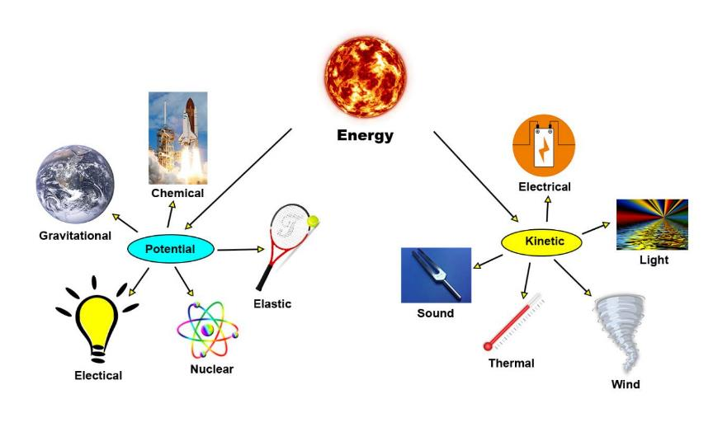
Review: Forms of Energy
All photographs courtesy of Pixabay.com
Notes:
10 min
a. Review kinetic energy and potential energy and highlight the examples (subsets) on the slide.
Kinetic energy is associated with the motion of a body, an object, or a system.
Potential energy is stored energy associated with the position of an object relative to another object. An object with potential energy has the capacity to move or to make something else move.
b. Review the definition of heat: Thermal energy that automatically flows (transfers) from hot things toward cooler things.
c. Draw participants’ attention to the subsets of kinetic and potential energy on the slide and ask these questions:
What is the moving entity in each example of kinetic energy on the slide?
Describe the stored energy in each example of potential energy on the slide.
Can you detect energy transfer in the form of heat in any of these examples?

Slide 18
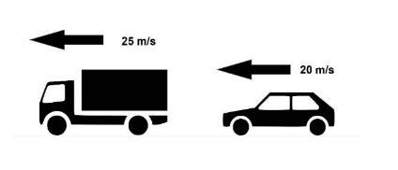
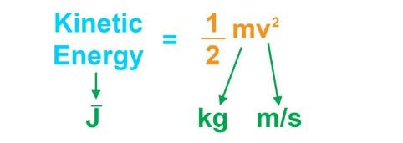
Kinetic Energy: Energy in Motion
The amount of kinetic (motion) energy in an object depends on its mass (m) and speed (v).
Notes:
1 min
a. Highlight the information on the slide and emphasize the following points:
When an object begins to move, stored potential energy converts to kinetic energy.
All of the particles of an object move in the same direction and at the same speed, unlike internal energy in which the energy in a system is generated from the relative positions and interactions of the parts.
Anything that moves must have some kinetic energy.
The amount of kinetic energy is proportional to the mass of object and the square of its speed (KE = 1/2mv²).

Slide 19
Potential Energy: Energy of Position
Potential energy is stored in a system because of the relative position or orientation of its parts.
The amount of potential energy in a system depends on the mass and relative distance between two objects.
Gravitational potential energy: depends on an object’s position from Earth’s center or the surface of Earth at its lowest point
Elastic potential energy: depends on the degree of stretching, squeezing, or bending
Chemical potential energy: depends on the chemical composition of combustible molecules
Notes:
2 min
a. Emphasize that potential energy is stored in a system because of the relative position or orientation of its parts.
b. “The amount of potential energy in a system depends on the mass and relative distance between two objects.”
c. Highlight the following examples:
Gravitational potential energy is the stored energy of an object at a higher elevation in relation to the ground. The amount of potential energy is determined by its position (or elevation) from Earth’s center or the surface of Earth at its lowest point.
Elastic potential energy relates to energy stored when matter is bent, stretched, or squeezed. The degree of stretching, squeezing, or bending determines the amount of potential energy.
Chemical potential energy relates to energy stored in a molecule based on the composition and arrangement of its atoms. The chemical composition of combustible molecules determines the amount of potential energy.

Slide 20
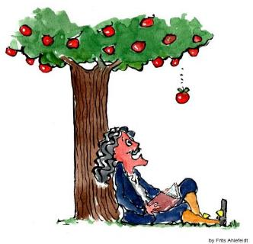
Example 1: Gravitational Potential Energy
Apples with more mass and/or higher in a tree have more potential energy.
Gravitational potential energy (GPE) is the product of an object’s mass (m), gravitational acceleration (g), height from a reference point (h):
GPE = mgh (g = 9.8m/s ²)
When calculating GPE, the lowest reference point is h = 0.
Potential energy converts to kinetic energy as an apple falls from a tree!
Courtesy of Frits Ahlefeldt
Notes:
4 min
a. Walk participants through the information on the slide.
b. Point out that height (h) relates to the height (distance) of an object (an apple) from a reference point (the ground). When calculating GPE, participants should make the lowest point of reference 0.
c. Emphasize that gravitational acceleration (g) is a constant number that equals the strength of an object’s acceleration toward Earth, a consequence of the mass of Earth and the distance from its center. All objects free-fall at a gravitational acceleration of 9.8 m/s² or 32 ft/s² (meters per second squared or feet per second squared).

Slide 21
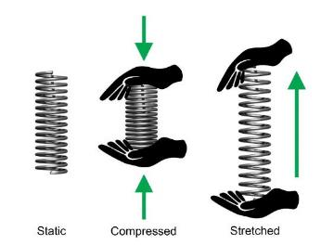
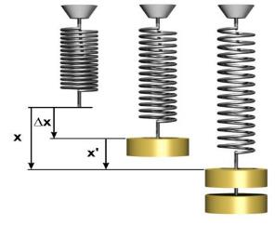
Example 2: Elastic Potential Energy
A spring at rest (static) has no stored potential energy. When stretched or compressed, it gains elastic potential energy.
Potential energy transforms into kinetic energy when the spring is released and returns to rest length.
Courtesy of Wikimedia.org
Notes:
3 min
a. Walk participants through the information on the slide.
b. Emphasize that a spring at rest or in a static position (neither stretched nor compressed) has no stored potential energy.
c. “When a spring is compressed or stretched, it gains elastic potential energy. The amount of potential energy depends on the amount of length change (∆x, or delta x) in the spring, the mass of the hanging object , and the stiffness of the spring (PE = 1/2kx²). In theoretically ‘perfect’ elastic springs, no energy is lost when spring length changes; it’s simply stored as potential energy and then released entirely as kinetic energy.”
d. “In the process of returning to rest or static length from a stretched or compressed length, a spring’s potential energy transforms into kinetic energy.”

Slide 22
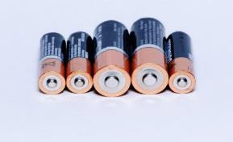
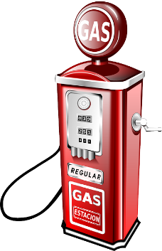
Example 3: Chemical Potential Energy
Chemical potential energy is stored in the chemical bonds that hold particles together. This energy can be absorbed or released during a chemical reaction.
All photographs courtesy of Pixabay.com
Notes:
2 min
a. Read the information on the slide.
b. Emphasize that chemical potential energy involves a complex interdependence between particles and the chemical bonds that hold them together. Chemical potential energy can be released as heat or through work (e.g., an electrical current).
c. Note that something somewhere paid, or exerted, great energy to break these chemical bonds.
d. Cite examples of materials with chemical potential energy, such as food, batteries, gasoline, candles, and firewood.

Slide 23
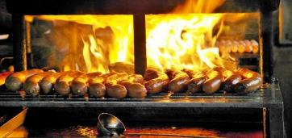
Modes of Heat
Heat: a transfer of energy from a high-temperature object to a low-temperature object (hot to cold).
Three modes of heat:
Conduction: Energy flows through a conducting medium that connects hot and cold objects.
Radiation: Light rays, infrared rays, and ultraviolet rays emitted from hot objects transfer to cooler objects.
Convection: Masses of air and liquid rise from hot places to cold places, taking energy with them.
Photo courtesy of Pixabay.com
Notes:
5 min
a. Review the definition and modes of heat on the slide.
b. Ask participants to describe the different modes of heat in the picture of sausages on a wood grill.
c. Cite other good examples:
Conduction: The energy that transfers from your hand to the cold drink you’re holding. As heat leaves your hand and decreases its internal energy (leaving it numb), it enters the drink and increases its internal energy.
Radiation: glowing coals, glowing toaster heating elements, and the Sun. No contact between objects is needed to receive the heat.
Convection: Hot air floats upward.

Slide 24
Characteristics of Heat
The flow of heat is spontaneous (automatic) and irreversible (always from hot to cold).
The loss or gain of heat energy in an object or system causes a change in its internal energy.
Energy that transforms into heat becomes less useful. It doesn’t disappear; it’s just displaced.
Unlike internal energy, which can be measured with a thermometer, heat energy isn’t easy to measure.
Notes:
2 min
a. Read through the information on the slide.
b. Emphasize that heat is not temperature, internal energy, or a state of matter. It’s a transfer of energy. Also remind participants that heat energy is kinetic energy.
c. Ask participants to compare heat energy in the following examples and identify which is more useful:
Heat from fuel entering the piston of a car engine versus heat escaping from a car’s exhaust pipe
Heat from a burning log versus heat rising into the sky
Heat radiating from the Sun versus heat radiating from Earth
Kinetic energy from a moving car versus heat energy radiating from car brakes
Heat spreading from Earth to the atmosphere.

Slide 25
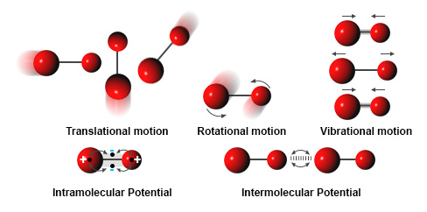
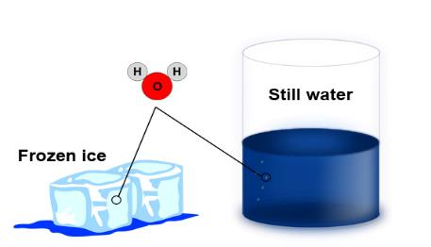
Internal Energy (IE)
IE is the sum of kinetic and potential energies of individual particles at the level of atoms.
It can be measured using a thermometer and roughly compared with other materials.
Work or the transfer of heat into or out of a system can increase or decrease internal energy.
Courtesy of Cal Poly Pomona
Courtesy of Pixabay.com
Notes:
2 min
a. Walk participants through the information on the slide.
b. Emphasize that internal energy isn’t a new kind of energy; it represents the total kinetic and potential energy in a system resulting from the random motion and arrangement of atoms. Potential energy increases internal energy, whereas kinetic energy decreases it.
c. “You can visualize internal energy by thinking of molecules as small balls moving around and attaching to each other by soaring like forces.”
d. Ask: “How does internal energy differ from kinetic energy?” [Answer: In kinetic energy, all particles move at same speed in the same direction, but with internal energy, the motion of particles is random.]

Slide 26
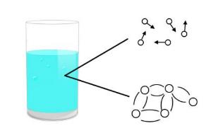
Heat versus Internal Energy
Does the water in a glass sitting on a table have any energy?
Macroscopic level: No apparent energy
Microscopic level: Molecules in motion (kinetic energy) and molecular attractive forces (potential energy) = internal energy
Notes:
3 min
a. Initially reveal only the title and the question on the slide.
b. Ask participants, “Does the water in a glass sitting on a table have any energy?”
c. Elicit ideas from participants and probe their responses.
d. Show the explanation on the slide.
e. Explain that on a macroscopic scale, we can’t see evidence that the water has energy. But microscopically, internal energy is evident in motion and attractive forces (kinetic and potential energy) of water molecules.

Slide 27
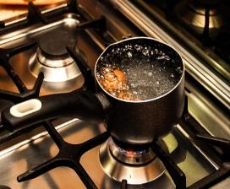
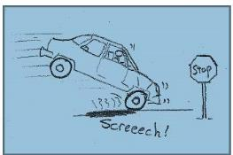
Heat versus Internal Energy
An object’s internal energy can be increased with heat or a force working against it.
Photo courtesy of Pixabay.com
Courtesy of Hector Mireles
Notes:
2 min
a. Emphasize that internal energy isn’t visible and can’t be felt, but heat from an object can be detected. This is a key difference between internal energy and heat.
b. “The internal energy of an object can be increased when heat is applied or a force works against it.”
c. Briefly discuss how heat increases internal energy in first example on the slide (the pot of boiling water). Ask participants which modes of heat are involved.
d. “Force working against an object can also increase internal energy. One example is rubbing one object against another object. Let’s rub our hands together. Do you feel them getting warmer? Frictional forces are increasing the internal energy.”
f. Draw participants’ attention to the second image on the slide and discuss how the tires working against the motion of the car relative to the frictional force from the road increases the internal energy of the car as it screeches to a stop. Emphasize that work is the product of force (frictional force from the road) and distance (the distance of the skid).

Slide 28
Common Misconceptions about Energy
Kinetic (motion) energy depends on speed, not mass.
Gravitational potential energy is the only type of potential energy.
Elastic potential energy happens only during stretching, not compression.
Only visible things have energy.
Only objects that feel warm or hot have thermal energy.
Internal energy is measured by touching it.
Notes:
15 min
a. Read the common misconceptions about energy on the slide.
b Pairs: “Discuss these misconceptions with an elbow partner and use the science ideas about energy that we’ve learned about in our content deepening work to develop a statement that corrects each misconception.”
c. Whole group: Ask participants to share their ideas for correcting each misconception. Probe participants’ responses and elicit differing points of view.
d. During the discussion, record key ideas on chart paper and highlight the following explanations as needed:
Kinetic (motion) energy depends on speed, not mass. The amount of kinetic energy in an object depends on speed (v) and mass (m). Mathematically, the relationship between energy, mass, and velocity is expressed KE = 1/2mv2. If a heavier marble and a lighter marble collide with a packing peanut at the same speed, the heavier marble will move the packing peanut a greater distance. Thus, both mass and speed affect the amount of kinetic energy.
Gravitational potential energy is the only type of potential energy. Other forms of potential energy exist besides gravitational potential energy. Elastic, chemical, and electromagnetic energy are also forms of potential energy. For example, a stretched rubber band stores elastic potential energy, gasoline stores chemical potential energy, and opposite electrical charges separated from each other by some amount of distance store electromagnetic energy. Each category of stored potential energy can be transformed into another form of energy.
Elastic potential energy happens only during stretching, not compression. Elastic objects, like springs, can be compressed (squeezed) or expanded (stretched). Both movements cause elastic potential energy to change. Bed springs are compression springs. Bungee cords are expansion springs. Both store potential energy.
Only visible things have energy. It’s common to think that energy requires a visible agent to express it. For example, a hammer hitting a nail is a visible agent of motion energy. But invisible objects are also agents of energy transfers and transformations. Heat waves (infrared radiation) are invisible, and yet they have energy. For example, the heat lamps used in restaurant buffets keep food warm until it’s served.
Only objects that feel warm or hot have thermal energy. All objects have some thermal energy because they’re composed of molecules in motion. For example, the warm water in one cup and the cold water in another cup both have thermal energy. The water molecules in both cups are in motion, but the warmer molecules are moving faster, on average, than the colder molecules. If both cups contain the same amount of water, we would say that the warm water has more thermal energy than the cold water.

Slide 29
Elastic and Inelastic Collisions
When two objects collide, there is a transfer of momentum but not necessarily a transfer of energy.
Elastic collisions: The total kinetic energy of all members (objects) remains the same before and after impact. No kinetic energy converts to heat or another form of energy.
Inelastic collisions: The total kinetic energy of all members (objects) isn’t the same before and after impact. Some kinetic energy is lost to friction, heat, sound, and light (sparks).
Notes:
5 min
a. Walk participants through the information on the slide.
b. Discuss examples of an elastic collision:
Rubber superballs (reach the same height after a bounce as when they started)
Billiard balls (complete transfer of kinetic energy from one ball to another)
Rare, idealized events
c. A familiar example of an inelastic collision is a car crash. Note that when two cars collide and mesh together rather than bounce off each other, all kinetic energy is lost, but the total momentum of both cars before and after the crash is the same.
d. Emphasize that collisions involve a transfer of momentum, but not necessarily a transfer of energy. An elastic collision doesn’t involve energy transfer, since the amount of kinetic energy in both objects remains the same before and after impact. None of the kinetic energy transforms into heat or another form of energy. In contrast, an inelastic collision involves a transfer of energy, since the amount of kinetic energy in both objects is different before and after impact. Some of the kinetic energy is lost as heat and transforms into other forms of energy (e.g., sound, light).

Slide 30
Key Science Ideas
Kinetic energy is the energy of motion. The amount of kinetic energy in an object depends on its mass (m) and speed (v).
Potential energy is stored energy associated with the relative position of two objects. The amount of potential energy in a system depends on the mass (m) and relative distance between two objects. Potential energy has several forms, including gravitational, chemical, and elastic.
Heat is a transfer of energy from a warmer object to a cooler object by conduction, radiation, and convection.
Internal energy equals the sum of the kinetic and potential energies of the individual atoms in a system.
In elastic collisions, all kinetic energy remains constant; in inelastic collisions, some kinetic energy converts to other forms of energy.
Notes:
5 min
a. Review the key science ideas on the slide to summarize the content deepening work so far.
b. Whole-group discussion: “Does everyone agree with these ideas? Would you like to add or revise anything?”
c. Have participants copy these science ideas into their science notebooks.

Slide 31
Content Deepening: Focus Question 1
What happens to energy when objects collide?
Notes:
Less than 1 min
a. Read the focus question on the slide.
b. Emphasize that this question will guide student learning throughout ET lessons 3a/b.
c. Ask participants to write the focus question in their science notebooks and draw a box around it.

Slide 32
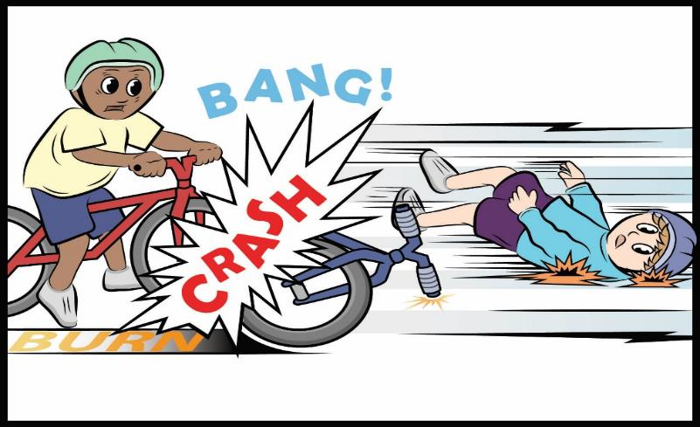
Mumford and Leroy’s Big Crash
Courtesy of BSCS
Notes:
5 min
a. Have participants locate handouts 3.1 and 3.2 (Mumford and Leroy’s Big Crash, parts 1 and 2) in their lesson plans binders.
b. Read the story aloud as participants follow along.
c. “Next, we’ll use the science ideas we’ve been learning about to investigate how energy moved and changed in this story.”

Slide 33
Investigation 1: Mumford and Leroy’s Collision
Look at each pictures on the handout. What happens to the kinetic energy and potential energy of Mumford and Leroy in each scene?
What do you think happens to the energy after the crash when everything stops moving? Where does all of the energy go?
What kind of collision is this? How do you know?
Write your descriptions on the handout and your answers to the questions in your notebook.
Courtesy of Hector Mireles
Notes:
15 min
a. Distribute handout 6.10 (Mumford and Leroy’s Collision). Read the questions on the slide and the directions on the handout.
b. Pairs : “First, pair up and discuss what happens with Mumford’s and Leroy’s energy before, during, and after their big crash. Look at each picture on the handout and think about the kinetic energy and potential energy of each boy. Try to reach a consensus about the energy transfers and transformations that take place in each scene. Then write your descriptions in the space provided. After completing the handout, discuss the other two questions on the slide and write your answers in your science notebooks. Make sure to include science ideas and evidence from the story in your responses.”
c. Whole group: Ask participants to share their ideas and evidence with the group. Probe participants’ responses and elicit differing points of view.
d. As participants share their ideas, record them on chart paper.
Ideal responses:
Question 1: All of Mumford’s energy at the top of the hill is potential energy. As Mumford races down the hill, his potential energy transforms to kinetic energy. Just before the crash, all of his potential energy has converted to kinetic energy. When Mumford and Leroy collide, a small amount of Mumford’s kinetic energy transfers to Leroy, causing him to fly off his bike and skid across the sidewalk. Eventually, Leroy skids to a stop. Some of Mumford’s kinetic energy also transforms to the sound of the crash and light from the sparks. But most of Mumford’s kinetic energy works against the materials in the crash (the bikes, tires, arms and legs, the ground) and heats them up. Ultimately, heat energy from the crash radiates into the environment.
Question 2: After the crash, when everything has stopped moving, all of the energy in the system (objects and environment) is in the form of internal energy.
Question 3: Mumford and Leroy’s big crash is an example of an inelastic collision because energy transfers from Mumford to Leroy when the boys collide.

Slide 34
Investigation 2: Colliding Marbles
The marbles in this model represent Mumford and Leroy, and the ruler-ramp represents the hill in the story.
Courtesy of Hector Mireles
What are some similarities and differences between this model and Mumford and Leroy’s collision?
Notes:
10 min
“In our previous content deepening session, we explored energy transfers and transformations using a ramp-and-marble model. In ET lesson 3, students designed a similar model using two marbles and a ramp to simulate Mumford and Leroy’s collision.”
Note: In addition to the diagram on the slide, you may want to set up and demonstrate a ramp-and-marble model from lesson 3a to support this investigation.
b. Explain that the marbles on the slide represent Mumford and Leroy, and the ruler-ramp represents the hill in the story.
c. Ask participants the question on the slide.
d. As participants share, record their observations on chart paper.
Ideal responses:
Similarities: Like Mumford, the first marble gains kinetic energy as it rolls down the ramp.
Differences: (1) Mumford and Leroy’s collision is inelastic, but the marbles’ collision is nearly an elastic collision. After the marbles collide (“click”), the second marble takes off at a speed very similar to the speed of first marble just before the collision. (2) The second marble continues rolling after the collision because light friction barely slows it down. The marble finally rolls to a stop far from the point of impact. Leroy, on the other hand, skids to a stop very quickly because of significant friction between his body and the ground.
Note: Participants may observe a slight uphill grade on the right side of the ramp on the slide that might also slow the marble down. This grade doesn’t appear in lesson 3a.

Slide 35
Reflect: Content Deepening Focus Question 1
What happens to energy when objects collide?
Notes:
5 min
a. Review the focus question on the slide.
b. Invite participants to share their ideas for answering the question, using science ideas about energy and evidence from the previous investigation.
c. Encourage participants to agree, disagree, ask questions, or add to the ideas others share.
d. During this discussion, record key ideas on chart paper.

Slide 36
Key Science Ideas
Energy can transfer or move from one object to another object.
When two objects collide, energy moves or transfers from one object to another.
Evidence that energy transfer is taking place is the changing speed of both objects following the collision. When Mumford (the first marble) hits Leroy (the second marble), he stops moving, and Leroy starts moving.
Notes:
5 min
a. Review the key science ideas on the slide that answer the focus question. Emphasize that participants’ observations helped shape these responses.
b. Whole-group discussion: “Does everyone agree with these ideas? Would you like to add or revise anything?”
c. Have participants copy these science ideas into their science notebooks under the focus question.

Slide 37
Content Deepening: Focus Question 2
Where does the energy of a moving object come from?
Notes:
Less than 1 min
a. Read the focus question on the slide.
b. Emphasize that this question will guide student learning throughout ET lesson 4a.
c. Ask participants to write the focus question in their science notebooks and draw a box around it.

Slide 38
Investigation 3: Energy Changing Costumes
Mumford’s potential energy changed to kinetic energy as he rode from the top of the hill to the bottom.
What other examples of energy changing costumes can you find in parts 1–3 of the story? (Include evidence from your handouts.)
Where do you see potential energy changing to kinetic energy?
Where do you see kinetic energy changing to some other form of energy?
Where do you see energy increasing or decreasing when it changes costumes?
Notes:
20 min
a. Have participants locate ET handout 4.1 (Mumford and Leroy’s Big Crash, Part 3) in their lesson plans binders. They’ll also need to use lesson handouts 3.1 and 3.2 and PD handout 6.10 as resources for this investigation.
b. Read part 3 of the story as participants follow along. Then discuss how Mumford’s energy changed costumes as he coasted from the top of the hill to the bottom. Focus on potential and kinetic energy, as well as energy increasing or decreasing.
c. Pairs: “Discuss the questions on the slide with an elbow partner and write your answers in your science notebooks. Make sure to include science ideas about energy and evidence from the handouts to support your answers.”
d. Whole-group share-out: Invite participants to share their ideas and evidence with the group. Probe participants’ responses and elicit differing points of view and evidence.
e. During this discussion, record key ideas on chart paper.
Note: If participants are having trouble with the concept of energy changing costumes, use the ramp-and-marble model to demonstrate where energy transformations are taking place.

Slide 39
Reflect: Content Deepening Focus Question 2
Where does the energy of a moving object come from?
Notes:
5 min
a. Review the focus question on the slide.
b. Invite participants to share their ideas for answering the question, using science ideas about energy and evidence from the previous investigation.
c. Encourage participants to agree, disagree, ask questions, or add to the ideas others share.
d. During this discussion, record key ideas on chart paper.

Slide 40
Key Science Ideas
The energy of a moving object can come from (1) an energy transfer or (2) an energy transformation (costume change).
Energy can change, or transform, from one form to another (e.g., potential energy to kinetic energy).
Potential energy can’t be detected using our senses.
To have potential energy, an object must be above or off the ground. It must have the potential to move from a higher place to a lower place.
The higher an object is off the ground, the more potential energy it has.
Notes:
5 min
a. Review the key science ideas on the slide that answer the focus question. Emphasize that participants’ observations helped shape these responses.
b. Whole-group discussion: “Does everyone agree with these ideas? Would you like to add or revise anything?”
c. Have participants copy these science ideas into their science notebooks under the focus question.

Slide 41
Lesson Analysis: Focus Question 2
How can selecting appropriate science activities help students develop a coherent science content storyline?
Notes:
Less than 1 min
a. Read the focus question on the slide.
b. “To help us answer this focus question, we’re going to explore STeLLA strategy C: Select activities that are matched to the learning goal.”

Slide 42
Strategy C: Purpose and Key Features
According to the strategies booklet, what are the purpose and key features of strategy C: Select activities that are matched to the learning goal?
Notes:
25 min
a. Ask participants to locate the section on strategy C in the STeLLA strategies booklet.
b. Have one participant lead the group in creating a chart that summarizes the purpose and key features of strategy C: Select activities that are matched to the learning goal.
c. Ask: “What does the strategies booklet say about science activities that are fun and engaging for students?
Ideal responses:
Activities should be selected because they can support students in understanding the main learning goal, not because they’re fun or easy to do.
Avoid activities that are only topically related (e.g., something about plants); instead, activities should focus on a specific science idea that is closely linked to the main learning goal (e.g., Plants get their food by making it out of carbon dioxide, water, and light energy).
Activities should not just be interesting supplements to the science content storyline; they should help develop it.
d. Follow-up: “Think back on science-lab activities in high school or college. Did these activities play a key role in helping you better understand the science concepts presented in textbooks or lectures? Or were they more like add-on activities that were only loosely related to the science concepts being taught?”

Slide 43
Lesson Analysis Question
Main Learning goal: Energy can transform or change from potential energy to kinetic energy.
Focus question: Where does the energy of a moving object come from?
Analysis question: Are the activities well matched to the main learning goal?
Notes:
1 min
a. For this lesson analysis, participants will view a set of three video clips from one Energy Transfer lesson.
b. Review the main learning goal and focus question on the slide. Then introduce the analysis question: Are the activities well matched to the main learning goal?

Slide 44
Lesson Analysis: Strategy C
Locate Analysis Guide C in your program binders (handout 6.4) and read the main learning goal at the top of page 1.
For this analysis, we’ll watch three video clips from the same Energy Transfer lesson.
Before each clip: Read the lesson context at the top of the video transcript.
After each clip: Complete part 1 of Analysis Guide C.
Links to video clips: 6.5_stella_et_knight_L4_c1;
6.6_stella_et_knight_L4_c2;
6.7_stella_et_knight_L4_c3
Notes:
50 min
Note: Refer to the content background document as needed throughout this lesson analysis.
a. Have participants locate Analysis Guide C (handout 6.4) in their PD binders and read the main learning goal at the top of page 1. Then orient them to part 1 of the analysis guide.
b. Before each clip: Have participants read the lesson context at the top of the corresponding video transcript.
c. Show each video clip.
d. After each clip (individuals or pairs): Allow time for participants to review the analysis guide, write down science ideas revealed in the activity, and assess how well matched these ideas are to the main learning goal.

Slide 45
Lesson Analysis: Strategy C
Discuss these questions with a partner:
Were the activities well matched to the learning goal? Provide evidence to support your response.
Suggest ways to improve the match between the activities and the main learning goal (part 2, Analysis Guide C).
Be prepared to share your ideas in a group discussion.
Notes:
12 min
a. Pairs: “Discuss the questions on the slide and be ready to share your ideas with the group.”
b. Whole group: Assess how well the activities in the video clips matched the main learning goal, and ask participants to offer suggestions for improving the match.
Key ideas:
The marble’s potential energy is greater at the top of the ramp than halfway down the ramp or at the bottom.
Potential energy is transformed to kinetic energy as the marble rolls down the ramp.
The marble’s kinetic energy is greatest at the bottom of the ramp than halfway down the ramp or at the top.
Potential energy decreases as kinetic energy increases.

Slide 46
Practice: Strategy C
Main learning goal: Energy can be transformed.
Activities:
Students construct a roller-coaster track out of paper-towel tubes.
Students push a weighted cart into a stationary weighted cart and look for evidence of energy transfer or transformation.
Ask these questions for each activity:
How well is the activity matched to the main learning goal (closely, partially, weakly, not at all)?
How might the activity be changed to better match the main learning goal?
Notes:
10 min
Note: This activity may be skipped if time is running short.
a. Individuals (2–3 min): “Think about how well the activities on the slide are matched to the main learning goal. Be prepared to give a rationale for your answers.”
b. Whole group: Invite participants to share their ideas and reasoning with the group.
Ideal response:
Activity 2 is much more closely matched to the learning goal than activity 1. When one weighted cart is pushed into a stationary cart, the stationary cart will start to move (energy transfer). There is also a sound when the collision occurs, which denotes an energy transformation.

Slide 47
Today’s Focus Questions
How can we begin and end a lesson to help students develop a coherent science content storyline?
How can selecting appropriate science activities help students develop a coherent science content storyline?
What happens to energy when objects collide?
Where does the energy of a moving object come from?
Notes:
Less than 1 min
a. Remind participants of today’s focus questions.

Slide 48
Summarize Today’s Work
Hold up three fingers when you have all of these in mind:
One idea you’re taking away about strategy C: Select activities that are matched to the learning goal
One idea you’re taking away about strategies B, I, and 7:
Set the purpose with a focus question or goal statement (strategy B)
Summarize key science ideas (strategy I)
Engage students in making connections by synthesizing and summarizing key science ideas (strategy 7)
One science idea about energy transfer that you’re taking away from today’s content deepening work.
Notes:
7 min
Individuals: Read the instructions on the slide and give participants enough time to come up with three ideas to summarize today’s work.
Whole group: In a round-robin, invite participants to share a key idea for each category on the slide. (Allow participants to pass if they wish.)

Slide 49
Homework
In the STeLLA strategies booklet, read about SCSL strategy D:
Select content representations and models matched to the learning goal and engage students in their use.
Fill in the appropriate column on your Z-fold summary chart.
Notes:
Less than 1 min
a. Go over the homework assignment and have participants write it in their notebooks.
b. Make sure participants understand each part of the assignment.

Slide 50
Reflections on Today’s Session
How are STeLLA strategies B, I, 7, and C related to one another?
What new insights or questions have emerged about energy transfer and transformation?
Only two more days are left of our time together at the Summer Institute. What burning questions do you think should be answered before the end of the week?
Notes:
7 min
a. Allow participants at least 5 minutes to think about today’s session and write their reflections and feedback on the Daily Reflections sheet (handout 6.11 in PD program binder).

Slide 51
Norms for Working Together: The Basics
Purpose: Build trust and develop a productive study group for all participants.
The Basics
Arrive prepared and on time; stay for the duration; return from breaks on time.
Remain attentive, thoughtful, and respectful; engage and be present.
Eliminate interruptions (turn off cell phones, email, and other electronic devices; avoid sidebar conversations).
Make room for everyone to participate (monitor your floor time).
Notes:
Hidden slide—available for use as needed.

Slide 52
Norms for Working Together: The Heart
Purpose: Build trust and develop a productive study group for all participants.
The Heart of RESPeCT Lesson Analysis and Content Deepening
Keep the goal in mind: analysis of teaching to improve student learning.
Share your ideas, uncertainties, confusion, disagreements, questions, and good humor. All points of view are welcome.
Expect and ask questions to deepen everyone’s learning; be constructively challenging.
Listen carefully; seek to understand other participants’ points of view.
Notes:
Hidden slide—available for use as needed.

