Slide 1
RESPeCT PD pROGRAM
Day 7
RESPeCT Summer Institute
Notes:
5 min
a. Take care of any housekeeping issues.

Slide 2
Agenda for Day 7
Day-6 reflections
Focus questions
Introducing SCSL strategy D
Sample analysis of content representations
Lesson analysis: SCSL strategy D
Lunch
Content deepening: energy transfer
Summary, homework, and reflections
Notes:
5 min
a. Talk through the agenda for the day.

Slide 3
Trends in Reflections
Lesson Analysis | Science Content Learning
Notes:
5 min
a. Give participants time to review your feedback on their reflections from day 6 and offer reactions, comments, or follow-up questions.

Slide 4
Norms for Working Together: The Basics
Purpose: Build trust and develop a productive study group for all participants.
The Basics
Arrive prepared and on time; stay for the duration; return from breaks on time.
Remain attentive, thoughtful, and respectful; engage and be present.
Eliminate interruptions (turn off cell phones, email, and other electronic devices; avoid sidebar conversations).
Make room for everyone to participate (monitor your floor time).
Notes:
2 min
a. Review the norms and ask participants to think about areas where they could improve individually or as a group.
b. “How do you think we’re doing individually and as a group applying these norms? Do you have any comments or suggestions about areas where we could improve?”

Slide 5
Norms for Working Together: The Heart
Purpose: Build trust and develop a productive study group for all participants.
The Heart of RESPeCT Lesson Analysis and Content Deepening
Keep the goal in mind: analysis of teaching to improve student learning.
Share your ideas, uncertainties, confusion, disagreements, questions, and good humor. All points of view are welcome.
Expect and ask questions to deepen everyone’s learning; be constructively challenging.
Listen carefully; seek to understand other participants’ points of view.
Notes:
5 min
a. Review the norms that are at the heart of the RESPeCT program and ask participants to think about areas where they could improve individually or as a group.
b. Emphasize: “We’re doing quite well with our norms, but as we approach the fall, I hope to see our interactions evolving so that you feel comfortable interacting less through your PD leaders as the ‘teachers’ and direct more of your questions and comments to one another, challenging each other, piggybacking on each other’s ideas, and listening carefully to one another so that everyone is contributing to the kind of productive analysis that will help us figure out ways to strengthen our students’ science learning.”
c. Offer an opportunity for participants to comment on how the group is doing with these norms. Ask, “Are there any areas where we could improve? Any suggested changes?”

Slide 6
Today’s Focus Questions
How do you know when a content representation is appropriate and matched to the main learning goal?
How can we engage students in using content representations and models in meaningful ways?
Where does energy come from? Where does it go?
Notes:
1 min
a. Introduce the focus questions on the slide.

Slide 7
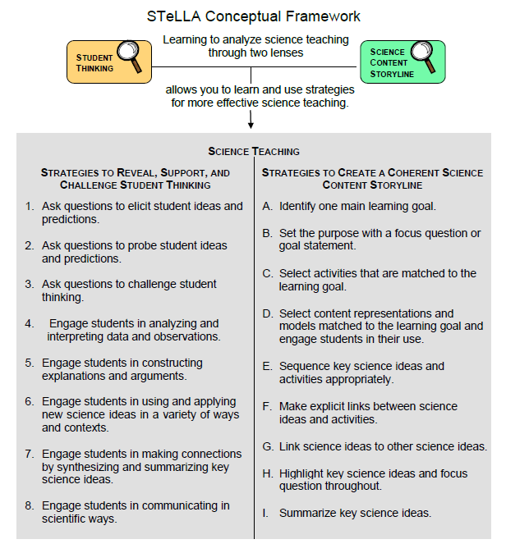
Notes:
2 min
a. “We’ll be focusing on STeLLA strategy D today. Notice that this SCSL strategy has two parts. The first part—select content representations and models matched to the learning goal—sounds similar to strategy C—select activities that are matched to the learning goal. The second part focuses on engaging students in the use of content representations. This ensures that students aren’t just looking at diagrams or models but are actively engaging with them.”

Slide 8
Lesson Analysis: Focus Question 1
How do you know when a content representation is appropriate and matched to the main learning goal?
Notes:
Less than 1 min
a. “Now let’s explore the first part of strategy D and our first focus question.”
b. Read the focus question on the slide.

Slide 9
SCSL Strategy D: Purpose and Key Features
What are the purpose and key features of this strategy?
Cite ideas and examples from the STeLLA strategies booklet and your SCSL Z-fold summary chart.
Notes:
25 min
a. Small groups (12 min): Divide participants into two groups and have each group make a chart identifying the purpose and key features of strategy D described in their SCSL Z-fold summary charts and the STeLLA strategies booklet.
b. Whole group (8 min): Have groups report out. Then ask, “What differences do you notice between the two charts?”
Key ideas:
Content representations can help students envision things that are too big or too small for them to see firsthand in the classroom, or processes that take place too quickly or slowly for them to perceive.
Content representations give students access to different ways of making sense of key science ideas.
If content representations or models are closely matched to the main learning goal, they can be especially useful in helping students see how the science content storyline fits together.
There are many different types of content representations (analogies, metaphors, and visual representations, such as diagrams, charts, graphs, concept maps, models, and role-plays).
Content representations can reveal and challenge student thinking if students are involved in creating, modifying, and analyzing the representations (instead of just listening to the teacher explain them).

Slide 10
Strategy D: Discussion Questions
How is this strategy similar to or different from selecting activities matched to the learning goal (strategy C)?
How might good content representations be especially helpful for English language learners?
Notes:
10 min
a. Whole group: Discuss the questions on the slide.
Key ideas:
Slide question 1: Both strategy C and strategy D emphasize that all activities must be matched to the main learning goal. Strategy D, however, emphasizes a very important kind of activity: content representations. It also emphasizes that teachers should actively engage students in creating, modifying, and using content representations.
Slide question 2: Good content representations can benefit all students, but they especially benefit ELL students because they present science ideas in pictures, images, and other visual formats in addition to words.

Slide 11
Analysis Guide for Strategy D
Read through Analysis Guide D (handout 7.1 in your PD program binder).
Keep this question in mind: What do you notice about how this guide is organized?
Notes:
10 min
a. Have participants locate Analysis Guide D in their PD program binders (handout 7.1).
b. Individuals : “As you read the analysis guide, keep in mind the discussion question on the slide.”
c. Whole group: Discuss the question on the slide.
Key ideas:
This analysis guide focuses on the main learning goal by having participants write that down first.
The guide is divided into three parts. Part 1 focuses on how well matched the content representation is to the main learning goal. Part 2 focuses on how well engaged students are in using the content representation.
The guide ends with identifying ways to improve the content representation and its use in a lesson (part 3).

Slide 12
Content Representation 1: Ramp-and-Marble Model
Read the main learning goal and the description of the content representation in Analysis Guide D1 (page 1 of handout 7.1).
Main learning goal: Energy can move or transfer from object to object.
Description of content representation: Students use a ramp-and-marble model (a ruler-ramp of varying heights, a marble, and a block of Styrofoam) to simulate the transfer of kinetic energy from one object to another.
Notes:
5 min
a. Set the context: “Now we’re going to analyze a content representation to see how well it’s matched to the learning goal stated on the slide.”
b. Have participants read the main learning goal and the description of the content representation in Analysis Guide D1 (page 1 of handout 7.1).

Slide 13
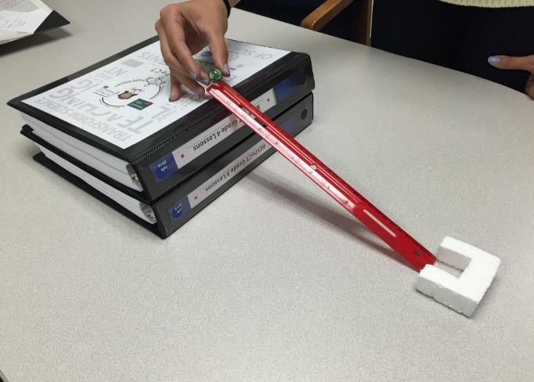
Content Representation 1: Ramp-and-Marble Model
Photo courtesy of Cal Poly Pomona
Notes:
15 min
Individuals: Have participants work independently on part 1 of Analysis Guide D1.
Pairs: “Now pair up and discuss your answers to the analysis questions.”

Slide 14
Does Content Representation 1 Match the Main Learning Goal?
How did you answer these questions from part 1 of Analysis Guide D1?
Is the content representation scientifically accurate?
Is it closely matched to the main learning goal?
Does it present science ideas to students in comprehensible ways?
Does it reinforce/introduce any misconceptions?
Does it address common misconceptions?
Does it contain distracting details?
Notes:
15 min
a. Whole group: Discuss participants’ responses to the questions in part 1 of Analysis Guide D1. (See ideal responses below.)
b. Ask: “How might this content representation be improved? Would you use it with your students?”
Key ideas:
Students roll a marble down a ruler-ramp, and it collides with a Styrofoam block at the bottom of the ramp. The marble pushes the Styrofoam across the table.
The height of the ramp affects the amount of potential and kinetic energy in the system.
The model shows a transfer of energy from the marble to the Styrofoam block when they collide.
The Styrofoam block moves farther when the marble rolls down a higher, steeper ramp than when it rolls down a lower, less-steep ramp.
The marble on the steeper ramp is moving faster and therefore has more energy than the marble on the lower ramp.
Ideal responses:
Yes.
Yes, this model closely matches the learning goal (energy can transfer from object to object).
Yes.
No.
Yes.
No, it doesn’t distract students with too many details. No really difficult vocabulary terms.
Take-home message: Trying to address all six criteria in the analysis guide is a balancing act or trade-off. To make complex science ideas meaningful and comprehensible to students, the content representation needs to be simplified, but simplifications can sometimes be misleading in terms of scientific accuracy. The important thing is for teachers to be aware of such problems so they can be addressed.

Slide 15
Content Representation 2: Hill-and-Marble Diagram
Read the main learning goal and the description of the content representation in Analysis Guide D2 (page 2 of handout 7.1).
Main learning goal: Energy can change, or transform, from potential energy to kinetic energy.
Description of content representation: Students examine a diagram showing four positions of a marble rolling down a hill and describe the amount of potential and kinetic energy the marble has in each position.
Notes:
5 min
a. Set the context for analyzing another content representation.
b. Have participants turn to Analysis Guide D2 (page 2 of handout 7.1) and read the main learning goal and description of the content representation.
c. Direct participants to locate handout 4.2 (Potential and Kinetic Energy: Energy Changing Costumes) in their lesson plans binders and review the activity in ET lesson 4b.

Slide 16
Content Representation 2: Hill-and-Marble Diagram
Notes:
10 min
a. Individuals: Have participants work independently on part 1 of Analysis Guide D2.
Note: If time is short, just do partner work.
b. Pairs: “Now pair up and discuss your answers to the analysis questions.”

Slide 17
Does Content Representation 2 Match the Main Learning Goal?
How did you answer these questions from part 1 of Analysis Guide D2?
Is the content representation scientifically accurate?
Is it closely matched to the main learning goal?
Does it present science ideas to students in comprehensible ways?
Does it reinforce/introduce any misconceptions?
Does it address common misconceptions?
Does it contain distracting details?
Notes:
10 min
a. Whole group: Discuss participants’ responses to the questions in part 1 of Analysis Guide D2. (See ideal responses below.)
b. Ask: “How might this content representation be improved? Would you use it with your students?”
Key ideas:
Energy moves from place to place and can transfer from object to object in a collision.
Some energy, such as potential energy, can’t be detected in the same way kinetic energy can.
Objects above the ground have potential energy. This form of energy is stored.
Energy isn’t created; it comes from somewhere.
Potential energy can transform into kinetic energy as an object moves from a higher place to a lower place.
Ideal responses:
Yes.
Yes, this content representation is matched to the learning goal.
Yes.
No.
Yes.
No.
Take-home message: Trying to address all six criteria in the analysis guide is a balancing act or trade-off. To make complex science ideas meaningful and comprehensible to students, the content representation needs to be simplified, but simplifications can sometimes be misleading in terms of scientific accuracy. The important thing is for teachers to be aware of such problems so they can be addressed.

Slide 18
Lesson Analysis: Focus Question 2
How can we engage students in using content representations in meaningful ways?
Notes:
Less than 1 min
a. Transition slide: “Next we’ll watch two video clips of strategy D in use in an Energy Transfer lesson. In addition to completing part 1 of Analysis Guide D4, we’ll focus on parts 2 and 3: How well engaged are students in using the content representation? And what suggestions do you have for improving the content representation and its use with students?”

Slide 19
Lesson Analysis 1: Strategy D
Read the context for the first video clip at the top of the transcript (handout 7.2).
Review the main learning goal and description of the content representation at the top of Analysis Guide D3.
Watch the video clip, keeping in mind the criteria for strategy D (part 1 of the analysis guide).
Work with a partner to complete part 1 of the analysis guide.
Share your responses with the group.
Link to video clip 1: 7.1_stella_et_bernstein_L3_c1
Notes:
25 min
a. Orient participants to Analysis Guide D3 and the transcript for video clip 1 (handout 7.2 in PD binder).
b. Have participants read the main learning goal and description of the content representation at the top of the analysis guide.
c. Show the video clip.
d. Pairs: Have participants pair up and complete part 1 of the analysis guide.
e. Whole group: Discuss participants’ responses to the questions in part 1 of the guide. (See ideal response below.)
Key ideas:
The height of the ramp affects the amount of energy in the system.
The speed of the marble increases as the ramp height is increased.
Ideal responses:
Yes.
Yes.
Yes.
No.
Yes.
No.

Slide 20
Lesson Analysis 1: Strategy D
Analysis Guide D3
Part 2
Are students engaged in modifying or creating the content representation?
Are students engaged in analyzing the meaning of the content representation?
Are students engaged in critiquing the content representation?
Part 3
What did you learn from watching the video clip that might suggest ways to improve the content representation?
Notes:
25 min
a. “Now we’re going to turn our attention to part 2 of strategy D, which engages students in using content representations. We’ll also consider ways the content representation could be improved.”
b. Individuals: “Study the video transcript again and think about parts 2 and 3 of Analysis Guide D3. Be ready to share evidence that supports your conclusions.”
c. Pairs: “Compare your conclusions about student engagement with the content representation.”
d. Whole group: Review participants’ responses to parts 2 and 3 of the analysis guide. Challenge participants to support their answers with evidence from the video transcript.
e. If it didn’t already come up in the discussion, ask participants, “How might the teacher have engaged these students in analyzing or critiquing the representation?”

Slide 21
Lesson Analysis 2: Strategy D
Read the context for the second video clip at the top of the transcript (handout 7.3).
Review the main learning goal and description of the content representation at the top of Analysis Guide D4.
Watch the video clip, keeping in mind the criteria for part 2 of the analysis guide and looking for ways the content representation might be improved (part 3).
Pairs: Complete parts 2 and 3 of the analysis guide.
Link to video clip 2: 7.2_stella_et_knight_L3_c1
Notes:
25 min
a. “Next, we’ll focus only on parts 2 and 3 of the analysis guide: How well engaged are students in using the content representation? And what suggestions do you have for improving the content representation and its use with students?”
b. Orient participants to Analysis Guide D4 and the transcript for the second video clip (handout 7.3 in PD binder).
c. Have participants read the main learning goal and description of the content representation at the top of the analysis guide.
d. “For this analysis, we’re going to look at a new classroom video and examine how students are (or are not) engaged in using the content representation.”
e. Show the video clip.
f. Pairs: Have participants pair up and complete parts 2 and 3 of the analysis guide.

Slide 22
Lesson Analysis 2: Strategy D
Analysis Guide D4
Part 2
Are students engaged in modifying or creating the content representation?
Are students engaged in analyzing the meaning of the content representation?
Are students engaged in critiquing the content representation?
Part 3
What did you learn from watching the video clip that might suggest ways to improve the content representation?
Notes:
15 min
a. Whole group: Discuss participants’ responses to parts 2 and 3 of Analysis Guide D4. Challenge participants to support their answers with evidence from the video transcript.
b. If it didn’t already come up in the discussion, ask participants, “How might the teacher have engaged these students in analyzing or critiquing the representation?”

Slide 23
Strategy D: Synthesize and Summarize
What new ideas do you have about these aspects of today’s lesson analysis work?
How to select content representations
How to engage students in using content representations
Did our content-representation work give you any new insights about energy transfer and transformations?
Notes:
10 min
a. Individuals (5 min): Have participants work on the slide questions. Encourage them to use their resources (e.g., the strategies booklet, their Z-fold summary charts, the content background document, notes they’ve taken).
b. Whole group (5 min): Have participants share out their new ideas for each question in a round-robin format, if time allows. Otherwise, have a couple of volunteers share their ideas for each question.

Slide 24
energy Transfer
SCIENCE CONTENT DEEPENING Grade 4
Notes:
Less than 1 min
a. Transition: This slide marks the transition to the content deepening work.
Note: Throughout this content deepening phase, refer as needed to the content background document and Common Student Ideas about Energy.

Slide 25
Review: Key Science Ideas about Energy
Think-Pair-Share:
What key science ideas about energy did we learn about in the previous content deepening session?
Summarize these ideas in your notebook and then share them with an elbow partner.
Notes:
8 min
a. Think-Pair-Share (5 min): “What key science ideas about energy did we learn about in the previous content deepening session? Summarize these ideas in your notebooks and then share them with an elbow partner.”
Note: If participants need a refresher on the definition and characteristics of science ideas, have them reread the information in the STeLLA strategies booklet (Student Ideas and Science Ideas Defined).
b. Whole group (5 min): Invite participants to share their ideas with the group.
c. During this share-out, record key ideas on chart paper. Combine similar ideas into one statement on the chart.

Slide 26
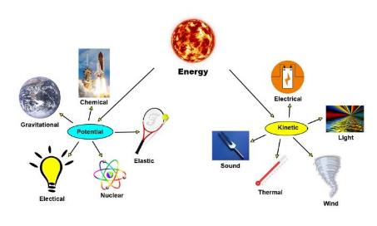
Review: Energy Summary
Three Forms of Energy:
Kinetic (energy in motion)
Potential (energy of position)
Internal (total kinetic and potential energy in a system)
Three Modes of Heat Energy:
Conduction (transfer of heat when objects touch)
Convection: (transfer of heat through motion of fluids/air)
Radiation: (transfer of heat through rays or waves)
All photos courtesy of Pixabay.com
Two Ways to Increase Internal Energy:
Work (force applied to an object to cause motion)
Heat (entering an object or system)
Notes:
10 min
a. Summarize the key concepts on the slide from the previous content deepening session.
b. Have participants locate the content background document in their lesson plans binders.
c. Individuals: Ask participants to scan the document and identify key concepts about energy that reflect their content deepening work from the past two sessions. Make sure they note the relevant sections in the content background document.
d. Whole group: Invite participants to share their findings with the group and cite the relevant sections in the content background document that match concepts discussed in content deepening sessions.
e. As participants share their findings, record them on chart paper.

Slide 27
Key Science Ideas
All energy is conserved in a closed system (law of conservation). Energy can’t be created or destroyed, but it can transfer from place to place and object to object. It can also transform from one form of energy to another form.
Some forms of energy, such as potential energy and heat energy, aren’t easy to detect or measure, but they’re always present in our environment.
Heat energy transfers automatically from warmer objects to cooler objects. Ultimately, all energy transforms to heat.
Some forms of energy are more useful than others. Useful forms (oil, coal, natural gas) are valuable because the process for extracting and using them is lengthy and complex. These forms of energy are vital for our existence and shouldn’t be wasted.
Notes:
8 min
a. Read the key science ideas on the slide.
b. Whole-group discussion: “Does everyone agree with these ideas based on our energy review? Would you like to add or revise anything?
c. Have participants copy these ideas into their science notebooks.
d. Ask participants, “How might we represent these concepts for our students as we teach the Energy Transfer unit?”
e. During this discussion, copy participants’ ideas on chart paper. Probe participants’ responses and differing views.
f. “Next, we’ll explore how we can facilitate student understandings of energy transfer using content representations and models.”

Slide 28
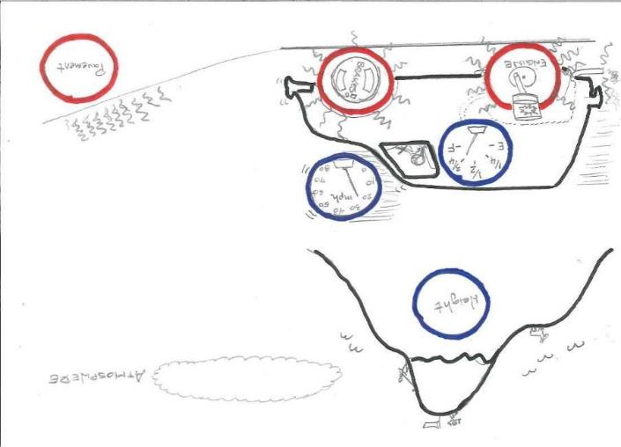
Investigation 1: Energy Beans
Courtesy of Hector Mireles
Notes:
10 min
a. Distribute handouts 7.4 (Energy-Beans Worksheet) and 7.5 (Energy-Beans Procedure).
b. Walk participants through the information on handout 7.5.
c. Emphasize that in this investigation, participants will explore energy transfers and transformations in a system. The system is a gas-powered car driving up a hill, the beans represent energy, and the cups represent four possible forms of energy: chemical energy, kinetic energy, gravitational potential energy, and internal energy. Energy transfers can take place in the system through work or heat. Energy transformations take place when beans are moved from one cup to another.
d. Ask participants to study the diagram on handout 7.4. Highlight the form of energy each object represents:
Mountain = gravitational potential energy
Speedometer = kinetic energy
Fuel-tank meter = chemical energy
Engine piston (red rear wheel) = internal energy (performs work on wheels to give the car kinetic energy)
Brakes (red front wheel) = internal energy (converts to heat energy when brakes are applied, which reduces the car’s kinetic energy)
Pavement = internal energy (converts to heat energy from wheels’ rolling friction and braking)
Atmosphere = heat energy (end destination of any heat that transfers away from the red objects)

Slide 29
Investigation 1: Energy Beans
Review the rules on handout 7.5 (Energy-Bean Procedure).
Can you justify each rule using the laws of energy transfer?
Notes:
5 min
a. Highlight the rules on handout 7.5 (Energy-Beans Procedure).
b. Ask participants, “Can you justify each rule using the laws of energy transfer?”

Slide 30
Investigation 1: Energy Beans
Pairs: Follow the directions and rules on handout 7.5 (Energy-Beans Procedure) for each scenario.
For each step, decide how to distribute your beans and then arrange them on the diagram (handout 7.4, Energy-Beans Worksheet).
Record your bean-distribution decisions in your science notebook. Make sure to describe the energy transfers and transformations in each step.
Discuss the questions at the end of each scenario and write your answers and evidence in your notebook.
Notes:
25 min
a. Have participants pair up; then distribute 30 beans and six plastic or paper cups to each pair.
b. Review the directions on the slide.
c. Pairs: Direct pairs to work through each scenario on the handout, deciding how to distribute their beans for each step and arranging them on the worksheet (handout 7.4) to reflect their decisions. Have participants record their bean-distribution decisions in their science notebooks and describe the energy transfers and transformations that take place in each step. Then have pairs discuss the questions at the end of each scenario and write their answers and evidence in their notebooks.
Note: A specific quantity of beans should be moved from object to object or place to place in each step of the scenario (e.g., from the gas tank to the engine to the atmosphere). Example from scenario 2:
Idling: One energy bean goes from the gas tank to the engine and out of the exhaust pipe into the atmosphere.
Accelerating: Two or three energy beans work to accelerate the car to a constant speed.
Cruising: One energy bean per minute is the cost to sustain a constant speed. The only work performed is against the friction between the tires and the road.
Climbing: The engine must now work against gravity, which costs two energy beans per minute.

Slide 31
Investigation 1: Energy Beans
As pairs share their energy distributions and descriptions for each scenario, be prepared to agree, disagree, ask questions, or add on.
How did you answer the questions for each scenario on the handout?
Follow-up question:
What are the strengths and limitations of the energy-beans content representation?
Notes:
10 min
a. Whole-group discussion: Invite one or two pairs to share their energy distributions and descriptions for each scenario, as well as their answers to the questions on the handout. Probe participants’ decisions and reasoning. Encourage others to agree, disagree, ask questions, or add on.
b. During this discussion, record key ideas on chart paper.
c. At the end of the discussion, ask participants to evaluate the strengths and limitations of the energy-beans content representation.

Slide 32
Content Representation: Energy-Beans Model
Locate the blank copy of Analysis Guide D (last page of handout 7.1) and record the following information:
Main learning goal:
Energy in a system is neither created nor destroyed, but it can transfer from object to object and transform from one form to another.
Description of content representation:
Students model energy transfer and transformation in a system (a gas-powered car) using dried pinto beans representing energy and plastic cups representing different forms of energy.
Notes:
10 min
Note: If time is running short, work as a group on part 1 of Analysis Guide D.
a. Have participants locate the blank copy of Analysis Guide D on page 5 of handout 7.1 and copy the learning goal and description from the slide onto the handout.
b. Pairs: Direct participants to work with their partners to complete part 1 of the guide.

Slide 33
Does the Content Representation Match the Main Learning Goal?
How did you answer these questions from part 1 of the analysis guide?
Is the content representation scientifically accurate?
Is it closely matched to the main learning goal?
Does it present science ideas to students in comprehensible ways?
Does it reinforce/introduce any misconceptions?
Does it address common misconceptions?
Does it contain distracting details?
Notes:
5 min
a. Discuss participants’ responses to the questions in part 1 of the analysis guide.

Slide 34
Content Deepening: Focus Question
Where does energy come from? Where does it go?
Notes:
Less than 1 min
a. Read the focus questions on the slide.
b. Emphasize that these questions will guide student learning throughout ET lesson 5a.
c. Ask participants to write the focus questions in their science notebooks and draw a box around them.

Slide 35
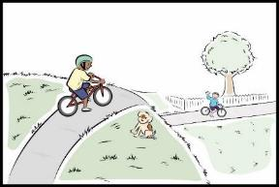
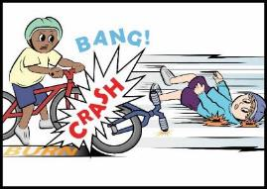
Investigation 2: Mumford and Leroy’s Big Crash
Courtesy of BSCS.org
Notes:
10 min
a. Have participants locate handout 5.1 (Mumford and Leroy’s Big Crash, Part 4) in their lesson plans binders.
b. Read the first page of the handout aloud and pose the questions at the bottom of the page.
c. Pairs: Have participants discuss these questions with their partners from the previous investigation and write their answers in their science notebooks.
d. Whole group: Finish reading the story aloud as participants highlight key energy words and sentences in their handouts.

Slide 36
Key Science Idea
All of the energy in Mumford and Leroy’s big crash came from somewhere and went somewhere.
Notes:
Less than 1 min
a. Highlight the key science idea on the slide.

Slide 37
Investigation 2: Mumford and Leroy’s Big Crash
To track the energy in Mumford and Leroy’s collision, we’ll use an energy-flow diagram.
This sample energy-flow diagram includes a box with a label and arrows showing where energy comes from and where it goes.
Mumford and Leroy’s Big Crash
Notes:
2 min
a. “Next, we’ll track the energy transfers and transformations in the story using an energy-flow diagram.”
b. “The sample diagram on the slide includes a box with a label and arrows indicating where energy comes from and where it goes.”

Slide 38
Investigation 2: Mumford and Leroy’s Big Crash
Think about where the energy came from and where it went in the story about Mumford and Leroy’s big crash.
Review the energy words and sentences you highlighted in the story.
Pair up and design an energy-flow diagram showing the energy transfers and transformations that happened in the story. Draw your diagrams in your notebooks.
Notes:
10 min
a. Read the instructions on the slide.
b. Circulate around the room as pairs work on their energy-flow diagrams. Answer questions and probe participants’ thinking as needed.

Slide 39
Investigation 2: Mumford and Leroy’s Big Crash
As you explain your energy-flow diagram to the group, make sure to include the following:
Show where energy transfers and transformations take place in your diagram.
Use evidence from the handout to support your ideas.
As others share their diagrams, be prepared to agree or disagree, ask questions, or add on.
Notes:
10 min
a. Invite pairs to share their energy-flow diagrams with the group, describing where energy transfers and transformations happened in the story.
b. “As others present their energy-flow diagrams, listen carefully and be prepared to agree or disagree, ask questions, or add on.”
c. During this discussion, encourage participants to use evidence (words, phrases, or sentences) from the story to support their ideas and comments.

Slide 40
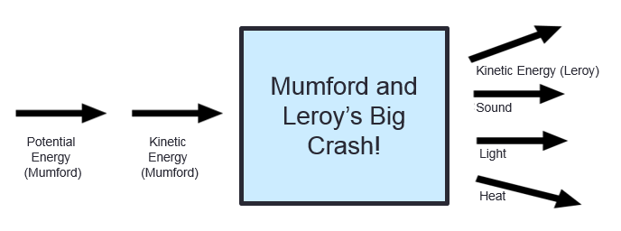
Investigation 2: Mumford and Leroy’s Big Crash
Does your energy-flow diagram look something like this? Do you want to make any changes to your diagram?
Notes:
5 min
a. Highlight the energy-flow diagram on the slide.
b. Ask participants, “Does your energy-flow diagram look something like this? In what ways is your diagram similar to or different from this diagram?”
c. Give participants an opportunity to revise their energy-flow diagrams based on this discussion.

Slide 41
Reflect Content Deepening Focus Question
Where does energy come from? Where does it go?
Notes:
5 min
a. Review the focus question on the slide.
b. Invite participants to share their ideas for answering the question, using science ideas about energy and evidence from the story about Mumford and Leroy’s collision and their energy-flow diagrams.
c. Encourage participants to agree, disagree, ask questions, or add to the ideas others share.

Slide 42
Key Science Ideas
Energy is conserved in a system. It can’t be created or destroyed, but it can undergo many changes.
Energy can transfer from object to object or transform from one form to another.
Ultimately, all energy transforms into heat, which spreads out into the atmosphere.
An energy-flow diagram tracks the energy transfers and transformations that occur in interactions within a system. In other words, it can show where energy comes from and where it goes.
Notes:
5 min
a. Review the key science ideas on the slide that answer the focus question. Emphasize that participants’ observations and evidence from the investigations helped shape these responses.
b. Whole-group discussion: “Does everyone agree with these ideas? Would you like to add or revise anything?”
c. Have participants copy these science ideas into their science notebooks under the focus question.

Slide 43
Summarizing Today’s Work
Think about the Science Content Storyline Lens strategies we’ve studied so far:
Think about your science-content-learning work today.
Reflect: What ideas or questions do you want to remember from today and refer back to?
A—Identify one main learning goal.
B—Set the purpose with a focus question or goal statement.
C—Select activities that are matched to the learning goal.
D—Select content representations and models matched to the learning goal and engage students in their use.
I—Summarize key science ideas.
Notes:
6 min
a. Individuals (4 min): Ask participants to think about the first two tasks on the slide and respond to the reflection question in their notebooks.
b. Whole group (2 min): Ask for volunteers to share an idea or question from their responses to the reflection question.

Slide 44
Homework
Read about SCSL strategies F, G, and H in the STeLLA strategies booklet and complete the Z-fold summary chart for these strategies.
Be ready to share your assigned lesson in the Energy Transfer (ET) lesson series.
Bring your calendar for the academic year so we can schedule the dates for our school-year study-group meetings!
Notes:
3 min
a. Review the homework assignment and have participants write it in their notebooks.
b. Make sure participants understand the assignment.
c. “We won’t address strategy E about sequencing science ideas and activities until the school year, since you’ll learn a lot about sequencing from teaching the RESPeCT lesson plans.”

Slide 45
Reflections on Today’s Session
What are your reactions to the strategy of selecting content representations and models that are matched to the lesson’s main learning goal?
What is something new you’ve learned about energy transfer? Did your content-representation analyses support this learning in any way?
Provide feedback about today’s session and the PD program so far (likes, dislikes, questions, concerns, and suggestions).
Notes:
6 min
a. Allow at least 5 minutes for participants to think about today’s session and write their reflections and feedback on the Daily Reflections sheet (handout 7.6 in PD program binder).

Slide 46
Norms for Working Together: The Basics
Purpose: Build trust and develop a productive study group for all participants.
The Basics
Arrive prepared and on time; stay for the duration; return from breaks on time.
Remain attentive, thoughtful, and respectful; engage and be present.
Eliminate interruptions (turn off cell phones, email, and other electronic devices; avoid sidebar conversations).
Make room for everyone to participate (monitor your floor time).
Notes:
Hidden slide—available for use as needed.

Slide 47
Norms for Working Together: The Heart
Purpose: Build trust and develop a productive study group for all participants.
The Heart of RESPeCT Lesson Analysis and Content Deepening
Keep the goal in mind: analysis of teaching to improve student learning.
Share your ideas, uncertainties, confusion, disagreements, questions, and good humor. All points of view are welcome.
Expect and ask questions to deepen everyone’s learning; be constructively challenging.
Listen carefully; seek to understand other participants’ points of view.
Notes:
Hidden slide—available for use as needed.

