Slide 1
RESPeCT PD pROGRAM
Day 8
RESPeCT Summer Institute
Notes:
5 min
Take care of any housekeeping issues

Slide 2
Agenda for Day 8
Day-7 reflections
Focus questions
Introducing SCSL strategies F, G, and H
Lesson analysis: SCSL strategies F, G, and H
Energy Transfer lesson plan review
Fall overview and study-group scheduling
Lunch
Math content deepening: energy transfer
Wrap-up and celebration!
Notes:
2 min
Talk through today’s agenda.

Slide 3
Trends in Reflections
Lesson Analysis | Science Content Learning
Notes:
5 min
Give participants time to review your feedback on their reflections from day 7 and offer reactions, comments, or follow-up questions.

Slide 4
Today’s Focus Questions
How can science content storyline coherence be enhanced by explicitly implementing STeLLA strategy F (Make explicit links between science ideas and activities), strategy G (Link science ideas to other science ideas), and strategy H (Highlight key science ideas and focus question throughout)?
How will the Student Thinking Lens and Science Content Storyline Lens strategies help you teach the Energy Transfer lessons in the fall?
What are independent and dependent variables, and how are they graphed?
Notes:
2 min
Introduce the focus questions that will guide today’s work.

Slide 5
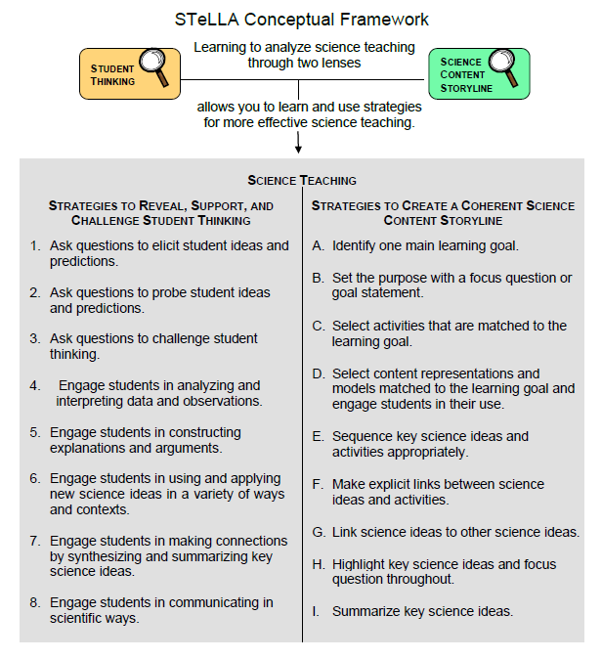
Notes:
1 min
“Today we’ll focus on three Science Content Storyline Lens strategies, all of which make explicit links to science ideas:
Strategy F explicitly links science ideas to activities that students are doing.
Strategy G explicitly links science ideas to other science ideas.
Strategy H explicitly highlights key science ideas and links them back to the focus question.”
“We won’t address strategy E about sequencing science ideas and activities until the school year, since you’ll learn a lot about sequencing from teaching the RESPeCT lesson plans.”

Slide 6
Lesson Analysis: Focus Question 1
How can science content storyline coherence be enhanced by explicitly implementing STeLLA strategy F (Make explicit links between science ideas and activities), strategy G (Link science ideas to other science ideas), and strategy H (Highlight key science ideas and focus question throughout)?
Notes:
Less than 1 min
Read the focus question on the slide.

Slide 7
SCSL Strategies F, G, and H: Purposes and Key Features
Group 1:
What are the purposes and key features of strategy F?
Why is this strategy important for science content storyline coherence?
Group 2:
What are the purposes and key features of strategy G?
Why is this strategy important for science content storyline coherence?
Group 3:
What are the purpose and key features of strategy H?
Why is this strategy important for science content storyline coherence?
Notes:
30 min
Small groups: Divide participants into three groups to make charts that capture the purposes and key features of strategies F, G, and H. Direct groups to refer to their Z-fold summary charts and the STeLLA strategies booklet.
Whole group: Have small groups share their charts with the entire group.
Challenge participants to imagine themselves in their Teacher Leader roles. Ask them, “How would you explain these strategies to the teachers you’re leading?”

Slide 8
SCSL Strategies F, G, and H: Discussion Question
What’s similar and different about these three strategies?
Notes:
10 min
Note: This slide may be skipped if similarities and differences were addressed in the previous discussion.
Individuals (3 min): “Look at your three strategy charts, your Z-fold summary charts, and the strategies booklet as you think about the question on the slide.”
Whole group: Have participants share their ideas about the three strategies.
Key ideas about strategies F, G, and H:
1. Similarities:
These strategies are all focused on linking complete sentence-length science ideas: Strategy F links science ideas to activities, strategy G links science ideas to other science ideas, and strategy H highlights key science ideas and links them to the focus question throughout the lesson.
All of these strategies emphasize making the links explicit, not just assuming that students will see the intended links.
All of these strategies can and should occur throughout the lesson.
2. Differences:
Strategy F explicitly links science ideas to student activities.
Strategy G explicitly links science ideas to other science ideas.
Strategy H explicitly highlights key science ideas and links them back to the focus question.

Slide 9
Preparing for Video-based Lesson Analysis
Read Analysis Guide F, part 1.
What is the difference between the main learning goal and supporting science ideas?
What is similar about the main learning goal and supporting science ideas?
Notes:
5 min
“Next, we’re going to watch a series of three classroom video clips on strategy F from Energy Transfer lesson 6. The first clip takes place before students start working on the activity; the second clip shows students while they’re working on the activity; and the third clip shows the teacher following up with students after the activity.”
Have participants locate Analysis Guide F (handout 8.1) in their PD program binders.
Tell participants that part 1 of the guide provides the context for the video clips.
Individuals: “Read part 1 of the analysis guide and be prepared to discuss the two questions on the slide.”
Whole group:
Discuss the questions on the slide.
Ask whether participants have any questions about the activity they’ll be observing in the video clips.
Key ideas:
Difference between the main learning goal and supporting science ideas: The main learning goal is the big idea that is the focus of the lesson. Supporting science ideas are smaller, connected ideas that build upon each other to support the main learning goal. See examples in part 1 of the analysis guide.
Similarity between the main learning goal and supporting science ideas: The main learning goal and supporting science ideas are all expressed as complete-sentence science ideas (not as topics, phrases, or activities).

Slide 10
Lesson Analysis: Strategy F
For each of the video clips, read the context at the top of the corresponding transcript and then watch the clip.
For each clip, use the criteria in part 2 of Analysis Guide F to analyze how well science ideas were linked to the activity.
Link to video clips: 8.1_stella_et_knight_L5_c1; 8.2_stella_et_knight_L5_c2;
8.3_stella_et_knight_L5_c3
Notes:
60 min—20 min/clip
Have participants review part 2 of Analysis Guide F. After they watch each video clip, ask them to study the corresponding transcript, answer the questions in part 2 of the analysis guide, and then analyze the links between science ideas and activities that were (or were not) made before, during, or after the activity.
Have participants read the context for video clip 1 at the top of the transcript (handout 8.2 in PD program binder).
Show video clip 1 and then guide participants through these tasks:
Individuals : “Study the video transcript and then complete part 2, section 1 of the analysis guide, Setup for the Activity.”
Whole group: Ask participants to share their analyses of the video clip.
Ideal responses:
Question a: The teacher introduces the lesson focus questions and prompts students to think about previous learning that might help them answer the questions.
Question b: The teacher explicitly links the Mumford and Leroy activity in a previous lesson to science ideas about energy.
Questions c: The teacher notes that the focus question may seem familiar to students, since previous lessons have built up to figuring out where energy comes from and where it goes.
Have participants read the context for video clip 2 at the top of the transcript (handout 8.3 in PD binder).
Show video clip 2 and then guide participants through these tasks:
Individuals: “Study the video transcript and then complete part 2, section 2 of the analysis guide, During the Activity.”
Whole group: Ask participants to share their analyses of the video clip.
Ideal responses:
Question a: Students are focused on science ideas related to where energy comes from and how it can transfer from one object to another object.
Question b: The teacher asks elicit and probe questions (e.g., “How does [energy] get from one object to another object?”) that challenge students to explain where energy comes from and where it goes (transfer and transformation) using specific examples.
Have participants read the context for video clip 3 at the top of the transcript (handout 8.4 in PD binder).
Show video clip 3 and then guide participants through these tasks:
Individuals: “Study the video transcript and complete part 2, section 3 of the analysis guide, Follow-up to the Activity.”
Whole group: Ask participants to share their analyses of the video clip.
Ideal responses:
Question a: The teacher engages students in a follow-up discussion about energy transfers and transformations (costume changes) that take place in a battery-operated remote device. Students are challenged to explain how these transfers and transformations are involved in making the device work.
Question b: Students are involved in making links between science ideas about energy and the operation of the remote device, but they’re struggling to make sense of the idea that energy not only transfers from object to object but also transforms from one form of energy to another (e.g., potential energy in the battery to kinetic energy).

Slide 11
Lesson Analysis: Strategies F, G, and H
Read the context of the video clip at the top of the transcript (handout 8.5).
What evidence of your assigned strategy might you find in the video?
Watch the video clip.
Link to video clip: 8.4_stella_et_knight_L5_c4
Notes:
7 min
a. “Now we’re going to watch another short video clip from the same lesson. In this clip, be on the lookout for evidence of strategies F, G, and H at the beginning and end of the lesson.”
b. Have participants read the context at the top of the video transcript (handout 8.5).
c. Small groups: Divide participants into three groups (or pairs). Group 1 will focus on finding evidence of strategy F in the clip, Group 2 will focus on strategy G, and Group 3 will focus on strategy H.
d. Ask each group: “What evidence of your assigned strategy might you find in the video?” (Encourage participants to refer to the STeLLA strategies booklet or strategy charts if they need to review the key features of each strategy.)
e. Show the video clip.
f. Whole group: Discuss the evidence each group came up with for their assigned strategy.

Slide 12
Lesson Analysis: Strategies F, G, and H
Strategy F:
Find examples in the video transcript where students are linking science ideas to a lesson activity.
Suggest one specific way to strengthen strategy F in this lesson.
Strategy G:
Find examples where two or more science ideas are being linked together.
Suggest one specific way to strengthen strategy G in this lesson.
Strategy H:
Find an example where the teacher is highlighting key science ideas or referring back to the focus question.
Suggest one specific way to strengthen strategy H in this lesson.
Notes:
10 min
Note: If time is running short, have participants work only on part A of their assigned task.
a. Go over the directions on the slide. Emphasize the importance of using the STeLLA strategies booklet and strategy charts as resources.
b. Individuals: “Study the transcript for video clip 4 and search for examples of your assigned strategy being used during the lesson. Be ready to share your ideas with the group, and make sure to support your answers with evidence.”
c. Whole group: Have participants share their findings. Encourage listeners to agree or disagree, ask clarification questions and add on.

Slide 13
Summary: Strategies F, G, and H
Use linking strategies to make the science ideas explicit to the whole class (strategies F and G).
Engage students in linking science ideas to activities before, during, and after an activity (strategy F).
Engage students in linking science ideas to other science ideas (strategy G).
Highlight key science ideas throughout the lesson (strategy H).
Keep returning to the focus question throughout and at the end of the lesson (strategy H).
Notes:
3 min
a. Read the summary statements on the slide or give participants time to read them silently.
b. Ask participants whether they have a brief comment or question about the summary.

Slide 14
Lesson Analysis: Focus Question 2
How will the Student Thinking Lens and Science Content Storyline Lens strategies help you teach the Energy Transfer lessons in the fall?
Notes:
Less than 1 min
a. Read the focus question on the slide.

Slide 15
Energy Transfer Lesson Plan Conversation
The science content storyline across lessons
Review the main learning goal for each lesson sequentially.
The science content storyline within lessons (5–7 min for each two-part lesson)
How does this lesson fit into the arc of all the lessons?
What are the main learning goal and focus question?
Describe the main activity (or activities).
How will the activity help students better understand the learning goal for the day?
What STeLLA strategy/strategies are highlighted in this activity?
What concerns or suggestions do you have about this activity?
Practical issues and questions
Notes:
60 min (in conjunction with next two slides)
Note: Create charts like the samples on the next two slides so that participants can view both as they report out.
Timing note: Make sure you limit the time for each lesson conversation so you can get through them all. Aim for 5–7 minutes for each lesson.
a. Give a brief overview of the science content storyline across lessons and then begin the lesson conversation.
b. For step 1 on the slide, review the main learning goal for each lesson sequentially and how it connects to the lesson before and after it. (5 min)
c. For steps 2 and 3, ask each participant to report on her/his two-part lesson, which was assigned on day 5.
Note: Encourage participants to present the big picture using the questions in step 2 on the slide, not to walk through every step in their lesson plans. They should bring up details only when they have some concern, question, or suggestion about a modification.
d. As participants give their reports, fill in the charts you’ve created, checking off the main strategies highlighted in each lesson. (See the chart format on next two slides.)
Note: Encourage participants to pick just one or two Student Thinking Lens strategies and one or two Science Content Storyline Lens strategies that are actually highlighted in the lesson. (Each lesson uses several strategies.)
Ideal pattern to highlight for the Student Thinking Lens strategies:
Elicit and probe strategies are very important in lesson 1. They also appear as students are engaged in making predictions in lessons 2, 4, and 5.
Probe and challenge strategies are used throughout all the lessons.
Strategies 4 (analyzing data) and 5 (constructing explanations) are highlighted in the middle lessons (lessons 2, 3, 4, 5) to help students construct new science ideas in evidence-based ways.
Strategy 6 (use and apply new science ideas) starts appearing after some new ideas have been introduced (lessons 3 and 5), but they become the main focus of the final two lessons.
Strategy 7 (synthesizing and summarizing) appears at the end of each lesson.
Ideal pattern to highlight for the Science Content Storyline Lens strategies:
To ensure that each lesson has a coherent science content storyline, all lessons include the following:
Strategy A: one main learning goal
Strategy B: focus question or goal statement
Strategy C: activities matched to the learning goal
Strategy F: links between science ideas and activities (before, during, after)
Strategy I: summaries of key science ideas
Strategy D (content representations) appears in two types of lessons. First, content representations are used in lessons where students analyze data and construct explanations (lessons 3 and 4). Second, they’re a central part of a use-and-apply lesson (lesson 6) in which students use what they’ve learned to construct their own content representations.
Strategies G (link science ideas to other science ideas) and H (highlight key science ideas) appear consistently after the first lesson as new science ideas are encountered.

Slide 16
STL Strategies Highlighted in the Energy Transfer Lessons
Lesson | 1a | 1b | 2a | 2b | 3a | 3b | 4a | 4b | 5a | 5b | 6a | 6b
1. Elicit
2. Probe
3. Challenge
4. Analyze/ Interpret
5. Explain/ Argue
6. Use/Apply
7. Synthesize/ Summarize
Notes:
a. As participants report out, complete this chart, indicating with check marks the STL strategies highlighted in the lessons.
b. Discuss the reasons certain strategies appear at specific times in the lesson sequence. (See ideal patterns on slide 15 and refer to the summary charts in the STeLLA strategies booklet as needed.)

Slide 17
SCSL Strategies Highlighted in the Energy Transfer Lessons
Lesson | 1a | 1b | 2a | 2b | 3a | 3b | 4a | 4b | 5a | 5b | 6a | 6b
A. Identify Main Learning Goal
B. Set Purpose and Focus Question
C. Match Activity to MLG
D. Match Content Reps to MLG
F. Link Activity to Science Ideas
G. Link Science Ideas
H. Highlight Key Science Ideas and Focus Question
I. Summarize Key Science Ideas
Notes:
a. As participants report out, complete this chart, indicating with check marks the SCSL strategies highlighted in the lessons.
b. Discuss the reasons certain strategies appear at specific times in the lesson sequence. (See ideal patterns on slide 15 and refer to the summary charts in the STeLLA strategies booklet as needed.)

Slide 18
Overview of Study-Group Sessions
Purpose: To practice, analyze, and learn from the use of the STeLLA strategies in your science teaching.
Review the focus of each study-group session:
What is the main focus for fall study-group sessions 1–3?
What is the purpose of the 2-hour meeting in December/January?
What is the main focus for spring study-group sessions 4–6?
Notes:
5 min
a. Have participants locate handout 8.6—Overview of School-Year RESPeCT Study Groups—in their PD program binders.
b. Emphasize: The purpose of the study-group sessions is to practice, analyze, and learn from using the STeLLA strategies in your teaching of the Energy Transfer (ET) lessons in the fall and the Earth’s Changing Surface (ECS) lessons in the spring.
c. Talk participants through Study Groups 1–3 on the handout.
d. Pause for questions and a summary task. Ask participants, “What is the main focus for fall study-group sessions 1–3?”
e. Talk participants through the 2-hour meeting in December/January and Study Groups 4–6 on the handout.
f. Pause for questions and a summary task. Ask participants, “What is the purpose of the 2-hour meeting in December/January?” and “What is the main focus for spring study-group sessions 4–6?”

Slide 19
Teaching the Energy Transfer Lessons
Before teaching lesson 1, give your students the classroom pretest.
Teach all the lessons and have one lesson video recorded.
Give your students the classroom posttest.
Hold on to your students’ pre-post tests! You’ll analyze them in preparation for Study Group 3.
Notes:
10 min
a. Before going over this slide, have participants locate the Energy Transfer classroom pre-post test in their lesson plans binders (pretabs section).
The classroom pre-post test: “This test is in your lesson plans binder. After you administer the test to your students, you’ll need to save all of them, since you’ll be analyzing them as part of our study-group work in the fall.”
b. Review the steps on the slide.
c. Emphasize: “It’s very important to follow these steps in order and save all of your classroom pre-post tests. Don’t return them to students until after Study Group 3.

Slide 20
Scheduling School-Year Study Groups
Proposed meeting day/time: Wednesdays 2:00–6:00 p.m.
Meeting place: In our classrooms, rotating from school to school
Possible dates for our study-group sessions:
Study Group 1: [insert possible date]
Study Group 2: [insert possible date]
Study Group 3: [insert possible date]
2-hour meeting to review Earth’s Changing Surface (ECS) lessons: [insert possible date]
Study Group 4: [insert possible date]
Study Group 5: [insert possible date]
Study Group 6: [insert possible date]
Notes:
15 min
Note: Include on this slide some possible dates for six 4-hour study-group meetings and the 2-hour meeting that occurs between Study Groups 3 and 4.
a. Suggest possible dates for the study-group sessions, starting with the Wednesday afternoon slot from 2:00 to 6:00 p.m.
Note: As you schedule the meetings, keep in mind that you’ll need some time between the end of the school day and the beginning of the meeting to get to the location and set up everything.
Study Group 1: Early October. Round-1 teachers should have their classroom video recordings completed at least three weeks before this session. You will need three weeks to watch the classroom video(s), select the ones you’ll use during the study groups, and prepare the video-clip selections and transcripts.
Study Group 2: Mid-November. Round-2 teachers should have their classroom video recordings completed at least three weeks before this session. You will need three weeks to watch the classroom video(s), select the ones you’ll use during the study groups, and prepare the video-clip selections and transcripts.
Study Group 3: Early December. This session can occur anytime after Study Group 2 and before the holiday break.
2-hour meeting: December/January. The purpose of this meeting is to review the Earth’s Changing Surface (ECS) lesson plans in preparation for teaching them.
Study Group 4: Early February. Round-1 teachers should have their classroom video recordings completed at least three weeks before this session. You will need three weeks to watch the classroom video(s), select the ones you’ll use during the study groups, and prepare the video-clip selections and transcripts.
Study Group 5: March. Round-2 teachers should have their classroom video recordings completed at least three weeks before this session. You will need three weeks to watch the classroom video(s), select the ones you’ll use during the study groups, and prepare the video-clip selections and transcripts.
Study Group 6. April. This session can occur anytime after, but preferably within a month of, Study Group 5.

Slide 21
Energy Transfer
MATH CONTENT DEEPENING Grade 4
Notes:
Less than 1 min
a. “Now let’s dig into some math content deepening that will focus on the importance of data collection and experimental design.”
Note: Throughout this content deepening phase, refer as needed to the Energy and Energy Transfer Content Background Document and Common Student Ideas about Energy.

Slide 22
Content Deepening Focus Question
What are independent and dependent variables, and how are they graphed?
Notes:
Less than 1 min
a. Read the focus question on the slide.
b. Emphasize that this question will guide today’s content deepening work.
c. Ask participants to write the focus question in their science notebooks.

Slide 23
Defining Variables
What is an independent variable?
What is a dependent variable?
How are these variables graphed?
How are x and y variables identified?
Notes:
4 min
a. Discuss the questions on the slide.
b. During this discussion, record key ideas on chart paper.
c. If the following ideas aren’t mentioned during the discussion, highlight them and reach a consensus on how terms will be defined and used throughout the content deepening phase:
In experimental science, a variable is a factor or category, such as an object, idea, time period, or event, that’s observed and measured.
An independent variable, also called an x variable, is a controlled factor that causes a change in another (dependent) variable being measured. Researchers can select and manipulate an independent variable, but other variables can’t change it.
A dependent variable, also called a y variable, depends on an independent variable to cause a measurable change. A dependent variable is the effect or result of a cause.
On a graph, the dependent variable is plotted along the vertical y-axis, and the independent variable is plotted along the horizontal x-axis.

Slide 24
Graphing Variables
The y-axis (aka the dependent axis or effect)
The x-axis (aka the independent axis or cause)
Notes:
4 min
a. Go over the information on the slide.
b. Emphasize that dependent variables are always plotted along the y-axis on a graph, and independent variables are plotted along the x-axis.
c. Ask participants to come up with some examples of dependent and independent variables.

Slide 25
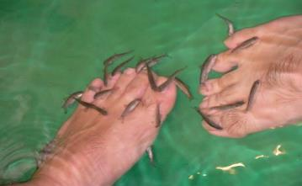
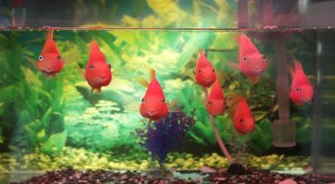
Identify the x and y Variables
What are the independent (x) and dependent (y) variables in these scenarios?
Number of surviving fish in tank
Water temperature in tank
Photo courtesy of Wikipedia.org
Photo courtesy of Pixabay.com
Number of surviving fish in tank: y variable
Water temperature in tank: x variable
Notes:
7 min
a. Reveal only the question at the top of the slide and the photos.
b. Pairs (4 min): “Think about the question on the slide; then share your answers and reasoning with an elbow partner. Choose your x and y variables carefully and indicate in your answers which variable depends on the other variable.”
c. Whole group (3 min): Invite pairs to share their answers and reasoning with the group. Remind them to use the words depends on in their explanations (e.g., “______depends on ______”). Encourage others to agree or disagree, ask questions, or add on.
d. Following the share-out, reveal the correct answer at the bottom of the slide.
Note: Participants should indicate that the number of surviving fish in the tank depend on the water temperature in the tank.

Slide 26
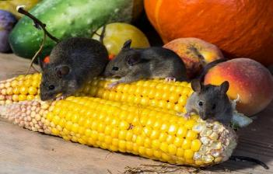
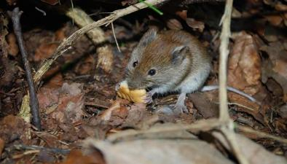
Identify the x and y Variables
What are the independent (x) and dependent (y) variables in these scenarios?
Grams of food mice consume per day
Daily growth rate of mice
Photo courtesy of Pixabay.com
Photo courtesy of Pixabay.com
Grams of food mice consume per day: x variable
Daily growth rate of mice: y variable
Notes:
7 min
a. Reveal only the question at the top of the slide and the photos.
b. Think-Pair-Share (4 min): “Think about the question on the slide; then share your answers and reasoning with an elbow partner. Choose your x and y variables carefully and indicate in your answers which variable depends on the other variable.”
c. Whole group (3 min): Invite pairs to share their answers and reasoning with the group. Remind them to use the words depends on in their explanations (e.g., “_____ depends on _____”). Encourage others to agree or disagree, ask questions, or add on.
d. Following the share-out, reveal the correct answer at the bottom of the slide.
Note: Participants should indicate that the daily growth rate of the mice depends on the grams of food the mice consume per day.

Slide 27
Controlled versus Uncontrolled Variables
Some x variables are easily controlled, such as the water temperature of a fish tank or the amount of food mice are fed.
Other x variables can’t be controlled; they can only be observed. This is especially the case when time is the x variable.
Notes:
1 min
a. Read the information on the slide.
b. Highlight examples of x variables that can be controlled and those that can only be chosen and observed.

Slide 28
The Time Variable
Keep in mind that time isn’t automatically the x variable (cause). Under some conditions or treatments, it can be the y variable (effect).
When might time be a dependent (y) variable?
Can you give some examples?
Notes:
2 min
a. Emphasize that time isn’t automatically the x variable or cause. Under some conditions or treatments, time can be the y variable or effect.
b. Ask: “When might time be a dependent (y) variable? Can you give some examples?”

Slide 29
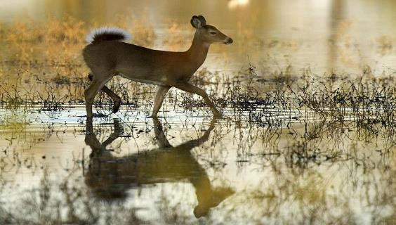
Identify the x and y Variables
What are the independent (x) and dependent (y) variables in this scenario?
Year
Size of deer population
Photo courtesy of Pixabay.com
Year: x variable
Size of deer population: y variable
Notes:
8 min
a. Reveal only the question at the top of the slide and the photo.
b. Think-Pair-Share (4 min): “Think about the question on the slide; then share your answers and reasoning with an elbow partner.
Choose your x and y variables carefully and indicate in your answers which variable depends on the other variable.”
c. Whole group (4 min): Invite pairs to share their answers and reasoning with the group. Remind them to use the words depends on in their explanations (e.g., “_____ depends on _____”). Encourage others to agree or disagree, ask questions, or add on.
Note: This scenario should elicit more discussion, since the x variable can only be observed, not controlled or manipulated. Be sure to allow plenty of time for participants to talk about what depends on what.
d. Following the share-out, reveal the correct answer at the bottom of the slide.
Note: Participants should indicate that the size of the deer population depends on the year. They should also observe that the x variable (time) in this case can’t be controlled.

Slide 30
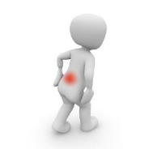
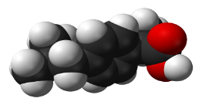
Identify the x and y Variables
What are the independent (x) and dependent (y) variables in this scenario?
Time to experience total pain relief
Dosage of ibuprofen
Ibuprofen 3D
Courtesy of Pixabay.com
Courtesy of Wikimedia.org
Courtesy of Pixabay.com
Time to experience total pain relief: y variable
Dosage of ibuprofen: x variable
Notes:
7 min
a. Reveal only the question at the top of the slide and the diagram.
b. Think-Pair-Share (4 min): “Think about the question on the slide; then share your answers and reasoning with an elbow partner. Choose your x and y variables carefully and indicate in your answers which variable depends on the other variable.”
c. Whole group (3 min): Invite pairs to share their answers and reasoning with the group. Remind them to use the words depends on in their explanations (e.g., “_____ depends on _____”). Encourage others to agree or disagree, ask questions, or add on.
d. “Now think about the time variable in the previous scenario compared to this scenario. Why do you think time is an x variable in that scenario and a y variable in this scenario?”
e. Following the share-out, reveal the correct answer at the bottom of the slide.
Note: Participants should indicate that the time required to experience total pain relief depends on the dosage of ibuprofen. The dosage can be controlled, but not the time. They should also observe that time is a y variable in this case because it’s the effect, not the cause. In the previous scenario, time was an x variable (the cause), since the size of the deer population depends on the year. However, in both scenarios, time can’t be controlled; it can only be observed.

Slide 31
Identify the x, y, and n Variables
What are the independent (x), dependent (y), and (n) variables in this scenario?
Embryo identification number
Size of embryo
Time since conception
Photo courtesy of Wikimedia.org
Embryo identification number: n variable (not included on graph)
Size of embryo: y variable
Time since conception: x variable
Notes:
7 min
a. Reveal only the question at the top of the slide and the photo.
b. Think-Pair-Share (4 min): “Think about the question on the slide; then share your answers and reasoning with an elbow partner. Choose your x and y variables carefully and indicate in your answers which variable depends on the other variable. The n variable is for identification purposes only and wouldn’t be included on a graph.”
c. Whole group (3 min): Invite pairs to share their answers and reasoning with the group. Remind them to use the words depends on in their explanations (e.g., “_____ depends on _____”). Encourage others to agree or disagree, ask questions, or add on.
d. Following the share-out, reveal the correct answer at the bottom of the slide.
Note: Participants should indicate that the size of the embryo depends on the time since conception.

Slide 32
Identify the x, y, and n Variables
What are the independent (x), dependent (y), and (n) variables in this scenario?
Teacher Social Security number
Student ID number
Percent of correct answers on test
Number of hours spent studying for test
Photo courtesy of Pixabay.com
Teacher Social Security number: n variable (not included on graph)
Student ID number: n variable (not included on graph)
Percent correct on test: y variable
Number of hours spent studying for test : x variable
Notes:
7 min
a. Reveal only the question at the top of the slide and the photo.
b. Think-Pair-Share (4 min): “Think about the question on the slide; then share your answers and reasoning with an elbow partner. Choose your x and y variables carefully and indicate in your answers which variable depends on the other variable. The n variables are for identification purposes only and wouldn’t be included on a graph.”
c. Whole group (3 min): Invite pairs to share their answers and reasoning with the group. Remind them to use the words depends on in their explanations (e.g., “_____ depends on _____”). Encourage others to agree or disagree, ask questions, or add on.
d. Following the share-out, reveal the correct answer at the bottom of the slide.
Note: Participants should indicate that the percent of correct answers on the test depends on the number of hours the student spent studying for the test.

Slide 33
Pendulums!
What do you know about pendulums?
Notes:
4 min
a. Ask participants, “What do you know about pendulums?”
b. Elicit participants’ ideas and record them on chart paper.

Slide 34
Defining a Pendulum
How would you define the term pendulum?
Definition: A pendulum is something hanging from a fixed point, which, when pulled back and released, is free to swing down by gravity and then out and up because of its inertia, or tendency to stay in motion.
Let’s make a pendulum!
Source: ScienceNetLinks; http://sciencenetlinks.com/student-teacher-sheets/foucaults-pendulum-answer-key/
Notes:
7 min
a. Initially show only the question on the slide.
b. Ask participants, “How would you define the term pendulum?”
c. Elicit a few key ideas and record them on chart paper.
Note: Keep this discussion brief.
d. Following the discussion, reveal the definition on the slide to make sure that everyone is using the same vocabulary when talking about pendulums.
e. Give each participant a 3- or 4-foot length of string and a washer to make a pendulum. Demonstrate how to make a simple pendulum participants can use to demonstrate their ideas during the content deepening work.
f. Allow adequate time for participants to assemble their pendulums.

Slide 35
Understanding Pendulums
A simple pendulum consists of a mass called a bob that’s attached to the end of a thin cord that’s attached to a fixed point.
When the bob is drawn upward and then released, the force of gravity accelerates it back to its original position.
Then the acceleration from gravity builds up momentum, causing the mass to swing in the opposite direction to a height equal to the original position.
What is this force called?
Notes:
6 min
a. Read through the information on the slide.
b. As you talk about the parts of a pendulum and how they work, encourage participants to experiment with their pendulums.
c. Ask participants to identify the force at work in the pendulum.
Note: They should identify the force as inertia. If they don’t, ask probe questions to guide them to the correct answer.
d. Emphasize that inertia is the resistance of an object to any change in motion. This is the force that keeps the pendulum in motion.

Slide 36
Understanding Pendulums: Period
A period is one full (complete) swing of the pendulum in one direction and back in the opposite direction.
Notes:
3 min
a. Read the information on the slide.
b. Make sure that everyone understands that a period is one full or complete pendulum swing up and back.
c. Demonstrate two or three periods with your pendulum and have participants do the same.

Slide 37
Understanding Pendulums: Frequency
Frequency is the number of back-and-forth pendulum swings in a certain length of time.
Notes:
4 min
a. Read the information on the slide.
b. Set a timer and have participants count the frequency of their pendulums for 1 minute.
c. In a round-robin, ask participants to share their frequency results.

Slide 38
Variables That Affect Frequency
What variables affect the frequency (swing time) of a pendulum?
The four most common variables:
Starting angle of pendulum
String length
Bob mass
Gravity
Notes:
5 min
a. Initially show only the question at the top of the slide.
b. Elicit participants’ ideas about variables that might affect the frequency (swing time) of a pendulum.
c. During this discussion, record ideas on chart paper and ask participants which variables they think are most common.
d. Reveal the most common variables on the slide.

Slide 39
Design a Research Experiment
How can we design a research experiment that tests pendulum frequency?
What variables can we control that might affect the outcome?
How can we control variables that affect pendulum frequency (swing time)?
Starting (pull-back) angle
String length
Bob mass
Notes:
8 min
a. Discuss the questions on the slide.
b. Elicit participants’ ideas about variables they can control, as well as ways they can accomplish this.
c. During this discussion, record participants’ ideas on chart paper and reach a consensus on how to control variables that might affect the outcome (e.g., holding the pendulum at a fixed pull-back angle; ensuring uniform string length and bob mass).
d. Have participants record these ideas in their science notebooks.

Slide 40
Design a Research Experiment
How would you design an experiment in which a pendulum swings exactly 60 times in a minute?
Pair up with an elbow partner and discuss your design. Record specific details about your design plan in your science notebooks.
You’ll need a timer and your pendulums for this experiment.
Notes:
7 min
a. “Pair up with an elbow partner and design an experiment in which a pendulum swings exactly 60 times in a minute. Make sure to record specific details about your plan in your science notebooks.”
b. Distribute a timer, a ruler, and graph paper to each pair. Also have participants locate their pendulums from the previous experiment.

Slide 41
Pendulum Experiment
What is the dependent variable in this experiment? Explain.
What is the independent variable in this experiment? Explain.
What are the controls in this experiment? Explain.
On graph paper, create a graph showing pendulum length and number of swings. Make sure to label your x and y variables.
How would you describe your graph?
Notes:
10 min
a. Read the questions on the slide.
b. Pairs: Direct pairs to discuss these questions and write their answers in their science notebooks. Emphasize that they need to specify this information before they can begin collecting their data.
c. Have participants collect data on pendulum length and number of swings using their pendulums and timers.
d. Whole group: Once everyone has collected their data, invite pairs to share their results and their answers to the slide questions.

Slide 42
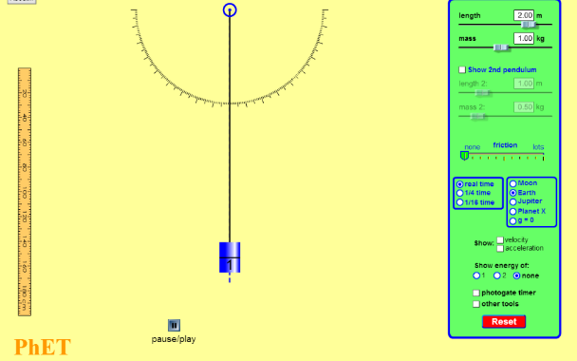
Pendulum Simulation
Courtesy of Phet.colorado.edu
Link to video clip: http://phet.colorado.edu/en/simulation/pendulum-lab
Notes:
5 min
a. Show the pendulum simulation.
b. Following the simulation, invite participants to share their comments and observations. Ask whether their initial ideas matched the concepts presented in the simulation. If not, how did they differ?

Slide 43
Pendulum Length
Changing pendulum length while keeping other variables constant changes the length of the period.
Longer pendulums have a lower frequency than shorter pendulums and thus have a longer period.
Notes:
3 min
a. Have participants refer to their graphs as you present the summary points on the slide.
Note: If participants are struggling to grasp the concepts, you may want to replay portions of the simulation.

Slide 44
Bob Mass and Starting Angle
Changing bob mass doesn’t affect pendulum frequency.
Changing the starting angle (how far you pull back the pendulum before releasing it) has only a very slight effect on pendulum frequency.
Notes:
3 min
a. Have participants refer to their graphs as you present the summary points on the slide.

Slide 45
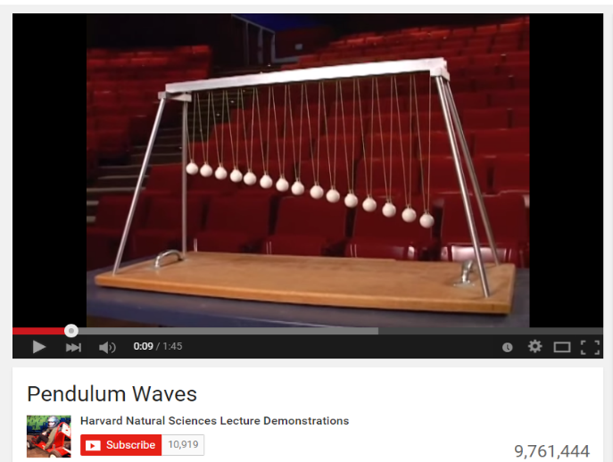
Pendulum Waves
Link to YouTube clip: https://www.youtube.com/watch?v=yVkdfJ9PkRQ
Notes:
5 min
a. Show the Pendulum Waves YouTube clip.
b. Following the clip, ask participants, “How does what you’ve learned about pendulum string length apply to this model?”
c. As participants share their ideas, probe their thinking and elicit differing views.

Slide 46
Reflect: Content Deepening Focus Question
What are independent and dependent variables, and how are they graphed?
Notes:
5 min
Review the focus questions on the slide.
b. Invite participants to share their ideas for answering the question, using observations and evidence from today’s content deepening work.
c. Encourage participants to agree, disagree, ask questions, or add to the ideas others share.
d. During this discussion, record key ideas on chart paper.

Slide 47
Key Science Ideas
In experimental science, a variable is a factor or category that can be measured.
An independent variable (x variable) is a controlled factor that causes another (dependent) variable to change in some measurable way.
A dependent variable (y variable) depends on an independent variable to cause a measurable change. It’s the effect or result of a cause.
On a graph, the dependent variable is plotted along the y-axis, and the independent variable is plotted along the x-axis.
Notes:
5 min
a. Review the key science ideas on the slide that answer the focus question. Emphasize that participants’ observations and evidence from today’s content deepening work helped shape these responses.
b. Whole-group discussion: “Does everyone agree with these ideas? Would you like to add or revise anything?”
c. Have participants copy these science ideas into their science notebooks under the focus question.

Slide 48
Today’s Focus Questions
How can science content storyline coherence be enhanced by explicitly implementing STeLLA strategy F (Make explicit links between science ideas and activities), strategy G (Link science ideas to other science ideas), and strategy H (Highlight key science ideas and focus question throughout)?
How will the Student Thinking Lens and Science Content Storyline Lens strategies help you teach the Energy Transfer lessons in the fall?
What are independent and dependent variables, and how are they graphed?
Notes:
5 min
a. Give participants a couple of minutes to think about today’s focus questions and then answer them in their notebooks.
b. If time allows, have a share-out of ideas.

Slide 49
Summarizing Science Content Storyline Lens Strategies
What does the organization of the summary chart in the STeLLA strategies booklet highlight about the Science Content Storyline Lens strategies?
Do you want to make any revisions or additions to our chart on effective science teaching?
Notes:
10 min
Note: Display one question at a time on the slide.
a. “This week we focused on the Science Content Storyline Lens and strategies. Let’s synthesize and summarize our learning by looking at the summary chart in your strategies booklet—Summary of the STeLLA Science Content Storyline Lens Strategies.”
Note: Participants may also refer to their SCSL Z-fold summary charts for this activity.
b. Individuals: “Look at this summary chart and how it’s organized. What do you think the organization highlights? Write your observations in your notebooks.”
c. Whole group: “What did you notice about the organization of this chart? What does it highlight about the science content storyline strategies?”
d. Reveal the second discussion question on the slide and invite participants to suggest additions or changes to the Effective Science Teaching chart.
Key ideas:
Many of the SCSL strategies must be completed during the lesson planning stage. For example, the main learning goal and activities that match them must be selected ahead of time.
Strategies B, F, G, H, and I are moves the teacher makes while teaching the lesson, but planning and anticipating how these strategies will help develop the lesson is critical to success.
The RESPeCT lesson plans provide examples of how strategies B, F, G, H, and I might be used during the lessons.
Strategies F, G, and H should be applied throughout the lesson. Strategy B is used at the beginning of a lesson, and strategy I is used at the end.
Each strategy has its own distinct purpose(s), but all of them contribute to creating a coherent science content storyline.

Slide 50
Let’s Celebrate!
Design your own end-of-program celebration and insert any comments or instructions here.
Notes:
15 min
a. Decide how you’ll celebrate the end of the RESPeCT PD program, and modify the slide accordingly. Here are a few ideas:
Have refreshments and toast the group’s success with a bubbly, nonalcoholic drink.
Have everyone write on an index card a “golden nugget” that represents something they’re taking away from the Summer Institute experience. Pass around a bowl filled with chocolates wrapped in gold paper, and have participants take a piece of chocolate when they drop their cards in the bowl. After the bowl is passed around, share the golden nuggets with the group.
Take a group photo.

Slide 51
Thank You!
Thank you for participating in the RESPeCT PD program!
Notes:
Less than 1 min
a. Before dismissing participants, thank them for participating in the RESPeCT PD program.

