Slide 1
Food Webs Lesson 2a
What Is Food for Plants?

Slide 2
Link to Previous Lesson
Name something that living things take into their bodies that is NOT food by the scientific definition. Be ready to give a reason for your choice.

Slide 3
The Scientific Definition of Food
Food is matter (building materials) that contains energy living things can use to live and grow, to heal wounds, and to keep all their parts working.

Slide 4
Today’s Focus Question
What is food for plants?

Slide 5
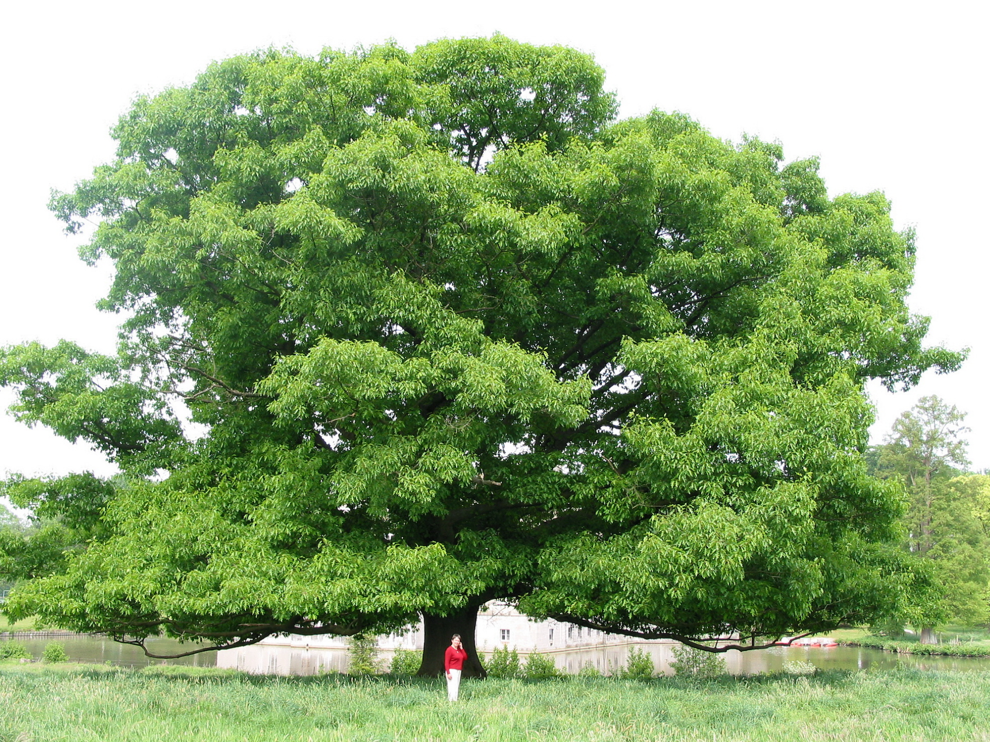
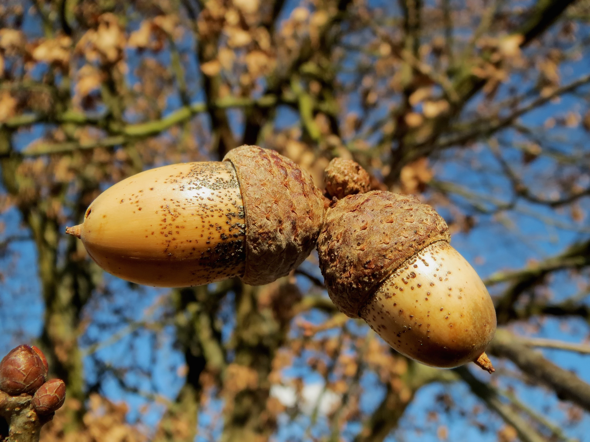
Photograph by Jean-Pol Grandmont
Photo courtesy of Pexels.com
Notes:
Oak acorn
Oak tree: Large Quercus rubra, Red Oak

Slide 6
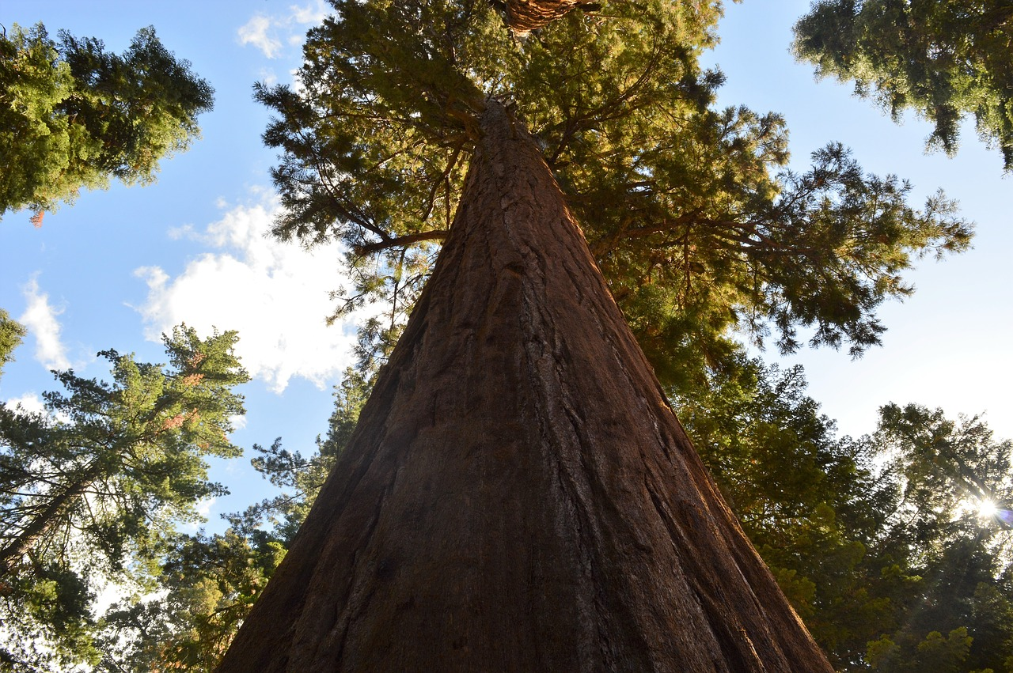
Photograph by Milton Taam
Photo courtesy of Pixabay.com
Notes:
Seedling: Author Milton Taam; Coast Redwood, Sequoia sempervirens, sprouts at the foot of a giant in Big Basin Redwoods State Park, California
Sequoia tree

Slide 7
How Do Plants Get Their Food?
Our Ideas about What Is Food for Plants | Evidence to Support Our Claims | Evidence to Challenge Our Claims

Slide 8
What Is Food for Plants? Let’s Read …

Slide 9
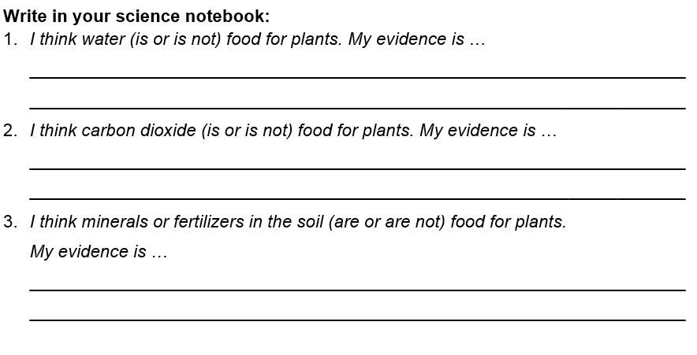
Are Water, Carbon Dioxide, and Minerals in the Soil Food for Plants?
Work on these questions with a partner:

Slide 10
Investigation 1: Are Water, Carbon Dioxide, and Minerals in the Soil Food for Plants?
What are your conclusions? What is your evidence? Listen to each other’s ideas to see if you agree or disagree.
Is water food for plants?
Is carbon dioxide food for plants?
Are minerals in the soil (“plant food”) food for plants?

Slide 11
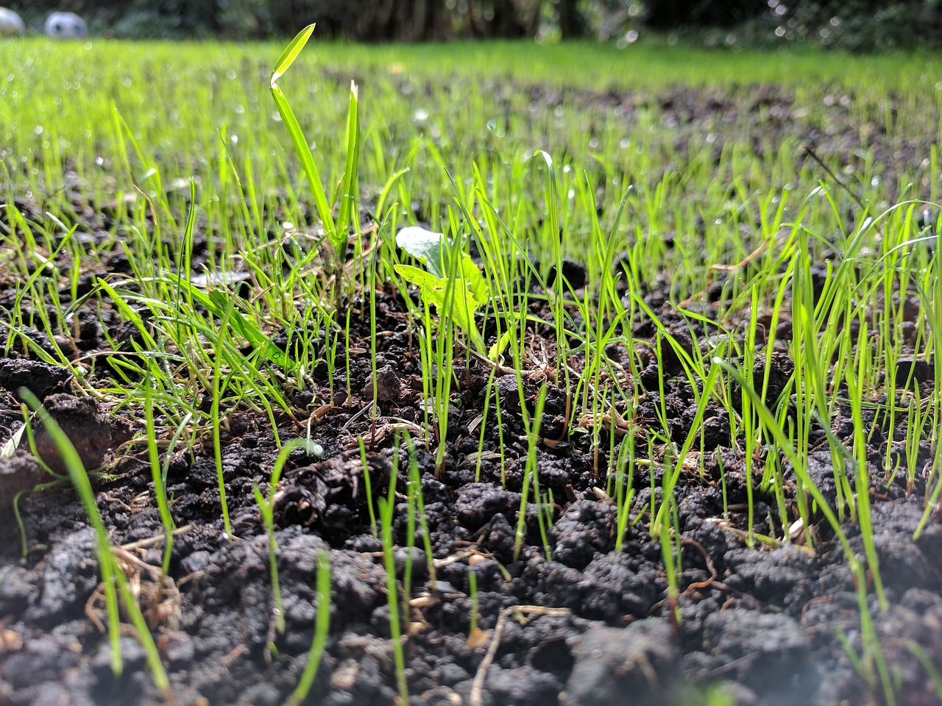
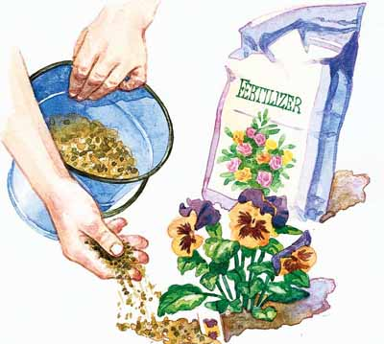
Investigation 2: Is Soil Food for Plants?
Talk about this question with a partner. Then share your ideas with the class.
Photo courtesy of Pixabay.com

Slide 12
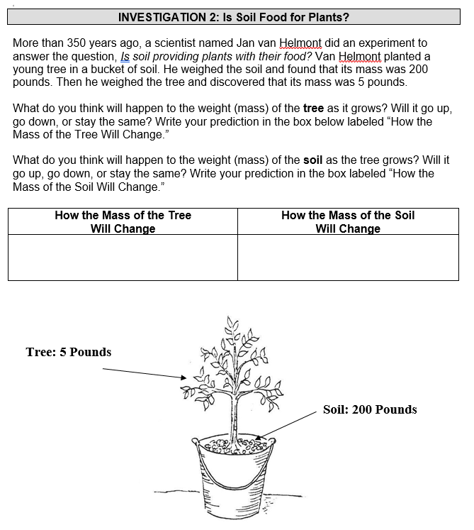
Is Soil Food for Plants? Let’s Investigate …
Read about Jan van Helmont’s experiment.

Slide 13
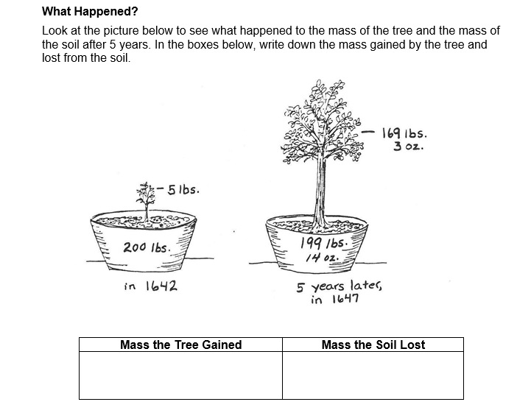
Is Soil Food for Plants? The Results …
What happened in Van Helmont’s experiment?

Slide 14
Is Soil Food for Plants? Your Conclusions
Answer these questions:
Van Helmont’s tree gained 164 pounds. Do you think all of this weight gain came from the soil? What is your evidence?
What do you think now about whether plants get their food from the soil?

Slide 15
Let’s Summarize!
What do we know so far about what is and is not food for plants?
Water
Carbon dioxide
Minerals in the soil (plant food)
Soil

Slide 16
Next Time
We know that water, carbon dioxide, minerals in the soil (“plant food”), and soil are NOT food that provides the matter and energy plants need to live and grow.
So what IS food for plants?
That’s what we’ll explore next!

