Slide 1
Food Webs Lesson 2b
What Is Food for Plants?

Slide 2
Today’s Focus Question
What is food for plants?

Slide 3
Investigation 3: Is Sunlight Food for Plants?
Photo courtesy of Pexels.com

Slide 4
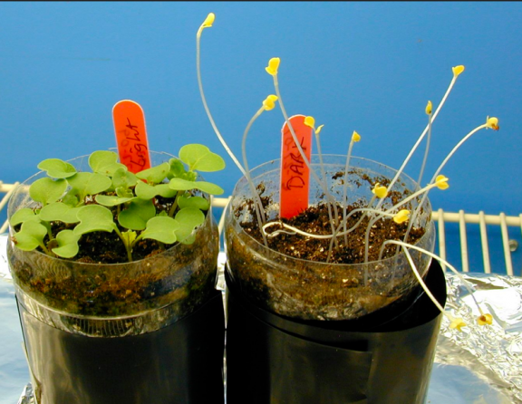
Plants Grown in Light and Dark Conditions
Photo courtesy of Wisconsin Fast Plants Program, College of Agricultural and Life Sciences: University of Wisconsin-Madison, Fastplants.org

Slide 5
Grass Seed Grown in Light and Darkness
Photograph by Kate Wright

Slide 6
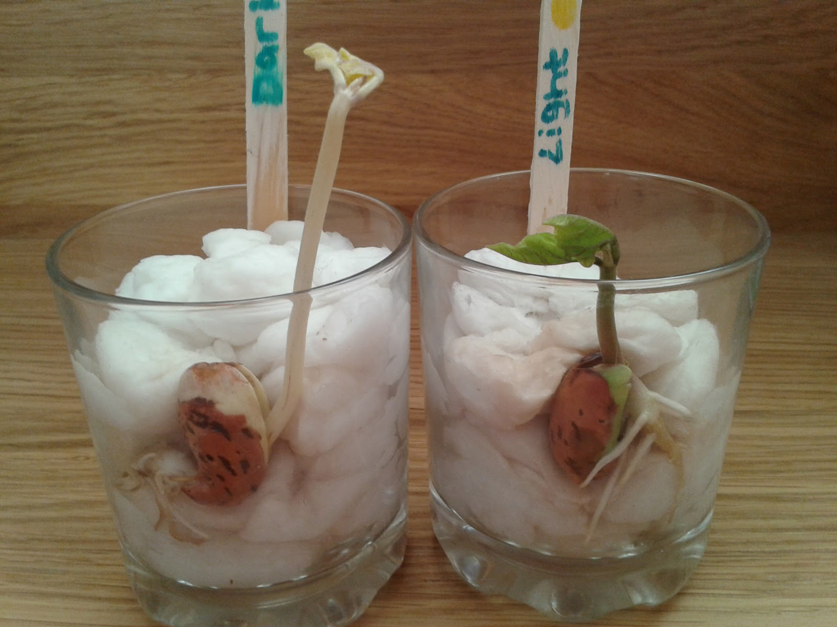
More Plants Grown in Light and Darkness
Photograph by Kirsty Lawson

Slide 7
Is Sunlight Food for Plants?
What are your ideas?
Photo courtesy of Pexels.com

Slide 8
Is Sunlight Food for Plants?
After reading about sunlight, what new ideas do you have that can help us answer the question, Is sunlight food for plants?
Use this sentence starter:
Sunlight (is or is not) food for plants by the scientific definition because …

Slide 9
Wrapping Up Our Investigation
What are your conclusions?
Is water food for plants?
Is carbon dioxide food for plants?
Are minerals in the soil food for plants?
Is soil food for plants?
Is sunlight food for plants?

Slide 10
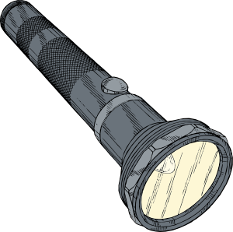
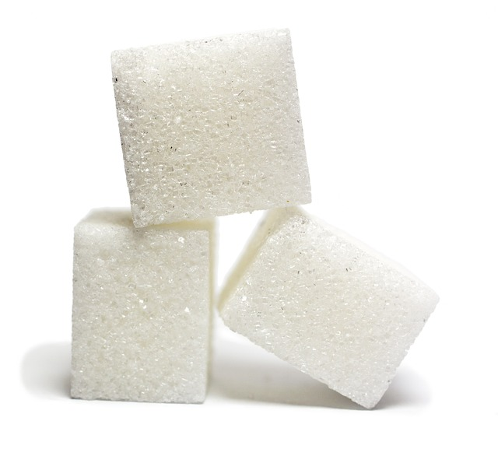
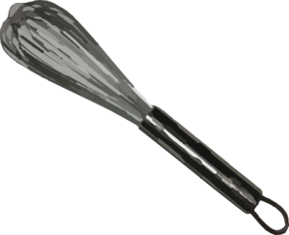
What Is Food for Plants? A Mixing-Bowl Model

Slide 11
What Are Plants?
Scientists call plants producers because they make or produce food.

Slide 12
What Is Food for Plants? A Role-Play

Slide 13
Let’s Summarize!
Today’s focus question: What is food for plants?
Answer this question as completely as you can using these words:
Matter
Energy
Carbon dioxide
Producer
Sunlight
Food
Water

Slide 14
Next Time
We’ve learned that food provides both matter and energy for living things.
Tomorrow we’ll explore this question: How do plants grow BIGGER?

