Slide 1
Food Webs Lesson 5A
What Happens to the Matter That Makes Up Wastes and Dead Organisms? (Part 1)

Slide 2
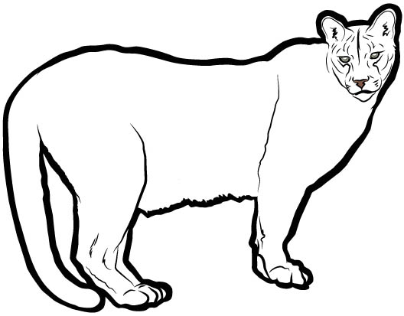
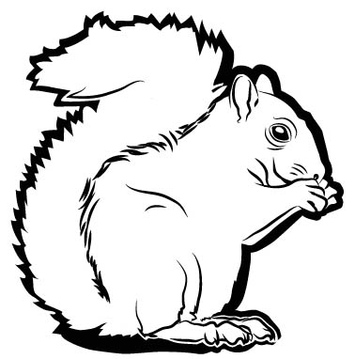
Tracking Matter in a Food Chain
What did we learn yesterday about what happens to the amount of matter as it is used and passed along to other organisms in a food chain?

Slide 3
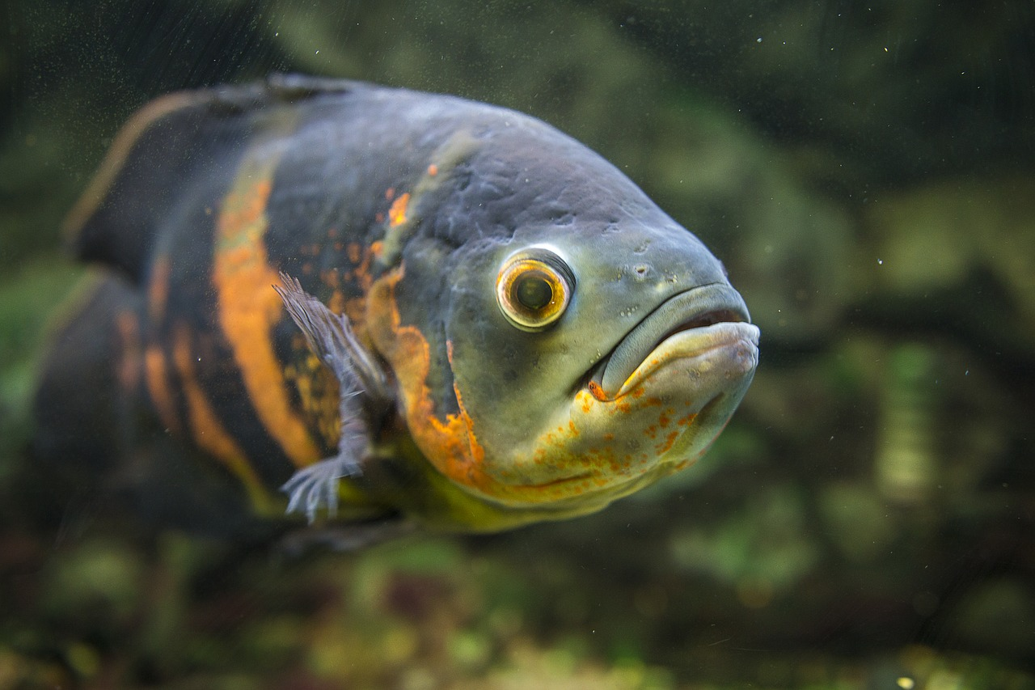
What Happens to Food Matter in the Plant?
1/2 of the food matter became part of the plant so it could grow bigger.
The fish ate 1/5 of the food matter.
Photo courtesy of Pixabay.com
1/10 of the food matter ended up as waste.
1/5 of the food matter was changed to CO₂ and H₂O when the plant broke it down to release stored energy.
Photo courtesy of Pixabay.com
How much of the food matter was used up and disappeared?

Slide 4
What Happens to Food Matter in the Fish?
The fish used 1/4 of the food matter to grow bigger.
The bear ate 1/2 of the food matter.
Photo courtesy of Pixabay.com
1/8 of the food matter ended up as waste.
2/16 of the food matter was changed to CO₂ and H₂O when the fish broke it down to release stored energy.
Photo courtesy of Pixabay.com
How much of the food matter was used up and disappeared?

Slide 5
What Pattern Do You Notice?
As matter moves from organism to organism in a food chain, what is always the same?

Slide 6
What Does This Pattern Tell Us?
Matter changes form and moves from one organism to another, but it never disappears or is lost.

Slide 7
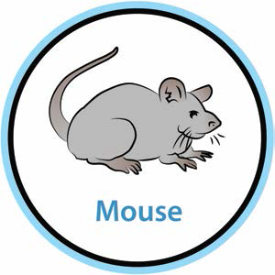
Show What Happens to Matter in a Food Chain
Think About …
Which organisms use matter to make food? What matter do they use to make food?
Which organisms use food matter to
grow?
get energy?
produce wastes?

Slide 8
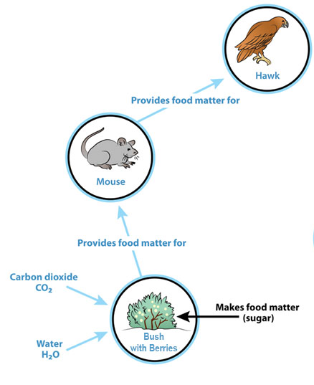
What Happens to Matter in a Food Chain?
Think About …
Which organisms use matter to make food? What matter do they use to make food?
Which organisms use food matter to
grow?
get energy?
produce wastes?

Slide 9
Today’s Focus Question
What happens to the matter that makes up wastes and dead organisms?
Where do you think the matter originally came from?

Slide 10
What Happens to the Matter?
What happens to living things when they die?
What happens to the wastes living things produce?

Slide 11
What Will Happen to the Strawberries?
These strawberries are no longer attached to a living plant.
What do you think will happen to the strawberries if we leave them in jars for a long time?
Write your prediction: After a long time, I think the strawberries will ______ because ______.

Slide 12
Your Predictions about Changes in Mass
If we let this strawberry jar sit for a month or two, will the mass stay the same, go down, or go up?
Write your prediction: I think the jar of strawberries will weigh [more/less/the same] because___________.

Slide 13
Your Observations
What is happening to the strawberries that have been in jars for a while? What do you notice?
Talk about your observations in your small groups.

Slide 14
Explaining What Is Happening and Why
Talk about these questions in your small group:
What do you think is happening to the strawberries?
Why is it happening?

Slide 15
What Happened to the Mass?
This strawberry jar was weighed when the strawberries were fresh and again the way they are now.
The result? The mass stayed exactly the same!
There was no loss of mass (weight) or gain!
How do you explain that the mass of the strawberry jar stayed the same? Does that surprise you?

Slide 16
Let’s Summarize!
Here’s what we know so far:
The strawberries are decomposing. They are breaking down into tiny pieces and shrinking.
There is something on the strawberries that we think is mold.
The mass of the strawberry jar is staying the same even though the strawberries are getting smaller.

Slide 17
Your Questions
What questions do you still have about what is happening to the strawberries?
What are you wondering about?

Slide 18
Next Time
My questions:
What does the mold on the strawberries have to do with decomposition?
Why isn’t the mass of the jar going down as the strawberries get smaller?
Tomorrow we’ll gather more information to help us answer these questions and our focus question: What happens to the matter that makes up wastes and dead organisms?

