Slide 1
Food Webs Lesson 6b
What Happens to Energy in Food Chains? Is It Recycled? (Part 2)

Slide 2
Today’s Focus Questions
What happens to energy in food chains? Is it recycled?

Slide 3
What Do You Know about Energy in Food Chains?
Imagine you’re out on a long
walk, and you’re feeling tired.
You eat a banana to get some energy so you can keep on walking.
How did energy get into the banana?
What happens to the energy in the banana after you eat it?
Photo courtesy of Freepik.com

Slide 4
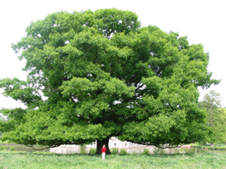
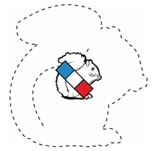
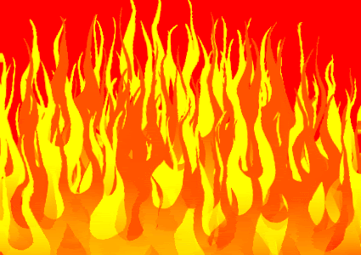
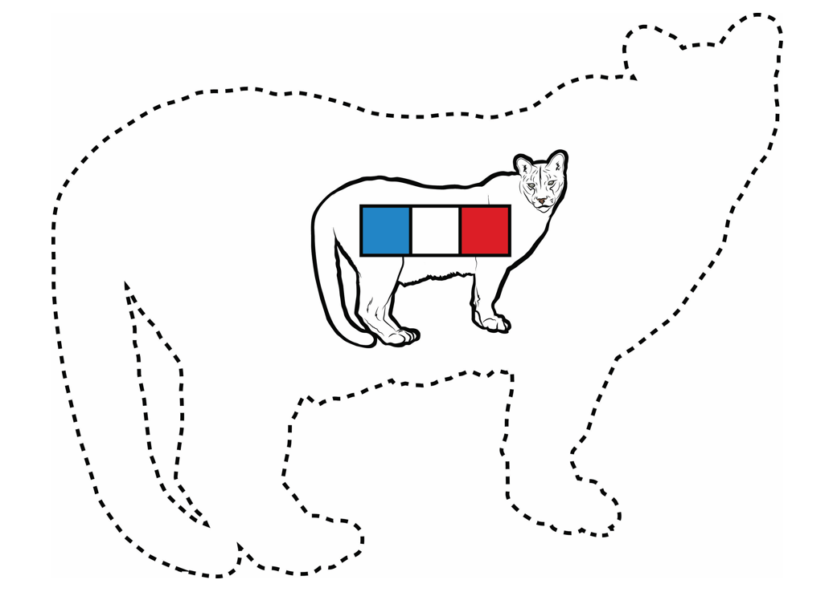
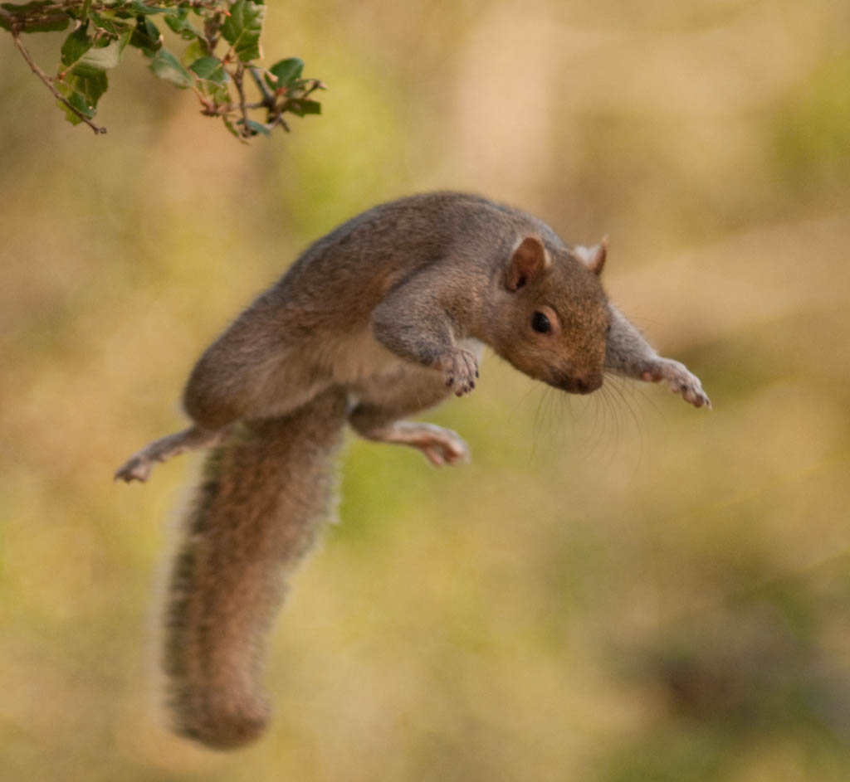
Energy in a Food Chain: Figure It Out!
Energy Stored in Food Molecules
Light Energy
Photograph by Jean-Pol Grandmont
Heat Energy
Stored Food Energy
Energy to Run
Stored Food Energy
Energy to Jump
Photo courtesy of Pixabay.com
Heat Energy
Photograph by Ed Sweeney

Slide 5
Create Your Own Food-Chain Diagram
Use the game cards to create a diagram showing what happens to energy in a food chain. Follow these steps:
Arrange your Sun and organism cards on the paper.
Refer to the Energy in Food Chains handout as a resource if you need help.
When you’re satisfied with how you’ve arranged the cards, tape or glue them in place.
Use a marker to add words and arrows showing what is happening to the energy in this food chain. Make sure you label your arrows!
On the back of your paper, write an explanation of what is happening to the energy in your food chain.

Slide 6
Diagram Presentations
Be good listeners during the presentations and make sure you communicate in scientific ways when you want to agree, disagree, add on, or ask a question:
I agree with __________ because …
I disagree with _________ because …
I want to add on to _______’s idea …
Are you saying that …?
What do you mean when you say …?
That idea doesn’t make sense because …

Slide 7
Today’s Focus Questions
What happens to energy in food chains? Is it recycled?

Slide 8
A Complicated Story!
Light Energy
Photograph by Jean-Pol Grandmont
Energy Stored in Food Molecules
Heat Energy
Stored Food Energy
Energy to Run
Stored Food Energy
Energy to Jump
Heat Energy
Photo courtesy of Pixabay.com
Photograph by Ed Sweeney
Notes:
Squirrel Jumping - By Ed Sweeney (originally posted to Flickr as Serious Squirrel) [CC BY 2.0 (http://creativecommons.org/licenses/by/2.0)], via Wikimedia Commons

Slide 9
Let’s Simplify the Story!
As energy moves through a food chain, it changes from
light energy to
energy stored in food molecules to
energy organisms use to move and live to
heat energy.
Energy is used and lost as heat to the environment.
Energy is not recycled.
So we always need a new supply of energy from the Sun!

Slide 10
Next Time
In the next lesson, you’ll use everything you’ve learned so far about matter and energy to explain what’s happening in more complicated food chains.

