Slide 1
Food Webs Lesson 7a
How Do Living Things Depend on One Another to Get the Food (Matter and Energy) They Need to Live and Grow?

Slide 2
Today’s Focus Question
How do living things depend on one another to get the food (matter and energy) they need to live and grow?

Slide 3
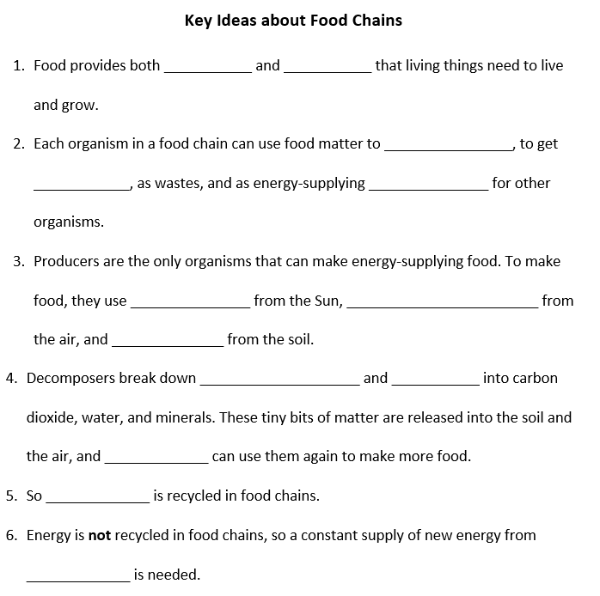
Let’s Review Some Key Science Ideas!

Slide 4
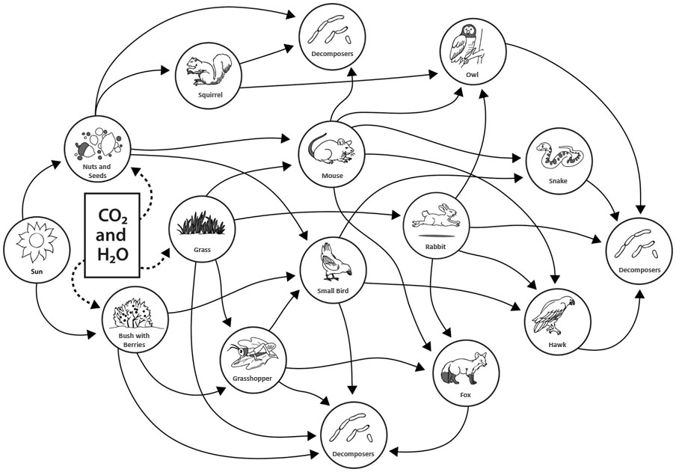
Identifying Food Chains in a Food Web

Slide 5
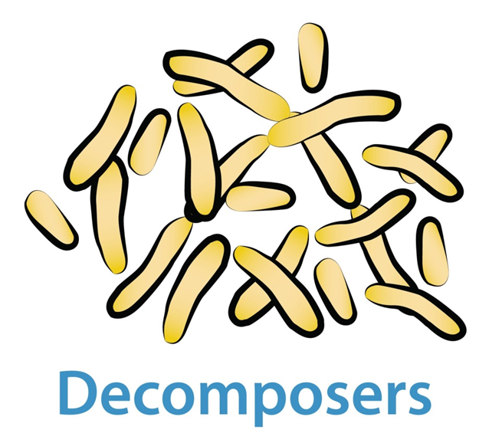
What We Know So Far
How do matter and energy move in a food chain?

Slide 6
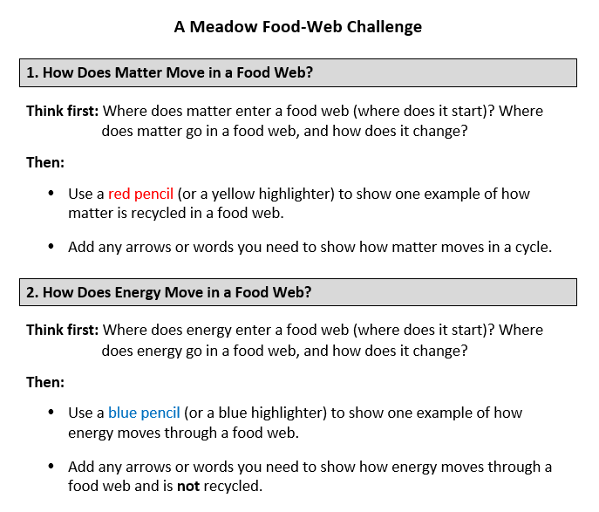
A Food-Web Challenge

Slide 7
Let’s Summarize!
Unit central question: How do living things depend on one another to get the food (matter and energy) they need to live and grow?
How are plants and animals connected to one another in a food web?
In what ways do organisms depend on one another in food webs?
Do plants depend on other organisms to get their food?
What about decomposers? Do they depend on other organisms?
All organisms in a food web depend on one important thing to get the food they need. What is it?

Slide 8
Next Time
Tomorrow we’ll explore how organisms in a mini-environment get the matter and energy they need to live and grow!

