Slide 1
WATER CYCLE LESSON 1B
Does Liquid Water Ever Disappear?

Slide 2
Unit Central Questions
How does water change in the world around us? Does Earth ever run out of water?

Slide 3
Review: Building a Scientific Explanation
Question: Why did the water level go down when the water was boiled?
Do we have a complete scientific explanation to answer this question?

Slide 4
Building a Scientific Explanation
Question: Why did the water level go down?
Claim: Make a statement that answers the question.
Evidence: Describe observations that support the claim.
Reasoning: Use science ideas to explain why the evidence supports the claim.

Slide 5
Today’s Focus Question
Does liquid water ever disappear? Explain your thinking.

Slide 6
Science Ideas Explain What Happened
The water did not disappear!
Liquid water can change to another form of water that is a gas called water vapor.
This water vapor is still water, but our eyes can’t see it because it’s so spread out in the air.
Some of the liquid water in our beaker changed to water vapor and went into the air.
The process of changing from liquid water to a gas is called evaporation.

Slide 7
Turn and Talk
Look at the diagram on chart paper that shows what is happening with the heated water.
What does the arrow represent?
Where did we see liquid water in our observations?
Where was water a gas in our setup?

Slide 8
Another Science Idea
Heat is necessary for liquid water to turn into a gas (water vapor).
What do we call this process?

Slide 9
An Important Vocabulary Word!
Evaporation is the process where a liquid changes to a gas.
Write this word in your science notebooks!

Slide 10
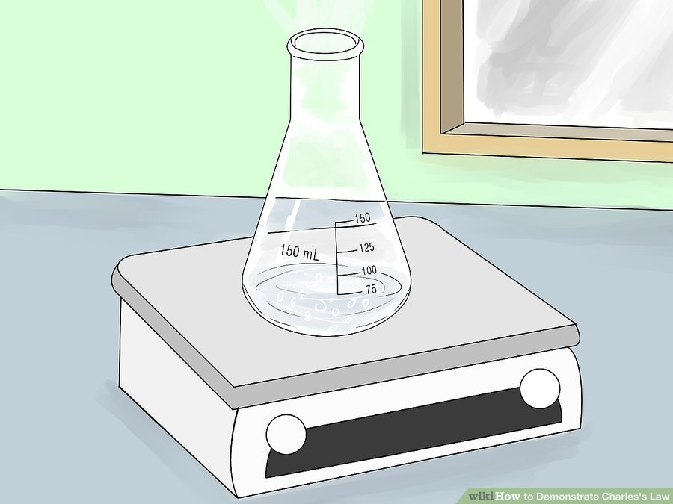
Explain Why the Water Level Went Down
Claim: Make a statement to answer the question.
Evidence: What observations support your claim?
Reasoning: Use science ideas to explain why the evidence supports your claim.
Words to use:
Liquid water
Water vapor
Gas
Heat
Evaporation
Courtesy of Wikihow.com

Slide 11
Today’s Focus Question
Does liquid water ever disappear? Explain your thinking.

Slide 12
Let’s Summarize!
Answer this question using what you’ve learned:
If you hang wet clothes on a clothesline on a hot, sunny day, the clothes will dry. Does the water in the clothes disappear? Explain your thinking.
Words you might use:
Evaporation
Liquid water
Water vapor/gas
Heating/cooling
Disappear

Slide 13
Next Time
Today we learned that when liquid water is heated, it changes to water vapor (an invisible gas) in a process called evaporation.
Tomorrow we’ll see whether the opposite will happen. Can water vapor change back to liquid water?

