Slide 1
WATER CYCLE LESSON 3a
Why Is Water Sometimes a Liquid, Sometimes a Solid, and Sometimes a Gas?

Slide 2
Unit Central Questions
How does water change in the world around us? Does Earth ever run out of water?

Slide 3
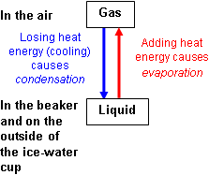
Review: Evaporation and Condensation

Slide 4
Today’s Focus Question
Why is water sometimes a liquid, sometimes a solid, and sometimes a gas?

Slide 5
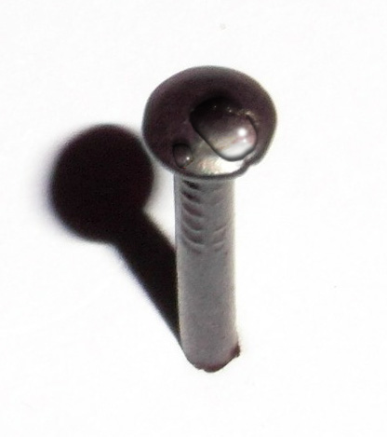
Water Is Made Up of Molecules
Photo courtesy of Pixabay.com

Slide 6
Water Molecules: H₂O
2 Hydrogen Atoms
H
H
O
1 Oxygen Atom

Slide 7
Drawing Water Molecules
Draw a circle in your science notebooks to represent a single drop of water.
How would you show that this water droplet is made up of water molecules?
Fill your circle with water molecules.

Slide 8
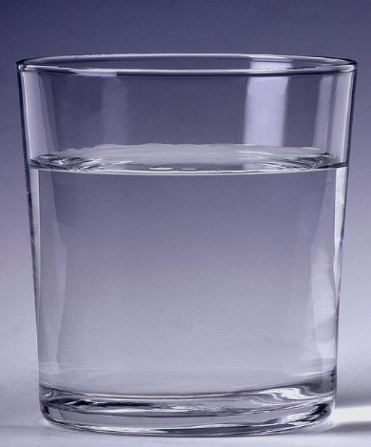
Do Water Molecules Move?
Photo courtesy of Pixabay.com

Slide 9
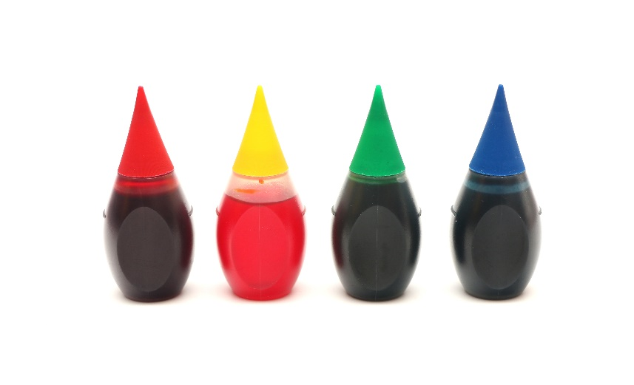
What Will Happen and Why?
Photo courtesy of Stock.Adobe.com
Photo courtesy of Pixabay.com

Slide 10
Observe Carefully What Happens
Draw a picture in your science notebooks showing what happens right after the food coloring is added. Then draw another picture later on when something new happens.
Photo courtesy of Stock.Adobe.com
Photo courtesy of Pixabay.com

Slide 11
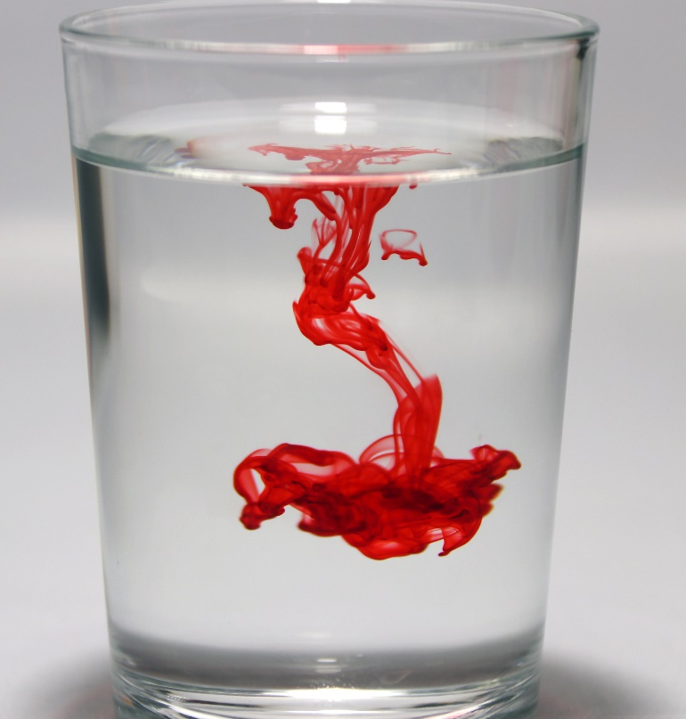
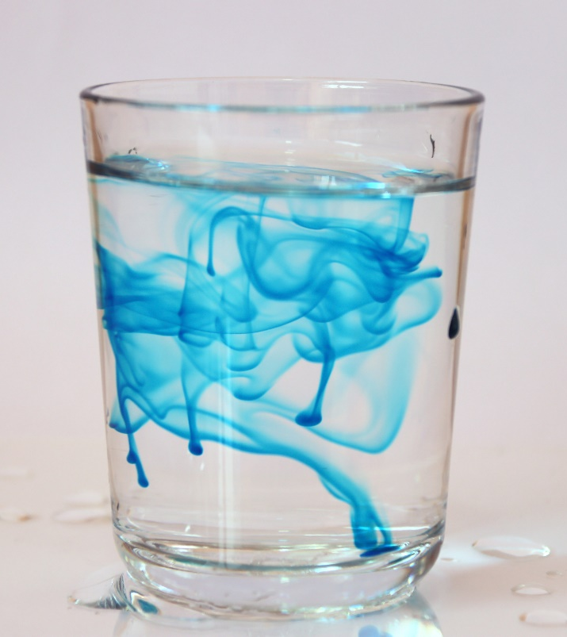
Discussion: What Is Causing the Food Coloring to Move?
Photo courtesy of Stock.Adobe.com
Photo courtesy of Stock.Adobe.com

Slide 12
Water Molecules in Motion
Turn and Talk: In what direction would the water molecules have to move to push the food coloring up, down, sideways, and all over the cup?

Slide 13
Today’s Focus Question
Why is water sometimes a liquid, sometimes a solid, and sometimes a gas?

Slide 14
Let’s Summarize!
In your science notebooks, write down two new ideas about water in the liquid state from today’s lesson.
Make sure to use the word molecules!

Slide 15
Part of the Answer to Our Focus Question
Why is water sometimes a liquid, sometimes a solid, and sometimes a gas?
Key ideas so far:
Water is made up of tiny pieces called molecules.
Water molecules in the liquid state are always moving around and sliding past one another.

Slide 16
Next Time
Today we explored the focus question, Why is water sometimes a liquid, sometimes a solid, and sometimes a gas?
To answer this question, we need to know more about water molecules in the solid and gaseous states.
Do they move like water molecules in the liquid state?

