Slide 1
WATER CYCLE LESSON 4B
How Can Ideas about Water Molecules Help Us Explain Evaporation and Condensation in a System?

Slide 2
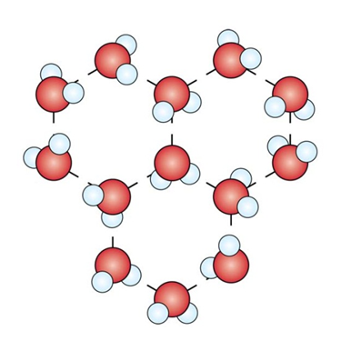
States of Water: Role-Play

Slide 3
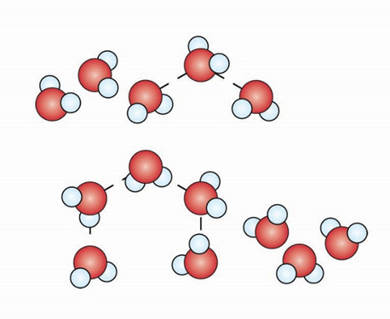
States of Water: Role-Play

Slide 4
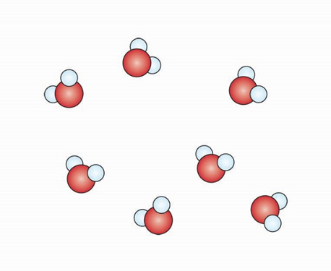
States of Water: Role-Play

Slide 5
Yesterday’s Focus Question
How can ideas about water molecules help us explain evaporation and condensation?

Slide 6
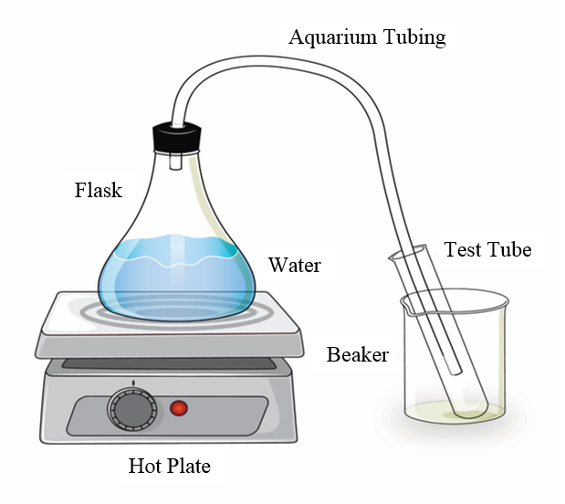
Today’s Focus Question
How can ideas about water molecules help us explain evaporation and condensation in a system?

Slide 7
Observing the Water-Changes System

Slide 8
Thinking about Water Changes in a System
Work on these three questions with a partner:
What’s happening in the flask?
What’s happening in the aquarium tubing?
What’s happening at the end of the setup where the test tube is?

Slide 9
Thinking about Water Changes in a System
Make these changes on your handout diagram of the water-changes system:
Label where the different states of water occur.
Draw 6 to 8 water molecules representing each of the states you labeled.
Label all the places where evaporation and condensation must be happening.

Slide 10
What Happened?
Let’s talk about what happened in the water-changes system. During our discussion, follow these steps:
Share your ideas.
Listen to others: Do you agree or disagree? Can you add on? Do you have any questions?
Make changes to your diagram in a new color ink or pencil.

Slide 11
Checking Our Understanding
Where should we label things as liquid or water vapor (gas)?
Where is evaporation occurring?
What happens to water molecules during evaporation?
Where is condensation occurring?
What happens to water molecules during condensation?
Where are water molecules gaining or losing energy? Where is water being heated or cooled?

Slide 12
More Questions about the Water-Changes System
What do you notice about the water level in the flask?
What does that mean? What happened? Did the water disappear?
If we pour the water from the test tube back into the flask, will the water level come back up to the original line? Why or why not?

Slide 13
Let’s Summarize!
Use at least 3 of the following words to explain something that happened in our water-changes system:
Liquid water
Water vapor (gas)
Molecules
Gain energy
Lose energy
Evaporation
Condensation

Slide 14
Answering Our Focus Question
How can ideas about water molecules help us explain evaporation and condensation in a system?
During evaporation, molecules in the liquid state gain energy, move faster, and escape into the air as water vapor (a gas).
During condensation, water-vapor molecules lose energy, slow down, and join together to form liquid-water droplets.
We saw that both of these processes can occur in one system.

Slide 15
Next Time
Tomorrow we’ll use these new ideas to explain what we observe in some everyday situations.

