Slide 1
WATER CYCLE LESSON 6A
Does Earth Ever Run Out of Water? Support Your Answer with Evidence and Reasoning.

Slide 2
Our Unit Central Questions
How does water change in the world around us? Does Earth ever run out of water?

Slide 3
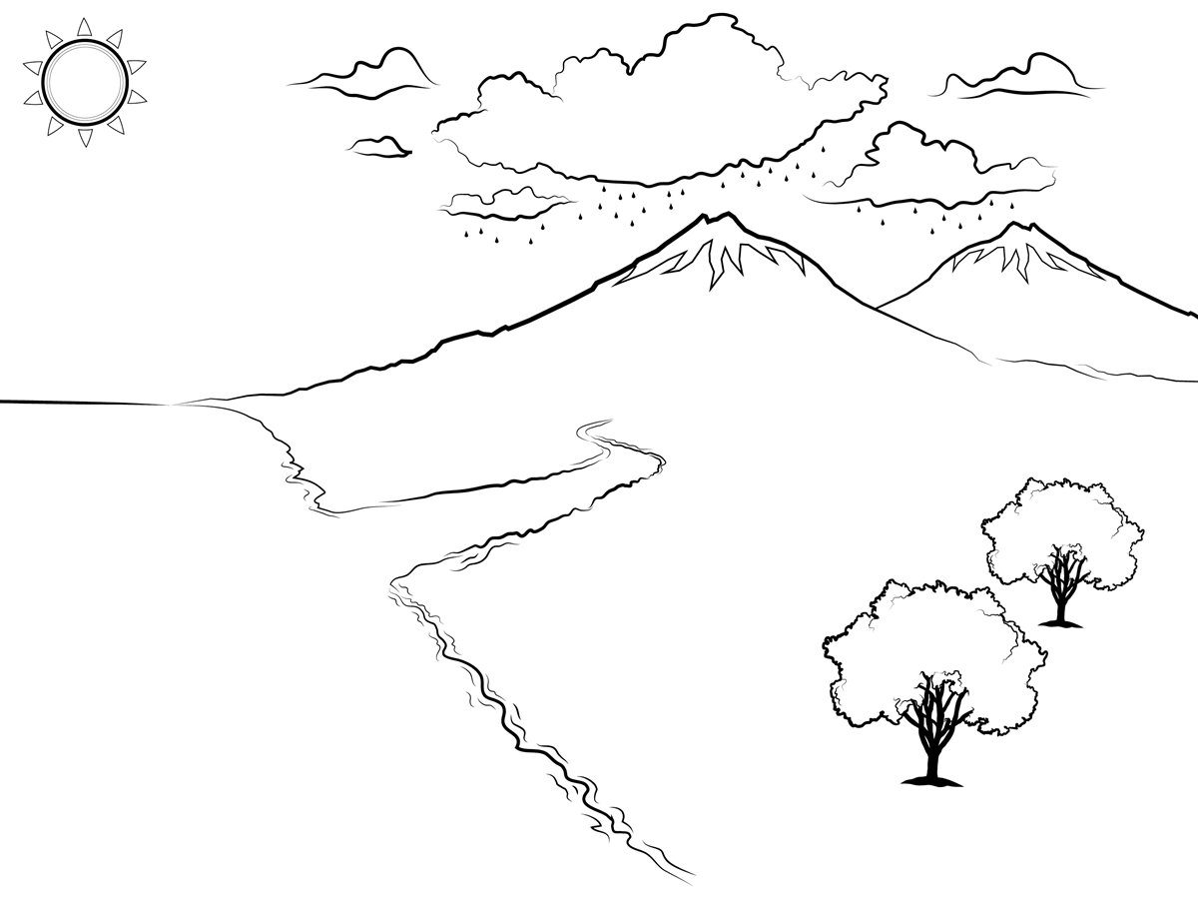
Question 1: How Does Water Change in the World around Us?

Slide 4
Today’s Focus Question
The second unit central question is today’s focus question:
Does Earth ever run out of water? Support your answer with evidence and reasoning.
What do you think? What are your ideas and reasons?

Slide 5
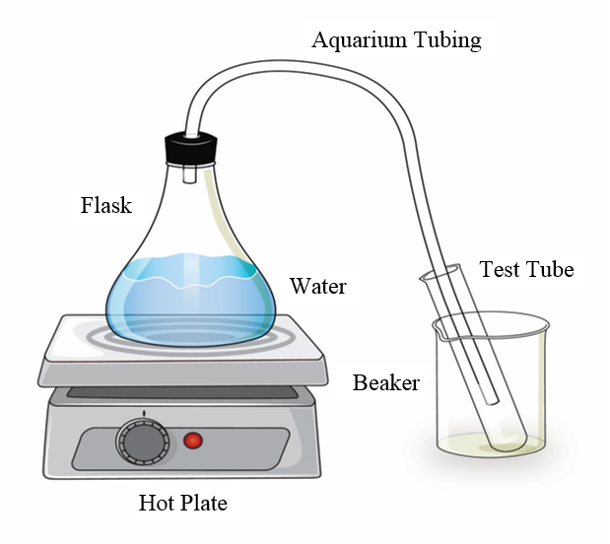
Let’s Revisit the Water-Changes System!
What changes did you observe in this system?
What happened to the water in the flask and the tubing?
What processes did you observe in this experiment?

Slide 6
What Happened to the Water Level?
Why didn’t we have the same amount of water in the flask at the end of the experiment as we did at the beginning?

Slide 7
This Is an Open System!
Some of the water in the system escaped into the air.

Slide 8
What If We Set Up a Closed System?
If we poured the water from the test tube back into the flask in a closed system, would the water level in the flask be the same as when we started?

Slide 9
We Need More Evidence!
We have some different ideas about what happens to water in a closed system, but we need to gather more evidence to answer our focus question.

Slide 10
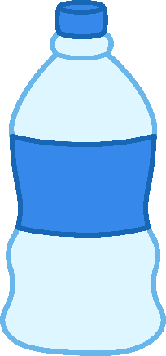
The Three-Bottles Experiment
What do you think happens to the mass of water when it changes states in a closed system?
Water
Water
Water
1 Freezer
2 Room Temp
3 Heated
Each of these bottles is a closed system.

Slide 11
Gathering Data on Mass
 | Bottle 1 Freezer | Bottle 2 Room Temp | Bottle 3 Heated
Mass at Start
Mass at End
Copy the data chart into your science notebooks.
Record the starting mass of each bottle.
Use mathematical symbols to write an equation that shows the starting masses of the three bottles in relationship to each other.

Slide 12
How Will the Mass of Each Bottle Change?
 | Bottle 1 Freezer | Bottle 2 Room Temp | Bottle 3 Heated
Mass at Start
Mass at End
Write your predictions as mathematical equations:
Use words and mathematical symbols < , >, and =. Example: Bottle 1 start = Bottle 1 end.
You can create more than one equation.
Be ready to give the reasons for your predictions.

Slide 13
Analyzing Sample Data: Did the Mass Change?
 | Bottle 1 Freezer | Bottle 2 Room Temp | Bottle 3 Heated
Mass at Start | 15.2 g | 15.3 g | 15.3 g
Mass at End | 15.2 g | 15.3 g | 15.3 g
What pattern do you see in these results?
Describe the pattern in a mathematical equation. Use words, numbers, and symbols (<, =, >).

Slide 14
Gathering Data on Mass
 | Bottle 1 Freezer | Bottle 2 Room Temp | Bottle 3 Heated
Mass at Start
Mass at End
Record the ending mass of each bottle in your science notebooks.
What pattern do you observe in your data?
Compare the results with the sample data. Is the pattern from both sets of data the same or different?

Slide 15
Patterns in the Data
Look at each mathematical equation you came up with to represent the pattern you observed in the experiment results:
Do you understand what this equation is saying?
Does this equation accurately describe the data?
Do you have any questions for this group?

Slide 16
What Do The Patterns Tell Us?
Turn and talk with a partner about this question:
As water changes states, does its mass change? Support your answer with evidence and reasoning.
Use the sample data to answer this question with a claim, evidence, and reasoning. You don’t need to write down your answer, but be prepared to share out.

Slide 17
The Results
Did the mass of the water change when it was frozen or heated?
NO!
Did the amount of water in each bottle change?
NO!
Did the number of water molecules in each bottle change?
NO!

Slide 18
What Water Molecules Can and Can’t Do
Let’s look at what water molecules can and can’t do when they change states in a closed system.
They CAN …
Gain or lose energy
Speed up or slow down
Change how they’re arranged in relationship to other water molecules
They CANNOT …
Gain or lose mass
Be destroyed
Disappear into nothingness

Slide 19
Today’s Focus Question
Does Earth ever run out of water? Support your answer with evidence and reasoning

Slide 20
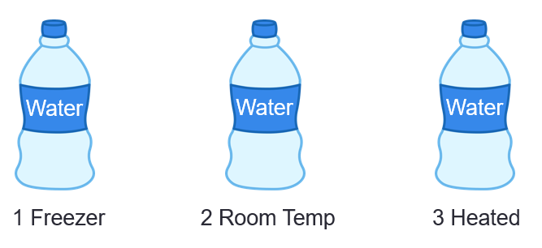
Earth Is Like Our Bottles!
They’re both closed systems for water!

Slide 21
Answer the Focus Question
Today’s focus question: Does Earth ever run out of water? Support your answer with evidence and reasoning.
Claim: Your answer to the question (in a sentence)
Evidence: What you observed mathematically in the experiment that supports your claim
Reasoning: Using science ideas about molecules to support your claim and link it to the evidence
Word Bank: Closed/open system Evaporation
Condensation Molecules Gain/lose energy Mass
Solid Liquid
Water vapor (gas)

Slide 22
Let’s Summarize!
Today’s big idea: In a closed system, water constantly changes state from a liquid to a solid or a gas, but the amount of water (its mass and number of molecules) doesn’t change.
Earth is a closed system for water, so water molecules keep changing state, but they never disappear or escape the system.
So Earth never runs out of water!

Slide 23
Next Time
Next time we’ll use everything we’ve learned about the water cycle to answer our central unit questions: How does water change in the world around us? Does Earth ever run out of water?

