Slide 1




RESPeCT PD pROGRAM
Day 1
RESPeCT Summer Institute
Notes:
5 min
a. Greet participants as they enter the room.
b. Help them find their notebooks and table tents.

Slide 2
Before We Dig In: Essentials
On-time session starts and endings
Sign-in sheets
Restrooms
Sustenance (lunch and snack breaks)
Questions or special needs?
Notes:
20 min for slides 2–14 presentation (averaging approximately 1 min per slide)
a. Give everyone a big welcome to the RESPeCT PD program!
b. Fill participants in on the essential details listed on the slide.

Slide 3
What Is RESPeCT?
Reinvigorating Elementary Science through a Partnership with California Teachers
A partnership built for long-term success!
A professional development program
A leadership development program
A research study
Notes:
Approximately 1 min
a. Emphasize: The RESPeCT project began with three main components:
A professional development program
A leadership development program
A research study
b. The district now sustains RESPeCT as a professional development program.

Slide 4

The RESPeCT Partnership
PUSD
CPP
PUSD:
Pomona Unified School District
CPP:
California State Polytechnic University, Pomona
Photo courtesy of Pixabay.com
BSCS
BSCS:
Biological Sciences Curriculum Study
Notes:
Approximately 1 min
a. The original RESPeCT partners included the following:
Cal Poly: science, science education, and mathematics faculty, as well as the Center for Excellence in Mathematics and Science Teaching (CEMaST)
PUSD: district central administrators, principals, teacher specialists, and teachers
BSCS: an additional partner located in Colorado that provides expertise on science curriculum development, science teacher professional development, and research on science teaching and learning. Note: Established in 1958, BSCS stands for Biological Sciences Curriculum Study, but the organization now deals with all sciences, not just biology.
Students: Emphasize that students are at the center of this partnership. Their learning is what the project is all about.

Slide 5
The RESPeCT PD Program
  Builds on the successful Science Teachers Learning from Lesson Analysis (STeLLA) program
  Has a significant impact on student learning as demonstrated in two rigorous studies
  Teaches videocase-based lesson analysis
  Facilitates science-content deepening
Notes:
Approximately 1 min
a. Let participants know they’ll be learning more about the RESPeCT PD program and STeLLA teaching strategies as they experience firsthand what it means to perform videocase-based lesson analysis.

Slide 6
The RESPeCT PD Program
Extends the STeLLA approach by
  Addressing grade-level standards in Next Generation Science Standards (NGSS)
  Incorporating Common Core English language arts (ELA) and math standards
  Addressing more explicitly the needs of English language learners (ELLs)
  Addressing all grade levels, K–6
Notes:
Approximately 1 min
a. Read the information on the slide.
b. Emphasize the importance of these additions to the STeLLA approach. By integrating Common Core English language arts (ELA) and math standards into the science curriculum, the RESPeCT PD program enables teachers to invest more time in teaching science. The teaching strategies developed in the RESPeCT PD program are also valuable tools in other subject areas.

Slide 7
Goals of the RESPeCT PD Program
Deepen teachers’ science-content knowledge and knowledge of effective science teaching.
Develop teachers’ analytical skills to improve lesson-plan development and the teaching of science.
Support teachers in the practical use of new knowledge and analytical skills in their classrooms.
Improve students’ science learning.
Achieve sustainability by eventually reaching all
K–6 teachers.
Notes:
Approximately 1 min
a. The bottom line: improving students’ science learning—a goal that has been reached in two previous research studies of this approach.

Slide 8
Summer Institute Study-Group Leaders
Grade [Insert grade level here]
[Insert leader names here]
[Insert leader names here]
Notes:
Approximately 1 min
a. Modify this slide to include the grade level of your study group and the names of the Teacher Leaders who will be facilitating the study-group sessions.
b. Formally introduce yourselves to the group.

Slide 9

The Key
Each of us is key to the success of the
RESPeCT PD program!
Notes:
Approximately 1 min
a. Many people are involved in organizing, planning, and leading this program, but the teacher-participants are the key to its success.

Slide 10
Summer Institute Schedule
Notes:
Note: This is a transition slide.

Slide 11
Summer Institute: A Typical Daily Schedule
8:00 Getting started
8:30 Video-based lesson analysis
10:00 BREAK
10:10 Lesson analysis continued
12:00 LUNCH
12:45 Content deepening
2:00 BREAK
2:10 Content deepening continued
3:00 Wrap-up: homework, summary, reflections
3:30 Adjourn
Notes:
Approximately 1 min
a. A typical daily schedule includes the following:
Time spent on videocase lesson analysis
Time focused on content deepening
Short homework assignments
A morning and an afternoon break, with a 45-minute lunch break

Slide 12
Summer Institute at a Glance
Week 1: Content Area 1 (The Water Cycle)
  Student Thinking Lens—strategies to make student thinking visible
  Analysis of video teaching in content area 1
  Analysis of lesson plans to be taught second semester
  Content deepening in content area 1
Week 2: Content Area 2 (Food Webs)
  Science Content Storyline Lens—strategies to create coherence
  Analysis of video teaching in content area 2
  Analysis of lesson plans to be taught in the fall
  Content deepening in content area 2
Notes:
Approximately 1 min
a. During the Summer Institute, each grade level will focus on two content areas, with one week devoted to each area. Participants will deepen their science-content knowledge, study lesson plans in each content area, and analyze videocases of teachers presenting this content.

Slide 13
School-Year Schedule
Fall [Insert year here]
Teach the first lesson set.
Meet three times as a study group (4 hours each).
Meet an additional time to review the second lesson-set plans (2 hours).
Winter/Spring [Insert year here]
Teach the second lesson set.
Meet three times as a study group (4 hours each).
Note: The study group will determine meeting dates and times.
Notes:
Approximately 1 min
a. “The Summer Institute is just the beginning! During the school year, you’ll continue meeting with your grade-level study group.”

Slide 14
Your RESPeCT PD Program Materials
Your science notebook
STeLLA strategies booklet
RESPeCT PD program binder
RESPeCT lesson plans binder
Materials kit (1 per topic)
Notes:
Approximately 1 min
a. Transition slide: “In a moment we’ll break up into grade-level study groups and dig into the RESPeCT PD program! But first let’s review this list of materials you’ll receive in your designated meeting rooms.”

Slide 15
Transition to Grade-Level Study Groups
Any questions before we break up into our grade-level study groups?
Notes:
5 min
a. “Any questions before we head to our grade-level study groups?”
b. Send-off: “Have a great day and be sure to let us know if there is anything we can do to support you in getting the most out of this experience!”

Slide 16
Notebook Setup
Write your name on the front cover of the notebook.
Leave two or three pages for the table of contents. (You’ll add to the TOC each day throughout the program.)
Number your pages. (Front and back pages should be numbered separately.)
Use sticky tabs to divide your notebook into two main sections: Lesson Analysis and Content Deepening. (Each section will comprise about half the notebook.)
Keep a chronological record of your activity in each section. Add a title for each entry and enter in your TOC to easily locate.
Customize and decorate your notebook any way you wish.
Notes:
8 min
a. Welcome participants to the study group and introduce yourself as they arrive.
b. Help participants find their table tents and materials so they can get settled.
c. Direct them to the instructions for setting up their notebooks (Setting Up Your Summer Institute Notebook in the pretabs section of their PD program binders) and get them started working on this task. Interact informally with them and allow them to chitchat as they work.

Slide 17
Getting Started: Introductions
Quick-write exercise:
  Describe your experience learning science in school.
  What do you hope to learn through RESPeCT in the coming year?
Share your responses with a partner.
Introduce each other to the group.
Notes:
15 min
a. Individuals (3 min): Have participants write their responses to the questions on the slide in their notebooks. Emphasize that this is an independent writing exercise.
b. Pairs (3 min): Have participants pair up and share their responses to the questions. Encourage them to learn other things about their partners as well (e.g., school, years of teaching, favorite subjects to teach, hobbies).
Note: If the group has an odd number of participants, pair up with one of them.
c. Whole group (9 min): Have each participant introduce her or his partner, highlighting what that partner hopes to learn from the RESPeCT PD program. Model the first pair of introductions to demonstrate that they should be brief.
Note: If you weren’t able to pair up with someone, simply introduce yourself.
Monitor the time: Introductions should be longer than a sentence, but not the length of a full essay!

Slide 18
RESPeCT PD Program Goals
Business-as-Usual PD
Not closely linked to day-to-day classroom teaching
Rarely see other teachers practice
Learning about content separate from learning about teaching
RESPeCT PD Program
Learn science content in the context of analyzing teaching and student learning.
Engage with one another
in a collaborative analysis of content-specific videocases
of other teachers.
Learn science content in the context of analyzing teaching and student learning.
Notes:
2 min
a. Talk through this slide, emphasizing how RESPeCT PD is different from many other professional development opportunities.

Slide 19
RESPeCT PD Program Goals: Lesson Analysis PD
Business-as-Usual PD
Focus on what to do tomorrow and “cool” activities
Development not sustained over time
Effectiveness measured in terms of teachers’ enjoyment
RESPeCT Lesson Analysis PD
Learn how to select and carry out science activities based on analysis of science content and student thinking and learning.
Be supported in using new teaching knowledge throughout the year.
Measure effectiveness in terms of teacher and student learning.
Notes:
1 min
a. Highlight the goals of RESPeCT lesson analysis PD and how it differs from other professional development opportunities.

Slide 20
Norms for Working Together: The Basics
Purpose: Build trust and develop a productive study group for all participants.
The Basics
Arrive prepared and on time; stay for the duration; return from breaks on time.
Remain attentive, thoughtful, and respectful; engage and be present.
Eliminate interruptions (turn off cell phones, email, and other electronic devices; avoid sidebar conversations).
Make room for everyone to participate (monitor your floor time).
Notes:
3 min
a. “To do this kind of work together, we need to develop a strong study group where everyone feels safe sharing their ideas, questions, confusion, successes, and stumbles. Having a set of agreed-upon norms will help us build such a learning community.”
b. Read over these basic norms.
c. “What do you think? Are there any changes or additions you’d like to suggest?”

Slide 21
Norms for Working Together: The Heart
Purpose: Build trust and develop a productive study group for all participants.
The Heart of RESPeCT Lesson Analysis and Content
Deepening
Keep the goal in mind: analysis of teaching to improve student learning.
Share your ideas, uncertainties, confusion, disagreements, questions, and good humor. All points of view are welcome.
Expect and ask questions to deepen everyone’s learning; be constructively challenging.
Listen carefully; seek to understand other participants’ points of view.
Notes:
5 min
a. “This set of norms moves beyond the basics and targets the heart of RESPeCT PD program goals.”
b. Read the list.
c. “Is anything unclear? Do you have any changes or additions you’d like to suggest? Do you have any concerns about these norms?”
d. Direct participants to handout 1.1 (Norms for Working Together) and pass out the half-page copy of the norms for them to paste on the inside front cover of their notebooks.
e. Ask participants if they’re willing to live with these norms today; then tell them they’ll have an opportunity to revise them tomorrow.

Slide 22
Agenda for Day 1
Focus questions and ideas about effective science teaching
The case for the Science Content Storyline Lens (SCSL)
The case for the Student Thinking Lens (STL)
Content deepening: water cycle
Lunch
Content deepening (continued)
STL strategies: elicit, probe, and challenge questions
Summary, homework, and reflections
Notes:
Less than 1 min
a. Talk through the agenda for the day.

Slide 23
Today’s Focus Questions
Lesson Analysis
Content Deepening
What are the STeLLA lenses and teaching strategies, and what is the evidence that they will make a difference in your science teaching?
Why do bonds form in water?
How do water molecules interact with each other?
How do the interactions among water molecules change as energy is gained? (Lessons 1a and 1b)
Notes:
1 min
a. “Each day we’re going to have at least one lesson analysis focus question and one content deepening focus question. These are today’s focus questions.”
b. Read the focus questions on the slide.

Slide 24
Ideas about Effective Science Teaching
What is your image of effective science teaching?
  What does it look like in action?
  What are key features of good science teaching?
Notes:
15 min
a. “Before we explore these questions, let’s create a list of ideas about effective science teaching.”
b. Individuals (3 min): “Take a few minutes to think and write about the questions on the slide.”
c. Whole group (10 min): Go around the group (round-robin) asking everyone to contribute an idea. Write the ideas on chart paper and title the chart “Effective Science Teaching.”
d. “Throughout the sessions, we’ll revisit this list to add new ideas, clarify our thinking, and make other modifications.”

Slide 25

Lesson Analysis Focus Question
What are the STeLLA lenses and teaching strategies, and what is the evidence that they will make a difference in your science teaching?
Student
Thinking Lens
Science
Content
Storyline Lens
Notes:
2 min
a. “This PD program will focus on two lenses as analytical tools to guide our learning: the Student Thinking Lens and the Science Content Storyline Lens.”
b. “Today we’re going to examine why these two lenses were chosen for our focus.”
c. “Let’s begin with the Science Content Storyline Lens.”

Slide 26
TIMSS Video-Study Questions
What does science teaching look like in different countries?
What can we learn from looking at science-teaching practice in higher-achieving countries?
Notes:
2 min
a. “A large video study of science teaching in different countries revealed the importance of the Science Content Storyline Lens.”
b. “The TIMSS video study explored the research questions on this slide.”
Background info:
TIMSS stands for Trends in Mathematics and Science Study.
TIMSS is known for its achievement studies comparing student performance in math and science internationally.

Slide 27
TIMSS Video-Study Comparisons
The study compared science teaching in the United States with science teaching in these higher-achieving countries:
Australia
Czech Republic
Japan
Notes:
2 min
a. “Australia, the Czech Republic, and Japan are higher-achieving countries in science compared to the United States.”
b. “In these countries, 100 eighth-grade lessons were randomly video recorded. The goal was to describe typical science teaching in each country.”

Slide 28
TIMSS Video-Study Results
Although each higher-achieving country had its own approach, they all had strategies for engaging students with core science concepts and ideas.
In US lessons, content played a less central role, and sometimes no role at all. Instead, lessons engaged students in carrying out a variety of activities.
Notes:
2 min
a. “The TIMSS video study showed these results.”

Slide 29
TIMSS Video-Study Results
Although each higher-achieving country had its own approach, they all had strategies for engaging students with core science concepts and ideas.
In US lessons, content played a less central role, and sometimes no role at all. Instead, lessons engaged students in carrying out a variety of activities.
Notes:
2 min
a. Call attention to the text highlighted in red to emphasize the difference between US science lessons and science lessons in higher-achieving countries.

Slide 30
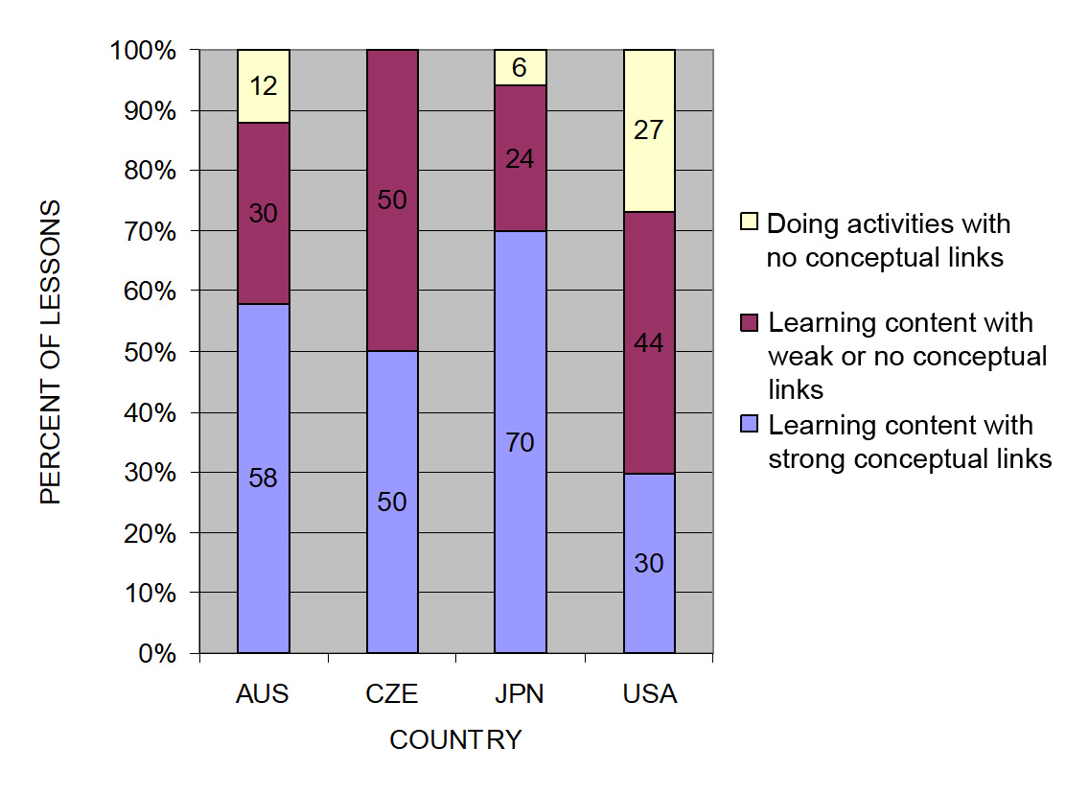
TIMSS: Conceptual Links
Source: TIMSS study
Notes:
3 min
a. Ask: “What do you notice from this graph? What do you make of this data?”
b. Emphasize: “In the US, more than a quarter of the lessons had no science content; whereas in the other countries, the majority of the randomly selected lessons (or typical lessons) had content with strong conceptual links.”
c. Example of a lesson with no science content: “What’s a science lesson with no content? In this research, a lesson with at least one complete statement of a science idea was scored as ‘learning content.’ Lessons with ‘no content’ had only topic-level mentions of science concepts. For example, one teacher started a lesson by telling students to take out their rockets and get to work. They had directions to follow, but the teacher’s only focus in his interactions with students was on how to build the rockets. At the end of the lesson, he told students to clean up and then dismissed them. This is a lesson with no science content!”
Other key ideas to highlight:
Each higher-achieving country engaged students with core science concepts and ideas (more consistently than the US).
All the higher-achieving countries linked ideas and activities (more consistently than the US).
In US lessons, the focus was on performing activities with less attention to content and even less attention to linking activities and science ideas.

Slide 31
What Makes a Difference?
Watch two video clips of 8th-grade science:
  A US classroom
  A Japanese classroom
What did you notice about these two classrooms?
In which classroom are students more likely to learn? Why do you think so?
Link to TIMSS US video clip: 1.1_TIMSS_US_Lesson3_c1
Link to TIMSS Japan video clip: 1.2_TIMSS_Japan_Lesson_c1_1
Notes:
20 min
a. Direct participants to the transcripts for Video Clips 1.1 and 1.2 (handouts 1.2 and 1.3) before showing each clip.
b. Show US classroom video: Ask participants to focus on what is going on with the science content and storyline.
c. Discuss: “What did you notice?”
Key ideas to emphasize and link back to the results include the following:
The teacher focuses on the activity and the procedure needed to complete the activity.
The teacher and students place no real focus on important science ideas.
There’s only a topic-level mention of science ideas (“pulleys,” “effort distance,” “resistance force”).
d. Show Japanese classroom video: Ask participants to focus on what is going on with the science content.
e. Discuss: “What did you notice?”
Key ideas to emphasize and link back to the results include the following:
Content ideas are made clear to students (focus question, pairs talk) before doing any activity.
Students are asked to talk about science ideas, not just procedures.
The lesson purpose is made clear to students.
f. Ending discussion: “In which classroom are students more likely to learn science concepts? Why?”
Note: Participants may be critical of both classrooms because student thinking isn’t made visible. This is true, but bring their focus back to the science content and storyline. They should see a clear distinction between the science content storylines in the Japanese and US lessons. Students in the Japanese classroom are more likely to learn because science-content ideas are made visible, and students are engaged in thinking about these ideas, not just science activities.

Slide 32
The TIMSS Findings Show …
Each higher-achieving country engaged students with core science concepts and ideas.
All the higher-achieving countries linked ideas and activities.
In US lessons, the focus was on performing activities with less attention to content and even less attention to linking activities and science ideas.
Notes:
1 min
a. Use this slide and the next to summarize key ideas from the TIMSS video study.

Slide 33
What Can We Learn from the Research?
A coherent science content storyline can …
make science ideas more prominent in science lessons,
  strengthen connections among science-content ideas,
  strengthen connections between science-content ideas and activities, and
improve lesson coherence by shaping science lessons as stories that make sense to students.
For more insights, see TIMSS Educational Leadership article, “What Science Teaching Looks Like: An International Perspective” (handout 1.4 in binder).
Notes:
1 min
a. After reading this slide, share with participants that the Science Content Storyline Lens addresses the need uncovered in the TIMSS video study: to strengthen the links between science ideas and lesson activities.
b. Encourage participants to read handout 1.4 (TIMSS Educational Leadership article) for further insight.

Slide 34
Discussion Questions
What new features can we add to our earlier description of effective science teaching?
Are there any ideas we should add to our list, modify, or delete?
Notes:
5 min
a. “What features on our list of ideas about effective science teaching are consistent with the TIMSS video-study findings?”
b. “Are there any ideas you’d like to add to our list, delete, or modify?”
Note: Use a different color to add/delete/modify ideas. Encourage participants to keep an open mind about changing their ideas. Provide opportunities for them to reflect on any changes and the reasons for those changes.
c. Transition: “During week 2 of the Summer Institute, we’ll focus on strategies for creating a strong, coherent science content storyline. This week, we’ll focus on the Student Thinking Lens. Right now, let’s consider the reasons for this focus.”

Slide 35
Lesson Analysis Focus Question
What are the STeLLA lenses and teaching strategies, and what is the evidence that they will make a difference in your science teaching?
Student
Thinking
Lens
Science
Content
Storyline
Lens
Notes:
Less than 1 min
a. “At this point, we’ll transition from a focus on the Science Content Storyline Lens (SCSL) to the Student Thinking Lens (STL).”
b. “We’ll be focusing on the Student Thinking Lens the rest of the day and throughout this week.”

Slide 36
Research on How Students Learn
Respond in your notebooks to the following question:
    Imagine that a seed is planted in the ground and grows into a tree. Where does most of the matter come from that makes up the wood and leaves of the tree?
We won’t share our responses with the whole group.
Notes:
3 min
a. Individuals: Have participants answer the question on the slide in their science notebooks.
Background for PD leaders: Participants will likely have the same misconceptions revealed in the video, but they may not yet be comfortable sharing their confusion. At this point, don’t ask them to share their ideas with the group. It will be interesting to see if some of them are willing to share their “wrong” ideas after they see the video.

Slide 37
Minds of Our Own
Minds of Our Own is a video that visually summarizes a large body of research on student learning in science classrooms.
As you watch, think about the following questions:
How do Harvard graduates answer the question about the mass of a tree? Is their response the same as or different from yours?
Does this give you any new ideas about effective science teaching?
Link to Minds of Our Own video clip.
Notes:
10 min
a. Read the information and instructions on the slide.
b. Watch the Minds of Our Own Lessons From Thin Air video. Total viewing time is approximately 10 minutes. (https://www.learner.org/series/minds-of-our-own/2-lessons-from-thin-air/?jwsource=cl)
MIT/Harvard interview—start at segment 3:30 and end at 5:40.
John preinterview, class, and post interview—start at segment 7:50 and end at 16:45.
Note: If time is short, stop after Phil Sadler. If you have enough time, you can show the entire segment from 3:30 to 16:45.

Slide 38
Discussion Questions
What did you notice in the Minds of Our Own video?
What does research on learning say to us about effective science teaching?
What new features can we add to our description of effective science teaching?
Notes:
15 min
a. There’s a lot to talk about in this video! Here are some additional questions you might pose:
Did John’s ideas about photosynthesis change through instruction?
What did the teacher say about his instruction?
What did the experts say?
How do the Harvard students’ responses compare with your own? What ideas does this give you about your own science learning experiences?
Key idea to emphasize: Research shows that we not only need to engage students in more thinking and sensemaking, but we also need to listen to their ideas—especially when they’re wrong—and use them to guide our instruction.
b. Modify the chart of ideas about effective science teaching as participants share features from the research.

Slide 39
What Can We Learn from the Research?
A Student Thinking Lens can …
reveal, support, and challenge student thinking throughout instruction;
provide opportunities for students to analyze and interpret data, as well as construct arguments and explanations;
engage students in making connections between ideas and activities; and
provide structures to teach students how to communicate in scientific ways.
For more insights, see “Synthesis of Research from How Students Learn: Science in the Classroom” (handout 1.5 in binder).
Notes:
2 min
a. “This slide nicely summarizes some of the ways we get students thinking and make their thinking visible.”
Note: Encourage participants to read handout 1.5 (“Synthesis of Research from How Students Learn: Science in the Classroom”) for further insight.
b. Transition: “Today we’ll start learning some particular strategies for making student thinking more prominent in science lessons.”
Background for PD leaders: The STeLLA conceptual framework addresses the need uncovered in this and other studies on how people learn and, more specifically, how students learn science.
If students’ initial knowledge is not engaged, they may fail to grasp the new concepts and information that are taught and may distort the new information to make it fit their prior experience.
This idea of learning with understanding has two parts: (1) factual knowledge must be placed in a conceptual framework (a big idea or a set of big ideas) organized in ways that enable students to use and apply that knowledge to make predictions, solve problems, explain new situations, and so forth; and (2) multiple representations that are rich in science ideas and details give concepts meaning.
This idea helps students monitor their developing understandings, engaging them in reflecting on their learning experiences, their changing ideas, and their remaining questions and musings.

Slide 40

Water Cycle
SCIENCE CONTENT DEEPENING Grade 5
Notes:
Note: Throughout this content deepening phase, refer as needed to the Water Cycle Content Background Document and The Water Cycle and Conservation of Matter: Learning Goals for Students and Teachers.
PD leader talk: “Now let’s begin our content deepening work on the water cycle.”
Timing note: To keep things moving so you don’t run out of time during this phase, adhere as closely as possible to the time you’ve allotted for each slide. If you’re running short on time, you may need to abridge or skip some of the group discussion.

Slide 41
Main Learning Goal
Explain the phenomena of the water cycle by examining the nature of water molecules.
Notes:
PD leader talk: “The main goal of this content deepening phase is to explain the phenomena of the water cycle by examining the nature of water molecules.”

Slide 42
Content Deepening Focus Questions
Why do bonds form in water?
How do water molecules interact with each other?
How do the interactions among water molecules change as energy is gained?
Notes:
PD leader move: Read each focus question on the slide and assure participants that they’ve acquired knowledge about water over the years, and you hope to enrich their ability to teach the water cycle. To ensure that all Teacher Leaders feel prepared to elicit, probe, and challenge student thinking that will be made visible during the actual lesson, some topics covered will exceed the students’ level of knowledge.
Note: Throughout this content deepening phase, refer as needed to The Water Cycle and Conservation of Matter: Learning Goals for Students and Teachers and the Water Cycle Content Background Document.

Slide 43
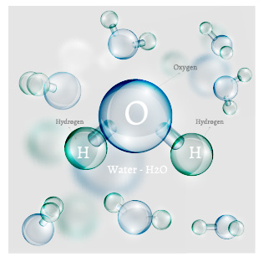


What Is Water?
Water is a transparent fluid that forms the world’s streams, lakes, oceans, and precipitation.
Photo used with permission by BSCS
Photo courtesy of Pixabay.com
Photo courtesy of Freedesignfile.com
Notes:
PD leader talk: “Water is a transparent fluid that forms the world's streams, lakes, oceans, and precipitation. I’d like you to perform a 30-second quick write charting any physical and chemical properties of water you can recall.”
PD leader move: Following the quick write, ask participants to form small groups and chart their responses on chart paper.
PD leader move: Each small group should share their compiled lists with the whole group. Don’t offer any feedback. Simply use this time to make group knowledge visible and note similarities among the small groups.
PD leader talk: “Among some of the similarities on your charts, I noticed the words atoms and bonds. To further explore the meanings of these terms, we may need to review a few aspects of the periodic table and quantum mechanics.”

Slide 44
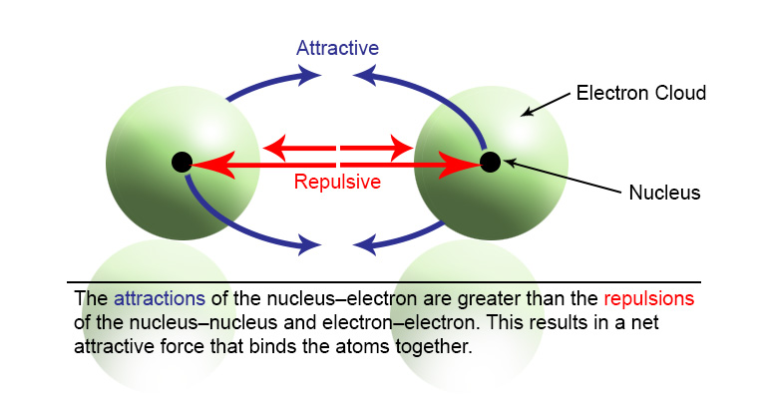
Bonding in Molecules
The positively charged nuclei of two atoms actually repel each other. But bonds are phenomena that bring two atoms together. This bonding results from the sharing of electrons between the two nuclei, which has a stabilizing effect!
Notes:
Chapter 7: Covalent Bonds and Molecular Structure
2/5/2020
Copyright © 2011 Pearson Prentice Hall, Inc.
44
Note: Hide the diagram on the slide initially.
PD leader talk: “Similar to hydrogen and oxygen in water, each atom each consists of a nucleus that contains protons (+) and neutrons (-). The presence of negatively charged electrons balances the positive charge of the nucleus. For the next 2 minutes, work with your elbow partner to develop a picture or model to explain why atoms bond with each other.”
PD leader move: When time is up, have one or two volunteers share their drawings with the group. Remind participants that you would like them to include a nucleus in their pictures; then advance the PowerPoint animation so the diagram of two atoms is visible. Have participants add to their models to reflect the model on the slide.
PD leader talk: “The positively charged nuclei of the two atoms actually repel each other. This makes sense because two friends with tempers usually can’t coexist. But in all relationships, bond formation is a phenomenon that brings two atoms or two people together. In life, even when it’s difficult to get along with spouses, partners, other staff members, or teammates, we find a way to make things work because there is strength in numbers. In atoms this results from two nuclei sharing electrons. The attraction of the nuclei to the negatively charged electrons overcomes the repulsion I mentioned earlier. The sharing of electrons has a stabilizing effect and explains why bonds form between atoms. Likewise, sharing our resources as teachers has a stabilizing effect on our jobs from day to day.”

Slide 45
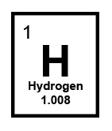
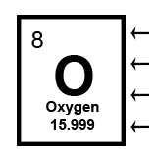
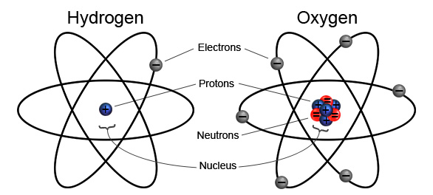
Atomic Structure
Hydrogen has an atomic number of 1 and a mass of 1. Therefore, it possesses 1 proton and 1 electron.
Oxygen has an atomic number of 8 and a mass of 16. Therefore, it possesses 8 protons, 8 neutrons, and 8 electrons.
Notes:
Note: Show only the atomic model on the slide initially.
PD leader talk: “I’m sure this discussion has raised even more questions for you! So let’s use this atomic model developed by a scientist named Ernest Rutherford to see how the atomic number we identified relates to atomic structure. Take a few minutes to see if you can unlock the code.”
PD leader move: When time is up, (1) chart any patterns the group is able to identify; (2) then reveal and discuss the findings on the slide.
PD leader talk: “You’ve discovered the code! Atomic number indicates how many electrons are in an atom. So hydrogen has 1 electron to match its atomic number of 1. Hydrogen also has a mass of about 1 atomic mass unit (amu), which indicates the nucleus of hydrogen has 1 proton. In the end, the number of protons and electrons balance each other.”
PD leader move: Someone in the group may wonder why the mass of hydrogen is 1.008 instead of exactly 1.00. Explain that this is a weighted average that also accounts for hydrogen isotopes that can have various numbers of neutrons in the nucleus. But since this is rare, it should be emphasized.
PD leader move: Next, have the group unlock the code for oxygen.

Slide 46
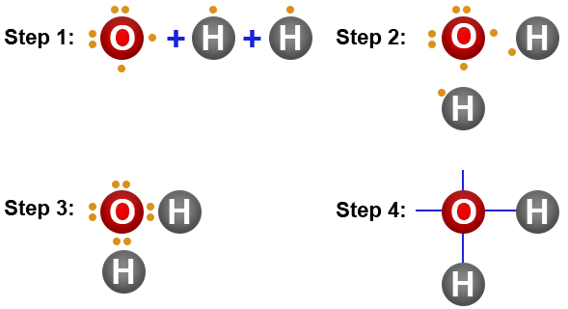
Lewis Dot Structures
Gilbert Lewis (UC Berkeley, 1916) proposed representing the outer electrons of an atom as dots used in bonding.
Notes:
PD leader talk: “Gilbert Lewis, a professor from UC Berkeley, was the first scientist to propose the dot-structure model to illustrate electrons in 1916. Lewis displayed only the outermost electrons in the outermost shell because bonds are made using the outermost surface of an atom. Electrons in the inner core are unaffected. Likewise, humans typically form initial bonds and attractions based on outward appearances. We don’t form close friendships until we really get to know what others are like at the core. Atoms are the same.”
PD leader talk: “Let’s use this Lewis dot-structure model to show how hydrogen and oxygen atoms share electrons by forming bonds:
“Step 1: A water molecule has 1 oxygen atom with 6 outer-shell electrons and 2 hydrogen atoms with 1 outer-shell electron.
“Step 2: Each hydrogen atom needs to share 1 electron from the oxygen atom (and vice versa) to gain stability. So the atoms arrange themselves to make this a reality.
“Step 3: Once the atoms are close enough, the electrons are shared, and two bonds are formed.
“Step 4: A single line between these bonds indicates that the electrons of each atom are being shared.”
PD leader move: Explain that the additional electrons surrounding the oxygen atom that are not involved in a bond with the hydrogen are key for the next content deepening phase.

Slide 47
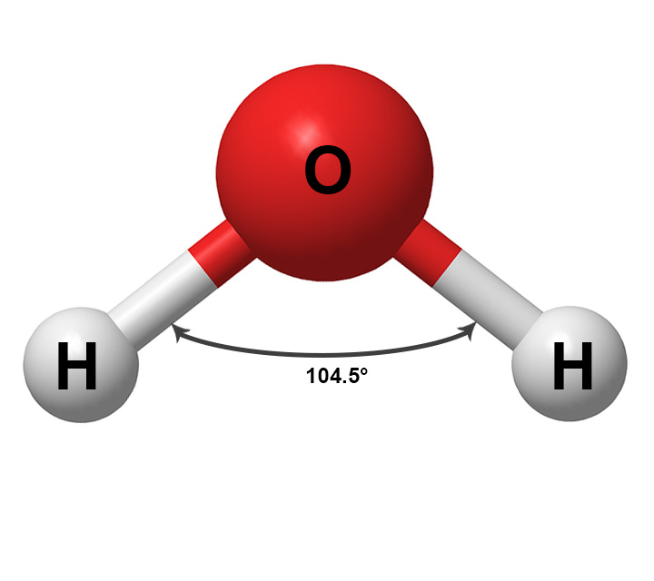
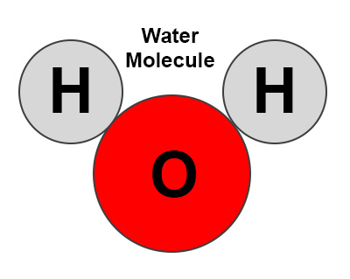
Drawing Water Molecules
Practice drawing three water molecules in your notebooks using the following Mickey Mouse model:
Notes:
PD leader talk: “The Lewis dot-structure theory has been awarded four Nobel Prizes in chemistry and physics over the years. Our students won’t need to know the theory itself, but they’ll need to recognize water as a molecule with 1 oxygen and 2 hydrogen atoms and be able to draw a Mickey Mouse model. Take 5 minutes to (1) build a water molecule using a ball-and-stick model in which the wooden pegs represent a bond; and (2) draw three Mickey Mouse water molecules in your notebooks.”
PD leader talk: “The hydrogen atoms are drawn as smaller circles because hydrogen has a smaller mass and fewer shells. This explains why the hydrogen atoms form Mickey’s ears, while the larger oxygen atom represents his head.”

Slide 48
Reflect: Content Deepening Focus Question 1
Why do bonds form in water?
Notes:
PD leader talk: “Reflect on our initial content deepening focus question for a moment; then take 5 minutes to write an answer in your notebooks, highlighting any additional understandings you’ve gained regarding this topic.”

Slide 49
Content Deepening: Focus Question 2
How do water molecules interact with each other?
Notes:
PD leader move: Read the second focus question and let participants know this content deepening work will (1) build upon previous knowledge they’ve gained, and (2) support their ability to elicit, probe, and challenge student thinking that will be made visible during the actual lesson.

Slide 50
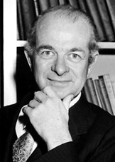
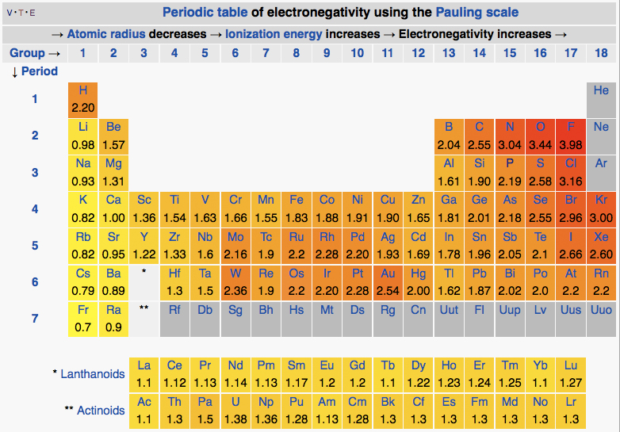
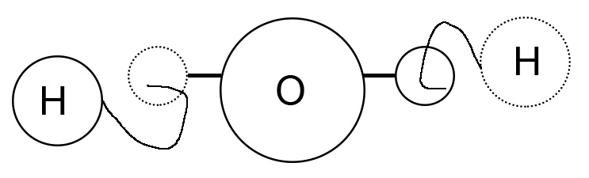
Linus Pauling: American Hero
Photo courtesy of Wikiquote.org
Courtesy of Wikimedia.org
Read “Linus Pauling: American Hero” (handout 1.8).
Notes:
Chapter 7: Covalent Bonds and Molecular Structure
2/5/2020
Copyright © 2011 Pearson Prentice Hall, Inc.
50
PD leader talk: “To understand how water molecules interact with each other, we need an additional model that explains the nature of these bonds. Let’s take a moment and read the handout titled “Linus Pauling: American Hero.”
PD leader move: Before participants begin reading, instruct them to underline any information they already understand and highlight any information that’s new to them.
PD leader move: Draw the group’s attention to the hydrogen-oxygen diagram on the slide and probe whether anyone can explain bonding in a water molecule using the hook-and-eye analogy.
PD leader talk: “What insights have you gained from the article regarding Gilbert Lewis’s description of a covalent bond in relation to an ionic bond?”
PD leader move: Give participants time to flesh out their thoughts.
PD leader talk: “Now let’s focus on developing definitions for an ionic bond and a covalent (nonpolar) bond.”
PD leader move: Develop group definitions on chart paper.

Slide 51
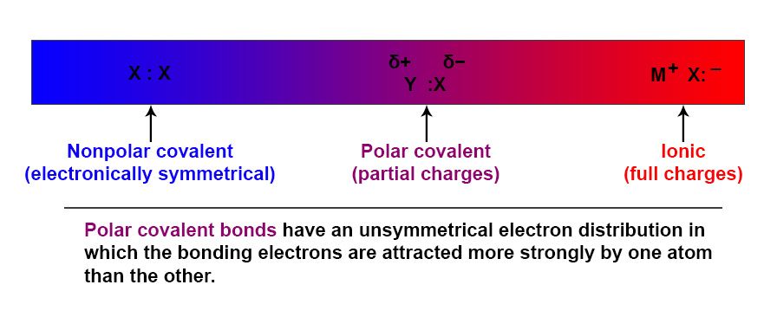
The Nature of a Bond
Electronegativity: The tendency of an atom in a molecule to attract and share electrons in a bond.
Notes:
Chapter 7: Covalent Bonds and Molecular Structure
2/5/2020
Copyright © 2011 Pearson Prentice Hall, Inc.
51
PD leader talk: “Linus Pauling proposed a type of bond represented in water that is known as a polar covalent bond. This notion was based on his theory of electronegativity—the tendency of an atom in a molecule to attract a shared electron in a bond. According to the Pauling electronegativity scale, oxygen has a greater attraction to the electrons shared in a water molecule.”
PD leader move: Ask participants to develop an electropotential map of a water molecule by placing a δ− or δ+ over the atoms to show the difference in how they will share electrons.

Slide 52
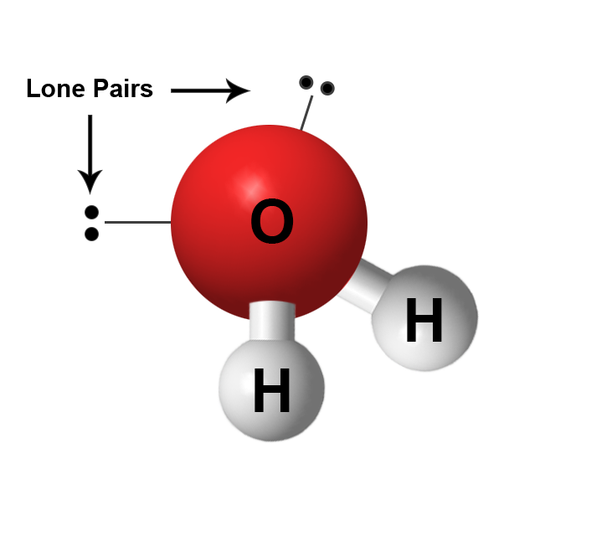

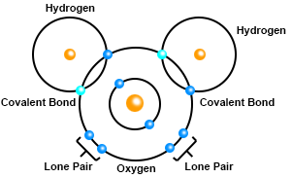
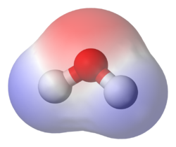
Polar Covalent Bonds in Water
Hydrogen and oxygen have different affinities for electrons, causing a dipole to form.
Notes:
PD leader talk: “Using the Pauling scale, we can develop three models of water molecules that incorporate all of our developed understandings. As we go around the room, would someone explain each of these diagrams?”
PD leader move: Highlight that the oxygen electrons that aren’t participating in a bond are sources of electron-density regions that are negatively charged based on polarity.
PD leader talk: “So if a water molecule has an electron-poor area and an electron-rich area, it’s almost as if it has poles (just like a magnet, where one region is negative and another region is positive). To simulate the electronegativity in a polar covalent bond, we’re now going to build another model of a water molecule that includes magnets with positive and negative poles.”
PD leader move: Instruct participants to build six water molecules using red oxygen atoms, white hydrogen atoms, and plastic sleeves.
PD leader talk: “Add magnets with the negative pole facing outward near the lone-pair electrons of the oxygen atoms.”
PD leader talk: “Next, add magnets with the positive pole facing outward near the hydrogen atoms.”
PD leader move: Use your own water molecule as a reference point to ensure that participants’ magnets are oriented correctly. Don’t answer questions, but if the construction is wrong, probe participants’ thinking.

Slide 53
How Water Molecules Interact
Build six water molecules using a model that includes magnets.
What major insights do you gain as the water molecules interact with each other?
Draw three water molecules in your notebooks using your new insights.
Notes:
PD leader talk: “Now that you have built your six water molecules, have them interact one on one and in large groups using the different poles.”
PD leader move: Have the group develop a response to the slide questions. Once consensus is reached, have a discussion about how water molecules interact with each other. Participants should reach a conclusion that based on the polarity of the bond, water molecules have temporary attractions to one another. Don’t call this interaction a hydrogen bond yet!

Slide 54
Reflect: Content Deepening Focus Question 2
How do water molecules interact with each other?
Notes:
PD leader talk: “Take a few moments to reflect on our second content deepening focus question, and then write down your thoughts in a 2-minute quick write.”

Slide 55
Content Deepening: Focus Question 3
How do the interactions among water molecules change as energy is gained?
Notes:
PD leader move: Read the third focus question and remind the group that this content deepening work will (1) build upon the previous knowledge everyone has gained, and (2) support their ability to elicit, probe, and challenge student thinking that will be made visible during the actual lessons.

Slide 56
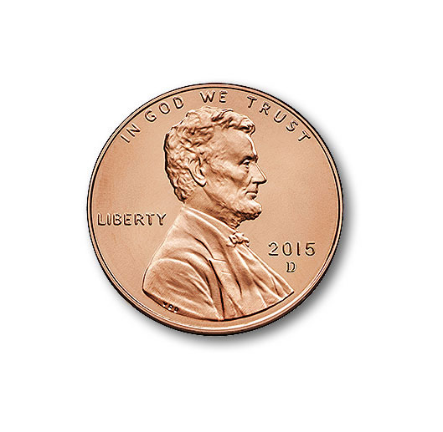


Interactions among Water Molecules
Definition of a solid: A solid has a defined shape and volume.
Photo courtesy of Pixabay.com
Photo courtesy of Wikimedia.org
Photo used with permission by BSCS
Notes:
PD leader talk: “Let’s begin by reviewing the definition of a solid. A penny, a soccer ball, and a cube of ice have a defined shape and volume, which makes each of them a solid.”

Slide 57

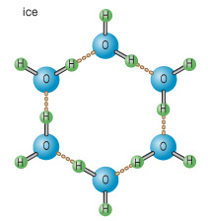
Interactions among Water Molecules
Redraw a solid-water (ice) lattice that includes six molecules of water participating in hydrogen bonds.
Solid-water (ice)
Photo used with permission from BSCS
Courtesy of Encyclopaedia Britannica,
© 2015, used with permission
Notes:
Note: Initially, reveal only the task and the ice-cube photo on the slide.
PD leader move: Have participants redraw a solid-water (ice) lattice that includes six water molecules participating in hydrogen bonds.
PD leader move: After participants have drawn their pictures, perform a gallery walk to identify key facets of various drawings that participants would like to include in their own. Encourage discussion to make their thinking visible.
PD leader move: Identify one drawing in which molecules are packed closely together.
PD leader move: Next, reveal the drawing of a solid-water (ice) lattice on the slide.
PD leader talk: “Can anyone find an interesting pattern in this drawing?”
PD leader move: Probe the thinking of group members to elicit the response that hydrogen bonds are visible through attractive (magnetic) forces in polar covalent bonds. These forces are shown with dotted lines because they aren’t actual bonds. They are temporary attractions between neighboring, partially negative oxygen atoms and hydrogen atoms with partial positive charges (similar to the attraction between magnets).
PD leader move: Have participants build a hexagon of water using the magnetic water molecules and highlighting H-bonds through magnetic attractions.
PD leader talk: “Finally, let’s explore this ice-crystal lattice model and then improve our individual solid-water drawings based on our new learning.”

Slide 58
Interactions among Water Molecules
Define a liquid:
Notes:
PD leader talk: “Next, I’d like you to develop a working definition of a liquid in your notebooks.”
PD leader move: Give participants enough time to develop a definition. Then have them compare definitions with their elbow partners.

Slide 59

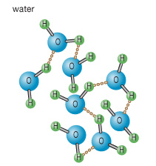
Interactions among Water Molecules
Definition of liquid: A fluid that conforms to the shape of its container. It is the only state in which water has a definite volume but no fixed shape.
Draw a beaker of liquid water that includes six molecules of water participating in hydrogen bonds.
Liquid water
Courtesy of Encyclopaedia Britannica,
© 2015, used with permission
Notes:
PD leader talk: “According to one definition I found, a liquid is ‘a fluid that conforms to the shape of its container. It is the only state in which water has a definite volume but no fixed shape.’ Are we all right with this as our working definition?”
PD leader move: Draw the group’s attention to the 200-ml beaker of water on a hot plate. Fill the beaker halfway with water and make sure to mark the starting volume. Ask participants to draw the beaker containing six water molecules. Encourage them to emphasize the magnetic interactions between the molecules.
PD leader move: Identify one drawing that emphasizes the proper hydrogen bonds, with the molecules a bit more spaced out compared to the solid-water (ice) version.
PD leader talk: “Remember, in a flowing liquid, water molecules are able to tumble past each other and are held together by temporary attractive forces.”
PD leader move: Start heating the beaker on the hot plate.
Note: Warn participants to stay away from the hot surface!

Slide 60

Interactions among Water Molecules
Define phase change:
Notes:
PD leader talk: “Now I’d like you to develop a working definition of a phase change in your notebooks.”
PD leader move: Have participants compare definitions with their elbow partners.

Slide 61
Interactions among Water Molecules
Definition of phase change: A transition between phases of the water cycle that typically involves the gain or loss of large amounts of energy.
Notes:
PD leader talk: “According to one definition I found, a phase change is ‘a transition that typically involves the gain or loss of large amounts of energy.’ Are we all right with this as our working definition?”

Slide 62
Interactions among Water Molecules
How does an absorption of energy affect the system? (Lessons 1a and 1b)
Can you draw how the system changes?
Notes:
PD leader talk: “Now that the water is boiling and a considerable amount of energy has been added to the system, draw another picture of how this system changes, using six water molecules.”
PD leader move: Participants will focus on the bubbles, but this is not the key finding. Probe their thinking as they consider what new phase some of the water molecules are transitioning to.
PD leader move: Encourage participants to include in their drawings water molecules in the liquid and gaseous phases in and around the beaker.
PD leader move: Ask participants to share their improved drawings with their elbow partners. Then facilitate a discussion of how energy absorbed by the water molecules increases their kinetic energy, thereby disrupting the H-bonds.
PD leader move: Point out that once enough energy is gained, the water molecules become a gas with no intermolecular attractions. The gas completely fills the environment above and beyond the beaker.

Slide 63
Reflect: Content Deepening Focus Question 3
How do the interactions among water molecules change as energy is gained?
Notes:
PD leader talk: “Take a few moments to reflect on our last content deepening focus question, and then write down your thoughts in a 2-minute quick write to conclude this phase.”

Slide 64
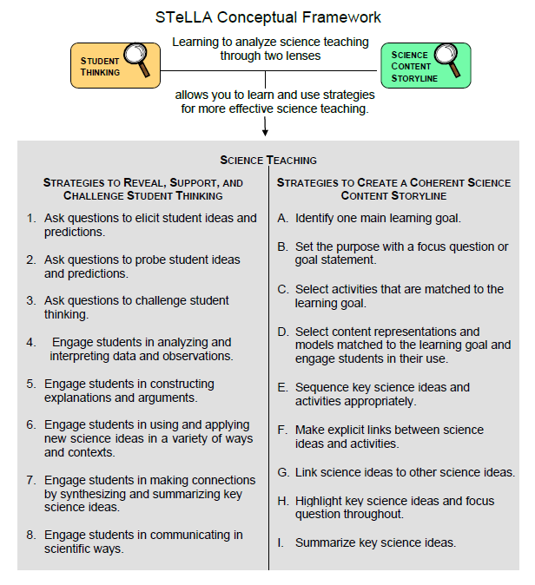
Lesson Analysis Focus Question
What are the STeLLA lenses and teaching strategies, and what is the evidence that they will make a difference in your science teaching?
Notes:
1 min
a. Read the focus question on the slide.
b. “This visual on this slide tells us a little about the first part of our focus question: What are the STeLLA lenses and teaching strategies? As you can see, there are eight specific science teaching strategies to support the Student Thinking Lens.”
c. Acknowledge: “I know you have existing frameworks (ideas and language) regarding teaching and learning, and I expect you’ll continuously draw from them throughout the Summer Institute.”

Slide 65
Lesson Analysis Focus Question
What are the STeLLA lenses and teaching strategies, and what is the evidence that they will make a difference in your science teaching?
Notes:
1 min
a. “Today we’ll begin learning about three of the Student Thinking Lens teaching strategies.
b. Read the strategies highlighted on the slide.
c. “These three types of questions will help reveal, support, and challenge student thinking.”
d. Emphasize: “Even though we’re studying the strategies this summer, you’ll better understand them as you start trying them out in your teaching next fall.”

Slide 66
Strategies 1, 2, and 3: Questions That Elicit, Probe, and Challenge Student Thinking
Student Thinking Lens: Strategies to reveal, support, and challenge student thinking.
  Strategy 1: Ask questions to elicit student ideas and predictions.
  Strategy 2: Ask questions to probe student ideas and predictions.
  Strategy 3: Ask questions to challenge student thinking.
Read and fill in the purpose and key features of each strategy on your blank STL Z-fold summary chart. Then share your charts with a partner.
Notes:
20 min
a. Orient participants to the STeLLA strategies booklet. Forecast that you’ll come back to this resource repeatedly to ensure consistent use of ideas, meaning, and language that match the STeLLA conceptual framework.
b. Individuals: Have participants read about all three strategies and write on their blank STL Z-fold summary charts the purpose(s) and key features of each strategy. State that in the future, they’ll do this kind of reading and writing as homework.
c. Pairs: Have participants pair up and share their Z-fold summary charts. Encourage them to provide evidence from the readings to support their ideas and ask each other questions consistent with the norms for working together, such as “Where did you find that?” or “I interpreted that differently.”

Slide 67
Elicit Questions
What are the purpose and key features of questions that elicit student ideas and predictions?
  Which question from the examples in the strategies booklet do you think would elicit the highest number of different student responses in your classroom? Why do you think so? (Cite ideas from the strategies booklet.)
Notes:
5 min
a. As a group, discuss the purpose and key features of questions that elicit student ideas and predictions. Write these features on chart paper and hang the chart where it can be referenced later.
b. Sample chart:
Key Ideas about Elicit Questions
Purpose: To reveal student ideas, predictions, misconceptions, and experiences before they learn about the content.
Key features:
Asked anytime, but often at the beginning of a lesson
Phrased in everyday language that students can understand even before studying the related content
Addressed to multiple students (usually the whole class)
Reveals a variety of student ideas
Useful to teachers in adapting instruction
Useful to students so they see that others have different ideas
Can be a prediction
Can set up a discrepant event

Slide 68
Probe and Challenge Questions
Probe Questions
What are the purpose and key features of questions that probe student ideas and predictions?
Challenge Questions
What are the purpose and key features of questions that challenge student thinking?
  Remember to cite ideas from the strategies booklet!
Notes:
13 min
a. Small groups (5 min): Split participants into two groups—one group for probe questions and one group for challenge questions. Have each group create a chart of the purpose and key features of the assigned strategy from the STeLLA strategies booklet (not from experience).
b. Whole group (8 min): Share the charts with the entire group. Encourage participants to add to, delete from, and modify them as needed to ensure they’re accurate and match the language in the strategies booklet.

Slide 69
Elicit versus Probe Questions
  What are some key differences between questions that elicit and questions that probe student ideas and predictions?
Notes:
5 min
a. Turn and Talk: “Discuss this question with an elbow partner.”
b. Whole-group share-out: Invite participants to share their ideas with the group.
Key ideas about elicit questions versus probe questions:
Elicit questions are addressed to the whole class; probe questions are addressed to individual students.
Elicit questions are used before students have studied a concept; probe questions can be asked at any time.
Elicit questions start a discussion; probe questions follow up on something a student has already said.

Slide 70
Elicit/Probe Questions versus Challenge Questions
  What are some key differences between questions that elicit and probe student ideas and predictions and questions that challenge student thinking?
Notes:
5 min
a. Turn and Talk: “Discuss this question with your elbow partner.”
b. Whole-group share out: Invite participants to share their ideas with the group.
Key ideas about elicit/probe questions versus challenge questions:
Elicit and probe questions focus on understanding students’ existing ideas rather than trying to change students’ thinking.
In contrast, challenge questions are designed to push students’ thinking toward more-scientific understandings and support them in changing their thinking.

Slide 71
The RESPeCT Lesson Plans Binder
What comes before the lessons?
  Scope and sequence
  Learning goals
  California NGSS
  Student pretest/posttest
  Features analysis chart
  Working with English language learners (ELLs) in science
Overview of lesson format and structure:
  Lesson overview
  Lesson outline
  Detailed lesson plan
Notes:
5 min
a. Foreshadow: “In a moment, we’ll review the details of a homework assignment related to the lesson plans you’ll be teaching in the upcoming school year.”
b. “But before we look at the assignment, let’s review the organization and contents of the lesson plans binder.”
c. Use the slide to guide participants through the binder contents.

Slide 72
Let’s Summarize Today’s Work!
We thought about what constitutes effective science teaching.
We examined the rationale for the Science Content Storyline Lens and analyzed the US and Japanese video clips from the TIMSS video study.
We examined the rationale for the Student Thinking Lens and watched the video of the Harvard and MIT graduates and John and his teacher.
We deepened our understandings of the interactions between water molecules.
We read and talked about the purposes and key features of elicit, probe, and challenge questions.
Notes:
5 min
a. Remind participants of the various activities they’ve been involved in today.
b. Foreshadow: Let participants know that you’re going to ask them to reflect on what they’ve learned from these activities.

Slide 73
How Did Today’s Work Help You Think about Our Focus Questions?
What are the STeLLA lenses and teaching strategies, and what is the evidence that they will make a difference in your science teaching?
Why do bonds form in water?
How do water molecules interact with each other?
How do the interactions among water molecules change as energy is gained?
(Lessons 1a and 1b)
Notes:
10 min
Note: If time is running short, you may want to skip the Turn and Talk or the entire slide.
a. Turn and Talk: “Discuss these questions with an elbow partner.”
b. Whole-group share-out: Invite participants to share their ideas with the group.

Slide 74
Extended Homework
Locate handout 1.7 (Extended Homework: RESPeCT Lesson Plan Analysis) in your PD program binder .
Between now and Friday, read the scope and sequence for the set of lessons and your assigned lesson plan in the lesson plans binder.
Be prepared to share your findings about your assigned lesson plan in a study-group conversation on Friday.
Notes:
5 min
a. Assign each participant one of the lessons in the Water Cycle lesson-plan sequence. There are six 2-part lessons in this content area. Each teacher should take responsibility for one 2-part lesson. That is, Teacher 1 will study lessons 1a and 1b; Teacher 2 will study lessons 2a and 2b; and so forth.
b. If the study group is small, figure out who will be assigned an extra lesson (or when you, as the PD leader, will cover any extra lessons).
c. If the study group is large, assign lessons to more than one teacher later in the sequence.
d. Go over the homework sheet (handout 1.7) with participants. If time allows, have them read the assignment sheet before discussing.

Slide 75
Reflections on Today’s Session
Complete the Daily Reflections sheet.
What were your first reactions to the STeLLA claim that it’s important to plan and analyze science teaching through the Student Thinking Lens and the Science Content Storyline Lens? What was convincing or not so convincing for you and why?
What questions do you have about what happens to molecules of water at various points of the water cycle?
Provide feedback about today’s session and the program so far (likes, dislikes, questions, concerns, suggestions).
Notes:
5 min
a. Review the questions on the Daily Reflections sheet (handout 1.8).
b. Ask participants to think about these questions and write down their reflections.

