Slide 1




RESPeCT PD pROGRAM
Day 4
RESPeCT Summer Institute
Notes:
5 min
a. Take care of any housekeeping issues.

Slide 2
Agenda for Day 4
Day-3 reflections
Importance of STL strategy 5: constructing explanations
Introducing Student Thinking Lens strategy 6
Lesson analysis: STL strategy 6
Review: STL strategies 1–6
Water Cycle lesson plans review
Lunch
Content deepening: water cycle
Summary, homework, and reflections
Notes:
3 min
a. Talk through the agenda for the day.

Slide 3
Trends in Reflections
Lesson Analysis | Science Content Learning
Notes:
5 min
a. Invite participants to look at your feedback on their reflections from day 3 and offer reactions, comments, or follow-up questions.

Slide 4
Today’s Focus Questions
Why is it necessary to engage students in using and applying new science ideas in a variety of ways and contexts?
How will the Student Thinking Lens strategies help you teach the Water Cycle lessons?
What are the two basic steps of cloud formation?
How does the process of distillation simulate the overall water cycle?
Notes:
1 min
a. Introduce the focus questions that will guide today’s work.
b. “Like STeLLA strategies 4 and 5, the goal of strategy 6 is to move student thinking forward toward deeper understandings of science ideas.”

Slide 5
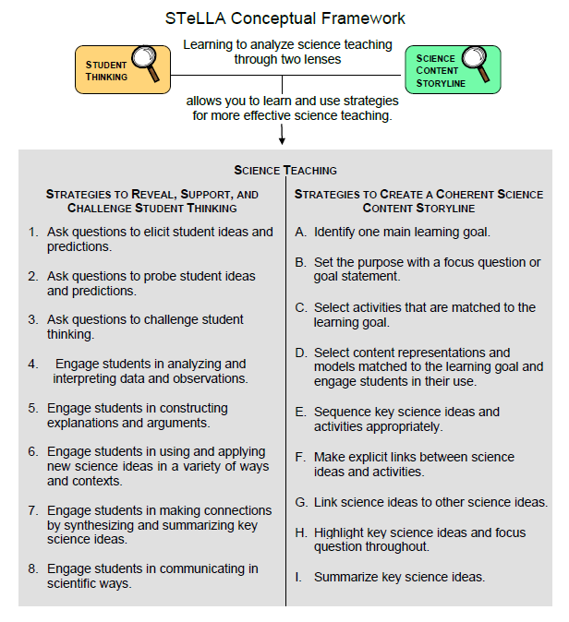
Notes:
1 min
a. Draw participants’ attention to the new strategy highlighted on the slide.
b. “Strategy 6 is the third STL strategy that is a type of activity designed to move student thinking forward.”

Slide 6
The Importance of Engaging Students in Constructing Scientific Explanations
Read handout 4.1 and your group-specific handout. Then complete the assigned task:
Group 1: Analyze a student explanation (handout 4.2).
Group 2: Summarize benefits for students of constructing scientific explanations (handout 4.3).
Group 3: Summarize the benefits for teachers of engaging students in constructing scientific explanations (handout 4.3).
Notes:
25 min
Note: If you need some time to catch up on day-3 activities, you can skip this slide. However, this activity is beneficial for reviewing strategy 5 (constructing explanations) and helping participants understand why explanation building is such important work in science and beyond.
Timing note: For this segment, allot 5 minutes for reading, 10 minutes to prepare for a group share-out, and 10 minutes for the share-out.
a. Divide participants into three groups or pairs. Assign each group a number (1, 2, 3).
b. Direct participants to three handouts:
Importance of Engaging Students in Constructing Scientific Explanations (handout 4.1 in PD program binder) (This handout describes what groups are to do with the following two handouts.)
Student Work from Zembal-Saul Book What’s Your Evidence? (handout 4.2 in PD binder) (Group 1’s task is linked to this handout.)
Benefits of Engaging Students in Constructing Scientific Explanations (handout 4.3 in PD binder) (Tasks for Groups 2 and 3 are linked to this handout.)
c. After participants have read the designated handouts for their groups and completed their assigned tasks, invite them to share out.

Slide 7
The CERA Framework for Constructing Scientific Explanations
Next, we’ll watch video clip of a 3rd-grade teacher instructing students how to construct scientific explanations.
Think about ideas this clip gives you for helping your students learn to construct scientific explanations by making a claim, supporting it with evidence and reasoning, and considering alternative explanations and strategies (CERA).
Link to Introducing the CER video clip.
Notes:
10 min
Note: This activity is optional but powerful.
a. “Let’s watch how one 3rd-grade teacher taught her students to construct scientific explanations. This is the teacher whose student writing Group 1 just read about. The class in this video clip has been studying simple machines (such as pulleys and levers).”
b. “We’re not going to analyze this video clip in terms of STeLLA strategies. Instead, think about ideas this gives you as to how you might introduce your students to the CERA framework for constructing scientific explanations, which involves making a claim, supporting it with evidence and reasoning, and suggesting alternatives.”
c. After watching the clip, discuss participants’ reactions and any ideas it gave them about how they might help their students learn to construct strong scientific explanations.
Note: Make sure participants are aware that in addition to using the CERA framework as a tool for teaching students how to develop scientific explanations and arguments (STeLLA strategy 5) in the classroom, they will be using the same framework for videocase-based lesson analysis of their science teaching in RESPeCT study groups throughout the school year.

Slide 8
Introducing STL Strategy 6
Engage students in using and applying new science ideas in a variety of ways and contexts.
What are the purpose and key features of this strategy?
Why do you think use-and-apply questions or activities are often shortchanged in science teaching?
Notes:
20 min
a. Small groups (10 min): Divide teachers into two groups to make charts highlighting the purpose and key features of strategy 6: Engage students in using and applying new science ideas in a variety of ways and contexts. Encourage participants to refer to the STeLLA strategies booklet and STL Z-fold summary charts for this activity.
b. Whole group (10 min): Have groups present their charts in a whole-group share-out and compare them. Ask participants, “What differences and similarities do you notice when you compare your charts with those of other groups?”
Key ideas:
Strategy 6 is a time for “strategic telling” and making sure students are using science ideas accurately.
A use-and-apply question or activity occurs after students have experienced/encountered a new science idea. It provides an opportunity for students to use and apply the idea in a new context or novel way and/or link two or more ideas together.
A common misconception is that use-and-apply questions or activities assess student learning. Teachers often talk about asking these kinds of questions on tests. However, according to research findings published in How People Learn (National Academy of Sciences, 2000) , application is part of the learning process, or developing a conceptual framework. If application is treated like assessment, students may encounter a use-and-apply question on a test without ever having had the opportunity to practice this way of thinking as part of their learning.

Slide 9
Lesson Analysis: Focus Question 1
Why is it necessary to engage students in using and applying new science ideas in a variety of ways and contexts?
Notes:
Less than 1 min
a. Highlight the focus question that will guide the lesson analysis work during this phase.

Slide 10
Lesson Analysis: Review Lesson Context
Read the lesson context for this video clip at the top of the transcript (handout 4.4 in your PD program binder).
Notes:
2 min
a. “Read the lesson context at the top of the video transcript (handout 4.4 in your PD program binders).”
b. Make sure participants understand the science content and activity that are the focus of this video clip.
Note: Refer to the Water Cycle Content Background Document as needed throughout the lesson analysis.

Slide 11
Lesson Analysis: Identify Strategy 6
  What makes this a use-and-apply task? (Focus on task.)
  What science ideas does each scenario require students to use and apply?
      2 cups of water (days 1 and 10)
      Cup of water in sealed plastic bag
      Cold water bottle
      Cold can of soda
      Teakettle
      What do you notice about the types of questions the teacher asks during the clip?
Link to video clip 1: 4.1_stella_WC_dieken_c1
Notes:
25 min
a. “As you watch the video, think about what makes the activity in this clip a use-and-apply task. What science ideas should students be using and applying in each scenario? Also notice what kinds of questions the teacher asks.”
b. Show the video clip.
c. Individuals: “Think about the questions on the slide and mark the transcript as you identify the use of strategy 6.
d. Whole group: Discuss participants’ responses to the questions.
Ideal observations:
a. This is a use-and-apply task because students in the video clip are using science ideas they have previously studied to explain five different scenarios. Thus, they are using new science ideas to explain a variety of contexts.
b. All of the scenarios challenge students to think about changes in heat energy and how they affect water molecules and changes of state in the water cycle.
Scenario 1 focuses on evaporation.
Scenario 2, the cup of water in the plastic bag, demonstrates both the evaporation of water molecules from the cup and the condensation of water on the inside of the baggie (changing from water vapor back to liquid water as heat energy is lost).
Scenarios 3 and 4 (cold water bottle/cold soda can) both demonstrate condensation. Water-vapor molecules in the air near the cold can or bottle lose heat energy, slow down, and join together to form droplets of liquid water.
Scenario 5, the teakettle, illustrates both evaporation and condensation. As the water boils, water molecules in the liquid state speed up, move apart, and escape into the air as water vapor. At the end of the spout, you see nothing—water vapor is there but invisible. Then the water vapor cools (loses heat energy) as it hits the cooler air above the spout, causing the molecules to slow down, move together, and form liquid-water droplets in the air above the spout. This cloud of water droplets is called steam. As these droplets collide with faster-moving water-vapor molecules in the air, they quickly gain energy, speed up, and evaporate again.
c. The video clip appropriately includes challenge questions (and statements) because the goal of strategy 6 is to move student thinking forward. (See examples of the teacher challenging students in video segments 19:58, 21:10, 21:25, 22:32, 22:37, 22:41, 23:17, 23:26, 24:35, 24:44, 24:46, 24:50, 25:05, and 25:20.)
Note : For examples of strategy 6, see PD Leader Master: 5th-Grade Guide to Video Clips for Day 4.

Slide 12
Lesson Analysis: Analyze Strategy 6 and Reflect
Analyze:
  What student thinking is revealed by engaging students in using and applying new science ideas? By providing a claim, evidence, and reasoning?
Reflect:
  What did you learn about strategy 6 from watching and analyzing this video clip?
Notes:
25 min
a. Individuals: “For the analysis question on the slide, study the video transcript and come up with a claim, evidence, and reasoning to support your claim.”
b. Whole-group share-out: As participants share their claims, evidence, and reasoning, encourage them to challenge one another by asking questions, disagreeing, and suggesting improvements or alternative explanations and arguments. (Refer to the norms at the heart of the RESPeCT program.)
Note: You may also want to ask participants whether they noticed in the transcript any missed opportunities for engaging students in using and applying new science ideas.
c. Reflect (1 min): Give participants time to think about the reflection question on the slide.
d. Whole-group discussion: Discuss the reflection question as a group. Make sure participants note specifically what they learned about strategy 6 from watching and analyzing this video clip.
Note: For examples of strategy 6, see PD Leader Master: 5th-Grade Guide to Video Clips for Day 4.

Slide 13
Check Your Understanding of Strategy 6
  Jot down your responses to this multiple-choice quiz:
  Use-and-apply tasks are used [before/during/after] new science ideas are introduced.
  For difficult content ideas, students might need to practice applying new ideas in [one/two/many] different contexts.
  [True/false]: Use-and-apply questions or activities are used primarily for student assessment at the end of a unit.
  It’s appropriate for teachers to ask [elicit/probe/challenge] questions during a use-and-apply activity.
  Teachers should [never/judiciously/always] tell students about science ideas they are missing or stating inaccurately.
Notes:
5 min
Note: This activity is optional if time is running short.
a. “To check your understanding of STL strategy 6, jot down your responses to this multiple-choice quiz.”
b. Have participants discuss their answers either in pairs or as a group. (If time is short, just read the answers aloud.)
Answer key:
After
Many
False
Challenge (and probe)
Judiciously (defined as “good or discriminating judgment; wise, sensible, or well advised”)

Slide 14
Reflect: Lesson Analysis Focus Question 1
Why is it necessary to engage students in using and applying new science ideas in a variety of ways and contexts?
Notes:
3 min
a. Individuals (1 min): “Think for a moment about how you would answer the focus question on this slide.”
b. Whole-group share-out (2 min): Have a few participants share their ideas.

Slide 15
Lesson Analysis: Focus Question 2
How will the Student Thinking Lens strategies help you teach the Water Cycle lessons?
Notes:
Less than 1 min
a. Transition: “Now we’ll shift our attention to the second lesson analysis focus question and spend some time summarizing what we’ve learned so far about Student Thinking Lens strategies 1–6. Then we’ll review the Water Cycle lesson plans and highlight how these strategies are used in the lessons you’ll start teaching in January.”

Slide 16
Notes:
Less than 1 min
a. “These are the Student Thinking Lens strategies we’ve explored so far. You’ll get practice using them as you teach the Food Webs and Water Cycle lessons next year.”

Slide 17
Review: Student Thinking Lens Strategies
Review the STL summary chart in the STeLLA strategies booklet and discuss these questions:
What pattern(s) do you see in this arrangement (organization) of the STL strategies?
How does this arrangement (organization) highlight the differences and similarities among the Student Thinking Lens strategies?
Notes:
3 min
a. Individuals: Have participants review STL strategies 1–6 on the summary chart in the strategies booklet (Summary of STeLLA Student Thinking Lens Strategies).
b. Whole group: Discuss the questions on the slide.
Key ideas:
Strategies 1–3 are types of questions, and strategies 4–6 are activities designed to move student thinking forward toward more-scientific understandings.
Some strategies are used at any time during the lesson (e.g., probe questions); others are used at specific times (e.g., elicit questions used before students have been introduced to new science ideas; use-and-apply activities used after students have been introduced to new science ideas).
Each strategy has it’s own specific purpose(s), but the strategies are closely connected to one another. That is, these strategies aren’t used in isolation; they’re complementary.

Slide 18
Lesson Analysis: Review Lesson Context
Read the lesson context for this video clip at the top of the transcript (handout 4.5 in your program binder).
Notes:
1 min
a. “Read the lesson context at the top of the video transcript (handout 4.5 in your program binders).”
b. Make sure participants understand the science content and activity that are the focus of this video clip.

Slide 19
Lesson Analysis: Identify Student Thinking Lens Strategies
  What Student Thinking Lens strategies can you identify in this video clip?
  After watching the video, study the transcript (handout 4.5) and fill in handout 4.6 (Identifying Student thinking Lens Strategies).
  Be ready to share your findings with the group, including any missed opportunities.
Link to video clip 2: 4.2_stella_WC_Anderson_c1
Notes:
30 min
Note: If absolutely necessary, you can skip this video analysis.
a. Orient participants to handout 4.6, Identifying Student Thinking Lens Strategies.
b. Make sure participants understand the context of the video clip (from the transcript). Emphasize that students in the clip have already learned about molecules gaining and losing energy during evaporation and condensation. Also emphasize that students are making predictions about the water-changes system, but they haven’t yet observed this system in action.
c. Show the video clip.
d. Individuals: “Study the video transcript and complete handout 4.6, Identifying Student Thinking Lens Strategies.”
e. Whole group: “What STL strategies did you identify in the video transcript? Did you spot any missed opportunities?”
Note: For examples of STL strategies, see PD Leader Master: 5th-Grade Guide to Video Clips for Day 4.

Slide 20
RESPeCT PD Program School-Year Plan
Summer Institute
Content deepening: Water Cycle and Food Webs |  | Lesson analysis: Introduction to the STeLLA framework and strategies
Fall Study-Group Sessions
Fall Teaching Rounds 1 and 2 | Use the STeLLA strategies while teaching lessons on food webs. Analyze student thinking and science content storylines using video from our own classrooms. Deepen content knowledge of food webs through lesson video analysis. |  | Food Webs
Spring Study-Group Sessions
Spring Teaching Rounds 1 and 2 | Use the STeLLA strategies while teaching lessons on the water cycle. Analyze student thinking and science content storylines using video from our own classrooms. Deepen content knowledge of the water cycle through video analysis. |  | Water Cycle
Notes:
2 min
a. “Before we share our reports about each of the Water Cycle lesson plans and how they support you in practicing these Student Thinking Lens strategies, let’s review the plan for the school year.”
b. “In the fall you’ll teach the Food Webs lessons, and we’ll meet in our study group to analyze video clips and student work from these lessons. This analysis will help us deepen our understandings of the STeLLA strategies, the science content, the lesson plans, and our students’ thinking and learning.”
c. “Starting in January, you’ll teach the Water Cycle lessons, and we’ll meet in our study group to analyze video clips and student work from these lessons. Do you have any questions?”
d. Important reminder: “Remember that we’re analyzing video clips of our own classroom teaching to help us all learn, not to evaluate and critique one another. Everyone is learning to use both new strategies and new lesson plans, so it’s predictable that our first attempts at teaching these lessons will have rough spots. We need to appreciate and acknowledge the courage each of us is demonstrating to share our initial efforts to teach these lessons. Please be assured that our analyses of the videos will focus on the strategies, the science content, and most importantly, how students are making sense of the lessons. We’re not going to focus on rough spots, or management problems. We’re here to support one another and to learn and grow as science teachers.”

Slide 21
The RESPeCT Lesson Plans as a Study Tool: Part 1
The RESPeCT lesson plans are study tools designed to support your learning and for our study group to analyze.
This has two implications.
These lessons don’t represent a complete unit. You may need to add lessons to help your students achieve all the learning goals, and …
Notes:
1 min
a. Read through the information on this slide.
b. Elicit and respond to any comments or questions from participants.

Slide 22
The RESPeCT Lesson Plans as a Study Tool: Part 2
As a study tool, the lesson plans are highly scripted to model how they might be implemented.
Study this script in your lesson planning.
Adapt the plans and PowerPoint slides to make them work for you and your students (but don’t add or drop main activities).
You don’t have to be tied to the script as you teach! Using the slides as a guide can help free you from the script.
Notes:
2 min
a. Read through the information on the slide.
b. Elicit and respond to any comments or questions from participants.

Slide 23
Lesson Plan Conversation
The science content storyline across lessons
  Review the main learning goal for each lesson sequentially.
The science content storyline within lessons (5–8 min for each two-part lesson)
  How does this lesson fit into the arc of all the lessons?
  What are the main learning goal and focus question?
  What is the main activity (or activities)?
  How will the activity help students better understand the learning goal for the day?
  What STeLLA strategies are highlighted in the activity?
  What concerns or suggestions do you have regarding the activity?
Practical issues and questions
Notes:
60 min in conjunction with next slide
a. For step 1 on the slide, have participants describe the main learning goal for their assigned two-part lesson (parts A and B) and how it connects to lessons that precede and follow it. (5 min)
b. For steps 2 and 3, have participants report on their assigned two-part lesson.
Note: Rather than walking through every step in the lesson plan, participants should present the big picture using the questions in step 2 on the slide. They should bring up details only when they have some concern, question, or suggestion about a modification.
c. As participants give their reports, mark on a chart the Student Thinking Lens strategies that are highlighted in each lesson. (Use the chart on the next slide as a model.)
Note: Encourage participants to pick just one or two Student Thinking Lens strategies that are highlighted in the lesson. (Several strategies may be used in a lesson.)
d. Highlight the following ideal pattern and how STL strategies work together across lessons:
Elicit and probe strategies are very important in lesson 1.
Probe and challenge strategies are used throughout the lessons.
Strategies 4 and 5 are highlighted in the middle lessons.
Strategy 6 is highlighted toward the end of a lesson, after students encounter new science ideas but before final unit assessments.
Timing note: Make sure you limit the time allotted for each lesson so you can get through them all. If you have 6 two-part lessons, you’ll have approximately 8 minutes for each lesson (4 minutes for part A, and 4 minutes for part B). If your lesson series has more than 6 two-part lessons, you’ll have to decrease the time for each lesson.

Slide 24
STL Strategies Highlighted in Water Cycle Lessons
 | 1a | 1b | 2a | 2b | 3a | 3b | 4a | 4b | 5a | 5b | 6a | 6b
1. Elicit
2. Probe
3. Challenge
4. Analyze/ Interpret
5. Explain/ Argue
6. Use/Apply
Notes:
60 minutes in conjunction with slide 21
a. Use this slide in conjunction with the previous slide.

Slide 25

Water Cycle
SCIENCE CONTENT DEEPENING Grade 5
Notes:
Note: Throughout this content deepening phase, refer as needed to the Water Cycle Content Background Document and Common Student Ideas about Matter, Molecules, and the Water Cycle.
PD leader move: This slide marks the transition to the content deepening phase.
Timing note: To keep things moving so you don’t run out of time during this phase, adhere as closely as possible to the time you’ve allotted for each slide. If you’re running short on time, you may need to abridge or skip some of the group discussion.

Slide 26
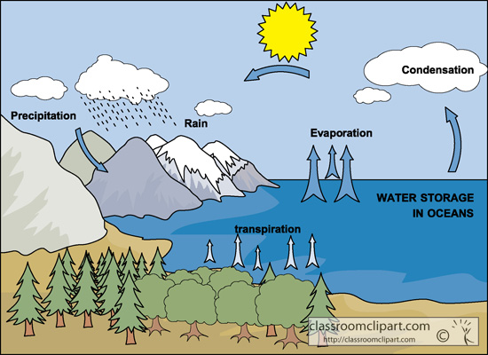
Overall Learning Goal
The phenomena of the water cycle can be explained by examining the nature of water molecules.
Courtesy of Classroomclipart.com
Notes:
PD leader talk: “This week, we’ve been using science ideas about the nature of water molecules to explain the phenomena of the water cycle.”

Slide 27
Content Deepening Focus Questions
What are the two basic steps of cloud formation?
How does the process of distillation simulate the overall water cycle?
Notes:
PD leader move: Read each focus question and continue emphasizing that participants have previous knowledge about water that they’ve acquired over the years, and you hope this content deepening work will enrich their ability to teach the Water Cycle lessons. To ensure that everyone feels prepared to elicit, probe, and challenge student thinking that will be made visible during the actual lessons, some topics covered will exceed the students’ level of knowledge.

Slide 28
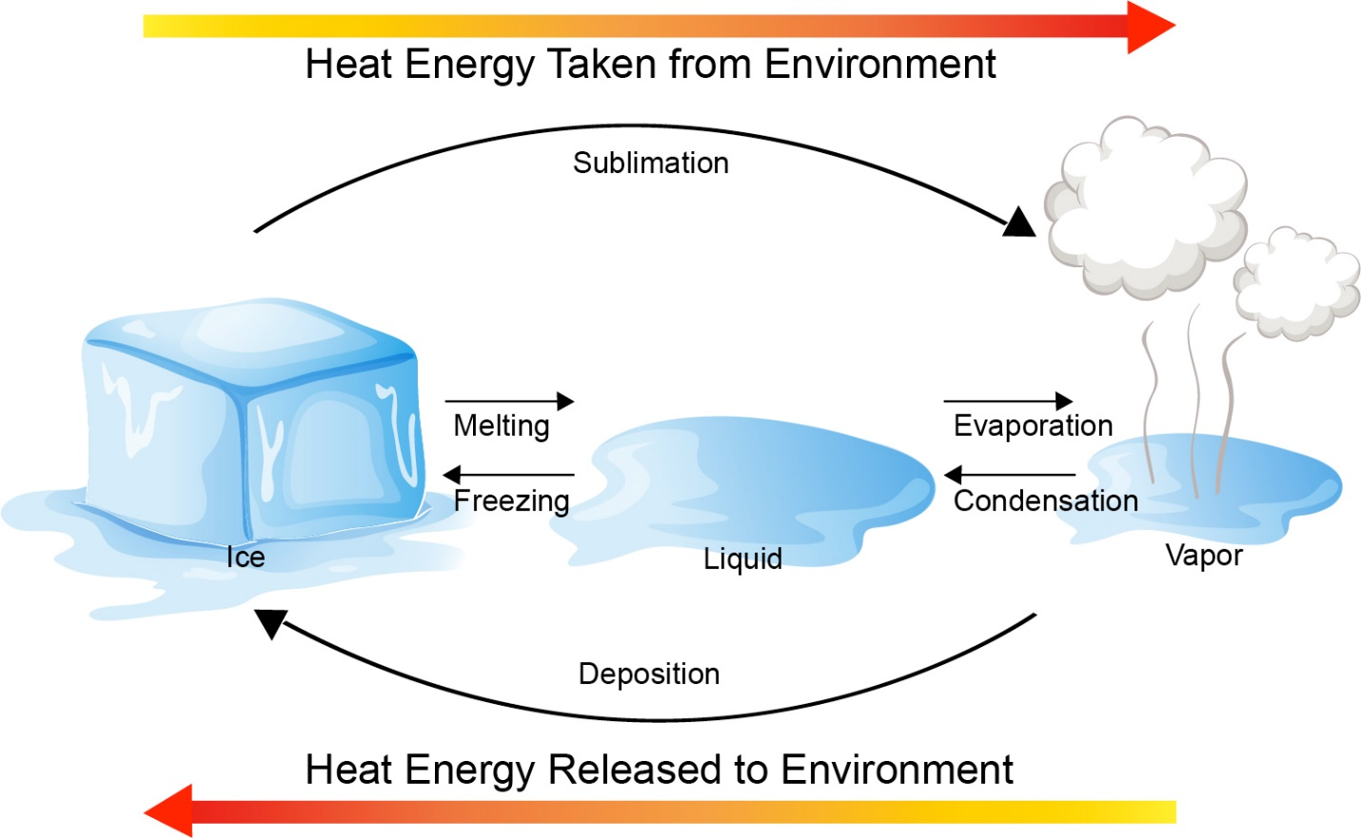
The Role of Energy in Phase Changes
Phase changes in water occur as energy is gained or lost. Using science ideas from the past few lessons, draw a diagram illustrating this concept.
Courtesy of Stock.Adobe.com
Notes:
Note: Hide the diagram on the PPT slide until participants have completed their drawings.
PD leader talk: “Phase changes in water occur as energy is gained or lost. Using science ideas from the past few lessons, draw a diagram illustrating this concept.”
PD leader move: Make sure participants use arrows in their diagrams, name the phases, and add the words energy loss and energy gain.
PD leader move: After participants have finished their drawings, reveal the diagram on the slide and discuss participants’ previous knowledge of the various states of matter.

Slide 29
Review: The Arrangement of Water Molecules
Let’s practice drawing water in its various states again!
Make sure to emphasize how water molecules are arranged (or attracted to each other) in the solid, liquid, and gaseous states.
Your drawings should include at least six water molecules.
Notes:
Chapter 7: Covalent Bonds and Molecular Structure
2/5/2020
Copyright © 2011 Pearson Prentice Hall, Inc.
29
PD leader talk: “Let’s practice drawing water in its various states again. Make sure to emphasize how water molecules are arranged (or attracted to each other) in the solid, liquid, and gaseous states. Your drawings should include at least six water molecules.”
PD leader move: Give participants 1 minute to draw water molecules in all three states, using at least six water molecules. Look at some of the diagrams and remind participants to include hydrogen bonds (H-bonds).
PD leader move: Have two volunteers share their drawings and another few volunteers use various molecular models (e.g., a ball-and-stick model with magnets) to demonstrate water molecules in the solid and liquid states.

Slide 30
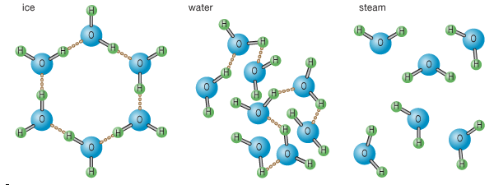

Drawing Water Molecules in Three States
Solid Water (Ice)
Liquid Water
Gaseous Water (Water Vapor)
Courtesy of Encyclopaedia Britannica, © 2015, used with permission
Courtesy of Pixabay.com
Notes:
Chapter 7: Covalent Bonds and Molecular Structure
2/5/2020
Copyright © 2011 Pearson Prentice Hall, Inc.
30
Note: Hide the photo on the slide until after participants discuss the question.
PD leader talk: “What similarities or differences do you see in your diagrams compared to those on the slide?”
PD leader move: After the discussion, reveal the photo of students engaged in a role-play. Have participants role-play water molecules gaining heat energy and undergoing a phase change into a gas and then back to a liquid. Tell participants that their torsos represent one oxygen atom, and their outstretched hands represent two hydrogen atoms.

Slide 31
Content Deepening: Focus Question 1
What are the two basic steps of cloud formation?
Notes:
PD leader move: Read the first content deepening focus question and ask participants to engage in a 2-minute quick write on cloud formation.
PD leader move: After a few minutes, have participants share their answers with an elbow partner.

Slide 32
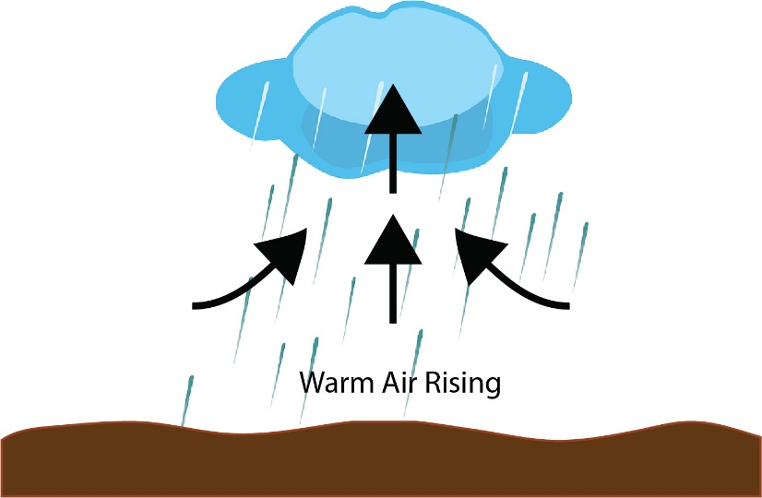
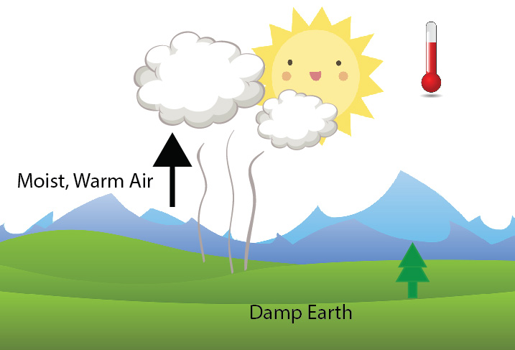
Cloud Formation
Students typically refer to cloud formation as a one-step process involving water vapor.
They view energy as a kind of invisible crane that picks up the warm water molecules as they change to a gas and carries them into the sky to form a cloud.
Courtesy of Cal Poly Pomona
Courtesy of Cal Poly Pomona
Notes:
Note: Hide the second image on the slide until participants have discussed the cloud-formation model.
PD leader talk: “This is a graphical representation of cloud formation based on scientific studies. How might your students explain what is happening in this model?”
PD leader move: After the discussion, reveal the second graphic on the slide.
PD leader talk: “Students typically refer to cloud formation as a one-step process involving water vapor. They view energy as a kind of invisible crane that picks up the warm water molecules as they change to a gas and carries them into the sky to form a cloud.”

Slide 33
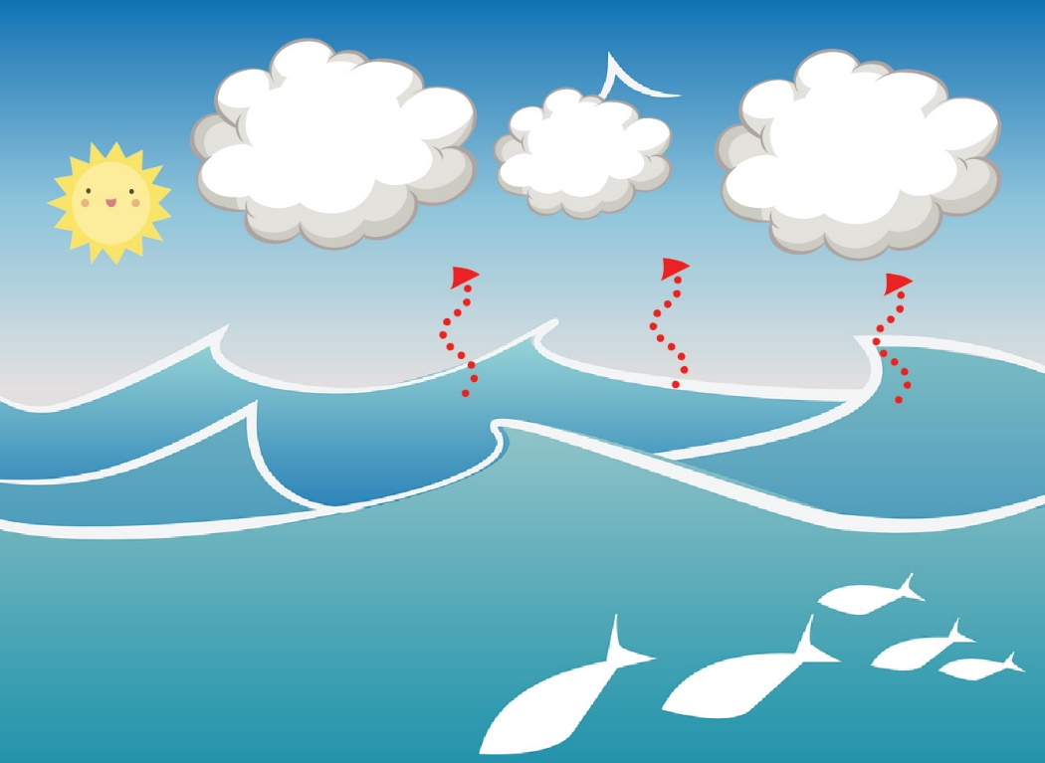
Labeling the States of Water
Courtesy of Cal Poly Pomona
A common misconception is that steam and clouds are visible kinds of water vapor formed from warm water molecules (humidity) in the air. Visible steam and clouds are actually water in its liquid state!
Notes:
Note: Hide the explanation at the bottom of the PPT slide until participants have labeled the diagram.
PD leader talk: “The slide shows another model of the water cycle. Let’s label the states of water in the ocean and the clouds that are identified with the black arrows.”
PD leader move: Don’t correct participants if they label the state of water in the clouds as a gas or steam. (This reflects how their students will think, and participants need to approach this topic as learners. Allow them to struggle with it!)
PD leader move: After participants have applied labels, reveal the misconception at the bottom of the slide.
PD leader talk: “A common misconception is that steam and clouds are visible kinds of water vapor formed from warm water molecules (humidity) in the air. Visible steam and clouds are actually water in its liquid state!”
PD leader move: Ask how participants might help their students overcome this conceptual hurdle.

Slide 34
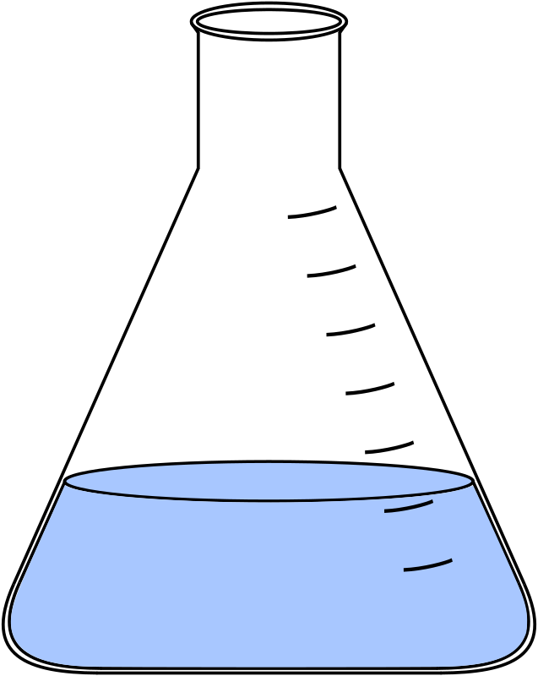

Interactions among Water Molecules
Liquid water conforms to the shape of its container, and the molecules are participating in hydrogen bonds.
Water-vapor molecules have gained heat energy and are no longer attracted to each other. They are free to fill their environment.
Add Heat
Notes:
PD leader talk: “One idea to advance student understanding is to emphasize their learning from lesson 1 and their observation of boiling water, which showed that water vapor is invisible.”
PD leader move: Read the statements on the slide; then have participants draw two flasks in their science notebooks, one containing water molecules in the liquid phase, and one containing molecules in the gas phase. Make sure they include at least six water molecules in each flask.

Slide 35

Two Steps of Cloud Formation
Courtesy of Cal Poly Pomona
What are the two basic steps of cloud formation?
Notes:
Note: Hide the question on the PPT slide until participants have labeled the diagram.
PD leader talk: “Let’s revisit this diagram and label the states of water in three places now: in the ocean, in the warm air above the ocean, and in the clouds. Make sure to use six water molecules for each phase. Once you complete this task, share your work with an elbow partner and discuss your insights.”
PD leader move: After the Turn and Talk, reveal the focus question below the PPT diagram.
PD leader talk: “Now take a moment or two and answer the focus question in your notebooks.”
PD leader move: Facilitate a group discussion around the topic of cloud formation. It’s OK if there is still some disagreement.

Slide 36
Reflect: Content Deepening Focus Question 1
What are the two basic steps of cloud formation?
Link to video clip at https://www.thehappyscientist.com/content/cloud-formation-part-1.
Notes:
PD leader talk: “Next we’ll watch a video clip to see if we can find common ground on this topic.”
PD leader move: After participants have viewed the clip, ask them to reflect on the focus question and consider how the video has influenced their thinking about cloud formation.

Slide 37
Content Deepening: Focus Question 2
How does the process of distillation simulate the overall water cycle?
Notes:
PD leader move: Read the focus question on the slide.
PD leader talk: “Now we’re going to build on our previous knowledge as we learn about the process of distillation. This content deepening will support our ability to elicit, probe, and challenge student thinking that will be made visible during the actual lesson.”

Slide 38
Distillation
Distillation is the process of heating a liquid until it boils, and then condensing and collecting the resulting hot vapors. The principles of distillation have been used for thousands of years. Ancient Arab chemists may have been the first to use distillation to isolate perfumes.
In modern organic chemistry, distillation is a powerful tool not only for identifying organic compounds but also for purifying them. The boiling point of a compound is one of the physical properties used to identify it.
The thermometer wasn’t invented until the early 1700s.
Notes:
PD leader talk: “For thousands of years, distillation was a common tool used to identify and purify a compound in organic chemistry well before the modern thermometer was invented.”

Slide 39
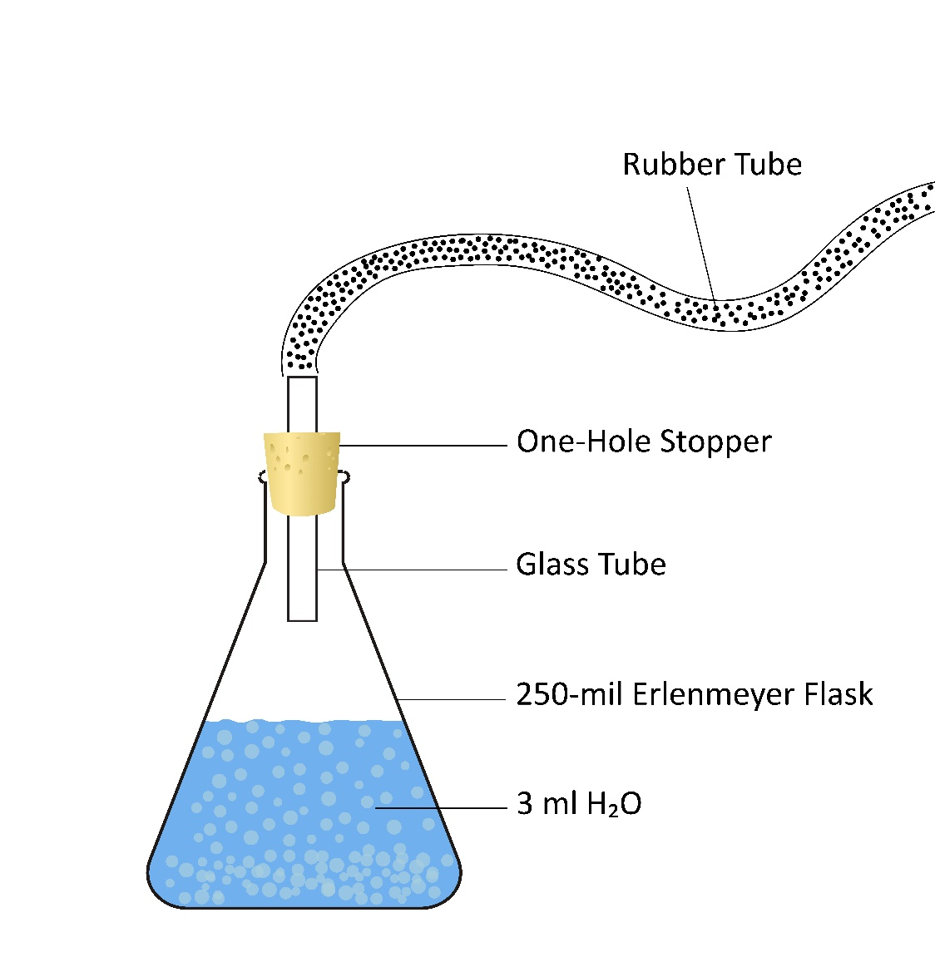
Distillation Apparatus
Draw this distillation apparatus in your science notebooks.
When the water in this system has heated to a boil, what happens to the water-vapor molecules the farther they rise from the heat source?
Courtesy of Cal Poly Pomona
Notes:
Note: Hide the question on the PPT slide until participants have finished their drawings.
PD leader talk: “Displayed here is a distillation apparatus consisting of an Erlenmeyer flask, water, a stopper, aquarium tubing, and a collection tube.”
PD leader move: As you assemble the apparatus and start heating the water, tell participants how the various parts of the apparatus are used.
PD leader talk: “While we’re waiting for the water in the flask to reach a boiling point, I’d like you to draw the apparatus in your notebooks. Make your drawing large because we’re going to add more details.”
PD leader move: Ask participants to observe the water in the system.
Note: Keep the heat low enough so the boiling water doesn’t distill into the collection tube. Once some condensation appears in the aquarium tubing, turn off the heat!
PD leader move: After participants have finished their drawings, reveal the question on the slide.
PD leader talk: “Now that your drawings are complete and our system has been heated, explain what happens to the water-vapor molecules as they rise from the heat source.”
PD leader move: Participants should observe that the water-vapor (gas) molecules lose heat energy (cool) and slow down as they move to the top of the beaker and enter the tubing. Don’t discuss what is happening beyond the entrance to the tubing.

Slide 40
Distillation Apparatus
How does this loss in energy eventually affect the movement and arrangement of the water molecules?
Add to your diagram by drawing water molecules in their various states.
Courtesy of Cal Poly Pomona
Notes:
Note: Hide the instruction at the bottom of the PPT slide until participants have responded to the question.
PD leader talk: “How does this loss of heat energy eventually affect the movement and arrangement of the water molecules?”
PD leader move: Participants should explain that the gas (water-vapor) molecules lose kinetic (heat) energy in the cooler environment, slow down, and undergo a phase change from a gas to liquid-water droplets through condensation.
Note: Don’t mention cloud formation yet!
PD leader move: After this discussion, display the instruction at the bottom of the slide.
PD leader talk: “Now add to your diagrams by drawing water molecules in their various states.”
PD leader move: Be sure participants show the liquid-water molecules forming hydrogen bonds in the tubing.

Slide 41


A Model of Cloud Formation
How does the first section of the distillation apparatus simulate cloud formation?
Similar to steam, clouds form when water molecules condense onto dust particles in the air.
Photo courtesy of Pixabay.com
Courtesy of Cal Poly Pomona
Notes:
Note: Hide the explanation at the bottom of the PPT slide until participants have responded to the question.
PD leader talk: “Can someone please explain how the first section of this distillation apparatus simulates cloud formation?”
PD leader move: Use elicit, probe, and challenge questions to push participants toward explaining the formation of a cloud in the tubing (evaporation → condensation).
PD leader move: After the discussion, reveal the explanation at the bottom of the slide.
PD leader move: Allow participants to discuss the statement on the slide: Similar to steam, clouds form when water molecules condense onto dust particles in the air.

Slide 42
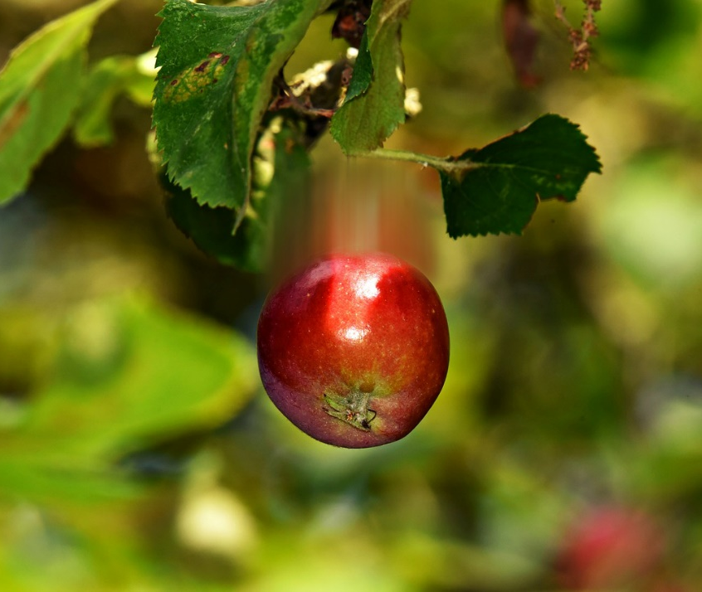

The Effects of Gravity
Photo courtesy of Pixabay.com
Photo courtesy of Pexels.com
Notes:
PD leader talk: “We’re all familiar with Newton’s law of gravity. When an apple ripens and gains enough mass, it falls from a tree. When a leaky faucet collects enough water to form a droplet, the droplet falls from the faucet.”

Slide 43

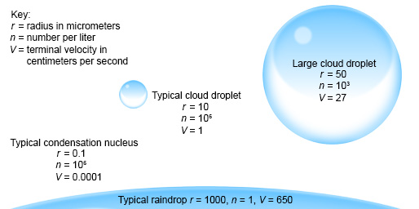

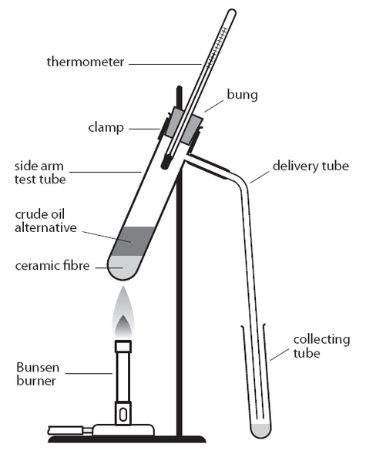
Precipitation
Courtesy of Cal Poly Pomona
As water molecules are attracted to each other and condense onto dust particles in the air, a cloud forms. Eventually the liquid-water droplets become so heavy that they fall to Earth as rain. How does a distillation apparatus simulate this process?
Courtesy of Royal Society of Chemistry
Notes:
Note: Hide the PPT diagram of the collection tube in a distillation apparatus until after the discussion.
PD leader talk: Gravity has a similar effect on condensation in a cloud. As water molecules are attracted to each other and condense onto dust particles in the air, a cloud forms. Eventually the liquid-water droplets become so heavy that they fall to Earth as rain in a process called precipitation.
PD leader talk: “Now I’d like you to identify how a distillation apparatus simulates this process.”
PD leader move: Use probe, elicit, and challenge questions to facilitate a discussion of how a distillation apparatus simulates precipitation.
PD leader move: At the end of the discussion, display the PPT diagram of the collection tube in a distillation apparatus.

Slide 44
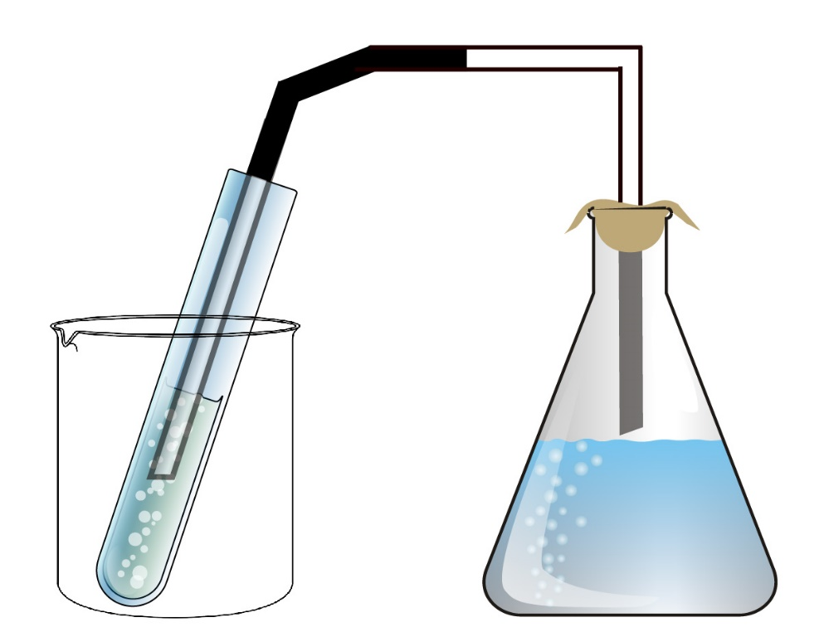
Reflect: Content Deepening Focus Question 2
How does the process of distillation simulate the overall water cycle?
Courtesy of Cal Poly Pomona
Notes:
PD leader talk: “Take a few moments to reflect on the second content deepening focus question; then jot down your ideas in a 2-minute quick write.”

Slide 45
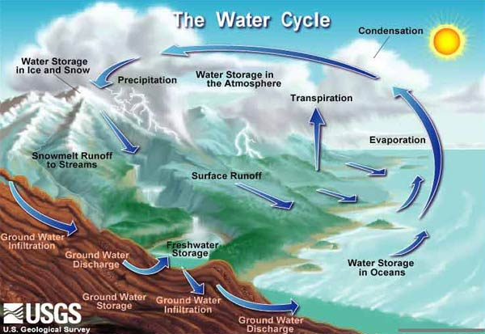
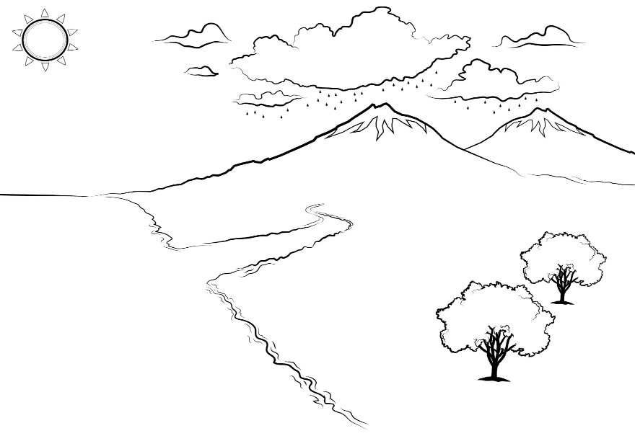
The Water Cycle
Water is abundant in our environment. The movement
and arrangement of water molecules as they gain and
lose energy is fascinating and dynamic!
Courtesy of USGS.com
How might students draw and label a diagram showing how water molecules interact in the water cycle?
Notes:
PD leader talk: “As we’ve observed in our demonstrations and experiments, water is abundant in our environment. The movement and arrangement of water molecules when they gain and lose energy is fascinating and dynamic!”
PD leader talk: “Our overall goal this week has involved using science ideas about the nature of water molecules to explain the phenomena of the water cycle. How might our students draw and label a diagram showing how water molecules interact in the water cycle?”
PD leader move: As participants share their ideas, draw and label a sample diagram on chart paper.
Note: You may also want to display a marked copy of the Water in the World around Us diagram (handout 5.3) from Water Cycle lesson 5b in the lesson plans binder.

Slide 46
Today’s Focus Questions
Why is it necessary to engage students in using and applying new science ideas in a variety of ways and contexts?
How will the Student Thinking Lens strategies help you teach the Water Cycle lessons?
What are the two basic steps of cloud formation?
How does the process of distillation simulate the overall water cycle?
Notes:
2 min
a. Review today’s focus questions.
b. Individual think time (1 min): Ask participants to reflect on these questions and think about how they might revise their answers.

Slide 47
Let’s Summarize!
Lesson Analysis Strategy 6
What new understandings did you develop?
What do you still have questions about?
Lesson Plans Review
What new insight(s) did you gain?
What do you still have questions about?
Content Deepening
What did you learn?
What do you still have questions about?
Notes:
5 min
a. Individual think time (1 min): Give participants a minute to think about the questions on the slide and consider questions they still have. Challenge them to formulate a statement summarizing what they learned in each area.
b. Whole-group share-out: Have participants share at least two different statements about each of the areas on the slide. Elicit more if time allows.

Slide 48
Homework
Read in the STeLLA strategies booklet:
  Student Ideas and Science Ideas Defined
  Introduction to the Science Content Storyline Lens
  Science Content Storyline Lens, STeLLA Strategy A: Identify One Main Learning Goal
Complete strategy-A column on the Coherent Science Content Storyline Strategies Z-fold summary chart (front binder pocket).
Notes:
3 min
a. “Next week we’ll focus on the Science Content Storyline Lens strategies and explore a new content area: food webs. To prepare, complete the homework tasks on the slide.”
b. Make sure participants copy the assignment into their science notebooks.

Slide 49
Reflections on Today’s Session
Complete the Daily Reflections sheet (handout 4.7 in PD program binder).
This weekend you bump into a friend who knew you were attending RESPeCT this week. What would you say you’ve learned about the STeLLA Student Thinking Lens strategies and their potential impact on your teaching practice and/or student learning?
What do you understand better about matter, molecules, and the water cycle after this week’s session? What helped clarify your understanding?
Notes:
5 min
a. Give participants time to reflect on today’s session and write their responses to the questions on the Daily Reflections sheet (handout 4.7 in PD program binder).

Slide 50
Norms for Working Together: The Basics
Purpose: Build trust and develop a productive study group for all participants.
The Basics
Arrive prepared and on time; stay for the duration; return from breaks on time.
Remain attentive, thoughtful, and respectful; engage and be present.
Eliminate interruptions (turn off cell phones, email, and other electronic devices; avoid sidebar conversations).
Make room for everyone to participate (monitor your floor time).
Notes:
Hidden slide: Available for use at any time as needed.

Slide 51
Norms for Working Together: The Heart
Purpose: Build trust and develop a productive study group for all participants.
The Heart of RESPeCT Lesson Analysis and Content
Deepening
Keep the goal in mind: analysis of teaching to improve student learning.
Share your ideas, uncertainties, confusion, disagreements, questions, and good humor. All points of view are welcome.
Expect and ask questions to deepen everyone’s learning; be constructively challenging.
Listen carefully; seek to understand other participants’ points of view.
Notes:
Hidden slide: Available for use at any time as needed.

