Slide 1
RESPeCT PD pROGRAM
Day 5
RESPeCT Summer Institute
Notes:
5 min
a. Take care of any housekeeping issues.

Slide 2
Agenda for Day 5
Day-4 reflections
Focus questions
Review strategy 6: use and apply
What Is the Science Content Storyline Lens?
Introducing SCSL strategy A
Lesson analysis: SCSL strategy A
Lunch
Content deepening: food webs
Summary, homework, and reflections
Notes:
2 min
a. Talk through the agenda for the day.

Slide 3
Trends in Reflections
Lesson Analysis | Science Content Learning
Notes:
5 min
a. Give participants time to review your feedback on their reflections from day 4 and offer reactions, comments, or follow-up questions.

Slide 4
Norms for Working Together: The Basics
Purpose: Build trust and develop a productive study group for all participants.
The Basics
Arrive prepared and on time; stay for the duration; return from breaks on time.
Remain attentive, thoughtful, and respectful; engage and be present.
Eliminate interruptions (turn off cell phones, email, and other electronic devices; avoid sidebar conversations).
Make room for everyone to participate (monitor your floor time).
Notes:
5 min
a. Review the norms as a group.
b. Ask: “Any comments or suggested changes? How are we doing with applying these norms?”

Slide 5
Norms for Working Together: The Heart
Purpose: Build trust and develop a productive study group for all participants.
The Heart of RESPeCT Lesson Analysis and Content Deepening
Keep the goal in mind: analysis of teaching to improve student learning.
Share your ideas, uncertainties, confusion, disagreements, questions, and good humor. All points of view are welcome.
Expect and ask questions to deepen everyone’s learning; be constructively challenging.
Listen carefully; seek to understand other participants’ points of view.
Notes:
5 min
a. Review these norms as a group.
b. Ask: “Any comments or suggested changes? Which of these norms do you think we could get better at applying individually and as a group?”
c. Remind participants: “These norms will become increasingly important during the Summer Institute and throughout the academic year as we analyze one another’s classroom videos and learn together.”

Slide 6
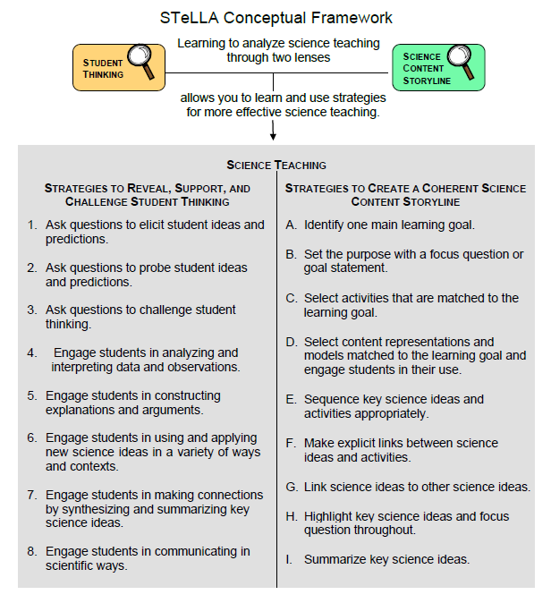
Notes:
1 min
a. Transition: This slide marks the transition from the STL strategies to the Science Content Storyline Lens strategies.
b. “Throughout the PD program, we’ll continue learning about the Student Thinking Lens (STL) strategies, but today we’ll transition to the Science Content Storyline Lens strategies.”
c. Highlight the SCSL strategies on the slide.

Slide 7
Focus for the Week
Content area 2: food webs
Science Content Storyline Lens
Strategies A, B, C, D, F, G, H, and I
Video-based lesson analysis (Food Webs lessons)
Food Webs lesson plans review (last day)
Academic-year schedule (last day)
Video recording
Study-group sessions
Notes:
1 min
a. “This week we’ll focus on a new content area: food webs. We’ll also examine the Science Content Storyline Lens strategies and the Food Webs lessons you’ll be teaching in the fall, analyze video clips of those lessons, and deepen your science-content knowledge related to the lesson plans.”
b. “On the last day of the RESPeCT PD program, we’ll review the lesson plans and the schedule for the academic year.”
c. “You may notice that we skip strategy E: Sequence key science ideas and activities appropriately. This strategy will be addressed during the school year as you teach the STeLLA lesson plans and analyze how they’re sequenced within each lesson and across lessons.”

Slide 8
Today’s Focus Questions
What is the Science Content Storyline Lens (SCSL)?
Why is one main learning goal essential for science content storyline coherence?
How can we trace the matter and energy in food?
Notes:
1 min
a. Introduce the focus questions that will guide today’s work.

Slide 9
Check Your Understanding of Strategy 6
Jot down your responses to this multiple-choice quiz:
Use-and-apply tasks are used [before/during/after] new science ideas are introduced.
For difficult content ideas, students might need to practice applying new ideas in [one/two/many] different contexts.
[True/false]: Use-and-apply questions or activities are used primarily for student assessment at the end of a unit.
It’s appropriate for teachers to ask [elicit/probe/challenge] questions during a use-and-apply activity.
Teachers should [never/judiciously/always] tell students about science ideas they are missing or stating inaccurately.
Notes:
7 min
Note: Display this slide only if it wasn’t used on day 4.
a. “To check your understanding of STL strategy 6, jot down your responses to this multiple-choice quiz in your science notebooks.”
b. Have participants discuss their answers either in pairs or as a group. (If time is short, just read the answers aloud.)
Answer key:
1. After
2. Many
3. False
4. Challenge (and probe)
5. Judiciously (defined as “good or discriminating judgment; wise, sensible, or well advised”)

Slide 10
Use and Apply Your Content Deepening Knowledge
What data would you use to predict whether you’ll see a lot of dew on the grass or on your car in the morning? Explain your thinking.
To answer this question, use and apply what you learned last week about matter, molecules, and the water cycle.
Notes:
8 min
a. Turn and Talk (4 min): “Discuss the use-and-apply question on the slide with a partner and be ready to share your ideas with the group.”
b. Whole-group share-out (4 min): “What ideas do you have for answering this question?”
Note: Participants should recognize the scenario as an example of condensation and should reason that water vapor in the air must cool to form droplets of liquid water.
Ideal response: Dew is liquid water that appears when water-vapor molecules in the air lose heat energy (cool), which makes them slow down and join together to form droplets of liquid water on objects near Earth’s surface (like grass or cars). This process is called condensation. Factors that enable us to predict whether we’ll see liquid-water molecules in the environment are (a) temperature (if the temperature drops below freezing, frost would be seen rather than dew), and (b) humidity. There needs to be sufficient water vapor in the air for condensation to occur. It the humidity is very low, we wouldn’t expect to see a lot of dew formation.

Slide 11
Planning Science Lessons: Quick Write
What is generally your thinking process when you plan your science lessons?
Be prepared to share your ideas with the group.
Notes:
6 min
Note: This activity is a lead-in for thinking about specific SCSL strategies. When planning science lessons, are participants thinking primarily about (1) SCSL issues, such as learning goals, (2) student misconceptions (an STL issue), which is a great start but doesn’t include SCSL strategies, or (3) activities and/or classroom management and timing issues?
a. Individuals: Direct participants to take 2–3 minutes to write down the key things they think about when planning science lessons.
b. Whole group: Ask participants to share their reflections with the group.
c. Tell participants: “The Science Content Storyline Lens strategies should provide some new or additional ways of thinking about planning your science lessons.”

Slide 12
Lesson Analysis: Focus Question 1
What is the Science Content Storyline Lens (SCSL)?
What is a science content storyline, and why is it important?
What is challenging about developing a science content storyline?
Notes:
7 min
a. Small groups: Direct half the group to focus on the first bulleted question on the slide, and the other half to focus on the second. Allow groups 2 minutes to think about their assigned questions as they review “Introduction to the Science Content Storyline Lens” in the STeLLA strategies booklet.
b. Whole group: Have each group share their ideas and responses for these questions.
c. As you listen to participants, make sure that what they’re saying is consistent with the strategies booklet. If you aren’t sure they’re interpreting the text accurately, ask them to identify the specific text they are drawing from.

Slide 13
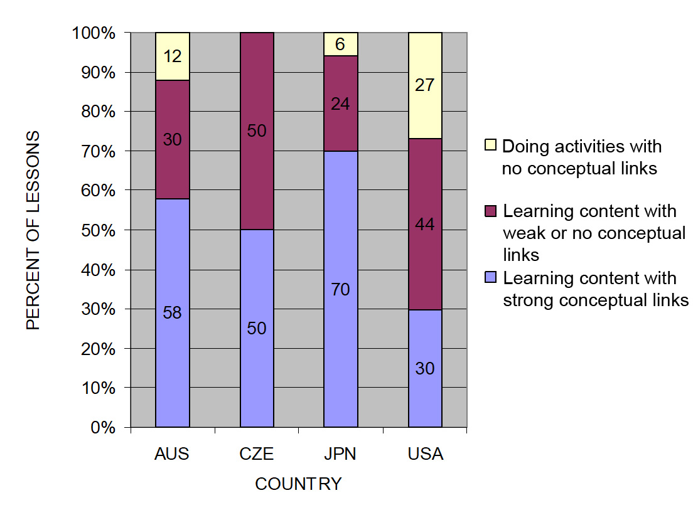
The TIMSS Video Study Findings and the Science Content Storyline Lens
Source: TIMSS study
Notes:
2 min
a. Emphasize the research basis for the Science Content Storyline Lens and its importance. Remind participants that the data on the slide was presented on day 1 of the PD program.
b. Ask: “What does this graph reveal about US science lessons compared with higher-achieving countries?”
Ideal response: According to the study, US science lessons didn’t do as well linking science ideas to lesson activities; in fact, many lessons were activity focused and included significantly fewer science ideas compared to other countries.
c. Summarize: Point to strategies F and G on the STeLLA strategies poster: Make explicit links between science ideas and activities (strategy F) and link science ideas to other science ideas (strategy G). These strategies and the idea of a Science Content Storyline Lens grew out of the TIMSS research findings.
d. “Today we’ll begin our study of the Science Content Storyline Lens, with a focus on strategy A: Identify one main learning goal.”

Slide 14
Lesson Analysis: Focus Question 2
Why is one main learning goal essential for science content storyline coherence?
Notes:
1 min
a. Read focus question on the slide.

Slide 15
Notes:
1 min
a. “Now let’s dig into SCSL strategy A!”
b. “As you can see, strategy A is the first of nine Science Content Storyline Lens strategies. It appears first because it’s the foundation on which all the other SCSL strategies are built. This will become clearer as we delve into the other strategies and see how important it is that each of them is matched to the lesson’s main learning goal.”

Slide 16
Purpose and Key Features of Strategy A
Review your SCSL Z-fold summary charts and share with a partner the purpose and key features of strategy A: Identify one main learning goal.
Remember to cite passages from the STeLLA strategies booklet.
Be prepared to share with the group.
Notes:
25 min
a. Pairs: “Share with a partner what you wrote on your Science Content Storyline Lens Z-fold summary chart about the purpose and key features of strategy A.”
b. Whole group: Have one or two participant volunteers lead the group in creating a chart that describes the purpose and key features of strategy A.
c. Transition: “Next, we’ll review the difference between a science idea and the main learning goal of a lesson. Then you’ll practice identifying and clarifying this distinction.”

Slide 17
A Main Learning Goal Is …
A big science idea that you want students to learn
A big idea that shows the relationship among science ideas
The focus of the lesson (or series of lessons)
Stated in a complete sentence (for planning purposes)
Stated by the teacher, a student, a text, or a multimedia resource
A support for teacher planning
Notes:
1 min
a. “This slide lists some key ideas about the definition of a main learning goal.”
b. Read through the ideas.
c. Emphasize: “Notice the parenthetical reference to ‘lessons’ in the third bullet point. Each lesson should have only one main learning goal, but you might need two or more lessons to help students accomplish a difficult goal. So it’s often necessary to spend more than one lesson on a specific learning goal.”

Slide 18
A Main Learning Goal Is NOT …
A topic or phrase
An activity
A question
A performance task or objective
A supporting detail, definition, or fact
A student misconception or idea that isn’t scientifically accurate
Notes:
1 min
a. Review what is not considered a main learning goal.

Slide 19
Definitions: One Main Learning Goal and Science Ideas
Read these sections in the STeLLA strategies booklet: (1) STeLLA Strategy A: Identify One Main Learning Goal, and (2) Student Ideas and Science Ideas Defined.
Based on these readings, what are the differences between a main learning goal and a science idea?
Notes:
10 min
a. Have participants locate these two readings in the strategies booklet: (1) STeLLA Strategy A: Identify One Main Learning Goal, and (2) Student Ideas and Science Ideas Defined.
b. “After you read these sections in the strategies booklet, we’ll discuss the differences between a science idea and a main learning goal.”
c. Individuals (3 min): Give participants time to read the specified sections in the strategies booklet.
d. Whole group (7 min): Discuss the question on the slide.
e. Emphasize: “While you might incorporate several science ideas that support the main learning goal of a lesson, be careful not to plan an ‘all about’ lesson with too many different science ideas that will likely come across to students as a bunch of disconnected facts to be memorized.”

Slide 20
Practice Identifying Student Ideas and Science Ideas
Identify any student ideas and science ideas in this list:
Energy and matter
Students do a role-play showing how a food web works.
Plants get their food by taking it from the soil.
Plants are producers.
Plants don’t need food to grow; they only need water.
Plant the seeds just below the surface of the soil and then water them everyday.
How do plants get their food?
Some animals get their food by eating plants.
Notes:
5 min
a. “Next, we’ll practice identifying student ideas and science ideas just to make sure you understand the way we’re defining these terms.”
Note: As needed, refer participants to the section in the strategies booklet where student ideas are defined (Student Ideas and Science Ideas Defined).
b. Individuals: “First, identify examples of science ideas on the slide. If you need help, refer to the document in your lesson plans binders titled Common Student Ideas about Food Chains and Food Webs. Then identify examples of student ideas on the slide.”
c. Individuals: “Next, identify examples of student ideas on the slide.”
d. Whole group: Discuss participants’ responses and the correct answers (see answer key).
Answer key:
Science ideas: 4, 8
Student ideas: 3, 5

Slide 21
Practice Identifying Student Ideas and Science Ideas in a Class Discussion
Identify one student idea and one science idea in this class discussion:
T: How do you think we get the energy we need to survive?
S: From exercising.
SN: From resting and sleeping.
SN: From food.
T: Do all living things get energy from food?
S: Yes.
SN: No, plants get energy from water and soil.
Food for thought: To avoid problems, why not require students to speak in complete sentences during science discussions?
Notes:
5 min
a. “It’s a little trickier to recognize student ideas and science ideas in class discussions because students sometimes give only one- or two-word answers to teacher questions. But if you link the teacher’s question with the student’s response, you can sometimes find a science idea or a student idea.”
Note: In the RESPeCT PD program, we encourage students to speak in complete sentences as much as possible.
b. “Let’s practice linking the teacher’s question with student responses in the sample discussion on the slide.”
c. Pairs: “Work with a partner to see if you can identify one student idea and one science idea in this discussion.”
d. Whole-group share-out: Have participants share the ideas they identified in the sample discussion. Then review the answers (see answer key).
e. Emphasize: “Here’s some food for thought: To make student thinking more visible, why not require students to speak in complete sentences during classroom discussions about science ideas?”
Answer key:
Student ideas/misconceptions:
We get energy we need to survive from exercise.
We get energy from resting and sleeping.
Plants get energy from water and soil.
Science ideas:
We get energy from food.
All living things get energy from food.

Slide 22
Science Ideas That Support the Main Learning Goal
Main learning goal: Plants take in sunlight, air, and water from their environment and use them to make their own food.
Supporting ideas:
An environment is a place where living things can get what they need to live and grow.
Plants are living things.
All living things, including plants, need food.
Plants cannot catch their food like animals do.
Plants take in water from their roots.
Plants take in sunlight and air through their leaves.
Plants use sunlight, air, and water to make their own food.
Notes:
6 min
a. Display only the main learning goal on the slide.
b. Pairs: “Work with a partner to come up with two or three science ideas that might support the development of this main learning goal. Use the Food Webs Content Background Document and the Common Student Ideas chart as resources.”
c. Whole group: Have pairs share the supporting science ideas they came up with.
d. Next, reveal the list of possible supporting science ideas one by one on the slide and compare them with participants’ ideas.
e. Highlight: “Some of these supporting science ideas could also be a lesson’s main learning goal.”

Slide 23
Practice Identifying Main Learning Goals
Small groups or pairs: Use the criteria in Analysis Guide A (handout 5.1 in binder) to analyze a list of candidate main learning goals related to food webs (handout 5.2: Practice Identifying One Main Learning Goal).
Select candidates from the list that you think are good main learning goals for the focus of the lesson and record the reasons for your choices on handout 5.2.
Whole group: Discuss and justify your selections.
Notes:
10 min
a. Direct participants to locate handout 5.1 (Analysis Guide A: Identifying One Main Learning Goal) and handout 5.2 (Practice Identifying One Main Learning Goal) in their PD program binders.
b. Small groups/pairs: Have participants form small groups or pairs and use the criteria from Analysis Guide A to analyze the list of possible learning goals on handout 5.2.
c. Direct participants to write yes or no on the handout to indicate whether the statement is or is not a good candidate for a lesson’s main learning goal. Then have them state the reason for each assessment using criteria from the analysis guide.
d. Whole-group share-out: Have participants share and discuss their selections.
e. Be sure to highlight what distinguishes a main learning goal from supporting science ideas, topics, phrases, activities, questions.
f. Also use this discussion to clarify science content.
Answer key: See PD Leader Master: Practice Identifying One Main Learning Goal (Answer Key).

Slide 24
Lesson Analysis: Strategy A
Next, we’ll watch a sequence of three video clips from a single lesson about food webs.
Analysis question for all three clips: Does this lesson have one main learning goal?
Follow-up questions:
If yes, what is it?
If no, what do you think is happening in the lesson?
Notes:
1 min
a. Make sure participants understand that they will be viewing a sequence of three video clips from the same Food Webs lesson.
b. “For all three clips, we’ll answer the analysis question, Does this lesson have one main learning goal?”
c. “If the answer is yes, what is the learning goal? If no, why do you think that’s the case? What do you think is happening in the lesson?”

Slide 25
Lesson Analysis: Review Lesson Context, Video Clip 1
5.1_stella_FW_belcastro__L1_c1
Read the lesson context on the video transcript (handout 5.3 in PD program binder).
As you watch the clip, keep the analysis question in mind: Does this lesson have one main learning goal?
If yes, what is it?
If no, what do you think is happening in the lesson?
Link to video clip 1: 5.1_stella_FW_belcastro_L1_c1
Notes:
5 min
a. Have participants read the lesson context at the top of the video transcript (handout 5.3 in PD program binder). (Less than 1 min)
b. Read the information on the slide. (Less than 1 min)
c. Show the video clip. (4 min)

Slide 26
Lesson Analysis: Analyze the Video, Video Clip 1
Study the video transcript and write down any science ideas the students and/or the teacher put on the table.
Pair up and compare the science ideas you identified. Then discuss the analysis question: Does this lesson have one main learning goal?
If yes, what is it?
If no, what do you think is happening in the lesson?
As a group, discuss what the main learning goal might be. Support your answers using your analysis of the science ideas you identified.
Notes:
25 min
a. Before participants analyze the video transcript, remind them of these key points: (1 min)
A science idea is a full-sentence idea that students could take away as something they learned during the lesson.
Science ideas are sometimes identified by linking the teacher’s question with the student’s response.
b. Individuals (8 min): “Study the video transcript and write in your notebooks any science ideas you identify in the discussion.”
c. Pairs (5 min): “Pair up and compare the science ideas you identified. Then discuss the questions on the slide.”
d. Whole group (11 min): Have participants share what they think might be the main learning goal of this lesson, using their analyses of the science ideas they identified.
e. List the possible learning goals on chart paper.
f. Let participants know they’ll revisit this list of possible main learning goals for the lesson after they watch the remaining video clips.
Note: For examples of student ideas, science ideas, and a possible main learning goal for the lesson, see PD Leader Master: 5th-Grade Guide to Video Clips for Day 5.

Slide 27
Lesson Analysis: Review Lesson Context, Video Clip 2
Read the lesson context on the video transcript (handout 5.4 in PD binder).
As you watch the clip, keep the analysis question in mind: Does this lesson have one main learning goal?
If yes, what is it?
If no, what do you think is happening in the lesson?
Link to video clip 2: 5.2_stella_FW_belcastro_L1_c2
Notes:
5 min
a. Have participants read the lesson context at the top of the video transcript (handout 5.4 in PD binder). (Less than 1 min)
b. Review the instructions on the slide. (Less than 1 min)
c. Show the video clip. (4 min)

Slide 28
Lesson Analysis: Analyze the Video, Video Clip 2
Study the video transcript and write down any student ideas and science ideas you identify.
Pair up and compare the student ideas and science ideas you identified. Then discuss this question: Are these ideas consistent with the possible main learning goal you identified for video clip 1?
As a group, discuss the possible main learning goal for this lesson. Make sure to support your answers using your analysis of the science ideas you identified.
Notes:
25 min
a. Review the definitions of a science idea and a student idea. Remind participants that students can express correct science ideas and inaccurate student ideas at the same time. (1 min)
b. Individuals (8 min): “Study the video transcript and write in your notebooks any student ideas and science ideas you identify.”
c. Pairs (5 min): “Pair up and compare the student ideas and science ideas you identified. Then discuss the question on the slide.”
d. Whole group (11 min): Have participants share out what they think might be the main learning goal of this lesson, using their analyses of the science ideas they identified to support their suggestions.
e. List the possible learning goals on chart paper.
f. Let participants know they’ll revisit this list of possible main learning goals for the lesson after they watch one more video clip.
Note: For examples of student ideas, science ideas, and a possible main learning goal for the lesson, see PD Leader Master: 5th-Grade Guide to Video Clips for Day 5.

Slide 29
Lesson Analysis: Review Lesson Context, Video Clip 3
Read the lesson context on the video transcript (handout 5.5 in PD binder).
As you watch the clip, keep the analysis question in mind: Does this lesson have one main learning goal?
If yes, what is it?
If no, what do you think is happening in the lesson?
Link to video clip 3: 5.3_stella_FW_belcastro_L1_c3
Notes:
5 min
a. Have participants read the lesson context at the top of the video transcript (handout 5.5 in PD binder). (Less than 1 min)
b. Review the instructions on the slide. (Less than 1 min)
c. Show the video clip. (4 min)

Slide 30
Lesson Analysis: Analyze the Video, Video Clip 3
Study the video transcript and write down any student ideas and science ideas you identify.
Pair up and compare the student ideas and science ideas you identified. Then discuss this question: Are these ideas consistent with the possible main learning goal you identified for clips 1 and 2?
As a group, discuss the possible main learning goal for this lesson. Make sure to support your answers using your analysis of the science ideas you identified.
Notes:
24 min
a. Individuals (8 min): “Study the video transcript and write in your notebooks any student ideas and science ideas you identify.”
b. Pairs (5 min): “Pair up and compare the student ideas and science ideas you identified on the transcript. Then discuss the question on the slide.”
c. Whole group (11 min): Have participants share what they think might be the main learning goal of this lesson. Make sure they use their analyses of the science ideas they identified to support their suggestions.
d. List the science ideas and possible learning goals on chart paper.
e. Ask: “Did the three video clips develop coherence across the lesson or include too many ideas that didn’t support the main learning goal?”
Note: For examples of student ideas, science ideas, and a possible main learning goal for the lesson, see PD Leader Master: 5th-Grade Guide to Video Clips for Day 5.

Slide 31
One Main Learning Goal?
Based on your analysis of these three video clips, does this lesson have one main learning goal? What do you think it is?
Use the criteria questions in Analysis Guide A to analyze the main learning goal identified in these clips.
Are there any supporting science ideas that don’t closely match the main learning goal?
Notes:
15 min
a. Whole group: Discuss the first question on the slide and reach a consensus on the main learning goal for the lesson.
Ideal response: Food has both matter [mass] and energy that living things need to live and grow.
b. Pairs: Have participants work in pairs to answer the criteria questions in Analysis Guide A for this agreed-upon main learning goal. Also have them identify any supporting science ideas that don’t closely match the main learning goal.
c. Whole group: Discuss participants’ responses to the questions in Analysis Guide A and question 3 on the slide.
Note: For ideal responses to the analysis questions for strategy A, see the final section of the PD Leader Master: 5th-Grade Guide to Video Clips for Day 5.

Slide 32
Examine Food Webs: Lesson 1a
Review the main learning goal for lesson 1a.
Read the main science ideas that support the main learning goal. (See column 3 in the lesson outline or column 2 in the detailed lesson plan.)
Included in the lesson storyline is the idea that water, carbon dioxide, and “plant food” are not food by the scientific definition. Why do you think this idea was included in the storyline?
Notes:
5 min
Note: This slide is optional if time is running short. It’s designed to help participants see how the lesson plans are written to highlight the main learning goal and science ideas that support the main learning goal.
a. Have participants look at Food Webs lesson 1a in their lesson plans binders and compare the main learning goal with the goal they came up with in their analyses of the Belcastro video clips. It should be a pretty close match.
b. Show participants how to find the main science ideas for the lesson in the lesson plans binder—column 3 of the lesson outline (How the Science Content Storyline Develops) or column 2 of the detailed lesson plan under the Main Science Idea(s) heading. All of these ideas should support the main learning goal.
c. Pose the question on the slide.
Ideal responses to the slide question: The ideas about water, carbon dioxide, and “plant food” are included in the science content storyline for two reasons: (1) They represent common misconceptions (of adults as well as children), and (2) to understand the meaning and power of the phrase “plants make their own food,” you have to appreciate that plants are taking matter (such as water and carbon dioxide) that cannot provide energy to living things and are transforming it into energy-supplying food. Living things cannot live off water, carbon dioxide, and minerals or fertilizers from the soil. They need energy-supplying food that only plants can make.

Slide 33
Food webs
SCIENCE CONTENT DEEPENING Grade 5
Notes:
Note: Throughout this content deepening phase, refer as needed to the Food Webs Content Background Document and Common Student Ideas about Food Chains and Food Webs.
PD leader talk: “Now let’s begin the content deepening phase on food webs.”
Timing note: To keep things moving so you don’t run out of time during this phase, adhere as closely as possible to the time you’ve allotted for each slide. If you’re running short on time, you may need to abridge or skip some of the group discussion.

Slide 34
Unit Central Question
How do living things depend on one another to get the food (matter and energy) they need to live and grow?
Notes:
PD leader move: Remind participants of the unit central question students will answer in the Food Webs lesson sequence. Tell them you’ll work together to understand the major science concepts needed to answer this question.
PD leader talk: “Write this unit central question in your notebooks and draw a double-lined box around it. This reinforces an important practice you should have your students follow.”

Slide 35
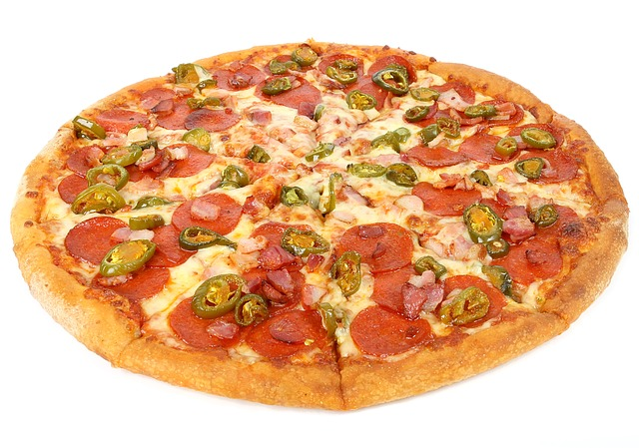
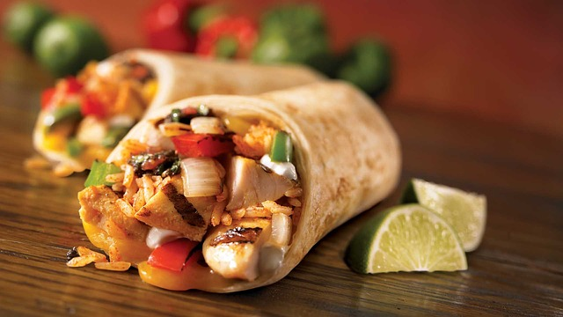
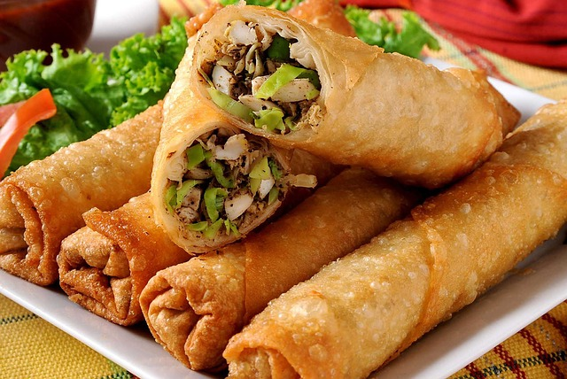
Content Deepening Focus Question
How can we trace the matter and energy in food?
Photo courtesy of Pixabay.com
Photo courtesy of Pixabay.com
Photo courtesy of Pixabay.com
Notes:
PD leader move: Introduce the content deepening focus question.
PD leader talk: “Write this focus question in your science notebooks and draw a box around it. This reinforces a practice your students should follow.”

Slide 36
Defining Food
Define food in your notebooks.
Which of these materials IS food? Why?
Orange juice
Sugar
Water
Vitamins
Plant food (fertilizers, minerals)
Seltzer water (carbon dioxide)
Salt
Mints
Which is NOT food? Why?
Notes:
PD leader talk: “Now I’d like you to define food in your notebooks and then determine whether the items listed on the slide are food or are not food according to your definition. Make sure to record your decisions and reasoning in your notebooks.”
PD leader move: Have participants share with a partner their food definitions of food and their decisions about each item. Remind them to use their definitions when explaining their decisions.
PD leader move: Have some participants share their decisions. During the share-out, ask questions that will probe participants’ thinking.

Slide 37
The Scientific Definition of Food
Food is matter (building materials) that contains energy living things can use to live and grow, to heal wounds, and to keep all their parts working.
Notes:
PD leader move: Read the scientific definition of food used in the RESPeCT program.
PD leader talk: “Compare your original definitions with the scientific definition and make any necessary revisions to your definitions using a different colored pen or pencil.”

Slide 38
Defining Energy
Write your own definition of energy in your notebooks.
Read section 3.4 of the Food Webs Content Background Document.
How does the definition in the reading compare to your definition of energy?
Notes:
PD leader talk: “One of the key terms in the definition of food is energy. To better help our students understand this definition, it’s important to make sure everyone is using energy terms in the same way.”
PD leader move: Ask participants to write a definition of energy in their notebooks.
PD leader move: After 1 minute, ask participants to read section 3.4 of the content background document.
PD leader talk: “How does the scientific definition of energy compare with your definitions?”

Slide 39
Useful and Common Ways of Talking about Energy
Many different units are used to quantify energy. The common unit in the United States is the calorie.
A calorie (lowercase c) is the amount of energy required to heat 1 gram of water 1 degree Celsius.
The energy content of food is measured in Calories (capital C), called dietary calories.
1 Calorie = 1,000 calories
Notes:
Note: At first, display only the slide title.
PD leader talk: “The content background document states that energy can be measured.”
PD leader move: Reveal the bullet points on the slide.
PD leader move: Read the definitions of a calorie and a dietary calorie (Calorie), pointing out the distinctions.

Slide 40
Energy Terms
Some ways to talk about energy:
Potential Energy | Kinetic Energy
Chemical Energy | Light Energy
 | Thermal Energy
Notes:
PD leader move: Reveal the energy terms on the slide.
PD leader talk: “These are some of the words scientists use to talk about energy.”
PD leader move: You may want to refer to some of the student-teacher learning goals from the 4th-grade Energy Transfer lesson set:
1. The production of heat, light, sound, or motion indicates that an object has energy.
2. The energy of an object depends on its mass, its velocity (during motion), or its position/composition.
3. Kinetic energy is the energy of motion.
4. Potential energy is the energy of position or composition.
5. Thermal energy is the energy of moving particles of matter. Heating causes systems to lose energy to the environment.
6. Heat is the transfer of thermal energy from matter of a higher temperature to matter of a lower temperature.

Slide 41
Investigation: How Can We Find Out Which Materials Are Food?
Look at nutrition labels for the materials listed on the handout. Use evidence from the labels to determine whether these materials are food for humans.
Material | Does It Have Mass (g) (an indicator that it is Matter)? | Does It Have Calories (a measure of Energy)? | Is It Food by the Scientific Definition?
Apple Juice
Cheez-It Crackers
Orange Juice
Bottled Water
Mints
Seltzer Water (Carbon-Dioxide Bubbles in Water)
Multivitamin
Plant Food (Fertilizer)
Sugar
Salt
Notes:
PD leader talk: “Next, I’d like you to work with a partner on an activity from lesson 1.”
PD leader move: Distribute the nutrition labels from Food Webs lesson 1b and ask participants to locate handout 5.6 (Food versus Not Food) in their PD program binders. Direct participants to the section on the handout titled “Are These Materials Food?”
PD leader talk: “Work with your partner to fill in the chart using evidence from the nutrition labels to determine whether each substance is food for humans.”
PD leader move: Discuss each pairs’ decisions, making sure to highlight that for a substance to be considered food, it needs to have both matter and energy that humans can use to live and grow. Use probe questions to help participants clarify their thinking.
PD leader talk: “Since all matter has energy, we need to be deliberate when we talk about energy for humans. For example, a glass of water has energy (as we’ll learn about in the Water Cycle lessons), but it isn’t energy humans can use to live and grow.”

Slide 42
Content Deepening Focus Question
How can we trace the matter and energy in food?
Notes:
PD leader talk: “Now that we have a working definition of food, let’s return to our focus question for this content deepening phase: How can we trace the matter and energy in food?”
PD leader talk: “What progress have we made so far in answering this question?”
PD leader move: Highlight any progress the group has made, such as reaching an agreement on what food is and how to talk about energy.
PD leader talk: “Next, we’ll think about the amount of chemical energy in a sample of burning food.”

Slide 43
Burning Food!
As you watch the video clip of food burning, think about the following questions:
Describe what is happening to the food matter. Where does the matter go?
What forms of energy do you see?
Where did the energy come from?
Where does it go?
Link to video of corn chip or peanut burning.
Notes:
PD leader talk: “So how can we trace the matter and energy in food? To find out, let’s watch some food burn!”
PD leader move: Introduce the questions on the slide and then show the video clip. Note that most people are surprised at how long the food remains on fire and how much energy is released.
PD leader talk: “Record in your notebooks your ideas for answering the questions on the slide. You’ll have an opportunity to revise your answers later.”

Slide 44
Make a Claim
Question: Does the matter in food have energy that can be released?
Examine the evidence and list it in your notebooks.
Use the evidence to make a claim that answers the question.
Construct a statement of your claim and include your evidence.
Notes:
PD leader move: Direct participants to make a claim that answers the question on the slide. This practice reinforces STeLLA strategy 5: Engage students in constructing explanations and arguments.
PD leader talk: “As we reflect on the food-burning experiment and discuss your claims and evidence, I’ll use a series of challenge questions to help push your thinking forward.”
Sample challenge questions:
How do you know that the energy released in the food-burning video was from the food matter and not just from the initial flame?
Do you think the matter in liquid food like orange juice also has energy that can be released? How might you collect evidence to support your claim?

Slide 45
A Sample Claim
Claim: I claim that the matter in food does have energy that can be released or transformed.
Evidence: My evidence is that the food released a great deal of heat and remained on fire for minutes after being lit.
Reasoning: Energy cannot be created, so the matter in the food must have been the source of the energy.
Notes:
PD leader move: Read through the sample claim on the slide.
PD leader talk: “How does this sample claim compare with your own claims?”
Note: Participants will likely not have included reasoning in their claims, since they weren’t asked to provide it, but it’s beneficial to see how a claim relates to a major scientific principle that is useful in the Food Webs lessons.

Slide 46
What Happened to the Matter in the Food?
Consider what would happen if the food burned in a closed jar. No matter could escape the jar, but heat could escape.
How would the mass of the jar and everything in it before the food burning compare with the mass after burning? Represent your answer with a diagram.
Notes:
PD leader move: Present the scenario and question on the slide.
PD leader talk: “Discuss this question with a partner and then make a diagram representing your ideas.”
PD leader move: Briefly discuss participants’ ideas for answering the question and probe their thinking.
PD leader move: After a few participants have shared, reveal that the mass in the closed jar would not change, since all the matter (and therefore mass) in the jar before the food was burned would still be in the jar afterward, just in different forms.

Slide 47
What Happened to the Energy in the Food?
Consider what would happen if the food burned in a closed jar. No matter could escape the jar, but heat could escape.
How would the amount of energy in the jar and in everything in the jar before the food burning compare with the energy after burning? Represent your answer with a diagram.
Notes:
PD leader move: Present the scenario and question on the slide.
PD leader talk: ”Discuss this question with a partner and then represent your ideas in a diagram.”
PD leader move: Briefly discuss participants’ ideas for answering the question and probe their thinking.
PD leader move: After participants share their ideas, reveal that the energy in the closed jar would change after the food burns, because some of the energy is used to heat the jar and is released outside the system.

Slide 48
Some Energy Rules
Energy cannot be created or destroyed.
How does this apply to your answer about what happened to the energy in the food after it burned?
Energy can change from one form to another.
What major forms of energy were present in the food before it burned? After it burned?
Find evidence of these rules in the content background document and answer the questions in your notebooks.
Notes:
PD leader move: Remind participants of today’s content deepening focus question: “How can we trace the matter and energy in food?” Then read the rules and questions on the slide.
PD leader talk: “These rules must be kept in mind whenever we trace the energy in a system: All the energy that enters a system must stay in the system or leave. It cannot be created or destroyed, but it can change forms.”
PD leader talk: “Spend a couple of minutes looking for evidence of these rules in the content background document and answering the questions on the slide.”
PD leader move: Have participants share their findings from the content background document. Remind them to refer directly to the passage in the reading that supports their responses.
Note 1: Reinforcing the practice of providing evidence for their answers will be useful during lesson analysis when participants are required to supply evidence from transcripts and/or video clips.
Note 2: Participants should note that chemical energy is present in the food before it burns, and chemical and thermal energy are present after it burns.
PD leader move: After the discussion, have participants revise their answers to the energy-related questions for the burning-food activity (slide 43).

Slide 49
Closed or Open System?
To trace matter and energy in food webs, we need to think about whether Earth is a closed system or an open system.
If a system is closed, nothing can move into or out of it.
If a system is open, something can move into or out of it.
Notes:
PD leader talk: “The Food Webs unit central question is ‘How do living things depend on one another to get the food (matter and energy) they need to live and grow?’ To answer this question, we need to understand the movement of matter and energy in food webs. And this requires thinking carefully about closed and open systems.”
PD leader move: Have participants work in groups of three to come up with two examples of the following systems:
Open for matter
Closed for matter
Open for energy
Closed for energy
PD leader move: Briefly discuss one example of each type of system. If the example doesn’t come up during the discussion, ask whether an animal is an open or closed system for matter.
Answer: An animal is an open system for matter, since matter enters and exits its body.

Slide 50
Closed or Open for Matter?
Is Earth closed or open for matter?
Read section 2.3 of the content background document and gather evidence to answer this question.
Notes:
PD leader move: Read the question on the slide.
PD leader talk: ”To answer this question, gather evidence from section 2.3 in the content background document.”
PD leader move: Have participants share their evidence from the reading.
PD leader move: After the share-out, reinforce the idea that Earth is a closed system for matter.

Slide 51
Closed or Open for Energy?
Is Earth (or any ecosystem) closed or open for energy?
Read sections 3.3 and 3.4 of the content background document and gather evidence to answer this question.
Notes:
PD leader move: Read the question on the slide.
PD leader talk: “To answer this question, gather evidence from sections 3.3 and 3.4 of the content background document.”
PD leader move: Have participants share their evidence from the reading.
PD leader move: After the share-out, reinforce the idea that Earth is an open system for energy.

Slide 52
Representations of Closed and Open Systems
Develop one representation of a system that is closed for matter, and one representation of a system that is open for energy.
Notes:
PD leader talk: “Now spend a few minutes developing one representation of a system that’s closed for matter, and one representation of a system that’s open for energy. For example, you could draw and label a diagram that represents a closed system for matter. ”

Slide 53
Practice Tracing Matter in a Closed System
We’ll use these materials to create a closed system for matter:
A bottle filled with 25 ml of water
Half an Alka-Seltzer tablet containing sodium bicarbonate (baking soda) and citric acid
A cap to seal the bottle
Notes:
Note: Set up the Alka-Seltzer activity now.
PD leader move: Remind participants of the content deepening focus question: How can we trace the matter and energy in food?
PD leader talk: “Now let’s practice tracing matter in a simple closed system using some of the representations from the Food Webs lessons.”
PD leader move: Direct participants to pair up for this activity; then hand out the materials listed on the slide.
PD leader move: Have participants use the graduated cylinder to measure out 25 ml of water and add it to the water bottle.
PD leader talk: “Alka-Seltzer contains sodium bicarbonate and citric acid. In this activity, we’ll focus on what happens to the bicarbonate as the citric acid dissolves in solution but doesn’t undergo a chemical reaction.”

Slide 54
Matter in a Closed System
Make a drawing of the system right before the Alka-Seltzer tablet hits the water. Make sure to include the bottle and cap, the water, and the tablet in your drawing.
Predict whether the mass of the system before the Alka-Seltzer hits the water will change after the tablet dissolves and releases a gas.
HCO₃⁻ + H⁺ → H₂CO₃ → H₂O + CO₂(g)
Bicarbonate
Carbonic Acid
Water
Carbon Dioxide (gas)
Notes:
PD leader move: Read the information on the slide.
PD leader talk: “First make a drawing of the system, and then work with your partner to predict whether the mass of the system before the Alka-Seltzer is added to the water will change after the tablet has dissolved.”
PD leader move: You may need to explain that the (g) symbol in the slide equation means that the carbon dioxide is a gas.

Slide 55
Measure the Mass!
At the beginning, measure the mass of the total system (bottle, cap, water, half an Alka-Seltzer tablet) using a scale and record the result in your notebooks.
Before adding the Alka-Seltzer to the water, squeeze a little air out of the bottle.
Drop the Alka-Seltzer tablet in the water and quickly seal the bottle with the cap.
Let the tablet dissolve completely.
Measure the mass of the system again.
Notes:
PD leader move: Have pairs complete the steps outlined on the slide.
PD leader talk: ”Make sure to measure the mass of the system before you begin the activity! It’s easy to forget this step.”
PD leader move: Following the activity, emphasize that the mass of the system at the beginning and at the end should be approximately the same. (Some gas may escape the system during the activity, so the mass may not be exactly the same.)

Slide 56
What’s the Matter?
Challenge: After completing the Alka-Seltzer activity, remove the bottle cap and determine the following:
What happens to the mass of the system when the cap is removed?
Did any matter that exited the system have mass?
Notes:
PD leader move: If you have time after the Alka-Seltzer activity, have participants work together on the challenge.
Note: The mass of the system should decrease a small amount when the bottle cap is removed.

Slide 57
Summarize What You Learned
Write a short summary of what you learned from the Alka-Seltzer activity. In your response, include these terms:
Open system
Closed system
Matter
Energy
Mass
Heat
Notes:
PD leader talk: “Spend the next few minutes summarizing what you learned from the Alka-Seltzer activity. Make sure to use the energy terms on the slide in your responses.”
PD leader move: Check that participants are using the energy terms correctly and understand the main point of the activity: Matter was conserved in the chemical reaction because the bottle was a closed system for matter. The bottle could lose or gain heat and other forms of energy, however, so the system was open for energy.

Slide 58
Common Student Ideas about Matter and Energy
Pair up and review the sections on matter and energy in the Common Student Ideas resource document.
Highlight any ideas about matter and energy that we’ve addressed in this content deepening phase.
Notes:
PD leader talk: ”Review the Common Student Ideas resource document with a partner and highlight any ideas about matter and energy that we’ve discussed during this content deepening phase.”
Note: Participants may mention these common student ideas about matter and energy:
Decomposers create matter.
Matter and energy are the same thing.
Matter can turn into energy, and energy can turn into matter.
Energy can be recycled in a food chain or food web. (Participants may think that energy is never created or destroyed, so it can be used over and over again.)
Decomposers release some energy back to plants.
The expression "Energy gets used up” means that energy disappears.

Slide 59
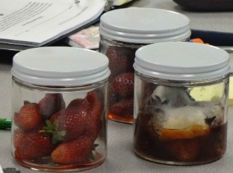
Mass in Food Webs
Compared to the mass of the strawberry jar before the strawberries decompose, what do you predict will happen after they decompose? Will the mass of the system increase, decrease, or stay the same?
Photo courtesy of Cal Poly Pomona
Notes:
PD leader talk: “What do you predict will happen to the mass of the strawberry jar after the strawberries decompose compared to the mass before decomposition? Will the mass of the system increase, decrease, or stay the same? Be prepared to share your predictions with the group.”
PD leader move: Have participants share their predictions and reasoning. Then emphasize that the mass of the system should stay the same before and after decomposition.
PD leader talk: ”Students will complete a similar activity in lesson 5, and we’ll examine that lesson later in the RESPeCT PD program.”

Slide 60
Let’s Summarize!
What have you learned today about mass and energy in food that was new to you?
Today’s content deepening focus question was “How can we trace the matter and energy in food?” Summarize what you’ve learned about tracing matter and energy in food.
What questions do you still have about the focus question?
Notes:
PD leader talk: “Now take a few moments to summarize what you learned about mass and energy today and note any questions you still have about the focus question. Write your responses to the slide questions in your notebooks.”
PD leader move: Discuss participants’ responses to gain insight into questions they may still have about the content deepening focus question.
Note: If time is running short, collect the responses and review them later, noting any questions or confusion that needs to be addressed.

Slide 61
Today’s Focus Questions
What is the Science Content Storyline Lens (SCSL)?
Why is one main learning goal essential for science content storyline coherence?
How can we trace the matter and energy in food?
Notes:
1 min
a. Review the focus questions addressed during today’s session.

Slide 62
Summary: Today’s Lesson Analysis Work
Reflect on today’s session:
STL strategy 6: use and apply
The Science Content Storyline Lens (SCSL)
Science ideas and student ideas
SCSL strategy A: identify one main learning goal
Based on our work today, do you have any suggestions for modifying our image of effective science teaching?
Notes:
3 min
a. Individual think time (1 min): Ask participants to reflect on the work they accomplished during today’s lesson analysis and then think about the question on the slide.
b. Whole-group share-out (2 min): Invite participants to share their ideas for modifying the image of effective science teaching based on today’s work. Revise the chart as needed.

Slide 63
Summary: Today’s Content Deepening Work
Name one main learning goal for today’s content deepening work.
OR
Name one supporting science idea you learned about food webs today.
OR
Name one common student idea (misconception) about food webs.
Notes:
3 min
Individual think time (1 min): Present the options on the slide and give participants 1 minute to come up with a statement that summarizes today’s content deepening work in one of these areas.
Whole-group round-robin (2 min): Go quickly around the room and have each participant share one summarizing statement. Push for complete sentences!

Slide 64
Homework
Read in the STeLLA strategies booklet:
SCSL strategy B: Set the purpose with a focus question or goal statement
SCSL strategy C: Select activities that are matched to the learning goal
SCSL strategy I: Summarize key science ideas
STL strategy 7: Engage students in making connections by synthesizing and summarizing key science ideas
Fill in the appropriate columns on your SCSL Z-fold summary charts.
Notes:
3 min
a. Review the homework assignment on the slide and have participants write it in their notebooks.
b. Make sure participants are clear about the reading and writing tasks.

Slide 65
Extended Homework
Locate handout 5.7 (Extended Homework) in your PD program binder.
Between now and Friday, read your assigned two-part lesson plan (parts A and B).
Be prepared to share your findings in a study-group conversation on our last day.
Notes:
3 min
a. Go over the information on this slide.
b. Have participants review the Extended Homework assignment sheet (handout 5.7), which provides further details about the assignment.
c. Remind participants that like the extended homework they were assigned on the Water Cycle lessons during week 1, participants are responsible for reading parts A and B of their assigned lesson plan.
d. Assign a two-part lesson plan to each participant.
e. Ask if there are any questions about the assignment.
f. Emphasize: The group share-out on the last day of the PD program (day 8) should focus on the assignment-sheet questions (section 2). Participants won’t have time to share all the details of each lesson plan.

Slide 66
Reflections on Today’s Session
Reflect on lesson analysis: In what way(s) did our lesson analysis work and/or our study of SCSL strategy A (one main learning goal) stretch your thinking? Give an example to support your response.
Reflect on content deepening: Describe how our content deepening work today helped you clarify a science-content idea.
Feedback: Provide feedback about today’s session and the program so far (likes, dislikes, questions, concerns, suggestions).
Notes:
7 min
a. Allow at least 5 minutes for participants to think about today’s session and write their reflections and feedback on the Daily Reflections sheet (handout 5.8 in PD program binder).

