Slide 1
RESPeCT PD pROGRAM
Day 6
RESPeCT Summer Institute
Notes:
5 min
a. Take care of any housekeeping issues.

Slide 2
Agenda for Day 6
Day-5 reflections
Focus questions
Review: science content storyline
Lesson analysis: STeLLA strategies B, I, and 7
Content deepening: food webs
Lunch
Content deepening (continued)
Lesson analysis: SCSL strategy C
Summary, homework, and reflections
Notes:
5 min
a. Go over the agenda for the day.

Slide 3
Trends in Reflections
Lesson Analysis | Science Content Learning
Notes:
5 min
a. Give participants time to review your feedback on their reflections from day 5 and offer reactions, comments, or follow-up questions.

Slide 4
Review: Science Content Storyline
In your notebooks, jot down …
things you remember from yesterday’s session,
ideas that seem important to you, and
question you have.
Be prepared to share one idea and question with the group.
3
2
1
Notes:
10 min
a. Point out the three tasks on the slide. Allow 4–5 minutes for participants to write their responses in their science notebooks.
b. Have each participant share one idea about the science content storyline that she or he thinks is really important.
c. Then ask participants to share their questions. If you can answer them quickly, go ahead and do so. If a question needs a more detailed response, write it down and schedule a time to address it.

Slide 5
Today’s Focus Questions
How can we begin and end a lesson to help students develop a coherent science content storyline?
How can selecting appropriate science activities help students develop a coherent science content storyline?
How do plants get the food (matter and energy) they need to live and grow?
How do living things grow bigger?
Notes:
2 min
a. Introduce today’s focus questions.

Slide 6
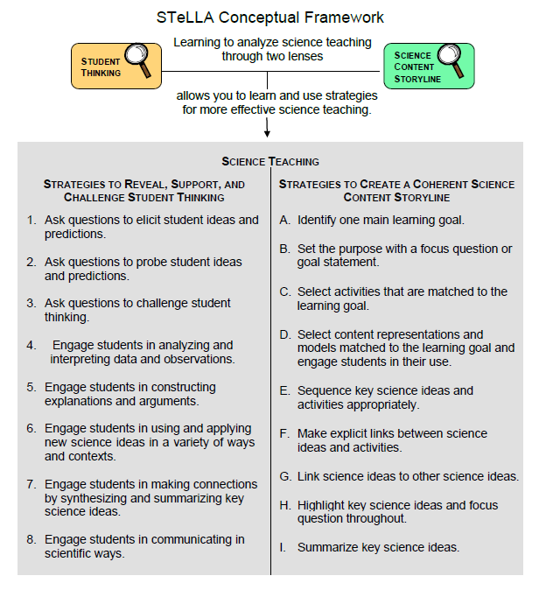
Notes:
3 min
a. “Today we’ll be looking at four new STeLLA strategies. Three of them are Science Content Storyline Lens strategies, and one is a Student Thinking Lens strategy. Throughout the session, think about how these strategies are different from one another and how they are closely linked to each other.”

Slide 7
Lesson Analysis: Focus Question 1
How can we begin and end a lesson to help students develop a coherent science content storyline?
Notes:
Less than 1 min
a. “Now let’s dig into our first focus question.”

Slide 8
Strategies B, I, and 7: Purposes and Key Features
Group 1: What are the purpose and key features of strategy B?
Why is a focus question or goal statement important for science content storyline coherence?
Group 2: What are the purpose and key features of strategy I?
Why is summarizing key science ideas important for science content storyline coherence?
Group 3: What are the purpose and key features of strategy 7?
How does strategy 7 compare with strategy I?
All groups: Make sure to cite ideas from the STeLLA strategies booklet in your answers.
Notes:
25 min
a. Pairs (3 min): Direct participants to retrieve their Z-fold summary charts and share with a partner what they learned from their homework assignment about STeLLA strategies B, I, and 7.
b. Small groups (12 min): Divide participants into three small groups and have them make charts that capture the purposes and key features of the three strategies.
Note: Challenge participants to imagine themselves in a Teacher Leader role. Ask them, “How would you explain these strategies to the teachers you’re leading?”
c. Whole group (10 min): Have small groups share their charts in a whole-group share-out.
Key ideas:
Make sure participants understand that a focus question is designed to do more than just get students interested in the lesson. It gets them thinking about a phenomenon or something else they’ve never thought about before. It also reveals important things about the knowledge and experiences they’re bringing to the lesson, it conceptually situates the learning, and it’s referred to throughout the lesson.
STeLLA strategies B, I, and 7 are like bookends that mark the beginning and end of a lesson. The science ideas used in the summary should match the focus question from the beginning of the lesson, and both the focus question and the summary should match the lesson’s main learning goal.

Slide 9
Discussion Questions: Strategy B
What is the difference between focus questions and goal statements?
Which do you think would be more useful in engaging student interest and making their thinking visible—focus questions or goal statements?
Notes:
7 min
a. Whole group: Discuss the questions on the slide as a group.
Key ideas:
A focus question is designed to be answered using the lesson’s main learning goal and supporting science ideas. A goal statement describes the main science idea to be learned.
Focus questions are always used in RESPeCT lesson plans because they’re useful in engaging student interest, making their thinking visible, and eliciting initial ideas at the beginning of a lesson. When posed at the end of a lesson, focus questions challenge students to use new ideas developed during the lesson.

Slide 10
Discussion Questions: Strategies I and 7
What are various ways a lesson or unit can be synthesized and/or summarized?
How are strategies I and 7 similar and different?
SCSL strategy I: Summarize key science ideas.
STL strategy 7: Engage students in making connections by synthesizing and summarizing key science ideas.
Notes:
7 min
a. Whole group: Discuss the first question on the slide. Participants can refer to the reading for strategy 7 in the STeLLA strategies booklet to identify a variety of ways in which key science ideas in a lesson can be synthesized.
b. Emphasize: “Toward the end of a unit, an entire lesson may be devoted to strategy 7, which engages students in synthesizing and summarizing science ideas across several lessons.”
c. Discuss the second question on the slide.
Key ideas:
In strategy I, the teacher creates a summary of key science ideas in the lesson. Strategy 7, however, engages students in synthesizing and summarizing key science ideas in the lesson. When students themselves perform this work, it makes their thinking visible, engages them in active sensemaking, and reveals to the teacher any misunderstandings or gaps in knowledge. Using both strategies brings coherence to a science lesson and is a powerful way to end it.
In strategy 7, summarizing involves making connections between key science ideas, which helps students synthesize the main learning goal or big idea in a lesson.
Summaries should focus on key science ideas, not activities; that is, focusing on “what we learned” versus “what we did.”
For a variety of reasons, a lesson sometimes ends before the main learning goal has been fully developed. However, summarizing work should still take place. For example, the teacher might say, “Our focus question today was How do plants get their food? What have we found out so far?” After students respond, the teacher could reply, “Yes, so far we’ve discovered that water and soil aren’t food for plants. But we still haven’t figured out what is food for plants. We’ll continue working on this question next time.”

Slide 11
Video-based Lesson Analysis
Next we’ll analyze two video clips from the beginning and end of a Food Webs lesson.
Notes:
Less than 1 min
a. Transition: This slide marks the transition to video-based lesson analysis.

Slide 12
Lesson Analysis: Strategy B
In Analysis Guides B and I (handout 6.1), review the four criteria for strategy B: Setting the purpose.
Read the lesson context for the first video clip at the top of the transcript (handout 6.2).
Watch the video clip, keeping in mind the criteria for strategy B.
Analyze the transcript using the analysis guide.
How well does the beginning of this lesson match the criteria for strategy B?
Share and compare your analyses.
Link to McCabe Video Clip 6.1: 6.1_role001-2-284-lvtf_300_mccabe_c2
Notes:
20 min
a. Have participants locate Analysis Guides B and I (handout 6.1 in PD program binder) and spend 1 or 2 minutes reading the criteria for strategy B: Setting the purpose.
b. Ask: “Do you have any questions about these criteria?”
c. Emphasize: “Keep the criteria for strategy B in mind as you watch the video clip from the beginning of a Food Webs lesson.”
d. Individuals: Give participants a couple of minutes to read and think about the lesson context at the top of the video transcript (handout 6.2).
e. Show the video clip.
f. Whole group: “How well does the beginning of this lesson match the criteria for strategy B?”
Note 1: During the discussion, be on the lookout for opportunities to clarify science-content ideas.
Note 2: For a sample analysis of the video clip using Analysis Guide B criteria, see PD Leader Master: 5th-Grade Guide to McCabe Video Clips for Day 6.

Slide 13
Lesson Analysis: Strategy I
In Analysis Guides B and I (handout 6.1), review the six criteria for strategy I: Summarizing key science ideas.
Read the lesson context for the second video clip at the top of the transcript (handout 6.3).
Watch the video clip, keeping in mind the criteria for strategy I.
Analyze the transcript using the analysis guide.
How well does the end of this lesson match the criteria for strategy I?
Share and compare your analyses.
Link to McCabe Video Clip 6.2: 6.2_role001-2-284-lvtf_300_mccabe_c3
Notes:
20 min
a. Allow participants 1 or 2 minutes to read the six criteria in the analysis guide for strategy I: Summarizing key science ideas.
b. Ask: “Do you have any questions about these criteria?”
c. Emphasize: “Keep the criteria for strategy I in mind as you watch the video clip from the end of the same Food Webs lesson.”
d. Individuals: Give participants a couple of minutes to read and think about the lesson context at the top of the video transcript (handout 6.3).
e. Show the video clip.
f. Whole group: “How well does the end of this lesson match the criteria for strategy I? How well does the summary statement match the beginning of the lesson?”
Note: For a sample analysis of the video clip using criteria from Analysis Guide I, see PD Leader Master: 5th-Grade Guide to McCabe Video Clips for Day 6.

Slide 14
Food Webs Lesson Plans: Reading and Analysis
Examine the main learning goal, the lesson focus question, and the lesson summary for your assigned Food Webs lesson plan (parts A and B).
Answer these questions in your notebooks, keeping in mind the analysis-guide criteria for strategies B and I:
What do you notice?
What do you wonder about?
Notes:
10 min
Note: This slide can be abridged or skipped if time is running short.
a. Read the instructions on the slide and assign a two-part lesson plan (parts A and B) to each participant.
b. Ask participants if they have any questions about the assignment.
c. Individual reading-and-analysis time (5 min): “Answer the slide questions in your notebooks, keeping in mind the analysis-guide criteria.”
d. Whole-group discussion (5 min): Briefly discuss participants’ observations and questions for their assigned lesson plans.
Note: Participants should see a close match between the main learning goal, the lesson focus question, and the summary. However, also welcome critiques and suggestions for improvement. Just make sure critiques are based on good understandings of the strategies involved.

Slide 15
Food webs
SCIENCE CONTENT DEEPENING Grade 5
Notes:
Note: Throughout this content deepening phase, refer as needed to the Food Webs Content Background Document and Common Student Ideas about Food Chains and Food Webs.
PD leader move: This slide marks the transition to the content deepening work.
Timing note: To keep things moving so you don’t run out of time during this phase, adhere as closely as possible to the time you’ve allotted for each slide. If you’re running short on time, you may need to abridge or skip some of the group discussion.

Slide 16
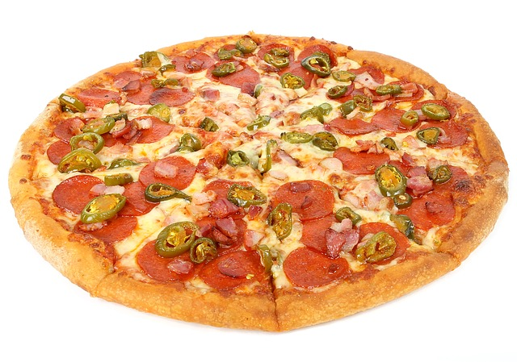
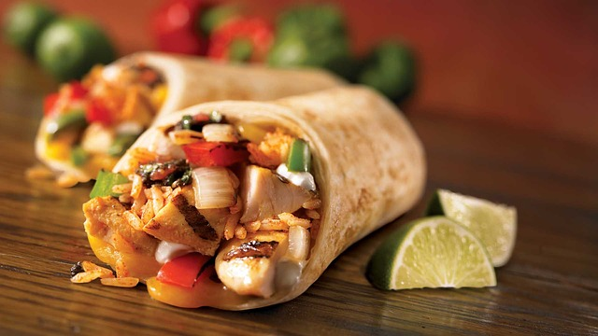
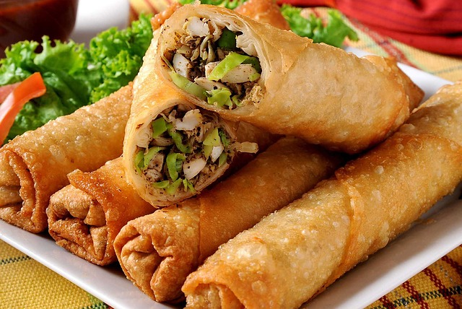
Yesterday’s Focus Question
How can we trace the matter and energy in food?
Photo courtesy of Pixabay.com
Photo courtesy of Pixabay.com
Photo courtesy of Pixabay.com
Notes:
PD leader move: Remind participants of the content deepening focus question from the previous session.
PD leader talk: “For review and to help you conceptualize an answer to this focus question, we’re going to make a model that demonstrates what happens in a closed system during a chemical reaction.”

Slide 17
The Alka-Seltzer Activity: A New Model
Gather these linking cubes for the activity: 10 blue (hydrogen), 5 red (carbon), 15 white (oxygen).
Join the linking cubes to make 5 bicarbonate molecules, leaving 5 hydrogen atoms:
Hydrogen Bicarbonate
H⁺ + HCO₃⁻
+
Notes:
PD leader talk: “Gather the linking cubes you’ll need for this activity, as well as a piece of chart paper and a marker.”
PD leader move: As participants assemble these materials, tell them that each of the linking cubes represents a specific “bit,” or atom, of matter. The model they’ll be making will include three types of atoms:
Hydrogen atoms (blue linking cubes)
Oxygen atoms (white linking cubes)
Carbon atoms (red linking cubes)
PD leader talk: “One of the main components of Alka-Seltzer is sodium bicarbonate. As the tablet dissolves, the sodium bicarbonate breaks down to form bicarbonate ions, which react with hydrogen to form water and carbon-dioxide gas.”
PD leader move: Demonstrate for participants how to construct the bicarbonate ions with the linking cubes.

Slide 18
What Just Happened?
Draw a big water bottle (with a cap) on chart paper.
Use the linking cubes to show what happened in the chemical reaction as the 5 hydrogen atoms and 5 bicarbonate molecules were rearranged to form carbon-dioxide and water molecules.
Explain why the mass in the system stayed the same.
Water (H₂O)
Carbon dioxide (CO₂)
Notes:
PD leader talk: “Now I’d like you to work in small groups to complete the tasks on the slide.”
PD leader move: Have each small group demonstrate how the bicarbonate ions break down to form water and carbon dioxide. Ask probe and challenge questions to move participants’ thinking forward.
PD leader move: Following the activity, hold a brief whole-group discussion about what happened during the reaction.
PD leader talk: “Why do you think the mass in the system stayed the same?”
Answer: None of the bits of matter left the system, so the mass stayed the same. New molecules were formed when these bits of matter changed partners, but the matter was still matter. None of it disappeared or was destroyed in the reaction.

Slide 19
Alka-Seltzer and Burning Food
How does the Alka-Seltzer activity relate to burning food?
Water (H₂O)
Carbon dioxide (CO₂)
Hydrogen Bicarbonate
H⁺ + HCO₃⁻
+
Notes:
PD leader move: Briefly discuss the question on the slide, emphasizing that in both reactions (Alka-Seltzer and the burning food), carbon dioxide (CO₂) and water (H₂O) were released, and mass was conserved. So all the bits of matter (linking cubes, or atoms) that were present at the beginning of each activity were still there at the end.
Note: Most participants won’t recognize this, but in both reactions, thermal energy was also released.
PD leader talk: “When the food burned, most of the matter in the food underwent a chemical change, and carbon dioxide and water were released. If the food in a person’s body burned, carbon dioxide would be exhaled, and the person would lose mass, since a body isn’t a closed system.”

Slide 20
Did the Activity Match the Learning Goals?
How did the Alka-Seltzer activity connect to these learning goals from yesterday’s content deepening work?
Matter is conserved in chemical reactions.
All the matter in a closed system remains in the system and can be traced.
How closely did the activity match these goals?
Notes:
PD leader move: Read the content deepening learning goals on the slide and briefly discuss the question to help participants build connections between the science content and the activities.
PD leader talk: “Did the Alka-Seltzer activity match these learning goals?”

Slide 21
Review: What Is NOT Food?
Name something that living things take into their bodies that is NOT food according to the scientific definition (but your students may think of as food).
Be ready to give a reason for your choices.
Notes:
PD leader move: Read the instructions on the slide. Mention that this task comes from lesson 2a of the Food Webs unit, and the next segment of the content deepening phase will follow that lesson somewhat closely.
PD leader talk: “Work individually for 1 or 2 minutes on this task. Make sure to name an item that is not considered food according to the scientific definition but may be something your students think of as food.”
Note: If participants need to review the scientific definition of food, show the next slide.
PD leader move: Have participants share their responses with the group. Answers may include carbon dioxide, plant food, vitamins, diet sodas, or water.

Slide 22
The Scientific Definition of Food
Food is matter (building materials) that contains energy living things can use to live and grow, to heal wounds, and to keep all their parts working.
Notes:
Note: Refer to this slide if participants need to review the scientific definition of food to complete the task on the previous slide.
PD leader move: Have participants write this definition in their notebooks (if they didn’t yesterday).

Slide 23
Content Deepening: Focus Question 1
How do plants get the food (matter and energy) they need to live and grow?
Notes:
PD leader move: Introduce the first content deepening focus question for the session.
PD leader talk: “Take a moment to write this focus question in your science notebooks.”
PD leader talk: “Now let’s talk about how yesterday’s focus question (“How can we trace the matter and energy in food?”) relates to this focus question. How do these questions create a coherent science content storyline?”
Note: This focus question appeared in an earlier version of lesson 2 and doesn’t reflect the current lesson plan.

Slide 24
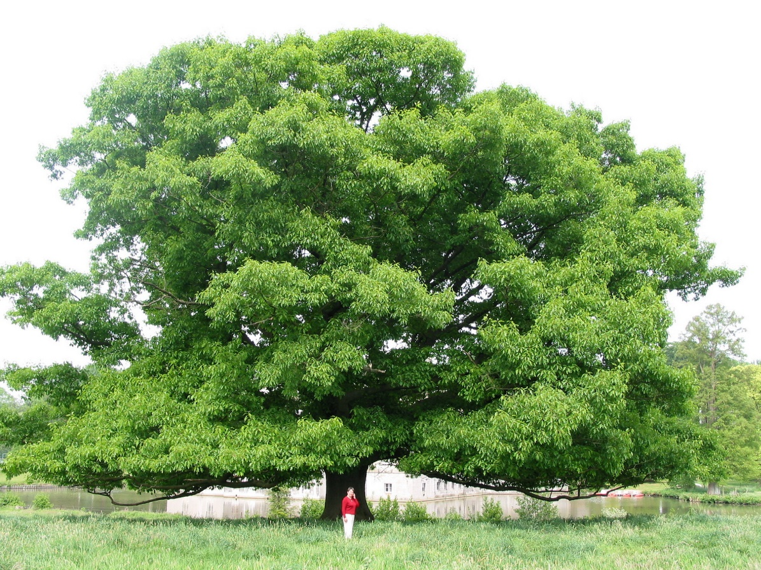
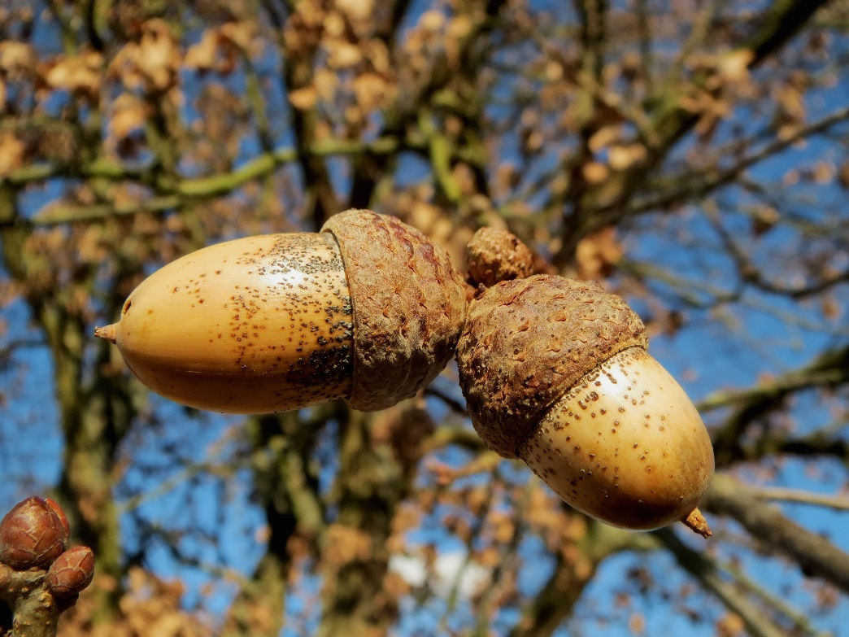
How Do Plants Get the Food They Need to Live and Grow?
Photograph by Jean-Pol Grandmont
Photo courtesy of Pexels.com
Notes:
PD leader talk: “The large oak tree on this slide grew from a tiny acorn.”

Slide 25
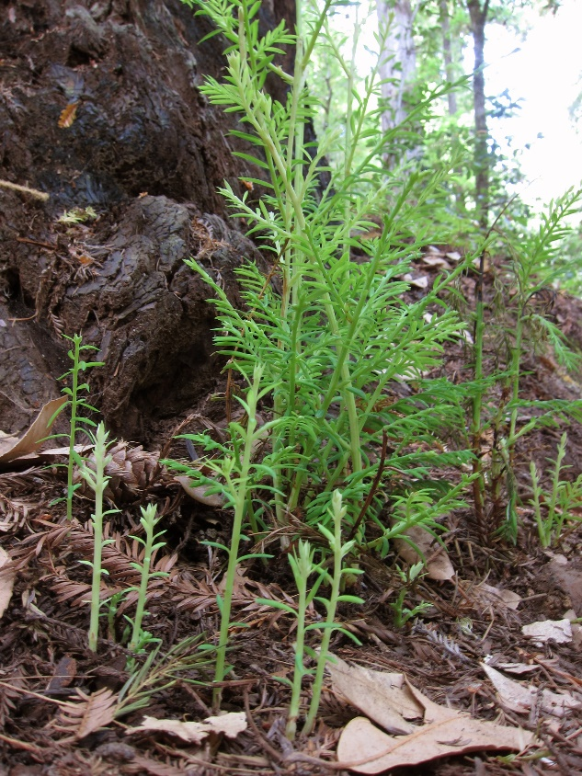
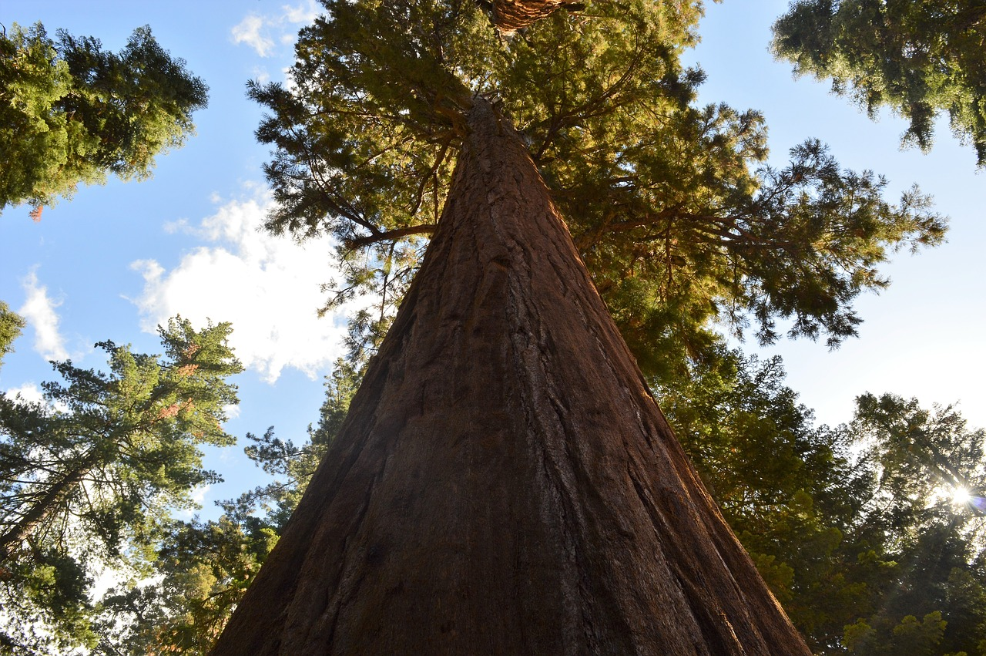
Seedling to Sequoia
Photograph by Milton Taam
Photo courtesy of Pixabay.com
Notes:
PD leader move: Now show the images of a tiny sequoia sapling and a gigantic sequoia tree.
PD leader talk: “How do trees get the food they need to live and grow bigger? How does a tiny sapling turn into a huge oak or sequoia tree?”
PD leader move: Give participants a minute to discuss their ideas with a partner.

Slide 26
How Do Plants Get Their Food?
Our Ideas about What Is Food for Plants | Evidence to Support Our Claims | Evidence to Challenge Our Claims
Notes:
PD leader talk: “Let’s hear your ideas about how plants get their food.”
PD leader move: Write each idea on chart paper, using the table on the slide as a model. After participants share four or five ideas, ask for evidence that supports and challenges each idea. Have participants write their supporting evidence on sticky notes and add them to the chart.

Slide 27
Investigation 1: Are Water and Carbon Dioxide Food for Plants?
I think water (is or is not) food for plants. My evidence is _____________.
I think carbon dioxide (is or is not) food for plants. My evidence is _______________.
Now read the sections for activity 1 (including setup and follow-up) in lesson 2a. Discuss how the teacher engages students in using and talking about evidence.
Notes:
PD leader talk: “Think about the scientific definition of food and whether you already have any evidence to answer the questions on the slide.”
Note: If it doesn’t come up, encourage participants to consider evidence from the nutrition labels they looked at yesterday.
PD leader move: Help participants come to the conclusion that both water and carbon dioxide have mass, but since they don’t have energy plants can use, they aren’t considered food. Again, it’s important to note that water and carbon dioxide do indeed have energy. They just don’t have the kind of energy plants can use to live and grow.
PD leader talk: “Read the sections in the lesson plan where this activity appears.”
Note: Direct participants to activity 1 in lesson 2a, including the setup and follow-up sections. If participants notice that the focus question in the current lesson plan isn’t the same as the one presented on slide 23 or in the video clips, remind them that the question appeared in an earlier version of lesson 2.
PD leader move: After participants have read the relevant content in the lesson plan, have a brief group discussion about the key STeLLA strategies in highlighted in this lesson.

Slide 28
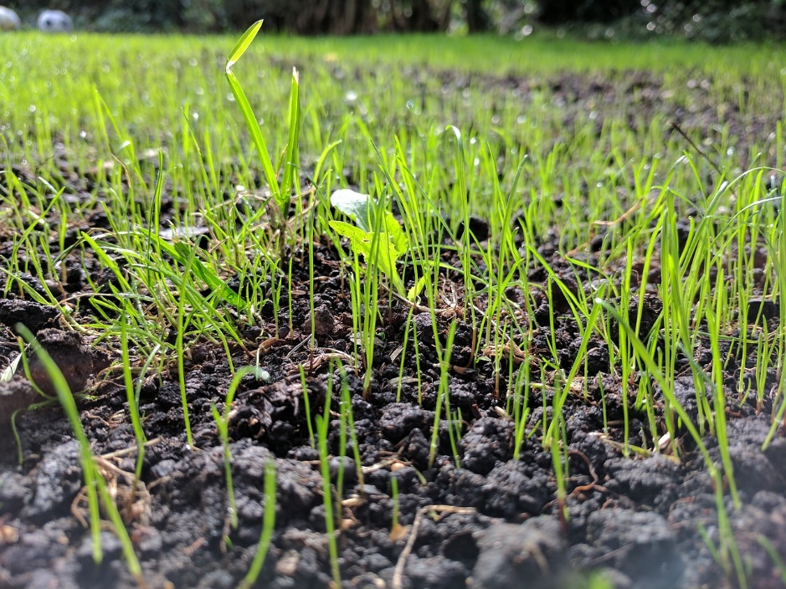
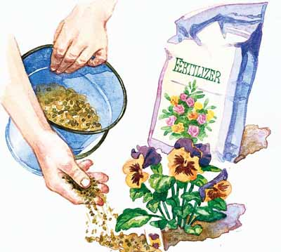
Investigation 2: Is Soil Food for Plants?
Read about Jan van Helmont’s experiment.
Photo courtesy of Pixabay.com
Notes:
PD leader talk: “Let’s consider a classic experiment to help us answer the question, Is soil food for plants?”
PD leader move: Ask participants to pair up and read about Jan van Helmont’s experiment in Investigation 2 of Food Webs lesson handout 2.1 (What Is Food for Plants?). Then have them talk about the results and answer the analysis questions on page 3 of the handout.
PD leader move: When pairs have completed their analyses, briefly discuss their observations and responses to the questions as a group.
PD leader talk: “Now let’s read and discuss the teacher’s content note in the lesson plan that explains the loss of mass in Van Helmont’s experiment:”
CONTENT NOTE: The slight loss of mass in the soil can be explained in several ways. It could have been a measurement error, especially given that measurement tools in Van Helmont’s day weren’t very sensitive. It also could have been that some dust in the soil got blown out of the pot. Or it could have been due to the non-energy-containing matter (minerals) that plants take in and use to maintain health and build cell parts (like vitamins for humans). This matter is partly what decomposers leave behind, but it isn’t energy-providing food. The minerals from the soil add a tiny bit of mass to the plant, but they don’t provide energy or account for the large growth in the plant’s mass over time. Avoid going into these details with students; instead, emphasize the main point that plants don’t get their mass/food from the soil. Therefore, soil (and minerals in the soil) aren’t food for plants.
PD leader move: Highlight the main conclusion about soil in the lesson plan: “Van Helmont’s experiment shows us that soil is not food for plants because the mass of the soil stayed essentially the same over a period of five years, while the mass of the tree increased a lot.”

Slide 29
Investigation 3: Is Sunlight Food for Plants?
We think plants (need or don’t need) sunlight. Our evidence is __________.
We think sunlight (is or is not) food that plants can use to live and grow. Our reasoning is __________.
Photo courtesy of Pexels.com
Notes:
PD leader talk: “The third investigation in the lesson handout explores the question, Is sunlight food for plants? To answer this question, pair up and complete the statements on the slide, making sure to provide evidence and reasoning for your responses.”
PD leader move: Give pairs 5 minutes to work on their answers; then elicit participants’ ideas in a brief group discussion.

Slide 30
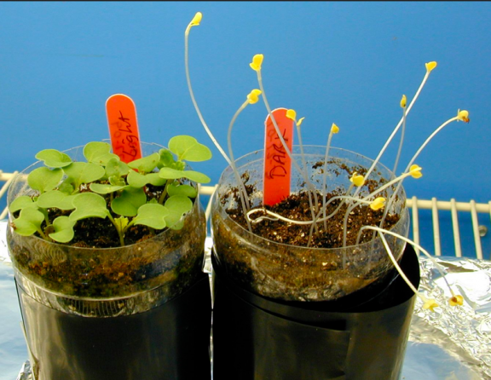
Mustard Plants
Photo courtesy of Wisconsin Fast Plants Program, College of Agricultural and Life Sciences: University of Wisconsin-Madison, Fastplants.org
Notes:
PD leader talk: “These small mustard plants in this photo were grown from seeds in light and dark conditions. The plants on the left were grown in the light, and the plants on the right were grown in the dark.”
PD leader talk: “How would you describe the differences between the plants grown in the light and those grown in the dark? What do you observe?”

Slide 31
Grass Seed
Photograph by Kate Wright
Notes:
PD leader move: Show further examples of plants grown in the light and the dark.
PD leader talk: “This image shows grass seed grown in light and dark conditions.”
PD leader talk: “From what you observe, do you think plants need sunlight to live and grow? Is sunlight food for plants? What is your evidence and reasoning?”

Slide 32
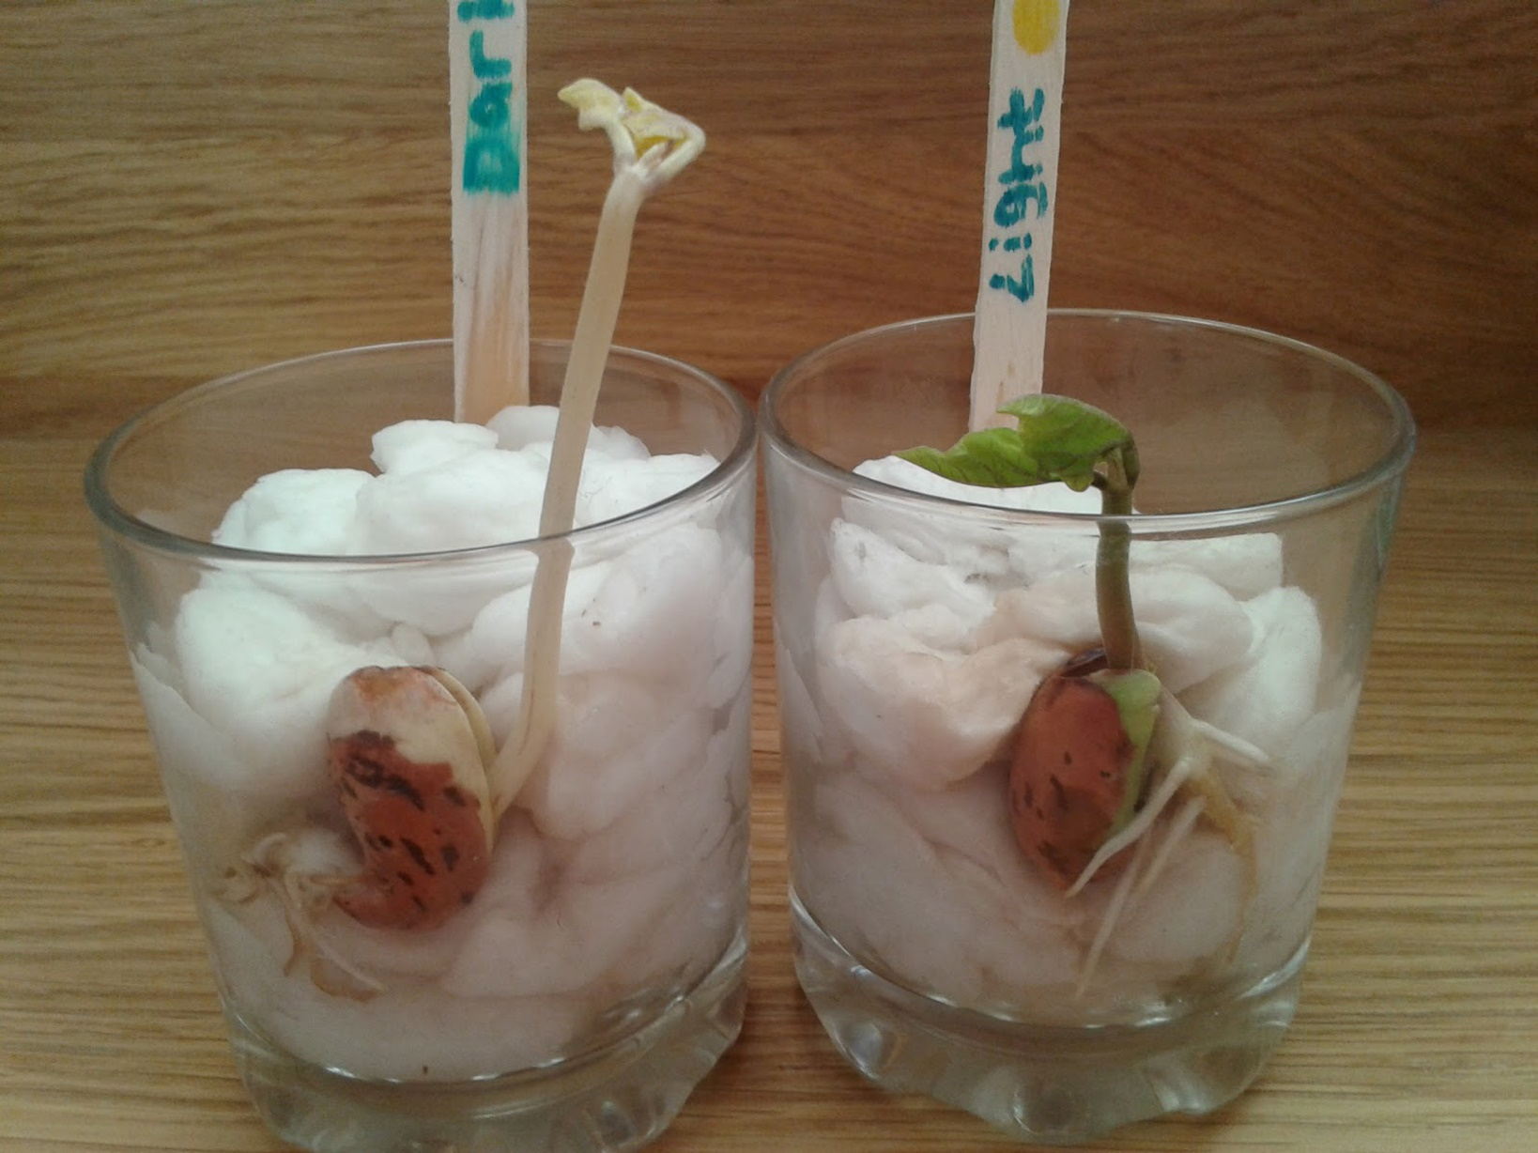
Bean Plants
Photograph by Kirsty Lawson
Notes:
PD leader move: Show a final image of bean plants grown in the dark and the light.
PD leader talk: “Based on this evidence, do you think many students will conclude that sunlight is food for plants? Why or why not?”
PD leader move: Emphasize that the photos clearly demonstrate that plants need light, which may lead many students to conclude that plants “eat” light.
PD leader move: Before displaying the next slide, read, as a group, the science-content paragraph on the last page of lesson handout 2.1.

Slide 33
Is Sunlight Food for Plants?
Sunlight (is or is not) food for plants by the scientific definition because ___________.
Notes:
PD leader talk: ”So is sunlight food for plants? Complete the statement on the slide in your notebooks, making sure to support your answers with evidence.”

Slide 34
Wrapping Up Our Investigations
What conclusions have we reached about these materials?
Is water food for plants?
Is carbon dioxide food for plants?
Is soil food for plants?
Is sunlight food for plants?
Notes:
PD leader talk: ”Now let’s summarize the evidence we gathered in our investigations for why none of the materials listed on the slide are food for plants.”

Slide 35
So What Is Food for Plants?
Sugar!
Photo courtesy of Pixabay.com
But how do plants make sugar?
Notes:
PD leader move: Click through the information on the slide, revealing one line at a time.
PD leader talk: “Now I’m going to perform a short demonstration from one of the Food Webs lessons to help us think about how plants make sugar.”

Slide 36
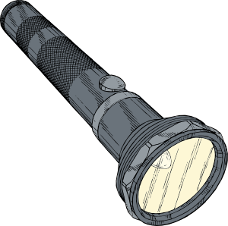
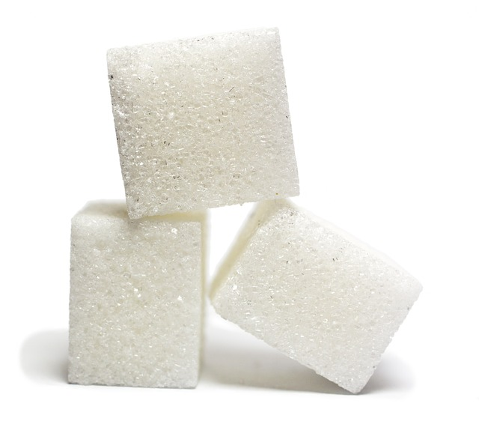
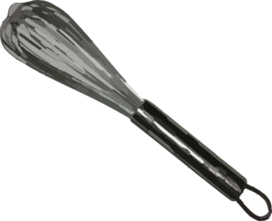
Photosynthesis Demonstration
Notes:
PD leader move: Perform the demonstration from Food Webs lesson 2b described below. Alternatively, you could have participants review the procedure in the lesson plan, and a volunteer could lead the group through the demonstration.
PD leader talk: “Scientists have learned that water, carbon dioxide, and sunlight are not by themselves food for plants. But plants can do something with these two kinds of matter (water and carbon dioxide) and one form of energy (sunlight). Here’s one way of imagining what is happening inside a plant.
“This green bowl represents a plant leaf. The leaf takes in water from the roots. Can someone pour some water into this leaf? The leaf also takes in carbon dioxide from the air that enters through tiny holes in the leaf. I have a baggie filled with air that contains carbon dioxide. Can someone give the leaf some carbon dioxide?
“Now we need someone to be the Sun and shine this flashlight on the leaf. When water, carbon dioxide, and sunlight come together, an amazing set of chemical reactions takes place in the leaf. I’ll represent those chemical reactions with this mixer. The plant rearranges the bits of carbon dioxide and water and changes them into sugar, which contains both matter and a new form of stored energy that we call food energy. [Show some sugar or sugar cubes.]
“So carbon dioxide by itself isn’t food for plants, water by itself isn’t food for plants, and sunshine by itself isn’t food for plants. But the plant can take these three things and make or produce food. This is why scientists call plants producers.”
PD leader move: Tell participants this process is called photosynthesis.

Slide 37
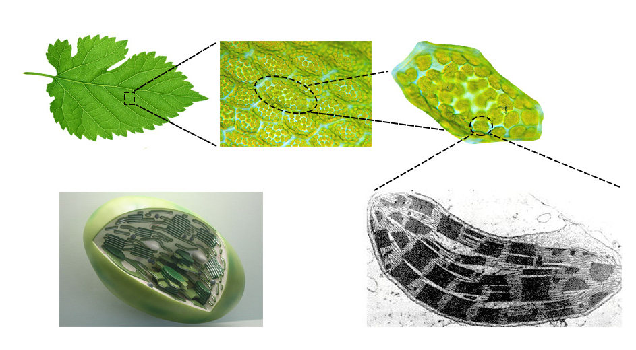
The Role of Chloroplasts in Photosynthesis
Leaves contain millions of chloroplasts.
1.
2.
3.
Cell
Chloroplasts are highly structured, membrane-rich organelles.
4.
5.
Chloroplasts
Photographs courtesy of Pixabay.com and Wikimedia.org
Notes:
PD leader move: Briefly review some of details of photosynthesis so participants have a stronger basis for understanding the model used in lesson 2b.
PD leader talk: “Look at image 1 on the slide. If this leaf were magnified, you’d see that it’s made up of tiny cells, seen in image 2. Image 3 shows a close-up of one of these cells, which has a lot of green ovals inside it. Each of these ovals is called a chloroplast. Image 4 is a protype version of a chloroplast, and image 5 was taken with a special instrument called a transmission electron microscope, which shows the membranes inside a chloroplast. All the complex reactions that take place during photosynthesis occur in the chloroplast.”

Slide 38
Matter and Energy in Photosynthesis
Photosynthesis is used to transform light energy into chemical-bond energy.
CO₂ and H₂O and Light E → Carbohydrates (Sugars) and Oxygen
from Air
from Soil
from Sun
Notes:
PD leader talk: “For photosynthesis to occur, plants need both matter and energy. Carbon dioxide from the air and water from the soil supply the matter, and sunlight provides the energy. When light energy from the Sun is present, plants convert the carbon dioxide and water into carbohydrates (or sugars) and oxygen in a chemical reaction. Sugars make plants bigger and are also a source of energy.”

Slide 39
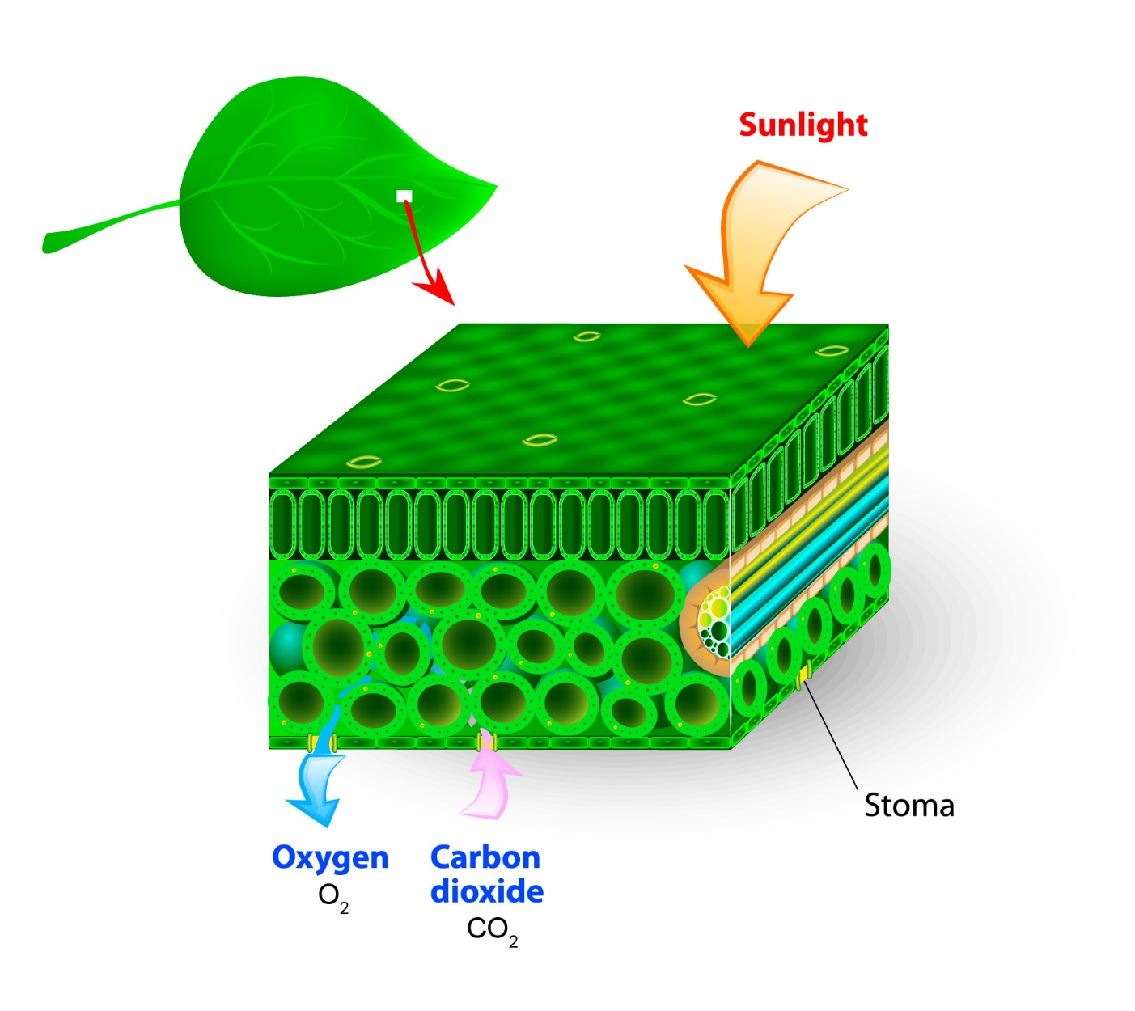
How Does Carbon Dioxide Enter a Leaf?
Carbon dioxide diffuses into leaves through stomata.
Leaf Surface
Interior of Leaf
Notes:
PD leader talk: “For photosynthesis to happen, a plant needs to take in carbon dioxide from the air. The image on the slide shows a cross section of a leaf with a pore or hole on the underside called a stoma. This hole allows carbon dioxide to enter the leaf. Plants can open and close their stomata.”

Slide 40
Reading: How Plants Use Matter and Energy
Read section 3.6 in the Food Webs Content Background Document: How Does Energy Get into the Food Web.
Highlight in one color any content that relates to matter.
Highlight in another color any content that relates to energy.
Summarize three main points from the reading.
Add two statements you have questions about.
Notes:
PD leader move: Have participants read section 3.6 in the content background document: How Does Energy Get into the Food Web?
PD leader move: Emphasize the following teacher learning goals (from the Food Webs lesson plans binder):
The process of photosynthesis converts carbon dioxide and water into sugars and released oxygen (section 3Ta).
Photosynthesis produces sugars that can be used immediately or stored for growth or later use (section 3Tb).
Most of the matter plants use for growth originates from carbon dioxide and water (section 3Tc).

Slide 41
What Happens to the Sugar Molecules?
Here’s what can happen to the sugar molecules produced during photosynthesis:
Sugars + enzymes → fats
Sugars + nitrogen from soil (and other elements) → proteins
Sugars + nitrogen and phosphorus from soil → DNA and RNA
In other words, sugar molecules and inorganic nutrients (like nitrogen and phosphorous) are used to make larger molecules (like proteins and DNA), which are used to form new plant cells. And new cells = growth!
Notes:
PD leader move: Read the information on the slide. These ideas also appear in the Food Webs Content Background Document.
PD leader talk: “Many people think that plants only make sugars, but in fact, they use sugar molecules to produce other molecules, including proteins, fats, and DNA, which are used to form new cells and make the plants grow bigger.”

Slide 42
Plants Are Producers That Make Food!
Food Molecules (Sugar)
Carbon Dioxide
Water
Oxygen
PRODUCES
MATTER THAT CONTAINS STORED ENERGY
MATTER THAT DOES NOT PROVIDE ENERGY
Notes:
PD leader talk: “Now let’s use the knowledge we’ve gained about photosynthesis to compare and contrast two diagrams.”
PD leader move: Review the diagram on this slide before advancing to the next slide.

Slide 43
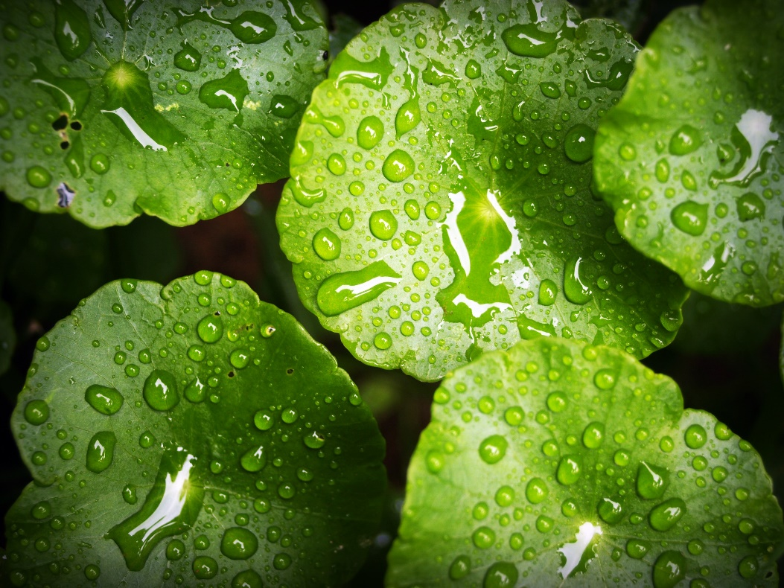
Plants Are Producers That Make Food!
Oxygen
Light Energy
Water
Plant makes food molecules (sugar)
Carbon Dioxide
Photo courtesy of Pexels.com
Matter that does not provide energy for living things
Matter that contains stored energy for living things to use
Notes:
PD leader move: First ask participants to compare and contrast the two representations of photosynthesis. (Switch back and forth between this slide and the previous slide as needed.)
PD leader move: Highlight the following similarities and differences between the two representations of photosynthesis:
In both diagrams, matter that doesn’t provide energy for living things is converted to matter that has stored energy living things can use.
The first diagram relies on words in an equation to make this point, while the second uses an image of plant leaves with labels and arrows to describe what happens during photosynthesis.
In the first diagram, students may not recognize that the sugars (food molecules) a plant produces are part of the plant itself. In the second diagram, this is clearer; however, it’s less clear that a set of chemical reactions leads to the formation of food molecules (sugar) and oxygen.
PD leader talk: “What are the strengths and weaknesses of each representation?”
Note: Discussing content representations and engaging participants in their use foreshadows STeLLA strategy D, which will be the focus of the next session.

Slide 44
Did the Activity Match the Learning Goal?
How did the investigations connect to these learning goals?
The process of photosynthesis converts carbon dioxide and water into sugars and released oxygen.
Most of the matter that plants use for growth comes originally from carbon dioxide and water.
The process of photosynthesis converts light energy to stored chemical energy in food molecules.
How closely did these activities match the learning goals?
Notes:
PD leader move: To help participants build connections between the science content and pedagogy work, read the learning goals on the slide and briefly discuss how well the three investigations matched these goals.

Slide 45
Content Deepening: Focus Question 2
How do living things grow bigger?
Notes:
PD leader move: Read the second content deepening focus question on the slide.

Slide 46
How Do Living Things Grow Bigger?
To help us answer this question, let’s look at some images of growing organisms.
Links to time-lapse videos:
http://www.youtube.com/watch?v=LICDb8nM5rs (tomato seedlings); https://www.youtube.com/watch?v=ISYBpayqL-0 (German shepherd)
Notes:
Note: Show participants either the time-lapse videos listed on this slide (if you have an Internet connection) or the photos of young and adult organisms on slides 47–54.
PD leader talk: “As you [watch the time-lapse videos video/look at the pictures] of growing organisms, think about the focus question, How do living things grow bigger?”

Slide 47
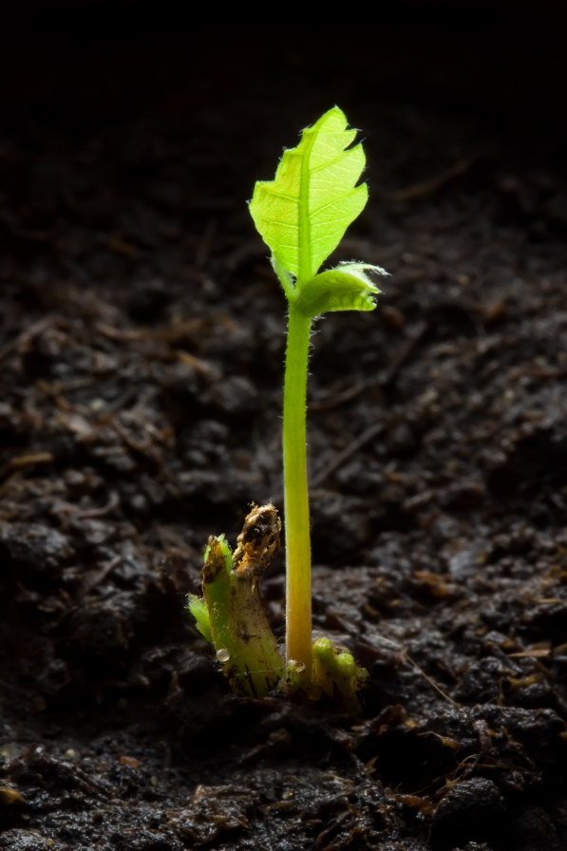
Photograph by Jean-Pol Grandmont
Photograph by Fotofermer
Notes:
2-day newborn oak sapling
Large Quercus rubra, Red Oak Tree

Slide 48
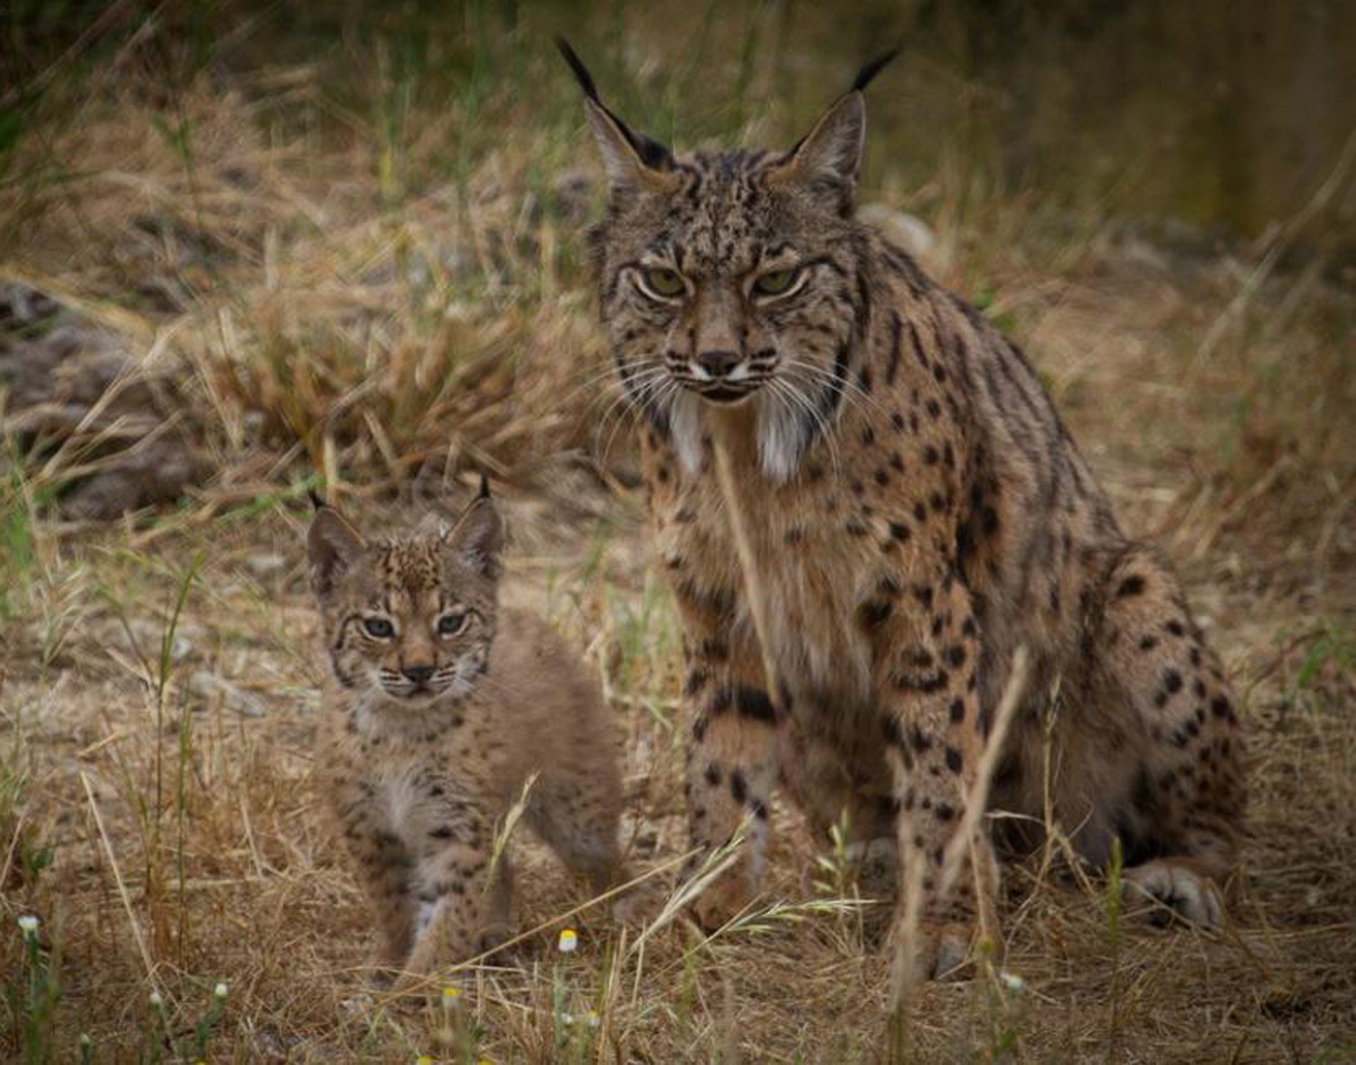
Photo courtesy of Lynxexsitu.es
Notes:
Lynx

Slide 49
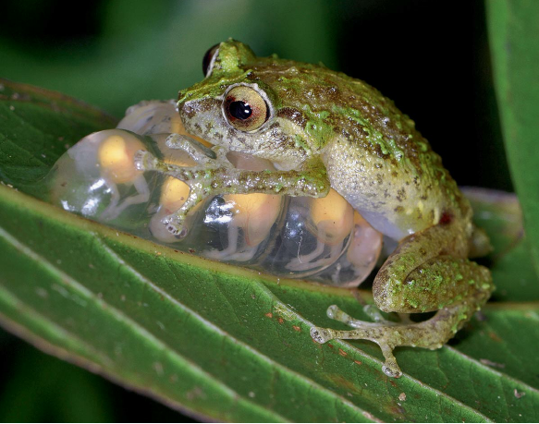
Photograph by Gregory Johnston
Notes:
Frog guarding froglets

Slide 50
Photo courtesy of Pixabay.com
Notes:
Brown bear and cub

Slide 51
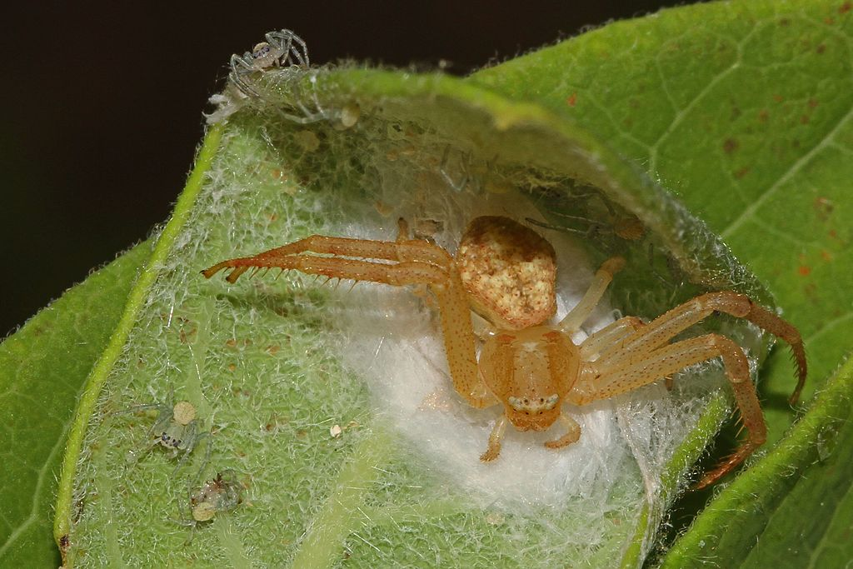
Photo courtesy of Wikimedia.org
Notes:
Spider and babies

Slide 52
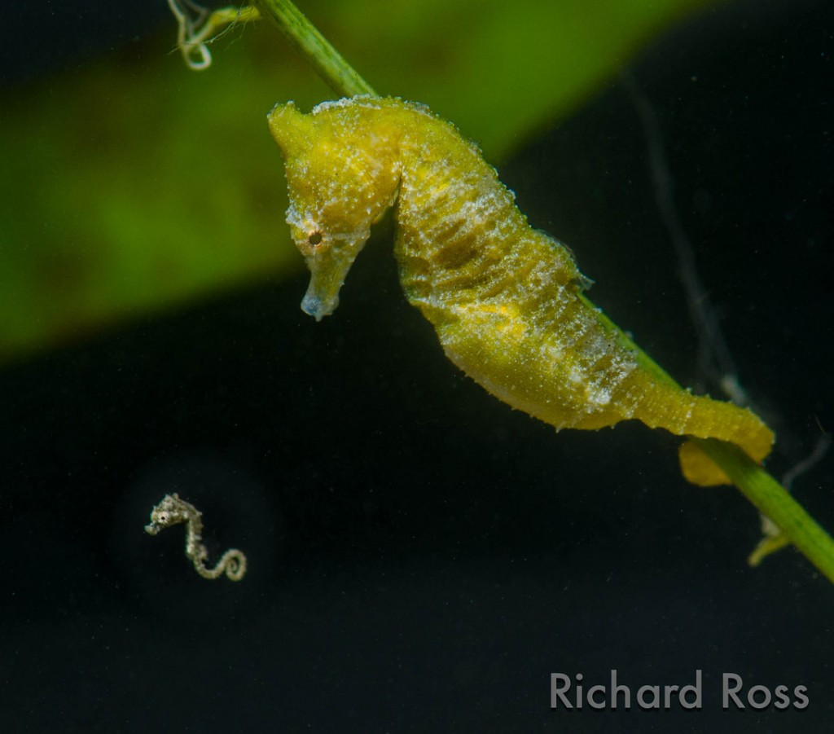
Photograph by Richard Ross
Notes:
Seahorse and baby

Slide 53
Photo courtesy of Pixabay.com
Notes:
Polar bear and cubs

Slide 54
How Do Living Things Grow Bigger?
After looking at these images of growing organisms, how would you answer this focus question?
Write your ideas in a complete sentence.
Notes:
PD leader move: After participants have looked at the images, ask them to write a possible answer to the focus question in their science notebooks. Remind them to use complete sentences.

Slide 55
Building a Food Web
Build a simple food web using your tree, squirrel, and mountain lion place mats.
Arrange the place mats in an order that shows what eats what.
Notes:
PD leader move: Distribute the laminated tree, squirrel, and mountain lion place mats from Food Webs lessons 3a and 3b (handouts 3.1, 3.2, and 3.3).
PD leader talk: “Using your tree, squirrel, and mountain lion organism place mats, build a simple food web, arranging the mats in an order that shows which organism eats another organism.”

Slide 56
What Happens to Matter in a Food Chain?
First, let’s create a model that shows how plants grow. Follow the steps in lesson 3a.
Use linking cubes to make 20 carbon-dioxide (CO₂) molecules, 10 water (H₂O) molecules, and 4 food (sugar) molecules.
Place one food molecule on the tree.
Place the carbon-dioxide molecules in the air surrounding the tree, and the water molecules in the soil near the tree.
Hold up one CO₂ molecule and one H₂O molecule to the light for energy.
Keep building food molecules and placing them on the tree until you run out.
Carbon-Dioxide Molecule (CO₂)
Water Molecule (H₂O)
Food Molecule (Sugar)
Notes:
PD leader move: Guide participants through this activity from Food Webs lesson 3a. To model plant growth for participants, demonstrate what the three types of molecules should look like based on the slide images. Make 20 linking-cube carbon-dioxide molecules, 10 linking-cube water molecules, and 4 linking-cube food/sugar molecules.
PD leader talk: “Turn to the section in lesson 3a where this activity appears in your lesson plans binder. Then follow the steps to show how plants grow.”
Place one food molecule on the tree poster/place mat. This baby tree is made up of food molecules, but not a lot of them.
Place the CO₂ molecules in the air surrounding the tree.
Place water molecules in the soil on the poster/place mat.
Take one CO₂ molecule and one water molecule and hold them together up toward the light (the Sun) to get energy. With this energy from the Sun, take the CO₂ and H₂O molecules apart and then rearrange the cubes to build sugar molecules. Emphasize that energy is now stored in the links between each of the cubes. The food molecules have stored energy.
As you build food molecules, place them on the tree poster/mat. The tree gets bigger by making more and more food molecules and using them as building blocks for its body structures.
Keep going through this process of building food molecules and growing the tree until you run out of linking cubes.
Note: A simplified version of a food molecule is used in this model to make the science content easier for students to grasp. In reality, a glucose or sugar molecule has a chemical formula of C₆H₁₂O₆ (which means there are 6 carbon atoms, 12 hydrogen atoms, and 6 oxygen atoms in one glucose molecule).

Slide 57
What Happens to Matter in a Food Chain?
Do you think animals grow bigger by making their own food like plants do?
Let’s use our organism place mats to show how animals grow bigger as matter moves from organism to organism in a food chain.
Notes:
PD leader talk: “Do you think animals can grow by making their own food molecules like plants do?”
PD leader move: Emphasize that the answer to this question is no. Then demonstrate how animals grow bigger by guiding participants through these steps from lesson 3b:
To show how the squirrel gets bigger, let’s imagine that it’s eating some of the nuts on this tree. When it does this, it takes food molecules the tree made and adds these molecules to its own body to grow bigger.
To model how the squirrel grows bigger by using this matter, move food molecules from the tree to the squirrel. But don’t move all of the food molecules, because the squirrel doesn’t eat the whole tree!
The mountain lion is going to get the matter (or food molecules) it needs to grow bigger by eating most of the squirrel (it doesn’t eat the bones).
So move most of the food molecules from the squirrel to the mountain lion to show how the mountain lion will grow bigger using the matter (or food molecules) it got from eating the squirrel.

Slide 58
Discussion Questions
How do living things get bigger? How do they grow?
Where did the mountain lion’s food matter come from at the very beginning?
Notes:
PD leader talk: “Answer the questions on the slide in your notebooks, and be prepared to share your ideas with the group.”
PD leader move: Invite participants to briefly share their ideas about how living things grow and where the mountain lion’s food matter originally came from.

Slide 59
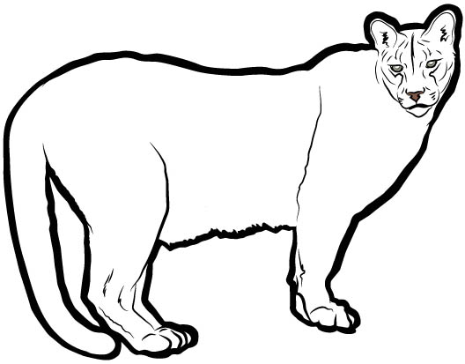
Organism Drawings
Sketch these living organisms in your notebooks. Then add arrows and labels to show how each of them grows bigger.
Notes:
PD leader talk: “Sketch each of these organisms in your notebooks and then work with a partner to complete the task on the slide. Make sure to add arrows and labels to your diagrams to show how each organism grows.”
PD leader move: After the activity, ask one or two pairs to describe their completed diagrams to the rest of the group.

Slide 60
Synthesize and Summarize
Draw and label a diagram that shows how matter moves in a food chain and helps living things grow. Pick 3 or 4 organisms from this list:
Bush with berries Small bird Squirrel
Raccoon Mouse Deer
Hawk Grass Oak tree with acorns
Grasshopper Wolf
Checklist:
____ Are the arrows labeled “provides food matter for”?
____ Are the organisms labeled producers or consumers?
Word bank for sentences: matter, molecules, carbon dioxide, water, food
Write a sentence underneath your diagram that explains how producers in this food chain grow. Producers grow by __________.
Write a sentence underneath your diagram that explains how consumers in this food chain grow. Consumers grow by __________.
Notes:
PD leader move: If time allows, have participants complete the synthesizing/summarizing task on the slide.
PD leader move: When participants have finished this task, lead them through the assessment questions on the following slide.

Slide 61
Assessing Your Work
Does your food chain start with a plant?
Did you label the plant a producer?
Did you draw an arrow from the plant to an animal? Did you label this animal an herbivore or a consumer?
Did you draw an arrow from this animal to another animal that eats it? Did you label this new animal a carnivore?
Are your arrows labeled “provides matter for”?
Does your sentence about producers say they make food out of carbon dioxide and water?
Does your sentence about consumers say they get food molecules by eating other organisms?
Do both of your sentences say that the organism uses food molecules to grow and get bigger (to build its body)?
Bonus: Do your sentences mention that consumers get their matter/food only by eating other organisms? That they can’t make their own food? Or that plants are the only organisms that can make their own food?
Extra: Does your food chain include more than three organisms?
Notes:
PD leader move: Read through the assessment questions on the slide and direct participants to write their responses in their science notebooks.
PD leader talk: “How has our content deepening work changed your thinking about the focus question, How do living things grow bigger?”

Slide 62
Lesson Analysis: Focus Question 2
How can selecting appropriate science activities help students develop a coherent science content storyline?
Notes:
Less than 1 min
a. Read the focus question on the slide.
b. “To help us answer this focus question, we’re going to explore STeLLA strategy C: Select activities that are matched to the learning goal.”

Slide 63
Strategy C: Purpose and Key Features
According to the strategies booklet, what are the purpose and key features of strategy C: Select activities that are matched to the learning goal?
Notes:
25 min
a. Ask participants to locate the section on strategy C in the STeLLA strategies booklet.
b. Have one participant lead the group in creating a chart that summarizes the purpose and key features of strategy C: Select activities that are matched to the learning goal.
c. Ask: “What does the strategies booklet say about science activities that are fun and engaging for students?
Ideal responses:
Activities should be selected because they can support students in understanding the main learning goal, not because they’re fun or easy to do.
Avoid activities that are only topically related (e.g., something about plants); instead, activities should focus on a specific science idea that is closely linked to the main learning goal (e.g., Plants get their food by making it out of carbon dioxide, water, and light energy).
Activities should not just be interesting supplements to the science content storyline; they should help develop it.
d. Follow-up: “Think back on science-lab activities in high school or college. Did these activities play a key role in helping you better understand the science concepts presented in textbooks or lectures? Or were they more like add-on activities that were only loosely related to the science concepts being taught?”

Slide 64
Lesson Analysis Question
Main Learning goal: Plants are producers that make their own food by using energy from the Sun to transform matter from the air (carbon dioxide) and matter from the soil (water) into energy-supplying food.
Focus question: How do plants get the food they need to live and grow?
Analysis question: Are the activities well matched to the main learning goal?
Notes:
1 min
a. For this lesson analysis, participants will view a set of four video clips from one Food Webs lesson.
b. Review the main learning goal and focus question on the slide. Then introduce the analysis question: Are the activities well matched to the main learning goal?
Note: The focus question in these video clips appeared in an earlier version of lesson 2 and doesn’t reflect the current lesson plan.

Slide 65
Lesson Analysis: Strategy C
Locate Analysis Guide C in your program binders (handout 6.4) and read the main learning goal at the top of page 1.
For this analysis, we’ll watch four video clips from the same Food Webs lesson (Food for Plants).
Before each clip: Read the lesson context at the top of the video transcript and the relevant pages on Investigations 2 and 3 in Food Webs lesson handout 2.1 (What Is Food for Plants?).
After each clip: Complete part 1 of Analysis Guide C.
Links to Belcastro video clips: 6.3_stella_FW_belcastro_L2_c1;
6.4_stella_FW_belcastro_L2_c2; 6.5_stella_FW_belcastro_L2_c3;
6.6_stella_FW_belcastro_L2_c4
Notes:
50 min
Note: Refer to the Food Webs Content Background Document as needed throughout this lesson analysis.
a. Have participants locate Analysis Guide C (handout 6.4) in their PD binders and read the main learning goal at the top of page 1. Then orient them to part 1 of the analysis guide.
b. Before each clip: First, have participants read the lesson context at the top of the corresponding video transcript. Then have them read the relevant pages on Investigations 2 and 3 in Food Webs lesson handout 2.1, What Is Food for Plants? Clip 4 addresses the question in Investigation 2, “Is soil food for plants?” and clip 5 addresses the question in Investigation 3, “Is sunlight food for plants?”
c. Show each video clip.
d. After each clip (individuals or pairs): Allow time for participants to review the analysis guide, write down science ideas revealed in the activity, and assess how well matched these ideas are to the main learning goal.
Note 1: For sample responses to part 1 of the analysis guide for each clip, refer to PD Leader Master: 5th-Grade Guide to Belcastro Video Clips for Day 6.
Note 2: Video clip 4 includes some nice illustrations of STL strategy 4 that you might want to highlight. See part 2 of the Belcastro PD leader master (point 2 under the question “What kept the students focused on the revised learning goal?”).

Slide 66
Lesson Analysis: Strategy C
Discuss these questions with a partner:
Were the activities well matched to the learning goal? Provide evidence to support your response.
Suggest ways to improve the match between the activities and the main learning goal (part 2, Analysis Guide C).
Be prepared to share your ideas in a group discussion.
Notes:
12 min
a. Pairs: “Discuss the questions on the slide and be ready to share your ideas with the group.”
b. Whole group: Assess how well the activities in the video clips matched the main learning goal, and ask participants to offer suggestions for improving the match.
Discussion notes:
Slide question 1: Make sure participants understand that the lesson was originally intended to include another activity that would have directly addressed the main learning goal. But since the teacher ran out of time for that activity, participants may have different ideas about how well the activities in the clips matched the learning goal. Some may argue that laying the groundwork for the main learning goal was a pretty close but partial match. Others may argue that the activities (the Van Helmont experiment and the sunlight activity) weren’t matched to the main learning goal at all. Either argument is fine.
Slide question 2: See the Belcastro PD leader master for suggestions on matching activities more closely to the learning goal. Participants may have other suggestions.
Inform participants that the analysis of this lesson ultimately led RESPeCT curriculum writers to revise and divide it into two parts (lessons 2a and 2b)s, each with its own main learning goal. See the relevant discussion in the Belcastro PD leader master.
Note: For sample responses in analyzing the use of strategy C in the video clips, see PD Leader Master: 5th-Grade Guide to Belcastro Video Clips for Day 6.

Slide 67
Lesson Analysis: Revised Main Learning Goal
The analysis of these four video clips led the RESPeCT team to revise the main learning goal for this lesson as follows:
Water, carbon dioxide, soil, and sunlight are not food for plants because they are not matter that contains energy plants can use to live and grow.
Study the video transcripts again and gather evidence to answer these questions:
What kept students focused on the revised learning goal?
What distracted students from the revised learning goal?
Notes:
12 min
a. Have participants reconsider the four Belcastro video clips in light of the revised main learning goal on the slide.
Note: The revised learning goal appeared in an earlier version of lesson 2 and varies slightly from the current lesson plan.
b. Individuals: Direct participants to look for evidence in the video transcripts that will help them answer these questions:
What kept students focused on the revised learning goal?
What distracted students from the revised learning goal?
c. Whole group: Ask participants to share their ideas and evidence in response to the questions.
Note 1: For ideas on what to highlight during the group discussion, see the PD Leader Master: 5th-Grade Guide to Belcastro Video Clips for Day 6.
Note 2: The second question (What distracted students from the revised learning goal?) and the ideas about light energy that Harry and Blake were so passionately arguing for in clip 5 (that sunlight is food for plants) offer an excellent content deepening opportunity for the group discussion.

Slide 68
Practice: Strategy C
Main learning goal: When energy moves from one organism to another in a food chain, it is used for life functions and given off as heat, but it is not recycled.
Ask these questions for each activity:
How well is the activity matched to the main learning goal (closely, partially, weakly, not at all)?
How might the activity be changed to better match the main learning goal?
Notes:
10 min
Note: This activity may be skipped if time is running short.
a. Have participants locate handout 6.9 in their PD binders (Practice: Is the Activity Matched to the Main Learning Goal?).
b. Individuals (2–3 min): “Think about how well the activities on the handout are matched to the main learning goal. Be prepared to give a rationale for your answers.”
c. Whole group: Invite participants to share their ideas and reasoning with the group.
Ideal responses:
Activity 1—Burning peanut: Partially matched or not matched to the learning goal. This activity addresses the idea that when food is used (burned), it gives off heat energy. But it doesn’t address what happens to food inside organisms. To more closely match the activity with the learning goal, the teacher could ask, “What do you think will happen when a squirrel or a person eats a peanut?”
Activity 2—Ocean food-chain diagram: Matched to all aspects of the learning goal. This is the activity in the Food Webs lesson series.
Activity 3—String food web: Partially matched to the learning goal. This activity focuses only on energy moving from one organism to another in a food chain. It doesn’t address how each organism uses energy for life functions, or that energy is released as heat but is not recycled. The teacher could more closely match this activity to the main learning goal by adding the Sun to the food web and focusing only on what is happening to the light energy and food energy. However, it’s difficult to imagine how this string representation could demonstrate in an accurate and meaningful way that energy is given off as heat but is not recycled.

Slide 69
Today’s Focus Questions
How can we begin and end a lesson to help students develop a coherent science content storyline?
How can selecting appropriate science activities help students develop a coherent science content storyline?
How do plants get the food (matter and energy) they need to live and grow?
How do living things grow bigger?
Notes:
Less than 1 min
a. Remind participants of today’s focus questions.

Slide 70
Summarize Today’s Work
Hold up three fingers when you have all of these in mind:
One idea you’re taking away about strategy C: Select activities that are matched to the learning goal
One idea you’re taking away about strategies B, I, and 7:
Set the purpose with a focus question or goal statement (strategy B)
Summarize key science ideas (strategy I)
Engage students in making connections by synthesizing and summarizing key science ideas (strategy 7)
One science idea about food webs that you’re taking away from today’s content deepening work.
Notes:
7 min
Individuals: Read the instructions on the slide and give participants enough time to come up with three ideas to summarize today’s work.
Whole group: In a round-robin, invite participants to share a key idea for each category on the slide. (Allow participants to pass if they wish.)

Slide 71
Homework
In the STeLLA strategies booklet, read about SCSL strategy D:
Select content representations and models matched to the learning goal and engage students in their use.
Fill in the appropriate column on your Z-fold summary chart.
Notes:
Less than 1 min
a. Go over the homework assignment and have participants write it in their notebooks.
b. Make sure participants understand each part of the assignment.

Slide 72
Reflections on Today’s Session
How are STeLLA strategies B, I, 7, and C related to one another?
What new insights or questions have emerged about matter and/or energy in food webs?
Only two more days are left of our time together at the Summer Institute. What burning questions do you think should be answered before the end of the week?
Notes:
7 min
a. Allow participants at least 5 minutes to think about today’s session and write their reflections and feedback on the Daily Reflections sheet (handout 6.10 in PD program binder).

Slide 73
Norms for Working Together: The Basics
Purpose: Build trust and develop a productive study group for all participants.
The Basics
Arrive prepared and on time; stay for the duration; return from breaks on time.
Remain attentive, thoughtful, and respectful; engage and be present.
Eliminate interruptions (turn off cell phones, email, and other electronic devices; avoid sidebar conversations).
Make room for everyone to participate (monitor your floor time).
Notes:
Hidden slide—available for use as needed.

Slide 74
Norms for Working Together: The Heart
Purpose: Build trust and develop a productive study group for all participants.
The Heart of RESPeCT Lesson Analysis and Content Deepening
Keep the goal in mind: analysis of teaching to improve student learning.
Share your ideas, uncertainties, confusion, disagreements, questions, and good humor. All points of view are welcome.
Expect and ask questions to deepen everyone’s learning; be constructively challenging.
Listen carefully; seek to understand other participants’ points of view.
Notes:
Hidden slide—available for use as needed.

