Slide 1
GENETICS LESSON 1a
Can You Predict What Offspring Will Look Like by Looking at Their Parents?

Slide 2
Unit Central Question
Why are individuals of a species different from one another?

Slide 3
Lesson Focus Questions
Can you predict what offspring will look like by looking at their parents? Why or why not?

Slide 4
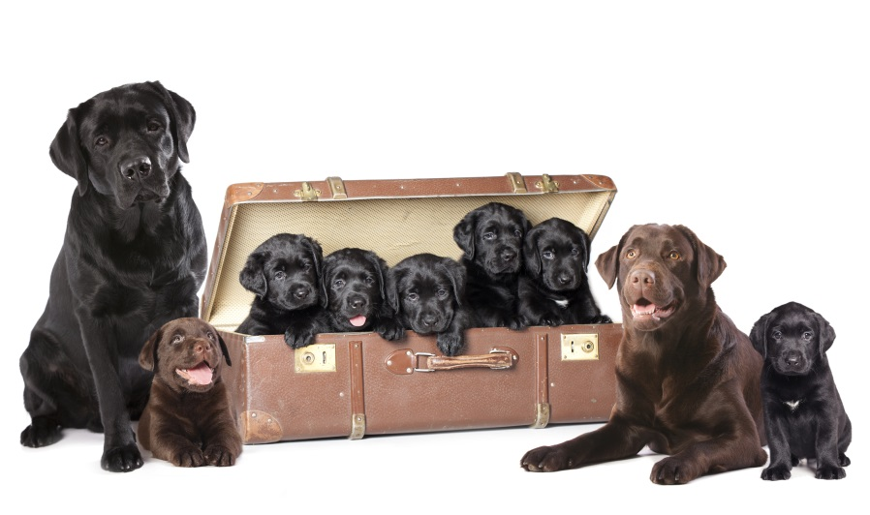
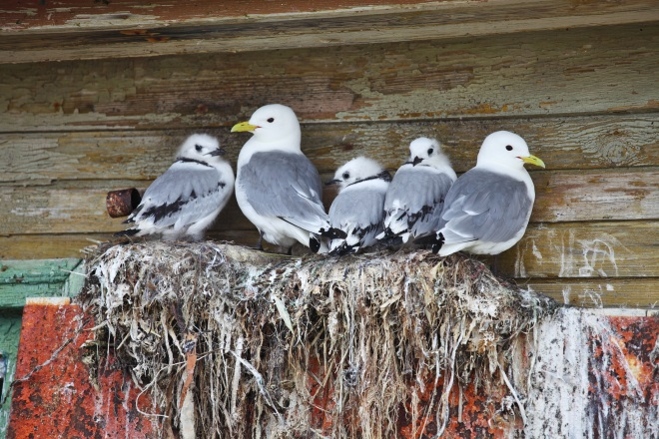
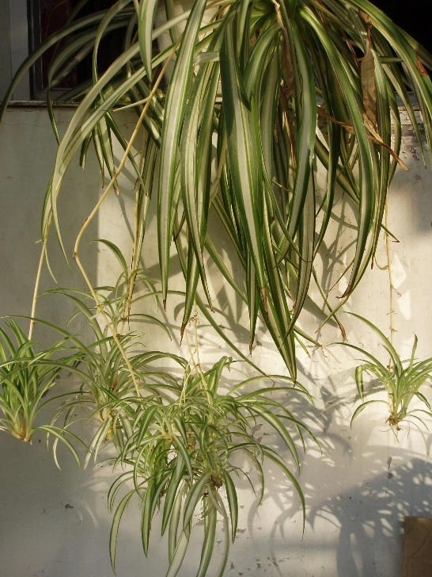
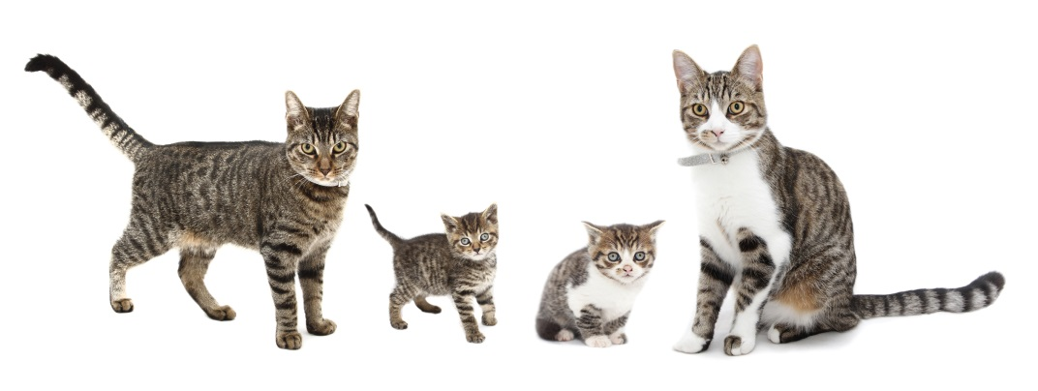
Family Photos
Photo courtesy © Lilun | Dreamstime.com
Photo courtesy of ©Zanskar | Dreamstime.com
Photo courtesy of © BCritchley | Dreamstime.com
Photo courtesy of Fanghong/Wikimedia Commons

Slide 5
Create a Circle Map
Why do individuals of a species look different or the same?

Slide 6
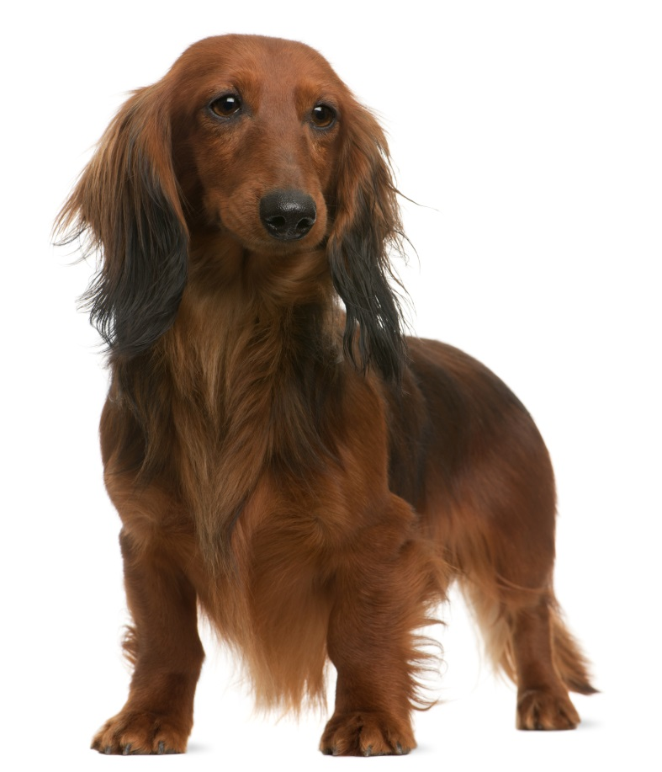
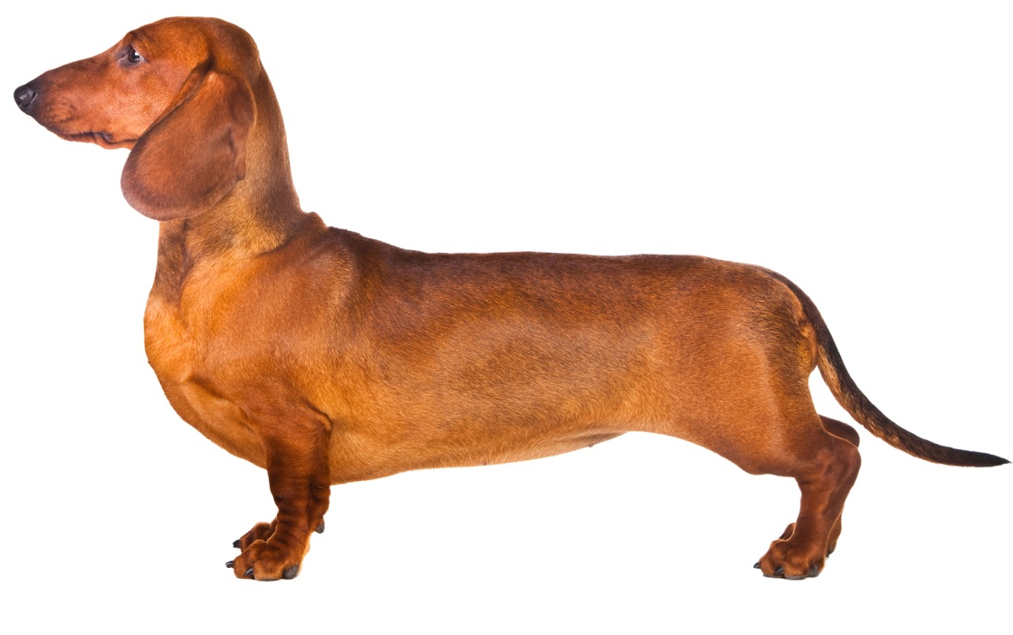
Identifying Dachshund Traits
Male
Female
Photo courtesy of © Isselee | Dreamstime.com
Photo courtesy of © Oxilixo | Dreamstime.com

Slide 7
Your Predictions about Dachshund Puppies
If these dachshunds get together and have a litter of puppies, what do you think the puppies will look like? Will they have short hair or long hair?
Make sure to include the reasons for your predictions!
Photo courtesy of © Isselee | Dreamstime.com
Photo courtesy of © Oxilixo | Dreamstime.com

Slide 8
Ideas and Questions about Inheritance
Let’s list our ideas and questions about trait inheritance on two charts:
Our Current Ideas about Inheritance
Our Questions about Inheritance
We’ll revisit these ideas and questions throughout this unit.

Slide 9
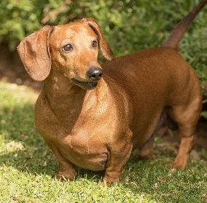
The Dachshund Puppies
Photo courtesy of Pixabay.com
Photo courtesy of Pixabay.com
Photo courtesy of Pixabay.com

Slide 10
Let’s Summarize!
Today’s focus questions: Can you predict what offspring will look like by looking at their parents? Why or why not?
How would you answer our focus questions based on the hair-length evidence from the dachshund puppies?
Make sure to include the key idea of traits in your response.

Slide 11
Next Time
Today we saw that all of the dachshund puppies from a long-haired parent and a short-haired parent had short hair.
What happened to the long-hair trait?
Tomorrow we’ll look at some claims other students have made about the hair-length trait and decide whether the evidence supports those ideas.

