Slide 1
GENETICS Lesson 1b
Can You Predict What Offspring Will Look Like by Looking at Their Parents?

Slide 2
Our Ideas and Questions about Inheritance
Our Current Ideas about Inheritance
Our Questions about Inheritance

Slide 3
Lesson Focus Questions
Can you predict what offspring will look like by looking at their parents? Why or why not?

Slide 4
Your Predictions about the Puppies
What did you predict last time about the puppies’ hair length?
Did you think the dachshund puppies would have long hair like their father, short hair like their mother, a combination of long and short hair, or maybe even medium-length hair?

Slide 5
Explaining the Results
Discovering that all of the puppies had short hair was surprising, wasn’t it?
How did you explain this result?

Slide 6
What Happened?
So what happened to the long-hair trait? Did it just disappear?
Let’s look at three possible explanations!

Slide 7
Three Ideas about What Happened
Juan’s claim: Since all the puppies have short hair, they must have inherited instructions for hair length from only one parent.
Celia’s claim: The puppies inherited information for hair length from both parents. But the instructions for short hair covered up the instructions for long hair.
Michael’s claim: The puppies got instructions for hair length from each parent, so they should have medium-length hair—a blend of short hair and long hair.

Slide 8
Which Claims Does the Evidence Support?
Did you agree or disagree with Juan, Celia, and Michael?
Which claim(s) did you accept?
Which claim(s) did you reject?
Make sure to give reasons and evidence for your answers!

Slide 9
Chart Review: Ideas about Inheritance
Let’s review our chart of ideas about inheritance.
What new ideas should we add?
What ideas should we revise or reject?

Slide 10
Chart Review: Questions about Inheritance
Do you think we should add anything to our chart of questions about inheritance?

Slide 11
Today’s Focus Questions
Can you predict what offspring will look like by looking at their parents? Why or why not?

Slide 12
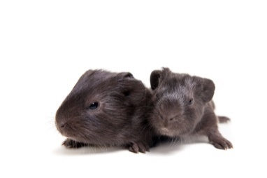
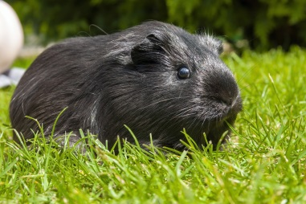
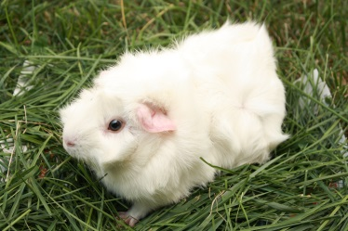
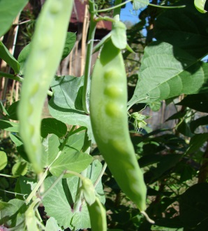
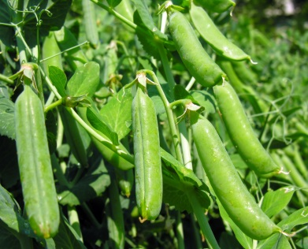
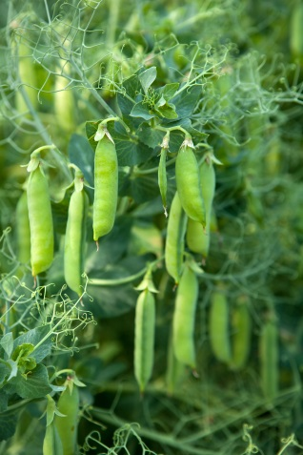
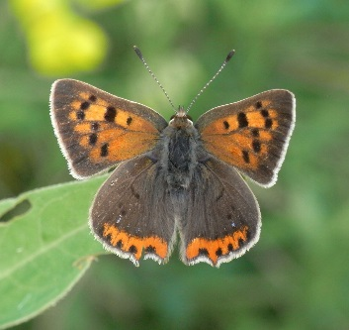
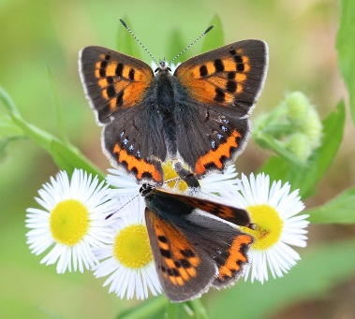
Different Traits of Parents and Offspring
Photograph by Farinoza
Photograph by Belizar
Photograph by Blueelephant
Photograph by Forest & Kim Starr
Photograph by Slogger
Photograph by Gordana Sermek
Photograph by Quartl, Wikimedia Commons
Photograph by Tanya Mass
Photograph by Alpsdake, Wikimedia Commons

Slide 13
What Will the Puppies Look Like?
Can you predict what offspring will look like by looking at the parents? Why or why not?
How would you answer these questions now?
Use one of these sentence starters:
I can predict what the dachshund puppies will look like because …
OR
I can’t predict what the dachshund puppies will look like because …

Slide 14
Let’s Summarize!
Today we observed that offspring look similar to their parents in some ways and different from them in other ways.
Key science idea: Offspring may exhibit the same trait as one parent or the other but not a blending of both parents’ traits.

Slide 15
Next Time
What happened to the long-hair trait in the dachshund puppies?
Tomorrow we’ll gather more information to help us answer this question.

