Slide 1
GENETICS Lesson 2b
Can Certain Traits Disappear in a Family? Can Offspring Have Traits Their Parents Don’t Have?

Slide 2
Last Time
At the end of yesterday’s lesson, you reviewed the claims of Juan, Celia, and Michael and decided which claim you agreed with based on the dachshund pedigree evidence.
How did you complete these statements:
I (support/don’t support) Juan’s idea because …
I (support/don’t support) Celia’s idea because …
I (support/don’t support) Michael’s idea because …

Slide 3
Lesson Focus Questions
Can certain traits disappear in a family? Can offspring have traits their parents don’t have?

Slide 4
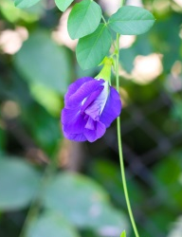
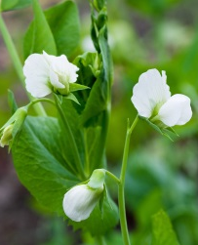
A Pedigree of Pea Plants
Photo courtesy of Pakpoom Phummee | Dreamstime.com
Photo courtesy of Maksym Surovtsev | Dreamstime.com

Slide 5
A Pedigree of Pea Plants
Photo courtesy of Pakpoom Phummee | Dreamstime.com
Generation 1
Generation 1

Slide 6
Generation 1
Photo courtesy of Pakpoom Phummee | Dreamstime.com
Generation 1
Generation 2
Generation 2

Slide 7
Mendel’s Ideas
Read each of Mendel’s ideas on the handout.
Restate each idea in your own words. Think about how the idea relates to the dachshund pedigree and the pea-plant pedigree.

Slide 8
Mendel’s Ideas
How do our ideas about trait inheritance compare with Mendel’s ideas?
Look at our class chart of current ideas about inheritance.
Compare each of Mendel’s ideas with ideas on the chart.
On your handouts, place a green sticky dot beside any of Mendel’s ideas that also appear on our chart.
Then place a blue sticky dot beside any of Mendel’s ideas that are NOT on the class chart.

Slide 9
Class Discussion
Which ideas on our class chart were similar to any of Mendel’s ideas? Let’s find out!
Group representatives: Demonstrate how an idea on our class chart is similar to an idea on Mendel’s list.
Do we all agree with this comparison?
If the answer is YES, place a green sticky dot beside the idea on our class chart.

Slide 10
Should We Revise Our Class Chart?
Look at the ideas on Mendel’s list that are NOT on our class chart.
Do you think we should add these ideas to our chart? Why or why not?
Now look at the ideas on our class chart that are NOT on Mendel’s list.
Do you think we should keep these ideas, modify them, or cross them off our chart? Why or why not?

Slide 11
Let’s Summarize!
Today’s focus questions: Can certain traits disappear in a family? Can offspring have traits their parents don’t have?
What evidence can you provide from the dachshund and pea-plant pedigrees to support your ideas?

Slide 12
What Makes Us Different?
Our unit central question: Why are individuals of a species different from one another?
Turn and Talk: How do you think the traits we inherit from our parents make us look like other people in some ways and different in other ways?

Slide 13
Next Time
Tomorrow we’ll explore how scientific discoveries after Mendel’s time led to new understandings of how traits are passed on from parents to offspring.
Stronger microscopes enabled scientists to see things that Mendel could only imagine!

