Slide 1
Genetics Lesson 4b
How Can a Model of Inheritance Further Explain How Offspring Can Have a Trait Their Parents Don’t Have?

Slide 2
Last Time
At the end of yesterday’s lesson, you wrote down your best response to this focus question:
How can a model of inheritance explain how a trait may seem to disappear in a family?
How did you answer this question?
Share your ideas with the class, making sure to include chromosomes, genes, and alleles in your explanation.

Slide 3
Today’s Focus Question
How can a model of inheritance further explain how offspring can have a trait their parents don’t have?

Slide 4
Traits in Generation 2 Duckos
What bill color do you predict the Generation 2 duckos will have?
Use what you know about chromosomes, genes, and alleles to explain your reasoning.

Slide 5
Making Generation 2 Duckos
The Generation 1 duckos have grown up and are ready to produce offspring (baby duckos) of their own.
Work with your partner to create the next generation of duckos. Follow the steps in handout 4.5 (Making Generation 2 Duckos).
Make sure to record the alleles for each generation of duckos on the handout.
What bill color does each of the Generation 2 offspring have?
Why do you think the Generation 2 offspring have this bill color?

Slide 6
Bill Color of Generation 2 Duckos
First, let’s count how many red-billed and orange-billed Generation 2 duckos we have.
Raise your hand if you have a red-billed ducko.
Raise your hand if you have an orange-billed ducko.

Slide 7
Looking for Patterns in the Data
Next, let’s organize our data for Generation 2 in a class bar graph.
What patterns do you see?
Use what you know about genes and alleles to explain the results.

Slide 8
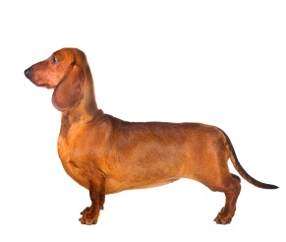
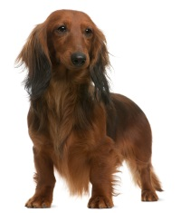
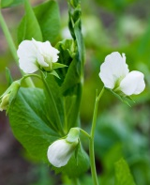
Generation 2 Traits in Other Organisms
Pea Plants
Dachshunds
Photograph by Pakpoom Phummee
Photograph by Maksym Surovtsev
Photo courtesy of © Oxilixo | Dreamstime.com
Photo courtesy of © Isselee | Dreamstime.com
Number of individuals 100 200 300 400 500 600 700 800 900
 | Purple White
Number of individuals 10 20 30 40 50 60 70 80 90
 | Short Hair Long Hair

Slide 9
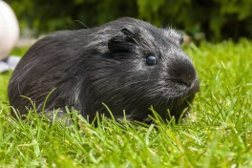
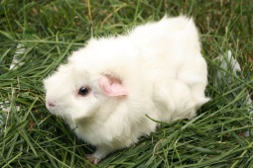
Generation 2 Traits in Other Organisms
Guinea Pigs
Parakeets
Photograph by Belizar
Photograph by Blueelephant
Photo courtesy of Pixabay.com
Photo courtesy of Pixabay.com
Number of individuals 20 40 60 80 100 120 140 160 180
 | Black White
Number of individuals 10 20 30 40 50 60 70 80 90
 | Green Blue
Notes:
The parakeets are free for commercial use – no attribution needed.
https://pixabay.com/en/budgie-bird-parakeet-animals-2201255/
https://pixabay.com/en/budgie-blue-bird-budgerigar-pet-2208261/

Slide 10
Today’s Focus Question
How can a model of inheritance further explain how offspring can have a trait their parents don't have?
In other words, can you explain how two red-billed ducko parents produced some orange-billed offspring?
Turn and Talk: Discuss these questions with a partner and then answer the focus question in your science notebook.
Include these key terms: chromosomes, genes, alleles, dominant and recessive traits.

Slide 11
Let’s Summarize!
Key science ideas:
If each parent has two different alleles of a gene, the dominant allele determines which trait they exhibit.
Even though both parents exhibit the dominant trait, each of them can still pass on a recessive allele to the offspring.
If both parents pass on a recessive allele, their offspring will exhibit the recessive trait.

Slide 12
Next Time
Today we figured out how the orange-bill trait skipped the Generation 1 duckos but reappeared in the Generation 2 duckos.
Next time we’ll explore how different combinations of alleles in the parents can influence the pattern of trait variations in their offspring.

