Slide 1
GENETICS Lesson 6b
How Can Ideas about Trait Inheritance Help Solve Real-World Problems?

Slide 2
Review: The Wilson Family Case Study
Let’s review some important science ideas about inheritance that we’ve been building on throughout this unit on genetics.
We’ll use examples from the Wilson family case study and pedigree to see what we’ve learned about these topics:
Chromosomes
Genes and alleles
Dominant and recessive alleles
Dominant and recessive traits

Slide 3
Key Science Ideas about Inheritance
For certain traits, individuals get a set of instructions—called a gene—from each parent. Different forms of the same gene are called alleles.
Some alleles are dominant, which means they override any other instructions for a trait, and offspring will exhibit the dominant trait even if a recessive allele is present.
Recessive alleles provide instructions for a trait variation that will appear in offspring only when two recessive alleles—one from each parent—are paired.

Slide 4
Key Science Ideas about Inheritance
Individuals with a trait controlled by a recessive allele must have two recessive alleles, which means they got one from their mother and one from their father.
Individuals with a trait controlled by a dominant allele might have two dominant alleles for that trait or a dominant allele from one parent and a recessive allele from the other parent.

Slide 5
Lesson Focus Question
How can ideas about trait inheritance help solve real-world problems?

Slide 6
Unit Central Question
Why are individuals of a species different from one another?

Slide 7
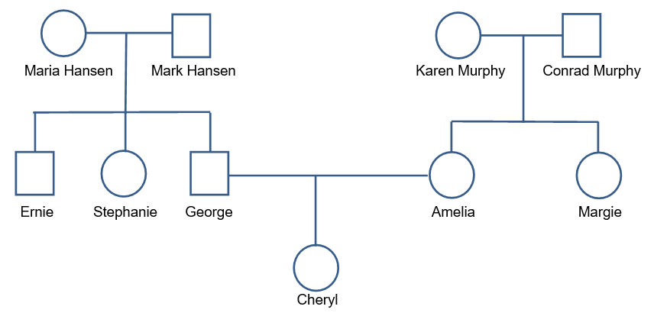
The Hansen Family Pedigree
Shade the circle or square of any family member who has a bad rash. If the pattern seems to indicate that this skin condition is an inherited trait, write the two-letter allele combination (SS, Ss, or ss) underneath each family member’s name. (Remember: A capital letter represents a dominant allele, and a lowercase letter represents a recessive allele.) If more than one allele combination is possible for an individual, write both combinations under that person’s name.

Slide 8
The Hansen Family
Several members of the Hansen family have a bad rash that their doctor thinks is an inherited condition. But it’s unclear whether this trait is caused by a dominant allele (S) or a recessive allele (s).
How can we find out?

Slide 9
The Hansen Family Case Study
Small groups: Read through the case study (handout 6.3) and discuss the questions in your group. Shade in the pedigree chart (handout 6.4) based on the information provided.
As you work through this challenge together, think about two questions:
Does the pattern of inheritance match what might be expected if the skin rash were a dominant trait?
Does the pattern of inheritance match what might be expected if the skin rash were a recessive trait?

Slide 10
What Did You Decide?
Do you think this skin condition is caused by genes that offspring have inherited from their parents?
Or do you believe there must be some other cause?
Support your answers with evidence from the Hansen family pedigree.

Slide 11
Lesson Focus Question
How can ideas about trait inheritance help solve real-world problems?

Slide 12
Unit Central Question
Why are individuals of a species different from one another?
Think-Pair-Share: Think about what you’ve learned in this unit that might help you answer this question and share your ideas with a partner. Then write your best answer in your science notebook.
Use these key terms in your response:
Chromosome Dominant Inherit
Gene Recessive
Allele Trait

Slide 13
Future Lessons on Genetics
There’s much more to learn about trait variations among individuals of species, including how the environment and other factors influence traits.
So stay tuned for future lessons on genetics!

