Slide 1
The sun’s effect on climate Lesson 1a
What Temperature Patterns Can You Find on Earth at Different Latitudes?

Slide 2
The Sun’s Effect on Earth’s Climate
Why is the Sun important for life on Earth?

Slide 3
Unit Central Question
Why are some places on Earth hotter than others at different times of the year?

Slide 4
Lesson Focus Question
What temperature patterns can you find on Earth at different latitudes?

Slide 5
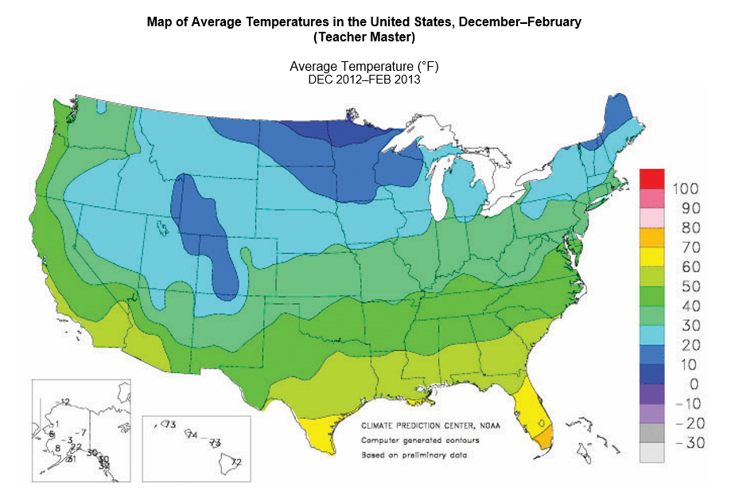
What Temperature Patterns Do You Observe?

Slide 6
Finding Patterns
Today’s focus question: What temperature patterns can you find on Earth at different latitudes?
Go back to the focus question in your science notebooks and circle the word patterns.
Finding patterns in temperature data will be our focus in this lesson.

Slide 7
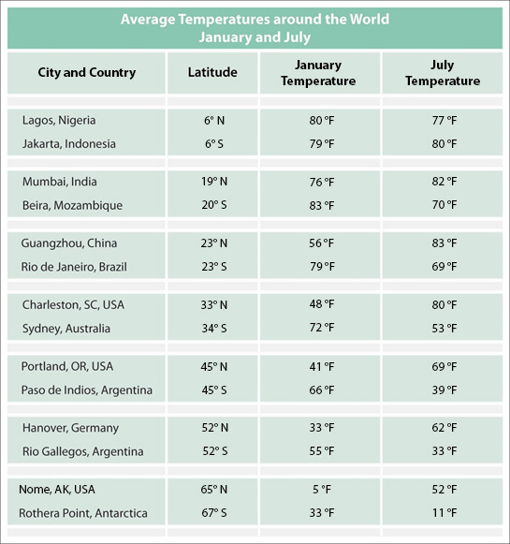
What Temperature Patterns Can You Find on Earth at Different Latitudes?

Slide 8
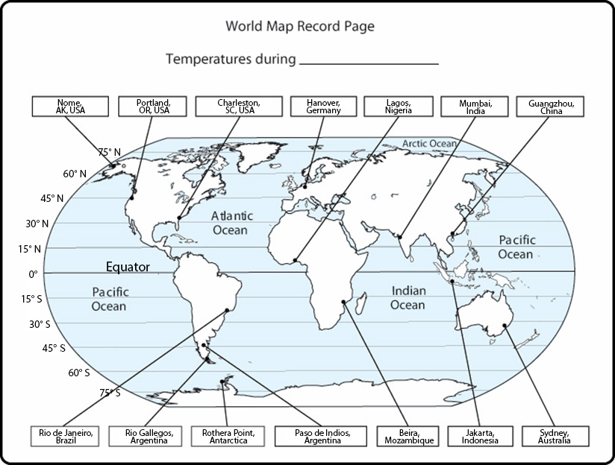
What Temperature Patterns Can You Find on Earth at Different Latitudes?

Slide 9
Looking for Patterns in the Temperature Data
Work with your partner to find the temperature data for different cities on handout 1.2 (Average Temperatures around the World: January and July).
Record the temperature data for each city on your world maps (handout 1.3). Make sure to write the temperatures on the correct maps for January and July!
As you record the temperature data, pay attention to the latitude of each city. Look for any patterns in the data!

Slide 10
Identifying Patterns in the Data
Today’s focus question: What temperature patterns can you find on Earth at different latitudes?
What types of patterns were you looking for in the data?
What temperature patterns did you notice in the data you recorded on your world maps? Give examples of specific locations.
What do you think latitude has to do the temperature patterns you observed?

Slide 11
Comparing Temperatures and Latitudes
On your world maps, look at the temperature data and latitudes for these locations:
Lagos, Nigeria
Jakarta, Indonesia
Nome, Alaska
Rothera Point, Antarctica
Compare the January and July data for Lagos, Nigeria, with the data for Jakarta, Indonesia.
Compare the January and July data for Nome, Alaska, with the data for Rothera Point, Antarctica.

Slide 12
Let’s Summarize!
What patterns do you observe in the January and July temperature data when a location is close to the equator or farther away from the equator?
Complete these sentences in your science notebooks:
The pattern I observe in January is _________.
The pattern I observe in July is ____________.
Be prepared to share your observations at the beginning of the next lesson.

Slide 13
Next Time
In the next lesson, we’ll use bar graphs to help us see patterns in our temperature data more clearly.
We’ll also talk about how the time of year influences temperature patterns.

